Slide 1

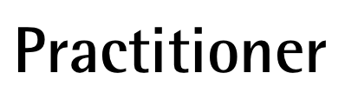
V 5.0

Slide 2
About the presenter
Industrial Engineer MBA, GPM-M, PMP with more than 25 years of experience in Electrical Companies: Telecomanded electric grid, Marketing and Communications, Corporate Social Responsibility.
Implementation and improvement of Organizational Management Systems according to ISO 9001, ISO 14001, ISO 26000, OHSAS 18001 y Argentinean Resolucion ENRE 057/2003 Public Safety for Electric Power Transmission in High and Medium Voltage (Since 2000).
She was part of the Communication Committee and Environmental and Sustainable Development Committee of Electricité de France (EDF) Branch America along with colleagues from France, Brazil and Mexico (2002-2004).
As independent contractor, she is Organizational System Manager at Baresi SRL a Polyolefin Recycling Company (since 2005); and Professor of CSR and Sustainable Development at GSPM, University for International Cooperation –UCI- Costa Rica (since 2013).
Founder member and volunteer of PMI Nuevo Cuyo Argentina Chapter ( 2008-2013). Liaison of PMI Educational Foundation in PMINC (2010-2012).
Council member in PMI Global Sustainability Community of Practice (2010-2012)
Countributor member of the PC/ISO 236 Project Committee: Project Management, and then ISO/TC 258 – Technical Committee: Project, Program, Portfolio Management. (Since 2011)
Member of the GPM Global Leadership Executive Team for Latin America. Main Assesor for the GPM® y GPM-m® Certifications in Latin America and Spain (Since oct2012).
Co-autor: The GPM® Reference Guide to Sustainability in Project Management and The GPM Global P5 Standard for Sustainability in Project Management.
Monica can be contacted at: monica.gonzalez@greenprojectmanagement.org
Mónica González

Slide 3
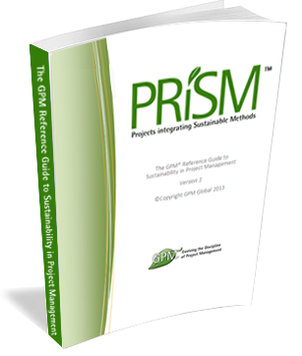
Course Kit
  You will be provided with:
  A One year Membership to the GPM to have access to:
    The GPM Reference Guide to Sustainability in Project Management eBook
    Responsible Management Education eBooks
    The Sustainability Calculator and other PM Templates
    USE CODE Agentofchange2015
    Visit members.greenprojectmanagement.org and select “partner discounted membership” enter the code in the discount code section
  And at the End of this course:
  A certificate of completion
  *PDUs or Professional Development Units are granted to the attendees completing the course.
  The GPM-b Certification for those who pass the exam.
*If Partner is a PMI REP, a code shall be provided, if not, Class B PDUs can be elected.
Notes:
Have the participants go to http://members.greenprojectmanagement.org and sign in using the PARTNER DISCOUNT MEMBERSHIP and add the code to receive a year for free.

Slide 4
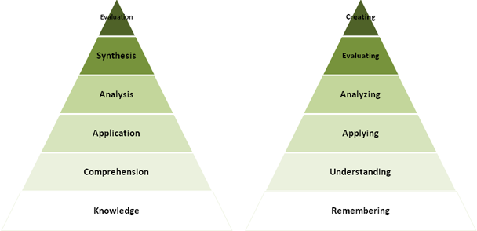
We will cover
This course will impart the knowledge and skills for
Project management using sustainable methods.
Where many training courses focus on knowledge, or memorization, we use an andragogical approach to ensure retention with a strong emphasis on “hands on”.
Course Modules
Sustainability Drivers
Systems Thinking - ISO
Ethics Principles and Values
Governance, Portfolio and Program Management
Organizational Capacity for Change
Business Case, Benefits and Value Management
Requirements Management
Project Management
Life Cycles and PRiSM
P5
Project Controls
Issue and Risk Management
Organizational Structures and Roles
Sponsorship
Stakeholder Engagement
Performance and Quality
Information Management and Reporting
Situational Leadership and Communication
Conflict and Negotiation
Notes:
We just covered a lot. Time for a quick break.

Slide 5
Learning Objectives
PRiSM™ Practitioner is a project management course that incorporates best practices, sustainability principles and governance in order to maximize value. The course places an emphasis on aligning benefits with strategic objectives to ensure that each project positions the organization for long-term growth and success through positive impacts to the economic, environmental, and social bottom lines.
The aim of PRiSM™ Practitioner is to train, educate, and develop individuals in project management and sustainability to improve the management and delivery of all types of projects within the set performance, time, cost and integration criteria throughout their own organization and to show how these changes can best be integrated into business as usual and become the normal embedded practices for the organization.

Slide 6
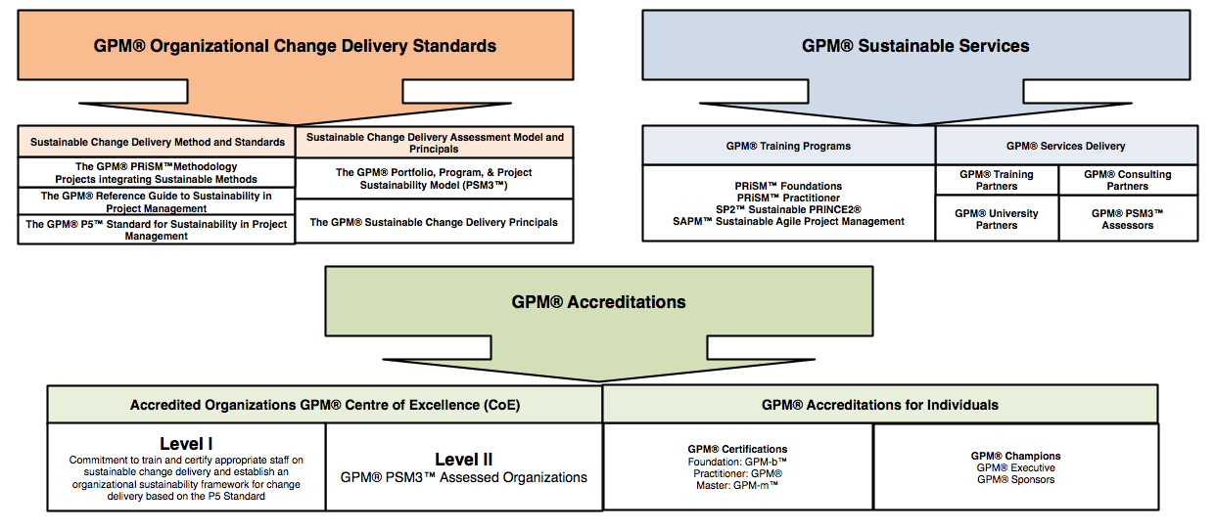
Introducing GPM
Notes:
GPM is a Social Enterprise established to address issues and profits realized are reinvested in the business with the aim of increasing social impact. Unlike a Non-Profit, the business is not dependent on donations or on private or public grants to survive and to operate, because, as any other business, it is self-sustainable and unlike a Non-Profit, where funds are spent only once on the field, our funds are invested to increase and improve the business' operations and the tools we offer to our partners. Our construct is unique among project management organizations in that we are able to function as a company and put into practice what we encourage others to do. (The GPMG Accreditation Board, is a separate not-for-profit organization that governs all GPM certifications.)

Slide 7
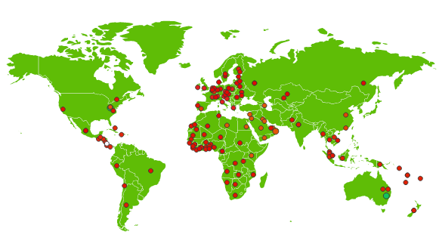

Active in over 140 countries and growing
GPM is the largest sustainability training organization in the world.
(The Sustainable Project Management Organization.)

Slide 8




Our Sustainability Affiliations
United Nations Global Compact
  First Project Management Professional Development Organization to become a signatory
United Nations PRME (Principles for Responsible Management Education) Supporting Organization
  One of only 14 worldwide
The Earth Charter Endorsers
  GPM founders have taken part since the initial 2001 Summit
UN Business for Peace Initiative
  GPM is a founding signatory

Slide 9
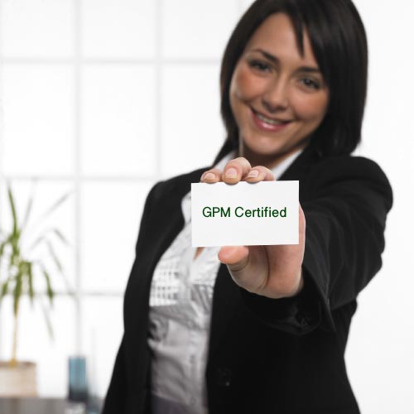
Our Focus – Change Delivery
Certification
  GPM-b™
  GPM®
  GPM-m™
Methodology
  PRiSM™
Assessments
  PSM3™
Training
  PRiSM™ Courses
  SP2™
  SAPM™
Notes:
What is SAPM?

Slide 10
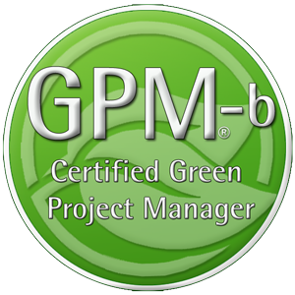
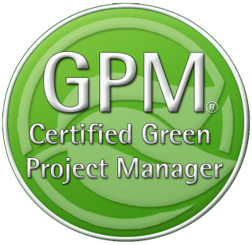

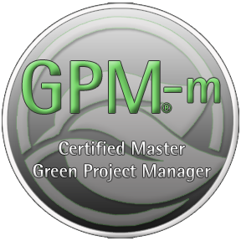
GPM Certifications
The GPM-b - Knowledge based foundational
Certification
The GPM® - Proficiency based Practitioner
Level Certification
The GPM-m - Proficiency Based Master
Level Certification
Notes:
GPM Adheres to ISO 17024, Certification of Professionals. All GPM Certifications are issued by the GPMG Accreditation Board, A semi-autonomous organization that provides governance and oversight

Slide 11
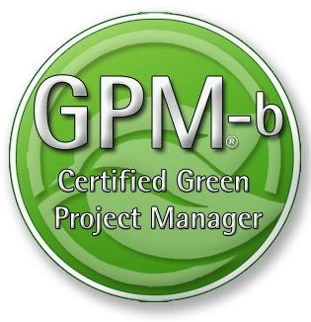
Certification
This course will prepare you for the GPM-b Certification.
The Certification Exam Format
To earn the Green Project Manager level B (GPM-b) credential, candidates must have 2,000 hours of project experience, and pass the 150 multiple choice question examination with a minimum passing score of 75%. The Exam is broken down into two primary sections as listed below.
1. Project Management
1.1. Project Management Standards based on ISO 21500
1.2. Project Management Competencies
1.3. Project management Knowledge Areas
1.4. Key Terms and Concepts
2. Sustainability Integration
2.1. Why Sustainability
2.2. PRiSM™
2.2.1. P5™
2.2.2. Sustainability Management Planning
2.2.3. Phases, inputs and outputs
2.3. Sustainability ISOs
2.3.1. The Energy Management Standard ISO 50001
2.3.2. The Environmental Management Standard ISO 14001
2.3.3. The Guidance on Social Responsibility ISO 26000
2.3.4. The Quality Management Standard ISO 9001
This course will prepare you for the IPMA Level D
Certification

Slide 12
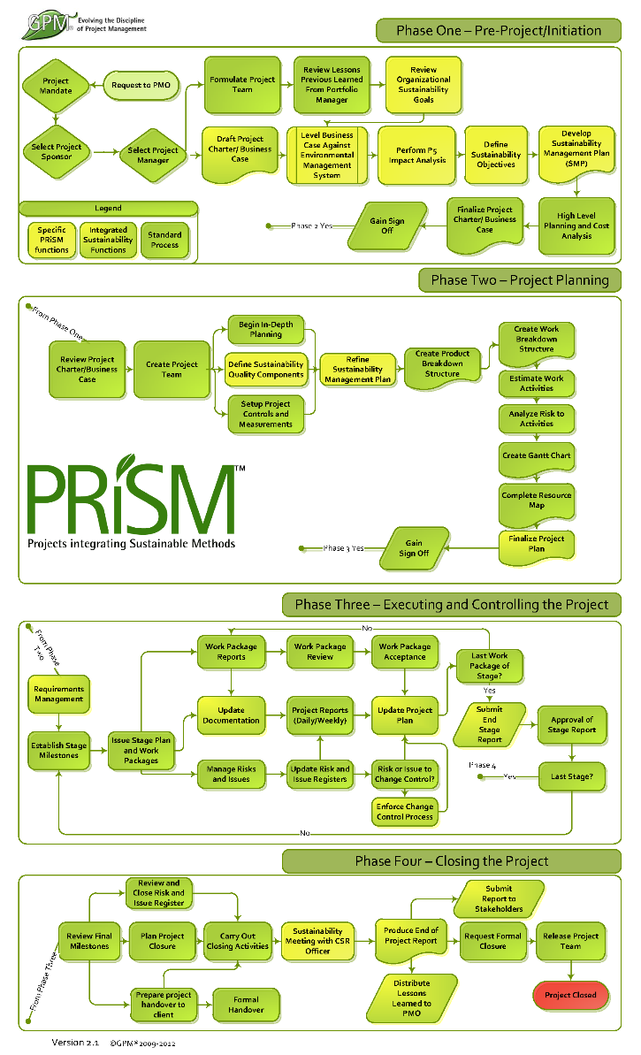
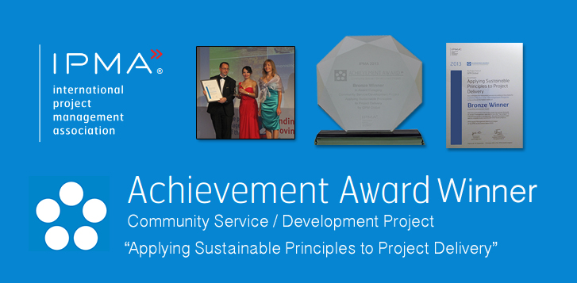
Industry Recognition
PRiSM is our structured project methodology that incorporates
ISO standards for:
Quality
Energy Management
Environmental Management
Corporate Social Responsibility
Project Management
The United Nations Global Compact Ten Principles for Sustainability
GRI G4 Framework
IPMA ICB 3.0 Competence Baseline
Notes:
GPM earned an achievement award from the International Project Management Association for the development of PRiSM.

Slide 13

Award Yourself and/or a Colleague!
Project of the Year
  Gold and Silver
Sustainability Award
Fundamentals Award
The GPM® Fundamentals Award is bestowed upon the person who submits the most thorough EnVex in a PRiSM Practitioner course in a given year.
EnVexes are in-course-virtual-projects that are taken from real life case studies. These exercises challenge course participants to apply what they learn in the course to achieve project objectives while realizing benefits from a social, environmental, and economic standpoint.
2013 Award Winner – Anna Wang – Volkswagen Financial Services

Slide 14
Sustainability Drivers
Module | Module Covers | Learning outcomes
# 2 Sustainability Drivers | Sustainability Challenges The UN Global Compact UN PRME Initiative The Global Reporting Initiative The Post 2015 Business Engagement Architecture | Understand current challenges with sustainability from a business perspective, the driving force for business to engage in sustainability and the organizations driving the way forward.
Language
English
Version
5.0

Slide 15

A Growing Problem
According to Global Footprint Network’s calculations, our (global) demand for renewable ecological resources and the services they provide is now equivalent to that of more than 1.6 Earths.
The data shows us on track to require the resources of two planets well before mid-century.
(We don’t have 1.6 Planets)
http://www.footprintnetwork.org/en/index.php/GFN/page/earth_overshoot_day/
Notes:
We just covered a lot. Time for a quick break.

Slide 16

THE EARTH SYSTEM CONTEXT
The Earth System provides the basis for all human societies and their economic activities. People need clean air to breathe, safe water to drink, healthy food to eat, energy to produce and transport goods, and natural resources that provide the raw materials for all these services
The 7 billion humans alive today are collectively exploiting the Earth’s resources at accelerating rates and intensities that surpass the capacity of its systems to absorb wastes and neutralize the adverse effects on
the environment.
http://www.unep.org/geo/
Notes:
GEO-5 is designed to be the most comprehensive, impartial and in-depth assessment of its kind. It reflects the collective body of recent scientific knowledge, drawing on the work of leading experts, partner institutions and the vast body of research undertaken within and beyond the United Nations system.
The launch of GEO-5 coincides with the final stages of preparation for the UN Conference on Sustainable Development (Rio+20), taking place two decades after the Rio Earth Summit that set the agenda for contemporary thinking about sustainable development. The report underlines the reasons why world leaders need to show decisive leadership in Rio and beyond. It highlights the state, trends and trajectories of the planet and its people, and showcases more than 100 initiatives, projects and policies from across the globe that are pioneering positive environmental change. (BAN Ki-moon, may 2012)
There is an urgent need to address the underlying drivers of the human pressures on the Earth System. At the same time, it is necessary to adopt approaches that can deal better with the complexities and inherent uncertainties of the Earth System. This must include three elements: basic research to understand interactions and feedbacks; sustained long-term monitoring and observation to underpin basic research; and regular evaluation of progress to allow the adjustment of responses when observations indicate that this is necessary.

Slide 17

The Accenture – UNGC 2013 Report
Survey result of 1,000 global CEOs, from 27 industries across 103 countries
93%
62%
of CEOs regard Sustainability as the new key for business success
of CEOs believe they can not quantify the value or their sustainability intiatives
SRC: http://www.accenture.com/SiteCollectionDocuments/PDF/Accenture-UN-Global-Compact-Acn-CEO-Study-Sustainability-2013.PDF
Notes:
Which is is great news as the world seems to be poised to support such an architecture as the majority of CEOs from around the world view sustainability as the key to business. Tge unfortunate truth is that these same CEOs can’t quantify the value of what they are doing to address it. What happens to projects that have no value to the organization?

Slide 18
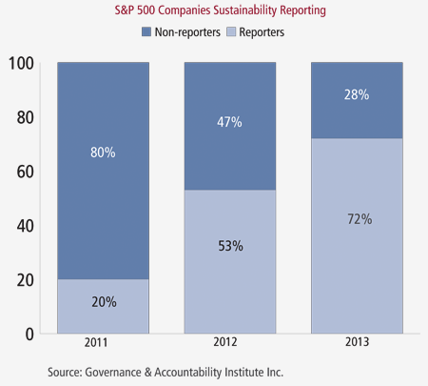
Fortune 500 Companies now Publishing
Sustainability/Responsibility Reports
“We are seeing clear indications over the past three years that senior corporate management understands the importance of adopting and implementing strategies that reflect the rising interest of investors and stakeholders in corporate sustainability,”
- Louis Coppola, executive vice president of G&A Institute.
72%
53%
20%
http://www.complianceweek.com/blogs/the-filing-cabinet/sustainability-reporting-on-the-rise
Notes:
It is no surprise to to see the trend shown here. If the number of CEOs that value sustainability as the way forward is on the rise and therefore reporting is also on the rise it is sure to create positive impacts. The problem is that focused attention in largely in part on supply chains.

Slide 19

The Cobb Salad Report
“These are all worthwhile topics however they are operationally focused and the emphasis needs to focus on what the organization produces from a product and service perspective.”
Timothy Hui. Head of Focal Point GRI for China
Health and Safety
Philanthropy
Carbon Emission Goals
Notes:
This rings loud and clear as when organizations report on sustainability, they look like chopped salads. Timothy Hui, Head of Focal Point GRI for China stated that the volume of reporting is increasing which is positive, however so is the volume of information in each report. Information is submitted on topics such as employee health and safety programs to carbon emission reduction goals to philanthropy initiatives (T. Hui, Presentation, May 27th, 2014). These are all worthwhile topics however they are operationally focused and the emphasis needs to focus on what the organization produces from a product and service perspective.
As of June 25th, 2014, 6,321 organizations having submitted over 15,234 reports to the Global Reporting Initiative alone.

Slide 20
What Happens?
50%
According to Executive Director Geog Kell, 50% of organizations that pledge to the the UN Global Compact are de-listed due to the fact that they are unable to fulfill their committment

Slide 21
Is this a problem?
97%
New report finds only 129 of 4,069 largest companies listed on the world’s stock exchanges are disclosing the most basic sustainability information
Src: http://www.theguardian.com/sustainable-business/2014/oct/13/97-companies-fail-to-provide-data-key-sustainability-indicators-stocck-exchange-report

Slide 22
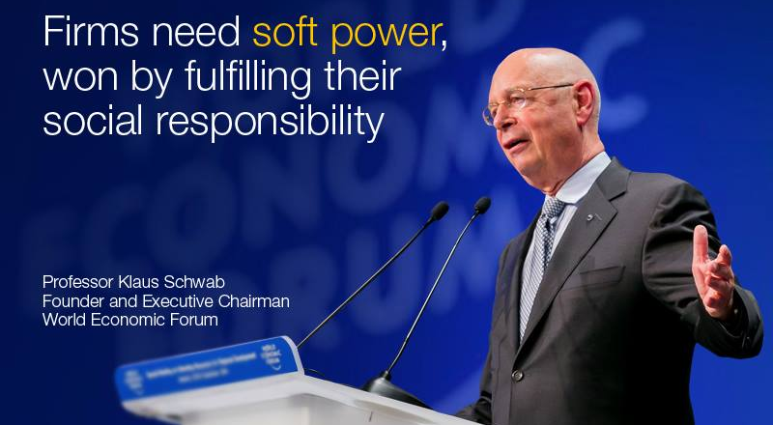
World Economic Forum
The real conflict is not between profit maximization and social responsibility, but rather between short- and long-term thinking," writes Professor Klaus Schwab.
https://agenda.weforum.org/2014/12/the-profitability-of-trust/

Slide 23
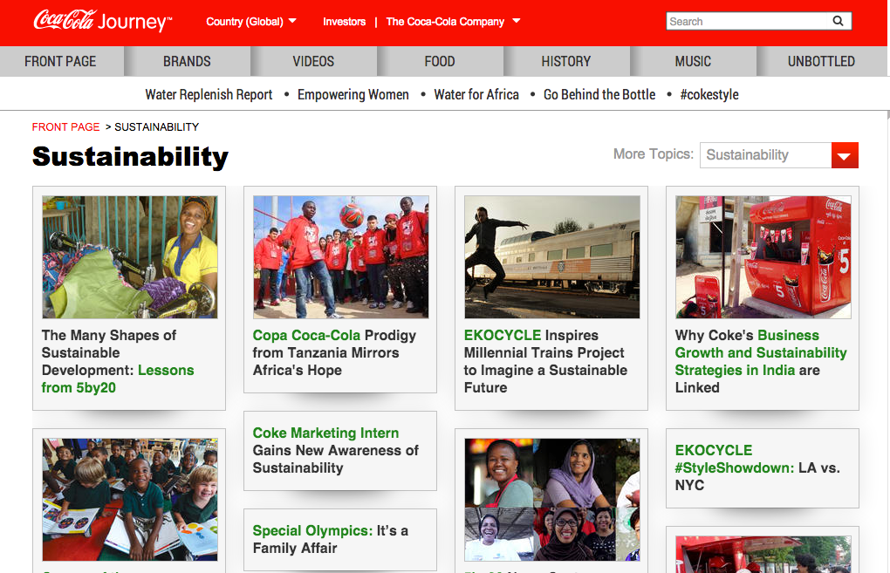


Example
Notes:
This is a snapshot coca cola’s sustainability website Each one of these efforts are outlined in a nice thick report of how responsible coca cola is and how much they care about sustainability. What is not shown is that coke spent One million seven hundred and fifty thousand USD to oppose labeling of food products that are made from GMO. Maybe they could focus on the sustainability of what they produce?

Slide 24
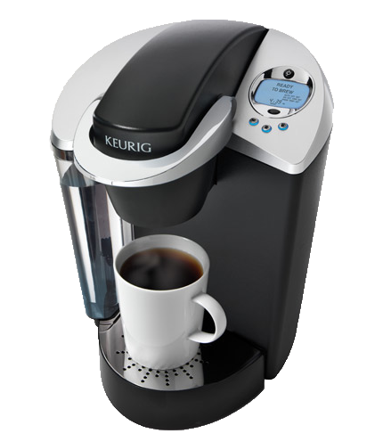

Success and Failures
In 2013, Green Mountain produced 8.3 billion K-Cups, enough to wrap around the equator 10.5 times.
Only five percent of its current cups are made out of recyclable plastic. (Don‘t buy any more K-cups until 2020)
Success or Failure?

Slide 25



Success and Failures
Nespresso Capsules are Aluminum
In many countries Nestle has setup pod
recycling centres to collect them so they can create new pods.
Success or Failure?

Slide 26
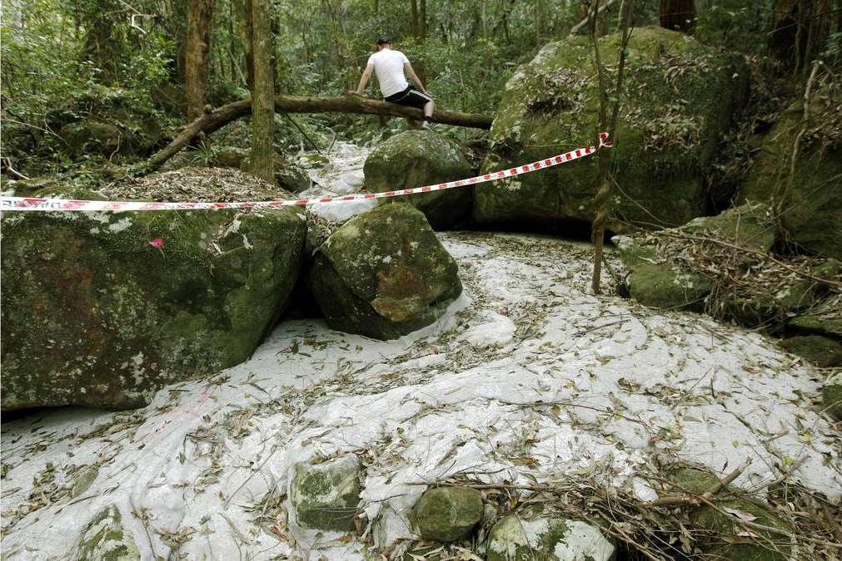

Success and Failures
Success or Failure?
Sugarloaf Colorado, USA
Workers Grouted the Coal Mine to fix cracks as a project to not impact the nature preserve that was adjacent to the mine.
Natural waterways absorbed the grout and created a concrete river in a nature reserve.
A massive fracture running up the hillside. Photo: Darren Pateman
Notes:
A large section of Sugarloaf State Conservation Area in the lower Hunter has been destroyed by massive subsidence from Glencore's West Wallsend Colliery.
A Fairfax Media investigation has uncovered cliff faces crumbled or collapsed, a waterway destroyed, large cracks opened in the earth and a huge collapse of a hillside.
Damage was tracked over more than two kilometres within the ecologically sensitive conservation area adjacent to the mine's Longwall 41.
In one area a cliff face fall of more than 20 metres was discovered.
Damage was cause by unplanned subsidence from longwall mining by West Wallsend Colliery that is mining beneath 23 per cent of the conservation area.
Fairfax Media can also reveal that in June this year a waterway was accidentally grouted by workers carrying out remediation works in the reserve.
Grouting in one of the cracks. Photo: Darren Pateman
A spokesman for the Office of Environment and Heritage confirmed grouting material, used to fill mine subsidence cracks and holes, leaked into a ''drainage line'' and the colliery had been ordered to ''clean up the site''.
Read more: http://www.smh.com.au/nsw/mine-subsidence-devastates-sugarloaf-conservation-area-20130828-2spuc.html#ixzz3D7KkWUy2

Slide 27
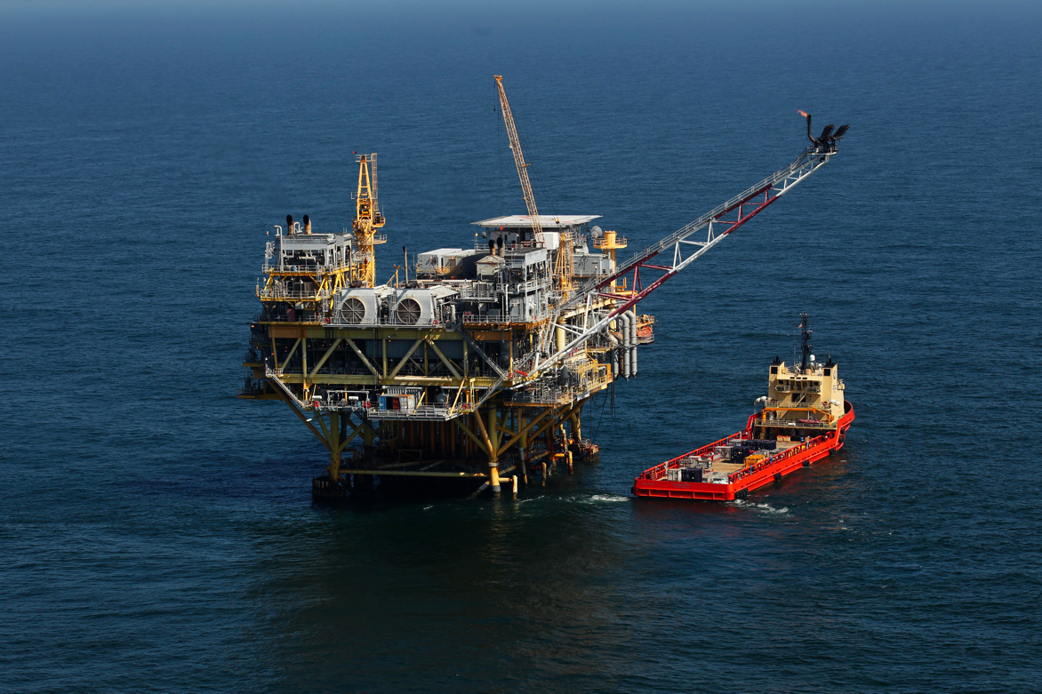

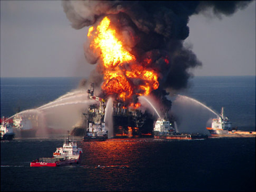
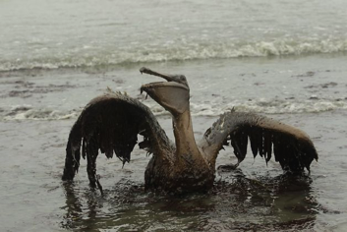
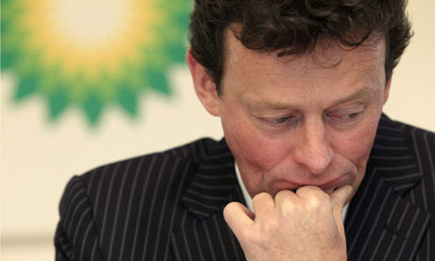
Success and Failures
Success or Failure?
Deep Water Horizon, USA
an ultra-deepwater, dynamically positioned, semi-submersible offshore oil drilling rig - Gulf of Mexico
Deep Water Horizon, USA
$20,000,000,000 USD in Fines
Or
734,60,000,000 AED

Slide 28
Organizations Driving Sustainability
Hundreds of NGO’s, Non-Profits and advocates promote sustainability
Internationally (and practically) the standards drivers are largely focused on
  ISO
  United Nations
    UN Global Compact
    UN PRME
  Global Reporting Initiative

Slide 29

The United Nations Global Compact
The Ten Principles
The UN Global Compact's ten principles in the areas of human rights, labour, the environment and anti-corruption enjoy universal consensus and are derived from:
The Universal Declaration of Human Rights
The International Labour Organization's Declaration on Fundamental Principles and Rights at Work
The Rio Declaration on Environment and Development
The United Nations Convention Against Corruption

Slide 30

The Ten Principles
Human Rights
Businesses should support and respect the protection of internationally proclaimed human rights; and
make sure that they are not complicit in human rights abuses.
Labour
3. Businesses should uphold the freedom of association and
the effective recognition of the right to collective bargaining;
4. the elimination of all forms of forced and compulsory labour;
5. the effective abolition of child labour; and
6. the elimination of discrimination in respect of employment and occupation.

Slide 31
The Ten Principles
Environment
7. Businesses should support a precautionary approach to environmental challenges;
8. undertake initiatives to promote greater environmental
responsibility; and
9. encourage the development and diffusion of environmentally friendly technologies.
Anti-Corruption
10. Businesses should work against corruption in all its forms, including extortion and bribery.

Slide 32

Principle 1 | Purpose: We will develop the capabilities of students to be future generators of sustainable value for business and society at large and to work for an inclusive and sustainable global economy.
Principle 2 | Values: We will incorporate into our academic activities and curricula the values of global social responsibility as portrayed in international initiatives such as the United Nations Global Compact.
Principle 3 | Method: We will create educational frameworks, materials, processes and environments that enable effective learning experiences for responsible leadership.
Principle 4 | Research: We will engage in conceptual and empirical research that advances our understanding about the role, dynamics, and impact of corporations in the creation of sustainable social, environmental and economic value.
Principle 5 | Partnership: We will interact with managers of business corporations to extend our knowledge of their challenges in meeting social and environmental responsibilities and to explore jointly effective approaches to meeting these challenges.
Principle 6 | Dialogue: We will facilitate and support dialog and debate among educators, students, business, government, consumers, media, civil society organisations and other interested groups and stakeholders on critical issues related to global social responsibility and sustainability.
Notes:
Launched at the 2007 UN Global Compact Leaders Summit in Geneva, the Principles for Responsible Management Education (PRME) initiative is the first organised relationship between the United Nations and business schools, with The mission of PRME is to inspire and champion responsible management education, research and thought leadership globally.
There are (only) 13 PRME supporting organizations. GPM Global represents the project management world.

Slide 33

Global Reporting Initiative (GRI)
A pioneering nonprofit propose a framework for sustainability reporting.
Companies use this report to inform its shareholders and consumers through their performance of economic, social and environmental
Learn more at www.globalreporting.org
Notes:
Global Reporting Initiative (GRI) is an organization whose purpose is to promote the development of sustainability reporting in all types of organizations. GRI produces a comprehensive framework for the preparation of Sustainability Reports, which are widely used worldwide. The Framework, including the Guide for the preparation of reports, sets out the principles and indicators that organizations can use to measure and disclose their economic, environmental and social. GRI is committed to continuously improving and increasing the use of these Guidelines, which are available to the public for free. ? GRI is a nonprofit organization with multiple stakeholders. It was founded by CERES and the United Nations Program for Environment (UNEP) in 1997 in the United States. In 2002, GRI moved its offices to Amsterdam, where he is currently its Secretariat. GRI has regional offices ("Focal Points") in Australia, Brazil, China, India and the United States, and also has a network of more than 30,000 people worldwide

Slide 34

Global Reporting Intiative’s Categories and Aspects
Economic
    Economic Performance
    Market Presence
    Direct Economic impact
Environment
  Materials, energy, water
  biodiversity
  Emissions, waste, transport
  Products and services
  Integral sustainability
Social
    Labor practices and decent work
    Society
    Human Rights
    Product liability
    Ethics
Notes:
Sustainability reporting’ is a broad term considered synonymous with others used to describe reporting on economic, environmental, and social impacts (e.g., triple bottom line, corporate responsibility reporting, etc.). A sustainability report should provide a balanced and reasonable representation of the sustainability performance
Reports can be used for the following purposes, among others:
• Benchmarking and assessing sustainability performance with respect to laws, norms, codes,
performance standards, and voluntary initiatives;
• Demonstrating how the organization influences and is influenced by expectations about sustainable development; and
• Comparing performance within an organization and between different organizations over time. – including both positive and negative contributions.

Slide 35
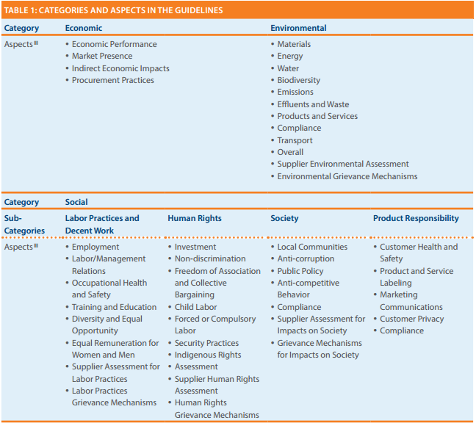
Going Deeper into 2013 G4 GRI
Product Responsability!!
(A little weak)
Notes:
The table in figure is from the 2013 G4 release for GRI reporting.
GRI G4 states “Sustainability reporting is fundamental to an organization’s integrated thinking and reporting process in providing input into the organization’s identification of its material issues, its strategic objectives, and the assessment of its ability to achieve those objectives and create value over time”.
The reporting indicators are primarily structured in pairs, with a Core Indicator seeking disclosure on the processes in place to address the aspect, and an additional Indicator to report on degree of compliance.
The final category “Product Responsibility” includes Customer Health and Safety, Product Labeling, Marketing Communications, Customer Privacy, and Compliance. A more complete approach to sustainability reporting would take into account lifespan and servicing as well as the efficiency and maturity of the product’s design and build process.

Slide 36
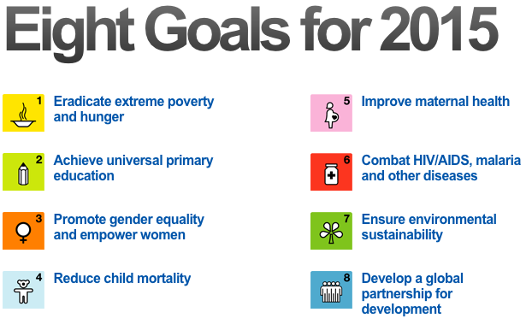
The UN Millenium Development Goals (MDGs)
Notes:
Globally, the The eight Millennium Development Goals or MDGs– which range from reducing extreme poverty to providing universal primary education, all by the target date of 2015 – form a blueprint agreed to by all the world’s countries and all the world’s leading development institutions. They have galvanized unprecedented efforts to meet the needs of the world.

Slide 37
Progress!
1. The world has reduced extreme poverty by half
In 1990, almost half of the population in developing regions lived on less than $1.25 a day. This rate dropped to 22 per cent by 2010, reducing the number of people living in extreme poverty by 700 million
2. 90% of children in developing regions are attending primary school
The school enrolment rate in primary education in developing regions increased from 83 per cent to 90 percent between 2000 and 2012. Most of the gains were achieved by 2007, after which progress stagnated. In 2012, 58 million children were out of school. High dropout rates remain a major impediment to universal primary education. An estimated 50 per cent of out-of-school children of primary school age live in conflict-affected areas.
3. Disparities in primary school enrolment between boys and girls are being eliminated in all developing regions
Substantial gains have been made towards reaching gender parity in school enrolment at all levels of education in all developing regions. By 2012, all developing regions have achieved, or were close to achieving, gender parity in primary education.
4. Child mortality has been almost halved
Worldwide, the mortality rate for children under age five dropped almost 50 per cent, from 90 deaths per 1,000 live births in 1990 to 48 in 2012. Preventable diseases are the main causes of under-five deaths and appropriate actions need to be taken to address them.

Slide 38
Progress!
5. Much more needs to be done to reduce maternal mortality
Globally, the maternal mortality ratio dropped by 45 percent between 1990 and 2013, from 380 to 210 deaths per 100,000 live births. Worldwide, almost 300,000 women died in 2013 from causes related to pregnancy and childbirth. Maternal death is mostly preventable and much more needs to be done to provide care to pregnant women.
6. Efforts in the fight against malaria and tuberculosis have shown results
Between 2000 and 2012, an estimated 3.3 million deaths from malaria were averted due to the substantial expansion of malaria interventions. About 90 percent of those averted deaths—3 million—were children under the age of five living in sub-Saharan Africa. The intensive efforts to fight tuberculosis have saved an estimated 22 million lives worldwide since 1995. If the trends continue, the world will reach the MDG targets on malaria and tuberculosis.
7. Major trends that threaten environmental sustainability continue, but examples of successful global action exist
Global emissions of carbon dioxide (CO2) continued their upward trend and those in 2011 were almost 50 percent above their 1990 level. Millions of hectares of forest are lost every year, many species are being driven closer to extinction and renewable water resources are becoming scarcer. At the same time, international action is on the verge of eliminating ozone-depleting substances and the proportion of terrestrial and coastal marine areas under protection has been increasing.
8. Last but not least… - The Global Partnership for Development (Next Slide…)

Slide 39
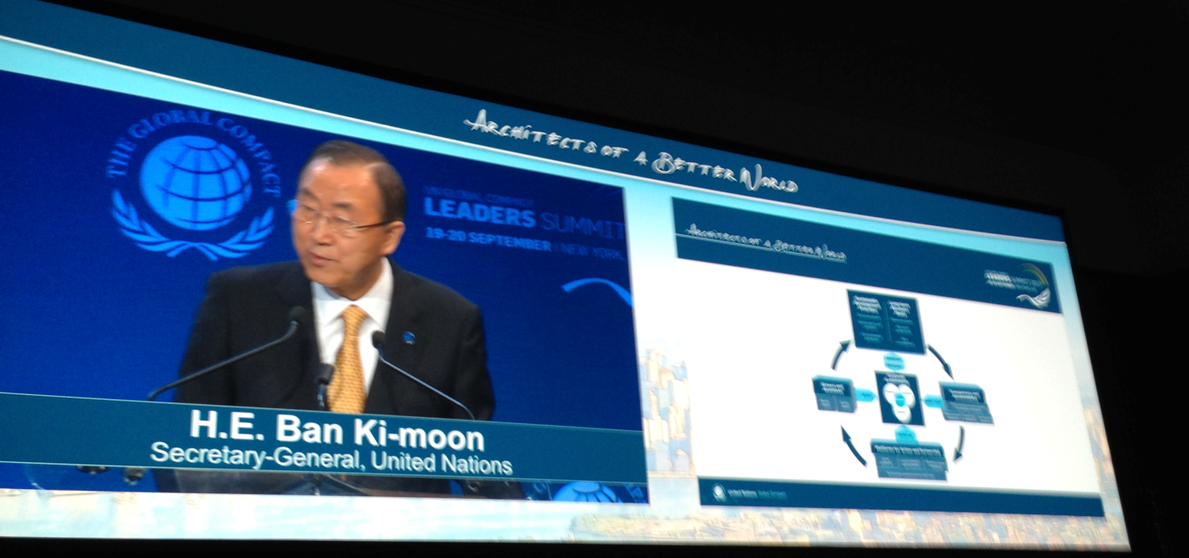
Explaining a Need for a Paradigm Shift
The MDGs brought together governments, the international community, civil society and the private sector to achieve concrete goals for development and poverty eradication. Much has been accomplished through the concerted and focused efforts of all, saving and improving the lives of many people, but the agenda remains unfinished. The analysis presented in this report points to the importance of intensifying efforts to meet all MDG targets.
Each of these building blocks (MDG’s) must be further strengthened and
connected through a comprehensive and collective effort.
UN Secretary Ban Ki-Moon outlining the Architecture on September 19th 2003
Notes:
The post-2015 development agenda is slated to carry on the work of the MDGs and integrate the social, economic and environmental dimensions of sustainable development. Continued progress towards the MDGs in the remaining year is essential to provide a solid foundation for the post-2015 development agenda

Slide 40
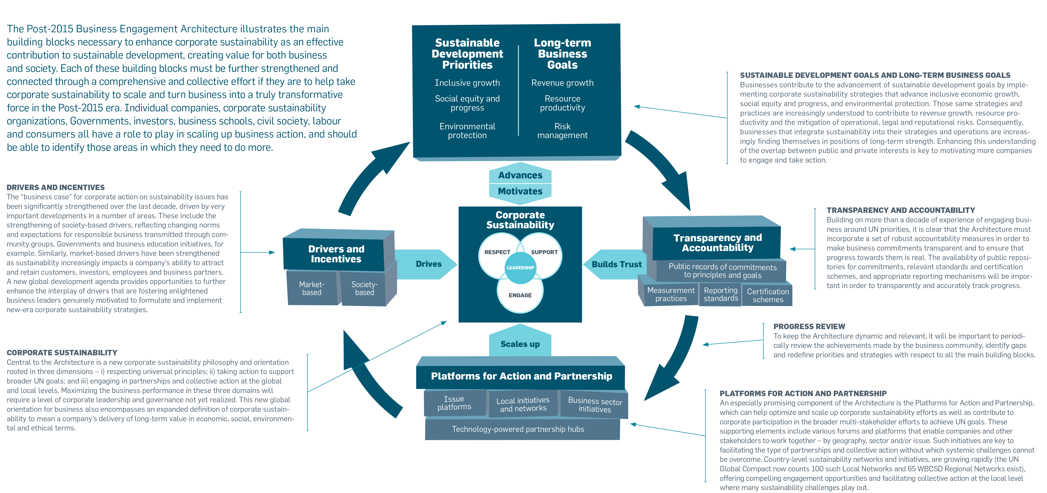

POST-2015 BUSINESS ENGAGEMENT ARCHITECTURE
Notes:
Facilitator – This slide is important but only from a high level. Highlight the fact that each building block is supposed to support forward progress towards business inclusion.
This model is a good from a high level, but what is missing are specific actionable items. GPM’s approach meets all of the requirements for this framework, including certification schemes under Transparency and Accountability. In this course, participants will learn how to naturally (holistically) put it into practice.

Slide 41

Essentially
• Leverage channels to communicate corporate sustainability performance to investors and, where relevant, adopt a responsible investment policy for corporate pension funds;
• Undertake sustainability due-diligence and set clear expectations before signing partnership contracts in order to encourage partners throughout the value chain to uphold minimum standards and advance sustainable practices;
• Intensify engagement in issue platforms and sector initiatives in order to scale-up and advance business engagement on sustainability issues and, as relevant, help overcome systemic challenges;
• Engage in local networks and initiatives, actively sharing best practice and learnings with local business community and providing operational support and resources, as appropriate;
• Engage in partnerships with other businesses and stakeholders that can have transformative impacts – moving beyond an ad-hoc project focus.
-RUN YOUR BUSINESS
-DO NO HARM
-MAKE THE WORLD A BETTER PLACE

Slide 42
What are we up against to embed sustainability into our culture?
Understanding the language
Topic legitimacy “is it our problem”
Prevailing mindsets and attitudes.
Eliminating the Silo mentality
Practical Tools
Organizational Capacity for Change
Aligning the challenges to Strategic Business goals

Slide 43
We have covered
Sustainability Challenges
UN Global Compact
Global Reporting Initiative
PRME
Millennium Development Goals
Post-2015 Business Engagement Architecture

Slide 44
Systems Thinking
Module | Module Covers | Learning outcomes
2 Systems Thinking | What is Systems Thinking ISO standards and how to use them. ISO 14000 Series on Environmental Management ISO 26000 Corporate Social Responsibility ISO 14000 Series on Environmental Management ISO 9000 Quality Management ISO 50001 Energy Management ISO 55000 Asset Management | This module covers a critical aspect of sustainable change delivery by explaining a thinking versus the traditional “input/output” approach
Language
English
Version
5.0

Slide 45
The GPM Sustainability Services Focus
Organizations are locked on process and output…
GPM encourages PMs to focus on the overall corporate system and benefits / strategic objectives… delivering real value for the business and customers!

Slide 46

What is a System?
A system is a set of parts that interact and affect each other, thereby creating a larger whole of complex thing.
Notes:
Let's start with a simple example from nature: the Earth. Our planet is a very complex system consisting of atmosphere, water, mountains, plains, jungles, plants, insects, animals, humans and our technological wonders, just to name a few. A scientist may look at many interactions of these parts in researching climate change. General patterns may be found in these interactions that may help explain the system and find solutions to the problems by changing the patterns of interaction between the parts.
Now, let's apply the idea of a system to business. We'll start small and work our way up. A business is a system consisting of many parts: employees, management, capital, equipment, and products, among others. Your business and your competitors comprise a system, which we may call an industry. Different industries, along with consumers, governments, and non-governmental organizations make up our economic system.
http://education-portal.com/academy/lesson/systems-thinking-in-management-definition-theory-model.html

Slide 47
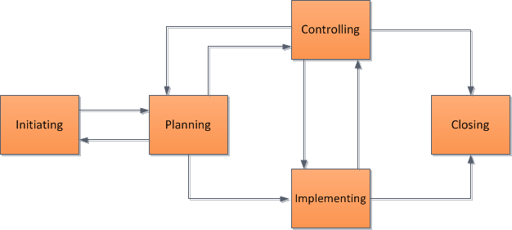
What is Systems Thinking?
According to system thinking, if we examine the interactions of the parts in a system, we will see larger patterns emerge.
By seeing the patterns, we can begin to understand the how the system works.
If the pattern is good for the organization, we can make decisions that reinforce it, but if the pattern is bad for the organization, we can make decisions that change the pattern.
Input/output thinking
Systems thinking
Notes:
System thinking is a major departure from the old way of business decision-making in which you would break the system into parts and analyze the parts separately. Supporters of system thinking believe that the old way is inadequate for our dynamic world, where there are numerous interactions between the parts of a system, creating the reality of a situation.

Slide 48


Why we encourage this?
Many Project Managers focus on project inputs and outputs rather than value and benefit to the overall system. This is the same as focusing on a single drop of water. If we pollute it, no big deal. It is only one drop…
That’s a lot of water… Over 20,000,000
Project Managers globally
Notes:
We just covered a lot. Time for a quick break.

Slide 49

Getting to Know ISO Standards (What drives systems…)
Notes:
CRITICAL!! Explain that we are going to review a few ISO standards that PMs should be familiar with not only from a conceptual point of view but in terms of how they are utilized in their organization, client organization and projects.

Slide 50

ISO standards
Guidelines and Standards
Guidelines
ISO 26000 - CSR
ISO 21500 – Project Management
Normative Standards
ISO 9000 – Quality Management
ISO 14000 - Environmental
ISO 50001- Energy Management
Notes:
What are the benefits of ISO International Standards?
We cover ISO Standards that pertain to sustainability as they are important in understanding the principles and approach that project managers should take to ensure quality, benefits and value.
ISO International Standards ensure that products and services are safe, reliable and of good quality. For business, they are strategic tools that reduce costs by minimizing waste and errors and increasing productivity. They help companies to access new markets, level the playing field for developing countries and facilitate free and fair global trade. (ISO.org)
There are two kinds. Guidelines and normative….

Slide 51

What ISO 26000 is NOT…
A management system standard.
Intended or appropriate for certification purposes or regulatory or contractual use.
Intended to provide a basis for legal actions, complaints, defenses or other claims in any international, domestic or other proceeding.
Intended to be cited as evidence of the evolution of customary international law.
Intended to prevent the development of national standards that are more specific, more demanding, or of a different type.

Slide 52
What ISO 26000 is…
Intended to assist organizations in contributing to Sustainable Development.
Intended to promote common understanding in the field of Social Responsibility.
Intended to complement other instruments & initiatives for Social Responsibility and not to replace them.
Intended to provide organizations with guidance concerning Social Responsibility and can be used as part of public policy activities.
Notes:
ISO 26000 contains no requirements and therefore the word “shall”, which indicates a requirement in ISO language, is not used
But does contain 386 “should”s

Slide 53
ISO 26000
Principles of Social Responsibility
Accountability
  Businesses are expected to be accountable for its impacts on society & the environment
Transparency
  Businesses are expected to be transparent in its decisions & activities that impact on society & the environment.
Ethical Behavior
  Businesses are expected to behave ethically at all times.
Stakeholder Interests
  Businesses are expected respect, consider & respond to the interests of its stakeholders.
Rule of Law
  Businesses are expected to abide by the rule of law for that region and or country.
International Norms of Behavior
  Businesses are expected to respect international norms of behavior, while adhering to the principle of respect for the rule of law.

Slide 54

ISO 14000 Family
A series of guidance documents and standards to help organizations address environmental issues.
These ISO’s below deal with Environmental Management Systems (EMS)
  14001: Environmental Management Systems
  14004: EMS general guidelines
  14010: Guidelines for Environmental Auditing
  14011: Guidelines for Auditing of an EMS
  14012: Auditing - Qualification criteria
  14064: Greenhouse gases
Notes:
ISO 14004 is guidance on how to implement ISO 14001
10, 11, and 12 relate to auditing of the 14001 standard. I would note here that a new joint auditing standard is currently being developed that will eventually replace 14010, 14011, and 14012. This new standard ISO 19011 is an auditing standard that may be used for both ISO 9000 and ISO 14001.
ISO 14064-1:2006
Greenhouse gases -- Part 1: Specification with guidance at the organization level for quantification and reporting of greenhouse gas emissions and removals

Slide 55
What is the Environment?
Environment: Surroundings in which an organization operates, including air, water, soil, natural resources, flora, fauna, humans and their interrelation. (ISO 14001:2004)

Slide 56
ISO 14001 Key Elements
  Policy Statement
  Identification of Significant Environmental Impacts and Environmental Legal Requirements
  Establishing Environmental Programs, Objectives and Targets
  Emergency Plan
  Operating Control to meet the Environmental Objectives and Targets
  Human Resources roles and Responsibilities.
  Training.
  Communication
  Internal Assessments. Corrective actions.
  Management Review (by Directors)

Slide 57
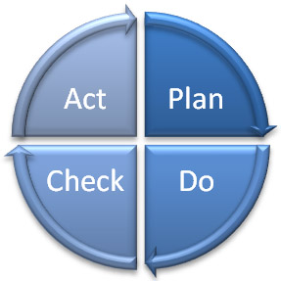
What is an EMS?
Deming Model - PDCA
Systematic way of managing an organization’s environmental affairs
Based on Plan-Do-Check-Act Model (PDCA)
Focused on Continual Improvement of system
Addresses immediate and long-term impact of an organization’s products, services and processes on the environment.
A tool to improve environmental performance
Management
Review
Planning
Checking
Corrective Action
Implementation
Notes:
I introduce the term “PDCA” here
I often use the term “activities, products, and services” here and reference the standard’s use of these terms
The steps in each successive PDCA cycle are:
PLAN Establish the objectives and processes necessary to deliver results in accordance with the expected output (the target or goals). By establishing output expectations, the completeness and accuracy of the specification is also a part of the targeted improvement. When possible start on a small scale to test possible effects.

Slide 58
Why Do Organizations Implement an EMS ?
Helps to identify the causes of environmental problems.
  better to make a product right the first time
  cheaper to prevent a spill or other accident
  cost effective to prevent pollution
Trade and competitive issues
  Inconsistency in environmental regulation and enforcement
Many individual parts may already be in place – just need to unify under the EMS umbrella!
??Why should a project manager be familiar with the EMS?

Slide 59

ISO 50001: 2011 Energy Management Systems
ISO 50001 gives organizations the requirements for energy management systems (EnMS)
Benefits:
1. Improved energy performance can provide rapid benefits for an organization by maximizing the use of its energy sources and energy-related assets, thus reducing both energy cost and consumption.
2. The organization will also make positive contributions toward reducing depletion of energy resources and mitigating worldwide effects of energy use, such as global warming.
Notes:
ISO 50001 — Why is it important?
Energy is critical to organizational operations and can be a major cost to organizations, whatever their activities. An idea can be gained by considering the use of energy through the supply chain of a business, from raw materials through to recycling.
In addition to the economic costs of energy to an organization, energy can impose environmental and societal costs by depleting resources and contributing to problems such as climate change.
The development and deployment of technologies for new energy sources and renewable sources can take time.
Individual organizations cannot control energy prices, government policies or the global economy, but they can improve the way they manage energy in the here and now. Improved energy performance can provide rapid benefits for an organization by maximizing the use of its energy sources and energy-related assets, thus reducing both energy cost and consumption. The organization will also make positive contributions toward reducing depletion of energy resources and mitigating worldwide effects of energy use, such as global warming.
ISO 50001 is based on the management system model that is already understood and implemented by organizations worldwide. It can make a positive difference
for organizations of all types in the very near future, while supporting longer term efforts for improved energy technologies.

Slide 60
ISO 50001: 2011 Energy Management Systems
Primary Energy Sources
  Renewable: Solar, Water, Wind, Biomass
  Non-Renewable: Oil, Gas, Carbon and Nuclear fusion
Secondary Energy
  Electric, mechanic, Thermic, Hot water, Compressed Air, Biodiesel and Fuel in general
Final Use
  Lighting, Refrigeration, Heating, Process,

Slide 61

Principles of Quality Management
These principles embodied in ISO 9001 have been developed with the intention that management can lead the organization towards improved performance.
Customer Focus
leadership
Involvement of people
Process Approach
System approach to management
continuous Improvement
Factual approach to decision making
Mutually beneficial supplier

Slide 62
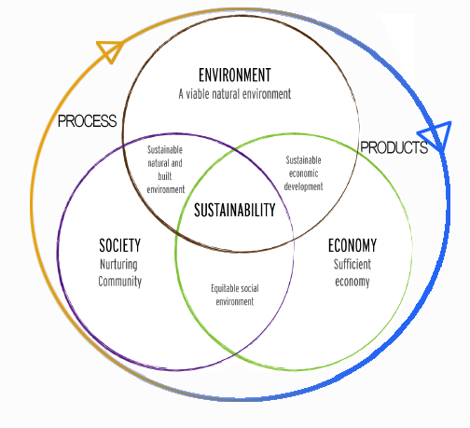
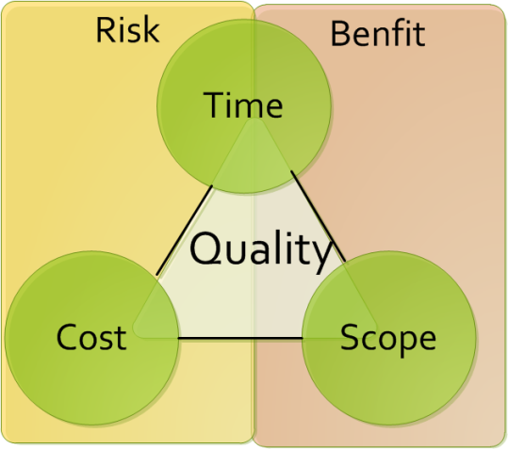
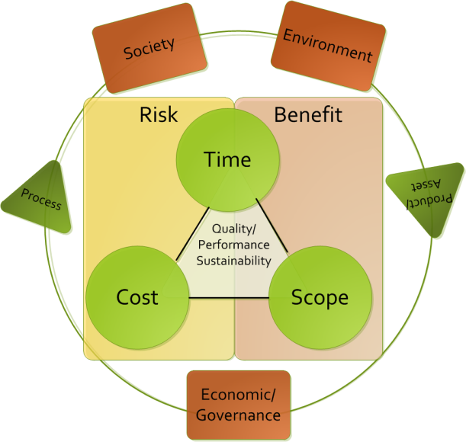
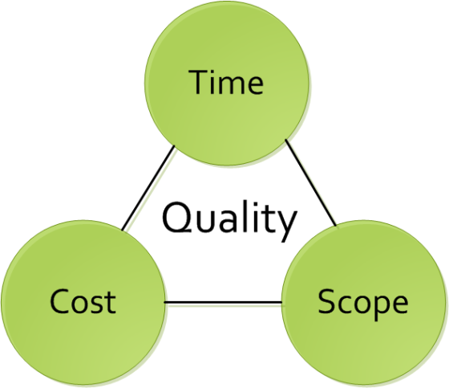
The Current PM Challenge - Quality
Many project managers are locked onto focusing on the traditional Time / Cost / Scope paradigm (if lucky they take into account quality)
Successful project managers focus on time, cost, quality, scope, benefits and risk
Exceptional project managers also take into account the other triple constraint… Though the key questions for organizations is how to facilitate this?
Notes:
SPEND TIME ON THIS SLIDE. This is THE key differentiator for GPM,

Slide 63

Audits
Audit Principles
  Ethical conduct: trust, integrity, confidentiality, and discretion.
  Fair Presentation: report truthfully and accurately
  Professional Care: Application of the audit. Necessary competence.
  Independence: the basis for the impartiality and objectivity of the conclusions.
Notes:
What is the Purpose of an Audit?
What are the stages of an Audit?
- Preparation, Execution, and Monitoring Report

Slide 64
What is ISO 55000?
The International Standard that is used for managing physical assets in particular, but can also be applied to other asset types.
Project managers must be responsible for the entire asset lifecycle and therefor understand how the asset (product) will be managed after it leaves the project lifecycle
55000
What other types of assets are there?

Slide 65
What is Asset Management
The factors which influence the type of assets that an organization requires to achieve its objectives, and how the assets are managed, include the following:
  the nature and purpose of the organization;
  its operating context;
  its financial constraints and regulatory requirements;
  the needs and expectations of the organization and its stakeholders.
These influencing factors need to be considered when establishing, implementing, maintaining and continually improving asset management.

Slide 66
What are the benefits of asset management?
The benefits of asset management can include, but are not limited to the following:
Improved financial performance: improving the return on investments and reducing costs can be achieved, while preserving asset value and without sacrificing the short or long-term realization of organizational objectives;
Informed asset investment decisions: enabling the organization to improve its decision making and effectively balance costs, risks, opportunities and performance;
Managed risk: reducing financial losses, improving health and safety, good will and reputation, minimizing environmental and social impact, can result in reduced liabilities such as insurance premiums, fines and penalties;
improved services and outputs: assuring the performance of assets can lead to improved services or products that consistently meet or exceed the expectations of customers and stakeholders;
Demonstrated social responsibility: improving the organization’s ability to, for example, reduce emissions, conserve resources and adapt to climate change, enables it to demonstrate socially responsible and ethical business practices and stewardship;
Demonstrated compliance: transparently conforming with legal, statutory and regulatory requirements, as well as adhering to asset management standards, policies and processes, can enable demonstration of compliance;
Enhanced reputation: through improved customer satisfaction, stakeholder awareness and confidence;
Improved organizational sustainability: effectively managing short and long-term effects, expenditures and performance, can improve the sustainability of operations and the organization;
Improved efficiency and effectiveness: reviewing and improving processes, procedures and asset performance can improve efficiency and effectiveness, and the achievement of organizational objectives.

Slide 67
Fundamentals : Leadership
Leadership and workplace culture are determinants of realization of value.
Leadership and commitment from all managerial levels is essential for successfully establishing, operating and improving asset management within the organization.
This includes:
clearly defined roles, responsibilities and authorities;
ensuring that employees are aware, competent, and empowered;
consultation with employees and stakeholders regarding asset management.

Slide 68
Fundamentals : Assurance
Asset management gives assurance that assets will fulfill their required purpose.
The need for assurance arises from the need to effectively govern an organization. Assurance applies to assets, asset management and the asset management system.
This includes:
developing and implementing processes that connect the required purposes and performance of the assets to the organizational objectives;
implementing processes for assurance of capability across all life cycle stages;
implementing processes for monitoring and continual improvement;
providing the necessary resources and competent personnel for demonstration of assurance, by undertaking asset management activities and operating the asset management system.

Slide 69
Correlation
According to ISO relevant asset management subject areas include:
data management;
condition monitoring;
risk management;
quality management;
environmental management;
systems and software engineering;
life cycle costing;
dependability (availability, reliability, maintainability, maintenance support);
configuration management;
tero-technology;
sustainable development;
inspection;
non-destructive testing;
pressure equipment;
financial management;
value management;
shock and vibration;
acoustics;
qualification and assessment of personnel;
project management;
property and property management;
facilities management;
equipment management;
commissioning process;
energy management.
Notes:
Ask the class which of these are not relevant to project management. The answer is none. They are all relevant. If a PM doesn’t understand asset management, they will not be successful.

Slide 70
Relationship to Projects
Stakeholders and organizational context
Portfolio, Program & Project Management
Organizational plans and objectives
Asset management policy
Strategic asset management plan (SAMP) Asset management objectives
Plans for developing asset management system & relevant support
Asset management plans
Implementation of asset management plans
Asset Management system + relevant support
Asset Portfolio
Performance evaluation and improvements
Based on ISO 55000, Relationship between key elements of an asset management system
Notes:
In blue, you will find the relationship between key elements of an asset management system. In green you will see the cross pollination to the project management realm.

Slide 71
We have covered
Systems Thinking
ISO 26000
ISO 14000 Series
ISO 9000
ISO 50001
ISO 55000

Slide 72
Ethics Values and Principles
Module | Module Covers | Learning outcomes
4 Ethics Values and Principles | Ethics Values Principles | Understand the Principles, Ethics and Values behind Sustainable Change Delivery.
Language
English
Version
5.0

Slide 73

Business Ethics
Business ethics are:
  Rules of conduct
  Patterns of behaviour in business
  ‘Doing the right thing’
Involves responsibility to:
  Suppliers
  Employees
  Wider community
  Even competitors…

Slide 74
Business Principles
Shared values horizontally and vertically
  Shape relationships with all stakeholders
  Affects dealings through supply chain
Key principles
  Respect for human rights
  Setting appropriate conditions of employment in suppliers’ factories

Slide 75

Costs of ethical behaviour
Increased costs due to
  Audits and training
  Remedial actions
  Employment of Ethical Trade teams
However….. These produce
  Improvements to a supplier mean standards improve
  Transparency in business gives all stakeholders, including customers, confidence in the brand

Slide 76
Corporate Social Responsibility
(Why Morally)
Corporations cause socio-environmental issues and should therefore play a role in solving them (E.g.: pollution)
As powerful players in society, they should use that power responsibly
Corporations rely on the contributions of shareholders, employees, suppliers, communities and consumers and have a duty to take into account their collective needs.

Slide 77
Corporate Social Responsibility
(Why Ethically)
Expectations by society go beyond meeting legal responsibilities
  For Example:
    Ensuring contractors and sub-contractors pay their employees
    Purchasing from suppliers that have good environmental practices
    Not working with organizations the violate human rights

Slide 78
What are Principles and Values
Principles: Fundamental norms, rules, or values that represent what is desirable and positive for a person, group, organization, or community, and help it in determining the rightfulness or wrongfulness of its actions. Principles are more basic than policy and objectives, and are meant to govern both.
Values: Important and lasting beliefs or ideals shared by the members of a culture about what is good or bad and desirable or undesirable. Values have major influence on a person's behavior and attitude and serve as broad guidelines in all situations. Some common business values are fairness, innovation and community involvement.
Notes:
Source: http://www.businessdictionary.com/definition/principles.html
http://www.businessdictionary.com/definition/values.html

Slide 79
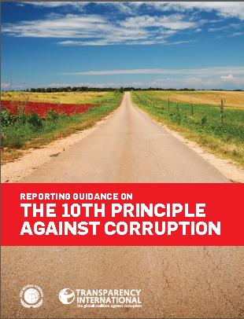
Communicating policies and values
According to Huguette Labelle - Chair, Transparency International Member, UN Global Compact Board
Reporting Guidance on the UNGC 10th Principle?
Through transparency, organizations can communicate to stakeholders and the public their values and polices and how they are being translated into action.
Transparency of commitment to values and openness about policies and processes will not only enhance a company’s reputation but act as a substantial deterrent to those wishing to act corruptly.
Transparency is a first line defence against corruption
Notes:
The Business Case for reporting on the 10th Principle:
There are three major benefits from reporting on anti-corruption. The first two categories apply to individual organizations (independent of their size), whereas the third category outlines benefits also for the overall community.
Increased internal integrity and transparency
Enhanced reputation
Common information basis
■■ sharing experience and procedures with other organizations;
■■ stimulating multi-stakeholder dialogues;
■■ increasing importance of disclosure on anti-corruption activities in overall sustainability agendas; and
■■ driving media coverage of good anti-corruption practices through provision of comparable progress reports.
Corruption is defined by Transparency International as “the abuse of entrusted power for private gain”. This convenient shorthand, encompassing myriad illegal and illicit acts, recognizes the breadth of the concept, but does not attempt to enumerate or precisely delimit. During the negotiations of the United Nations Convention against Corruption, UN Member States carefully considered the opportunity for the global anti-corruption treaty to provide a legal definition of corruption. Concluding that any attempt at a comprehensive definition inevitably would fail to address some relevant forms of corrupt behaviour, the international community reached global consensus on a large number of manifestations of corruption while leaving each State free to go beyond the minimum standards set forth in the Convention.
The Convention calls for ratifying States to outlaw, at a minimum, bribery of public officials; embezzlement, trading in influence, abuse of function, and illicit enrichment by public officials; and bribery and embezzlement in the private sector, as well as money laundering and obstruction of justice. These corrupt actions are spelled out under the chapter of the Convention devoted to criminalization
and law enforcement, denoting that corruption is a crime, which is a notion wider than bribery and extortion. In consonance with this approach, the 10th Principle of the United Nations Global Compact calls for companies to work against corruption in all its forms, including extortion and bribery.

Slide 80
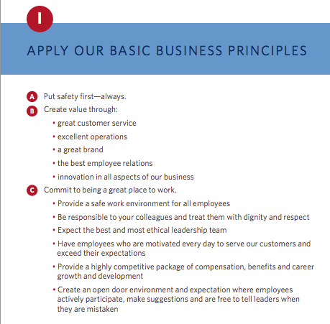
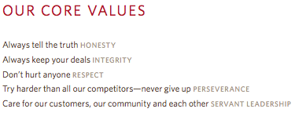
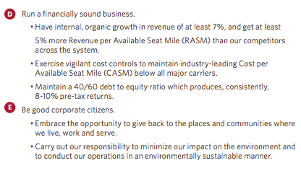
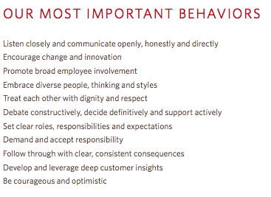

Example – Delta Airlines
http://www.delta.com/content/dam/delta-www/pdfs/policy/delta-rules-of-the-road.pdf

Slide 81
GPM® Sustainable Change Delivery Principles
Commitment & Accountability - Recognizing the essential rights of all to healthy, clean and safe environments, equal opportunity, fair remuneration, ethical procurement, and adherence to rule of law
Ethics & Decision Making - Supporting organizational ethics, decision making with respect for universal principles through identification, mitigation, and the prevention of adverse short and long-term impacts on society and the environment
Integrated & Transparent - Fostering the interdependence of economic development, social integrity, and environmental protection in all aspects of governance, practice and reporting
Principal & Values Based - Conserving and enhancing our natural resource base by improving the ways in which we develop and use technologies and resources
Social & Ecological Equity - Assessing human vulnerability in ecologically sensitive areas and centers of population through demographic dynamics
Economic Prosperity - Establishing fiscal strategies, objectives, and targets that balance the needs of stakeholders, including immediate needs and those of future generations
IF YOU DO NOT FACTOR THESE, YOUR PROJECT IS NOT SUSTAINABLE.

Slide 82
PSM3™ Levels for Sustainability
(Applying Principles to PM)
Level 5
PRINCIPLED
Has industry leading practices and procedures with continuous improvement, quantifiable value from sustainability initiatives
Level4
Essential
Organization demonstrates active interest, adopted policies and procedures for sustainability
Level 3
Foundational
Organization has formal policies, has identified formal processes and procedures

Slide 83
PSM3™ Levels for Sustainability
Level 2
Provisional
The organization is aware of some competency demonstrated in sustainable practice.
Level 1
Nonexistant
The organization is unaware of any focused attention to sustainability
Level 0
Uncertain
Organization does not know where it currently stands.

Slide 84
VALUES, MORALS & ETHICS
Values are the fundamental beliefs that we hold. They are the principles that we hold regarding what is right, good, and just.
Morals are the values which are inherent in a system of beliefs – a higher authority such as a business society in which business values such as performance excellence, quality, safety, service, and accomplishing desired results are important.

Slide 85
Eight ethical guidelines foundation for projects.
Recognize that managing ethics is a process. Ethics management is the process of reflection and dialog . that produces deliverables such as codes, policies and procedures.
The goal of an ethics management initiative is preferred behaviour in the project environment.
The best way to manage ethical dilemmas, like negative project risks, is to avoid their occurrence in the first place
Make ethics decisions in teams, and make decisions public, as appropriate
Integrate ethics management with other project practices. Define preferred ethical values directly in the project plan
Use cross-functional teams to develop your ethics management plan. Benefit from varied input
Value forgiveness Help project personnel recognize and address their mistakes and then support them to continue to try to operate ethically
Give yourself credit for trying Attempting to operate ethically and making a few mistakes is better than not trying at all. All projects are comprised of people and people are not perfect.
APMBoK V. 5

Slide 86
We have covered
Principles For Sustainable Change Delivery
Values
Ethics

Slide 87
Governance and P3O
Module | Module Covers | Learning outcomes
#5 Governance, Portfolio and Program Management | What is Project Governance Principles of Project Governance Project Governance Areas P3O (Portfolio, Program, Project Offices) Portfolio Management Program Management Benefits of Project Offices Types of Project Offices Responsibilities of Project Offices | Gain an understanding of governance, portfolio and program management.
Language
English
Version
5.0

Slide 88
Project Governance
Governance is the framework by which an organization is directed and controlled. Project governance includes, but is not limited to, those areas of organizational governance that are specifically related to project activities.
Project governance may include subjects such as the following:
  — defining the management structure;
  — the policies, processes and methodologies to be used;
  — limits of authority for decision-making;
  — stakeholder responsibilities and accountabilities;
  — interactions such as reporting and the escalation of issues or risks.
The responsibility for maintaining the appropriate governance of a project is usually assigned either to the project sponsor or to a project steering committee.
ISO 21500

Slide 89
Corporate Governance
The ongoing activity of maintaining a sound system of internal control by which the directors and officers of an organization ensure that effective management systems, including financial monitoring and control systems, have been put in place to protect assets, earning capacity and the reputation of the organization.
Src. GPM® PSM3™ 2014
Notes:
Sustainability is a critical function of project governance and change delivery in general.

Slide 90
Where Project Governance Exists
Project Governance
Notes:
Here is a diagram, from ISO 21500, Guidance on Project Management page 3 that depicts the project organization. The boxes represent project management concepts and the arrows represent a logical flow by which the concepts are connected. The dotted lines are organizational boundaries.
The blue box listed as opportunities represents what becomes the project initiation phase and comes from organizational need, market demand and so forth. I will stress that factors outside the organizational boundary include regulatory, socio-economic, and ecological. If they are penetrating the organization then where would they most likely live within the project environment? Project Governance. Makes sense.

Slide 91
Portfolio management characteristics
Screening, analysis and financial appraisal of project and program characteristics (resources, schedules, cash flows, risks, benefits, etc.) in relation to overall business strategy.
Prioritization and/or selection of projects and programs within the portfolio, given the resources available, likely returns and risks.
Continued monitoring of the portfolio characteristics as projects and programs develop.
Adjustment of the portfolio with regard to the constraints, risks and anticipated returns in the light of developing circumstances.
APMBoK V. 5
Notes:
This means:
Don’t take on more projects/programs than you can cope with. If you want to start up a new program/project you may need to slow or stop one or more others to free up the resources (including financial resources).
Don’t take on too many projects/programs that are high risk at any one time – unless you want to end up like Lehmann Brothers.
Keep an eye on the mix to make sure it doesn’t get out of hand.
When commercial/economic/political circumstances change, you might need to change what’s in the portfolio. Some projects/programs may no longer be appropriate or affordable. If costs rise on a key project/program you may need to close/suspend others to be able to continue to pay for the overrun.

Slide 92
More on portfolio management
Portfolio management is needed when an organisation operates a number of projects and programs
Normally it is part of the role of senior managers
A central project office, or network of project offices, can assist by providing information and updates about projects and programs

Slide 93
Project management vs. program management
Project
Defined start and end
Shorter timescale
May change
Delivers products
Benefits usually follow
Consists of activities
Manages resources
Program
Ends once goal achieved
Longer timescale
May evolve
Delivers strategic change
Benefits usually during
Consists of projects
Manages resource conflict

Slide 94
Program manager’s role
Identify and define projects within the program
Delegate to project managers
Monitor the projects in terms of time, cost, quality, risks and issues
Monitor interdependencies
Focus on strategic benefits
Intervene in projects when necessary
Manage resource conflicts

Slide 95
Benefits of program management
Closer alignment of projects with business strategy
Closer alignment with business priorities
Improved prioritisation of projects within the program
Improved focus on benefits
Improved resource management
Consistent management reporting within the program
program wide and cross-project view of risk
Consistent project management processes and standards within the program

Slide 96
Organizational Capacity for Change
Module | Module Covers | Learning outcomes
5 Organizational Capacity for Change | What is OCC Why Change initiatives fail The Eight Dimensions for OCC Six Points for Innovative Cultures ADKAR Model | Understand what Organizational Capacity for Change is, why it is necessary and what the critical components for change culture are.
Language
English
Version
5.0

Slide 97
Organizational Capacity for Change Defined
Organizational capacity for change (OCC) can be conceptualized as the overall capability of an organization to either effectively prepare for or respond to an increasingly unpredictable and volatile environmental context. This overall capability is multidimensional, and it comprises three ingredients:
  (a) human skill sets and resources
  (b) formal systems and procedures, and
  (c) organizational culture, values, and norms.

Slide 98
The New Mandate for Change Leadership
Executive leaders must react quickly to current problems and opportunities, they must also look to and prepare for the future.
Organizations must become more agile, flexible, and nimble.
The new leadership mandate for the 21st century is delivering results in the short term while building change capacity for the long term.

Slide 99
Primary Reasons for Failure to Bring About Change
Organizational members operating in “departmental silos” that focus on local optimization at the expense of the entire system.
Organizational Change takes time, a precious commodity.
The traditional view of organizations is that they are hierarchies with power concentrated at the top with rational and logical employees operating throughout this hierarchy. (While it is true that all organizations are hierarchical in some form and that organizational members are rational at times, this viewpoint is limited and not terribly realistic.)

Slide 100
The Eight Dimensions of organizational capacity for change
Corporate Social Infrastructure
Critical Human Capital
Accountable Cultures
Trustworthy Leadership
Systems
Thinking
Organizational
Capacity for
Change (OCC)
Involved
Mid-management
Innovative
Culture
Capable
Champions
Communication
Systems
Trustworthy
Followers
Adapted from Building Organizational Capacity for Change, Business Expert Press 2011, Pg. 8

Slide 101
Six points to establish Innovative Culture
Make Innovation Everyone’s Responsibility
Hire and Retain Creative Employees
Put as Many Promising Ideas to the Test as Possible
Use Your Human Resources System to Create Psychological Safety
Emphasize Interdisciplinary Teams Throughout the Entire Organization
Change Cultural Artifacts, Assumptions and Values to Signal Importance of Innovation
Notes:
Notes:
Easily Explained
Easily Explained
Easily Explained
Some mistakes are more lethal than others, so mistakes that do not jeopardize the survival of the organization need to be accepted, even welcomed by leaders. Relatedly, it is more important to focus on the ideas rather than the individuals behind the ideas so that failure is not personalized. And “failure-tolerant leaders emphasize that a good idea is a good idea, no matter where it comes from.
In the 1970s and 1980s, many organizations tried to create specialized subunits where their mandate was to make the organization more innovative. This structural approach to innovation largely failed, either immediately or in the long term. For example, General Motors created the Saturn division as a built-from-scratch innovative new way to produce and sell cars. At first, Saturn had spectacular success. However, the lessons learned from Saturn never translated to the rest of the organization and recently the Saturn division was eliminated. Similarly, too many large organizations try to rely solely on their research and development units for innovation, which greatly constrains the idea production and development process.
Hanna, D. (2010, March 8). How GM destroyed its Saturn success. Forbes, 28.

Slide 102
Business Case, Benefits and Value Management.
Module | Module Covers | Learning outcomes
6 Business Case, Benefits and Value Management. | What is the purpose of the business case. Contents of the business case Practical use of the business case Investment Appraisal techniques Calculating Valuation Understanding Benefits | This module covers the business case, how it relates to the project, how to evaluate value and manage benefits
Language
English
Version
5.0

Slide 103
What is the business case?
The business case provides justification for undertaking a project, in terms of evaluating the benefit, cost and risk of alternative options and rationale for the preferred solution
Its purpose is to obtain management commitment and approval for investment in the project
The business case is owned by the sponsor
APM BoK, 5th edition

Slide 104
Why do we need a business case
Every project should in some way contribute to the business strategy of the organisation and deliver benefits to the organisation or its customers
In most organisations there are usually several initiatives competing for limited funds.
The purpose of the Business Case is to demonstrate why a particular project should be favoured over others.
It should contain enough relevant information to enable a reasoned decision to be made

Slide 105
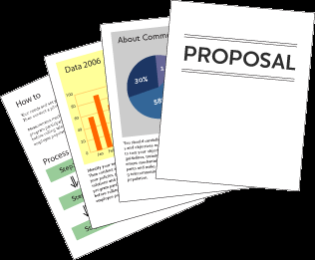
Purpose of Business Case
Justification of the project
To obtain authorization for the project and its funding
Used to give direction to a project team
Baseline document for phase and stage reviews
Used in evaluation of change requests
Baseline document for benefits reviews
Used by organization to facilitate lessons learned
Notes:
The Business Case is the key document to any project. Without a detailed and authorised Business Case a project should not be allowed to proceed.
It is also a document that lives on beyond the Project Lifecycle into the Operations Phase where the Benefits realization Review takes place, conducted by the Project Sponsor and any additional and useful stakeholders that can assist him/her in the identification and verification of the benefits.
Throughout the whole Project Lifecycle and beyond, the Business Case has many purposes.
It is there to justify the meaning of carrying out the work.
It is used as an authorization for a project to proceed or obtain its funding.
In the early stages of a project team’s development, it can be used by the Project Manager to give direction and purpose to the team.
It is the baseline document to all project activities to gauge performance and progress against the original plan of benefits.
It is used a an evaluating tool for any formal Change Control requests that may be submitted to a project to assess them against the potential alteration to the perceived benefits.
Within the Operations Phase it is used as the benchmark for Benefit realization.
After all project reviews it can be used to facilitate the future improvements to a project team and its organization by being using to learn from lessons within its project.

Slide 106

Contents of Business Case
Purpose
Project Summary
Business Objectives
Project Objectives
Benefits
Deliverables
Performance Indicators
Risks and Opportunities
Market and Competition Conditions
Organizational Constraints
Project Sponsor
Product Owner
Project Control
Resources
Other Constraints
Business Case
Business Case
(Not the one we are referring to.)
Notes:
The typical contents of a Business Case are shown on the slide above. (Couldn’t help the bad humor… in the picture.)
The first element to the document should be the reason or justification for the project.
A statement of Success and Acceptance Criteria should be shown within the Business Case to allow the Project Manager to identify from these the Quality Standards that he/she will be expected to achieve in their project goals.
The Project Sponsor should also identify what benefits the organization should be looking to gain by having this project go ahead so that anyone reading the document can see the reason and result of the project within one area.
The Project Manager will also need to know what they are being asked to produce as an end product. This product needs to be clear and precise so that the Project Manager can develop a prescriptive scope of work to match the deliverables.
A further area of the Business Case will be the Investment Appraisal which will give financial support to the project giving the true value of a project to the organization.
It is important within a Business Case to list the options or approaches available or being considered and this must also include the option of not doing the project and its relevant impact.
The Business Case as stated early is the driving force behind each project and so at every review it must be present for consideration as to whether or not the project should proceed or be halted as the justification or benefit can not now be realised. This is most commonly known as the Go/No go decision point.

Slide 107

Sustainability in the Business Case
Should include references to:
  Corporate Sustainability Governance
  Regulatory Compliance
  Goals and Objectives
  Principles and Values
  Performance Indicators Using P5 (We will get to that)
Project Managers should always review the Business Case or Charter from a CSR Perspective by leveling the deliverables against the EMS or with the CSR Officer.

Slide 108
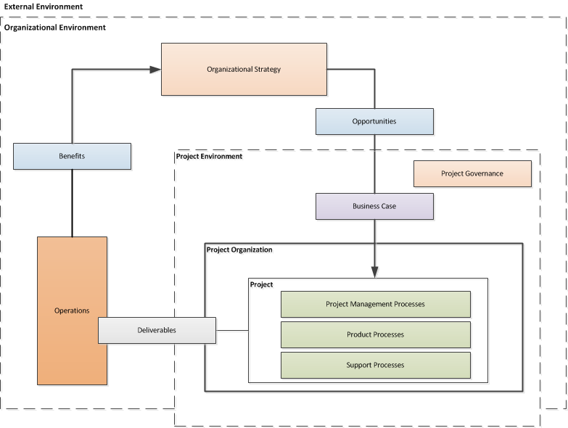
Business case in terms of concept to relationships
Business Case
Notes:
Overview of project management concepts and their relationships

Slide 109
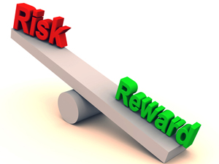
Investment appraisal
The investment appraisal enables the financial viability of projects to be measured both on a standalone basis and in comparison with other projects competing for funds
The process should confirm why the forecast cost and time will be worth the investment and justify the project based upon the estimated costs and the value of projected benefits.

Slide 110
Investment analysis techniques
Payback Period
The time taken to pay back the project investment.
Return on Investment (RoI)
The percentage ratio of average yearly profit over the productive life of the project, divided by the original investment.
Social Return on Investment (S-RoI)
A method for measuring extra-financial value (i.e., environmental and social value not currently reflected in conventional financial accounts) relative to resources invested.
Discounted Cash Flow (DCF)
DCF uses compound interest calculation to reflect the cost of money by “discounting” future cash flows to an equivalent “present value”
Net Present Value (NPV)
The aggregate of future net cash flows discounted back to a common base date, usually the present.
Internal Rate of Return (IRR)
The discount rate at which the Net Present Value of future cash flows is zero.

Slide 111
Payback period
If a project costs $1,000,000 and yields benefits as follows:
  Year 1 $200,000
  Year 2 $300,000
  Year 3 $500,000
  Year 4 $400,000
  Year 5 $400,000
The Payback Period is three years
$1M
Year 3
$500k
Year 2
$300k
Year 1
$200k

Slide 112
Return on investment (ROI)
ROI = (Average Annual Profit/Original Investment) x 100%
where Average Annual Profit = Total Profit/Years
Year | Investment | Benefits
0 | $1,000,000 | $0
1 |  | $200,000
2 |  | $300,000
3 |  | $500,000
4 |  | $400,000
5 |  | $400,000
 |  | $1,800,000
Average Annual Profit = ($1,800,000-$1,000,000)/5 = $160,000
ROI = ($160,000/$1,000,000) * 100% = 16%

Slide 113
Discounted cash flow
Leaving money invested in a deposit account at 10% interest would see growth based on compound interest:
Year 0 | $1.00
Year 1 | $1.10
Year 2 | $1.21
Year 3 | $1.33
If we kept the money instead of investing it, its comparative value would fall:
Year 0 | $1.00
Year 1 | $1.00/$1.10 = $0.91
Year 2 | $1.00/$1.21 = $0.83
Year 3 | $1.00/$1.33 = $0.75
Discounting is the opposite of compound interest. It recognises that the $1.33 in three years time is worth the same as $1.00 now.

Slide 114
Discounted cash flow example
Year | Investment | Benefits | DCF
0 | $1,000,000 | $0 | $0
1 |  | $200,000 x 0.91 | $182,000
2 |  | $300,000 x 0.83 | $249,000
3 |  | $500,000 x 0.75 | $375,000
4 |  | $400,000 x 0.68 | $272,000
5 |  | $400,000 x 0.62 | $248,000
 |  | $1,800,000 | $1,326,000

Slide 115
Net present value
The net present value (NPV) is the sum of all the discounted cash flows (both investments and benefits). It is the value of the project expressed in current monetary value.
Year | Investment | Benefits | Net cash flow | Discount factor (10%) | DCF
0 | $1,000,000 | $0 | -$1,000,000 | 1.00 | -$1,000,000
1 |  | $200,000 | $200,000 | 0.91 | $182,000
2 |  | $300,000 | $300,000 | 0.83 | $249,000
3 |  | $500,000 | $500,000 | 0.75 | $375,000
4 |  | $400,000 | $400,000 | 0.68 | $272,000
5 |  | $400,000 | $400,000 | 0.62 | $248,000
Total | $1,000,000 | $1,800,000 | $800,000 |  | NPV $326,000

Slide 116
Social Return on Investment (SROI)
Establishing scope and identifying key stakeholders. Clear boundaries about what the SROI will cover, and who the will be involved are determined in this first step.
Mapping outcomes. Through engaging with stakeholders, an impact map, or theory of change, which shows the relationship between inputs, outputs and outcomes is developed.
Evidencing outcomes and giving them a value. This step first involves finding data to show whether outcomes have happened. Then outcomes are monetized – this means putting a financial value on the outcomes, including those that don’t have a price attached to them.
Establishing impact. Having collected evidence on outcomes and monetized them, those aspects of change that would not have happened anyway (deadweight) or are not as a result of other factors (attribution) are isolated.
Calculating the SROI. This step involves adding up all the benefits, subtracting any negatives and comparing them to the investment.
Reporting, using and embedding. Easily forgotten, this vital last step involves sharing findings and recommendations with stakeholders, and embedding good outcomes processes within your organization.
Notes:
It can help organizations understand what social value an activity creates in a robust and rigorous way and so manage its activities and relationships to maximize that value.
The process opens up a dialogue with stakeholders, helping to assess the degree to which activities are meeting their needs and expectations.
SROI puts social impact into the language of 'return on investment’, which is widely understood by investors, commissioners and lenders. There is increasing interest in SROI as a way to demonstrate or measure the social value of investment, beyond the standard financial measurement.
Where it is not being used already, SROI may be helpful in showing potential customers (for example, public bodies or other large purchasers) that they can develop new ways to define what they want out of contracts, by taking account of social and environmental impacts.
SROI can also be used in strategic management. The monetized indicators can help management analyze what might happen if they change their strategy, as well as allow them to evaluate the suitability of that strategy to generating social returns, or whether there may be better means of using their resources.

Slide 117
What is project success and benefits management?
Project success is the satisfaction of stakeholder needs and is measured by the success criteria as identified and agreed at the start of the project.
Benefits management is the identification of the benefits at an organisational level and the monitoring and realisation of those benefits.
Src. APM BoK, 5th edition

Slide 118
What is success?
The definition of success will vary from project to project.
  The 2016 Olympics must open on time.
  A new medicine must be safe.
Each stakeholder will define success differently.
  The bride’s father wants the wedding to come in on budget.
  The bride’s mother wants every relative to be invited.

Slide 119
When to define success
Success should be defined and documented up front in the Concept phase of the project.
Success should be defined as a set of success criteria.
Once agreed and approved the success criteria should only be changed through formal change control.
Success is measured at the end.
Notes:
Ask the delegates what happens if success criteria aren't agreed up front.

Slide 120
Focusing on Benefits
Business Case
Project Outputs
Enable
Desired
Outcomes
Business
Changes
Create
Measured in
Also Cause
Benefits
Side-effects and consequences
Further Realize
Helps Achieve one or more
Result in
Strategic Initiatives
Dis-benefits
Notes:
Senior managers tend to focus on output delivery, which has no quantifiable value or benefit until successfully accepted, adopted and integrated into the organization as business as usual.
The real focus should be on demonstrable value and benefits aligned to strategic objectives, which also aligns with sustainability principals.

Slide 121
Key Principles / KPIs
Follow Best Practices while developing using Common Sense and Principles:
  Aligned to Strategy, Principles, Priorities and Expectations
  Conduct a Health Check
  Establish Governance
  Define the Vision
  Establish a Transformational approach
  Identify your Numbers
  Establish a Support Structure
  Don’t ignore Social and Environmental impacts

Slide 122
Benefits Realization
Measures of success
Common project management practice dictates that
benefits are based on business specific economic returns.
Concept
Definition
Implementation
Handover and Closeout
Operations
Benefits Realisation

Slide 123
Benefits Realization
Projects Infusing Sustainability
GPM’s benefits extend beyond economic returns
P5 Sustainability Framework
Concept
Definition
Implementation
Handover and Closeout
Operations
Benefits Realisation
Benefits are based on:
Business Specific Economic Returns
Alignment with Organizational and Government Sustainability Initiatives/Goals
Risk Responsiveness and Aversion
Global Reporting Initiative Reporting Standards & UN Post 2015 Engagement Architecture Reporting Capabilities
Alignment with ISO 14001 Environmental Management
Alignment with ISO 50001 Energy Management
Alignment with ISO 26000 Corporate Social Responsibility
Increased efficiency of process and increased organizational maturity in projects

Slide 124
Benefits Realization Plan
Description of the benefit
What strategic objective does it support?
Against values will the benefits be assessed and recorded?( for example: money, number of visitors, number of jobs, CO2 reduction etc.)
What is the current value of the benefit and what future value is anticipated?
Outputs required for the benefit to be realized
Dependency to other benefits
Benefit owner (see Benefit responsibilities section)
Which stakeholders this benefit will effect
How the benefit will be measured
Notes:
One of the causes for ineffective benefits management in practice is the lack of clear responsibilities in this respect. Assigning benefits management responsibilities can be challenging because this activity continues after the project.

Slide 125

The Benefit Owner
Benefit owner
The benefit owner is an individual who is responsible for ensuring it is realized.
The benefit owner is assigned during project initiation. Benefit owners do not have to be part of the project team but do play a role which is increasingly important towards the end of the project.
Typical responsibilities of the benefit owner will be:
Own the benefit profile
Provide input for the benefits realization plan
Manage benefits measurements
Organize benefit reviews
Report on progress of benefits realization

Slide 126
We have covered
What is the purpose of the business case.
Contents of the business case
Practical use of the business case
Investment Appraisal techniques
Calculating Valuation
Understanding Benefits

Slide 127
Requirements Management
Module | Module Covers | Learning outcomes
7 Requirements Management | The importance of requirements management Requirements and Definition | Understand requirements management, the dos and don’ts.
Language
English
Version
5.0

Slide 128
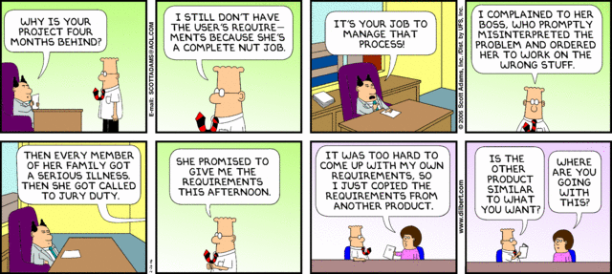
Poor Requirements = Poor Performance
Dilbert.com
Notes:
A simple opening on requirements.

Slide 129
What is Requirements Management?
Requirements management is the process of capturing, analysing and testing the documented statement of stakeholder and user wants and needs.
Requirements are a statement of the need that a project has to satisfy, and should be comprehensive, clear, well structured, traceable and testable.
47%
of unsuccessful projects
fail to meet goals due to poor requirements management
APM BoK 5th Edition
http://www.pmi.org/~/media/PDF/Knowledge%20Center/PMI-Pulse-Requirements-Management-In-Depth-Report.ashx
Notes:
We just covered a lot. Time for a quick break.

Slide 130
What Are Requirements?
The stakeholders’ and users’ wants and needs
They state ‘What’ is required NOT ‘How’ it is to be achieved
They contain acceptance criteria
They provide a measure against which project success can be judged
High-level requirements are documented during the Concept phase of the life cycle
They are further developed and agreed during the Definition phase

Slide 131
Requirements Life Cycle
Design Freeze
Baseline
Quick
Look
Detailed
Look
Finish
off
Benefits
Realization
Idea
Do It
Requirements Capture and Testing
Configuration Management & Change Control
Requirements Reviews
Notes:
The existence of a product specification is essential at the commencement of the implementation stage. This may initially only define requirements such as physical features, performance aspects and key acceptance criteria. To ensure the development of the design will achieve the objectives and benefits a series of reviews are conducted. This enables the design to be compared to the requirements in order to identify and address any deviations or shortcomings. A requirements review may be conducted during design to check that designers understand and can achieve the stated requirements.
As the product design develops, further reviews are carried out to check that the design will meet the product requirements. At the end of development the design is reviewed prior to build. As the design develops further, acceptance criteria, plans and methods are fully defined. These, the designs and production readiness are typically reviewed prior to the release of the design to production. This will check that the test methods are appropriate and will ensure that the product is adequately tested in line with the requirements.
Tests and inspections are typically carried out during the acceptance stage to verify that the deliverable products meet the requirements. If satisfactory, the product is formally accepted and signed off.
Throughout the development, the requirements, product specification and associated documentation is controlled using a formal change control and configuration management process.
The requirements management process facilitates the opportunity to provide confidence to the Project Team and the Stakeholders during the life cycle that the product is more likely to achieve the project objectives and its proposed benefits.

Slide 132
Requirements Structuring
Factors used to structure the construct of the requirements:
Value
  The size of the benefit from each requirement
Priority
  Stakeholders agree the priority order
Time
  Deadlines for each requirement
Process
  The way the solution is to be built, by which sub-contractors
Impact
  The P5* impact that the requirement has
*Sustainability Impact - People, Planet, Profit, Project Process and Resulting Product

Slide 133
Elements of a Requirements Management Plan
Introduction
  Purpose of The Requirements Management Plan
Requirements Management Overview
  Organization, Responsibilities, and Interfaces
  Tools, Environment, and Infrastructure
Requirements Management
  Assumptions/Constraints (Sustainability Impacts)
  Requirements Definition
  Requirements Traceability
  Workflows and Activities
Change Management
Key Terms
Requirements Management Plan Approval Page

Slide 134
Important Skills For Requirements Management
Active Listening and Communication Skills
Interpreting and articulating requirements, their alignment to organizational strategic goals and principles
Navigating ambiguity
Active Engagement of Stakeholders
Understanding the Need “You gave me what I asked for but not what I needed.”
Clearly defined and functioning change control
Ability to articulate the business value of the requirement

Slide 135
The study of why things go wrong
If you don’t know what you want,
or what you want keeps changing;
or you can’t commit the required money to the project;
or you don’t have anyone in charge of the project,
or you keep changing the person in charge,
or the person who
is supposed to be in charge doesn’t really call the shots;
or the person at the top of the business doesn’t care about the project;
and you don’t focus on what the actual benefit to the business is;
and you don’t regularly talk to the people who will have to use the system;
and you don’t constantly check progress;
or you have an unrealistic timetable and try to run before you can walk;
or you fail to test the system properly before you launch it;
or if you don’t provide enough training;
or you don’t have a Plan B in case things go wrong;
or you try to bite off more than you can chew in one go;
or if you don’t realise that the bigger project the greater the chance of its being overtaken by events or new technology or new legislation;
or you don’t realise that you may not have the skills you need to manage the project;
or you don’t realise that some suppliers are quite capable of telling you they can deliver when they can’t;
Then…..

Slide 136
The frequent result
Don’t be surprised if you end up with:
a mess that is way behind schedule,
damages your organiszation,
traumatises your staff,
costs much more than it is supposed to,
(and doesn’t work.)”

Slide 137
We have covered
Requirements Management
Requirements Lifecycle
Requirements Structuring
Requirements Management Plan
Important Skills For Requirements Management

Slide 138
Project Management
Module | Module Covers | Learning outcomes
8 Project Management | What is a Project What is Project Management What are Process Groups and how What are Subject Groups What is the project Environment | Understand what project management is, the ins and outs and the project environment
Language
English
Version
5.0

Slide 139


What is a Project?
A project consists of a unique set of processes consisting of coordinated and controlled activities with start and end dates, performed to achieve project objectives.
Achievement of the project objectives requires the provision of deliverables conforming to specific requirements. A project may be subject to multiple constraints.
Although many projects may be similar, each project is unique. Project differences may occur in the following:
  deliverables provided;
  stakeholders influencing;
  resources used;
  constraints;
  the way processes are tailored to provide the deliverables.
Every project has a definite start and end, and is usually divided into phases.
Both the Burj Khalifa and the wooden step stool are results of projects.
Notes:
http://en.wikipedia.org/wiki/File:Burj_Khalifa.jpg

Slide 140
Project Management
Constraints
time, cost, quality, technical, other performance parameters, legal, environmental, social
Input
Project Management
Output
business need
problem
opportunity
project deliverables:
Products
Services
change
Mechanisms
people, tools, techniques, equipment, organization
Notes:
Projects
A project consists of a unique set of processes consisting of coordinated and controlled activities with start and end dates, performed to achieve project objectives. Achievement of the project objectives requires the provision of deliverables conforming to specific requirements. A project may
be subject to multiple constraints.
Although many projects may be similar, each project is unique. Project differences may occur in: deliverables provided; stakeholders influencing; resources used; constraints; and the way processes are tailored to provide the deliverables.
Every project has a definite start and end, and is usually divided into phases
Project Management
Project management is the application of methods, tools, techniques and competencies to a project.
Project management includes the integration of the various phases of the project life cycle
Project management is performed through processes. The processes selected for performing a
project should be aligned in a systemic view. Each phase of the project life cycle should have
specific deliverables. These deliverables should be regularly reviewed during the project to meet
the requirements of the sponsor, customers and other stakeholders
ISO 21500 Section 3.2 and 3.3

Slide 141
Project Management Process Groups
Notes:
The management of a project starts with the initiating process group and finishes with the closing process group. The interdependency between process groups requires the controlling process group to interact with every other process group as shown in Figure 5. Process groups are seldom discrete or one-time in their application. The process groups are normally repeated within each project phase to drive the project to completion. All or some of the processes within the process groups may be required for a project phase.

Slide 142
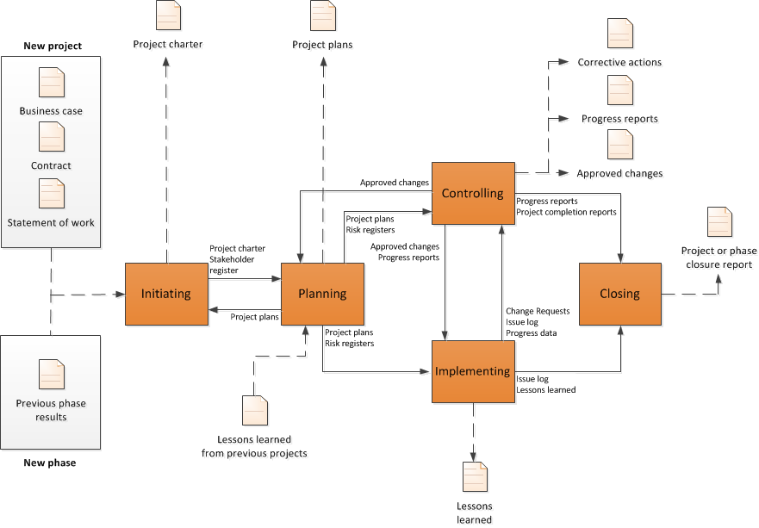
Interaction Among Process Groups
Source ISO 21500 Pg.12
Notes:
This page shows the interactions among the process groups inside the boundaries of the project, including the representative inputs and outputs of processes within the process groups. With the exception of the controlling process group, linkages between the various process groups are through individual processes within each process group. While linkage is shown in the diagram between the controlling process group and other process groups, the controlling process group may be considered self-standing because its processes are used to control not only the overall project, but also the individual process groups.

Slide 143
Subject Groups
Each subject group consists of processes applicable to any project phase or project. These processes are defined in terms of purpose, description and primary inputs and outputs in and are interdependent. Subject groups are independent of application area or industry focus.
Integration – Processes to identify, define, combine, unify, coordinate, control and close activities.
Stakeholder - the processes required to identify and engage the project sponsor, customers and other stakeholders
Scope – the processes required to identify and define the work and deliverables required
Resource – the processes required to identify and acquire adequate project resources
Time – the processes required to schedule the project activities and to monitor progress to control the schedule
Cost – the processes required to develop the budget and to monitor progress to control costs
Risk - the processes required to identify and manage threats and opportunities
Quality - the processes required to plan and establish quality assurance and control
Procurement - the processes required to plan and acquire products, services or results, and to manage supplier relationships
Communication - includes the processes required to plan, manage and distribute information relevant to the project
Derived from ISO 21500
Notes:
Some Organizations call these “knowledge areas”. This is incorrect. It is not enough to be knowledgeable. You must be proficient.
Each subject group consists of processes applicable to any project phase or project. These processes are defined in terms of purpose, description and primary inputs and outputs in and are interdependent. Subject
groups are independent of application area or industry focus.
ISO 21500 Definitions
Integration - The integration subject group includes the processes required to identify, define, combine, unify, coordinate, control and close the various activities and processes related to the project.
Stakeholder - The stakeholder subject group includes the processes required to identify and engage the project sponsor, customers and other stakeholders.
Scope - The scope subject group includes the processes required to identify and define the work and deliverables, and only the work and deliverables required.
Resource - The resource subject group includes the processes required to identify and acquire adequate project resources such as people, facilities, equipment, materials, infrastructure and tools.
Time - The time subject group includes the processes required to schedule the project activities and to monitor progress to control the schedule.
Cost -The cost subject group includes the processes required to develop the budget and to monitor progress to control costs.
Risk - The risk subject group includes the processes required to identify and manage threats and opportunities.
Quality - The quality subject group includes the processes required to plan and establish quality assurance and control.
Procurement - The procurement subject group includes the processes required to plan and acquire products, services or results, and to manage supplier relationships.
Communication - The communication subject group includes the processes required to plan, manage and distribute information relevant to the project.

Slide 144
Relationship between project management concepts and processes
Project management is accomplished through processes utilizing the concepts [knowledge] and application [competencies.]
A process is a set of interrelated activities. Processes used in projects are generally categorized into three major types.
  project management processes -- specific to project management and determine how the activities selected for the project are managed
  delivery processes -- not unique to project management, result in the specification and
  provision of a particular product, service, or result and vary depending on the particular project
Deliverable support processes -- not unique to project management, provide relevant and valuable support to product and project management processes in such disciplines as logistics, finance, accounting and safety
Notes:
This standard addresses only project management processes. However, it should be noted that product, support and project management processes might overlap and interact throughout a project.

Slide 145
True or False?
1. A project starts when the performing organization completes the processes required to mandate a new project.
FALSE
TRUE
2. A project ends when the project deliverables have been accepted or the project has been prematurely terminated, and when all project documentation is delivered and all closure activities have been completed.
TRUE
3. A project manager’s responsibility for a project ends when all closure activities have been completed.
Notes:
Understanding the management of the outcome after handover is important.

Slide 146
The Project Environment
ISO 21500
Notes:
This slide shows the project environment. Organizational Strategy creates opportunities that become business cases. The business case is carried out via projects that hand deliverables over to the operations side of the organization. Benefits are then derived and realized by the strategic level.
The Project Manager is responsible for benefit realization.

Slide 147

Project Complexity
GAPPS has developed an approach to categorizing projects based on their management complexity. The GAPPS framework uses a tool called the Crawford-Ishikura Factor Table for Evaluating Roles, or CIFTER. The tool, named after two major contributors to GAPPS, is used to differentiate project manager roles based on the complexity of the projects managed.
1. Stability of the overall project context
2. Number of distinct disciplines, methods, or approaches involved in performing the project
3. Magnitude of legal, social, or environmental implications from performing the project
4. Overall expected financial impact (positive or negative) on the project’s stakeholders
5. Strategic importance of the project to the organization or organizations involved
6. Stakeholder cohesion regarding the characteristics of the product of the project
7. Stakeholder cohesion regarding the characteristics of the product of the project
Notes:
Project Managers are expected to produce essentially the same results – outputs and outcomes that are acceptable to relevant stakeholders. However, the context in which these results are produced may differ: some projects are inherently harder to manage than others. A project manager who is competent to manage an easier, less complex project may not be competent to manage a harder, more complex project.

Slide 148
Great Project Managers
Focus on Customer Needs
Challenge “That’s the way we have always done it…”
Meet Face to Face (video conference also counts ;)
Understand the requirements and how they relate to organizational principles and benefit
Collaborate with the project team
Delegate Effectively
Are comfortable in the “C” Suite
Are proactive
Can lead under pressure

Slide 149
We have covered
What is a Project
What is Project Management
What are Process Groups and how What are Subject Groups
What is the project Environment

Slide 150
Project Lifecycles and PRiSM
Module | Module Covers | Learning outcomes
8 Project Life Cycles and PRiSM | Project and Product life cycles. Product Lifespans Cradle to Cradle and Cradle to Grave Project phases such as Initiate, Plan Implement and Close. The relationship between phases and stages. The PRiSM Flow | Describe a project life cycle. Describe a product life cycle Understand The PRiSM Life Cycle Understand the Product LifeCycle
Language
English
Version
5.0

Slide 151
Requirements Life Cycle
Design Freeze
Baseline
Idea
Quick
Look
Detailed
Look
Do It
Finish
off
Get the
benefits
Requirements Capture and Testing
Configuration Management & Change Control
Requirements Reviews
Notes:
The existence of a product specification is essential at the commencement of the implementation stage. This may initially only define requirements such as physical features, performance aspects and key acceptance criteria. To ensure the development of the design will achieve the objectives and benefits a series of reviews are conducted. This enables the design to be compared to the requirements in order to identify and address any deviations or shortcomings. A requirements review may be conducted during design to check that designers understand and can achieve the stated requirements.
As the product design develops, further reviews are carried out to check that the design will meet the product requirements. At the end of development the design is reviewed prior to build. As the design develops further, acceptance criteria, plans and methods are fully defined. These, the designs and production readiness are typically reviewed prior to the release of the design to production. This will check that the test methods are appropriate and will ensure that the product is adequately tested in line with the requirements.
Tests and inspections are typically carried out during the acceptance stage to verify that the deliverable products meet the requirements. If satisfactory, the product is formally accepted and signed off.
Throughout the development, the requirements, product specification and associated documentation is controlled using a formal change control and configuration management process.
The requirements management process facilitates the opportunity to provide confidence to the Project Team and the Stakeholders during the life cycle that the product is more likely to achieve the project objectives and its proposed benefits.

Slide 152
Initiation phase
Initiate
Plan
Handover & Closeout
Implement
The sponsor is selected
The Need/Problem/Opportunity is established
Feasibility is investigated
Fit with strategy is checked
High level risks are identified and assessed
Levelling against Management Systems are completed
P5 Impact analysis is completed and SMP is initiated
Initial stakeholders are identified and analysed
High level requirements are identified
Business options (inc Do Nothing) are identified, evaluated and documented in the Business Case
Plans for next phase (Definition) are produced.

Slide 153
Planning phase
Initiate
Plan
Handover & Closeout
Implement
Project Manager is appointed (if not already in place)
The preferred solution is checked against high level requirements
Alternative designs are considered
The approach is agreed with the Sponsor
Detailed requirements are gathered and refined
The Project Management Plan (PMP) is prepared
Estimates of time, resources and costs are produced
The Business Case is updated to reflect plans and estimates
Detailed plans for next phase (Implementation) are prepared

Slide 154
Implementation phase
Initiate
Plan
Handover & Closeout
Implement
Implementation phase may be divided into Stages:
  Design
    Design optimised and completed
    Design documentation produced
    Design approved
  Build
    Actual products are now produced
    Components tested against acceptance criteria
Project Manager:
  Controls and monitors the delivery
  Manages risks, issues and changes
  Communicates progress with stakeholders

Slide 155
Handover & closeout phase
Initiate
Plan
Handover & Closeout
Implement
Test the completed set of deliverables in operational mode
Sponsor and users accept products
Transfer ownership
Complete all project documentation
Review project performance (Post Project Review)
Capture and disseminate lessons (Lessons Learned)
Close the project

Slide 156

The Strength of PRiSM
The only project methodology that aligns with ISO 26000, 21500, 14001, 9000, 50001,55000 the UNGC Ten Principles, and The GRI G4 Framework for Sustainability Reporting and the Earth Charter.
Notes:
We are now going to do a walkthrough of the PRiSM Methodology from a Workflow Perspective before diving in a little deeper.
PRiSM Short for (Projects integrating Sustainable Methods)
PRiSM™ (Projects integrating Sustainable Methods) is the sustainability based project delivery method which incorporates tangible tools and methods to manage the balance between finite resources, social responsibility, and delivering “green” project outcomes. It was developed for organizations to integrate project processes with sustainability initiatives to achieve business objectives while decreasing negative environmental impact.
PRiSM is a structured project management methodology that highlights areas of sustainability and integrates them into the traditional core project phases which, when understood and effectively addressed, can reduce negative environmental impacts in all types of projects while maximizing opportunities to manage sustainability and finite resources. PRiSM is cut from the same cloth as the globally accepted standards for professional project management. These standards are the “books of knowledge” as they are known to project managers. PRiSM incorporates a framework of activities derived from ISO 21500, 14001, 26000, 50001 and 9001, focuses on specific areas and incorporates best practices to practically answer the question: "How do I apply sustainability in to my projects?”

Slide 157
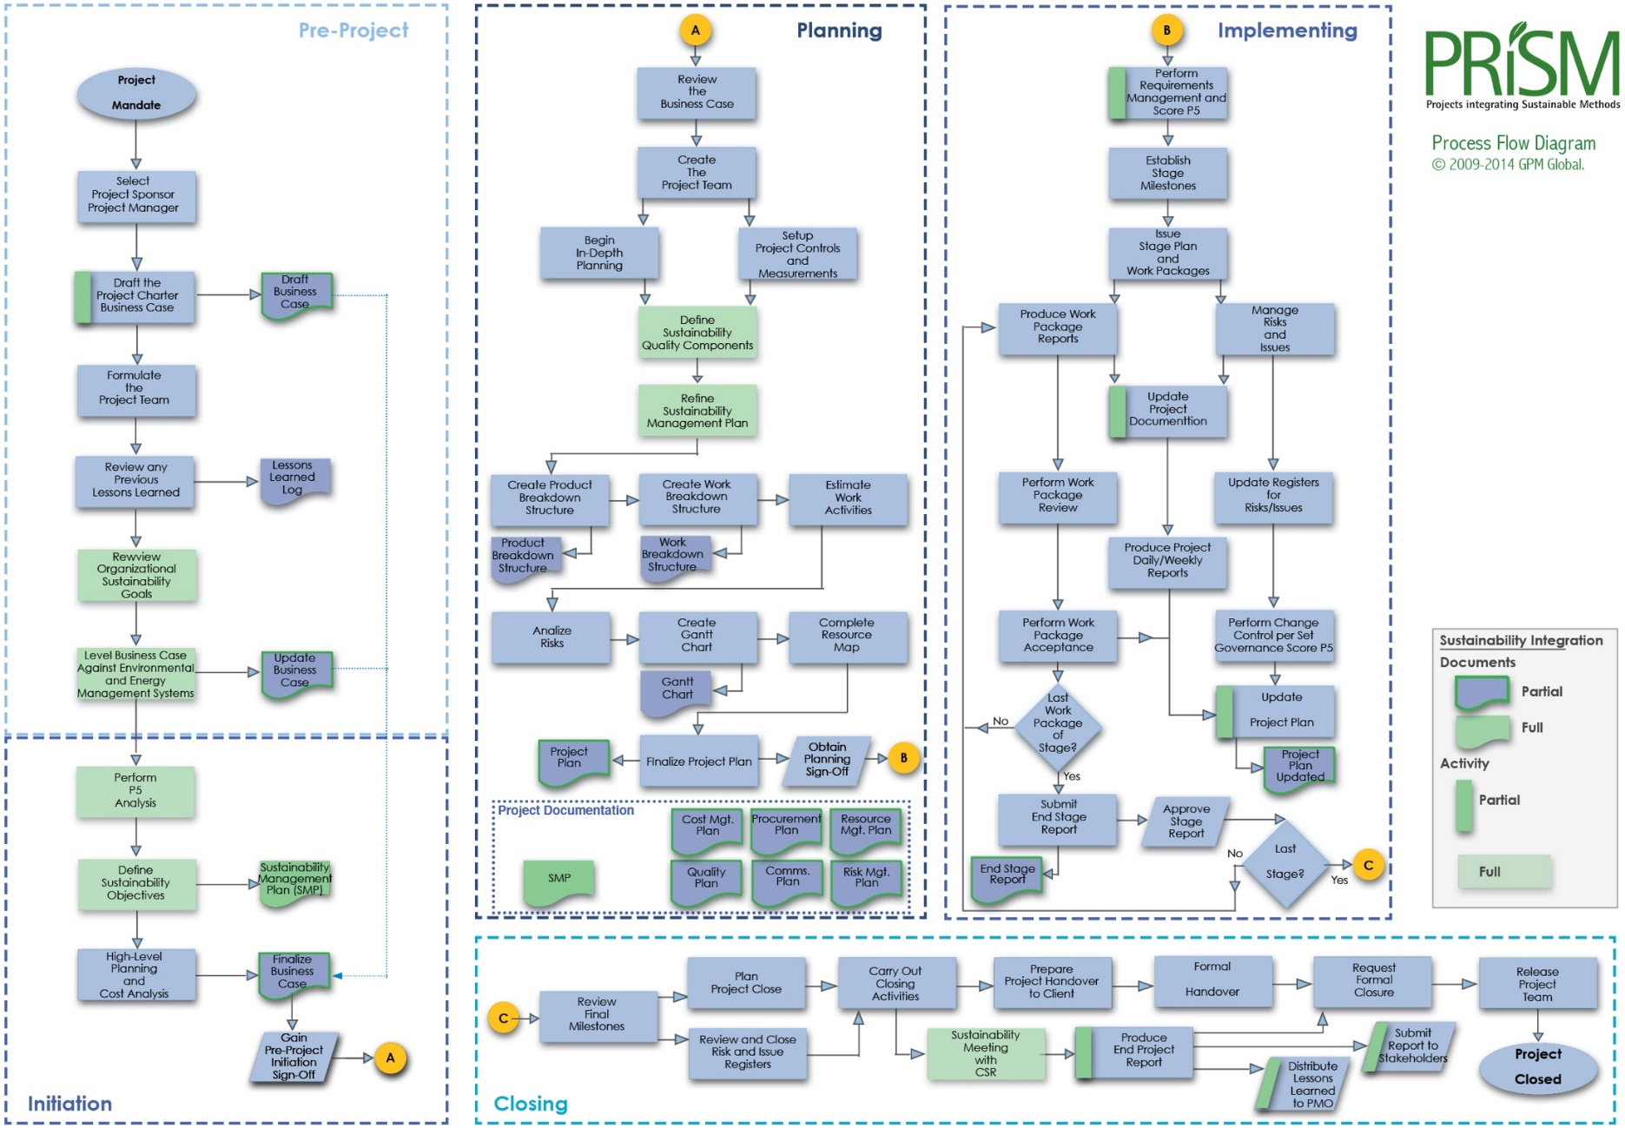
The Full PRiSM Process Flow

Slide 158
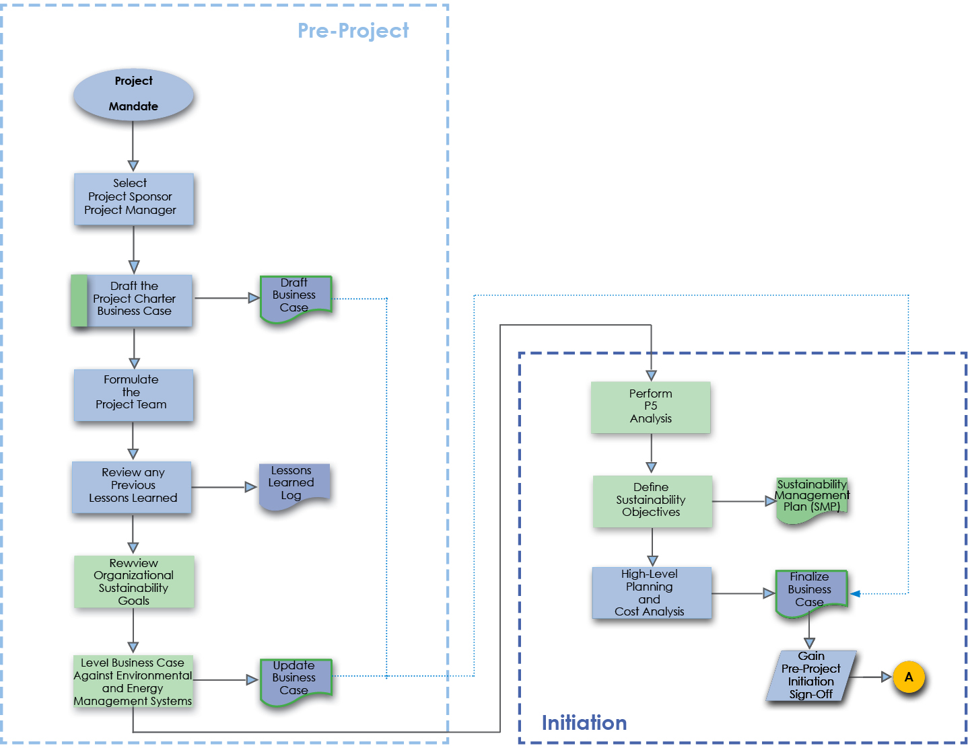
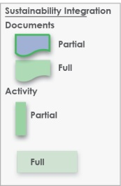
The PRiSM Pre Project/Initiation Phase
Review Organizational Sustainability
Goals
Notes:
The initiation phase is one where the ideas are formulated and the business reviews whether this is a feasible project or element of a project to be included within the portfolio of projects that it is currently running. What you see here is an example of steps-to-take in an initiation phase for sustainability integration. I will go over them in detail.
The key deliverable within this phase is the Project Charter. the value of the sustainability elements are housed here. We are going to mainly focus on this phase today but will touch on all four.

Slide 159

Leveling against the EMS
Notes:
As a project manager, we recommend that when you review the project charter, always level it against the corporate EMS. Meaning, does the request align with corporate targets and objectives already in place? Don’t leave it up to the project sponsor or anyone who handles the charter before it touches your hands to do so.

Slide 160

Project Sustainability Impact Analysis
Notes:
Performing an Impact analysis begins with mapping your project deliverables up by each category.

Slide 161

The PRiSM Pre Project/Initiation Phase
Notes:
The pre project phase is one where the ideas are formulated and the business reviews whether this is a feasible project or element of a project to be included within the portfolio of projects that it is currently running.
The key deliverable within this phase is the Project Charter or Business Case that will show the value of the sustainability element within the full project document. In addition, to support the charter, the delivery has to be leveled against the organization’s environmental management system allowing it therefore to develop further its Sustainability Management Plan (SMP) for the future.

Slide 162

Define Sustainability Objectives
Notes:
The next step is to define sustainability objectives.
Although, there may be some already in the charter, it is important to take what your findings from your impact analysis and what you have identified from the EMS and also what you may have learned from a CSR officer or from your company’s and outline some high level objectives. How are you going to address the impacts? Think of the deming model, Plan Do Check Act, this would be plan step to establish output expectations.
The outcomes from your P5 Impact analysis should result in sustainability objectives. If you have many +2s or +3s they should be documented and planned for in your SMP.

Slide 163

What is an SMP?
Notes:
Green Project Management® or Sustainability in Project Management in short addresses the impact of a project on the environment. There have been several theories identified over the past several years but none that can be adopted as repeatable processes that provide governance and deliver consistent results.
In order for green project management to take a permanent foothold a new set of activities that focus strictly on the sustainable aspects of an initiative through project governance is required.
The sustainability management plan (SMP) addresses these needs by determining how green the project delivery will be and how it aligns with organizational standards set forth in the environmental management system and or regulatory compliance standards document. The SMP is a true method to measure the impacts -long and short term- to organizational goals such as waste reduction, resource consumption, and energy efficiency.
The SMP is used to govern the benefits of the project and so therefore belongs either as part of or as an attachment to the business case. When it is accepted that the business case is the driving document of all projects, then it would be remised to believe that sustainability could exist without some sort of impact with the business case.
With the understanding that the business case must align itself with the strategy of the organization or company, then having a SMP and Environmental Management System in place ensures that the organization’s approach meets the strategy laid out within that. That is not to say that the business case has to ensure that it produces green projects each and every time, but that the elements or subjects within the business case also ask or investigate the five measureable aspects of sustainability to gain the full understanding, direction, costs and benefits available within this area for the organization.

Slide 164
Tools to Integrate Sustainability and Project Management
The SMP Ties corporate CSR goals and objectives to the project plan and identifies project impacts from an Environmental, Social, and Economic standpoint
Notes:
Sustainability in Project Management in short addresses the impact of a project on the environment. There have been several theories identified over the past several years but none that can be adopted as repeatable processes that provide governance and deliver consistent results.
The SMP uses a change management process to map sustainability objectives derived from the P5 impact analysis into a column table that outlines the P5 category (People, Planet, or Profit,) sub category, and element as well as the reason for the inclusion, the initial score, any legal or regulatory conflicts and a proposed action.

Slide 165

What is included in an SMP
Table of Contents
Document Control
  Version History and recipients list
Purpose
  A brief on what the document is
Executive Summary or Brief
  An outline of the sustainability factors in the project
List Project Sustainability Objectives
  Derived from the P5 Impact Analysis
Outline Key Measures and Performance Indicators (Qualitative and Quantitative)
The P5 Impact Assessment Score (and updates)
Scope Exclusions
Sustainability Reviews and Reporting
Checklist

Slide 166
What is included in an SMP
Table of Contents
Document Control
  Version History and recipients list
Purpose
  A brief on what the document is
Executive Summary or Brief
  An outline of the sustainability factors in the project
List Project Sustainability Objectives
  Derived from the P5 Impact Analysis
Outline Key Measures and Performance Indicators (Qualitative and Quantitative)
The P5 Impact Assessment Score (and updates)
Scope Exclusions
Sustainability Reviews and Reporting
Checklist

Slide 167
Version Control and Distribution

Slide 168
Key Performance Measures
(Qualitative and Quantitative)
Example:
Key Performance Indicators Environmental
Energy: Number of green Buildings in the city
Waste: Amount of dangerous waste treated
Transport: Number of electric public transport
Water Usage: Amount of building with water recycled system
Materials and Resources: amount of promotional benefits to acquire local materials and their impacts in the local industries. ie. Construction
Key Performance Indicators Financial
Return on Investment: ROI
Business Agility: number of days to resolve upcoming squatting, weeds, pests, unsafe buildings, graffiti
Key Performance Indicators Products
Servicing of Product: Satisfaction Survey Results (surveys carried out be independent agency)
Lifespan of Product: The Enforcement Agency should have 60% Community Satisfaction
Key Performance Indicators Processes
Maturity of process: Maturity of the EMS: Plan-Do-check-Act
Maturity Efficiency and fairness of process: number of corrective actions and its financial impact
Key Performance Indicators Personal
Labour Practices and Decent Work: Number of labor accidents and amount of money incurred
Society and Customers: Number of children received training course regarding Sustainability.
Ethical Behaviour: implement “Sustainability Awards” at school, restaurants, event organizer, etc.

Slide 169
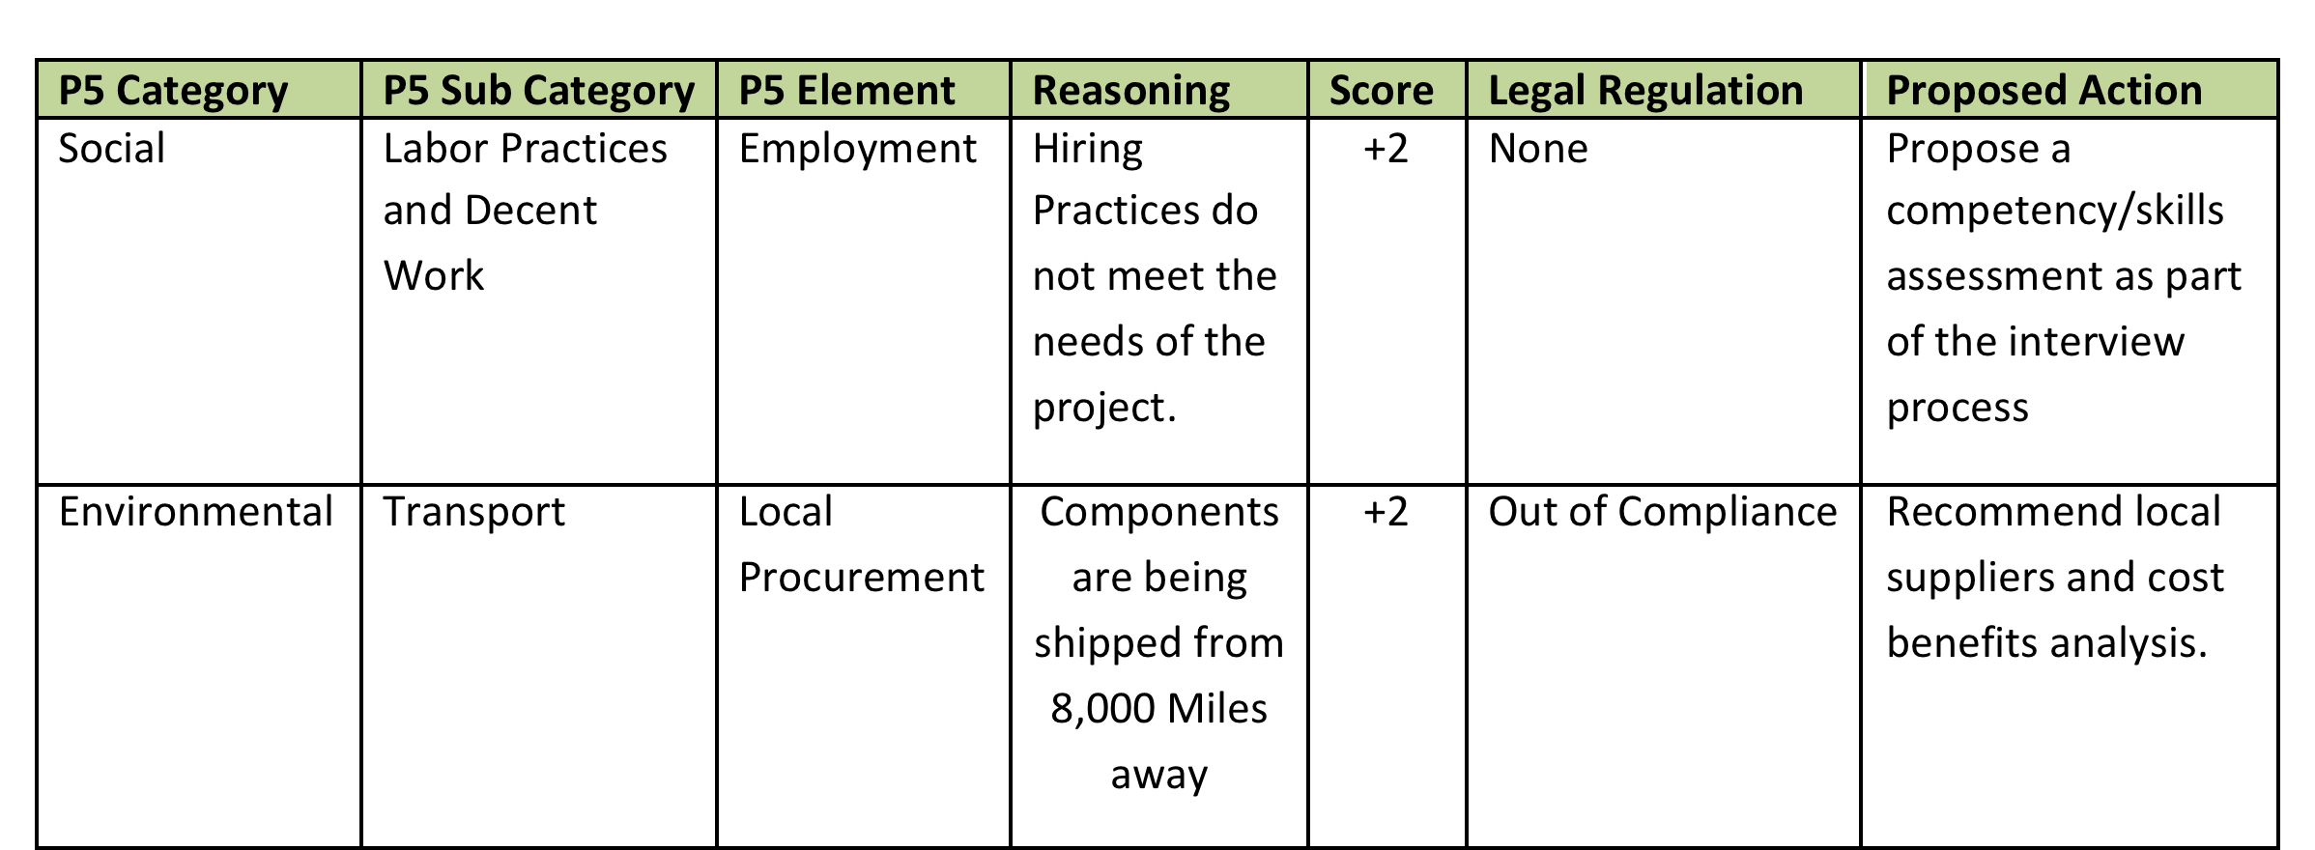
P5 Impact Assessment
A summary of the planned environmental impact and steps that will be taken to decrease the effects or increase the opportunities identified

Slide 170
The final pieces
Scope Exclusions
None.
Sustainability Risk Management
For the Sustainability Risk Management the agency will apply the PMBOK® Guide. The Sustainability Risk Plan should include the above environmental aspects and impacts and the response for each of one.
Reviews and Reporting
The Enforcement Agency members monthly will review and make a Sustainability Report that will be published at website of Enforcement Agency; and maintain periodically meeting with representatives of local community groups, and State and local officials.
Current Sustainability (P5) Score
+2.03
Checklist
The Following Assessments are considered in this Sustainability Management Plan:
Financial Assessment
Process Assessment
Product Assessment
Environmental Assessment
Social and Corporate Assessment

Slide 171
Where does the SMP Interface with the Project?
Source ISO 21500 Pg.12

Slide 172
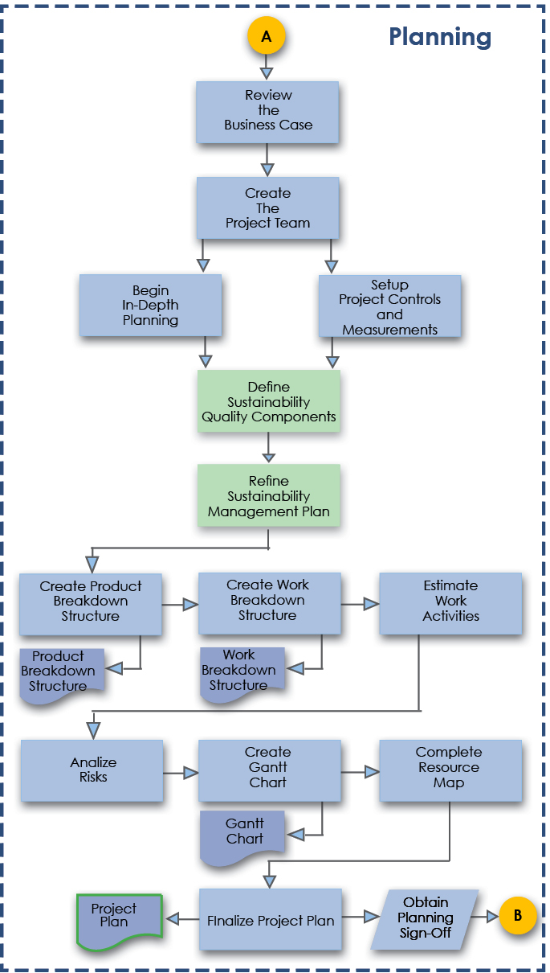
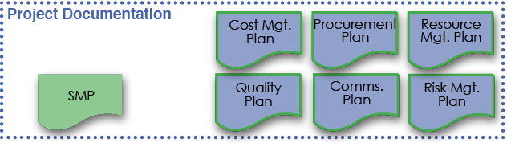
The Planning Phase
Notes:
The planning phase is the moment when the project starts to come to life. Here the project manager needs to gain a real understanding of what the client or organization is looking to achieve so that they can plot the best way to deliver the project, its main deliverables and the planned benefits in the most sensible and safest manner to benefit all parties involved.

Slide 173
Refining an SMP
Refine
Sustainability Management
Plan
Notes:
Green Project Management® or Sustainability in Project Management in short addresses the impact of a project on the environment. There have been several theories identified over the past several years but none that can be adopted as repeatable processes that provide governance and deliver consistent results.
In order for green project management to take a permanent foothold a new set of activities that focus strictly on the sustainable aspects of an initiative through project governance is required.
The sustainability management plan (SMP) addresses these needs by determining how green the project delivery will be and how it aligns with organizational standards set forth in the environmental management system and or regulatory compliance standards document. The SMP is a true method to measure the impacts -long and short term- to organizational goals such as waste reduction, resource consumption, and energy efficiency.
The SMP is used to govern the benefits of the project and so therefore belongs either as part of or as an attachment to the business case. When it is accepted that the business case is the driving document of all projects, then it would be remised to believe that sustainability could exist without some sort of impact with the business case.
With the understanding that the business case must align itself with the strategy of the organization or company, then having a SMP and Environmental Management System in place ensures that the organization’s approach meets the strategy laid out within that. That is not to say that the business case has to ensure that it produces green projects each and every time, but that the elements or subjects within the business case also ask or investigate the five measureable aspects of sustainability to gain the full understanding, direction, costs and benefits available within this area for the organization.

Slide 174

Refining the SMP
The Refinement of the SMP should include:
  Scope Changes
  Sustainability Quality Components
  Changes to the P5 Score +/-
  Sustainability Risks Identified

Slide 175
The Planning Phase
Define
Sustainability
Quality
Components

Slide 176
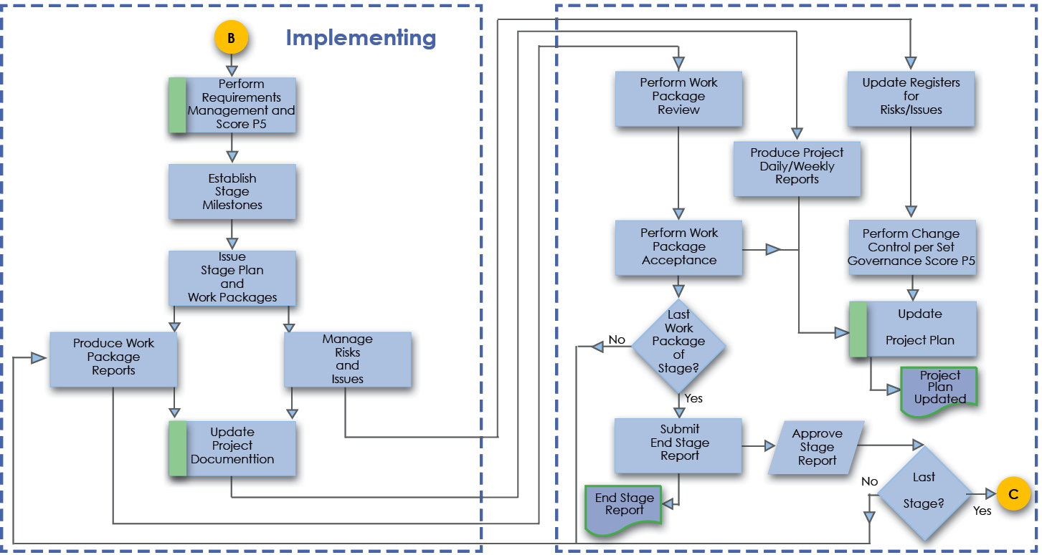
The Implementing Phase
Notes:
Note that ISO 21500 Calls Implementing what the PMI PMBOK® Guide Calls Executing

Slide 177
The Implementing Phase
Update Documentation
Notes:
Note that ISO 21500 Calls Implementing what the PMI PMBOK® Guide Calls Executing

Slide 178
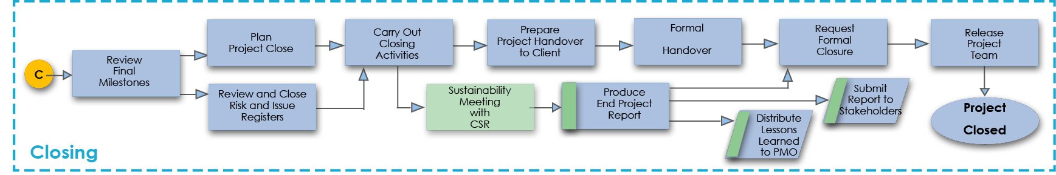
Closure Phase and Reviews
Meet with
Corporate Social Responsibility Officer
Notes:
The final phase of the project is the closure phase. The project manager has many activities to deliver in this phase and must ensure that they have planned the closure in a structured and organized manner to make sure that everything is truly accounted for within the project.
Carrying out a review of the project once it has been delivered is essential for learning for future development. The green matters of the project should be included as part of the project review, however early maturity or highly mature organizations may choose to hold the sustainability element of the review separately from the remainder of the post project review. This is a personal choice, however the most important thing is that a review is carried out, the lessons are captured and that the organization then use these lessons to develop in the future.
However, the story does not stop there. Ensuring that the product or service is used in a sustainable manner throughout its full life allows the continuance of sustainability into operations and then through to its demise and disposal in a clean and sustainable way.

Slide 179
Cradle to….
Mining of resources
Production
Use
Cradle to Cradle
Simple Cradle
to Cradle Diagram
Recycle
Cradle to Grave
Mining of resources
Production
Use
Simple Cradle
to Grave Diagram
Dispose
Notes:
Cradle to cradle production all material inputs and outputs are seen either as technical or biological nutrients. Technical nutrients can be recycled or reused with no loss of quality and biological nutrients composted or consumed. By contrast cradle to grave refers to a company taking responsibility for the disposal of goods it has produced, but not necessarily putting products’ constiuent components back into service.

Slide 180
Product Life Cycle
TIME
Product
Extension
Sales
Introduction
Growth
Maturity
Decline
Notes:
The Product Life Cycle (PLC) is based upon the biological life cycle. For example, a seed is planted (introduction); it begins to sprout (growth); it shoots out leaves and puts down roots as it becomes an adult (maturity); after a long period as an adult the plant begins to shrink and die out (decline).
In theory it’s the same for a product. After a period of development it is introduced or launched into the market; it gains more and more customers as it grows; eventually the market stabilizes and the product becomes mature; then after a period of time the product is overtaken by development (extensions/new releases/models) and the introduction of superior competitors, it goes into decline and is eventually withdrawn.

Slide 181
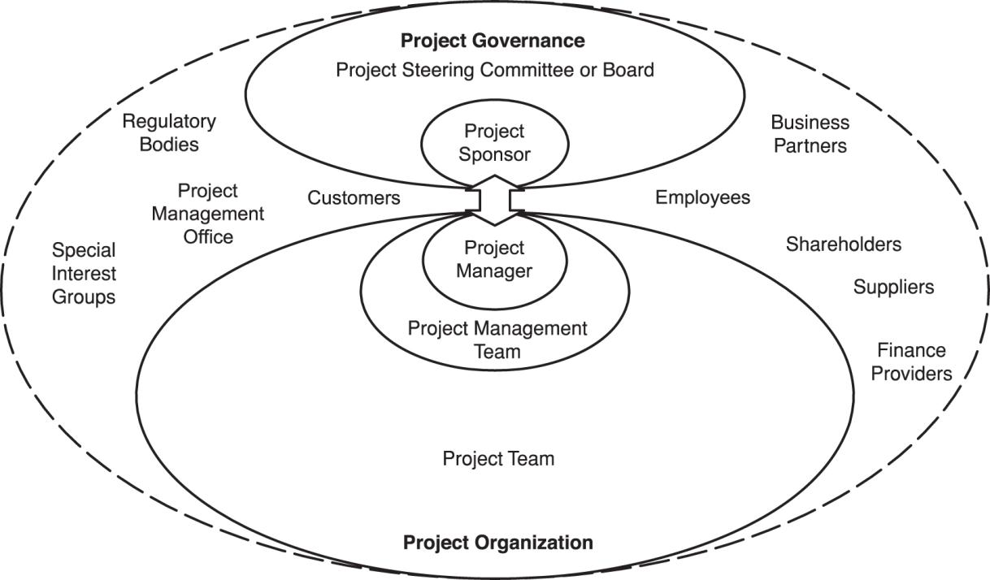

Stakeholder Management and Organization Roles
These Stakeholders are looking at CSR Practices
Notes:
Stakeholders and project organization
The project stakeholders, including the project organization, should be described in sufficient detail
to enable project success. The roles and responsibilities of stakeholders should be defined and
communicated based on the organization and project goals. Typical project stakeholders are
shown in the slide. Stakeholder interfaces should be managed within the project through the project management
Processes. The project organization is the temporary structure that includes project roles, responsibilities, and
levels of authority and boundaries that need to be defined and communicated to all stakeholders of
the project. The project organization may be dependent on legal, commercial, interdepartmental or
other arrangements that exist among project stakeholders.
The project organization may include the following roles and responsibilities:
• project manager – leads and manages project activities and is accountable for project
completion
• project management team – supports the project manager in leading and managing the project
activities
• project team – performs project activities
Project governance may involve the following:
• project sponsor – authorizes the project, makes executive decisions, and solves problems and
conflicts beyond the project manager’s authority
• project steering committee or board – contributes to the project by providing senior level
guidance to the project
The Slide — Project stakeholders
Figure 4 includes some additional stakeholders:
• customers or customer representatives – contribute to the project by specifying project
requirements and accepting the project deliverables
• suppliers – contribute to the project by supplying resources to the project
• project management office – may perform a wide variety of activities including governance,
standardization, project management training, project planning and project monitoring

Slide 182
Deliverables from a concept to relationships perspective
Deliverables
Notes:
This graphic is from ISO 21500 Guidance on Project Management, Page 3. and shows how project management concepts relate to each other. The organizational strategy identifies opportunities. The opportunities are evaluated and should be documented. Selected opportunities are further developed in a business case or other similar document, and can result in one or more projects that provide deliverables. Those deliverables can be used to realize benefits. The benefits can be an input to realizing and further developing the organizational strategy.

Slide 183

Handover
Product Delivery (Deliverables)
Acceptance Criteria
Punch List
Transfer of Ownership
Handover and Acceptance Process
Key Stakeholders present
Start Up requirements and knowledge transfer
Review of risks and issues to be transferred into operations phase with deliverable
Notes:
The Handover milestone is a significant point in the project life cycle since it allows the project to enter into an operational environment. At this point the ownership of all project deliverables is transferred from the project manager to the sponsor and user.
The decision will depend on the product achieving the acceptance criteria.
A snagging list is generated during handover to list any minor shortcomings identified during acceptance. Typically rectification actions will be agreed between the sponsor, project manager and operators as appropriate.
It defines handover objectives, identifies the stakeholders involved, and explains how acceptance and handover will be achieved for each deliverable.
Key stakeholders likely to be involved include:
project manager – achievement of acceptance and delivering products
project sponsor – formal acceptance of product and handover to operators/users
project team – conducting acceptance testing and handover activities
quality assurance – monitoring and auditing acceptance and certifying results
users – (including those people involved in the business as usual activities) witness acceptance testing, taking delivery and starting up product operation
The handover plan will include tasks to be undertaken by the project implementation team to complete acceptance and delivery of the products, and tasks that need to be carried out by the sponsor and stakeholders (most likely operators and users), to receive, start up and operate the deliverables safely in their final operation mode. Handover may be an instantaneous, gradual or phased process.
The handover stage also includes the transfer of any live risks, actions or issues associated with the product. This allows the customer or the Project Sponsor to have a defined and precise view of potential problems that may exist with the product throughout its whole life cycle.

Slide 184
Closure
Closure Report
  Compared to Success Criteria and reviewed against each milestone
  Transfer/close outstanding Risks and Issues
Carry out audits, close documentation
Contract review and closure
Asset lifecycle review and team redeployment
Carry out Post Project Review
Project Sponsor Formal Sign Off
Notes:
Project closeout will normally occur when all of the products have been delivered and the implementation stage is complete. In certain circumstances such as changes in viability or requirements, projects may be closed before planned completion.
Project closeout involves completion of all product and project handover activities in a controlled manner. Product handover activities are included in the previous discussion covering product handover.
A closure report is produced by the project manager to record the final outcome of the project against the Success Criteria, any issues outstanding and actions arising from closure.
Actions specific to project closure include:
identification and disposal of non deliverable materials and documents. For example, product design data may need to be archived to enable retrieval at a later date.
demobilisation, including arrangements for disbanding the project team and supporting infrastructure; conducting performance appraisals; completion of technical and quality audits.
contract and purchase order closure and arrangements for any continuing contractual obligations such as technical support during operation.
all project accounts are finalised
Before project closure, the project manager should conduct the Post-Project Review, record lessons and recommend improvements.
Finally, when all closure tasks have been completed, the sponsor will formally sign off the project to release the project manager.

Slide 185
We have covered
Project and Product life cycles.
Product Lifespans Cradle to Cradle and Cradle to Grave
Project phases such as Initiate, Plan Implement and Close.
The relationship between phases and stages.
The PRiSM Flow
The Product Life Cycle

Slide 186
The P5 Standard
Module | Module Covers | Learning outcomes
10 The P5™ Standard | The P5™ Standard | Be able to use the P5 standard for project selection, risk management, and sustainability governance.
Language
English
Version
5.0

Slide 187







Introducing the GPM® P5™ Standard for Sustainability and Project Management
Notes:
P5 is the link between the UNGC, GRI, TBL, and PMLC

Slide 188
P5 Overview
Five measureable elements to sustainability
Each measured individually and through Mutual Possession
  Planet (Environmental aspect)
  People (Social aspect)
  Profit (Financial aspect)
  Process (Governance aspect)
  Product (Technical aspect)
Notes:
(Cue and read from slide… DETAILS to follow in upcoming slides)

Slide 189

The P5 Chart
Notes:
This diagram shows how Process and product Impact the Categories, Sub-Categories, and Elements.

Slide 190

What is a product?
A "product" defined to be any tangible or intangible service, good(s), change, resource, business result or outcome undertaken by an organization using the project management processes as the method to create, update, expand, maintain and eventually dispose of the products, with the objective to use the "product" to provide future benefit to the organization. "
Products commonly follow four stages
Introduction – A product is introduced to the market
Growth – the product starts to grow in the market
Maturity – the product is established, sales increase and eventually stabilize
Decline – the stage where the product begins to decline and either the market for the product is no longer there.
Notes:
P5 looks at the product life cycle from a different perspective. The product’s impact from a social, environmental, and economic perspective during each of these phases should be accounted for in the product’s project from the time that the idea for the product is conceived until it is handed off in its final form.

Slide 191

What is a Project Process?
According to ISO 21500, A process is a set of interrelated activities. Processes used in projects are generally categorized into three major types:
Project management processes, which are specific to project management and determine how the activities selected for the project are managed;
Delivery processes, which are not unique to project management, which result in the specification and provision of a particular product, service or result, and which vary depending on the particular project deliverable;
Support processes, which are not unique to project management and which provide relevant and valuable support to product and project management processes in such disciplines as logistics, finance, accounting and safety.

Slide 192
How to Perform the Analysis
There are several ways to perform a P5 impact analysis. Developing a risk register using each element, as a category is the simplest.
The most effective way is to use a scoring system.

Slide 193

Example
When using a scoring system, each product deliverable and project process will be scored against each element of P5 based on a positive/neutral/negative scale ranging from a neutral (o) high (+ or -3) , medium (+ or -2) , and low (+ or -3).
This method is a simplified Analytic Hierarchy Process, one of the most popular analytical techniques for complex decision-making problems.
  Note: An AHP hierarchy can have as many levels as needed to fully characterize a particular decision situation.

Slide 194
Why do this?
The P5 impact analysis will provide key insight on where the problem areas are from a sustainability perspective.
Once the analysis is completed, the items that pose a risk (anything with a + score) should be sectioned off and reviewed, and mapped to into a Sustainability Management Plan (SMP)

Slide 195





A lot of good info…
Notes:
Calculating sustainability on a project is critical.

Slide 196
Compared with the GRI and UNGC

Slide 197

Group Exercise
Learning How to use P5
You are a project manager for ABC Beverage Company who just
Came up with a new idea “bottled water”.
With your project management hat on, what are some examples of projects that would be associated with bottled water?

Slide 198


Class Exercise. Learning How to use P5
Notes:
The number of projects that surround a simple consumer beverage range in the hundreds. We are going to take a
Step 1.
Determine how many P5 Elements could be measured from what is shared in this video. (Circle on your worksheet).
Exercise 2.
In groups of four, assign a score to each element. For positive impacts score High Medium Low (3,2,1) For Negative Impacts Score High Medium Low (-3.-2.-1) Add up the total score.

Slide 199
P5 and…
Project Governance – How could it be used?
Risk Management – How could it be used?
Project Selection – How could it be used?
Notes:
Use this slide to facilitate a dialogue in class.

Slide 200
We have covered
The P5™ Standard

Slide 201
Project Controls
Module | Module Covers | Learning outcomes
11 Project Controls | What is Project Control? Managing Project Control Controls Process PBS/WBS/OBS Estimating Accuracy Procurement Estimating/ Budgeting/ Costing Earned Value Management Analysis and Reporting Change Control | This module covers areas of project control. While there are many factors to controlling a project, some of which are covered in detail in other modules, this module focuses on Analysis, Costing, Estimating and Reporting
Language
English
Version
5.0

Slide 202

What is Project Control?
Project controls ensure that actual project performance aligns with the business case through analyzing variances in scope, costing, and activities, and taking appropriate corrective and preventive action with regard to risk as needed in order to realize benefits.
Can sometimes feel like herding cats
Img src: https://www.youtube.com/watch?v=FEU1lPzD5RQ

Slide 203
Project Controls Breakdown
Project
  Planning
  Costing/Procurement
  Scheduling
  Reporting
  Analyzing
Also includes management of:
  Change
  Risk
  Issues
  Benefits
  Sustainability
Covered in this module
Also part of project controls but are
Covered in other areas
Notes:
We just covered a lot. Time for a quick break.

Slide 204
Establishing Project Control
The first step in setting up analytics for project control is to identify the key factors to be monitored
The project manager must define precisely which specific characteristics of performance, cost, and time, risk, quality, and sustainability are in accordance with the business case and should be controlled
Exact boundaries must then be established, within which control should be maintained

Slide 205
Establishing Project Control
The best source of items to be monitored is the project plan documents.
  The control system is a direct connection between planning and control
  It is common to focus control activities on data that are easily gathered - rather than important
  Control analytics should concentrate primarily on measuring various facets of performance as it relates to the business case.

Slide 206
Project Controls Principles
A
Original plan
B
Trend
Actual Route
Monitoring
“Are we there yet?”
Notes:
Variances are useful in showing where the project is at any point in time and how far away the project is from the baseline plan. Variances alone will not show how well the project will meet its objectives.
By comparing the current variance with the plan the pro rata effect on the overall parameters can be assessed allowing the completion dates, costs and quality to be forecasted. However, this assumes that the past performance will continue. Also the simple analysis may be misleading if the intervals between measurements are too large.
By tracking performance more frequently, trends can be developed and these may give a more realistic view of performance, allowing the development of corrective action plans.
Earned Value Analysis to be discussed later, is a particularly useful method since it provides variances, trends and allows the development of what if scenarios.

Slide 207
Project Controls Process
Approval
Plan
Baseline
Do work
Update plans
Monitor
Corrective Action
Acceptance
Notes:
A simple control process is shown above.
Effective control involves the comparison between actual performance and the baseline plan. Changes to baseline plans must therefore be controlled.
The purpose of monitoring is to establish deviations and evaluate their impact. Tolerances may be set to enable work to continue with minor deviations.
Control and co-ordination involves the planning and implementation of corrective actions to address adverse situations. Alternatively, it may involve re-planning if the original plans appear to be unworkable or unrealistic.
On completion of all project work, the project is formally accepted.
The key control and co-ordination cycle and associated processes are shown in more detail above.
Reporting – the status of the project is reported in accordance with requirements defined in the project management plan and agreed between the project sponsor and project manager.
Monitoring and Evaluation – measuring achievement, identifying variances between the CSCs, problems and establishing the current position. This will enable further analysis to determine trends and predict the final result based on current performance. It is therefore important to establish the root causes of problems and variances to enable appropriate corrective action to be taken. Such analysis can be done by specific techniques such as Critical Path Analysis (time) and Earned Value Analysis.
Corrective action - there are typically four options depending on the situation:
if performance is outside the specification but within agreed tolerances, corrective action is taken to improve performance
if the original plan is no longer representative, the baseline plan may be changed
if performance is outside the specification (off spec), the variance is escalated to a higher authority
if the variance is due to unauthorised scope changes, the change process is invoked retrospectively.

Slide 208

Product Breakdown Structure
In the PRiSM planning phase
and occurs after refining the SMP
Chocolate Chip Cookie
Chocolate Chips
Dough
Flour
Eggs
Sugar
Butter
Notes:
The Product Breakdown Structure (PBS) is a hierarchical breakdown of the products that are to be produced by the project. Typically the final solution for the project is shown at the highest level, with major products that make up that solution shown at the next highest level. The components of each product (or sub products) will typically be shown at lower levels. The higher levels are used to support development of the Work Breakdown Structure, asking what needs to be done to complete each product. Products are easily identified on a breakdown structure, as they are nouns or naming words. The PBS also used in the identification of the items to be used in configuration management and on change impact assessments.
The PBS provides a high level view of the key products and is useful for the project stakeholders who are more likely to be focused on products than the work to be accomplished.

Slide 209
Work Breakdown
In the PRiSM Initiation Phase
Derived from the PBS
Chocolate Chip Cookie
Chocolate Chips
Dough
Flour
Eggs
Sugar
Butter
Work Packages at lowest level of any branch
Beat Eggs until fluffy
Notes:
The Product Breakdown Structure (PBS) is a hierarchical breakdown of the products that are to be produced by the project. Typically the final solution for the project is shown at the highest level, with major products that make up that solution shown at the next highest level. The components of each product (or sub products) will typically be shown at lower levels. The higher levels are used to support development of the Work Breakdown Structure, asking what needs to be done to complete each product. Products are easily identified on a breakdown structure, as they are nouns or naming words. The PBS also used in the identification of the items to be used in configuration management and on change impact assessments.
The PBS provides a high level view of the key products and is useful for the project stakeholders who are more likely to be focused on products than the work to be accomplished.

Slide 210
Numbering System
1.0
Level One
1.1
1.2
1.3
Level Two
1.3.1
1.3.2
Level Three
1.3.1.1
1.3.1.2
Level Four
Notes:
It is important to provide a unique numbering system to ensure that each element of the product or work breakdown structure can be referenced. The system should maintain the hierarchical relationship, as shown above.
Considerations that may need to be taken into account when deciding the level of breakdown are:
Single point accountability – when one person can be assigned to manage an appropriate manageable level of work, and that no one person controls too many work packages.
Clear definition of work – when work has been defined in clear terms of deliverables, objectives and critical success criteria.
Performance Measurement – when the same methods of performance measurement can be used for activities within a work package (particularly important for earned value management).
Cost – that cost can be allocated to the work package. This may depend on the level and type of cost involved, for example sub contract work, high cost materials.
Criticality or risk – where critical and risky activities may need greater visibility, further decomposition may be appropriate and advantageous.
External contracting - the possibility of controlling external work through contracts can reduce the need for detailed breakdown. In this way areas of the PBS/WBS can be ‘blocked off’ and allocated to the contractor for their own structure to be developed.

Slide 211
Responsibility Matrix
Organization Structure
Project Manager
Product or Work Breakdown Structure
Team Manager
Team Manager
1
Jane
Sam
Joe
Mary
Dave
Contractor
1.1
1.1.1
R
A
C
I
1.1.2
R
A
C
I
1.1.3
I
R
C
A
Products or Work Packages
R – Responsible A -Accountable
C - Consult I - Inform
Notes:
The Responsibility Assignment Matrix is used to define the accountability, role and responsibility of each team member. It is developed by combining the WBS (or PBS) and the OBS.
The completed matrix shows who is accountable, who is responsible for performing the work, who is responsible for product delivery, who else may be involved and their particular role and contribution.
When completing a RAM, one very important rule is that if the highest level you have set in the matrix is ‘Responsible’, only one person can be allocated this for each line.

Slide 212
Cost Breakdown
Company Cost Accounting System
Accounts
Project Work Breakdown Structure
Labor
Purchases
1
Mgmt.
Design
Manf.
Material
Contract
Expense
1.1
1.1.1
1.25k
0.25k
3.25k
1.1.2
1.15k
5.00k
2.75k
1.1.3
0.25k
0.25k
Other Areas
Work Packages
Notes:
Another useful breakdown that can be derived from the WBS is the Cost Breakdown Structure (CBS). It important that costs for each work package are broken into elements since different types require different monitoring and control processes. For example, in-house labour may be controlled through time sheets, materials through purchase orders and contracts used to control sub-contracted work. Some cost categories will need to be isolated if earned value is to be used for cost control.
The Cost Breakdown Structure is derived from the company system of allocating costs and the WBS. Typically, budgets (estimates) for each work package are broken down into cost elements corresponding to the company system of accounts. Actual costs charged to each work package are detailed at cost element level. This enables work package managers to compare actual costs with baseline work package budgets to pinpoint variances and problem areas, allowing them to take any corrective action.

Slide 213
Procurement Terms
Sustainable Procurement
A process whereby organizations meet their needs for goods, services, works and utilities in a way that achieves value for money on a whole life basis in terms of generating benefits not only to the organization, but also to society and the economy, whilst minimizing damage to the environment.
Sustainable Procurement seeks to achieve the appropriate balance between the three pillars of sustainable development i.e. economic, social and environmental.
Economic factors include the costs of products and services over their entire life cycle, such as: acquisition, maintenance, operations and end-of-life management costs (including waste disposal) in line with good financial management;
Social factors include social justice and equity; safety and security; human rights and employment conditions;
Environmental factors include emissions to air, land and water, climate change, biodiversity, natural resource use and water scarcity over the whole product life cycle.
http://www.unep.org/resourceefficiency/Consumption/SustainableProcurement/WhatisSustainablePublicProcurement/tabid/101245/Default.aspx

Slide 214
A risk based approach
Foundation
Embed
Practice
Enhance
Lead
Best practice on the development and implementation of sustainable procurement is based on risk.
Utilize a flexible framework
Src: UK Government Flexible Framework Guidance Pg. 3

Slide 215
Foundation :Level 1, People
Flexible Framework
Sustainable procurement Champion identified
Key procurement staff have received basic training in sustainable procurement principles
Sustainable procurement is included as part of a key employee induction program
Embed :Level 2, Policy Strategy & Comm’s
  Review and enhance sustainable procurement policy, in particular consider supplier engagement
  Ensure it is part of a wider sustainable development strategy
  Communicate to staff, suppliers and key stakeholders

Slide 216
Practice: level 3, Procurement Process
Flexible Framework
All contracts are assessed for general sustainability risks and management actions identified
Risks managed throughout all stages of the procurement process
Targets to improve sustainability are agreed with key suppliers.
Enhance: level 4, Engaging Suppliers
  Key suppliers targeted for intensive development
  Sustainability audits and supply chain improvement programs in place
  Achievements are formally recorded
  Executive involved in the supplier engagement program.

Slide 217
Lead: Level 5 Measurements and Results
Flexible Framework
Measures used to drive organizational sustainable development strategy direction
Progress formally benchmarked with peer organisations
Benefits from sustainable procurement are clearly evidenced
Independent audit reports available in the public domain.

Slide 218
Common Project Procurement Terminology
Acquisition
Contracts
  Firm Fixed Price, Fixed Price
  Cost plus Incentive
  Cost plus Fixed Fee
  Cost - reimbursable
Changes & Variation Orders
Notes:
Procurement is the process of acquiring new services or products. It covers the financial appraisal of the options available, development of the procurement or acquisition strategy, preparation of contract documentation, selection and acquisition of suppliers, pricing, purchasing, and administration of contracts. It may also extend to storage, logistics, inspection, expediting, transportation, and handling of materials and supplies. It may cover all members of the supply chain. Operations and maintenance, for example, often need to be supported by a ‘supply chain’ management process.
The are a number of general types of contract and payment structures:
Firm fixed price
Fixed price
Cost plus incentive fee
Cost plus fixed fee
Cost-reimbursement
Although these are general definitions, most contracts include specific clauses defining cost and profit/fee payment terms.

Slide 219

Evaluation and Selection Criteria
Price
Quality
Timescales – Delivery Dates
Contract Terms – Guarantees, etc.
Support Costs/Arrangements
Risk Management
Quality Management
Responsiveness to Changes
Sustainability Factor*
Notes:
The main criteria for evaluating bids would be drawn from the project Critical Success Criteria, Specific Procurement Requirements and Performance required from the supplier. Examples are given below:
Price – linked to the overall project cost budgets
Quality – requirements of project deliverables
Timescales – linked to overall project timescales
Supplier delivery dates
Contractual Terms -including payment arrangements
Incentives and Guarantees
Cost of in service support - such as spares and maintenance
Risk Management capability
Resource and mobilisation capability
Quality Management capability
Responsiveness to changes
Sustainability Factor

Slide 220



Green Vendor Scorecard
Notes:
Green supplier selection criteria may be developed with intent of focusing on meeting government regulations, focusing on process improvement, and focusing on buying company’s environmental policy. P.K Humphreys, et al (2003) categorize the green criteria into two groups of Qualitative and Quantitative Criteria. Depending on whether an organization is using a reactive or proactive environmental management strategy, one or both groups of criteria may be used at the same time.
Quantitative environmental criteria:
These criteria are based on the cost in monetary terms. A potential supplier may incur costs investing in environmental management of its processes or it may be a source of environmental costs because of its destructive processes.
Pollutant costs/effects: Representing environmental costs caused by a potential supplier.
Improvement cost: Represent the degree of commitment the supplier has in environmental management.
Qualitative environmental criteria:
These are more subjective criteria and their application depends on the weight given to each one depending on its importance to the organization or industry and total points score obtained on the bases of the measured parameters.
Management competences
Green image
Design for Environment (DFE)
Environment Management Systems
Environment competencies

Slide 221
Benefits of Cost Management
More likely to achieve Budget
Control expenditure within Ability to Pay
Control cash flow
Learn Lessons
Improve Estimating Accuracy
Notes:
Some benefits from cost management are shown above.
The Project Manager is more likely to achieve their planned budget
Having a controlled expenditure within an ability to pay as and when invoices are charged within each phase or stage
Knowing what funds are available throughout the life cycle with a control on cash flow
learn lessons from previous work to ensure that the costs of materials and tasks is better understood for the future
improve estimating accuracy on the work packages by feeding back the information to assist future projects

Slide 222
Project Costs
Committed – Placement of an order for work to be done. The money has already been allocated to the resource.
Accrual – Work that has been done but for which payment has not yet been made
Actual – Real expenditure that has left the budget and has already been spent.
Forecast Out-turn – The total of Committed Costs, Accruals and Actual costs plus the estimate of the costs remaining in the work packages left to complete the project
Notes:
There are typically four types of costs that will be incurred by a Project Manager as they work through the logical network of work packages.
These are:
Committed Costs – Where a placement for an order for work to be done has been made, but the work is yet to be started. This money has already therefore been allocated to the resource and cannot be used by the project for anything other than that payment.
Accrual – Work that has been done by the contractor, but for which the project has not yet paid but will be doing in the near future.
Actual – Real expenditure that has left the budget and has already been spent.
Forecast Out-turn – The total of Committed Costs, Accruals and Actual costs plus the estimate of the costs remaining in the work packages left to complete the project.

Slide 223
Pre-Requisites to EVM
Define the Work Breakdown Structure (WBS)
Identify the Organization / Who is on the team
Integrate the WBS and OBS (Who will do what)
Schedule the work / When to do the what
Identify milestones / When will we know we are there
Set time phased Budget / How much can we spend
Record direct costs / Maintain the budget
Determine variances / What are the differences
Sum Data and Variance / What is the impact of the variance
Manage Action Plans / Determine action items
Incorporate Changes / …
Notes:
For Earned Value Management to be carried out most effectively, many pre-requisites must be in place before attempting to carry out the calculations, measurements or reports.
These include:
A detailed and robust WBS where the budgets have been distributed correctly
Defined responsibilities for all the team members involved within the EVM activity
A baseline plan with a fully authorised work schedule
A recognised method for measuring achievement of the task being carried out for EVM
A budget phased over time within the work packages
Baseline Plans fully authorised
A cost recording mechanism in place
Performance data collection and analysis methods
Forecasts for remaining work must be in place and methods to do so

Slide 224
Earned Value Parameters
Earned Value
Value of useful work achieved at specific time based on performance measurements
Planned Value
Actual Cost
Value of work planned at specific time taken from baseline estimates and schedules
Costs for work accomplished – i.e. bills, invoices, etc.
Notes:
Earned Value Analysis uses the measurement of useful work (earned value) that has been accomplished to enable comparison with the planned value and actual costs at any time in the project. This provides an instant health view of the project and enables variances to be established showing areas that are under achieving in terms of cost and schedule. It also enables schedule and cost efficiency to be calculated in terms of useful work as a ratio of planned work and actual costs incurred. Performance Indices can be used for trend analysis and prediction of forecast completion dates and costs.
There are three key parameters in Earned Value Analysis:
Planned Value – this is developed by scheduling activities and their budgets against project timescales. The Planned Spend is typically represented by a spend profile or ‘S’ curve that shows the planned spend against time.
Actual Cost – the actual costs charged for the work accomplished. Actual costs are taken from bills, labour booking and invoices for materials, sub contract work etc., as recorded in operating accounts.
Earned Value – a measured value of the work completed (or performed) based on the percentage progress and the budget for the completed activity.
All three parameters must be synchronised to the ‘Time Now’ date to prevent inaccuracies.

Slide 225

Earned Value Principles
New Pipeline
Ground Works
Pipe
Works

buy pipe
lay pipe




Work completed
Alaska Pipeline
Notes:
The principles of Earned Value Analysis can be illustrated through a simple example as shown.
The project objectives are to lay a new pipeline. The work has been broken down into two areas: Ground Works and Pipe Works. Ground works has been completed. There are two work packages in the Pipe Works. The first, ‘Buy Pipe’ has been completed and the pipe has been delivered to site. The other work package ‘Lay Pipe’ has been in progress for two weeks.
Here are the key objectives and parameters for the ‘lay pipe’ work package:
Estimated cost for laying pipe = $100 per meter
Length to be laid = 1000 meter
Thus total budget allocated = $100K
Duration for WP = 8 weeks
Quality = no leaks

Slide 226
Advantages of Earned Value
Measures the efficiency of work in progress
Provides auditable and repeatable answers to:
  Current performance
  Future out-turn predictions
  Future performance improvement needs
Provides reliable information to aid decision making
Facilitates trend analysis
Provides data for future estimates of similar work
Notes:
There are a number of advantages that can be gained by the correct use of EVM.
It provides an application to measure the efficiency of work in progress
It provides an auditable and repeatable answers to:
The project’s current performance
How the project is predicting to be completed (Future out-turn)
A guide to the Project Manager as to the future performance improvement needs
Quality EVM provides reliable information to aid with decision making
It facilitates trend analysis to see how things are starting to change and how this may change the end result
Provides data for future estimates of similar work so therefore helping with lessons learned and continuous improvement

Slide 227
Disadvantages of EVM
Because the technique takes a whole view, over-performance in one area may hide under-performance in another
EVM requires considerable data administration and effort
Notes:
Although Earned Value can be used as a very powerful tool in Project Management, it must be reminded that no method is completely full proof and that EVM or EVA should be carried out in a disciplined manner to ensure that the right message is passed over and that one area of over performance is not allowed to mask the inadequacies of another area as this will now allow the true development of the project team or the organization.
All this work and analysis takes a great deal of time and commitment and so this can also been seen as a distinct drain on your project resources through all the administrative effort that is required to manage this discipline correctly.

Slide 228
Need for Change Control
To control adverse impact of uncontrolled changes
To enable beneficial changes
To communicate changes to stakeholders
To maintain baselines for effective control
Notes:
Uncontrolled change is seen as one of the major causes of project failure. It is inevitable that changes to the project will be required because the environment has changed or that a better solution to the original problem has been identified. Change should not be stifled but it should be controlled. Uncontrolled changes will undermine the validity of baseline plans and forecasting. Any proposed and authorised changes should be clearly and swiftly communicated to the stakeholders to ensure that there is no misunderstanding on what versions or what specifications the project is working to. This is why Change Control is so closely linked with Configuration Management.

Slide 229
Roles
External Stakeholders
  Customers
  Users
  Experts
  Regulators
Corporate Management
Project Sponsor
Sustainability Manager
Functions
Quality Assurance
Change Control Board
Project Manager
Project Support Office
Team Leader
Team Leader
Team Leader
Notes:
Sponsor – has overall responsibility for authorising changes internal changes and for co-ordinating external changes. External changes may be raised by clients, or arise through a change in the organizations overall business strategy through other external stakeholders such as regulators.
The sponsor may delegate some authority to a Change Control Board or the project manager.
Change Control Board – in complex projects involving many key stakeholders it may be appropriate to establish a team with responsibility for approving or evaluating changes and making recommendations for approval.
Project Manager – is responsible for defining the change and configuration management process for the project and for agreeing authorization limits, tolerances and priority categories with the sponsor. The project manager will co-ordinate and control changes throughout the implementation phase.
Project Team – may raise changes where appropriate to address problems, be involved in change management activities such as assessment and will implement the changes as approved.
Project Support Office – are likely to carry out the day to day change management processes, provide support during impact assessment, planning and implementation.

Slide 230

Best Practice
Review what the original requirement was
Assess the Impact on the Sustainability Measures
Look for additional benefits within the change request
Recommend action or actions to be taken with summarised impact
Await Authorization

Slide 231
We have covered
What is Project Control?
Managing Project Control
PBS/WBS/OBS
Estimating Accuracy
Procurement
Estimating/ Budgeting/ Costing
Earned Value Management
Analysis and Reporting
Change Control

Slide 232
Issue and Risk Management
Module | Module Covers | Learning outcomes
12 Issue and Risk Management | What is the definition of a risk? Both positive and negative effects on project objectives Threats and Opportunities What are Issues? How to manage Risk and Issues | Gain an understanding of risks, issues and how to manage them.
Language
English
Version
5.0

Slide 233
Context
External context can include:
  Social and cultural, political, legal, regulatory, financial, technological, economic, natural and competitive environment whether international, national, regional or local
  Key drivers and trends
  Relationships with, perceptions and values of external stakeholders
Internal context can include:
  Governance, organizational structures, roles and accountabilities
  Policies, objectives and strategies
  Capabilities
  Relationships with, perceptions and values of internal stakeholders
  The organization’s culture
  Information systems, information flows and decision making processes
  Standards, guidelines and models
  Contractual relationships

Slide 234

Terminology
Risk Event
  What might happen – Opportunity or
  Threat
Risk Probability
  What is the chance of it happening
Risk Impact
  If it happens, what are the consequences
Risk Planning
  What can we do about it
Risk Management
  How do we stay on top of it
Inherent risk
  The exposure arising from a specific risk before any action has been taken to manage it
Residual risk
  The risk remaining after the risk response has been applied
Secondary risk
  A risk event that may occur as a result of invoking a risk response or fallback plan
https://stancarey.files.wordpress.com/2013/01/dilbert-buzzword-bingo.gif
Notes:
We just covered a lot. Time for a quick break.

Slide 235
Levels of Risk
Strategic
Portfolio
Project
Operational
Social | Environmental | Economic
Notes:
Risk occurs at every level and in all aspects of any organization.
Risks from one level can affect other levels and it can be difficult to identify precisely at what level a risk should be managed. The reason for allocating different levels of risk is to clearly assign who is best placed to take responsibility for its management.
Strategic
All companies face risks to their business strategy. This can range from currency fluctuations to threat or opportunity of takeovers. Risks of this level are typically handled by the Board of Directors.
Program
Major changes that are required to realise the business strategy are often achieved through the management of many diverse projects. Risks that occur at this level can be due to factors such as the interdependencies of component projects, resource conflicts or project priorities. These risks are managed by the Program Management Team.
Project
Risks at this level are threats to the achievement of the objectives agreed for time, cost and quality. These may well arise from threats or opportunities at another level, but must be placed at this level so that they can be managed by the Project Management Team.
Operational
Day to day activities have their own risks such a Health and Safety or Industrial relations. The whole emphasis of projects and programs is to bring about change and so this may introduce new or eliminate existing risks from the work place. The operational readiness to change will affect the project or program risks. Pure operational risk must be managed by the operational managers but they should always be working closely with the relevant project and program management teams.

Slide 236

Sustainability in Risk Management
“Project Managers need to evaluate all risk exposures relative to potential sustainability issues, as well as how those sustainability issues may impact other risks present within the organization. Organizations can then prioritize the issues within traditional considerations of impact and probability.”
Notes:
Risk Management
Sustainability should be top-of-mind when considering risk identification as a whole, but particularly when comparing sustainability risks and opportunities against a change initiative such as a project. At this level, sustainability can pose a higher-level impact, which subsequently defines how the organization evaluates the risks and opportunities.
The objective of the Risk Identification process is to identify, classify and rank the risks that could both negatively and positively affect the project. That said, perhaps Green Project Management is way of identifying the positive elements of risk within a project. These positive elements of risk are also known as Opportunities. The information that is captured in the Risk Identification process is used to develop an effective risk response plan and to define action items, thresholds and metrics for the Risk Monitoring and Control process. The risk data captured within the Risk Identification process can also be used to estimate the project’s impact and likelihood of risk occurrence. ISO 14000 and EMS will guide the Project Manager through identifying environmental issues that can be affected by the risks in the complete life cycle.
Practical Application
Include in your requests for quotations or proposals that vendors and suppliers include with their response how they might meet your green criteria.
Examples
Quantitative criteria:
A vendor may incur costs by executing an environmental management plan or be a source of environmental costs because of wasteful processes. Early identification of these costs can point the Project Manager in the right direction to a suitable vendor or not as applicable.
Pollution Case/Effect: Representing environmental costs caused by a potential supplier
Environmental Commitment: Represents the degree of commitment the supplier has in environmental management.
Qualitative criteria
Scoring on qualitative criteria will depend on the weight that is applied to each item on a pre-assigned scorecard based on the importance that your organization or you as the Project Manager place on each category.
Environmental Commitment: Their overall corporate goals to decrease their carbon footprint
Logistics: How streamlined are their logistics
Strength of their SMP: How their action and results measure up to their goals

Slide 237



Oil and Water
The project to deploy the the Deepwater Horizon did not include an SMP or Risk Register.
Notes:
Talk about the cost of not doing one.

Slide 238
Risk Balance vs. Sustainability
Drawbacks
Benefits
Overhead
Visibility
Hard
Soft
Notes:
The benefits of Risk Management are significant, but it is often the case that it is the drawbacks that people focus on.
Benefits can be broken down into two styles.
Hard
These comprise direct benefits to the project plan such as having the ability to make better more informed decision making, being less likely of accepting unsound projects, increased likelihood of project adherence to its plan and provision of data that assists with future lessons learned.
Soft
The softer benefits are less tangible but include a better understanding of the project by the stakeholders, being able to have the management team focus on the most significant risks and to assist in the distinction between being a good manager and a lucky one.The drawbacks of Risk Management are also broken down into two specific aspects.

Slide 239
Risk Management Process
INITIATE
Project definition
Risk management focus
IDENTIFY
What are the risks
Sources of risk
ASSESS
Likelihood / Impact
Ranking / Prioritisation
MANAGE PROCESS
PLAN RESPONSES
Identify & evaluate options
Plan mitigation strategies
IMPLEMENT RESPONSES
Assigned responsibilities
Monitor & review
Notes:
Project risk management recognises a formal approach to the process as opposed to an intuitive approach. Risks, once identified and assessed, should be managed in order to minimise or completely mitigate their effect on a project.
Key steps in the risk management process shown above are as follows:
Plan – a Risk Management Plan is developed to provide guidance on how risk management will be carried on the project.
Identification – aims to identify all significant risks that may impact on project objectives, and gather all relevant information for analysis. The possibility of new risks are investigated throughout the life of the project.
Analysis – qualitative methods are typically used to determine the probability and impact of each risk. The information is used to prioritise risks and decide appropriate responses. Quantitative methods are used to determine the effects of uncertainties and risks on project objectives.
Responses – appropriate responses are considered, selected on the basis of overall benefit, authorised and implemented.
Monitor & Control – current risks are monitored and corrective action taken for adverse trends. Action Plans are monitored to ensure progress and effectiveness. The overall process is audited and reviewed typically at end of phases to ensure effectiveness.

Slide 240
Risk Identification Methods
P5 Impact Analysis
Brainstorming
Interviews
Risk Identification workshops
Checklists
Questionnaires
Expert facilitation
Lessons Learned (Previous Projects)
Assumption analysis
SWOT analysis
Notes:
Brainstorming - interactive, open format group method to identify and rank risks. Strengths: quick and inexpensive; easy to use. Useful as start up activity and for team building. Weaknesses: requires expert involvement for reliable inputs; unreliable for identifying high level risks in complex scenarios.
SWOT Analysis - A specific brainstorming technique using Strengths, Weaknesses, Opportunities and Threats as main focal points. Threats and Weaknesses indicate risks, Opportunities and Strengths support definition of responses. Strengths: encourages 'big picture' view; can stimulate thinking; others as for brainstorming. Weaknesses: may miss important areas of uncertainty; others as for brainstorming.
Assumption Analysis - check assumptions in project documents for validity. If invalid, check significance in terms of impact on project success criteria. If significant determine nature of risk and decide appropriate response. Strengths: helps to reduce uncertainty; can be easily integrated into routine everyday procedures. Weaknesses: time consuming; requires disciplined and consistent action.
Delphi Technique - For use where you have a number of experts with differing opinions. This technique uses a facilitator to gather opinions, summarise them and then redistribute for further consideration. The range of opinions gradually narrows until an agreed consensus is arrived at.
Interviews - Interviews with stakeholders and experts to identify risks and possible responses. Strengths: relatively quick and inexpensive; often provides information on preventive actions. Weaknesses: may not be relevant to current situation; requires good interviewing technique.
Prompt and Check Lists - Open and specific structured questions to identify risks. Strengths: useful for gathering information; reduces need for expert involvement; easy to use. Weaknesses: may not include new risks; may not be relevant (therefore unproductive).
Post Project Reviews – Use of historical records that describe how a risk has been handled previously. This can be beneficial if the risk is similar again although the context of the project must be taken into consideration before the response is selected.

Slide 241
Risk Register
Risk Register
Version………….
Project:
Project number
Page ……. of ……..
Ref.
Description
Probability
Impact
Action
Owner
1273
Residents object to planning submission
H
VH
Agree to develop garden amenity area
DPJ
1274
Furniture damaged en route
M
M
Pay premium for high quality removal
AJD
firm and agree packing specification
1275
Production line equipment damaged en
H
M
Pay premium for high quality removal
AJD
route
firm and agree packing specification
1276
Furniture supplier fails to meet delivery
H
H
Retain old furniture temporarily
JK
deadline
1277
Building company goes bust
VL
VH
Perform detailed financial check
FDM
Poor weather during external
Plan external work when weather is
LD
1278
refurbishment
L
M
favourable. May require short term
changes to schedule
1279
Scope of refurbishment work extended
H
H
Maintain strict Change Control
FDM
procedures
1280
Injury during decommissioning
M
L
Ensure safety regulations are strictly
PH
enforced
1281
Petty vandalism
L
H
Cover with insurance
FDM
1282
New furniture faulty
M
M
Retain old furniture temporarily
JK
Identification
Assessment
Response
Other fields that may be included: Proximity/Status/Title/Associated Risks/Project Area
Notes:
The Risk Register - is a key document that is used to record, communicate and track risks.
The simple register above contains the minimum set of information that is required. Most registers contain more detail on the nature of the risk such as who may be affected, changes in risk status and the status of the risk.
It is important to record ownership of risks, where a risk owner is generally considered to be the person best placed to manage a particular risk through the process. Other people may also be responsible for undertaking specific actions and responses.
It is a live document used to communicate risks and their status to stakeholders. A data entry form is typically used to gather detailed information on each risk.
A risk register should be opened as soon the first risks are identified and updated as new information emerges or on a regular basis if the current risks are the only records. This is essential even though it may be earlier than implementation (e.g. during Feasibility) and before a full risk management plan has been developed. New risks will arise throughout the life of the project and the risk register is used to capture these, show ownership and ensure they are communicated and tracked through the whole process. It is therefore applied as soon as possible and for the duration of the project.

Slide 242
Analysis (Assessment)
Two Techniques
  Qualitative
    Subjective judgement of probability and impact.
    These techniques will be used for the majority of risks identified. They involve subjective assessments of the probability and impacts of risks. The key element to this style of risk assessment is that it involves the need for judgement.
  Quantitative
    Statistical assessment of variations. These focus on the numerical analysis of risk and range from statistical assessment of variations in activity duration or cost, to decision making tools.
Notes:
Qualitative – These techniques will be used for the majority of risks identified. They involve subjective assessments of the probability and impacts of risks. The key element to this style of risk assessment is that it involves the need for judgement.
Quantitative – These focus on the numerical analysis of risk and range from statistical assessment of variations in activity duration or cost, to decision making tools. Examples include Monte Carlo techniques.
Note, an example could include a Monte Carlo technique is a problem solving technique used to approximate the probability of certain outcomes by running multiple trial runs, called simulations, using random variables.

Slide 243
Probability & Impact Grid
High
Probability
Medium
Low
Low
Medium
High
Impact
Notes:
Risks may be plotted on probability-impact charts for analysis, as shown above. Categories such as High, Medium and Low Values are typically used for probability and impact scales.
These categories represent ranges. For example, a high cost impact may be greater than $100K, a medium between $50 - 100K, and a low impact less than $50K. The purpose of these definitions is to ensure consistency throughout project teams in risk estimates.
The benefits of probability impact charts are:
useful for plotting & comparing risks in order to decide priorities
can show cost, time and quality factors
provides bands for escalation
provides bands for RAG reporting
scales are directly related to project critical success criteria
highlights the difference between Low Impact- High Probability and High Impact - Low Probability risks
visual easy to understand
ensures consistency
Whilst probability-impact charts are an ideal way to show risk priorities, there may be other considerations that affect priority decision such as when the risk is likely to occur, or the cost of risk reduction.

Slide 244
Risk Response
Risk responses should be tied to the drivers of risk and anchored in what is an acceptable range of solutions. Sustainability factors that form the core of an organization’s values can help frame what will or won’t serve as an acceptable risk response, and why.
Sample Sustainable Risk Balanced Sustainability Scorecard
Sustainability Performance | Sustainability Risk
Develop a new green product or service | Stakeholder backlash or accusations of “green washing” if product or service not truly green or sustainable enough
Move operations to a low-cost geography | Increased exposure to political instability, employee dissatisfaction, negative brand impact from exporting jobs.
Use of harmful chemicals/materials | Compliance risk for non-disclosure, negative consumer and investor reactions
Sub-par or non existent Sustainability Reporting | Decreased consumer confidence, decreased competitive advantage and market share.

Slide 245
Risk Threat Responses
Response plans can be developed and implemented once the risks have been assessed and prioritized. There are a number of generic response strategies.
Avoidance - an alternative approach is taken to avoid the risk.
Transfer - assign contractual responsibility to for example, a sub contractor better placed to manage the risk. Another example of this is insurance where another party provides compensation in event of risk impact
Reduction - proactive measures to reduce likelihood, impact or both Ideally reduction measures should be taken for high level risks.
Acceptance - where the risk impact is low or cost of mitigation too high. This is sometimes known as absorption.
Notes:
Response plans can be developed and implemented once the risks have been assessed and prioritized. There are a number of generic response strategies.
Avoidance - an alternative approach is taken to avoid the risk.
Transfer - assign contractual responsibility to for example, a sub contractor better placed to manage the risk. Another example of this is insurance where another party provides compensation in event of risk impact
Reduction - proactive measures to reduce likelihood, impact or both Ideally reduction measures should be taken for high level risks.
Acceptance - where the risk impact is low or cost of mitigation too high. This is sometimes known as absorption.

Slide 246
Risk Opportunity Responses
Exploit – This method is carried out when an opportunity materializes that allows you to truly gain from it.
Enhance – This is where the project team puts in place pro-active measures to maximize the likelihood of a situation occurring. Opposite to the reduce response.
Share – This is a chance where not only your project but any other relevant projects that can use the situation make sure that the opportunity is fully communicated to gain the most company wide.
Reject – This is a response that can be chosen should the situation not be right for the project at the time for financial or other reasons.
Contingency - A fall-back plan that will be implemented if the risk occurs. Additionally we can add an allowance included in estimates for events that cannot be predicted with any degree of reliability.
Notes:
Exploit – This method is carried out when an opportunity materialises that allows you to truly gain from it in the fullest way.
Enhance – This is where the project team put in place pro-active measures to maximise the likelihood of a situation occurring. Opposite to the reduce response.
Share – This is a chance where not only your project but any other relevant projects that can use the situation make sure that the opportunity is fully communicated to gain the most company wide.
Reject – This is a response that can be chosen should the situation not be right for the project at the time for financial or perhaps storage reasons and so no matter the fact that a saving could be made it is passed over on this occasion.
Contingency - A fallback plan that will be implemented if the risk occurs. Additionally we can add an allowance included in estimates for events that cannot be predicted with any degree of reliability.

Slide 247
Monitor and Control
Monitor and Control
Risk Happens
Unidentified or
accepted risk
Identified Risk
Implement planned
Response
Quantify effect
on project
Links to
performance, cost and change control
Develop responses
and implement
Revise plans
Notes:
Monitor and Control
We should periodically review the Risk Response Plan to identify changes in status of any of the existing risks or to review and identify new risks. This will link closely to other forms of control such as Change Control where the assessment of change requests will naturally include a review of risk from identification through to planning responses.
Risk Happens
Hopefully, our threat avoidance or reduction measures will prevent the threats from occurring but inevitably some will still happen. Conversely, we hope that enhancement actions will cause opportunities to occur.
Implement Planned Response
If the risk had been identified, we should implement our planned response. This may be as simple as claiming on the insurance we took out to transfer the risk or as complex as implementing an extensive contingency plan. However, if we had accepted the risk, or a risk arises that we had not identified we need to take immediate action. Because the risk has now happened there is no element of uncertainty so strictly speaking it is not a risk. The next two steps are therefore often referred to as Issue Management. An issue is something that has no uncertainty and must be dealt with by a higher authority than the Project Manager.

Slide 248

GPM Best Practice
Understand the three elements
  Cause, Event and Impact
Look for the opportunities
Can the risk provide a sustainable benefit ?
Plan the response to risk in detail
Watch and react

Slide 249
PESTLE
Factors in a PESTLE Analysis
Political The current and potential influences from political pressures
Economic The local, national and world economic impact
Sociological The ways in which changes in society affect the project
Technological How new and emerging technology affects our project / organization
Legal How local, national and global legislation affects the project
Environmental Local, national and global environmental issues
PESTLE is an analytical tool which considers external factors and to assist in determining impacts.
Notes:
Is a useful for understanding the “big picture” of the environment in which you are operating. By understanding your environment, you can take advantage of the opportunities and minimize the threats.
Provides the context within which more detailed planning can take place to take full advantage of the opportunities that present themselves.

Slide 250
SWOT
SWOT
Strengths
Weaknesses
Threats
Opportunities
SWOT is an analytical tool to identify opportunities. Similar to PESTLE, it is used to help in decision making.
Notes:
Possible Questions.
Strengths
-What advantages does your organization have?
-What do you do better than anyone else?
-What unique or lowest-cost resources can you draw upon that others can't?
-What do people in your market see as your strengths?
Weaknesses
-What could you improve?
-What should you avoid?
-What are people in your market likely to see as weaknesses?
-What factors lose you sales?
Opportunities
-What good opportunities can you spot?
-What interesting trends are you aware of?
-Useful opportunities can come from such things as:
-Changes in technology and markets on both a broad and narrow scale.
-Changes in government policy related to your field.
-Changes in social patterns, population profiles, lifestyle changes, and so on.
-Local events.
Threats
-What obstacles do you face?
-What are your competitors doing?
-Are quality standards or specifications for your job, products or services changing?
-Is changing technology threatening your position?
-Do you have bad debt or cash-flow problems?
-Could any of your weaknesses seriously threaten your business?

Slide 251
Issue Definition
Threat to project objectives that cannot be resolved by Project Manager
Problems are day to day concerns
Risks may not happen
Issues have already occurred and must be escalated
Outside the direct control of the Project Manager
Project Sponsor has the option to further escalate
Poor Issue Management is a major source of project failure
Notes:
An issue is defined as a threat to the project objectives that cannot be resolved by the Project Manager.
Issues should be differentiated from problems, which are the day to day concerns that a Project Manager has to deal with case by case.
In addition, risks should not be confused with issues. Risks are uncertain in that an event may not occur, whereas issues have already occurred and are therefore not uncertain.
The importance of Issue Management in projects is that issues are outside the direct control of the Project Manager.
It is the Project Manager’s responsibility to ensure that all issues are escalated to the Project Sponsor, who can then assess and decide on the next course of action. If the Project Sponsor deems that it requires further escalation then they can further escalate the issue to the Project Steering Group.
Issues that remain unaddressed or unresolved are the cause of many project failures. Therefore, it is the Project Manager’s responsibility to ensure all issues are correctly identified, registered, appropriately escalated and then resolved.

Slide 252
Issue Escalation Route
Stakeholders
Steering Group
Project Sponsor
Issues
Project Manager
Day to Day Activity
Problems
Team Members
Notes:
Problems and risks are managed on a day to day basis by the project team.
A concern that threatens the project objectives becomes an issue when it cannot be controlled by the project manager. In such situations, the project manager must escalate the issue to the project sponsor. The sponsor will then seek a resolution by engaging the stakeholders as appropriate and/or involvement of the project steering group.
Issue management is a fundamental purpose of the steering group and the appropriate membership of the group will impact on their ability to resolve issues.
Reporting on the development or progress of an issue is performed by the project manager until it has been successful concluded.
Common problems in issue management are:
The Project Manager incorrectly identifying problems as issues and therefore diverting senior management’s attention away from other important tasks.
Failing to escalate issues in a timely manner when the resolution owner has been unable to resolve the issue.

Slide 253
Issue Log - Contents
# | Description: | Reported by: | Date of Issue | Impacts | Possible resolution | Owner | Final Outcome | Closure Date
1 | Delivered Concrete is not not the grade we ordered | Chris | January 1st | Structure could be unstable | 1. Perform Stress test and use concrete 2. Put activity on hold and require higher grade concrete | Chris | Performed Stress test. Ordered new concrete | January 7th.
Notes:
The issue log is used to communicate and track progress through life, support project reviews and lessons learned exercises.
It should be maintained throughout the whole of the Project Life Cycle and then should be closed off formally by the Project Manager as part of the closure of the project and any outstanding actions or issues transferred to the product owner within the Operations phase.

Slide 254
We have covered
What risk is
Both positive and negative effects on project objectives
Threats and Opportunities
What are Issues?
How to manage Risk and Issues

Slide 255
Organizational Structures and Roles
Module | Module Covers | Learning outcomes
13 Organizational Structures and Roles | Different types of organizational structures: Functional Project based (Projectized) Matrix | Gain an understanding of the various types of organizations and roles in each.
Language
English
Version
5.0

Slide 256
Functional
Organization
Works well for projects contained within a single function/department
Larger projects tend to get passed from function to function
Line manager responsible for projects as well as business-as-usual
Function #1 (Sales)
Function #2 (Production)
Function #3 (Accounts)

Slide 257
Advantage / Disadvantage
+
-
Full control over resources for functional projects
Easy access to expertise
Easy to solve functional problems
Simple communication structure
Good for personal development within function
Projects are learning opportunities
Resources are more loyal to their function/department that to project
Tends to be inward looking
Can be isolated
Larger projects get passed from function to function
Larger projects have many PMs
No single authority/ responsibility for larger projects
Decreased Flexibility and Capacity for change

Slide 258
Projectized
Organization
Works well for large, long-term project
Project manager has overall control of both work and line management
Uses a dedicated team
Project #1
Project #2
Function #1
Function #2
Function #3
Function #1
Function #2
Function #3

Slide 259
Advantage / Disadvantage
+
-
Project manager has full authority
Strong sense of identity with the project and team
Focussed on the project’s goals
Dedicated resources
Good environment for developing project skills
A dedicated team can be expensive, and an inefficient use of budget resources
Team members can fall behind in their functional skills
Team can become isolated
Limits the number of projects that can be taken on at one time
End of project can mean end of employment

Slide 260
Matrix
Organisation
Responsibility split between project manager and line manager
Team members have responsibilities to both project(s) and to business-as-usual
Project office can help with communication, prioritisation and integration
Project #1
Function #1
Function #2
Function #3
Function #4
Project #2
Project #3

Slide 261
Advantage / Disadvantage
+
-
Efficient use of resources
Entire organisation is a single resource pool
Consistent methods across projects
Easy to respond to changes
Flexible approach
Can handle different types of project
Resource conflict is common
  between projects
  between projects and business-as-usual
Easy to overload resources
Conflict of loyalties
Conflict of instructions
Conflict over development path: functional or project

Slide 262
Organizational Influences
Functional Orientation
Project Orientation
Strong Project
Relative Level of Influence
Strong Functional
Strong technological & process centres of excellence
Stable, consistent, efficient
Good vertical integration through function – clear lines of communication
Poor horizontal integration across functions
Strong business and product focus
Flexible, inconsistent, effective
Good vertical integration through project – clear lines of communication
Poor horizontal integration across projects
Notes:
Between these extremes the relative level of influence changes from strong functional on the left to strong project on the right. Traditionally, organizations were either functional or project orientated.
Each of them have their own strengths and weaknesses. Certain types of structure suit certain types of industry. The Project Manager must gain a clear understanding of what environment they are in before any real control of the project can be attained.

Slide 263
Organizational Roles
Organisational roles are the roles performed by individuals or groups in a project
Both roles and responsibilities within projects must be defined to address the transient and unique nature of projects and to ensure that clear accountabilities can be assigned
APM BoK, 5th edition

Slide 264
Example project team structure
Organizational Strategy
PMO Function
Project
Project Board
Project Executive/Sponsor
Project Manager
Project Support
Team Leader
(internal/external)
Team Leader
(internal/external)

Slide 265
Project Sponsor/Executive
Responsibilities
Activities
Primary owner of the project on behalf of the business (should have the relevant level of business authority).
  Accountable for the investment in the project and the resultant benefit delivery.
  Produces and ‘owns’ the Business Case.
  Obtains approval for expenditure.
  Authorizes phase transitions and the key management outputs.
  Terminates the project if necessary.
Defines the business investment aims and priorities
  Initiates the project and ensures a competent project manager is selected.
  Agrees the project’s success criteria.
  Supports the project manager during the project lifecycle
  Monitors project progress & makes control decisions when necessary.
  Monitors the project’s external environment and business risks.
  Keeps executive stakeholders informed and engaged

Slide 266

Project Manager
A project manager is an individual responsible for accomplishing the stated project objectives.
Key project management responsibilities include developing clear and attainable project objectives, documenting the project requirements, and managing the constraints of the project’s finite resources to successful completion.

Slide 267
Project Board
Provides strategic direction and guidance (including inputs to context beyond the project)
Ensures cross-functional representation from the business
Chaired by the sponsor
Includes representatives from
  Users
  Suppliers
  Key stakeholder groups
Project Manager may attend board meetings
Resolves escalated risks and issues that Project Manager and Sponsor cannot resolve
May fulfil role of deciding ‘Go / No Go’ decisions at end of each phase of the project lifecycle on behalf of the business

Slide 268
We have covered
Functional organizations
Project based (Projectized)
Matrix organizations

Slide 269
Project Sponsorship
Module | Module Covers | Learning outcomes
14 Project Sponsorship | The role and responsibilities of the project sponsor How sponsors impact the project life cycle. | Learn where the project sponsor comes in to play, the relationship with the project manager and the functions they are responsible for.
Language
English
Version
5.0

Slide 270
Project Sponsorship
Project sponsorship is an active senior management role, responsible for identifying the business need, problem or opportunity.
The sponsor ensures the project remains a viable proposition and that benefits are realised, resolving any issues outside the control of the project manager.
APM BoK, 5th edition

Slide 271
Roles
External Stakeholders
  Customers
  Users
  Experts
  Regulators
Corporate Management
Project Sponsor
Sustainability Manager
Functions
Quality Assurance
Change Control Board
Project Manager
Project Support Office
Team Leader
Team Leader
Team Leader
Notes:
Sponsor – has overall responsibility for authorising changes internal changes and for co-ordinating external changes. External changes may be raised by clients, or arise through a change in the organizations overall business strategy through other external stakeholders such as regulators.
The sponsor may delegate some authority to a Change Control Board or the project manager.
Change Control Board – in complex projects involving many key stakeholders it may be appropriate to establish a team with responsibility for approving or evaluating changes and making recommendations for approval.
Project Manager – is responsible for defining the change and configuration management process for the project and for agreeing authorization limits, tolerances and priority categories with the sponsor. The project manager will co-ordinate and control changes throughout the implementation phase.
Project Team – may raise changes where appropriate to address problems, be involved in change management activities such as assessment and will implement the changes as approved.
Project Support Office – are likely to carry out the day to day change management processes, provide support during impact assessment, planning and implementation.

Slide 272
Role of the sponsor
Represents the business
Provides leadership from a business perspective
Sets goals and direction
Makes timely decisions
Primary risk taker
Owns the business case
Provides a link to senior management
Supports the project manager

Slide 273
Responsibilities of the sponsor
Responsible for benefit realisation
Obtains approval for the overall expenditure / investment
Deals with obstacles
Chairs the steering group
Authorises phase transitions and the key management outputs (e.g. PMP)
Terminates the project if necessary

Slide 274
Characteristics of the sponsor
A business leader and decision maker
Can work across functional boundaries
Can commit time and support
Sufficiently experienced in projects to judge effectiveness
Needs to understand the stakeholders
Needs good influencing skills

Slide 275
The relationship between Sponsor and PM
Sponsor
Project Manager
Benefits in mind
Concerned with effectiveness
Provides direction
Deals with investment
Delivery and benefits in mind
Concerned with efficiency and effectiveness
Provides management
Deals with budget

Slide 276
We have covered
The role and responsibilities of the project sponsor and how it impacts the project life cycle.

Slide 277
Stakeholder Engagement
Module | Module Covers | Learning outcomes
15 Stakeholder Engagement | What/Who are Stakeholders Management or Engagement Analysis, Methods, Techniques and Competence | This module covers stakeholder engagement and the necessary skills that a project manager needs to have in order to manage change with the support of stakeholders.
Language
English
Version
5.0

Slide 278

What are Stakeholders?
Definition:
A Stakeholder is a person, group or organization that has interests in, or can affect, be affected by, or perceive itself to be affected by, any aspect of the project.
Stakeholders
ISO 21500 Pg. 2 and 7
Notes:
Stakeholder person, group or organization that has interests in, or can affect, be affected by, or perceive itself to be affected
by, any aspect of the project

Slide 279
Management of Stakeholders
Engagement
Most PM Associations and organization refer to what is called “Stakeholder Management”.
ISO 21500, Guidance on Project Management states on Page 18 that the purpose of “Manage Stakeholders” is:
  To give appropriate understanding and attention to stakeholders’ needs and expectations. This process includes activities such as identifying stakeholder concerns and resolving issues.
  Diplomacy and tact are essential when negotiating with stakeholders. When it is not possible for the project manager to resolve stakeholder issues, it may be necessary to escalate the issues to a higher authority, in accordance with the project organization, or to elicit the assistance of external individuals.
  A detailed analysis should be made of stakeholders and of the impacts they might have on the project, so that the project manager can take maximum advantage of their contribution to the project. From this process, prioritized stakeholder management plans may be developed.
IMPORTANT: DO NOT Manage Stakeholders, Engage them!

Slide 280
Why?
Project Managers must be comfortable engaging with individuals in the “c” suite. (CEO, CFO, CTO, CST, etc.)
PMs are looked upon as strategists and must make decisions that affect the business
The individuals who entrust PMs with the mandates to do these activities are higher on the corporate ladder. You can’t manage your boss.

Slide 281
Keys to Stakeholder Engagement
Get to know them.
  Who are they? What do they care about? How do they relate to the initiative you are trying to launch?
Engage as early as possible.
  No one likes to be surprised by change.
Listen with Both Ears
  Take the time to ask stakeholders for their opinions or to open the doors for participation and make sure it counts for something. You must be open to receiving incorporating stakeholder input, even if it doesn’t align with the project’s vision or goals.

Slide 282
Keys to Stakeholder Engagement
Communicate, Communicate, Communicate.
  Stakeholders must be aware of the project’s status but also have a clear understanding of goals and benefits and a strong sense of how it will impact them.
Use Policy as a Carrot, not as a Baseball bat.
  Policy is what a PM falls back on when they fail to secure buy-in from stakeholders. In essence, the tendency to mandate change through rules and regulations without more comprehensive change management efforts to encourage and support new behaviors

Slide 283
Stakeholder Engagement process
Identify stakeholders
Analyze
Stakeholder mapping
Develop strategy
Communications plan
Gather information
Review influence
Notes:
Start the process with Identify stakeholders. Mention brainstorming. Mention asking the initial set of stakeholders who else they think should be involved.
Gather information is about finding out how interested they are in the project as it is currently defined. What financial or political interest do they have in the outcome of your work? Is it positive or negative? It is worth also finding out what motivates each stakeholder, so you know what to include to bring them on board. What is their current opinion of your work? Is it based on good information?
Review influence is primarily about how much power and influence each stakeholder wields. However, it is also worth considering who influences their opinions generally, and who influences their opinion of you? Should some of these influencers therefore become important stakeholders in their own right? Who else might be influenced by their opinions? Should these people become stakeholders in their own right?
Analyze is covered on subsequent slides.
Stakeholder mapping allows stakeholders to be grouped together so they can be managed as just a few groups rather than having to manage each individually.
Develop strategy has to answer questions such as: If they are not likely to be positive, what will win them around to support your project? If you don't think you will be able to win them around, how will you manage their opposition?
Communication plan is about developing a communication plan to help you manage the stakeholders. What information do they want from you? How do they want to receive information from you? What is the best way of communicating your message to them? The plan then needs to be continuously monitored and reviewed in light of changing situations.

Slide 284
Identify stakeholders
Who is involved in, affected by or can affect the project?
Identifying stakeholders may help identify:
  Resources needed
  Organizations/people affected
  Organizations/people with influence
  Statutory and regulatory bodies

Slide 285
Stakeholder analysis
Are they interested in the project succeeding?
Will they openly support it?
Are they ambivalent?
Are they negative?
What are their expectations and how can these be managed?

Slide 286
Analysis tools – 2x2 grid
Blockers
Champions
High
Level of power and influence
Detractors
Supporters
Low
Negative
Positive
Level of interest
Notes:
Champions (high power, highly interested people): these are the people you must fully engage and make the greatest efforts to satisfy.
Blockers (high power, less interested or negative people): put enough work in with these people to keep them satisfied, but not so much that they become bored with your message.
Supporters (low power, highly interested people): keep these people adequately informed, and talk to them to ensure that no major issues are arising. These people can often be very helpful with the detail of your project.
Detractors (low power, less interested or negative people): again, monitor these people, but do not bore them with excessive communication.
.

Slide 287
Stakeholder Register
Depending on each stakeholder’s influence and impact rating, the Project Manager can develop a strategy to assess each stakeholder’s level and timing of involvement.
Notes:
The aim of this document is to list the stakeholders, identify what role they play in the organization and assess how they are involved in the project. This document may need to be revised as new stakeholders may be identified or existing stakeholders may change in terms of their involvement, influence, etc.

Slide 288

Skills Essential for Effective Stakeholder Engagement
Behavioral Competence
Strong Leadership
Ability to Engage Executives
Self – Control
Assertiveness
Dependent Upon:
Ability to Relax under Stress
Openness to new ideas
Creativity to try something new
Focused on Results
Efficiency
Able to Consult and Negotiate
Effective during a crisis or conflict
Reliability and Patient
Strong appreciation for values, Principles and Ethics

Slide 289
We have covered
What/Who are Stakeholders
Management or Engagement
Analysis, Methods, Techniques and Competence

Slide 290
Performance and Quality
Module | Module Covers | Learning outcomes
16 Performance and Quality | Quality planning, quality assurance, quality control and continuous improvement. The need to manage the quality of the deliverables (products) or service that a project delivers. The need to manage the quality of the project management process. Techniques used in quality planning and assurance such as quality plans, audit, procedures/checklists. Techniques used in quality control and improvement such as inspection, Ishikawa diagrams, Pareto analysis, control charts. The importance of acceptance criteria for each work package. Benefits and costs of project quality management. | Describe project quality management. Explain the differences between quality planning, quality assurance the quality control and continuous improvement. Explain benefits of project quality management.
Language
English
Version
5.0

Slide 291



The evolution of Quality
Quality means that the end result produces the intended benefits.
Designed by Martin Barnes in 1978
“The Iron Triangle”
Evolution to a benefits focus to include
Risk and Benefits to emphasize performance
The GPM Standard includes Social, Environmental and Economic/Governance as they relate to the delivery process and asset lifecycle.

Slide 292
Preamble
The customer will have quality requirements
These need to be expressed in measurable terms
Which of these examples are measureable?
The cake must be tasty
The house must have a front door
The car must be able to accelerate to 80 MpH
The patient must survive the surgery

Slide 293
Four quality processes
Quality planning
Prepares to meet stakeholders’ quality requirements
Allows trade-offs between scope, time, cost and quality
Quality assurance
Provides confidence that quality will be achieved
Validates the consistent use of procedures and standards
Uses independent reviews and quality audits
A source of lessons and ideas
Quality control
Inspection, testing and quality measurement
Verifies deliverables conform to specification, are fit for purpose and meet stakeholders expectations
Continuous improvement
Meeting requirements without wasting time or resources

Slide 294
Quality of deliverables
Stakeholders’ requirements and expectations need to be captured
They need to be expressed in ‘provable’ terms so that the project team knows when it has achieved the right quality
Each deliverable needs a set of acceptance criteria to specify its quality requirements/expectations

Slide 295
Acceptance criteria
Answer the question “How good does it have to be?”
Must be measurable
Must relate to the product / deliverables (WBS / Work Packages)
Could have a tolerance

Slide 296
Why manage quality
Quality doesn’t just happen it needs to be planned and managed
More likely to meet stakeholders’ expectations
Failure to manage quality can mean:
Producing what the customer doesn’t want
Not producing what the customer really wants
Wasting time and resource

Slide 297
Techniques in quality planning and assurance
Planning
Defining a project quality plan
Setting up a quality log/register
Training staff
Assurance
Defining a quality management system (QMS)
Setting standards
Conducting reviews and audits
Ensuring staff are qualified

Slide 298
Techniques in quality control
Inspection
Testing
Walkthroughs
Measurement
Ishikawa (Cause and Effect / Fishbone) Diagrams
Pareto Analysis

Slide 299
Quality in work packages
The PM delegates work/products to specialist teams
The Work Package is the formal method of communicating the scope and quality of this delegated work
As well as non-quality information, the work package includes relevant aspects of quality such as:
  Standards
  Specific Processes to be used (specialist and management)
  Change control procedures
  Configuration Management procedures (e.g. version control)
  Acceptance Criteria and sign-off requirements

Slide 300
Benefits of quality management
Right first time
Lowers costs
Improves team morale
Build reputation
Encourages structured and objective thinking
Reduces risk & uncertainty

Slide 301

Quality Principles from ISO 9001
These principles embodied in ISO 9001 have been developed with the intention that management can lead the organization towards improved performance.
Customer Focus
leadership
Involvement of people
Process Approach
System approach to management
Continuous Improvement
Factual approach to decision making
Mutually beneficial supplier

Slide 302
Quality Control Tools
Cause & effect
Pareto chart
Flowchart
Seven quality control tools
Run chart
Histogram
Scatter
Control chart
A P5 Matrix is a Control Chart
Notes:
Cause & Effect (Ishikawa) – is simply a graphical technique to help develop an understanding of how certain causes may lead to a particular effect.
Pareto – a type of histogram that orders the information in a particular way. This gives rise to the Pareto principle that 80% of the problems are the result of 20% of the causes. This enables us to direct problem solving where it will be most effective.
Run Chart – plots the history of a single variable. For example if a key performance criteria for a project was the variance between actual cost and budget cost, this variable could be plotted over time to track its variation and identify trends.
Control Chart – plots value for each of a number of outputs of the same process. It also sets tolerances for the values measured. This allows us to identify if the process is in or out of control. For example plotting the results of a test on each weld on the ship to ensure our welding process was within acceptable control limits.
Scatter – used where there are two variable and we want to see if there is a relationship between them. e.g. the strength of a number of cubes against recorded outside temperatures may show relationship between strength and temperature.
Histogram – plots frequency of variables. The height of the bar shows how often a particular result occurs and the number of bars indicates the range of results.
Flowchart – a graphical representation of a process showing activities and decision points. A flow chart is used to show how different parts of a system interrelate. It can help the project team identify where quality problems may occur or redesign a process to correct problems.

Slide 303
We have covered
Quality planning, quality assurance, quality control and continuous improvement.
The need to manage the quality of the deliverables (products) or service that a project delivers.
The need to manage the quality of the project management process.
Techniques used in quality planning and assurance such as quality plans, audit, procedures/checklists.
Techniques used in quality control and improvement such as inspection, Ishikawa diagrams, Pareto analysis, control charts.
The importance of acceptance criteria for each work package.
Benefits and costs of project quality management.

Slide 304
Information Management and Reporting
Module | Module Covers | Learning outcomes
17 Information Management | What is Information management? What is a PMIS? Project Reporting | Learn how project information is managed and what the function of a PMIS is and what types of reports are recommended for stakeholder engagement and project success.
Language
English
Version
5.0

Slide 305
Purpose
Ensures information is available to support decision making in a timely manner
Controls the quality, use and maintenance of information throughout the project life and after
Supports communication processes
Notes:
Reliable information is required by project stakeholders to enable them to make effective decisions, anticipate and respond to future events such as risks and opportunities and take into account uncertainties and current problems.
Information management is required to ensure that appropriate information relevant to and generated in the course of a project, is made available to project stakeholders in a timely manner to help with more improved decision making.
A project information management plan defines how information will be managed during the life and after the project, the purpose and scope of information products, their ownership, formats, distribution, control, processing, storage and disposal.
The Plan will address the following:
Information Management Objectives
Roles and responsibilities
The process
Documentation and Information Product specifications
Links to the communication plan and process
The way in which information is managed should be established as early as possible in the project. Typically this would be part of the communications strategy in the project management plan.

Slide 306
Information Processing
Documents
Communicate
Store
Data
Acquire
Access
Sources
Process
Archive
Retrieve
Notes:
The process will define how information will be acquired, accessed, stored, communicated, disposed of and archived. The Communication Plan will define stakeholder information requirements in terms of scope and timing, the source of the information, the media and format, distribution and ownership.
Sources - data received during the life of project is varied and may be collected in many ways, for example through meetings, from reports on progress and so on.
Distribution - information needs to recorded if relevant and communicated. Key questions such as the level of information needed and who needs to be informed, must be answered.
Recording and storage - records may be handwritten or created electronically. Whichever method is used, records must be maintained to support the project and for auditable purposes.
Access – dependant upon the project and the sensitivity of the data, many organizations will have restrictions on certain data access. Team members will need to be able to have information that allows them to complete their tasks, but some information will be protected from some stakeholders.

Slide 307
Key Information Products
Business Case
Product Specifications
Requirements
Plans
Reports
Project Management Plan
Baseline Plans
Handover Plan
Reports (Highlight, End of Stage and Closure)
Logs (Changes, Quality and Risk)
Notes:
Documents used to define requirements include the Business Case and Product Specification. These are typically defined during Concept and Definition and updated in the course of the project. Stakeholders involved in these documents are likely to include the project sponsor, project manager, users and operators, external client and corporate management.
Planning documents include the project management plan, supporting plans such as quality, change and risk management plans, and implementation plans such as project networks. These are mainly used by the project team and other stakeholders such as resources managers, to define and control day to day activities.
Control documents include routine progress reports, exception reports, various logs such as quality, change, risk and configuration logs. These are used for both day to day activities and at major milestones to record and communicate status on progress to project stakeholders.

Slide 308

Example – Pie from PieMatrix
Sustainable
Cloud Based
PRiSM is part of the platform
Hosted in a data center that runs on renewable energy
Notes:
We just covered a lot. Time for a quick break.

Slide 309

Features of a PMIS
Social Collaboration
| Status Dashboard
| Task List

Slide 310



Features of A PMIS
Doc Management
| Schedule Management
| Reports

Slide 311
We have covered
What is Information management?
What is a PMIS?
Project Reporting

Slide 312
Situational Leadership and Communication
Module | Module Covers | Learning outcomes
18 Situational Leadership | Leadership Leadership Traits Deadly acts of Leadership Communication Motivation Responsibilities | Gain insight on leadership, what it means to be a leader and how leaders communicate
Language
English
Version
5.0

Slide 313

Leadership
Manager Analytical, structured, controlled, deliberate, orderly | Which makes the best PM? | Leader Experimental, visionary, flexible, undeterred, creative
Uses the power and logic of the rational mind Considers the dangers Concentrates on short-term results Follows visions Pursues the tangible Performs duties Controls Depends on authority |  | Uses the power of intuition and logic of the heart Senses opportunity Focuses on long-term results Creates visions Searches for potential Seeks the intangible Pursues dreams Inspires Depends on influence
Notes:
Management is doing things right; leadership is doing the right things.
(Ask audience their thoughts on which is best.)

Slide 314
Perspectives
Looking Upwards
Looking Outwards
Managing the internal sponsor to
Managing external stakeholders
achieve organizational
(including the client, suppliers and
commitment
subcontractors) to ensure the
project meets their needs
Sustainability Manager
Looking Backwards
Looking Forwards
Monitoring progress,
Planning to ensure the
learning from mistakes.
team sets realistic targets
and obtains the resources
to meet them
Looking Inwards
Looking Across
Managing yourself by reviewing your
Ensuring contribution and
performance to ensure your
co-operation from
leadership is a positive contribution
departments
to the project
Looking Downwards
Managing the team in order to
maximise their performance
Notes:
If the Project Manager is to be a good leader, then they must know where and when to look and lead in the right direction.
They must know when they look upwards towards the Sponsor and Corporate Management, how the performance of their project can affect the strategy of the organization and where it fits into the vision set by those above.
The Project Manager must also know when to look outward, realising that their team alone, may not have the answers to all the projects questions. Here the project manager must learn to influence and direct stakeholders from outside their natural line of management.
A good leader knows when to look forward, to plan and strategise the route ahead for the project, whilst also reflecting backwards on those tasks they have been completed and the lessons that they have learned and brought with them to develop themselves and the team for the future.
Understanding the needs of their team is paramount, whilst also addressing their performance and supporting those in need. Knowing that your project does not lay in isolation, makes the project manager understand the effects that others have on their projects as much as they are dependent on theirs.
A true leader know how to look inward, at themselves and their own performance, knowing they are the standard bearer, the setter of the standards, where self discipline is the highest form of discipline.
To quote an Indian proverb, “Leadership is lifting a person's vision to higher sights, the raising of a person's performance to higher standards, the building of a personality beyond its normal limitations.”

Slide 315
Practical Traits
Does this describe you?
  Genuinely interested in other peoples ideas;
  Do you smile? An old Chinese proverb states “A man without a smiling face must not open up a shop.”
  Are you a good listener?
  Do you make the other person feel important and do it sincerely?

Slide 316
Leadership Skills
Focused
Manages conflict
Good team Motivator
Flexible & adaptable using the right appropriate styles
Good Risk Taker
Influencer & Problem Solver
Delegates & Communicates
Gives and Receives Constructive Feedback
Notes:
Key attributes of successful leaders:
Focus -gives clear direction and provides the vision, is fully committed to the project critical success criteria and able to maintain focus throughout the project life.
Manages conflict – a good leader is able to identify conflict, establish its impact on the project and resolve quickly.
Good team motivator – recognises need to manage motivational factors such as recognition, job satisfaction, reward. Recognises success and gives credit.
Flexible and adaptable - able to use an appropriate leadership style to suit the circumstances.
Good risk taker- having situational awareness, so they are able to weigh up the pro’s and con’s and make effective decisions.
Good influencer – able to obtain commitment to project goals from the project stakeholders, including the external and internal team, end-user and subcontractors.
Good problem solver - able to deal with uncertainty through innovation.
Able to delegate – defines clear objectives, empowers, gives authority and responsibility – ensures individual is competent, defines effective rules for escalation, and provides adequate supervision and support.
Good communicator - good networker able to maintain constructive relationships with all project stakeholders and ensure effective communications throughout.
Gives Feedback - able to provide constructive criticism and feedback

Slide 317
Situational Leadership
HIGH
Supporting
Coaching
Supportive (Relationship) Behaviour
Delegating
Directing
LOW
HIGH
Directive (Task) Behavior
Notes:
Leading the Individual
One of the best known frameworks for the development of an individual within a team is the Situational Leadership model developed by Hersey and Blanchard. The model was not specifically developed for projects and is a little simplistic for the project environment but it is still a useful framework.
The model describes the developing relationship between leader and team member. The matrix has two dimensions: Task Behaviour and Relationship Behaviour.
Directing
When the team member first arrives there is anxiety, tension and confusion. The leader adopts a task oriented approach, provides specific instructions and closely supervises performance.
Coaching
As individuals begin to understand what is required the leader will spend more time establishing a relationship of trust and mutual understanding. Since the individual may not yet have developed sufficient competency to assume full responsibility for the task it is still necessary to explain decisions and provide the opportunity for clarification.

Slide 318
Leadership Focus
Task
Planning and
Controlling Processes
Team
Individual
Tuckman Model
Situational Leadership
Notes:
John Adair identified three overlapping areas of core responsibility: Task, Team and Individual.
Effective leaders are able to balance their focus in these areas according to the situation. If there is too much focus in one area it will have a detrimental effect on the others. Conversely, each area has a positive influence on the others if properly balanced. For example a well thought out Project Management Plan provides effective guidance to the individual and the team. However, a well though out plan can only be achieved through awareness of the team and individual’s needs.
Task - the leader has to ensure that the required task is achieved. This requires the setting of task objectives, control and co-ordination. The leader must maintain focus on the objectives until completion.
Individual - good leaders recognise that each individual has needs that are fulfilled through the task. They understand the needs, strengths and weakness of individuals, and are able to apply the leadership style appropriate to the situation. They are able to produce the motivation and commitment needed for the individual to perform their task.
Team - an effective leader recognises that the team is an entity that also requires direction, information, performance feedback and support, as well as the individuals within the team.

Slide 319
Follower Readiness
High
Able and Confident
Able but Insecure
Follower Readiness
Moderate
or
Unable but Confident
Low
Unable and Insecure
Notes:
Supporting
As the individual develops high levels of competency and motivation, greater delegation and group decision making is possible. The leader concentrates on developing relationships with individuals.
Delegating
Finally a point is reached where team members are confident in their ability, trusted to get on with the task and have a good relationship with the leader. Both task and relationship behaviour drop to low levels. Complacency on the part of the leader is now, perhaps, the greatest danger.
The parallel development of the individual through these stages can be viewed in a different way. Hersey and Blanchard also identify something called Follower Readiness which is a combination of Ability (knowledge, experience and skill) and Confidence (willingness, commitment and motivation).
A new team member may not have all the necessary ability or confidence. It is the leader’s job to develop both in the individual as they move through the four stages.

Slide 320

5 Deadly Acts of Leadership
1. Lust
Google Executive Forrest Hayes (51 years) was found dead in the cabin of his luxury yacht abandoned by a high end call girl, dying of a drug overdose.
Security camera footage shows her stepping over Hayes' body to finish a glass of wine while he lay unconscious, making no attempt to help him.
Hayes was a married father of five and previously held senior roles at Sun Microsystems and Apple.
Co-workers praised his professionalism and work ethic. "You showed us how to be better engineers and a better team.” "Your impact and focus was tremendous, but your touch for inspiring those around you is what made you an incredible leader."
Notes:
We just covered a lot. Time for a quick break.

Slide 321

5 Deadly Acts of Leadership
3. Pride
Microsoft - Steve Ballmer constructed his own private bubble.
Passionate in his belief that so long as he said it, could and would be done; furthermore he was convinced that so long as he vociferously denounced any competing product or service that would be the end of it.
Steve Ballmer's Windows 8 strategies created media scorn, investor derision, and relatively few happy customers. Microsoft began losing it's dominance in the software industry.
Under Ballmer, Microsoft's stock slumped, losing 44 per cent during his tenure.
Notes:
The ego must go. It’s not about you. Build a strong team and surround yourself with smart, passionate and highly competent people.vDeveloping leadership skills is a lifetime project.It’s too easy, as a leader, to feel like you have to be the one who knows everything. Great leaders recognize that they need to keep learning. Additionally, treat everyone with respect at all times whether they are employees, customers, suppliers, or partners. Be humble. The more humble you remain, the more subordinates would be motivated to share their suggestions and recommendations with you. The greater your success, the more you need to stay in touch with fresh opinions and perspectives and welcome honest feedback.

Slide 322

5 Deadly Acts of Leadership
4. Complacency
Blackberry – Research with no motion; In a board meeting, Mike Lazaridis, the BlackBerry co-founder and former chief executive pointed to a BlackBerry “I get this,” he said. “It’s clearly differentiated.”
Then he pointed to a touchscreen phone. “I don’t get this.” To turn away from a product that had always done well with corporate customers, and focus on selling yet another all-touch smartphone in a market crowded with them, was a huge mistake, Lazaridis warned his fellow directors.
Some of them agreed. Success had come almost naturally to the Blackberry, until Apple released the first iPhone and upended their long-held strategy of appealing primarily to email-addicted professionals.
Notes:
Get rid of Complacency. Embrace Change. Be adaptable. Consumer needs and the market place are ever evolving. The global playing field has leveled. As a result of continuous technology acceleration, the change is rapid, inevitable and unstoppable. Listen to what your customers and employees are saying and go back to the drawing board. I remember once making a recommendation to a boss and being told thanks but no thanks. “This is how we have always done things and we will continue to do it this way.”

Slide 323

5 Deadly Acts of Leadership
5. Greed
The death of the 57-year-old banker Richard Talley, CEO of Denver-based American Title Services (ATS) was accompanied by the fact that his firm was under investigation by the insurance regulators.
Prosecutors had launched a criminal investigation for over $2 million missing from escrow accounts. Talley committed suicide.
Police found him dressed for work, sitting in his car. Records show Talley was to be confronted about the missing escrow funds the morning he died. ATS filed for bankruptcy liquidation shortly after Talley's suicide.
Notes:
GREED and Dishonesty go hand in hand. Reputation, Integrity and Credibility is everything. Your reputation, whether good or bad will spread faster than a viral video on YouTube. Once lost it is extremely difficult to regain.

Slide 324
Motivation - Autonomy
People’s need to perceive that they have choices, that what they are doing is of their own volition, and that they are the source of their own actions.
The way leaders frame information and situations either promotes the likelihood that a person will perceive autonomy or undermines it.
Frame goals and timelines as essential information to assure a person’s success, rather than as dictates or ways to hold people accountable.
Refrain from incentivizing people through competitions and games. Few people have learned the skill of shifting the reason why they’re competing from an external one (winning a prize or gaining status) to a higher-quality one (an opportunity to fulfill a meaningful goal).
Don’t apply pressure to perform. Sustained peak performance is a result of people acting because they choose to — not because they feel they have to.
Harvard Business Review November, 2014

Slide 325
Motivation - Relatedness
Relatedness is people’s need to care about and be cared about by others, to feel connected to others without concerns about ulterior motives, and to feel that they are contributing to something greater than themselves. Leaders have a great opportunity to help people derive meaning from their work.
Validate the exploration of feelings in the workplace. Be willing to ask people how they feel about an assigned project or goal and listen to their response. All behavior may not be acceptable, but all feelings are worth exploring.
Take time to facilitate the development of people’s values at work — then help them align those values with their goals. It is impossible to link work to values if individuals don’t know what their values are.
Connect people’s work to a noble purpose.
Harvard Business Review November, 2014

Slide 326
Motivation - Competence
Competence is people’s need to feel effective at meeting every-day challenges and opportunities, demonstrating skill over time, and feeling a sense of growth and flourishing. Leaders can rekindle people’s desire to grow and learn.
Make resources available for learning. What message does it send about values for learning and developing competence when training budgets are the first casualty of economic cutbacks?
Set learning goals — not just the traditional results-oriented and outcome goals.
At the end of each day, instead of asking, “What did you achieve today?” ask “What did you learn today? How did you grow today in ways that will help you and others tomorrow?”
Harvard Business Review November, 2014

Slide 327

Forms of Communication
Primary forms of communication
  Verbal
  Body language
  Written
Environment
A Project Manager depends on a communication network. This may be formal or informal.
Channels of communication
  Active
  Passive
Notes:
When developing a Communication plan, the first step is Stakeholder analysis. It is important to know what your audience wants to know, when they want to know it, how they want it presenting and how often they want it. The Project Manager must understand where their information is coming from and if they are receiving any assistance in collating or collecting the information. One last consideration is to understand how as a Project Manager you will approach the dissemination of unexpected information. The majority of this time the news is bad, knowing your team and trying to anticipate their reaction needs many hours of team development and understanding by the Project Manager.

Slide 328
Barriers to Communication
Scope of Source’s Experience
Scope of Recipient’s Experience
Message
Environmental
Background
Mutual
Understanding
Source
Recipient
Personal
Organizational
Feedback
Send Reinforcements, we are going to advance .....
Send Three and Four pence, we are going to the dance
Notes:
Barriers to communication
In the simple model above there are in effect four potential barriers that the communication navigate.
Environmental - Noise, temperature and air fall into this category
Background – individuals are influenced by their technical, social and educational backgrounds. It is also important to consider social and cultural differences.
Personal - Tiredness, hunger, thirst, etc. any affect ability to communicate well. Permanent or temporary loss of vision, sight, hearing, etc. can have an impact on sending and receiving communications. Personal prejudices also have an impact.
Organizational - The relative position or status of the individual will clearly have an impact. For example, individual to peers, individual to boss, individual to subordinates. These relationships may affect the quality of the communication process.

Slide 329
Communication Responsibilities
Benefits
Risks
Environmental Factors
Users
Corporate Management
Business Case
Changes
Achieving Success Criteria
Key Performance Indicators
Project Risks
Improvements
Focus & Motivation
Integration & Co-ordination
Sponsor
Sustainability Manager
Longer Term
Day to Day
Notes:
The main communication responsibilities for the Project Sponsor and Project Manager differ. In essence the Project Sponsor is mainly concerned with the longer term, i.e. achieving the benefits whereas the project manager is actively managing the project on a day to day basis.
The project sponsor is more likely to be communicating with project external stakeholders such as users, corporate management and regulators. The project manager on the other hand is more likely to be concerned with project internal communications and keeping the project moving to achieve its critical success criteria.
Effective communications between the project sponsor and project manager is therefore crucial to the successful management of the project.

Slide 330
We have covered
Leadership
Leadership Traits
Deadly acts of Leadership
Communication
Motivation
Responsibilities

Slide 331
Conflict and Negotiation
Module | Module Covers | Learning outcomes
20 Negotiation and Conflict | Negotiation Preparing Negotiation Skills Negotiation Tactics Conflict Resolution Conflict Approaches | This module covers how to address negotiations and how to manage conflict.
Language
English
Version
5.0

Slide 332
Setting the Stage for Negotiations
Meeting Pre-Requisites
Understand differences between Stakeholder Interests
  Are there different views or approaches
  What authority exists
  Is there any power or influence
  What are your tolerance limits
  What is the impact of failure? Success?
Notes:
All projects involve negotiations. The art of negotiation in projects is to balance the needs of the project with the needs of the stakeholders involved in the negotiations.
In projects therefore, the aim of negotiations should be to develop a ‘win-win’ solution that is in line with the overall project objectives and needs of the stakeholders.
A pre-requisite stage for any negotiation is to conduct a stakeholder analysis in order to anticipate the needs of the stakeholders involved, their authority (e.g. are they able to make formal agreements), their relative power and influence.
It is also important to understand the negotiation limits and impact on the project in terms of success or failure.

Slide 333
Negotiation Process
Preparation
What are your Objectives?
What are the Other Party’s Objectives?
What are the Variables?
What will your Opening Offer be?
Where are you willing to make Concessions?
Introduce Parties and Explain their Roles
State your Objectives
Invite the other Party to State their Objectives
Agree a Loose Agenda
Opening
Present Your Offer
Evaluate other Party’s Response
Bargain for Specifics
Seek Agreement
Bargaining
Final Trade Offs
Summarize Agreements and Actions
Schedule Further Negotiations
Closing
Notes:
The major part of the negotiation process is broken down in four distinct areas.
Preparation – the selection and briefing of the negotiation team on the definition of objectives, consideration of the other party’s objectives, defining the variables, and a strategy including opening offer, bargaining limits and concessions that can be made.
Opening – introductions, objectives should be stated by both parties, an agenda and the rules of the negotiation should be agreed.
Bargaining – collaborating to achieve a win - win solution. Present offers, evaluate responses, bargain and seek agreement.
Closing – conduct final trade offs before starting to closeout, summarise the findings of the negotiations and record and approved all agreements made, follow up actions needed to be taken before future meeting and conclusions reached. Agree the timetable for any further negotiations if necessary.

Slide 334

Tactics
Pressure Release
Time Out
Silence
Coercion
Leading Questions
Unbalanced Concessions
Segmentation
Challenging
Notes:
Parties may use various tactics during bargaining to achieve their objectives. Tactics can be used positively or negatively.
Pressure Release – a concession may be offered as a way of apparently breaking a stalemate. Stand firm and hold the planned limits. Do not concede unless the concession is beneficial. Make a counter offer or take time out if further consideration is required.
Coercion, intimidation – ignore any emotive aspects and maintain focus on the key objectives. Maintain an assertive approach and continually remind the other party of the overall objectives. Agree rules at the beginning to reduce the possibility of coercion and intimidation. Use an expert negotiator/facilitator.
Unbalanced Concessions – making concessions that have much greater value to one party than the other. Maintain awareness, or make rough assessments of the value of the offer. Explain your perception of the concession to the other party.
Challenging – the right amount of challenging can be constructive, too much can be destructive. Keep positive and acknowledge the other party’s position. Keep focused on the objectives and take time out to consider appropriate responses with your team.
Time out – the parties break into their teams to discuss the situation and tactics privately. Time outs are useful when the negotiation team experiences fatigue, loss of concentration, or gets ‘bogged down’. Over use of time outs can be disruptive. Only agree to Time out requests if beneficial. Agree time scales and rules for taking time out, prior or during the introduction stage.

Slide 335
Key Skills
Use Questions to Persuade
Label your Behaviour
Be Innovative
Don’t Dilute a good Argument
Use Questions to Control
Set Deadlines
Test & Summarize
Notes:
As well as tactics, it is important that the other party knows and understands who they are dealing with. There are certain skills that you can use to control a meeting. Keep in mind however, you are there to achieve a win-win scenario and not to over power or bully your counterpart.
Label your behaviour – give warning signals and signposts to avoid surprises and shocks. Indicate when you intend to ask a question.
Test and Summarize - test common understanding, summarise agreements and clarify key points at appropriate times.
Don’t dilute a good argument – use few strong points rather than many weak ones.
Use questions to persuade – structured questions can enhance a case and weaken resistance.
Use questions to control – asking questions can give control and more time to think.
Set deadlines – setting time limits can motivate towards achieving an agreement.
Be innovative - look for possible points of conflict and search for innovative solutions.

Slide 336
Quantitative Costs of Conflict
The total value of lost work time due to stress is estimated to be $1.7 billion. (WarrenShepel online], Health &Wellness Research Database, 2005)
Conflict accounts for up to 90% of involuntary departures (Dana, Dan, [online] The Dana Measure of Financial Cost of Organizational Conflict, 2001)
42% of a Manager's Time is spent addressing conflict in the workplace. (Watson, C & Hoffman, R, Managers as Negotiators, Leadership Quarterly 7(1), 1996)

Slide 337
Conflict Causes
Conflict is the emotional, verbal, written or physical expression of differences regarding wants, needs or expectations between two or more individuals.
Conflict directly impacts behavior, decision-making and the ability to complete assigned tasks.
Conflict is inevitable in the workplace; it cannot be eliminated.
The key to a functional workplace is the ability to minimize the escalation of conflict and ultimately resolve the differences.

Slide 338
Model of Conflict Progression:
Trigger Event/Hot Button
Resulting Behavior
Consequences of resulting behavior
Notes:
Conflict exists where there are differences between individuals or groups and must be managed throughout the project life cycle.
Conflict may occur between stakeholders throughout the life cycle.
Project managers should anticipate potential conflicts and their significance and deal with them before they cause negative impacts on the project.
Often conflict is caused through lack of understanding, lack of facts or because individuals have different interests, beliefs and values.
Conflict may either be destructive (having an adverse effect on a project) or constructive (positive benefit). For example, if the cause of a conflict is due to a technical misunderstanding it is beneficial to bring this into the open and involve all interested parties. Conversely, destructive conflict typically occurs due to differences values, beliefs, feelings and background. Because these are usually emotively based they are more difficult to resolve and require sensitivity and empathy.
If conflicts cannot be resolved, they may need to be escalated to higher authorities, or specialist facilitators.

Slide 339
Qualitative Costs of Conflict
Stress, frustration and anxiety
Loss of sleep
Strained or broken relationships
Grievances and Litigation
Employee Absenteeism
Employee turnover
Loss of productivity
Decrease in customer service quality
Injury and accidents
Disability claims
Presenteeism
Sabotage

Slide 340
Conflict Management Model
Root Causes
Causes
Cause and Effect Analysis
Conflict
Resolution
Stakeholder Analysis
Sources
Stakeholder Needs & Power
Notes:
The model is based on the work of Blake and Mouton and provides a framework for understanding and resolving conflict.
Causes - the subjects such as timescales, or priorities, changes.
Sources - the people involved in the conflict.
Conflict – the nature of the problem or issue, and its intensity.
Intensity may be defined as the combination of magnitude (say impacts on project objectives) and frequency (how often the conflict occurs).
Two techniques that support conflict management are:
Cause and Effect Analysis – establishing the root cause will help to determine how often it is likely to occur and will enable conflict intensity to be determined. Root causes often lead to the definition of preventive measures.
Stakeholder Analysis – understanding the needs and influences of the stakeholders will help to prevent conflict situations arising, or in the event of conflict, it will enable effective management strategies to be used.
Preventing conflict may also be covered by appropriate risk management.
A number of methods may be used to manage conflict such as formal negotiations, mediation and workshops, depending on the nature of the conflict and stakeholders involved.

Slide 341
Conflict through the Life Cycle
Concept
Definition
Implementation
Handover & Closure
Ideas
Benefits
Options
Funding
Benefits
Requirements
Options
Funding
Success Criteria
Risks
Schedules
CSC priorities
Resources
Changes
Tech & Performance Issues
Risks
Acceptance
Snags
Demobilisation
Handover Activities
Risks
Cause
Sponsor
Corporate Management
Sponsoring bodies
Sponsor
Users
Corporate Management
External Customers
Sponsor
Project Manager
Project Team
Sub Contractors
Resource Managers
Sponsor
Operators
End Users
Project Team
Acceptance Authority
BAU groups
Source
Project Life Cycle
Notes:
Conflict occurs throughout the project. The nature and scale of conflict is directly related to the activities undertaken and the stakeholders involved.
Understanding where and who might be involved in the conflict will help the Project Manager in its early identification and resolution.
BAU – Business as Usual

Slide 342

Conflict Resolution
Notes:
The diagram above based on Thomas Kilman Model, shows strategies for managing conflict.
Competition (Win/Lose) – where one party drives to meet their own interests and disregards the other’s interests.
Avoidance (Lose/Lose) – withdrawing from conflict; where one party is unable to influence the more dominant party and wishes to avoid conflict.
Accommodation (Lose/Win) - the party is prepared to submit or comply to the other’s interests.
Compromise (Win/Win – Lose/Lose) – parties trade gains against losses.
Collaboration (Win/Win) - typically found in high performing teams, a problem solving style where parties confront issues and seek solutions that meet the interests of both parties.

Slide 343
Conflict Approaches
Common strategies or approaches used to manage interpersonal conflict are shown above and described in more detail below:
Avoidance (Withdrawing) – contentious issues are avoided. This strategy is more likely to cause or exacerbate conflict in the long term, especially if issues are of significant importance. Useful where conflict issues are trivial, where the damage from conflict outweighs the benefits, or to reduce tension.
Accommodation (Smoothing) - playing down differences and emphasising common interests; issues that might cause divisions or hurt feelings are not discussed. It may be useful to preserve harmony and maintain focus on important factors.
Compromising - splitting the difference, bargaining, search for an intermediate position. No one loses but no one wins. Useful when there is a need to avoid disruption, achieve temporary settlements, where time is critical.
Competition (Forcing) – where one person can use their authority through knowledge or position to force a solution. A win-lose situation; use when quick decisive action is required such as emergencies, where time is critical and will not allow other solutions to be achieved.
Collaboration (Confrontation) – open exchanges of information about the conflict or problem as each sees it, and a working through of their differences to reach a solution that is optimal to both. Both can win. Useful when it is too important to compromise, there is a need to gain commitment or better understanding.
Notes:
Common strategies or approaches used to manage interpersonal conflict are shown above and described in more detail below:
Avoidance (Withdrawing) – contentious issues are avoided. This strategy is more likely to cause or exacerbate conflict in the long term, especially if issues are of significant importance. Useful where conflict issues are trivial, where the damage from conflict outweighs the benefits, or to reduce tension.
Accommodation (Smoothing) - playing down differences and emphasising common interests; issues that might cause divisions or hurt feelings are not discussed. It may be useful to preserve harmony and maintain focus on important factors.
Compromising - splitting the difference, bargaining, search for an intermediate position. No one loses but no one wins. Useful when there is a need to avoid disruption, achieve temporary settlements, where time is critical.
Competition (Forcing) – where one person can use their authority through knowledge or position to force a solution. A win-lose situation; use when quick decisive action is required such as emergencies, where time is critical and will not allow other solutions to be achieved.
Collaboration (Confrontation) – open exchanges of information about the conflict or problem as each sees it, and a working through of their differences to reach a solution that is optimal to both. Both can win. Useful when it is too important to compromise, there is a need to gain commitment or better understanding.

Slide 344
We have covered
Negotiation Preparing
Negotiation Skills
Negotiation Tactics
Conflict Resolution
Conflict Approaches

Slide 345
Acknowledgements and References
The Energy Management Standard ISO 50001
The Environmental Management Standard ISO 14001
The Guidance on Social Responsibility ISO 26000
The Quality Management Standard ISO 9001
Guidance on Project Management ISO 21500
Global Reporting Initiative. G3, GRI
ICB 3.0® International Project Management Association
PMBOK® Guide, 5th. Ed, 2013. Project Management Institute
Sustainability in Project Management. (2011) Gilbert Silvius and Ron Schipper
http://worldinbalance.net/intagreements/1987-brundtland.php
Maria Eugenia Gonzalez, Jorge Martinez del Campo, Lorena Perdomo, Monica Gonzalez, Gilbert Silvius, Ron Schipper, Michael Ruiz
Dr. R. M. Belbin http://Belbin.com
United States Census Bureau
http://www.un.org/en/sustainablefuture/
Coca Cola http://en.wikipedia.org/wiki/New_coke
UNWCED: United Nations World Commission on Environment and
Development (1987). Our Common Future (Brundtland Report). Oxford: Oxford University Press.
Fourth Assessment Report of the Intergovernmental Panel on Climate Change, (2007) IPCC. University of Cambridge.
The United Nations Framework Convention on Climate Change
, (1992) UNFCCC. New York, New York
International competence baseline. (3.0 ed.) (2006). Nijkerk, The Netherlands: International Project Management Association.
ISO 26000. In (2012). Guidance on Corporate Social Responsibility (ISO 26000:2012 E). Geneva, Switzerland: International Standards Organization.
G4 sustainability reporting guidelines. (2013). Amsterdam, The Netherlands: Global Reporting Initiative.
Post-2015 business engagement architecture. (2013). New York, New York: UN Global Compact Office.\
ECONOMIC life (The equivalent annual cost of owning and operating an asset (EUAC or AW) http://www.investopedia.com/terms/e/economic-life.asp
The logical framework document - details. (n.d.). Retrieved from http://lgausa.com/logframdoc.htm on 1/3/201
Decision making in manufacturing environment using graph theory and fuzzy multiple attribute decision making. (2013) (Vol. 2). Springer.
ISO 21500. In (2012). Guidance on Project Management (ISO 21500:2012 E ). Geneva, Switzerland: International Standards Organization.
Elkington, J. (1997). Cannibals with forks. Oxford: Capstone Publishing.
Engendering the Logical Framework – Helen Hambly Odame, Research Officer, ISNAR, August 2001
Why Change Management -(2014, 1 03). Retrieved from https://www.prosci.com/change-management/why-change-management/
Carboni, Gonzalez, Hodgkinson (2013) The GPM Reference Guide to Sustainability in Project Management
Epa faqs on ewaste. (2012, 11 14). Retrieved from http://www.epa.gov/osw/conserve/materials/ecycling/faq.htm
http://www.cs.utexas.edu/~fussell/courses/cs352h/papers/moore.pdf
The Sustainability Reporting definitions for P5 were developed internally to match what is required from the GRI G4 Framework sourced from https://www.globalreporting.org/resourcelibrary/Sust-Dev-Review.pdf Read more at www.globalreporting.org

