Slide 1

PRiSM Practitioner
Projects integrating Sustainable Methods
V 3.0

Slide 2
Course Instructor

Slide 3
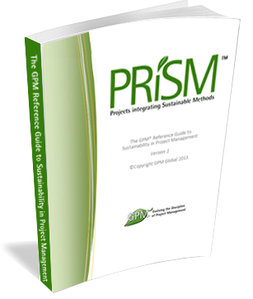
Course Kit
  You will be provided with:
  A One year Membership to the GPM to have access to:
    The GPM Reference Guide to Sustainability in Project Management eBook
    The Sustainability Calculator and other PM Templates
    USE CODE XXXXXX (replace x by code)
  And at the End of this course:
  A certificate of completion
  PDUs or Professional Development Units are granted to the attendees completing the course.
  The GPM-b Certification for those who pass the exam.

Slide 4
Learning Objectives
Sustainability as a Differentiator
Reporting Frameworks
ISO Standards
Define what Sustainability in Project Management or "Green Project Management“ is
Define the differences between a green project and standard project management
Understand the sustainability integrators to PMI PMBOK® Knowledge Areas.
Sustainability and Project Governance
The PRiSM Methodology
Define P5, the five bottom lines of sustainability and project management.
Exercise 1 Learning How to Use P5
Understand how to develop a sustainability management plan
Exercise 2. Learning how to develop a Sustainability Management Plan (SMP)
Exercise 3. Applying Sustainability to a Project
Notes:
We just covered a lot. Time for a quick break.

Slide 5


Introducing GPM
Training Development and Standards
Certification and Governance
Notes:
GPM is a Social Enterprise established to address issues and profits realized are reinvested in the business with the aim of increasing social impact. Unlike a Non-Profit, the business is not dependent on donations or on private or public grants to survive and to operate, because, as any other business, it is self-sustainable and unlike a Non-Profit, where funds are spent only once on the field, our funds are invested to increase and improve the business' operations and the tools we offer to our partners. Our construct is unique among project management organizations in that we are able to function as a company and put into practice what we encourage others to do. (The GPMG Accreditation Board, is a separate not-for-profit organization that governs all GPM certifications.)

Slide 6
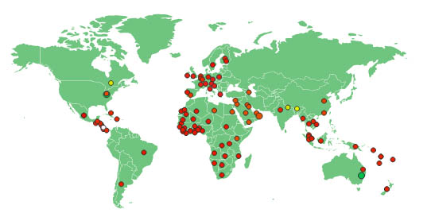
Active in over 100 countries and growing
GPM is the largest sustainability training organization in the world.
(The only Sustainable Project Management Organization.)
(Not to be confused with the German Project Management Association)

Slide 7

Our Focus
Certification
  GPM-b
  GPM
  GPM-m
Methodology
  PRiSM
Training
  PRiSM Courses
  SP2
  SAPM
Notes:
What is SAPM?

Slide 8
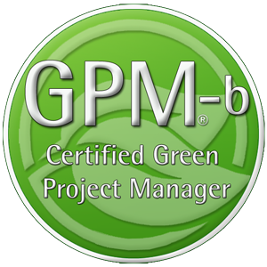
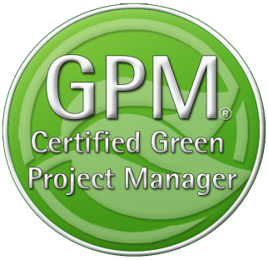
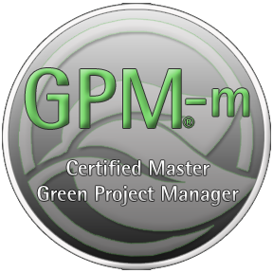
GPM Certifications
The GPM-b - Knowledge based foundational
Certification
The GPM® - Proficiency based Practitioner
Level Certification
The GPM-m - Proficiency Based Master
Level Certification

Slide 9
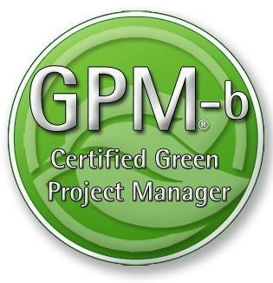
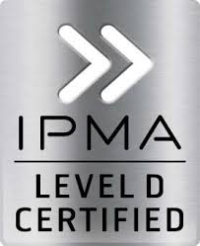
Certification
This course will prepare you for the GPM-b Certification.
The Certification Exam Format
To earn the Green Project Manager level B (GPM-b) credential, candidates must have 2,000 hours of project experience, and pass the 150 multiple choice question examination with a minimum passing score of 75%. The Exam is broken down into two primary sections as listed below.
1. Project Management
1.1. Project Management Standards based on ISO 21500
1.2. Project Management Competencies
1.3. Project management Knowledge Areas
1.4. Key Terms and Concepts
2. Sustainability Integration
2.1. Why Sustainability
2.2. PRiSM™
2.2.1. P5™
2.2.2. Sustainability Management Planning
2.2.3. Phases, inputs and outputs
2.3. Sustainability ISOs
2.3.1. The Energy Management Standard ISO 50001
2.3.2. The Environmental Management Standard ISO 14001
2.3.3. The Guidance on Social Responsibility ISO 26000
2.3.4. The Quality Management Standard ISO 9001
Ask your Trainer for details on how you can earn your Certification!
This course will prepare you for the IPMA Level D
Certification

Slide 10
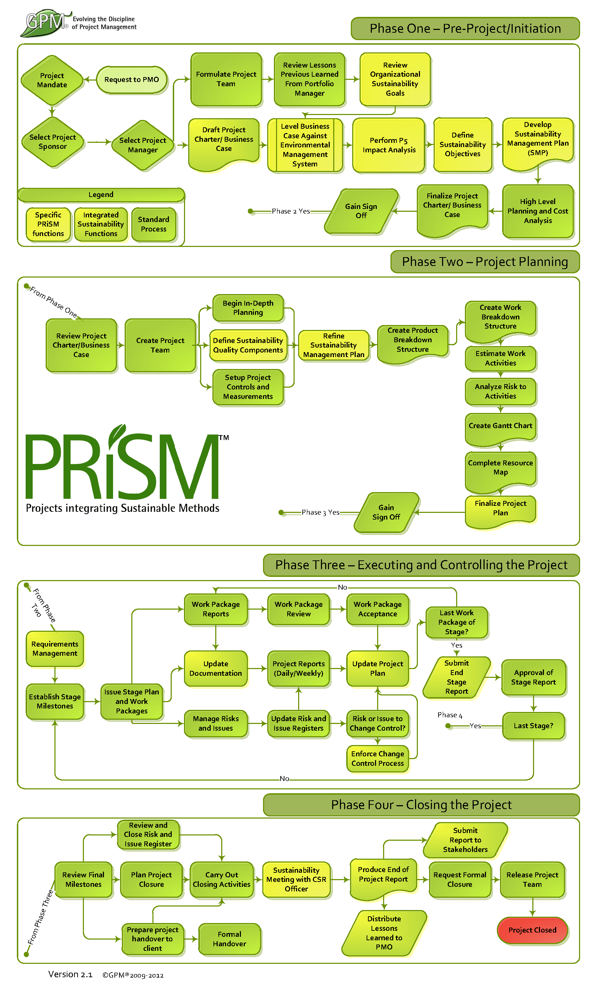
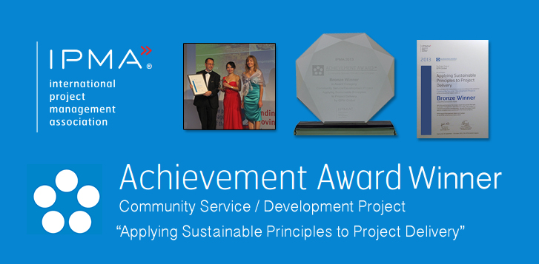
Industry Recognition
PRiSM is our structured project methodology that incorporates
ISO standards for:
Quality
Energy Management
Environmental Management
Corporate Social Responsibility
Project Management
The United Nations Global Compact Ten Principles for Sustainability
GRI G4 Framework
IPMA ICB 3.0 Competence Baseline
Notes:
GPM earned an achievement award from the International Project Management Association for the development of PRiSM.

Slide 11

Award Yourself and/or a Colleague!
Project of the Year
  Gold and Silver
Sustainability Award
Fundamentals Award
The GPM® Fundamentals Award is bestowed upon the person who submits the most thorough EnVex in a PRiSM Practitioner course in a given year.
EnVexes are in-course-virtual-projects that are taken from real life case studies. These exercises challenge course participants to apply what they learn in the course to achieve project objectives while realizing benefits from a social, environmental, and economic standpoint.
2013 Award Winner – Anna Wang – Volkswagen Financial Services

Slide 12


Agents of Change
Notes:
Tsunesaburo Makiguchi, a Japanese education reformer from the 1930's used to say. “Although there is a saying that even dust, when it accumulates, can form a mountain, there are in fact no mountains that have been made from accumulated dust…Real mountains are formed by sudden, dramatic shifts in the earth’s crust.” I view challenge of integrating sustainability and project management the same way. In order to accommodate the changing demands of our global economy and decrease our negative environmental impact, project management as a discipline, must evolve with a dramatic shift.
A study by Gartner in 2010 stated that there were 18 Million Project Managers worldwide . A similar study by PMI stated that there were 20 million. Let’s take the average and call it 19 million.
If this number didn’t increase and in 2050 our planet’s population reaches 9 billion that roughly one in every 475 people will consider themselves as a project manager. That is a lot of people who have the ability to impact change on a large scale one project at a time. We obviously can’t wait that long. It starts with one person. That’s why we call project manager’s change agents.

Slide 13

Sustainability
Getting up to Speed

Slide 14
Terms to know
Corporate Social Responsibility (CSR) - The corporate belief that a company needs to be responsible for its actions – socially, ethically, and environmentally.
Sustainable Development – Development that meets the needs of the present without compromising future generations from meeting their own needs
ISO (International Organization for Standardization) - The world’s largest developer of voluntary International Standards. Founded in 1947, ISO has published more than 19,500 International Standards covering almost all aspects of technology and business.
Our Common Future, also known as the Brundtland Report, from the United Nations World Commission on Environment and Development (WCED) was published in 1987.

Slide 15
Terms and Definitions used:
Sustainability
Sustainability Reporting
Social Responsibility
Social Sustainability
Economic Sustainability
Environmental Sustainability
UN Global Compact
Triple Bottom Line
P5 Concept
PESTLE
Sustainability Management Plan
Energy Management Systems
ISO 21500
ISO 14001
ISO 26000
ISO 50001
ISO 9001
Primary Energy
Secondary Energy
Quality
Environment
Occupational Health and Safety
Notes:
The approach taken for the content of this theme is based upon PRISM™ (Projects Integrating Sustainable Methods). PRISM is a structured project management methodology that highlights areas of sustainability and integrates them into the core project phases. The methodology answers the question: ‘How do I apply sustainability to my projects?’
The typical Sustainability element have been distilled and applied to PRINCE2®, these elements can be found in the Sustainability theme of Green PRINCE2.
PRISM also covers a full process approach and is compliant with the International Project Management Competence Baseline 3.0, these element of PRISM are not covered in this training for integrating between PRISM and PRINCE2®.

Slide 16
Terms to know
Climate Change
“Change in the state of the climate that can be identified (e.g. using statistical tests) by changes in the mean and/or the variability of its properties, and that persists for an extended period, typically decades or longer. It refers to any change in climate over time, whether due to natural variability or as a result of human activity” (According to Intergovernmental Panel on Climate Change –IPCC)
“Change of climate that is attributed directly or indirectly to human activity that alters the composition of the global atmosphere and that is in addition to natural climate variability observed over comparable time periods” (According to United Nations Framework Convention on Climate Change UNFCCC )
Notes:
Source:
http://caringforclimate.org/about/
http://caringforclimate.org/news/
Warming of the climate system is unequivocal, as is now evident from observations of increases in global average air and ocean temperatures, widespread melting of snow and ice and rising global average sea level.
Source: UN Global Compact–Accenture CEO Study on Sustainability, (Page 19)
In May 2013, for the first time in human history, the concentration of carbon dioxide in the atmosphere passed the milestone level of 400 pm.11 And despite government agreements to limit the rise in global average temperature to 2 degrees Celsius, the International Energy Agency (IEA) warned in 2012 that, on current emissions trends, average temperatures will rise by 6 degrees Celsius by the end of the century.
In 2012, researchers estimated that the cost of climate change and air pollution combined will rise to 3.2% of global GDP by 2030. The world’s least developed countries are forecast to bear the brunt, suffering losses of up to 11% of GDP. And the impacts are already being felt: the authors estimate that climate change is contributing to the deaths of nearly 400,000 people a year and costing the world more than $1.2 trillion, wiping 1.6% annually from global GDP.

Slide 17
Sustainability - Global Concerns
Sustainable Development
Climate Change
Ethics
Social Responsibility
Supply Chains
Notes:
The global concern on Sustainable Development, Climate Change, Ethics, Social Responsibility and Supply Chains has increased in recent years. The criticality of Sustainability to change the values ​​of all elements of society is a global imperative. There is a growing demand for sustainable business practices through their processes and products, so that they are more sensitive and responsive to environmental sustainability and to community (or multiple communities) in which they operate.
We are at a moment in history in which our ethics acquire crucial importance. Business ethics (also corporate ethics) is a form of applied ethics or professional ethics that examines ethical principles and moral or ethical problems that arise in a business environment. It applies to all aspects of business conduct and is relevant to the conduct of individuals and entire organizations. For example, today most major corporations promote their commitment to non-economic values under headings such as ethics codes and social responsibility charters.
Companies today "can not be socially responsible if not aspire to sustainable development. Their culture, their daily behavior and its economic, environmental and social performance must be aligned and consistent with the highest towards global sustainable development goals.
Longstanding concerns about poor social and environmental conditions in companies’ supply chains, along with heightened public scrutiny of business behavior, have led to rising expectations that companies should seek more effective ways to improve their suppliers’
environmental, social and governance (“ESG”) practices.

Slide 18



PRiSM - The Methodology
Integration
Sustainability
Project Management
Notes:
PRiSM™ (Projects integrating Sustainable Methods) is the sustainability based project delivery method which incorporates tangible tools and methods to manage the balance between finite resources, social responsibility, and delivering “green” project outcomes. It was developed for organizations to integrate project processes with sustainability initiatives to achieve business objectives while decreasing negative environmental impact.
PRiSM is a structured project management methodology that highlights areas of sustainability and integrates them into the traditional core project phases which, when understood and effectively addressed, can reduce negative environmental impacts in all types of projects while maximizing opportunities to manage sustainability and finite resources.

Slide 19
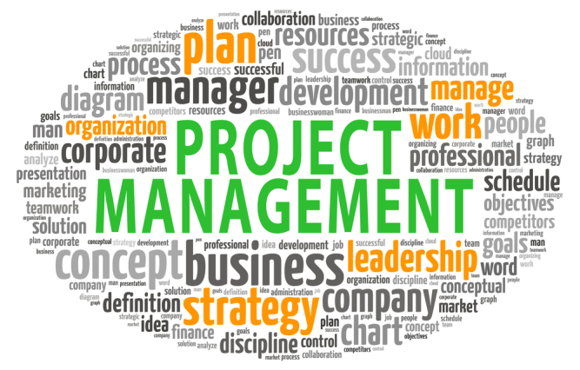
A Project
Consists of a unique set of processes consisting of coordinated and controlled activities with start and end dates, performed to achieve project objectives. Achievement of the project objectives requires the provision of deliverables conforming to specific requirements.
Although many projects may be similar, each project is unique. Project differences may occur in the following:
— deliverables provided;
— stakeholders influencing;
— resources used;
— constraints;
— the way processes are tailored to provide the deliverables.

Slide 20
What is Sustainable or “Green” Project Management?
Notes:
Green Project Management® or Sustainability in Project Management in short addresses the impact of a project’s delivery on the environment (ecological), society, and the economy. There have been several theories for integration identified over the past several years but none that can be adopted as repeatable processes to provide governance and deliver consistent and measurable results.
Project Management, as a discipline has been continuously evolving since the times of early civilization.
It wasn’t until the mid-20th century however when Project Management as a discipline began to take on a definitive form with the Pioneering minds of Henry Gantt who developed the Gantt chart and Henri Fayol the architect of the five management functions that are the basis of today’s various bodies of knowledge.
Tools, techniques, methods and standards continue to be honed and streamlined by organizations, both public and private and certifications based on a project manager’s ability execute based the use of these standards give further credence to the discipline.
Since the adoption of ISO 14001, which exists to help organizations minimize how their operations impact the environment and comply with applicable laws, the subject of sustainability through project management had remained nebulous at best as there had been a lack of continuity among organizations who desire to use project management as the mechanism to impart change.
As a best practice organization, GPM is working to streamline and promote the practical application of green project management to not only decrease an organization’s negative environmental impact but achieving business objectives.
Our sustainability based framework which you will become masters of over the next four days, measures environmental impact down to the task level, and employs methods to measure value. Our set of best practices to augment the current bodies of knowledge so that when employed, organizations can better understand how they contribute to their carbon footprint and can thus take measures to decrease it without sacrificing their bottom line.

Slide 21


Which of these images represent
Green Project Management?
Is sustainable or green project management:
A. The management of a "green" initiative such as the solar panels or the car?
B. The integration of sustainable methods with project delivery to achieve a complete sustainable outcome?
C. Both
Notes:
There is a difference between "Green Project" Management and Green "Project Management". Here we will elaborate on the two. There are projects that by definition are green. A GPM however is not defined by how many green initiatives they undertake.
Question:
The answer is B.
Why?
If you chose "A"
The deliverable may be environmentally friendly however the focus of green project management is on METHOD by which it is delivered and the long term impacts it has on the organizations five bottom lines.
Why it is "B"
If GPM is applied to a "green" initiative it will produce the best of both worlds in that the deliverable will be environmentally friendly and it will be delivered in a manner that positively impacts all five bottom lines. If GPM is applied to an infrastructure, retail, media, IT, or any other type of project, it will ensure that the delivery is as environmentally conscious as possible thus aligning with and contributing to the organization's ethical and environmental goals.
Why not "C"
The focus should be on the delivery and methods used to ensure that it aligns with organizational goals and objectives while decreasing negative environmental impact.

Slide 22
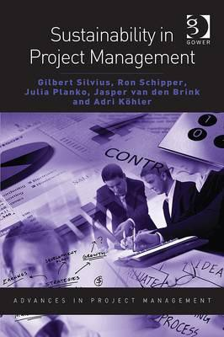
Sustainability In Project Management
Sustainability is about…
…balancing or harmonizing social,
environmental and economical interests
…both the short term and the long term
...local and global
…consuming income, not capital
...transparency and accountability
...personal values and ethics
(Silvius & Schipper 2011)
Highly Recommended!

Slide 23
What is Corporate Social Responsibility?
  Contributes to sustainable development, including health & welfare of society
  Takes into account expectations of stakeholders
  Is in compliance with applicable law and consistent with international norms of behavior
  Is integrated throughout and practiced in an organization’s relationships
Notes:
Social Responsibility (SR) is the responsibility of an Organization for the impacts of its decisions & activities on society and the environment, through transparent & ethical business behavior

Slide 24
Why do we need a Guidance on Corporate Social Responsibility?
The perception & reality of an organization’s Social Responsibility performance can influence:
Competitive Advantage
Reputation
Ability to attract and retain workers or members, customers, clients or users
Employee morale, Commitment and Productivity
View of Investors, Donors, Sponsors and Financial Community
Relationship with Companies, Governments, Media, Suppliers, Peers, Customers and the Community in which it operates.
Notes:
Organizations around the world, and their stakeholders, are becoming increasingly aware of the need for & benefits of socially responsible behavior.
An organization's performance in relation to the society in which it operates & to its impact on the environment has become a critical part of measuring its overall performance and its ability to continue operating effectively. This is, in part, a reflection of the growing recognition of the need for ensuring healthy ecosystems, social equity & good organizational governance.

Slide 25
Phases of Sustainability
1. Pre-Compliance
3. Beyond Compliance
4. Integrated Strategy
2. Compliance
5 Purpose and Passion
Reactive Proactive
(The next sustainability wave, 2005, Bob Willard)
Notes:
The next sustainability wave, 2005
Stage 1: The company feels no obligation beyond profits. It cuts corners and tries not to get caught if it breaks the law or uses exploitative practices that cheat the system. It ignores sustainability and actively fights against related regulations.
Stage 2: The business manages its liabilities by obeying the law and all labor, environmental, health, and safety regulations. It reactively does what it legally has to do and does it well. Emerging environmental and philanthropic social actions are treated as costs, projects are end-of-pipe retrofits, and CSR is given lip service.
Stage 3: The company moves from defense to offense. It realizes it can save expenses with proactive and incremental operational eco-efficiencies, cleaner processes, and better waste management. It recognizes community investment and social marketing can minimize uncertainty, enhance its reputation, and help maximize shareholder value. However, sustainability initiatives are still marginalized in specialized departments — they are tacked on as "green housekeeping," not built in and institutionalized.
Stage 4: The firm transforms itself. It re-brands itself as a company committed to sustainability and integrates sustainability with key business strategies. It captures added value from breakthrough sustainability initiatives that benefit all stakeholders. Instead of costs and risks, it sees investments and opportunities. It makes cleaner products, applies eco-effectiveness and life-cycle stewardship, and enjoys competitive advantages from sustainability initiatives.
Stage 5: Driven by a passionate, values-based commitment to improving the well-being of the company, society, and the environment, the company helps build a better world because it is the right thing to do.
The Stage 3 to Stage 4 Transformation and the Stage 5 Difference
The leap from Stage 3 to Stage 4 on the sustainability journey requires linking market opportunities with corporate responsibilities: creating positives like innovative products and services for the world's poor while eliminating negatives like pollution, waste, and child labor; creating new value like sanitation, health, safe food, clean water, and new jobs while eliminating non-value; seeing partnerships with diverse stakeholders in the market as a source of innovative solutions; seeing sustainability as an engine for growth as well as risk mitigation.

Slide 26
CSR Stage 1
The Business of Business is Business
Realization: Business leaders recognize the Profit is required to sustain business.
CSR POV: CSR is a cost and serves no useful purpose to increase profitability and does not add to shareholder value.
CSR Risk: Government regulation means the business must be in “compliance”.
CSR Threat: There is risk that competitors that practice CSR may gain competitive advantage.
CSR Opportunity: Fake Social Responsibility marketing efforts.
Notes:
Milton Friedman’s famous viewpoint.

Slide 27
CSR Stage 2
Business embraces CSR
Realization: People and Planet sustainability is required to sustain Profit in the business. Exploiting the environment will result in loss of necessary resources for the business. Exploiting people will result in less customers.
CSR POV: CSR increases profitability because it grows the supply chain and ensures enough customers.
CSR Risk: The holistic view of environmental and social sustainability leading to sustainable business is difficult to measure. Business needs to improve outcome measurements.
CSR Threat: CSR arms race develops. Large enterprises can leverage high profits for philanthropy. On the other hand, marketing noise can make it difficult for buyers to know the difference between real and fake CSR.
CSR Opportunity: People prefer to buy from ethical businesses.

Slide 28
CSR Stage 3
For Profit Social Enterprise (FOPSE)
Realization: Profit drives innovation
CSR POV: Profit can be a more effective feedback loop for success in solving social or environmental issues. FOPSE may be more effective than the non-profit model for solving some issues.
CSR Risk: FOPSE requires questioning traditional business models. (In this case, BP must not only be “beyond petroleum” but petroleum free.) FOPSE companies compete against mainstream organizations with well-understood value propositions.
CSR Threat: FOPSEs tend to be smaller businesses competing against very large companies. Those larger companies, especially those with real CSR initiatives, can out market FOPSEs.
CSR Opportunity: FOPSE is disruptive and can create sustainable competitive advantage.

Slide 29
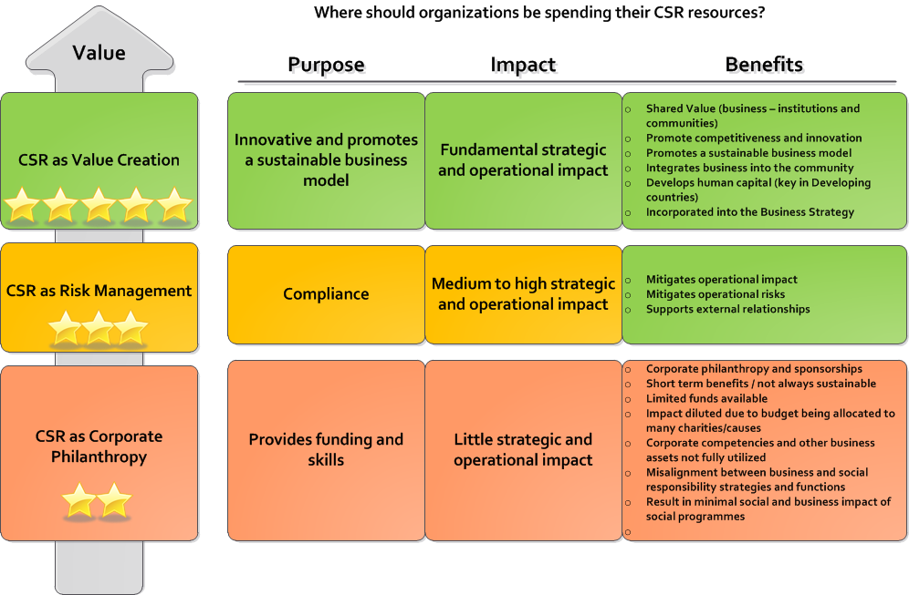
CSR New style
Notes:
So, how can boards best organize themselves and act so as to add perspective and value in these matters? First, they must develop the capacity to examine and evaluate individual CSR-oriented actions, this is a process that requires both an understanding of the motivation behind them and an assessment of their impact on society and on the firm. Second, they need to ensure that the firm’s CSR activities constitute a coherent and effective CSR strategy. Third, they have to see to it that their firm’s CSR strategy and decision-making are integrated into the company’s overall strategy. (Leonard and Rangan, Harvard Business School)

Slide 30
Corporate Responsibility
To: Good
Sustainability as a strategy
Products that make our clients more sustainable
From:
Less Bad
Less poluting resources
Better isolated buildings
Better safety clothing
Notes:
Corporate can be seen in this view as a variation of Herzberg’s Motivator-Hygiene Model where there are certain characteristics of a job or organization in this case, where there are strong motivators to drive corporate responsibility and change and hygiene factors which are based on a cluster of factors which are not necessarily motivational but, deal directly with issues of organization policy, administration, supervision, and organization environment and impacts on the environment.

Slide 31
Corporate Responsibility
Products
/Services
To: Good
Business
Model
Business
Processes
From:
Less Bad
Business Resources

Slide 32

RIO +20 Anyone hear about this?
In section 46 it states:
“We acknowledge that the implementation of sustainable development will depend on active engagement of both the public and private sectors. We recognize that the active participation of the private sector can contribute to the achievement of sustainable development, including through the important tool of public-private partnerships. We support national regulatory and policy frameworks that enable business and industry to advance sustainable development initiatives taking into account the importance of corporate social responsibility. We call on the private sector to engage in responsible business practices, such as those promoted by the UN Global Compact.”
AlREADY EXISTING ISO STANDARDS!
Notes:
<Talk about RIO and the outcome document>
The outcome document from RIO which concluded at the end of June, offers recognition and acknowledgement of the need for renewed efforts on the part of both private and public sectors to adopt sustainable business practices.
All 283 paragraphs are pretty lame. They have been attacked by the press and NGOs. Why? The commitment is not there. There are a lot of paragraphs that recognize and acknowledge but very little “decision” in the outcome. Over the past 20 years all we have done is recognize and reaffirm. This is where we must become decisive and respond.
Active participation from the corporate world is emerging as more and more companies are adopting corporate social responsibility into their mission statements and are working towards more ethical management of their supply chains Coca Cola is just one of hundreds of large companies that list their efforts in energy efficiency, climate protection, sustainable packaging, water stewardship, and workplace ethics on the main menu of their website.
While there is little doubt that project management plays vital roles in the delivery of these initiatives, delivery standards are non-existent.
In my role with GPM, I have had discussions with numerous Chief Sustainability Officers, Corporate Social Responsibility Coordinators, and Sustainable Practice Directors. One of the most common responses I receive when I ask how they integrate sustainability with product and service delivery is the challenge of getting project managers to “speak their language”. Amy from Bell Helicopter likened it to talking to dolphins.

Slide 33
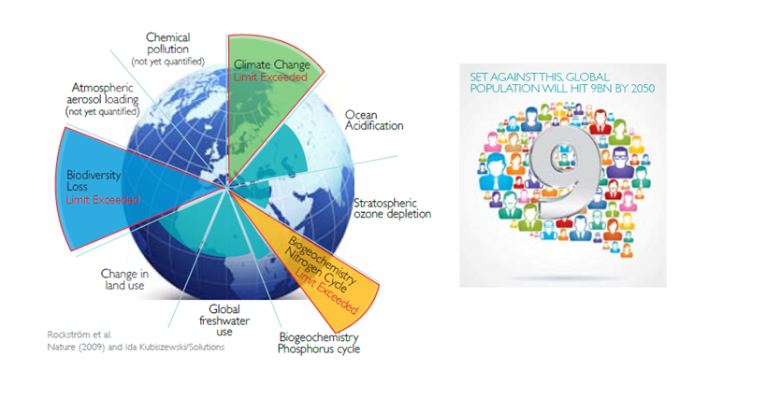
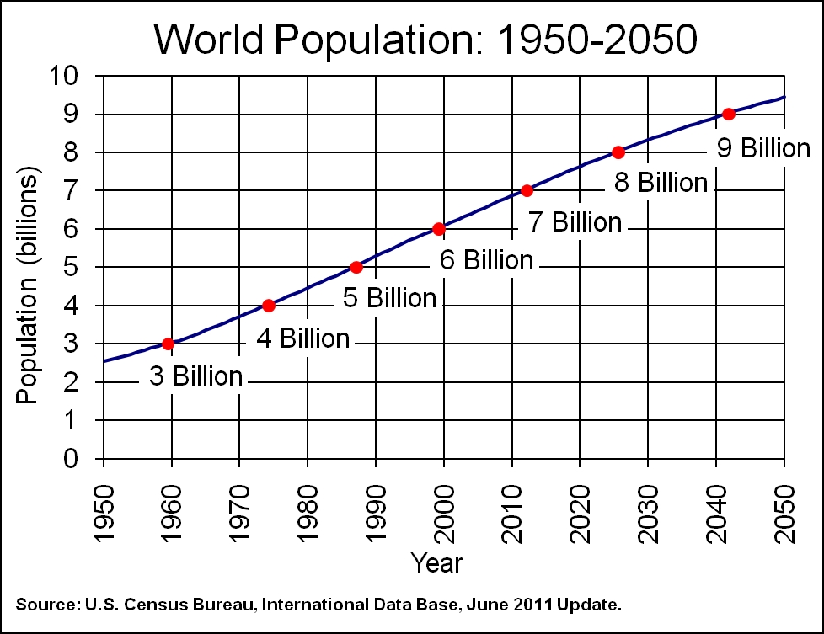
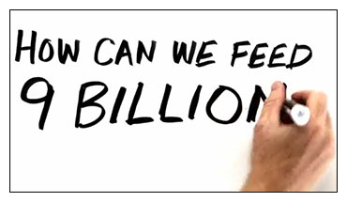
Since the RIO Declaration in 1992, conditions have not changed.
Notes:
NEW YORK (UN Population Division/DESA) ­ World populationreached 7 billion early in 2012, up from the current 6.8 billion, and surpass 9 billion people by 2050, reveals the 2008 Revision of the official United Nations population estimates and projections, released today.
A Great demand of humanity (and growing) of energy and resources is placing great emphasis on the physical and biological capacity of the Earth to sustain life in a stable manner . Climate destabilization due to emissions of greenhouse gases is only one concern . Scientists have identified nine " planetary boundaries " out of which the Earth can not function in a stable state , the state in which civilizations have thrived .
Three of these boundaries ( climate change, biological diversity and nitrogen input to the biosphere) have already been exceeded . Several others, such as ocean acidification , are near the tipping point. To keep the Earth in the "safe areas of operation, " we have to rethink fundamentally human civilization . We need to think deeply about how energy , water , food , housing , transportation, and all we need is obtained. We have to find ways billions of people on the planet can achieve a decent life in a way that can be sustained in the long term.

Slide 34

2012: International Year of Sustainable Energy for All
Launched by United Nations
“It is the golden thread that connects economic growth, increased social equity and preserving the environment.”
Notes:
Secretary-General Ban Ki-moon speaks at the opening ceremony of the World Future Energy Summit 2012 in Abu Dhabi, United Arab Emirates. UN Photo/Evan Schneider
International Year of Sustainable Energy for All kicked off 16 January 2012, United Nations officials called on governments, the private sector and civil society to help expand energy access, improve efficiency and increase the use of renewables.
Mr. Ban said “We are here to build a new energy future… a future that harnesses the power of technology and innovation in the service of people and the planet”.
“Sustainable energy for all is within our reach,” he told the summit, which also serves as the global launch of 2012 as the International Year.
Mr. Ban stressed that energy is central to everything, from powering economies to achieving the anti-poverty targets known as the Millennium Development Goals (MDGs), from combating climate change to underpinning global security.
“It is the golden thread that connects economic growth, increased social equity and preserving the environment.”

Slide 35
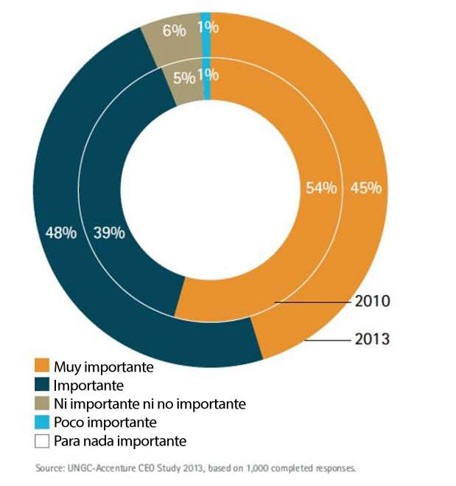
The Accenture – UNGC 2013 Report
Survey result of 1,000 global CEOs, from 27 industries across 103 countries
93% of CEOs regard Sustainability as the new key for business success

Slide 36
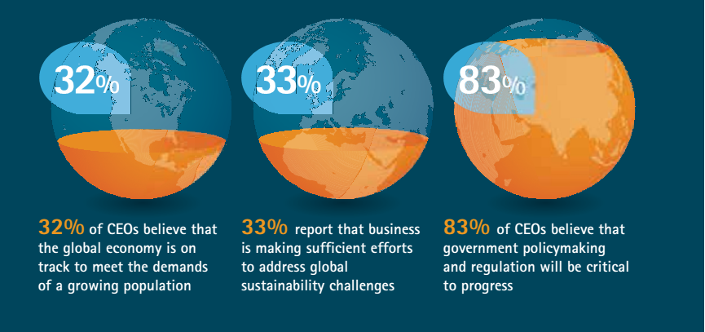
The Accenture – UNGC 2013 Report
…reveals that business leaders are not satisfied with
business progress in tackling global sustainability challenges.

Slide 37
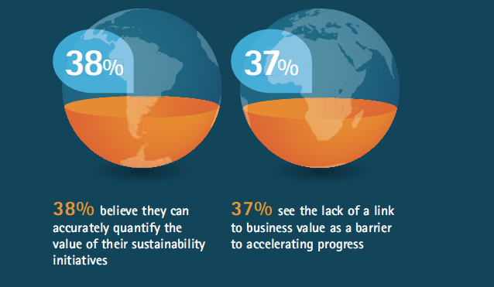
The Accenture – UNGC 2013 Report (Cont)
Probably they don´t use the PRiSM Methology

Slide 38
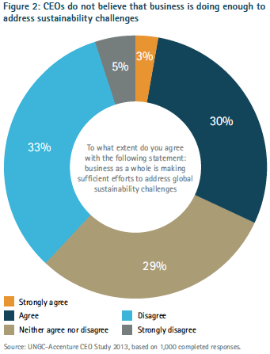
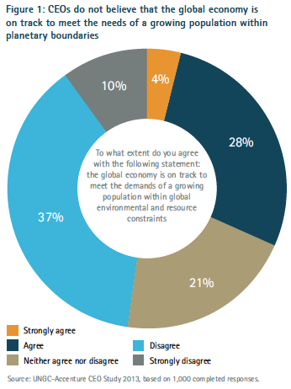

What the view of the problem is

Slide 39

Global Reporting Initiative (GRI)
Pioneering nonprofit propose a framework for sustainability reporting.
Companies use this report to inform its shareholders and consumers through their performance of economic, social and environmental
Learn more at www.globalreporting.org
Notes:
Global Reporting Initiative (GRI) is an organization whose purpose is to promote the development of sustainability reporting in all types of organizations. GRI produces a comprehensive framework for the preparation of Sustainability Reports, which are widely used worldwide. The Framework, including the Guide for the preparation of reports, sets out the principles and indicators that organizations can use to measure and disclose their economic, environmental and social. GRI is committed to continuously improving and increasing the use of these Guidelines, which are available to the public for free. ? GRI is a nonprofit organization with multiple stakeholders. It was founded by CERES and the United Nations Program for Environment (UNEP) in 1997 in the United States. In 2002, GRI moved its offices to Amsterdam, where he is currently its Secretariat. GRI has regional offices ("Focal Points") in Australia, Brazil, China, India and the United States, and also has a network of more than 30,000 people worldwide

Slide 40
GRI Categories and Aspects
Economic
    Economic Performance
    Market Presence
    Direct Economic impact
Environment
  Materials, energy, water
  biodiversity
  Emissions, waste, transport
  Products and services
  Integral sustainability
Social
    Labor practices and decent work
    Society
    Human Rights
    Product liability
    Ethics
Notes:
Sustainability reporting’ is a broad term considered synonymous with others used to describe reporting on economic, environmental, and social impacts (e.g., triple bottom line, corporate responsibility reporting, etc.). A sustainability report should provide a balanced and reasonable representation of the sustainability performance
Reports can be used for the following purposes, among others:
• Benchmarking and assessing sustainability performance with respect to laws, norms, codes,
performance standards, and voluntary initiatives;
• Demonstrating how the organization influences and is influenced by expectations about sustainable development; and
• Comparing performance within an organization and between different organizations over time. – including both positive and negative contributions.

Slide 41
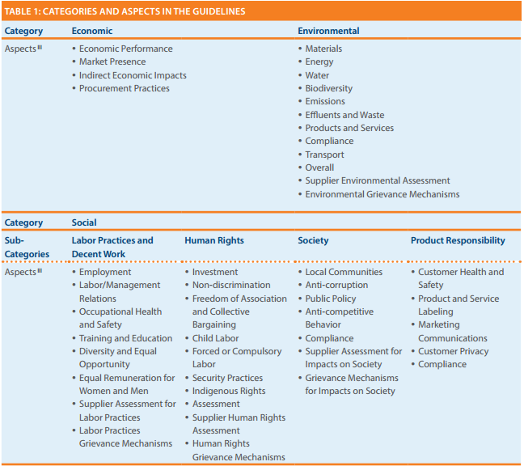
Going Deeper into 2013 G4 GRI
Product Responsability!!
Notes:
The table in figure is from the 2013 G4 release for GRI reporting.
GRI G4 states “Sustainability reporting is fundamental to an organization’s integrated thinking and reporting process in providing input into the organization’s identification of its material issues, its strategic objectives, and the assessment of its ability to achieve those objectives and create value over time”.
The reporting indicators are primarily structured in pairs, with a Core Indicator seeking disclosure on the processes in place to address the aspect, and an additional Indicator to report on degree of compliance.
The final category “Product Responsibility” includes Customer Health and Safety, Product Labeling, Marketing Communications, Customer Privacy, and Compliance. A more complete approach to sustainability reporting would take into account lifespan and servicing as well as the efficiency and maturity of the product’s design and build process.

Slide 42

The United Nations Global Compact
The Ten Principles
The UN Global Compact's ten principles in the areas of human rights, labour, the environment and anti-corruption enjoy universal consensus and are derived from:
The Universal Declaration of Human Rights
The International Labour Organization's Declaration on Fundamental Principles and Rights at Work
The Rio Declaration on Environment and Development
The United Nations Convention Against Corruption
GPM Global is a contributor to the UN Global Compact and can be found on their registry

Slide 43

The Ten Principles
Human Rights
Businesses should support and respect the protection of internationally proclaimed human rights; and
make sure that they are not complicit in human rights abuses.
Labour
3. Businesses should uphold the freedom of association and
the effective recognition of the right to collective bargaining;
4. the elimination of all forms of forced and compulsory labour;
5. the effective abolition of child labour; and
6. the elimination of discrimination in respect of employment and occupation.

Slide 44
The Ten Principles
Environment
7. Businesses should support a precautionary approach to environmental challenges;
8. undertake initiatives to promote greater environmental
responsibility; and
9. encourage the development and diffusion of environmentally friendly technologies.
Anti-Corruption
10. Businesses should uphold the freedom of association and the effective recognition of the right to collective bargaining; the elimination of all forms of forced and compulsory labour; the effective abolition of child labour; and the elimination of discrimination in respect of employment and occupation.

Slide 45
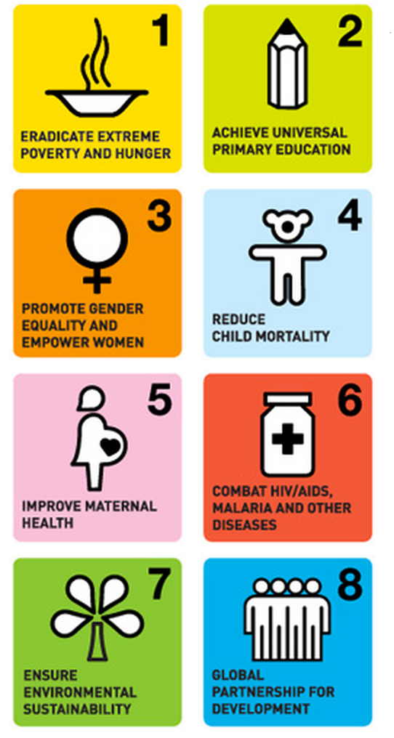
Millennium Development Goals
The Eight Millennium Development Goals
Notes:
There have been significant strides towards the Millennium Development Goals.
More children than ever are attending primary school, child deaths have dropped dramatically, emphasis on providing access to safe drinking water has been a greatly expanded, and targeted investments in fighting malaria, AIDS and tuberculosis have saved millions of lives.
The MDGs are making a real difference in millions of lives and are set to expire in 2015. In order to Realize what UN Secretary Ban Ki-Moon calls “A life of Dignity for All” we will need to dig deeper and take a slightly different approach.

Slide 46
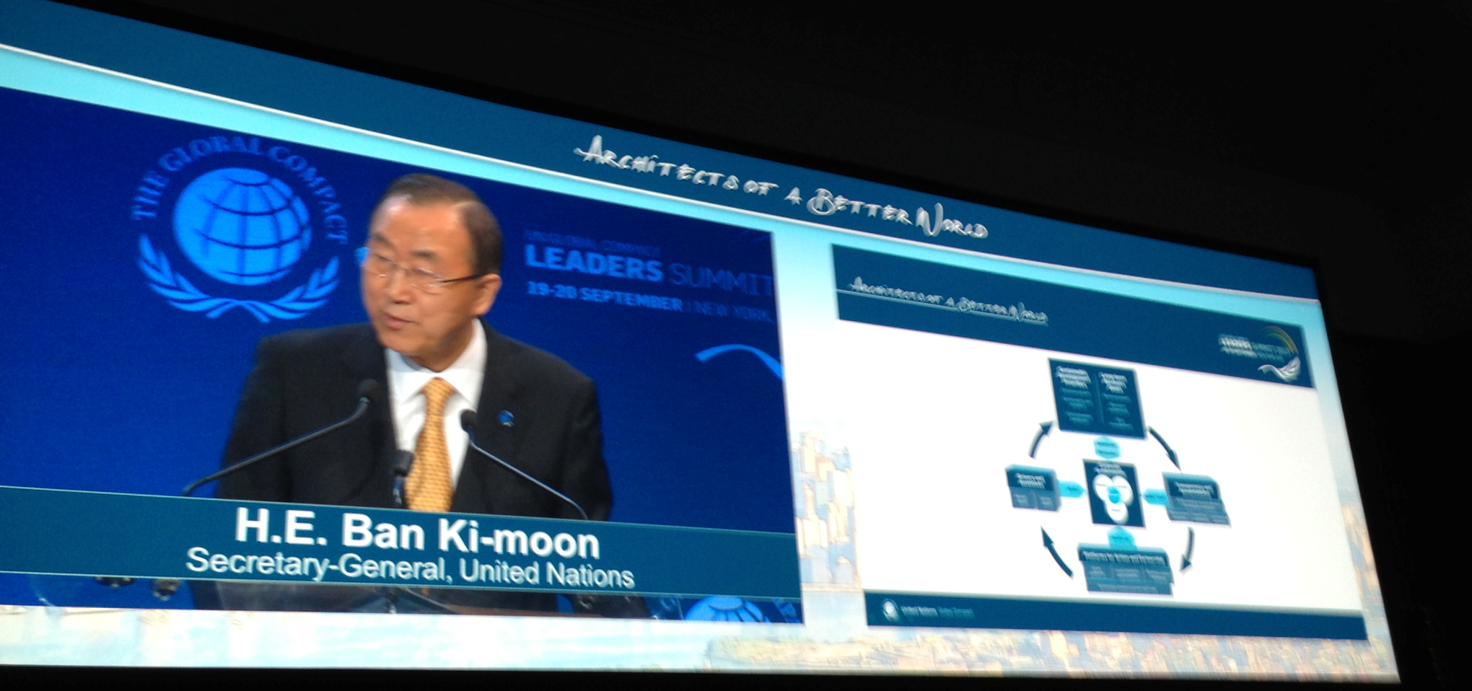
Explaining a Need for a Paradigm Shift
Each of these building blocks must be further strengthened and
connected through a comprehensive and collective effort.
UN Secretary Ban Ki-Moon outlining the Architecture on September 19th
Notes:
…if they are to help take corporate sustainability to scale and turn business into a truly transformative
force in the Post-2015 era.
The Post-2015 Business Engagement Architecture illustrates the main building blocks necessary to enhance corporate sustainability as an effective contribution to sustainable development, creating value for both business and society.

Slide 47
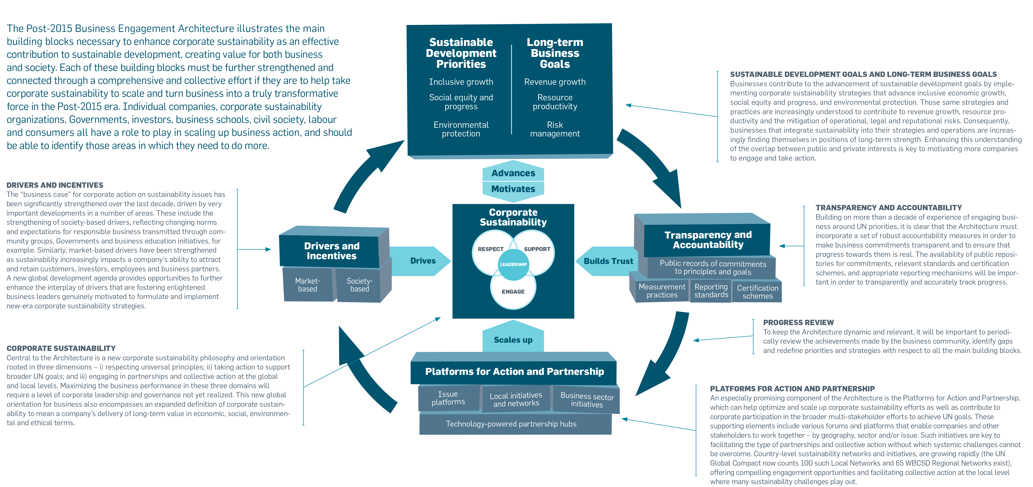

POST-2015 BUSINESS ENGAGEMENT ARCHITECTURE
Notes:
This model is a good from a high level, but what is missing are specific actionable items. GPM’s approach meets all of the requirements for this framework, including certification schemes under Transparency and Accountability.

Slide 48
What Companies are Being asked to do:
• Respect the universal principles of the UN Global Compact – over and above minimum regulator requirements in countries of operation – and make a public commitment to do so;
• Maintain ongoing and inclusive dialogue with stakeholders and experts to identify, prevent, mitigate and account for sustainability impacts to society and environment from business activities;
• Align business strategies, models and R&D priorities with global sustainability responsibilities and set targets to support the achievement of specific sustainable development goals;
• Integrate sustainability into governance mechanisms and corporate culture, creating the right incentives for management and employees to make the company more sustainable;
• Report on progress to stakeholders in an open and transparent manner and integrate sustainability information into communication with customers and investors, applying relevant reporting standards such as the Global Reporting Initiative, respected measurement practices and certification schemes;

Slide 49

Continued
• Leverage channels to communicate corporate sustainability performance to investors and, where relevant, adopt a responsible investment policy for corporate pension funds;
• Undertake sustainability due-diligence and set clear expectations before signing partnership contracts in order to encourage partners throughout the value chain to uphold minimum standards and advance sustainable practices;
• Intensify engagement in issue platforms and sector initiatives in order to scale-up and advance business engagement on sustainability issues and, as relevant, help overcome systemic challenges;
• Engage in local networks and initiatives, actively sharing best practice and learnings with local business community and providing operational support and resources, as appropriate;
• Engage in partnerships with other businesses and stakeholders that can have transformative impacts – moving beyond an ad-hoc project focus.
-DO NO HARM
-MAKE THE WORLD A BETTER PLACE
-GROW YOUR BUSINESS

Slide 50

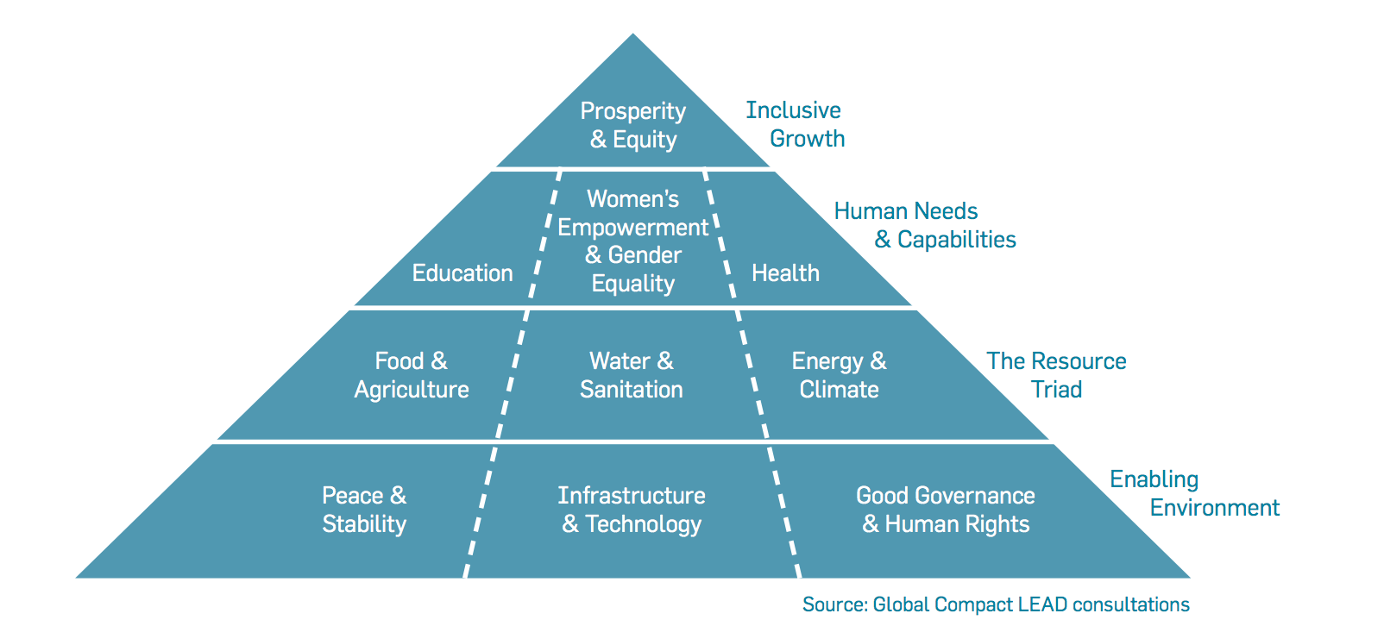
Areas of Focus
Notes:
This chart depicts the areas of focus for the new architecture. In the course, we will explain how to achieve these through project management. The current model by the UN doesn’t provide a step by step process, we do.

Slide 51

About the Architecture
The Post-2015 Business Engagement Architecture illustrates the main
building blocks necessary to enhance corporate sustainability as an effective contribution to sustainable development, creating value for both business and society.
Each of these building blocks must be further strengthened and
connected through a comprehensive and collective effort if they are to help take corporate sustainability to scale and turn business into a truly transformative
force in the Post-2015 era.
UN Secretary Ban Ki-Moon
Outlining the Architecture on September 19th

Slide 52
The big disconnect
This year, unique insights from CEOs, supported by analysis from Accenture's
High-Performance Business research, have identified seven themes that are enabling leading companies to achieve both value creation and impact on global sustainability challenges.
4 Value & performance:
“What gets measured gets managed”
1 Realism & context:
Understanding the scale of the challenge—and the opportunity
5 Technology & innovation:
New models for success
2 Growth & differentiation:
Turning sustainability to advantage and value creation
6 Engagement & dialogue:
Broadening the conversation
3 Partnerships & collaboration:
New challenges, new solutions
7 Advocacy & leadership:
Shaping future systems
Keep in mind these 7 key themes for Sustainability
Notes:
If we are only measuring supply chains, that that is all that is being managed. There is a major disconnect here. Products aren’t created through supply chains but through projects.

Slide 53

Getting to Know ISO Standards

Slide 54

ISO standards
Guidelines and Standards
Guidelines
ISO 26000 - CSR
ISO 21500 – Project Management
Normative Standards
ISO 9000 – Quality Management
ISO 14000 - Environmental
ISO 50001- Energy Management
Notes:
What are the benefits of ISO International Standards?
ISO International Standards ensure that products and services are safe, reliable and of good quality. For business, they are strategic tools that reduce costs by minimizing waste and errors and increasing productivity. They help companies to access new markets, level the playing field for developing countries and facilitate free and fair global trade. (ISO.org)

Slide 55

What ISO 26000 is NOT…
A management system standard.
Intended or appropriate for certification purposes or regulatory or contractual use.
Intended to provide a basis for legal actions, complaints, defenses or other claims in any international, domestic or other proceeding.
Intended to be cited as evidence of the evolution of customary international law.
Intended to prevent the development of national standards that are more specific, more demanding, or of a different type.

Slide 56
What ISO 26000 is…
Intended to assist organizations in contributing to Sustainable Development.
Intended to promote common understanding in the field of Social Responsibility.
Intended to complement other instruments & initiatives for Social Responsibility and not to replace them.
Intended to provide organizations with guidance concerning Social Responsibility and can be used as part of public policy activities.
Notes:
ISO 26000 contains no requirements and therefore the word “shall”, which indicates a requirement in ISO language, is not used
But does contain 386 “should”s

Slide 57
ISO 26000
Principles of Social Responsibility
Accountability
  Businesses are expected to be accountable for its impacts on society & the environment
Transparency
  Businesses are expected to be transparent in its decisions & activities that impact on society & the environment.
Ethical Behavior
  Businesses are expected to behave ethically at all times.
Stakeholder Interests
  Businesses are expected respect, consider & respond to the interests of its stakeholders.
Rule of Law
  Businesses are expected to abide by the rule of law for that region and or country.
International Norms of Behavior
  Businesses are expected to respect international norms of behavior, while adhering to the principle of respect for the rule of law.

Slide 58

ISO 14000 Family
A series of guidance documents and standards to help organizations address environmental issues.
These ISO’s below deal with Environmental Management Systems (EMS)
  14001: Environmental Management Systems
  14004: EMS general guidelines
  14010: Guidelines for Environmental Auditing
  14011: Guidelines for Auditing of an EMS
  14012: Auditing - Qualification criteria
  14064: Greenhouse gases
Notes:
ISO 14004 is guidance on how to implement ISO 14001
10, 11, and 12 relate to auditing of the 14001 standard. I would note here that a new joint auditing standard is currently being developed that will eventually replace 14010, 14011, and 14012. This new standard ISO 19011 is an auditing standard that may be used for both ISO 9000 and ISO 14001.
ISO 14064-1:2006
Greenhouse gases -- Part 1: Specification with guidance at the organization level for quantification and reporting of greenhouse gas emissions and removals

Slide 59
What is the Environment?
Environment: Surroundings in which an organization operates, including air, water, soil, natural resources, flora, fauna, humans and their interrelation. (ISO 14001:2004)

Slide 60
ISO 14001 Key Elements
  Policy Statement
  Identification of Significant Environmental Impacts and Environmental Legal Requirements
  Establishing Environmental Programs, Objectives and Targets
  Emergency Plan
  Operating Control to meet the Environmental Objectives and Targets
  Human Resources roles and Responsibilities.
  Training.
  Communication
  Internal Assessments. Corrective actions.
  Management Review (by Directors)

Slide 61
What is an EMS?
Systematic way of managing an organization’s environmental affairs
Based on Plan-Do-Check-Act Model (PDCA)
Focused on Continual Improvement of system
Addresses immediate and long-term impact of an organization’s products, services and processes on the environment.
A tool to improve environmental performance
Notes:
I introduce the term “PDCA” here
I often use the term “activities, products, and services” here and reference the standard’s use of these terms

Slide 62
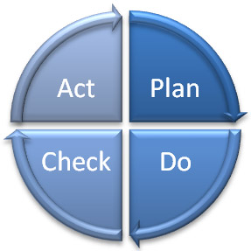
What is an EMS?
Deming Model - PDCA
Management
Review
Planning
Checking
Corrective Action
Implementation
Notes:
The steps in each successive PDCA cycle are:
PLAN Establish the objectives and processes necessary to deliver results in accordance with the expected output (the target or goals). By establishing output expectations, the completeness and accuracy of the specification is also a part of the targeted improvement. When possible start on a small scale to test possible effects.
DO Implement the plan, execute the process, make the product. Collect data for charting and analysis in the following "CHECK" and "ACT" steps.
CHECK Study the actual results (measured and collected in "DO" above) and compare against the expected results (targets or goals from the "PLAN") to ascertain any differences. Look for deviation in implementation from the plan and also look for the appropriateness and completeness of the plan to enable the execution, i.e., "Do". Charting data can make this much easier to see trends over several PDCA cycles and in order to convert the collected data into information. Information is what you need for the next step "ACT".
ACT Request corrective actions on significant differences between actual and planned results. Analyze the differences to determine their root causes. Determine where to apply changes that will include improvement of the process or product. When a pass through these four steps does not result in the need to improve, the scope to which PDCA is applied may be refined to plan and improve with more detail in the next iteration of the cycle, or attention needs to be placed in a different stage of the process.

Slide 63
Why Do Organizations Implement an EMS ?
Helps to identify the causes of environmental problems.
  better to make a product right the first time
  cheaper to prevent a spill or other accident
  cost effective to prevent pollution
Trade and competitive issues
  Inconsistency in environmental regulation and enforcement
Many individual parts may already be in place – just need to unify under the EMS umbrella!
??Why should a project manager be familiar with the EMS?

Slide 64

ISO 50001: 2011 Energy Management Systems
ISO 50001 gives organizations the requirements for energy management systems (EnMS)
Provides a framework for
  Industrial plants
  Commercial
  Institutional and governmental facilities
  Entire organizations to manage energy
Notes:
ISO 50001 establishes a framework for industrial plants ; commercial, institutional, and governmental facilities ; and entire organizations to manage energy.
Targeting broad applicability across national economic sectors, it is estimated that the standard could influence up to 60 % of the world’s energy use.*
* This estimate is based on information provided in the section, “ World Energy Demand and Economic Outlook ”, in the International Energy Outlook 2010, published by the US Energy Information Administration. This cites 2007 figures on global energy consumption by sector, including 7 % by the commercial sector (defined as businesses, institutions, and organizations that provide services), and 51 % by the industrial sector, (including manufacturing, agriculture, mining, and construction). As ISO 50001 is primarily targeted at the commercial and industrial sectors, adding the above figures provides an approximate total of 60 % of global energy demand on which the standard could have a positive impact.

Slide 65
ISO 50001: 2011 Energy Management Systems
ISO 50001 — Why is it important ?
1. Improved energy performance can provide rapid benefits for an organization by maximizing the use of its energy sources and energy-related assets, thus reducing both energy cost and consumption.
2. The organization will also make positive contributions toward reducing depletion of energy resources and mitigating worldwide effects of energy use, such as global warming.
Notes:
ISO 50001 — Why is it important?
Energy is critical to organizational operations and can be a major cost to organizations, whatever their activities. An idea can be gained by considering the use of energy through the supply chain of a business, from raw materials through to recycling.
In addition to the economic costs of energy to an organization, energy can impose environmental and societal costs by depleting resources and contributing to problems such as climate change.
The development and deployment of technologies for new energy sources and renewable sources can take time.
Individual organizations cannot control energy prices, government policies or the global economy, but they can improve the way they manage energy in the here and now. Improved energy performance can provide rapid benefits for an organization by maximizing the use of its energy sources and energy-related assets, thus reducing both energy cost and consumption. The organization will also make positive contributions toward reducing depletion of energy resources and mitigating worldwide effects of energy use, such as global warming.
ISO 50001 is based on the management system model that is already understood and implemented by organizations worldwide. It can make a positive difference
for organizations of all types in the very near future, while supporting longer term efforts for improved energy technologies.

Slide 66
ISO 50001: 2011 Energy Management Systems
Primary Energy Sources
  Renewable: Solar, Water, Wind, Biomass
  Non-Renewable: Oil, Gas, Carbon and Nuclear fusion
Secondary Energy
  Electric, mechanic, Thermic, Hot water, Compressed Air, Biodiesel and Fuel in general
Final Use
  Lighting, Refrigeration, Heating, Process,

Slide 67

Principles of Quality Management
These principles embodied in ISO 9001 have been developed with the intention that management can lead the organization towards improved performance.
Customer Focus
leadership
Involvement of people
Process Approach
System approach to management
continuous Improvement
Factual approach to decision making
Mutually beneficial supplier
Look for this again during Project Quality Management!

Slide 68
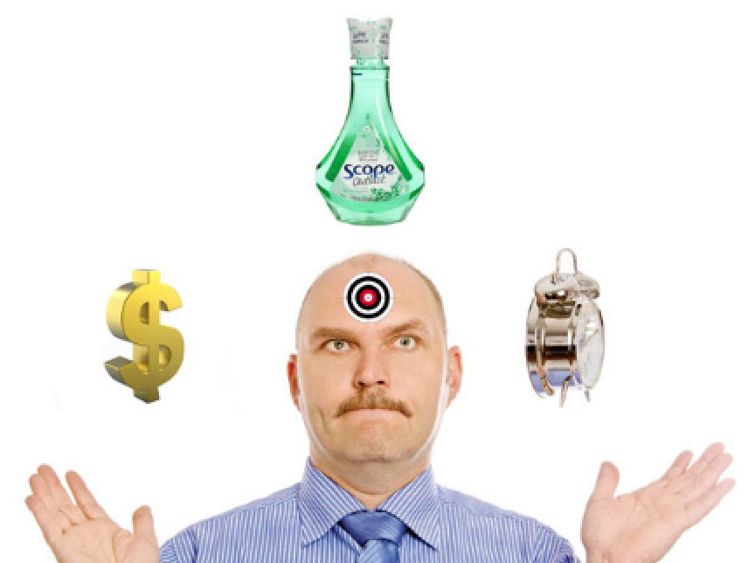


Constraints to Quality
Time
PERFORMANCE
Cost
Scope
Notes:
There is a common link to all constraints within project management.
The three major constraints that are placed upon a project are time, cost, and performance or quality. These constraints and how they are approached determine not only if the objectives are met but to what degree of success they will be. The understanding of these limitations early is crucial to assisting with project success.
Dr. Martin Barnes, Past President of the Association for Project Management (APM), stated in a keynote at the second-day plenary session of the 26th IPMA World Congress on October 30th titled “We can and should raise the standards”. [20]
Dr. Barnes’s keynote was very engaging and focused on how standards are more than processes. He shared that project management standards are frameworks for activities and provide benchmarks for performance. He shared the story behind the “iron triangle” which has been understood as time > cost > scope = quality
Dr. Barnes, the originator of the “iron triangle” (1972) asked everyone in the audience to replace quality with performance going forward as quality was not an appropriate component– performance would make a much better component as projects are so much more about the outcome.
He used a metaphor to make his point.
If a Surgeon contacts a patient after completing a procedure and explains that he accomplished a successful surgery even though it did not cure the patient’s illness. As it was on time, in scope, and in line with his fees, it was a quality procedure.
He further simplified his point saying that project success should be determined by the outcome matching the intent. “Does it work?
DISCUSSION POINTS:
How does sustainability affect the triple constraint?
(Additional discussion points…)

Slide 69

Internal Audits
Definitions (ISO 9000:2005)
"A systematic, independent and documented process for obtaining audit evidence of
Audit Evidence: Records, statements of fact or other information relevant to the audit criteria and verifiable
... And evaluating it objectively to determine the extent to which they meet the criteria for audit “
Audit Criteria: A set of policies, procedures or requirements.
(They are used as a benchmark against which we compare the evidence of the audit)

Slide 70
Internal Audits
Audit Principles
  Ethical conduct: trust, integrity, confidentiality, and discretion.
  Fair Presentation: report truthfully and accurately
  Professional Care: Application of the audit. Necessary competence.
  Independence: the basis for the impartiality and objectivity of the conclusions.
Notes:
What is the Purpose of an Audit?
What are the stages of an Audit?
- Preparation, Execution, and Monitoring Report

Slide 71
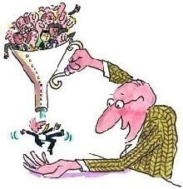
Internal Audits
Who in the room likes Audits?
That process has been operating as planned: sequence of activities, conformity procedures, operational control.
That critical resources of each of the processes are under control: HR, environment, equipment.
That the documents of each of the processes are under control: management manual, procedures, instructive records.
Processes that are under control and produce the expected results: process indicators, monitoring and control, control variables. Corrective and preventive actions.
Processes are being improved and will reach planned objectives: objectives and policy, plan management, monitoring and review

Slide 72

Diving In to Project Management

Slide 73
Key Terms
The Project Environment: A project usually exists inside a larger organization
encompassing other activities. In such cases, there are relationships between the project and
its environment, business planning and operations. Pre-project and post-project
activities may include activities such as business case development, conducting
feasibility studies and transition to operations. Projects may be organized within
programmes and project portfolios. Figure 3 illustrates these relationships.
Project Portfolio - A project portfolio is generally a collection of projects and programmes
and other work that are grouped together to facilitate the effective management of that
work to meet strategic goals.

Slide 74
The relationship Between Project Management and
organizational Strategy
Organizational strategy should provide guidance and direction to project management—especially when one considers that projects exist to support organizational strategies. Often it is the project sponsor or the portfolio or program manager who identifies alignment or potential conflicts between organizational strategies and project goals and then communicates these to the project manager.
If the goals of a project are in conflict with an established organizational strategy, it is incumbent upon the project manager to document and identify such conflicts as early as possible in the project. At times, the development of an organizational strategy could be the goal of a project rather than a guiding principle. In such a case, it is important for the project to specifically define what constitutes an appropriate organizational strategy that will sustain the organization.
Organizational strategy should provide guidance and direction to project management—especially when one considers that projects exist to support organizational strategies. Often it is the project sponsor or the portfolio or program manager who identifies alignment or potential conflicts between organizational strategies and project goals and then communicates these to the project manager.
If the goals of a project are in conflict with an established organizational strategy, it is incumbent upon the project manager to document and identify such conflicts as early as possible in the project. At times, the development of an organizational strategy could be the goal of a project rather than a guiding principle. In such a case, it is important for the project to specifically define what constitutes an appropriate organizational strategy that will sustain the organization.
Organizational strategy should provide guidance and direction to project management—especially when one considers that projects exist to support organizational strategies. Often it is the project sponsor or the portfolio or program manager who identifies alignment or potential conflicts between organizational strategies and project goals and then communicates these to the project manager.
If the goals of a project are in conflict with an established organizational strategy, it is incumbent upon the project manager to document and identify such conflicts as early as possible in the project. At times, the development of an organizational strategy could be the goal of a project rather than a guiding principle. In such a case, it is important for the project to specifically define what constitutes an appropriate organizational strategy that will sustain the organization.
©2013 Project Management Institute. A Guide to the Project Management Body of Knowledge (PMBOK® Guide) – Fifth Edition Pg.15

Slide 75

Where is the Disconnect?
Q. If Projects are central to how a company constructs, implements, and delivers products (or change), and companies are changing to adopt sustainability as part of corporate strategy, why aren’t project managers using sustainability as a performance criteria?
A. No one has developed a repeatable process to accommodate it.
Notes:
Read question. Click to show Answer
Even more, noone really even acknowledges its importance. If the business community is adopting sustainability on an ever increasing scale, why not?

Slide 76

  Key moment in the history of sustainability in project management
  “ The further development of the project management profession requires project managers to take responsibility for sustainability”.
Mary McKinlay
Former IPMA Vice President
IPMA World Congress 2008 Keynote
Notes:
IPMA 2008 World Congress – IPMA Vice-President Mary McKinlay’s keynote speech stated this. (What is the IPMA…)
Key moment in the history of sustainability in project management IPMA World Congress 2008 Keynote

Slide 77
Question
What is the difference between “sustainable development” and “sustainable delivery”?
Notes:
Read off slide then talk about sustainable delivery.
Engage the group. There is no “globally accepted answer” The only place you will find it on Wikipedia is in reference to PRiSM.
G’head. Google it.

Slide 78

The New ISO for Project Management
ISO 21500:2012 provides high-level description of concepts and processes that are considered to form good practice in project management.
Projects are placed in the context of programmes and project portfolios.
The ISO does not provide detailed guidance on the management of programmes and project portfolios.
Topics pertaining to general management are addressed only within the context of project management.
The ISO is 36 pages and was developed over the course of five years
The Project Management Institute served as secretariat of the ISO committee

Slide 79
Let’s Review
ISO 1400 Series
ISO 26000
ISO 50001
ISO 9001
ISO 21500
Notes:
Have the participants explain what each ISO is related to.

Slide 80
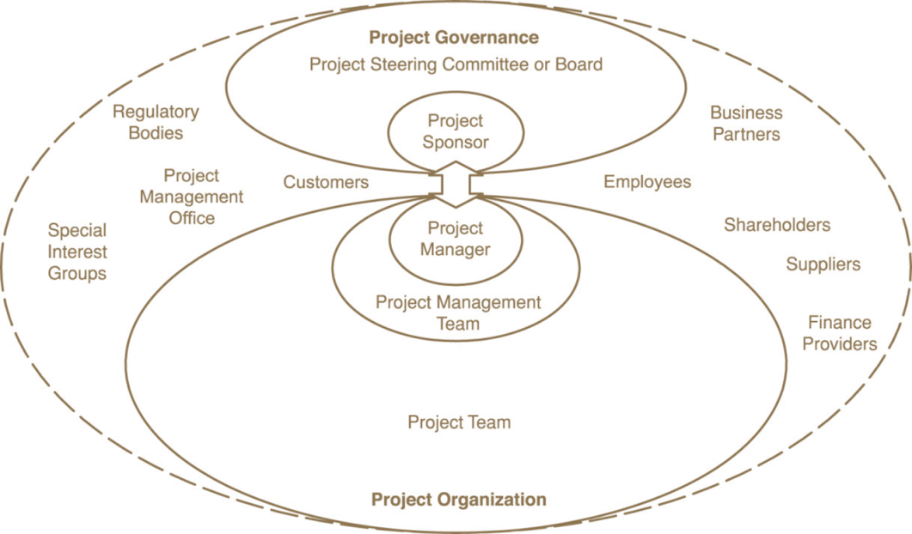
Common Challenges to
Sustainability in Project Management
Managing in an Integrated Manner while involving all stakeholders
Aligning Social Responsibility with Corporate Strategy
Rationalizing harmony with economic, compliance, and ethical responsibility
Managing Risk to Brand and Reputation
Integrating Eco-Design into Product and Service Offerings
SRC ISO 21500 Pg.7
Global Sustainability Community of Practice
Notes:
I would like to outline some of the key challenges to sustainability in project management. The diagram, which is from the new ISO 21500 Guidance on Project Management, shows a diagram of project stakeholders. The ISO states that the roles and responsibilities of stakeholders should be defined and communicated based on the organization and project goals. Bear in mind that the project organization is also included in this diagram. Some of the challenges to integrating sustainability with project management are due to the constraints of how we function. If this was a diagram depicting operations, the regulatory bodies would be more connected.
Other keys challenges are
-rationalizing and harmonizing the economic, compliance, ethical, and sustainability dimensions of corporate responsibility and sustainability in the context of stakeholder requirements;
-managing non-financial risk, particularly to brand, reputation, local license to operate and to performance instability as an integral part of corporate sustainability management;
-integrating eco-design and other sustainability requirements into product and service offerings;
·managing the sustainability performance optimization process to continually increase stakeholder satisfaction;
·developing strategic responsibility and sustainability capabilities;

Slide 81
Challenges to Project Managers
The misconception of added steps (increased workload)
Proving the value
Established standards
Lack of consistent and repeatable processes
Lack of Governance
Lack of tools
SRC ISO 21500 Pg.7
Global Sustainability Community of Practice
Notes:
On the individual level, there are some misconceptions.
The misconception of added steps (increased workload) - Many times, the response we get is that we are adding extra layers that don’t belong.
Proving the value – Sustainability is a not a function of project management, “operations should worry about that.”
Established standards – There aren’t any standards for sustainability in project management, and we only do what is inside the box…
Lack of consistent and repeatable processes – How would we go about integrating the two on a practical level. We already recycle our paper… what else is there?
Lack of Governance – This exists at the portfolio level therefore if one individual wants to adopt it, it can be a challenge.
Lack of tools – How can we show project impact to the triple bottom line People, Planet, Profit? This is also the challenge for sustainability Coordinators or CSR Officers as they coordinate the organizational reporting and project management is left out.

Slide 82
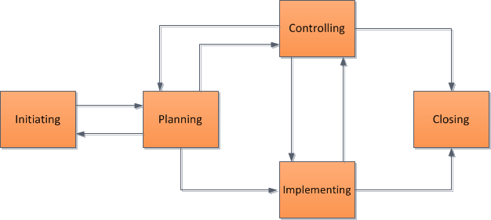

How about this challenge?
Notes:
Ask class. Would you all agree that a project has a defined start and end? What are project managers trained to manage to? Click to show the brick walls. Is this a misconception? A project manager is only responsible for what happens inside that box. Does that mean that accounting for post close impacts can’t be part of the process? Is that the excuse? I believe so.

Slide 83

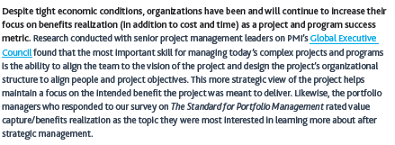
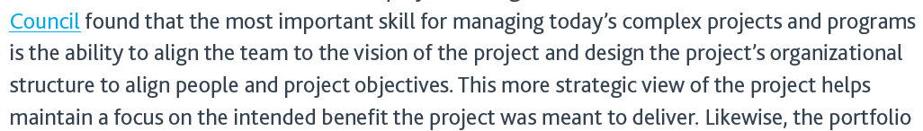
Project Management Institute’s Take
SRC: http://www.pmi.org/~/media/PDF/Research/2012_Pulse_of_the_profession.ashx
Notes:
http://www.pmi.org/~/media/PDF/Research/2012_Pulse_of_the_profession.ashx
This was published last year by the PMI, an organization that we have a great relationship with and hold much respect for.
How would you interpret this? A little foreshadowing.

Slide 84
According to PMI’S Pulse of the Profession

Slide 85
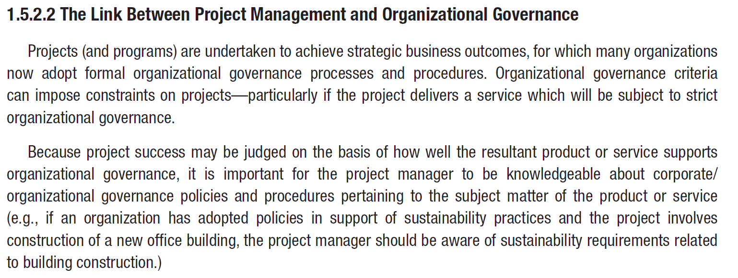
The New PMBOK® Guide Includes Sustainability!
Notes:
Anyone care to read what is inside the red box?
PMI’s PMBOK Guide is the most widely adopted text on project management standards in the world. The newly released book of 616 pages now accounts for sustainability.

Slide 86
The Project Environment
Notes:
Here is a diagram, from ISO 21500, Guidance on Project Management page 3 that depicts the project organization. The boxes represent project management concepts and the arrows represent a logical flow by which the concepts are connected. The dotted lines are organizational boundaries.
The blue box listed as opportunities represents what becomes the project initiation phase and comes from organizational need, market demand and so forth. I will stress that factors outside the organizational boundary include regulatory, socio-economic, and ecological. If they are penetrating the organization then where would they most likely live within the project environment? Project Governance. Makes sense.

Slide 87
Organizational Strategy – Projects - Operations
The organizational strategy identifies opportunities.
  The opportunities are evaluated and should be documented. Selected opportunities are further developed in a business case or other similar document, and can result in one or more projects that provide deliverables. Those deliverables can be used to realize benefits. The benefits can be an input to realizing and further developing the organizational strategy.
Projects.
  performed by temporary teams, are non-repetitive and provide unique deliverables.
Operations.
  performed by relatively stable teams through ongoing and repetitive processes and are focused on sustaining the organization;

Slide 88
Where Sustainability Most Commonly Exists
Global Sustainability Community of Practice
Notes:
Where does sustainability most commonly live? Organizational strategy and operations. Look on any fortune 500 website and you will see Social Responsibility and the vast majority is tied to supply chains, and operations. If opportunity is driven through projects, then why do we not have best practices for sustainability within project management?
Example Coca Cola

Slide 89
Where Sustainability is Left Out
The Bermuda Triangle of
Sustainability…
Global Sustainability Community of Practice
Notes:
By all accounts, this entire section is excluded.

Slide 90
Where Sustainability Exist
Needs to
Global Sustainability Community of Practice
Notes:
Sustainability governance needs to exist in within project governance. When organizations talk about cradle to cradle, unless they are including the delivery process, something is missing.
A couple things to note:
Some of the benefits of incorporating sustainability with project governance at the portfolio level:
It becomes a standard way of practice.
The organization shares best practices and so improvements occur more rapidly
Response to and from lower levels becomes easier to make changes to business approach
At the program level it is important to try and share experiences, resources and practices.
If the sustainability program has been started in a different part of the organization and the practices are working to deliver a project within this area then it is the responsibility of the Program Manager to ensure that each of the projects under their control embrace the changes and that they are promoted through good communication and a clear education to all departments.

Slide 91
Project Governance
Governance is the framework by which an organization is directed and controlled. Project governance includes, but is not limited to, those areas of organizational governance that are specifically related to project activities.
Project governance may include subjects such as the following:
  — defining the management structure;
  — the policies, processes and methodologies to be used;
  — limits of authority for decision-making;
  — stakeholder responsibilities and accountabilities;
  — interactions such as reporting and the escalation of issues or risks.
The responsibility for maintaining the appropriate governance of a project is usually assigned either to the project sponsor or to a project steering committee.

Slide 92
Project Management
Constraints
time, cost, quality, technical, other performance parameters, legal, environmental
Input
Project Management
Output
business need
problem
opportunity
project deliverables:
Products
Services
change
Mechanisms
people, tools, techniques, equipment, organization
Notes:
Projects
A project consists of a unique set of processes consisting of coordinated and controlled activities with start and end dates, performed to achieve project objectives. Achievement of the project objectives requires the provision of deliverables conforming to specific requirements. A project may
be subject to multiple constraints.
Although many projects may be similar, each project is unique. Project differences may occur in: deliverables provided; stakeholders influencing; resources used; constraints; and the way processes are tailored to provide the deliverables.
Every project has a definite start and end, and is usually divided into phases
Project Management
Project management is the application of methods, tools, techniques and competencies to a project.
Project management includes the integration of the various phases of the project life cycle
Project management is performed through processes. The processes selected for performing a
project should be aligned in a systemic view. Each phase of the project life cycle should have
specific deliverables. These deliverables should be regularly reviewed during the project to meet
the requirements of the sponsor, customers and other stakeholders
ISO 21500 Section 3.2 and 3.3

Slide 93
Relationship between project management concepts and processes
Project management is accomplished through processes utilizing the concepts [knowledge] and application [competencies.]
A process is a set of interrelated activities. Processes used in projects are generally categorized into three major types.
  project management processes -- specific to project management and determine how the activities selected for the project are managed
  delivery processes -- not unique to project management, result in the specification and
  provision of a particular product, service, or result and vary depending on the particular project
Deliverable support processes -- not unique to project management, provide relevant and valuable support to product and project management processes in such disciplines as logistics, finance, accounting and safety
Notes:
This standard addresses only project management processes. However, it should be noted that product, support and project management processes might overlap and interact throughout a project.

Slide 94
Challenges to Sustainability in Project Management
Managing in an Integrated Manner while involving all stakeholders
Aligning Social Responsibility with Corporate Strategy
Rationalising harmony with economy, compliance, and ethical responsibility
Managing Risk to Brand and Reputation
Integrating Eco-Design into Product and Service Offerings
Notes:
Key challenges in Sustainability management include:
·managing in an integrated manner the full lifecycle of strategy formulation, implementation, evaluation and evolution incorporating stakeholder participation;
·aligning responsibility strategy to corporate strategy focusing on:
-rationalising and harmonising the economic, compliance, ethical, and sustainability dimensions of corporate responsibility and sustainability in the context of stakeholder requirements;
-managing non-financial risk, particularly to brand, reputation, local licence to operate and to performance instability as an integral part of corporate sustainability management;
-integrating eco-design and other sustainability requirements into product and service offerings;
·managing the sustainability performance optimisation process to continually increase stakeholder satisfaction;
·developing strategic responsibility and sustainability capabilities;

Slide 95
Sustainability at the Program Level
Improved resourcing leads to less waste
Linking and connecting projects can bring greater efficiencies
Risks and Issues are managed at the right level and can in some cases be curtailed prior to occurrence
Connection with “business as usual” means that sustainability message doesn’t get restricted to project with a clearer route for communication
Notes:
At Program level it is important to try and share experiences, resources and practices.
If the sustainability program has been started into a different part of the organization and the practices are working to deliver a project within this area then it is the responsibility of the Program Manager to ensure that each of the projects under their control embrace the changes and that they are promoted through good communication and a clear education to all departments.

Slide 96
Governance Environment
Strategic Objectives
Organization
Portfolio Direction
Corporate governance
Governance of Project Management
Sponsorship
Disclosure & Reporting
Project Management
Project Management
Notes:
Governance of project management is a responsibility of corporate management requiring the support of project sponsors, project managers and project teams. Effective governance of project management will ensure that the organization’s projects are:
aligned to organization’s strategic objectives
delivered efficiently
sustainable
The relationships between management responsibilities are shown above. This shows that the activities involved in the governance of project management is a subset of corporate governance. It shows that most project management activities are outside the responsibility of corporate governance. This suggests that the control of projects must be shared between corporate governance and project management.
Application of principles - APM suggests that monitoring performance in four component areas will indicate the extent to which the principles are applied. These are:
portfolio direction
project sponsorship
project management
disclosure and reporting.

Slide 97

PROJECT SPONSORS
Support to Projects

Slide 98
Project Sponsor Roles
Own, Develop and Maintain Business Case
Monitor Project Environment for Risks and Communicate to Project Manager and External Stakeholders
Review the viability of a Project against Critical Success Criteria at Stage and Phase Gates
Notes:
Typical activities performed by the Project Sponsor during the project life cycle include:
Developing and maintaining the Business Case, assigning the Project Manager and authorising the project management plan and any updates.
Monitoring the project environment for risks, communicating with the Project Manager and other project stakeholders to identify any changes required.
Reviewing progress against critical success criteria and checking that the planned business benefits will be achieved. Depending on progress the sponsor may decide to stop, change or continue the project.
Accepting the project deliverables, signing off the project and handing the products to the operating authority.
Conducting benefits realization reviews during the Operations Phase.

Slide 99
Project Sponsor Roles
Acceptance of Project Deliverables at Handover and Project Sign Off
Conduct Benefits realization Reviews
Notes:
Typical activities performed by the Project Sponsor during the project life cycle include:
Developing and maintaining the Business Case, assigning the Project Manager and authorising the project management plan and any updates.
Monitoring the project environment for risks, communicating with the Project Manager and other project stakeholders to identify any changes required.
Reviewing progress against critical success criteria and checking that the planned business benefits will be achieved. Depending on progress the sponsor may decide to stop, change or continue the project.
Accepting the project deliverables, signing off the project and handing the products to the operating authority.
Conducting benefits realization reviews during the Operations Phase.

Slide 100

Project Success and Benefits Management
What defines Success?
Notes:
Success Criteria
Success criteria are the specific parameters that will be used to judge the project’s success. They must be measurable and unambiguous. Use of subjective phrases will inevitably lead to disputes over interpretation at some stage of the project. Criteria must be achievable within the scope of the project. They will be unique to the project and derived from the stakeholders needs.
In summary, effective success criteria will be:
Defined as part of the business case
Reviewed at the end of each phase or stage
SMART (Specific, Measurable, Achievable, Realistic and Time bound)
Agreed between the Sponsor and the Project Manager
Inclusive of tolerances
Related to the benefits within the Business Case

Slide 101



What is Success?
Business Objectives
Continuous Improvement
Increased
Market Share
Successful Change
Footprint
Reduction
Product
Delivery
Management
Processes
Happy
Workforce
Notes:
Success:
"The person who succeeds is not the one who holds back, fearing failure, nor the one who never fails... but rather the one who moves on in spite of failure. Far better to dare mighty things, to win glorious triumphs, even though checkered by failure, than to take rank with those poor spirits who neither enjoy much nor suffer much because they live in the grey twilight that knows not victory or defeat”. Author: Theodore Roosevelt
It is convenient to think of four main areas where a project may be judged to be a success or failure and a fourth result or benefit that can be achieved by these successes.
Product Delivery
This is the area that has been historically recognised as being the judge of whether a project has been a success or not. It is concerned with the delivery of the final product within the budget set, within the timescales agreed and to the required specification.
Business Objectives
It is important to define and quantify benefits that are derived from the project in line with corporate strategy. These benefits are realised mainly after the project’s end product has been delivered and the project team disbanded.
Even if the project has done all it was asked to do in terms of the end product, the project may still be regarded as a failure if we do not eventually get the benefits that were used to justify the project in the first place.
Management Process
Delivering the project within its specific constraints is one aspect of success, but delivering it using the defined processes within a governed system and administering the project in a set prescribed manner is another. Imagine a long car journey that gets you to the correct destination on time and within budget, but the driver takes very rough dusty roads, almost has an accident and never stops for a comfort break. The driver may consider the journey a great success as it achieved its product delivery objectives. But feeling dusty, car sick and tired in the back, you may have a very different view.
Continuous Improvement
The three previous areas of potential success relate to individual projects. This area is about achieving success time after time as efficiently as possible.
Footprint Reduction
As we discussed earlier, the natural by-product of successful green project management is when the four aforementioned criteria results in a reduction to your organization’s carbon footprint or dependency on natural or non-renewable resources.

Slide 102




Success Criteria
Time
Money
Scope
P5 Impact
Notes:
Success criteria are the measurable at the end of the project, the way that the project delivery is judged. These are typically broken down into three areas.
Time
This parameter is the simplest but you should just bear in mind that sometimes delivering the product early can be as undesirable as delivering it late. Some sources refer to this parameter as the schedule.
Cost
The cost of a project is the thing that customers most often want to fix. But it is also the parameter that is most often exceeded. This inevitably occurs because people do not understand the relationship between the project cost and the other two parameters. One of the major reasons for project cost overrun is a lack of understanding of the true scope of the work involved.
Scope
This parameter is given various names by various sources. Traditionally it has been called Quality and more recently Performance or Specification. Whatever you call it, it is fundamentally about the definition of the end product. The early stages of requirements management are crucial in understanding the needs of the customer.
The use of the term Scope fits better with the modern approach to the subjects of Scope Management and Quality which deals with a lot more than just the specification of the end product.
Throughout the lifetime of a project these three parameters are likely to conflict. The role of the project manager can be depicted as a juggler, trying to balance the conflicting demands for an extensive and ever changing scope in a short timescale at minimum cost.
For any project, priorities must be set and it is a useful exercise to place a project within this triangle to indicate the relative flexibility, or lack of it, in any of the three parameters. The closer the project appears to one of the corners, the more important and therefore less flexible that parameter is. Naturally, the tendency is to want to show that all three parameters are fixed, but as you move the project towards one corner it naturally gets further away from the others.

Slide 103
Success Factors
Senior management support
Clearly defined goals
Good communications
Team motivation
Strong leadership
Supports the direction of the organization
Does No Harm.. (Financial, Environmental, Social)
Notes:
Success factors
Success factors are elements of the project context (environment) and management processes that will enable success – or reduce the chance of failure. For example:
Senior management support
Clearly defined team roles and goals
Good communications
Team motivation
Strong Leadership
Research has shown that the absence of such factors is more likely to lead to failure and therefore the project sponsor and project manager should identify and address any weaknesses and build on their and the team’s existing strengths.

Slide 104

The 2022 World Cup Stadium Project
Dozens of Nepalese migrant laborers have died in Qatar in recent weeks and thousands more are enduring appalling labor abuses, a Guardian
investigation has found, raising serious questions about Qatar's
preparations to host the 2022 World Cup.
According to documents obtained from the Nepalese embassy in Doha, at least 44 workers died between 4 June and 8 August.
More than half died of heart attacks, heart failure or workplace accidents.
Photo Courtesy of FIFA.com

Slide 105
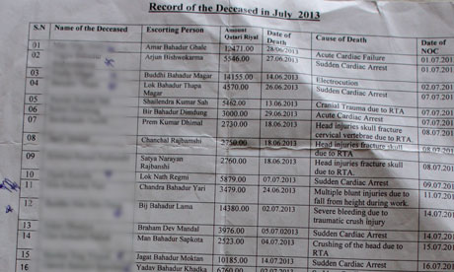
The 2022 World Cup
The investigation by the Guardian reveals:
• Evidence of forced labour on a huge World Cup infrastructure project.
• Some Nepalese men have alleged that they have not been paid for months and have had their salaries retained to stop them running away.
• Some workers on other sites say employers routinely confiscate passports and refuse to issue ID cards, in effect reducing them to the status of illegal aliens.
• Some laborers say they have been denied access to free drinking water in the desert heat.
• About 30 Nepalese sought refuge at their embassy in Doha to escape the brutal conditions of their employment.
Photo Courtesy of www.theguardian.com

Slide 106

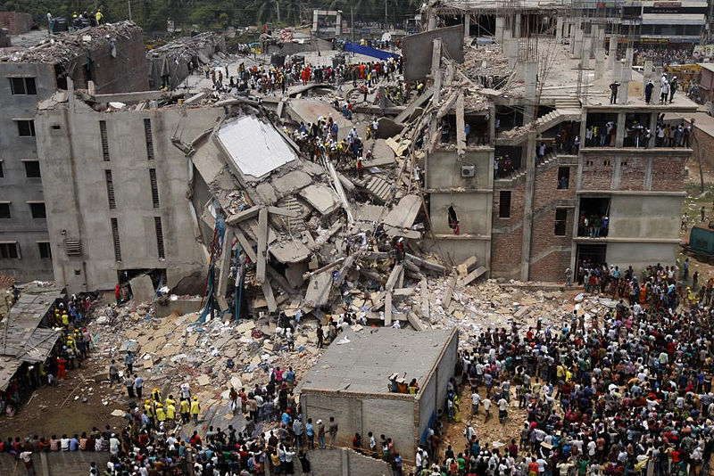




2013 RANA Plaza Collapse – Many Projects Failed…
The Rana Plaza factory collapse in Bangladesh killed 1,132 garment workers and injured more than 2,500 in April

Slide 107
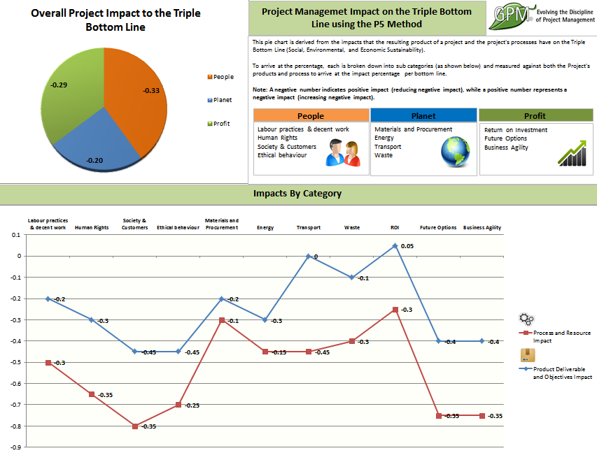
Measuring Sustainable Success.
Important to Trend Sustainable Impact
Set Baselines
View Projects as Cyclical
Drive Sustainability Through Projects
Notes:
GPM has a sustainability calculator that measures sustainability from a project to project basis. Each of you will be provided this at the end of the course.

Slide 108
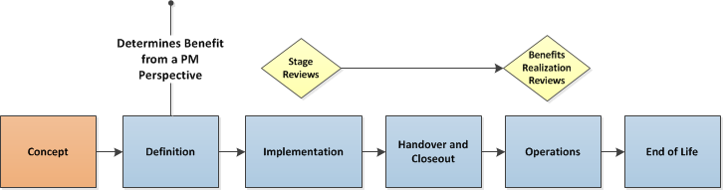
Benefits Management
Examples of Benefits
Increased market share
Increased turnover and profit
Greater output capacity
larger product portfolio
Improved security
Increased staff satisfaction
Higher Brand position
Decrease in Carbon Footprint
Cradle to Cradle Reporting
(Supply Chains)
Notes:
Benefits Management
Benefits realization is generally the responsibility of organizational management, which may use
the deliverables of the project to realize benefits in alignment with the organizational strategy. The
project manager should consider the benefits and their realization as they influence decision making
throughout the project life cycle.
The benefit of a project is the quantified and measured improvement resulting from completion of the project deliverables. This will typically be in monetary values but not necessarily. Again, project stakeholders will judge the success of the project in meeting the planned benefits. Examples of these are:

Slide 109




GPM Best Practice
The Interdependency of Key Performance Indicators is a simple concept.
Budget miscalculations = increased/decreased scope time
Poor Timelines = More Resources needed
Undefined or Confusing Scope = More Money & Time
Unsustainable = Causes Harm to the Environment and or Society
Notes:
Environmental Impact
The goods and services you use during the project, the methods you employ to communicate and the use of time are all interdependent and all can all lead to project failure if they are not detailed and have a risk assessment with failover plans ready to go.
Due to this any unanticipated plan for possible increase in the project timeline, scope and budget can impact other projects, the cost of the product being developed, the time it takes to deliver the product to market, which opens up the opportunity for your competition to take market share.
Indirectly, the soft costs to address these after the fact, in terms of:
Increased communication – uses time, delivery and action based on unplanned communications
Budget increases – Materials may need to be procured for new sources, higher cost on short notice
Undefined Scope – Opens up the door for vague deliverables which will amplify the previous two
A GPM will take this into account before the project leaves the INITIATION phase.

Slide 110
Understanding Organizational Goals
Project Managers must have an understanding of organizational goals beyond project objectives.
Projects or deliverables that do not align with organizational goals need to be weighted for risk.
Q. What are some ways to keep current?

Slide 111
Knowledge Areas
Let’s review knowledge (subject) areas and see where sustainability fits in!

Slide 112
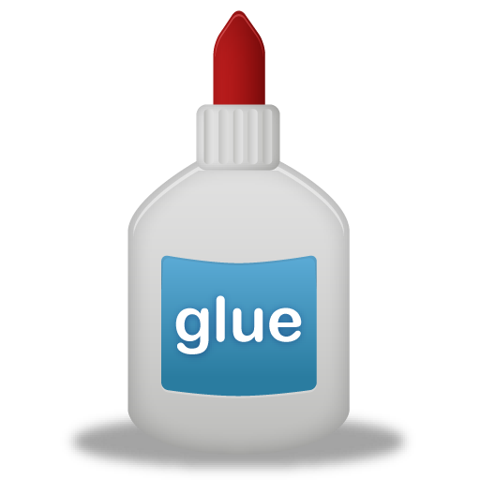
Knowledge Areas
Sustainability in Integration Management
Integration Management- includes the processes required to identify, define, combine,
unify, coordinate, control and close the various activities and processes related to the project.
Notes:
Integration Management
By applying the green methodology processes to the standard Integration Management process this can create a collision at times with Operational Change Control within projects and most organizations. Understanding the best approach to align these processes and how they work with change management and configuration management will allow the green project manager to establish a best practice approach to the delivery of the product. Gartner surmises that any operational change management is a prerequisite to providing high service quality and to setting the bar for successful transition. This not only supports functional business processes, but is also an enabler that functional organizations rely on, expect to be available and provides the highest quality in service management. These expectations and concerns within an organization cannot be achieved or addressed without a structured framework towards green and change management processes.
These are the key processes that are often overlooked by the project managers from a Green perspective. However, it should be an aspect that is evaluated with each change and factored into the overall practice.
The original defined project scope and the integrated performance baseline must be maintained by continuously managing changes to the baseline, either by rejecting new changes or by approving changes and incorporating them into a revised baseline. Any alterations to the original baseline require that the full impact of the change be assessed against the expected green benefits that were being achieved to then gain full appreciation of how this change might now affect the green aspect of project delivery.
Integrated Change Control requires:
Maintaining the integrity of performance measurement baselines (configuration control libraries)
Coordinating changes across knowledge areas. For example, a proposed schedule change will often affect cost, risk, quality, resource and the environment
Ways to incorporate “green” into Integration Management
The Project Charter – The charter rarely contains criteria or gives credence to the goal of how green the project will be. As the charter is the one document that dictates control over the entirety or the project, it is the first place to start.
Key Benefits:
It gets the project thinking sustainability from the initiation phase
It authorizes the Project Manager to formalize the organization’s green processes into the Project Management Plan
If the Charter is used in a budget authorization, showing any improvements in environmental elements such as waste reduction can be used to demonstrate financial impact which may stimulate a strong justification for project funding
It should also be used as a base measurement for the project as one of the acceptance or success criteria to demonstrate to stakeholders what benefits have been achieved giving softer issues such as environmental impact assessments greater credence
Example:
Your company determines that the billing system is nearing its end of life and needs replacing. You have been tasked with finding a successor to the system and then implementing it within the organization. The current system was purchased because the initial purchase price was the lowest, which is the company’s standard operating procedure. However, this is where you can add the key objectives and therefore change the emphasis towards overall efficiency.
Some criteria that can be used within the scoring matrix can include:
Efficiency – will the new system free up staff time to be re-allocated to other duties thus speeding up other processes in the organization?
Does it allow for new functionality and so will it reduce the dependency on paper based systems?
License fees, Ease of use, Hardware resources required, Maintenance costs, Compatibility, Support costs, Implementation costs, Training costs
If you base your assessment on these and other criteria, you will be able to show the longer term cost savings and the improved efficiencies of going to a greener option. This should then assist in helping you accomplish your project objectives while also possibly changing your procurement and project practices.

Slide 113

Knowledge Areas
Sustainability in Resource Management
Resource Management- Includes the processes required to manage finite
resources effectively.
Notes:
Human Resource Management
Human Resources Management focuses on the allocation of resources and how to manage them effectively. This knowledge area distinguishes itself in its management of organizational resources, (e.g. training, compensation, stakeholder buy-in) to verify that the appropriate people are placed in the right positions due to their knowledge and experience so that they have the right tools they need to succeed. human resources management involves “organizing and managing the project team”
This element of project and man management involves developing the suitable roles and responsibilities for each project team member by identifying the needs and qualification requirements of a particular post to manage their work to be completed. These requirements are completed in the Human Resources Planning, the Project Team Acquisition and the Development and Management process areas. The primary role from an environmental or a green project management standpoint in the ‘Acquire Project Team’, ‘Develop Project Team’ and ‘Manage Project Team’ process areas is to provide input and guidance for the areas of training and the qualifications of the right person to manage environmental concerns based on your EMS and the guidelines set forth in ISO 14000. Ensuring that the right message and the correct understanding of what difference having a greener approach will make will allow the whole team to gain a fuller appreciation of the justification of spending the extra time spent, finances issued and resources associated to the project, something that can sometimes be considered an expense or a waste in time that can be better utilized within the organization elsewhere.

Slide 114

Knowledge Areas
Sustainability in Cost Management
Cost Management: the processes required to develop the budget and to monitor progress to control costs.
Notes:
Cost Management
Within Cost Management, a project manager must develop the parameters and authorized thresholds necessary to regulate the costs for the overall project. According to the PMBOK® Guide, Cost Management involves “planning, estimating, budgeting, and controlling costs so that the project can be completed within the approved budget”. The three primary areas of influence for ISO 14000 and EMS are the Cost Estimating, Cost Budgeting and Cost Control Process. Each knowledge area contains processes and activities that support project integration with ISO 14000.
ISO 14000 and EMS inputs support estimating and budgeting efforts by providing guidance on resource selection and allocation. Knowing what work needs to be accomplished to comply with environmental regulations will help a project manager set a more realistic project cost baseline. Once the initial budgeting is complete, the Cost Control process will then monitor overages in the cost thresholds set by the project board or sponsor and then to justify the need for additional resource or finance if the objectives of the project are not being met.
As a best practice approach, it has been suggested within many early sustainable projects, that the costs that are attributable to green elements are calculated separately in the first projects that an organization. By doing this, the company can then see what small amounts can be spent to create such large effects. By generating this evidence early, it encourages other parts of the organization to join in and develop their own and embrace the whole company approach to green project management.

Slide 115
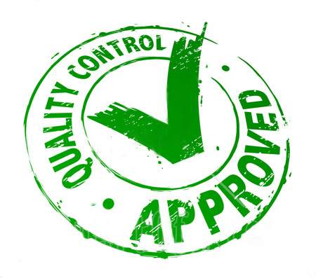
Knowledge Areas
Sustainability in Quality Management
Quality Management: the processes required to plan and establish quality assurance
and control.
Notes:
Quality Management
In Quality Management, Project Managers utilize constraints that will deliver the intended result. Quality Management “involves determining quality policies, objectives, and responsibilities so that the project will satisfy the need for which it was undertaken”. In a simpler description, Quality Management is accountable for making sure that any work performed is done so correctly to first time to avoid rework and wasted energy or resource.
Quality Management has a direct relationship with Green Project Management. Ensuring that the right standard or specification to a product or a piece of work is carried, first time all of the time, means that your wastage costs are minimized. Quality typical falls into three costs brackets; the first of these is the cost of prevention. Preventing failure or reducing the number of quality review failures means that by prior planning and a strong control regime, all project work is given greater confidence in its ability to be delivered to the needs of the client in the most cost efficient manner. The second of the cost elements is that of quality appraisal, or the checking of the products or procedures as the project progresses through its full lifecycle. By ensuring the right checks are done by the right people when it is most beneficial to carry out the checks, means that the organization will keep strong supervision and accountancy for the delivery without having excess resource wasted. The third and final cost for quality is that of the cost of failure, both internally and externally. What is the cost to a company if it has products being returned or being subjected to enquiries? Cost of failure goes beyond the wasted material and the time needed for re-work, all the way to the cost of reputation and therefore future contracts and repeat work.

Slide 116

According to PMBOK® Guide – Fifth Edition
These principles embodied in ISO 9001 have been developed with the intention that management can lead the organization towards improved performance.
“Project Quality Management includes the processes and activities of the performing organization that determine quality policies, objectives, and responsibilities so that the project will satisfy the needs for which it was undertaken. Project Quality Management uses policies and procedures to implement, within the project’s context, the organization’s quality management system and, as appropriate, it supports continuous process improvement activities as undertaken on behalf of the performing organization. Project Quality Management works to ensure that the project requirements, including product requirements, are met and validated.”
©2013 Project Management Institute. A Guide to the Project Management Body of Knowledge (PMBOK® Guide) – Fifth Edition Page 227
Look for this again during Project Quality Management!
Customer Focus
leadership
Involvement of people
Process Approach
System approach to management
Continuous Improvement
Factual approach to decision making
Mutually beneficial supplier

Slide 117

Knowledge Areas
Sustainability in Communications Management
Communication Management: The processes required to plan, manage and distribute
information relevant to the project.
Notes:
Communications Management
Within the Communications Management knowledge area, a Project Manager will outline requirements for communicating with all project stakeholders. According to the PMBOK® Guide, communications management involves the “timely and appropriate generation, collection, distribution, storage, retrieval, and ultimate disposition of project information”.
Therefore, Communications Management must seek to manage all project information in a way that works most efficiently and carries and delivers the message most effectively to the stakeholders of the project. The process areas that control these functions are contained in the Communications Planning and Performance Reporting process areas. ISO standards provides direction on which areas to monitor and how to communicate the information. This guidance will aid the Project Manager in developing the metrics for measurement that will support decision making among the project management team and stakeholders on the environmental concerns within delivery.
The performance reporting process, in conjunction with the EMS, EnMS, and PMIS systems, can be used to monitor thresholds set by the Communications Planning process and help build the case
to justify change or corrective actions in change management.
One question that has to be asked when preparing the communications whether internal or external from the project is what message are we trying to deliver, or what is it we are trying to tell the recipient? Having the understanding of that above all else means that you will be able to address the concerns, issues and problems that may arise during the project.

Slide 118
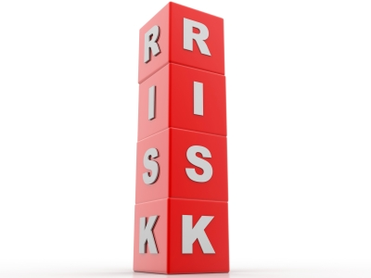
Knowledge Areas
Sustainability in Risk Management
Risk Management: processes required to identify and manage
threats and opportunities.
Notes:
The objective of the Risk Management Planning process area is to define and document how the project will deal with risk, set tolerance levels, thresholds, reporting requirements, roles and responsibilities. So what risks exist within Green Project Management; how can something that can help the planet be a risk to the project?
The objective of the Risk Identification process is to identify, classify and rank the risks that could both negatively and positively affect the project. That said, perhaps Green Project Management is way of identifying the positive elements of risk within a project. These positive elements of risk are also known as Opportunities. The information that is captured in the Risk Identification process is used to develop an effective risk response plan and to define action items, thresholds and metrics for the Risk Monitoring and Control process.
Practical Application
Include in your requests for quotations or proposals that vendors and suppliers include with their response how they might meet your green criteria.
Examples
Quantitative criteria:
A vendor may incur costs by executing an environmental management plan or be a source of environmental costs because of wasteful processes. Early identification of these costs can point the Project Manager in the right direction to a suitable vendor or not as applicable.
Pollution Case/Effect: Representing environmental costs caused by a potential supplier
Environmental Commitment: Represents the degree of commitment the supplier has in environmental management.
Qualitative criteria
Scoring on qualitative criteria will depend on the weight that is applied to each item on a pre-assigned scorecard based on the importance that your organization or you as the Project Manager place on each category.
Environmental Commitment: Their overall corporate goals to decrease their carbon footprint
Logistics: How streamlined are their logistics
Strength of their SMP: How their action and results measure up to their goals

Slide 119

Knowledge Areas
Sustainability in Procurement Management
Procurement Management: the processes required to plan and acquire products,
services or results, and to manage supplier relationships.
Notes:
Procurement Management
According to the PMBOK® Guide, Procurement Management includes “the processes to purchase or acquire the products, services, or results to complete the work associated with the project” (PMI, 2004, p. 269). In essence, Procurement Management serves as the mechanism to manage external relationships and access specialized support for skill areas. The convergence of ISO 14000, which shapes your Environmental Management System (EMS) and Procurement Management are contained within the Purchase and Acquisition Plan and Contract Administration process areas.
The Purchases and Acquisitions Plan process looks at developing or acquiring products or services to accomplish the project objectives. The rules of procurement are established and documented in the procurement management plan. ISO 14000 inputs as well as your Environmental Management System can be used to influence the development and interpretation of requirements as well as influence the selection of vendors and products. The inputs that are molded by ISO 14000 policies should be utilized to create assumptions, constraints, measurement metrics and other criteria for making decisions and that will be incorporated into the plan.
The Contract Administration process monitors performance of any contracts that correlate to the project and its overall completion. The ISO 14000 EMS can be used to monitor vendor performance against the environmental standards that you decreed in the original procurement or contractual document.
The results of the measurements can also be used to in change management to keep the project within the guidelines set forth in the project charter. In addition, the project team would use these outputs to conduct audits and inspection to verify that project work is not only meeting requirements, but also meeting ISO 14000 requirements and are in line with your organization’s EMS.
So when it comes to Green Project Management, you can see, it is not to replace standard project management nor is it a new process that will solve all your problems and green issues alone. Green Project Management is not simply just a badge to be held or achieved, so what is it? What Green Project Management gives you, a new way of looking at delivering projects, in alignment with those tools and techniques that best practice project management gives you; by thinking through the project, by planning it, by delivering and controlling it, whilst thinking about how you can improve the environment, but without stopping a project or spending a fortune to alter your deliverables, you can be a part of the changing evolution in the project management industry, the change that is a Green Project Manager.

Slide 120

Knowledge Areas
Sustainability in Time
and Scope Management
Time Management - the processes required to schedule the project activities
and to monitor progress to control the schedule.
Scope Management - he processes required to identify and define the work
and deliverables, and only the work and deliverables required.

Slide 121
The Strength of PRiSM
The only project methodology that aligns with ISO 26000, 21500, 14001, 9000, 5001 the UNGC Ten Principles, and The GRI G4 Framework for Sustainability Reporting
Notes:
We are now going to do a walkthrough of the PRiSM Methodology from a Workflow Perspective before diving in a little deeper.
PRiSM Short for (Projects integrating Sustainable Methods)
PRiSM™ (Projects integrating Sustainable Methods) is the sustainability based project delivery method which incorporates tangible tools and methods to manage the balance between finite resources, social responsibility, and delivering “green” project outcomes. It was developed for organizations to integrate project processes with sustainability initiatives to achieve business objectives while decreasing negative environmental impact.
PRiSM is a structured project management methodology that highlights areas of sustainability and integrates them into the traditional core project phases which, when understood and effectively addressed, can reduce negative environmental impacts in all types of projects while maximizing opportunities to manage sustainability and finite resources. PRiSM is cut from the same cloth as the globally accepted standards for professional project management. These standards are the “books of knowledge” as they are known to project managers. PRiSM incorporates a framework of activities derived from ISO 21500, 14001, 26000, 50001 and 9001, focuses on specific areas and incorporates best practices to practically answer the question: "How do I apply sustainability in to my projects?”

Slide 122
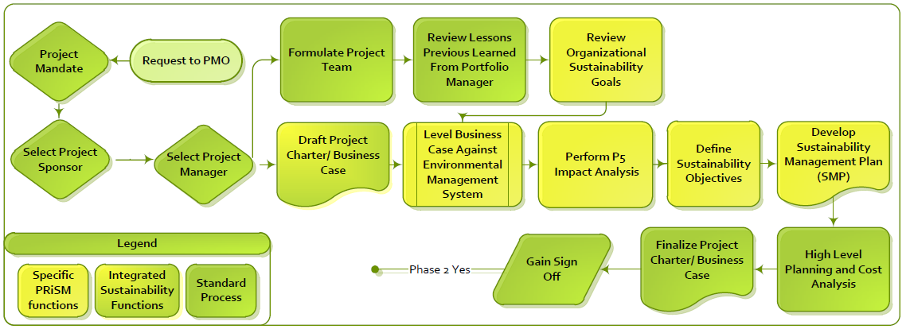
The PRiSM Pre Project/Initiation Phase
/map
Notes:
The pre project phase is one where the ideas are formulated and the business reviews whether this is a feasible project or element of a project to be included within the portfolio of projects that it is currently running.
The key deliverable within this phase is the Project Charter or Business Case that will show the value of the sustainability element within the full project document. In addition, to support the charter, the delivery has to be leveled against the organization’s environmental management system allowing it therefore to develop further its Sustainability Management Plan (SMP) for the future.

Slide 123
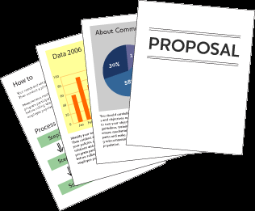
Purpose of Business Case
Justification of the project
To obtain authorization for the project and its funding
Used to give direction to a project team
Baseline document for phase and stage reviews
Used in evaluation of change requests
Baseline document for benefits reviews
Used by organization to facilitate lessons learned
Notes:
The Business Case is the key document to any project. Without a detailed and authorised Business Case a project should not be allowed to proceed.
It is also a document that lives on beyond the Project Lifecycle into the Operations Phase where the Benefits realization Review takes place, conducted by the Project Sponsor and any additional and useful stakeholders that can assist him/her in the identification and verification of the benefits.
Throughout the whole Project Lifecycle and beyond, the Business Case has many purposes.
It is there to justify the meaning of carrying out the work.
It is used as an authorization for a project to proceed or obtain its funding.
In the early stages of a project team’s development, it can be used by the Project Manager to give direction and purpose to the team.
It is the baseline document to all project activities to gauge performance and progress against the original plan of benefits.
It is used a an evaluating tool for any formal Change Control requests that may be submitted to a project to assess them against the potential alteration to the perceived benefits.
Within the Operations Phase it is used as the benchmark for Benefit realization.
After all project reviews it can be used to facilitate the future improvements to a project team and its organization by being using to learn from lessons within its project.

Slide 124

Contents of Business Case
Purpose
Project Summary
Business Objectives
Project Objectives
Benefits
Deliverables
Performance Indicators
Risks and Opportunities
Market and Competition Conditions
Organizational Constraints
Project Sponsor
Product Owner
Project Control
Resources
Other Constraints
Business Case
Business Case
(Not the one we are referring to.)
Notes:
The typical contents of a Business Case are shown on the slide above. (Couldn’t help the bad humor… in the picture.)
The first element to the document should be the reason or justification for the project.
A statement of Success and Acceptance Criteria should be shown within the Business Case to allow the Project Manager to identify from these the Quality Standards that he/she will be expected to achieve in their project goals.
The Project Sponsor should also identify what benefits the organization should be looking to gain by having this project go ahead so that anyone reading the document can see the reason and result of the project within one area.
The Project Manager will also need to know what they are being asked to produce as an end product. This product needs to be clear and precise so that the Project Manager can develop a prescriptive scope of work to match the deliverables.
A further area of the Business Case will be the Investment Appraisal which will give financial support to the project giving the true value of a project to the organization.
It is important within a Business Case to list the options or approaches available or being considered and this must also include the option of not doing the project and its relevant impact.
The Business Case as stated early is the driving force behind each project and so at every review it must be present for consideration as to whether or not the project should proceed or be halted as the justification or benefit can not now be realised. This is most commonly known as the Go/No go decision point.

Slide 125

Sustainability in the Business Case
Should include references to:
  Corporate Sustainability Governance
  Regulatory Compliance
  Goals and Objectives
  Performance Indicators Using P5 (We will get to that)
Project Managers should always review the Business Case or Charter from a CSR Perspective by leveling the deliverables against the EMS or with the CSR Officer.

Slide 126
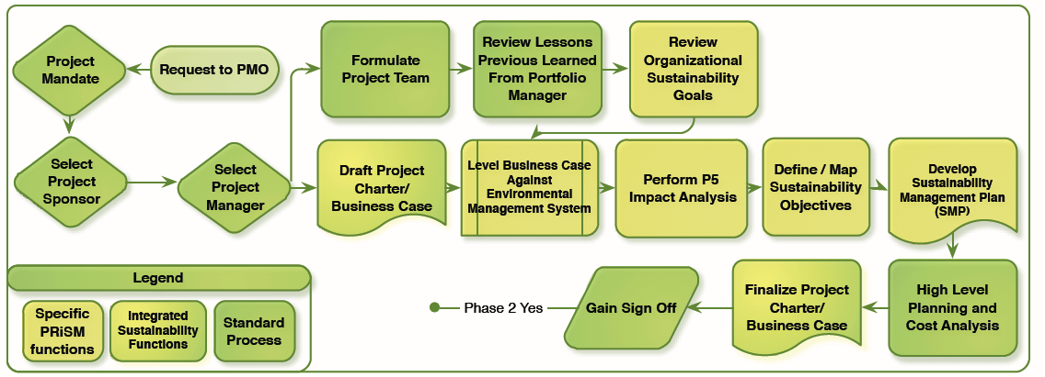
The PRiSM Pre Project/Initiation Phase
Review Organizational Sustainability Goals
Notes:
The initiation phase is one where the ideas are formulated and the business reviews whether this is a feasible project or element of a project to be included within the portfolio of projects that it is currently running. What you see here is an example of steps-to-take in an initiation phase for sustainability integration. I will go over them in detail.
The key deliverable within this phase is the Project Charter. the value of the sustainability elements are housed here. We are going to mainly focus on this phase today but will touch on all four.

Slide 127
Leveling against the EMS
Notes:
As a project manager, we recommend that when you review the project charter, always level it against the corporate EMS. Meaning, does the request align with corporate targets and objectives already in place? Don’t leave it up to the project sponsor or anyone who handles the charter before it touches your hands to do so.

Slide 128
Project Sustainability Impact Analysis
Notes:
Performing an Impact analysis begins with mapping your project deliverables up by each category.

Slide 129
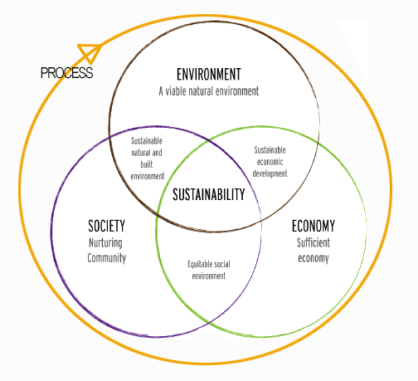
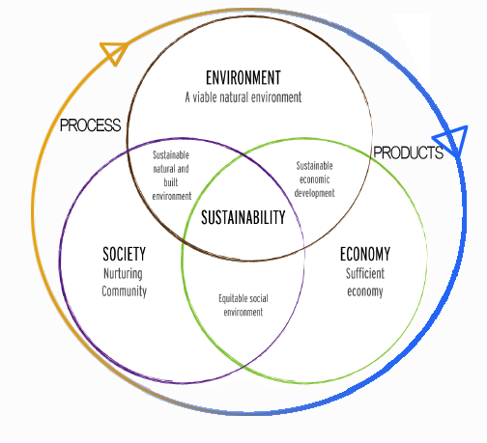
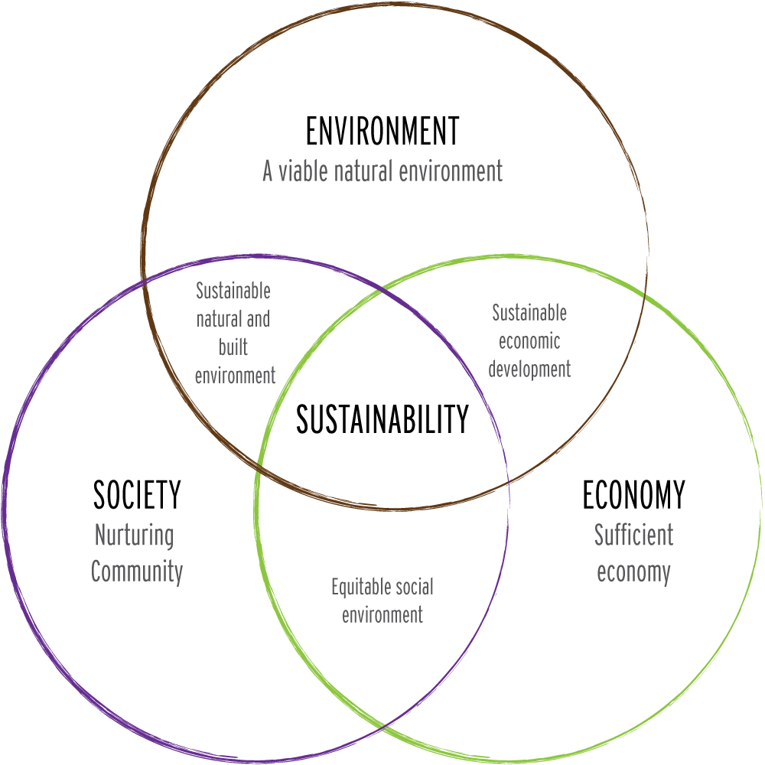
The Triple Bottom Line and Project Management
Notes:
The phrase “the triple bottom line” was first coined in 1994 by John Elkington, the founder of a British consultancy called SustainAbility. His argument was that companies should be preparing three different (and quite separate) bottom lines. One is the traditional measure of corporate profit—the “bottom line” of the profit and loss account. The second is the bottom line of a company's “people account”—a measure in some shape or form of how socially responsible an organization has been throughout its operations. The third is the bottom line of the company's “planet” account—a measure of how environmentally responsible it has been. The triple bottom line (TBL) thus consists of three Ps: profit, people and planet. It aims to measure the financial, social and environmental performance of the corporation over a period of time. Only a company that produces a TBL is taking account of the full cost involved in doing business.
THIS DOESN’T GEL VERY EASILY WITH PROJECT MANAGEMENT. THAT IS WHY GPM CREATED P5.

Slide 130
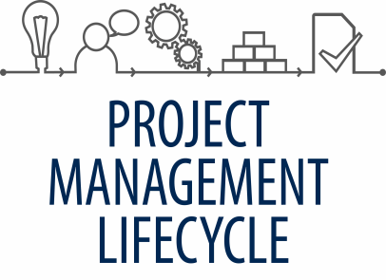

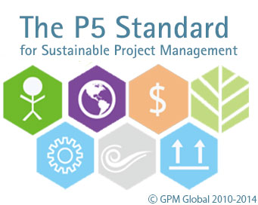



Introducing the P5 Standard
Notes:
P5 is the link between the UNGC, GRI, TBL, and PMLC

Slide 131
P5 Overview
Five measureable elements to sustainability
Each measured individually and through Mutual Possession
  Planet (Environmental aspect)
  People (Social aspect)
  Profit (Financial aspect)
  Process (Governance aspect)
  Product (Technical aspect)
Notes:
(Cue and read from slide… DETAILS to follow in upcoming slides)

Slide 132
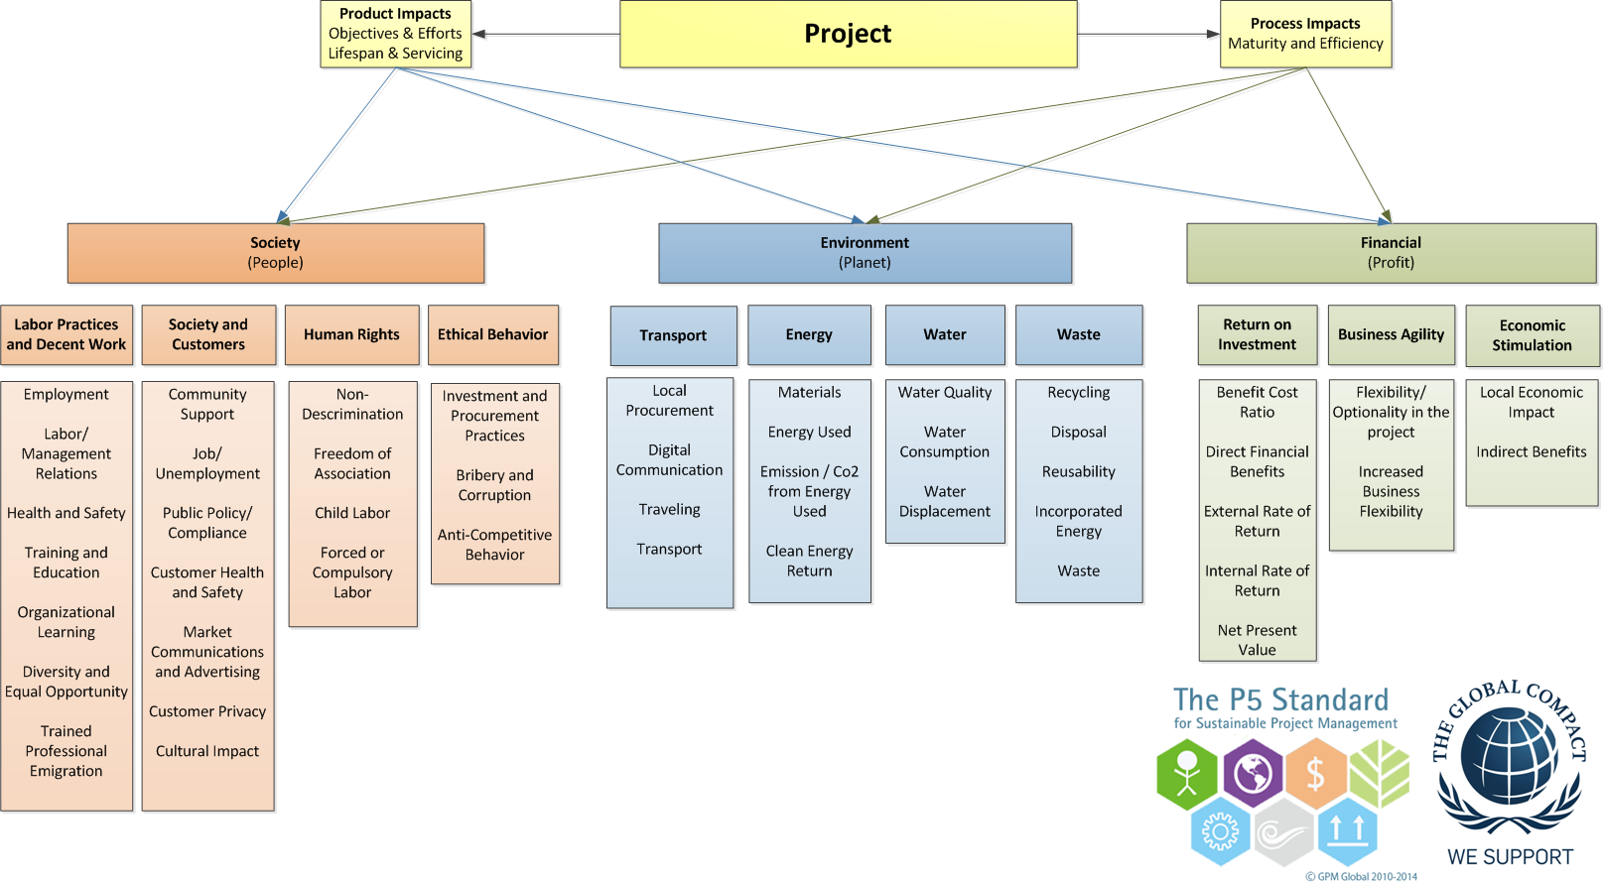
The P5 Chart
Notes:
This diagram shows how Process and product Impact the Categories, Sub-Categories, and Elements.

Slide 133

What is a product?
A "product" defined to be any tangible or intangible service, good(s), change, resource, business result or outcome undertaken by an organization using the project management processes as the method to create, update, expand, maintain and eventually dispose of the products, with the objective to use the "product" to provide future benefit to the organization. "
Products commonly follow four stages
Introduction – A product is introduced to the market
Growth – the product starts to grow in the market
Maturity – the product is established, sales increase and eventually stabilize
Decline – the stage where the product begins to decline and either the market for the product is no longer there.
Notes:
P5 looks at the product life cycle from a different perspective. The product’s impact from a social, environmental, and economic perspective during each of these phases should be accounted for in the product’s project from the time that the idea for the product is conceived until it is handed off in its final form.

Slide 134

What is a Project Process?
According to ISO 21500, A process is a set of interrelated activities. Processes used in projects are generally categorized into three major types:
Project management processes, which are specific to project management and determine how the activities selected for the project are managed;
Delivery processes, which are not unique to project management, which result in the specification and provision of a particular product, service or result, and which vary depending on the particular project deliverable;
Support processes, which are not unique to project management and which provide relevant and valuable support to product and project management processes in such disciplines as logistics, finance, accounting and safety.

Slide 135

P5 and the Social Bottom Line
Labor Practices and Decent Work
Employment
Labor Management Relations
Health and Safety
Training and Education
Organizational Learning
Diversity and Equal Opportunity
Trained Professional Emigration
Notes:
This sub-category covers project governance policies as they pertain to labor practices, the relationship to policy set forth in organizational strategy, and operations, its hiring and staffing policies and procedures, treatment of employees, and their well-being.

Slide 136
P5 and the Social Bottom Line
Society and Customers
Community Support
Public Policy/ Compliance
Customer Health and Safety
Products Labeling and Services Labeling
Market Communications and Advertising
Customer Privacy
Notes:
This sub-category covers the impacts of a portfolio, program, or project on the society in which the project’s product will impact the end users or customers that will make use of it.

Slide 137
P5 and the Social Bottom Line
Human Rights
Non Discrimination
Freedom of Association
Child Labor
Forced or Compulsory Behavior
Notes:
This sub-category covers project process and product impacts as they pertain to human rights.
Among the human rights issues included are non-discrimination, gender equality, freedom of association, collective bargaining, child labor, forced or compulsory labor.
The international legal framework for human rights is comprised of a body of law made up of treaties, conventions, declarations and other instruments. The corner stone of human rights is the United Nations (UN) International Bill of Rights, which is formed by three instruments:
• United Nations (UN) Declaration, ‘Universal Declaration of Human Rights’, 1948
• United Nations (UN) Convention, ‘International Covenant on Civil and Political Rights’, 1966
• United Nations (UN) Convention, ‘International Covenant on Economic, Social, and Cultural Rights’, 1966
These are the first reference points for any organization reporting on human rights.

Slide 138
P5 and the Social Bottom Line
Ethical Behavior
Investment and Procurement Practices
Bribery and Corruption
Anti-Competitive Behavior
Notes:
This sub-category covers project process and product impacts as they pertain to ethical behavior and focuses on three areas: Investment and Procurement, Bribery and Corruption, and Anti-Competition.
Each element in this sub-category extends beyond a behavioral competence to organizational culture in how conscious leadership and higher purpose are cornerstones to successful projects and ultimately stronger business.

Slide 139

P5 and the Environmental Bottom Line
Transport
Local Procurement
Digital Communication
Traveling
Notes:
The environmental aspect of sustainability concerns portfolio, program, or project’s impact on living and non-living natural systems, including land, air, water and ecosystems.

Slide 140
P5 and the Environmental Bottom Line
Energy
Energy Used (Consumed)
Emission / Co2
Clean Energy Return
Notes:
This sub-category covers project process and product impacts as they pertain to energy resources and focuses on three primary areas: Energy used, Emissions/Co2, and Clean Energy Return.

Slide 141
P5 and the Environmental Bottom Line
Water
Water Quality
Water Quantity
Water Consumption
Water Displacement
Notes:
This sub-category covers project process and product impacts as they pertain to water resources and focuses on three primary areas: Water Quality, Water Consumption, and Water Displacement.

Slide 142
P5 and the Environmental Bottom Line
Waste
Recycling
Disposal
Reusability
Incorporated Energy
Waste
Notes:
This sub-category covers project process and product impacts as they pertain to waste that during the extraction of raw materials, the processing of raw materials into intermediate and final products, the consumption of final products and focuses on five primary areas: Recycling, Water Disposal, Reusability, Incorporated Energy, and Waste.

Slide 143

P5 and the Financial Bottom Line
Return on Investment
Direct Financial Benefits
Benefit Cost Ratio
External Rate of Return
Internal Rate of Return
Net Present Value
Notes:
This sub-category covers project process and product impacts as they pertain to waste that during the extraction of raw materials, the processing of raw materials into intermediate and final products, the consumption of final products and focuses on five primary areas: Recycling, Water Disposal, Reusability, Incorporated Energy, and Waste.

Slide 144
P5 and the Financial Bottom Line
Business Agility
Flexibility / Optionality in the Project
Increased Business Flexibility
Economic Stimulation
Local Economic Impact
Indirect Benefits
Notes:
This sub-category covers project process and product impacts as they pertain to waste that during the extraction of raw materials, the processing of raw materials into intermediate and final products, the consumption of final products and focuses on five primary areas: Recycling, Water Disposal, Reusability, Incorporated Energy, and Waste.

Slide 145
How to Perform the Analysis
There are several ways to perform a P5 impact analysis. Developing a risk register using each element, as a category is the simplest.
The most effective way is to use a scoring system.

Slide 146
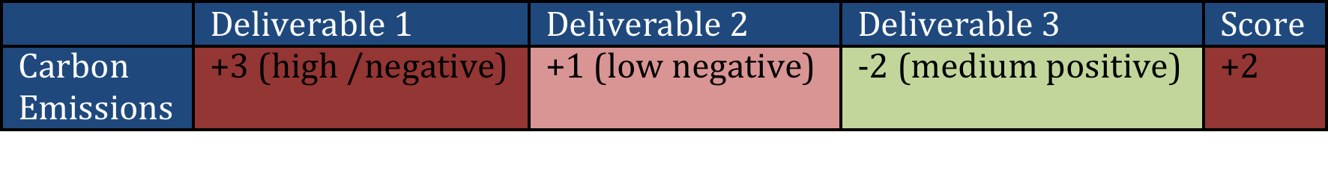
Example
When using a scoring system, each product deliverable and project process will be scored against each element of P5 based on a positive/neutral/negative scale ranging from a neutral (o) high (+ or -3) , medium (+ or -2) , and low (+ or -3).
This method is a simplified Analytic Hierarchy Process, one of the most popular analytical techniques for complex decision-making problems. Note: An AHP hierarchy can have as many levels as needed to fully characterize a particular decision situation.

Slide 147


P5 Scoring
Notes:
When we designed the P5 measurement scale in 2012, we wanted to take a high-medium-low approach but wanted to be able to account for a pendulum swing towards the positive by reducing or eliminating social and environmental impacts while creating value and benefit.
The simple approach would have been to set a scale from 1 to 7.
7- Highest (Problem Area/ Risk)
6 - Medium
5 – Low
4 – Neutral - 0 Impact
3 - Low
2 – Medium
1 – High (Value Creating/ Benefit)
We decided to keep the high-medium-low scale but instead score it from -3 to +3
+3- Highest (Problem Area/ Risk)
+2 - Medium
+1 – Low
0 – Neutral - 0 Impact
-1 - Low
-2 – Medium
-3 – High (Value Creating/ Benefit)
Low Beneficial Impact
Medium Beneficial Impact
High Beneficial Impact
High Harmful Impact
Medium harmful Impact
Low Beneficial Impact
Scoring each risk from +/- allows for the use of (0) as a neutral point and would allow averages to be calculated more accurately. When there was a measurement that was either neutral or non applicable it would be be excluded and greater weight then could be added to the measurable elements. The whole goal of a P5 Analysis is to determine what needs to be managed, the severity, and how to prioritize
A high number indicates that there is a risk. A negative number indicates that there is value being delivered from an environmental or societal context. This picture gives a graphical representation.
Another way to view it would be to look at an actual impact. The second image shows what an impact could look like.
Because sustainability risk mitigation when it comes to products have largely to do with reducing, the goal is to eliminate and at minimum get to zero. Anything more, is creating value at a deeper level.
To learn more about how to score sustainability using P5, check out a PRiSM, SP2 or SAPM course.

Slide 148
Why do this?
The P5 impact analysis will provide key insight on where the problem areas are from a sustainability perspective.
Once the analysis is completed, the items that pose a risk (anything with a + score) should be sectioned off and reviewed, and mapped to into a Sustainability Management Plan (SMP)

Slide 149





A lot of good info…
Notes:
Calculating sustainability on a project is critical.

Slide 150
Compared with the GRI and UNGC

Slide 151

Group Exercise
Learning How to use P5
You are a project manager for ABC Beverage Company who just
Came up with a new idea “bottled water”.
With your project management hat on, what are some examples of projects that would be associated with bottled water?

Slide 152


Class Exercise. Learning How to use P5
Notes:
The number of projects that surround a simple consumer beverage range in the hundreds. We are going to take a
Step 1.
Determine how many P5 Elements could be measured from what is shared in this video. (Circle on your worksheet).
Exercise 2.
In groups of four, assign a score to each element. For positive impacts score High Medium Low (3,2,1) For Negative Impacts Score High Medium Low (-3.-2.-1) Add up the total score.

Slide 153
Define Sustainability Objectives
Notes:
The next step is to define sustainability objectives.
Although, there may be some already in the charter, it is important to take what your findings from your impact analysis and what you have identified from the EMS and also what you may have learned from a CSR officer or from your company’s and outline some high level objectives. How are you going to address the impacts? Think of the deming model, Plan Do Check Act, this would be plan step to establish output expectations.
The outcomes from your P5 Impact analysis should result in sustainability objectives. If you have many +2s or +3s they should be documented and planned for in your SMP.

Slide 154
What is an SMP?
Notes:
Green Project Management® or Sustainability in Project Management in short addresses the impact of a project on the environment. There have been several theories identified over the past several years but none that can be adopted as repeatable processes that provide governance and deliver consistent results.
In order for green project management to take a permanent foothold a new set of activities that focus strictly on the sustainable aspects of an initiative through project governance is required.
The sustainability management plan (SMP) addresses these needs by determining how green the project delivery will be and how it aligns with organizational standards set forth in the environmental management system and or regulatory compliance standards document. The SMP is a true method to measure the impacts -long and short term- to organizational goals such as waste reduction, resource consumption, and energy efficiency.
The SMP is used to govern the benefits of the project and so therefore belongs either as part of or as an attachment to the business case. When it is accepted that the business case is the driving document of all projects, then it would be remised to believe that sustainability could exist without some sort of impact with the business case.
With the understanding that the business case must align itself with the strategy of the organization or company, then having a SMP and Environmental Management System in place ensures that the organization’s approach meets the strategy laid out within that. That is not to say that the business case has to ensure that it produces green projects each and every time, but that the elements or subjects within the business case also ask or investigate the five measureable aspects of sustainability to gain the full understanding, direction, costs and benefits available within this area for the organization.

Slide 155
Tools to Integrate Sustainability and Project Management
The SMP Ties corporate CSR goals and objectives to the project plan and identifies project impacts from an Environmental, Social, and Economic standpoint
Notes:
Sustainability in Project Management in short addresses the impact of a project on the environment. There have been several theories identified over the past several years but none that can be adopted as repeatable processes that provide governance and deliver consistent results.
The SMP uses a change management process to map sustainability objectives derived from the P5 impact analysis into a column table that outlines the P5 category (People, Planet, or Profit,) sub category, and element as well as the reason for the inclusion, the initial score, any legal or regulatory conflicts and a proposed action.

Slide 156



Is it because the Global Market doesn’t want it?
This snapshot of the BP website was taken in January. CSR is key to BP’s operations.
Three Clicks from Disney.com.
Must be important?

Slide 157




Oil and Water
The project to deploy the the Deepwater Horizon in the Gulf of Mexico did not include an SMP. (or a Risk Register…)
Notes:
Talk about the cost of not doing one.

Slide 158

What is a Sustainability Management Plan?
The sustainability management plan (SMP) provides the the framework to address impacts short and long term to sustainability objectives as they pertain to the project with an emphasis on Environmental, Social, and Economic impacts to
An SMP determines how green / sustainable the project delivery will be and how it will align with organizational strategy through governance
  An SMP outlines the processes to manage and mitigate a project’s negative socio-eco-environmental impact .

Slide 159
The Value of an SMP
Enhances the focus to the shared connections with the next projects in the queue
Highlight opportunities for external stakeholder communication identifying increased controls in process as well as social, environmental and economic impacts.
It reinforces that sustainability equates to profitability!

Slide 160
The Value of an SMP
As a project foundational document to promote visibility and governance
Establish the communication plan to broadcast the gains in management of finite resources and minimizing waste
Indicate and enhance focus to the shared connections with the next projects in the queue
Highlights opportunities for external stakeholder communication identifying increased controls in process as well as positive environmental impacts

Slide 161
Not Gold Plating, Consulting
1. Analyze situation and context.
2. Identify goals and (next-best) options.
4. Identify common ground and differences.
5. Diagnose the problem, identify solutions and/or take actions to circumvent the problem.
6. Resolve differences or agree on differences and the way to resolve them.
7. Consider consequences; document and communicate.
8. Apply learning to future projects or phases of the same project.
3. Listen to others’ arguments.
Notes:
Consultation is the competence to reason, to present solid arguments, to listen to the other point
of view, to negotiate and to find solutions. It is basically the exchange of opinions about project
issues. Based on respect, systematic and structured thinking, analysis of facts and arguments or
scenarios it leads to mutually accepted decisions. Consultation brings differences of opinion into
the open. It is useful in project role-play.
Reasoning makes it possible to change a person’s point of view, to be able to understand situations
in any discipline and to resolve issues with a high degree of certainty. It challenges solutions and
conclusions built on the basis of perception and prejudice.
Logical questions and solutions can be communicated more easily in the project organisation. They
should lead to more foreseeable and manageable results. Structures and logic underpin project management,
but can also make the process more difficult if they are applied too rigidly.
Possible process steps:

Slide 162

GPM Best Practice
Most Project Management courses teach that the project sponsor is the one to provide the business case and develop the charter – GPM is no different
Make sustainability part of the business case to gain acceptance sooner
Demonstrate clearly and precisely what benefits can be achieved in a sustainable environment or using sustainable methods
Notes:
Often times a business case for a project has to compete with others in terms of acceptance or prioritization, the sponsor will gather input from project management to ensure the business case can be translated to a formidable project.
What are some ways to assist in getting the project prioritized?
Determine if the outcome will benefit other parts of the company.
Determine what waste can be eliminated and help the company reduce resource dependency.
Determine if this project can be aligned with another project that is being developed.
(Create BP for major topics)

Slide 163

What is included in an SMP
Table of Contents
Document Control
  Version History and recipients list
Purpose
  A brief on what the document is
Executive Summary or Brief
  An outline of the sustainability factors in the project
List Project Sustainability Objectives
  Derived from the P5 Impact Analysis
Outline Key Measures and Performance Indicators (Qualitative and Quantitative)
The P5 Impact Assessment Score (and updates)
Scope Exclusions
Sustainability Reviews and Reporting
Checklist

Slide 164
What is included in an SMP
Table of Contents
Document Control
  Version History and recipients list
Purpose
  A brief on what the document is
Executive Summary or Brief
  An outline of the sustainability factors in the project
List Project Sustainability Objectives
  Derived from the P5 Impact Analysis
Outline Key Measures and Performance Indicators (Qualitative and Quantitative)
The P5 Impact Assessment Score (and updates)
Scope Exclusions
Sustainability Reviews and Reporting
Checklist

Slide 165
Version Control and Distribution

Slide 166
Purpose
Example
This document has the purpose to develop the Sustainability Management Plan for the Code Enforcement Agency Project.
This Project fits strategically upon the Aims & Priorities of the Detroit City Council in particular, but also of the Federal Security Agency, USA. with regards to their policies and guidance on environmental and sustainability governance.
This document details activities, objectives and key performance Indicators taken into account to establish, implement and maintain a new code enforcement that will resolve the problems detected, but also increase the prestige of the city, which will be recognize as one of “Greenest City” of the United States.
The renewed prestige of Detroit will impact positively in the local and international tourism with an increase of 40%, with at least of 15% increase of Geographic Gross Product and 5% increase of Total Gross Product in 5 years according to Statistics Agency XYZ.

Slide 167
Executive Summary
What is the project trying to achieve from a high level and how does it affect
The planet
Society
Corporate bottom line

Slide 168
Project Sustainability Objectives
Sustainability objectives are taken from the P5 analysis. Anything that needs to be improved upon is included.

Slide 169
Key Performance Measures
(Qualitative and Quantitative)
Example:
Key Performance Indicators Environmental
Energy: Number of green Buildings in the city
Waste: Amount of dangerous waste treated
Transport: Number of electric public transport
Water Usage: Amount of building with water recycled system
Materials and Resources: amount of promotional benefits to acquire local materials and their impacts in the local industries. ie. Construction
Key Performance Indicators Financial
Return on Investment: ROI
Business Agility: number of days to resolve upcoming squatting, weeds, pests, unsafe buildings, graffiti
Key Performance Indicators Products
Servicing of Product: Satisfaction Survey Results (surveys carried out be independent agency)
Lifespan of Product: The Enforcement Agency should have 60% Community Satisfaction
Key Performance Indicators Processes
Maturity of process: Maturity of the EMS: Plan-Do-check-Act
Maturity Efficiency and fairness of process: number of corrective actions and its financial impact
Key Performance Indicators Personal
Labour Practices and Decent Work: Number of labor accidents and amount of money incurred
Society and Customers: Number of children received training course regarding Sustainability.
Ethical Behaviour: implement “Sustainability Awards” at school, restaurants, event organizer, etc.

Slide 170

P5 Impact Assessment
A summary of the planned environmental impact and steps that will be taken to decrease the effects or increase the opportunities identified

Slide 171
The final pieces
Scope Exclusions
None.
Sustainability Risk Management
For the Sustainability Risk Management the agency will apply the PMBOK® Guide. The Sustainability Risk Plan should include the above environmental aspects and impacts and the response for each of one.
Reviews and Reporting
The Enforcement Agency members monthly will review and make a Sustainability Report that will be published at website of Enforcement Agency; and maintain periodically meeting with representatives of local community groups, and State and local officials.
Current Sustainability (P5) Score
+2.03
Checklist
The Following Assessments are considered in this Sustainability Management Plan:
Financial Assessment
Process Assessment
Product Assessment
Environmental Assessment
Social and Corporate Assessment

Slide 172

Where does the SMP Interface with the Project?
Source ISO 21500 Pg.12

Slide 173
Where Sustainability Exists
Needs to
Notes:
This is the project

Slide 174

Exercise 2
Learning how to use an SMP
Notes:
Refer to Mini Envex In the dropbox folder

Slide 175
Brief
We have been hired in to save Awesome Cookies Inc.
Awesome Cookies Inc. has no project management standards or methodology. The average staff person however has been employed within the company for 15 years. Their CEO recently was caught in a scandal and they have been listed as one of the most wasteful companies in terms of production and distribution and sales are declining.
Core Problems:
Unless their core product, “The Ultimate Choco-Cookie” can be redeveloped from the ground up to become a more sustainable product, they may have to close operations
It is rumoured that ingredients in the cookies are not accurately reported on the labels and blogs and YouTube videos have popped up with consumers complaining.
Distribution has been difficult, as the taxes in Athens have skyrocketed due to the economic challenges in Greece.
Their CEO passed away unexpectedly and so the executive board has hired our management-consulting firm to guide them towards a new and brighter future.
As the future of their brand and company rests in our hands, we are to recommend a project-based strategy to turn this company around:

Slide 176
Our Tasks
Recommend Four Projects to turn this company around.
Develop a high level statement of work for each project.
Use P5 to measure Impact based on what we already know about their products and supply chain and recommend changes through the development of an SMP.

Slide 177
Reorganization
Develop the Cookie
Market
Distribution

Slide 178

Day One Review
Basics of Sustainability
Sustainability in Project management
ISO 9000
ISO 14000
ISO 50001
The Pre-Project Phase

Slide 179

EnVex #1

Slide 180
Responses from other Students
“
Having completed the various exercises for building the “Data Centre of the Future” it has certainly brought home the fact that with “Sustainability glasses” on you can pretty much evaluate every aspect of every project in a different light. A key lesson has been that, whilst a product might seem more sustainable or “green”, there are loads more elements in the overall chain to be considered i.e sometimes the process by which that product was manufactured or transported has a far more detrimental impact on the environment than perhaps an alternative product.
I’ve realized that there are a lot more sustainable products available than I initially thought. Hopefully, in time, there will be more choice in this space.
Sustainability today is our future tomorrow!
Riana Husselman, IP Project Manager BBC London
“

Slide 181

The Planning Phase
Notes:
The planning phase is the moment when the project starts to come to life. Here the project manager needs to gain a real understanding of what the client or organization is looking to achieve so that they can plot the best way to deliver the project, its main deliverables and the planned benefits in the most sensible and safest manner to benefit all parties involved.

Slide 182
Why Plan?
Life Cycle
Purpose
Plans
Content
Levels
Notes:
Project management can be said to comprise of two elements, planning and control. In the first, we decide what we intend to do and how we intend to do it, whilst in the second, we actually carry this out.
Planning is the foundation of control. Without any plans we have nothing to control and no targets to aim for.
Because planning is such a major and fundamental part of project management there are numerous opinions about how it should be structured and performed. Unfortunately, the terminology that surrounds the subject varies from one source to another.
As a basic guide, you can always take solace from a little poetry.
In the immortal words of Rudyard Kipling:
“I have six faithful serving men
They taught me all I knew
Their names are What and Where and When
And Why and How and Who”
Plans are the project manager’s ‘faithful serving men’. They explain the what, where, when, why, how and who of the project.
Plans are statements of intent, they define what the project is intended to achieve and how we intend to achieve it. That simple statement means that they have to cover a great deal of information. However, remember a plan is exactly that at a Project Manager should be prepared and flexible enough to change and update it as the project progresses.

Slide 183
Project Plan Document
Owner/Author
  Project Manager
Authority
  Project Sponsor
Audience
  Project Team, Stakeholders and interested parties
Development
  Ongoing throughout the whole project lifecycle keeping it ‘live’ to all changes
  Includes the Sustainability objectives from the SMP
Notes:
So if you know what is in the Project Management Plan, then who needs it for what reasons?
Owner/Author
The owner of the Project Management Plan is the Project Manager. In addition he is responsible for writing and updating the plan as the project matures and becomes subject to changes.
Authority
The role of authority of the Project Management Plan falls to the Project Sponsor. He approves it initially in the Definition Phase but then reviews it and approves it against any changes or at Phase or Stage reviews.
Audience
The Project Management Plan should be available for reading and reviewing by all members of the Project Team, all internal and external Stakeholders and in addition any interested parties that are cleared to read this information. Dependant upon the type of the project, the material that is placed inside the plan may need to have a restricted access policy.
Monitor and control
How achievement of benefits is to be measured, managed and monitored.
Development
The Project Management Plan cannot have a defined list of personnel that help develop it. It is important that the Project Management Plan includes all the team members and specialist knowledge that is available to the Project Manager as this will not only mean that the project will not only be developed with the best opportunity of success but also the document will be used as a bond for the team to feel part of the team and to give them all the direction needed to deliver the project objectives most effectively.

Slide 184
Project Plan Purpose and Contents
Taken from the business case/charter
Why?
Location
Why
Deliverables
Acceptance Criteria
Success Criteria
Key Performance Indicators
Scope of Work
Where?
What?
Key Areas
& Considerations
Timescales
Milestones
Phasing
When?
How?
Project Strategy
Work Breakdown
Structure
Handover
Tools/Techniques
Control & Reporting
Specific plans
Who
Roles and Responsibilities
Resource Plan
How much
Budget
Cost Management
Process
Notes:
The Project Management Plan provides a baseline description of how the project will be managed. It is periodically reviewed and updated through change control. The PMP will be the baseline document upon which changes are considered.
It can easily be defined with its contents by the words why, what, how, how much, who, when and where. When preparing a PMP the Project Manager should be always asking these questions and in that given order.
Key points:
describes policies for managing changes, communication, configuration, governance, health and safety, environmental issues, procurement, quality and risk
progressively developed during planning and is a live configuration controlled document

Slide 185
Defining the Scope
Stakeholder needs identification, analysis and prioritisation
Product Requirement Specification
product characteristics
  physical
  performance
Initial statement of requirements
acceptance criteria
Evaluate requirements against needs, benefits and project objectives against P5
Concept Phase
Definition Phase
Analyse and prioritize:
Value of benefit
Order of priority for requirements
Time to market
Best process of delivery
Notes:
The purpose of Define scope is to achieve clarity of the project scope including objectives,
deliverables, requirements, and boundaries by defining the end state of the project.
The definition of project scope makes clear what the project will contribute to the strategic goals of
the organization. The project scope statement should be used as the basis for future project
decisions, as well as for communicating the importance of the project and the benefits that should
be realized by performing the project successfully.

Slide 186
Acceptance Criteria
Defined as part of Requirements Gathering
Reviewed constantly but rigorously in the early phases
Agreed between the Customer and the Project Manager
Approval by Project Sponsor within Project Plan
Planned Process of Acceptance
Notes:
Acceptance Criteria
Acceptance Criteria are the requirements of the Customer by which the project’s delivery success will be gauged. They must be measureable and unambiguous. They are identified as early as possible by the Project Manager so that it will help with accuracy when planning work and estimating costs and schedules. The use of loose descriptions or phrases will inevitably lead to disputes over the interpretation of the product delivery at some stage during the project. Criteria must be achievable within the scope and budget of the project. They will be unique to the project.

Slide 187
Refining an SMP
Refine Sustainability Management Plan
Notes:
Green Project Management® or Sustainability in Project Management in short addresses the impact of a project on the environment. There have been several theories identified over the past several years but none that can be adopted as repeatable processes that provide governance and deliver consistent results.
In order for green project management to take a permanent foothold a new set of activities that focus strictly on the sustainable aspects of an initiative through project governance is required.
The sustainability management plan (SMP) addresses these needs by determining how green the project delivery will be and how it aligns with organizational standards set forth in the environmental management system and or regulatory compliance standards document. The SMP is a true method to measure the impacts -long and short term- to organizational goals such as waste reduction, resource consumption, and energy efficiency.
The SMP is used to govern the benefits of the project and so therefore belongs either as part of or as an attachment to the business case. When it is accepted that the business case is the driving document of all projects, then it would be remised to believe that sustainability could exist without some sort of impact with the business case.
With the understanding that the business case must align itself with the strategy of the organization or company, then having a SMP and Environmental Management System in place ensures that the organization’s approach meets the strategy laid out within that. That is not to say that the business case has to ensure that it produces green projects each and every time, but that the elements or subjects within the business case also ask or investigate the five measureable aspects of sustainability to gain the full understanding, direction, costs and benefits available within this area for the organization.

Slide 188

Refining the SMP
The Refinement of the SMP should include:
  Scope Changes
  Sustainability Quality Components
  Changes to the P5 Score +/-
  Sustainability Risks Identified

Slide 189
Quick Review: The Principles of Quality Management
These principles embodied in ISO 9001 have been developed with the intention that management can lead the organization towards improved performance.
Customer Focus
leadership
Involvement of people
Process Approach
System approach to management
Continuous Improvement
Factual approach to decision making
Mutually beneficial supplier

Slide 190
Product Breakdown
Completed
Garden
Beds
Patio Area
Lawn
Barbeque
Patio
Notes:
The Product Breakdown Structure (PBS) is a hierarchical breakdown of the products that are to be produced by the project. Typically the final solution for the project is shown at the highest level, with major products that make up that solution shown at the next highest level. The components of each product (or sub products) will typically be shown at lower levels. The higher levels are used to support development of the Work Breakdown Structure, asking what needs to be done to complete each product. Products are easily identified on a breakdown structure, as they are nouns or naming words. The PBS also used in the identification of the items to be used in configuration management and on change impact assessments.
The PBS provides a high level view of the key products and is useful for the project stakeholders who are more likely to be focused on products than the work to be accomplished.

Slide 191
Work Breakdown
Completed
Garden
Derived from Product Breakdown Structure
Beds
Patio Area
Lawn
Barbeque
Patio
Work Packages at lowest level of any branch
Lay Foundations
Lay Slabs
Notes:
The Work Breakdown Structure provides a hierarchical structure showing the tasks to be undertaken in a project. The preferred and most common form is based on the breakdown of products as shown above. Once this has been done, task decomposition breaks the products into manageable units of work. The decomposition is continued until an appropriate level is reached. This level is decided by the Project Manager dependant upon the team he has and the experience they have. This will allow him to decide what level of control he will need to take and therefore the depth of detail in which the WBS must be taken. Elements at the lowest level in any branch are called the work packages. The elements are easily recognised by the use of verbs (action words) to describe them, rather than the nouns found in a PBS.
The WBS should enable members of the project team to define their tasks to a meaningful level of detail.
The main benefits of the WBS are as follows:
enables breakdown of work into easily definable and manageable units (chunks) of work
provides a structure for defining the statement of work at each level including, requirements, budgets, deliverables.
helps to define relationships with the organization and cost management systems
provides a framework for communicating throughout the project including performance reporting and escalation of issues
enables assignment of single point accountability and supports allocation of resources
supports risk identification and assessment showing relationships between tasks

Slide 192
Numbering System
1.0
Level One
1.1
1.2
1.3
Level Two
1.3.1
1.3.2
Level Three
1.3.1.1
1.3.1.2
Level Four
Notes:
It is important to provide a unique numbering system to ensure that each element of the product or work breakdown structure can be referenced. The system should maintain the hierarchical relationship, as shown above.
Considerations that may need to be taken into account when deciding the level of breakdown are:
Single point accountability – when one person can be assigned to manage an appropriate manageable level of work, and that no one person controls too many work packages.
Clear definition of work – when work has been defined in clear terms of deliverables, objectives and critical success criteria.
Performance Measurement – when the same methods of performance measurement can be used for activities within a work package (particularly important for earned value management).
Cost – that cost can be allocated to the work package. This may depend on the level and type of cost involved, for example sub contract work, high cost materials.
Criticality or risk – where critical and risky activities may need greater visibility, further decomposition may be appropriate and advantageous.
External contracting - the possibility of controlling external work through contracts can reduce the need for detailed breakdown. In this way areas of the PBS/WBS can be ‘blocked off’ and allocated to the contractor for their own structure to be developed.

Slide 193
Organization Breakdown
Project Manager
Team Leader
Team Leader
Section
Leader
Team Members
Notes:
One structure derived from the WBS is the Organization Breakdown Structure. This is regularly seen as an Organization Chart in most industries, as shown above. It shows the roles and titles of the team members (related to the work they are managing), their span of control and the approved reporting structure.
The project OBS is used with the WBS to form the Responsibility Assignment Matrix.
To produce the Organization Breakdown Structure, the work breakdown and tasks are analysed. Typically, team leaders or co-ordination roles are assigned to individuals in order to manage groups of tasks. The criteria used to decide on management levels for groups may be:
size and nature of the tasks
complexity in terms of interdependencies
criticality and risks
The Project OBS identifies key decision making authorities and ownership of work areas. It therefore supports communications, performance monitoring, control, and reporting.

Slide 194
Responsibility Matrix
Organization Structure
Project Manager
Product or Work Breakdown Structure
Team Manager
Team Manager
1
Jane
Sam
Joe
Mary
Dave
Contractor
1.1
1.1.1
R
A
C
I
1.1.2
R
A
C
I
1.1.3
I
R
C
A
Products or Work Packages
R – Responsible A -Accountable
C - Consult I - Inform
Notes:
The Responsibility Assignment Matrix is used to define the accountability, role and responsibility of each team member. It is developed by combining the WBS (or PBS) and the OBS.
The completed matrix shows who is accountable, who is responsible for performing the work, who is responsible for product delivery, who else may be involved and their particular role and contribution.
When completing a RAM, one very important rule is that if the highest level you have set in the matrix is ‘Responsible’, only one person can be allocated this for each line.

Slide 195
Cost Breakdown
Company Cost Accounting System
Accounts
Project Work Breakdown Structure
Labor
Purchases
Mgmt.
Design
Manf.
Material
Contract
Expense
1
1.1
1.1.1
1.25k
0.25k
3.25k
1.1.2
1.15k
5.00k
2.75k
1.1.3
0.25k
0.25k
Other Areas
Work Packages
Notes:
Another useful breakdown that can be derived from the WBS is the Cost Breakdown Structure (CBS). It important that costs for each work package are broken into elements since different types require different monitoring and control processes. For example, in-house labour may be controlled through time sheets, materials through purchase orders and contracts used to control sub-contracted work. Some cost categories will need to be isolated if earned value is to be used for cost control.
The Cost Breakdown Structure is derived from the company system of allocating costs and the WBS. Typically, budgets (estimates) for each work package are broken down into cost elements corresponding to the company system of accounts. Actual costs charged to each work package are detailed at cost element level. This enables work package managers to compare actual costs with baseline work package budgets to pinpoint variances and problem areas, allowing them to take any corrective action.

Slide 196
GPM Best Practice
Separate off the Sustainable objectives to be integrated into the project plan
Develop your own PBS and WBS
Identify what work is needed
Assign responsibility for the tasks
Integrate your PBS/WBS with the Project Manager
Align the needs and the deliverables

Slide 197
Estimating Accuracy
Level of Uncertainty
Estimating Accuracy
Need
Produce
Use
Idea
Quick
Look
Detailed
Look
Do It
Finish
off
Notes:
Estimates in projects are quantified assessments of resources and time required to complete part or all of a project. They are used to support Investment Appraisal and support project Go/No Go decisions. They are also used throughout the project to support performance assessments and predictions.
Estimating accuracy will vary through the project lifecycle depending on the level of uncertainty and the quality and availability of information. Generally, information during the concept stage is likely to include only high level designs and strategies, consequently its accuracy is likely to be in a ‘rough order of magnitude’ due to the uncertainties and lack of defined information. As more data becomes available during definition, estimating accuracy should be sufficient for the approval of the business case. Accuracy will continue to improve at the beginning of implementation as detailed designs, scope of work and detailed plans are produced. This is necessary to control cost, time and performance during implementation since unreliable estimates could cause management problems and reduce team morale. Estimating accuracy should improve throughout implementation sub stages as more details and results of work are defined and recorded. At the end of each sub stage, information and lessons learned will help to improve estimating accuracy by the use of these actual costs and tasks being completed.
The reliability of estimates is likely to influence decisions to continue or terminate the project at the end of each project stage and sub stage.
Remember, cost and time always remains an estimate up until the final day of the project when it is closed. At no time should a Project Manager guarantee what their costs or timescales are going to be.

Slide 198

Resource management
The ability to manage finite resources is a critical skill

Slide 199
Types of Resources
Consumable
  Raw materials
  Money
  Natural Resources
Non Consumable
  Machines
  Facilities
  Test equipment
  People
Notes:
There are two main types of resource, those that can be consumed during work and those that can reused and are non-consumable. For example, the fuel that goes into a car is a consumable while the car is re-usable.
Remember, the most valuable resource that you will ever have is your people, so ensure you lead them and care for them well as they are the most re-useable assets that any Project Manager will ever have.

Slide 200

Resourcing Process
The three basic steps:
Allocation - once activities been scheduled resources are allocated to each activity. This enables the total requirements to be determined against the project timescale.
Aggregation – resource requirements are totalled to determine the level of resources required for each time period.
Scheduling – it is unlikely that the availability of resource requirements will map to the requirements (or demand). Such constraints are applied to the resource requirements and an optimized schedule is determined.
Notes:
A resource is anything required to complete the work of an activity. It could be people, equipment or materials. Resource management ensures that the right resources have been identified and made available as an when necessary.
The sequence of steps during the resource process is as follows:
Allocation - once activities have been scheduled resources are allocated to each activity. This enables the total requirements to be determined against the project timescale.
Aggregation – resource requirements are totalled to determine the level of resources required for each timescale period. This is typically shown as a histogram.
Scheduling – it is unlikely that the availability of resource requirements will fit exactly into the requirements (or demand). Such constraints are applied to the resource requirements and an optimised schedule is determined. This may require activities to be delayed, extended and perhaps de-scoped.

Slide 201
Resource Management
Effective resource management ensures:
  Efficient utilization of resources
  Confidence that the schedule is realistic in terms of the required and available resources
  Early identification of resource capacity bottlenecks and conflicts.
Notes:
The effective application of Resource Management by the Project Manager increases the opportunity for the project to:
Be more efficient in the utilisation of resources, this is vitally important when the resource is specialised or scarce.
Have greater confidence that the schedule is more realistic in what is really required and how it fits in terms of the resources available.
Have early indication of any resource bottlenecks or conflicts that will need managing.

Slide 202
GPM Best Practice
Work with the Project Manager to schedule your activities
Compliment the Project Delivery with a Supporting Role
Keep a tight control over resourcing matters to avoid scope drift
Cost and Monitor each resource for further lessons in the future to ensure audit ability

Slide 203

Quality
Ensuring the best outcomes

Slide 204
Constraints
Time
PERFORMANCE
Cost
Scope
Notes:
There is a common link to all constraints within project management.
The three major constraints that are placed upon a project are time, cost, and performance or quality. These constraints and how they are approached determine not only if the objectives are met but to what degree of success they will be. The understanding of these limitations early is crucial to assisting with project success.
Dr. Martin Barnes, Past President of the Association for Project Management (APM), stated in a keynote at the second-day plenary session of the 26th IPMA World Congress on October 30th titled “We can and should raise the standards”. [20]
Dr. Barnes’s keynote was very engaging and focused on how standards are more than processes. He shared that project management standards are frameworks for activities and provide benchmarks for performance. He shared the story behind the “iron triangle” which has been understood as time > cost > scope = quality
Dr. Barnes, the originator of the “iron triangle” (1972) asked everyone in the audience to replace quality with performance going forward as quality was not an appropriate component– performance would make a much better component as projects are so much more about the outcome.
He used a metaphor to make his point.
If a Surgeon contacts a patient after completing a procedure and explains that he accomplished a successful surgery even though it did not cure the patient’s illness. As it was on time, in scope, and in line with his fees, it was a quality procedure.
He further simplified his point saying that project success should be determined by the outcome matching the intent. “Does it work?
DISCUSSION POINTS:
How does sustainability affect the triple constraint?
(Additional discussion points…)

Slide 205
The Planning Phase
Define Sustainability Quality Components

Slide 206
What does Quality Mean?
Outputs and processes of the project meet the needs of stakeholders
  Fit for purpose
  Degree of conformance
Notes:
Key points:
the requirements for quality are defined in measureable terms as acceptance criteria.
outputs and processes can only be fit for purpose if the purpose is understood.
definition of requirements enables the project manager to trade off between scope, time, cost and quality.
Also from ISO 5001 on Quality Management (page 37)
Customer Focus
Leadership
Involvement of people
Process Approach
System approach to management
Continuous Improvement
Factual approach to decision making
Mutually beneficial supplier

Slide 207
Quality Responsibilities
Management responsible for creating an environment for achieving project quality (organization & project)
Organization responsible for improving project processes – learning from experience (continuous improvement)
Quality covers products and management processes
Notes:
Management is responsible for creating an environment for quality for the project. This is shared by the organization and project (ISO 10006, Section 5, Quality in project management processes).
The objectives, responsibilities, processes and methods for achieving quality at an organizational level are typically defined in the organization’s Quality Management System. The Project Manager is responsible for creating and implementing a quality management system for the project. This is defined in a Project Quality Management Plan.
The Plan sets out specific quality practices, resources and the sequence of quality management activities required to achieve the project objectives. It will also refer to processes and requirements defined in the organization’s quality management system.

Slide 208
Quality Environment
Quality Planning
Quality Improvement
Quality Assurance
Quality Control
Notes:
The Quality Environment essentially covers four processes:
Quality Planning – defining standards, criteria to be achieved, appropriate actions to ensure the required quality is achieved. The Quality Plan provides guidance to project stakeholders on how quality management will be performed on the project. It includes a statement on stakeholder expectations, success criteria, standards applicable, how they will be applied and how quality will be assured through specific actions, e.g. auditing.
Quality Assurance – this involves pre-planned, regular reviews & independent audits to verify that work is being carried out consistently in accordance with defined procedures, and to provide confidence to stakeholders that the project will satisfy relevant quality requirements and standards.
Quality Control – the process of monitoring project results, evaluation to verify results are compliant with relevant standards and taking corrective action to eliminate causes or address unsatisfactory performance. Typically includes visual inspection, testing or trials to verify that the project deliverables conform to specification, that they are fit for purpose and meet stakeholder’s expectations.
Continuous improvement – continual systematic approaches to quality improvement such as TQM, ‘six sigma’, Kaizen. The focus is on specifying requirements tightly and meeting them as effectively and efficiently as possible. In order to measure success organizations use maturity models (e.g. the EFQM excellence model) which provide focus, motivation and mechanisms for objectively improving performance in every aspect of the business.

Slide 209
Quality Control Tools
Cause & effect
Pareto chart
Flowchart
Seven quality control tools
Run chart
Histogram
Scatter
Control chart
A P5 Matrix is a Control Chart
Notes:
Cause & Effect (Ishikawa) – is simply a graphical technique to help develop an understanding of how certain causes may lead to a particular effect.
Pareto – a type of histogram that orders the information in a particular way. This gives rise to the Pareto principle that 80% of the problems are the result of 20% of the causes. This enables us to direct problem solving where it will be most effective.
Run Chart – plots the history of a single variable. For example if a key performance criteria for a project was the variance between actual cost and budget cost, this variable could be plotted over time to track its variation and identify trends.
Control Chart – plots value for each of a number of outputs of the same process. It also sets tolerances for the values measured. This allows us to identify if the process is in or out of control. For example plotting the results of a test on each weld on the ship to ensure our welding process was within acceptable control limits.
Scatter – used where there are two variable and we want to see if there is a relationship between them. e.g. the strength of a number of cubes against recorded outside temperatures may show relationship between strength and temperature.
Histogram – plots frequency of variables. The height of the bar shows how often a particular result occurs and the number of bars indicates the range of results.
Flowchart – a graphical representation of a process showing activities and decision points. A flow chart is used to show how different parts of a system interrelate. It can help the project team identify where quality problems may occur or redesign a process to correct problems.

Slide 210
Cost of Quality
Prevention
Cost
Failure
Inspection /Appraisal
Year 1
Year 2
Year 3
Year 4
Year 5
Notes:
Whether it be technical excellence or customer satisfaction there must be some cost in achieving high standards.
The often heard slogan “quality is free” goes back to the book written by Crosby in the late seventies. The principle is that money invested in quality up front will produce a reduction in costs longer term.
Quality costs are broken down into the three following categories, prevention, failure and appraisal.
Prevention
These are the costs associated with any action designed to reduce the incidence of defects and failures. The correct training of an individual and the use of suitable and well maintained equipment helps with this.
Failure
This can be further broken down into internal failure and external failure. Internal failure costs are those of investigating the cause, wasted materials, repairs and rework. External failure costs relate for example to the damage to reputation, your customer relationships and liability costs.
Appraisal
This is also called inspection costs, these relate to the costs of sampling and testing products, checking specifications and supervising staff.

Slide 211
Sustainability and Quality Components
Notes:
Quality Management
In Quality Management, Project Managers utilize constraints that will deliver the intended result. Quality Management “involves determining quality policies, objectives, and responsibilities so that the project will satisfy the need for which it was undertaken”. In a simpler description, Quality Management is accountable for making sure that any work performed is done so correctly to first time to avoid rework and wasted energy or resource. ISO 14000 and EMS convergence points are contained within each process of the quality management knowledge area.
The Quality Planning activity defines the inputs and controls for quality assurance activities. The inputs from ISO 14000 and the EMS set the level of influence that the standards will have on defining "quality".
Quality standards will be used in the development of a baseline and as the basis for monitoring within the Quality Assurance and Quality Control processes. The EMS and PMIS systems will monitor thresholds set by the quality management plan and help in developing changes for the change management process.
Quality Management has a direct relationship with Green Project Management. Ensuring that the right standard or specification to a product or a piece of work is carried, first time all of the time, means that your wastage costs are minimized. Quality typical falls into three costs brackets; the first of these is the cost of prevention. Preventing failure or reducing the number of quality review failures means that by prior planning and a strong control regime, all project work is given greater confidence in its ability to be delivered to the needs of the client in the most cost efficient manner.
The second of the cost elements is that of quality appraisal, or the checking of the products or procedures as the project progresses through its full lifecycle. By ensuring the right checks are done by the right people when it is most beneficial to carry out the checks, means that the organization will keep strong supervision and accountancy for the delivery without having excess resource wasted. The third and final cost for quality is that of the cost of failure, both internally and externally. What is the cost to a company if it has products being returned or being subjected to enquiries? Cost of failure goes beyond the wasted material and the time needed for re-work, all the way to the cost of reputation and therefore future contracts and repeat work.

Slide 212

The Implementing and Controlling Phase
Notes:
Note that ISO 21500 Calls Implementing what the PMI PMBOK® Guide Calls Executing

Slide 213

Requirements management
You gave me what I asked for but not what I needed…

Slide 214
Requirements Life Cycle
Design Freeze
Baseline
Idea
Quick
Look
Detailed
Look
Do It
Finish
off
Get the
benefits
Requirements Capture and Testing
Configuration Management & Change Control
Requirements Reviews
Notes:
The existence of a product specification is essential at the commencement of the implementation stage. This may initially only define requirements such as physical features, performance aspects and key acceptance criteria. To ensure the development of the design will achieve the objectives and benefits a series of reviews are conducted. This enables the design to be compared to the requirements in order to identify and address any deviations or shortcomings. A requirements review may be conducted during design to check that designers understand and can achieve the stated requirements.
As the product design develops, further reviews are carried out to check that the design will meet the product requirements. At the end of development the design is reviewed prior to build. As the design develops further, acceptance criteria, plans and methods are fully defined. These, the designs and production readiness are typically reviewed prior to the release of the design to production. This will check that the test methods are appropriate and will ensure that the product is adequately tested in line with the requirements.
Tests and inspections are typically carried out during the acceptance stage to verify that the deliverable products meet the requirements. If satisfactory, the product is formally accepted and signed off.
Throughout the development, the requirements, product specification and associated documentation is controlled using a formal change control and configuration management process.
The requirements management process facilitates the opportunity to provide confidence to the Project Team and the Stakeholders during the life cycle that the product is more likely to achieve the project objectives and its proposed benefits.

Slide 215

The Swing
Notes:
In summary, effective Acceptance Criteria will be:
Defined as part of the Requirements Management Process
Reviewed constantly with the Customer but rigorously in the early phases to obtain the best description of the product with the greatest detail on its size, shape and performance capability
SMART (Specific, Measurable, Achievable, Realistic and Time bound)
Agreed between the Customer and the Project Manager then approved by the Project Sponsor
Inclusive of tolerances as to when and how the acceptance will take place
Process of acceptance when the product is ready for delivery, commonly found within the Handover Plan

Slide 216
The Implementing Phase
Update Documentation
Notes:
Note that ISO 21500 Calls Implementing what the PMI PMBOK® Guide Calls Executing

Slide 217

Status Reports
Project status reports are key to monitoring and controlling projects and should include at minimum:
The progress towards project milestones
Current issues and status
Current risks and how they are being addressed
A budget update
A P5 update
Notes:
Project status reports are key to monitoring and controlling projects and should include at minimum the progress towards project milestones, current issues and status, current risks and how they are being addressed, a budget update, and a P5 update. In support of a Log Frame Analysis the report provides key insight to the status on key elements of a project.
The P5 sustainability score that is derived during the initial analysis sets the baseline for the project. As the project life cycle continues, risk is introduced, scope changes, or issues arise, it is important to re-evaluate your analysis and the sustainability score.
Including the score in the project status report keeps stakeholders up to date and provides key insights for the organization to support overall sustainability reporting.
The status report should include a section that includes the following information

Slide 218

Risk Management
Keys to Sustainability are defining every possible risk to an initiative.

Slide 219

What is a Risk?
What is the definition of a risk?
Both positive and negative effects on project objectives
Threats and Opportunities
Notes:
Risks are present in all projects, whatever their size or complexity and whatever industry or business sector. Risks exist as a consequence of uncertainty. In project management terms, risks are those factors that may cause a failure to meet the project’s objectives.
“The exposure to a potential event that could impact adversely on business benefits or project critical success criteria.”
While risks are, according to the dictionary, associated with the possibility of failure, they may also be associated with opportunities. Risk management should balance the upside opportunities with downside risks, doing so in an open, clear and formal manner. A wider definition of risk is therefore:
“Combination of the probability or frequency of the occurrence of a defined threat or opportunity and the magnitude of the consequences of that occurrence”
The definition indicates a relationship between risks and opportunities. Both factors are possible future events and therefore have degrees of uncertainty.

Slide 220
Levels of Risk
Strategic
Program
Project
Operational
Notes:
Risk occurs at every level and in all aspects of any organization.
Risks from one level can affect other levels and it can be difficult to identify precisely at what level a risk should be managed. The reason for allocating different levels of risk is to clearly assign who is best placed to take responsibility for its management.
Strategic
All companies face risks to their business strategy. This can range from currency fluctuations to threat or opportunity of takeovers. Risks of this level are typically handled by the Board of Directors.
Program
Major changes that are required to realise the business strategy are often achieved through the management of many diverse projects as a program. Risks that occur at this level can be due to factors such as the interdependencies of component projects, resource conflicts or project priorities. These risks are managed by the Program Management Team.
Project
Risks at this level are threats to the achievement of the objectives agreed for time, cost and quality. These may well arise from threats or opportunities at another level, but must be placed at this level so that they can be managed by the Project Management Team.
Operational
Day to day activities have their own risks such a Health and Safety or Industrial relations. The whole emphasis of projects and programs is to bring about change and so this may introduce new or eliminate existing risks from the work place. The operational readiness to change will affect the project or program risks. Pure operational risk must be managed by the operational managers but they should always be working closely with the relevant project and program management teams.

Slide 221
Sustainability in Risk Management
Notes:
Risk Management
In the Risk Management knowledge area, a Project Manager will identify any and all possible risks to the project and establish an effective method to address them. Risk Management involves “planning, identification, analysis, responses, monitoring and control”. In other words, it is the Project Manager’s responsibility to address the possible detractors, identify the causes and situations of the risk, analyze the hurt or impact it will create should it occur and then develop work around to protect the project in the best manner. The convergence point for ISO 14000 and EMS within risk management fall under the Risk
Management Planning, Risk Identification, and Risk Monitoring and Control process areas.
The objective of the Risk Management Planning process area is to define and document how the project will deal with risk, set tolerance levels, thresholds, reporting requirements, roles and responsibilities. So what risks exist within Green Project Management; how can something that can help the planet be a risk to the project?
The objective of the Risk Identification process is to identify, classify and rank the risks that could both negatively and positively affect the project. That said, perhaps Green Project Management is way of identifying the positive elements of risk within a project. These positive elements of risk are also known as Opportunities. The information that is captured in the Risk Identification process is used to develop an effective risk response plan and to define action items, thresholds and metrics for the Risk Monitoring and Control process. The risk data captured within the Risk Identification process can also be used to estimate the project’s impact and likelihood of risk occurrence. ISO 14000 and EMS will guide the Project Manager through identifying environmental issues that can be affected by the risks in the complete life cycle.
Practical Application
Include in your requests for quotations or proposals that vendors and suppliers include with their response how they might meet your green criteria.
Examples
Quantitative criteria:
A vendor may incur costs by executing an environmental management plan or be a source of environmental costs because of wasteful processes. Early identification of these costs can point the Project Manager in the right direction to a suitable vendor or not as applicable.
Pollution Case/Effect: Representing environmental costs caused by a potential supplier
Environmental Commitment: Represents the degree of commitment the supplier has in environmental management.
Qualitative criteria
Scoring on qualitative criteria will depend on the weight that is applied to each item on a pre-assigned scorecard based on the importance that your organization or you as the Project Manager place on each category.
Environmental Commitment: Their overall corporate goals to decrease their carbon footprint
Logistics: How streamlined are their logistics
Strength of their SMP: How their action and results measure up to their goals

Slide 222
Is it because the Global Market doesn’t want it?
This snapshot of the BP website was taken in January. CSR is key to BP’s operations.
Three Clicks from Disney.com.
Must be important?

Slide 223
Oil and Water
The project to deploy the the Deepwater Horizon did not include an SMP.
Notes:
Talk about the cost of not doing one.

Slide 224
Risk Balance vs. Sustainability
Drawbacks
Benefits
Overhead
Visibility
Hard
Soft
Notes:
The benefits of Risk Management are significant, but it is often the case that it is the drawbacks that people focus on.
Benefits can be broken down into two styles.
Hard
These comprise direct benefits to the project plan such as having the ability to make better more informed decision making, being less likely of accepting unsound projects, increased likelihood of project adherence to its plan and provision of data that assists with future lessons learned.
Soft
The softer benefits are less tangible but include a better understanding of the project by the stakeholders, being able to have the management team focus on the most significant risks and to assist in the distinction between being a good manager and a lucky one.
The drawbacks of Risk Management are also broken down into two specific aspects.

Slide 225
Risk Management Process
Plan
Identify
Qualitative
Quantitative
Analysis & Assessment
Response
Monitor and
control
Notes:
Project risk management recognises a formal approach to the process as opposed to an intuitive approach. Risks, once identified and assessed, should be managed in order to minimise or completely mitigate their effect on a project.
Key steps in the risk management process shown above are as follows:
Plan – a Risk Management Plan is developed to provide guidance on how risk management will be carried on the project.
Identification – aims to identify all significant risks that may impact on project objectives, and gather all relevant information for analysis. The possibility of new risks are investigated throughout the life of the project.
Analysis – qualitative methods are typically used to determine the probability and impact of each risk. The information is used to prioritise risks and decide appropriate responses. Quantitative methods are used to determine the effects of uncertainties and risks on project objectives.
Responses – appropriate responses are considered, selected on the basis of overall benefit, authorised and implemented.
Monitor & Control – current risks are monitored and corrective action taken for adverse trends. Action Plans are monitored to ensure progress and effectiveness. The overall process is audited and reviewed typically at end of phases to ensure effectiveness.

Slide 226
Risk Management Plan
Strategy
Organization
Budgets
Tools &
Techniques
Templates
Notes:
The typical contents of a Risk Management Plan can be categorized into five areas:
Strategy
In this area it is important to note the approach the project is taking to risk and how risk is planned to be accepted into the process. In addition, any points for escalation and the criteria that the risks will fall into for escalation will need to be explained.
Organization
Within this section, the roles and responsibilities of the Project Team with regards to what tasks and what skill sets are needed and who is being placed into these positions need completing.
Budgets
In this section, the budget allocation for the resources handling the risks will need to be mentioned and then also the allowance for contingency for each of the risk individually should this be applicable.
Tools and Techniques
Within this section it is important to describe the method by which the risks are being identified and then which tools or equipment is being used and which style of assessment is being planned to analyze the risks.
Templates
The final section of the plan is the templates department, this will give examples of any Risk Entry Forms and the Risk Register with explanations of how each can be completed to help anyone wishing to submit entries into the project.

Slide 227
Risk Identification Methods
P5 Impact Analysis
Workshops
Post Project Reviews
Check and Prompt Lists
Brainstorming
Assumptions analysis
SWOT analysis/PESTLE analysis
Interviews
Cause and Effect Analysis
Notes:
Brainstorming - interactive, open format group method to identify and rank risks. Strengths: quick and inexpensive; easy to use. Useful as start up activity and for team building. Weaknesses: requires expert involvement for reliable inputs; unreliable for identifying high level risks in complex scenarios.
SWOT Analysis - A specific brainstorming technique using Strengths, Weaknesses, Opportunities and Threats as main focal points. Threats and Weaknesses indicate risks, Opportunities and Strengths support definition of responses. Strengths: encourages 'big picture' view; can stimulate thinking; others as for brainstorming. Weaknesses: may miss important areas of uncertainty; others as for brainstorming.
Assumption Analysis - check assumptions in project documents for validity. If invalid, check significance in terms of impact on project success criteria. If significant determine nature of risk and decide appropriate response. Strengths: helps to reduce uncertainty; can be easily integrated into routine everyday procedures. Weaknesses: time consuming; requires disciplined and consistent action.
Delphi Technique - For use where you have a number of experts with differing opinions. This technique uses a facilitator to gather opinions, summarise them and then redistribute for further consideration. The range of opinions gradually narrows until an agreed consensus is arrived at.
Interviews - Interviews with stakeholders and experts to identify risks and possible responses. Strengths: relatively quick and inexpensive; often provides information on preventive actions. Weaknesses: may not be relevant to current situation; requires good interviewing technique.
Prompt and Check Lists - Open and specific structured questions to identify risks. Strengths: useful for gathering information; reduces need for expert involvement; easy to use. Weaknesses: may not include new risks; may not be relevant (therefore unproductive).
Post Project Reviews – Use of historical records that describe how a risk has been handled previously. This can be beneficial if the risk is similar again although the context of the project must be taken into consideration before the response is selected.

Slide 228
Risk Register
Risk Register
Version………….
Project:
Project number
Page ……. of ……..
Ref.
Description
Probability
Impact
Action
Owner
1273
Residents object to planning submission
H
VH
Agree to develop garden amenity area
DPJ
1274
Furniture damaged en route
M
M
Pay premium for high quality removal
AJD
firm and agree packing specification
1275
Production line equipment damaged en
H
M
Pay premium for high quality removal
AJD
route
firm and agree packing specification
1276
Furniture supplier fails to meet delivery
H
H
Retain old furniture temporarily
JK
deadline
1277
Building company goes bust
VL
VH
Perform detailed financial check
FDM
Poor weather during external
Plan external work when weather is
LD
1278
refurbishment
L
M
favourable. May require short term
changes to schedule
1279
Scope of refurbishment work extended
H
H
Maintain strict Change Control
FDM
procedures
1280
Injury during decommissioning
M
L
Ensure safety regulations are strictly
PH
enforced
1281
Petty vandalism
L
H
Cover with insurance
FDM
1282
New furniture faulty
M
M
Retain old furniture temporarily
JK
Identification
Assessment
Response
Other fields that may be included: Proximity/Status/Title/Associated Risks/Project Area
Notes:
The Risk Register - is a key document that is used to record, communicate and track risks.
The simple register above contains the minimum set of information that is required. Most registers contain more detail on the nature of the risk such as who may be affected, changes in risk status and the status of the risk.
It is important to record ownership of risks, where a risk owner is generally considered to be the person best placed to manage a particular risk through the process. Other people may also be responsible for undertaking specific actions and responses.
It is a live document used to communicate risks and their status to stakeholders. A data entry form is typically used to gather detailed information on each risk.
A risk register should be opened as soon the first risks are identified and updated as new information emerges or on a regular basis if the current risks are the only records. This is essential even though it may be earlier than implementation (e.g. during Feasibility) and before a full risk management plan has been developed. New risks will arise throughout the life of the project and the risk register is used to capture these, show ownership and ensure they are communicated and tracked through the whole process. It is therefore applied as soon as possible and for the duration of the project.

Slide 229
Analysis (Assessment)
Two Techniques
Qualitative
  Subjective judgement of probability and impact
Quantitative
  Statistical assessment of variations
Notes:
Qualitative – These techniques will be used for the majority of risks identified. They involve subjective assessments of the probability and impacts of risks. The key element to this style of risk assessment is that it involves the need for judgement.
Quantitative – These focus on the numerical analysis of risk and range from statistical assessment of variations in activity duration or cost, to decision making tools. Examples include Monte Carlo techniques. (NB: these are not included in the APMP syllabus.)

Slide 230
Probability & Impact Grid
High
Probability
Medium
Low
Low
Medium
High
Impact
Notes:
Risks may be plotted on probability-impact charts for analysis, as shown above. Categories such as High, Medium and Low Values are typically used for probability and impact scales.
These categories represent ranges. For example, a high cost impact may be greater than $100K, a medium between $50 - 100K, and a low impact less than $50K. The purpose of these definitions is to ensure consistency throughout project teams in risk estimates.
The benefits of probability impact charts are:
useful for plotting & comparing risks in order to decide priorities
can show cost, time and quality factors
provides bands for escalation
provides bands for RAG reporting
scales are directly related to project critical success criteria
highlights the difference between Low Impact- High Probability and High Impact - Low Probability risks
visual easy to understand
ensures consistency
Whilst probability-impact charts are an ideal way to show risk priorities, there may be other considerations that affect priority decision such as when the risk is likely to occur, or the cost of risk reduction.

Slide 231

PERT
Program Evaluation Review Technique
  Estimates are uncertain
  Based on three point estimates
  Assumes a Beta distribution
  Generates a single result
  Used for costs, schedules and technical parameters
Notes:
The Program Evaluation Review Technique (PERT) takes into account uncertainty in task estimates to produce a more realistic forecast of the project out turn. (Three Point Estimating) It can be used for costs, schedules and technical parameters. It is commonly used to evaluate project timescales.
Whereas critical path analysis is usually carried out with a single value for each task duration, PERT uses three estimates: Optimistic, Most Likely and Pessimistic. Most analyses assume a Beta type of probability distribution as the profile for the range of probable durations, although other profiles can be used. The formula below provides the mean for a Beta distribution.
Mean = Optimistic + 4x Most Likely + Pessimistic / 6
The mean for each task is used in place of the single point estimate to produce the Critical Path Analysis. As a result, the overall project duration will be weighted according to the degree of pessimism and optimism in task estimates and is generally more realistic.
The quality of the data used is obviously important and will affect the overall reliability of the result. Obtaining reliable three point estimates may be difficult and depends on the experience of the estimator and availability of historical data. If PERT is going to be used in calculating the project duration, this should be explained and used from the start and not once subjective estimating has started as this tends to cause confusion from the team. This is because PERT Analysis has the capability of effecting the Critical Path Analysis work.

Slide 232
PERT Process
Three point estimates:
    Optimistic
    Pessimistic
    Most likely
Calculate mean duration:
  = optimistic + (4 x most likely) + pessimistic
      6
Notes:
In PERT analysis we make three estimates for each task:
Optimistic – O - (very unlikely that the task will take shorter than this)
Pessimistic – P - (very unlikely that the task will take longer than this)
Most likely - L - (this is what we really think it will take)
These are then used to calculate a mean duration based on a Beta distribution.
Mean Duration = Optimistic + (4 x Most Likely) + Pessimistic
6
Or to show it more formally:
Mean Duration = O + 4L + P
6
For task B, it may be that although we think it is likely to take 5 days, there is a possibility that it could be done in 4 but there could be problems causing it to take as long as 12 days.
Its Mean Duration is therefore: 4 + (4 x 5) + 12 = 6
6

Slide 233
CPA PERT Demonstration
2
5
7
7
8
15
16
9
25
B
C
F
3
1
8
8
1
16
16
0
25
0
2
2
25
3
28
A
G
0
0
2
25
0
28
2
14
16
16
7
23
D
E
2
0
16
18
2
25
Notes:
The Program Evaluation and Review Technique (PERT) was developed for the Polaris project in 1956. It is based on the idea of estimating three durations for each task rather than the single estimate used in Critical Path Analysis (CPA).
The network above shows a normal CPA calculation with tasks A, D, F and G forming the critical path and an overall duration of 28 days.
However, it is based on a single point estimate and therefore does not take into account the possible range of each estimate.

Slide 234
PERT Durations
Task
Optimistic
Most Likely
Pessimistic
Mean
A
2
2
8
3
B
4
5
12
6
C
7
8
15
9
D
10
14
18
14
E
6
7
14
8
F
7
9
17
10
G
2
3
10
4
Notes:
You take the whole Network Diagram and place it into a spreadsheet, using the most likely figures as the starting point.
After elicitation, it should be possible to have identified the optimistic and pessimistic views of the group of individuals. The best practice to this method is to then remove the two most extreme durations or costs and remove them, before using the remainder to calculate the mean of each of the calculations.
Once these two measurements are taken into account they can be added to the spreadsheet and then used in the calculation to come up with the PERT mean figure.

Slide 235
Recalculated CPA
Task
Optimistic
Most likely
Pessimistic
Mean
A
2
2
8
3
B
4
5
12
6
C
7
8
15
9
D
10
14
18
14
E
6
7
14
8
F
7
9
17
10
G
2
3
10
4
3
6
9
9
9
18
18
10
28
B
C
F
3
0
9
9
0
18
18
0
28
0
3
3
28
4
32
A
G
0
0
3
28
0
32
3
14
17
17
8
25
D
E
4
1
18
20
3
28
Notes:
If mean durations are used in the network instead of the most likely estimates the duration is now 32 days and the critical path has changed. It now comprises tasks A, B, C, F and G.
Exactly the same principle may be used to deal with estimated ranges of cost. We simply use three estimates of the costs of each task rather than one and perform the same calculation to calculate a Mean Cost for each task. The total project cost is then the sum of all the Mean Costs.
These techniques were originally known as PERT/Time and PERT/Cost to distinguish which aspect of a project was being analysed.

Slide 236
Risk Threat Responses
Response plans can be developed and implemented once the risks have been assessed and prioritized. There are a number of generic response strategies.
Avoidance - an alternative approach is taken to avoid the risk.
Transfer - assign contractual responsibility to for example, a sub contractor better placed to manage the risk. Another example of this is insurance where another party provides compensation in event of risk impact
Reduction - proactive measures to reduce likelihood, impact or both Ideally reduction measures should be taken for high level risks.
Acceptance - where the risk impact is low or cost of mitigation too high. This is sometimes known as absorption.
Notes:
Response plans can be developed and implemented once the risks have been assessed and prioritized. There are a number of generic response strategies.
Avoidance - an alternative approach is taken to avoid the risk.
Transfer - assign contractual responsibility to for example, a sub contractor better placed to manage the risk. Another example of this is insurance where another party provides compensation in event of risk impact
Reduction - proactive measures to reduce likelihood, impact or both Ideally reduction measures should be taken for high level risks.
Acceptance - where the risk impact is low or cost of mitigation too high. This is sometimes known as absorption.

Slide 237
Risk Opportunity Responses
Exploit – This method is carried out when an opportunity materializes that allows you to truly gain from it.
Enhance – This is where the project team puts in place pro-active measures to maximize the likelihood of a situation occurring. Opposite to the reduce response.
Share – This is a chance where not only your project but any other relevant projects that can use the situation make sure that the opportunity is fully communicated to gain the most company wide.
Reject – This is a response that can be chosen should the situation not be right for the project at the time for financial or other reasons.
Contingency - A fall-back plan that will be implemented if the risk occurs. Additionally we can add an allowance included in estimates for events that cannot be predicted with any degree of reliability.
Notes:
Exploit – This method is carried out when an opportunity materialises that allows you to truly gain from it in the fullest way.
Enhance – This is where the project team put in place pro-active measures to maximise the likelihood of a situation occurring. Opposite to the reduce response.
Share – This is a chance where not only your project but any other relevant projects that can use the situation make sure that the opportunity is fully communicated to gain the most company wide.
Reject – This is a response that can be chosen should the situation not be right for the project at the time for financial or perhaps storage reasons and so no matter the fact that a saving could be made it is passed over on this occasion.
Contingency - A fallback plan that will be implemented if the risk occurs. Additionally we can add an allowance included in estimates for events that cannot be predicted with any degree of reliability.

Slide 238
Monitor and Control
Monitor and Control
Risk Happens
Unidentified or
accepted risk
Identified Risk
Implement planned
Response
Quantify effect
on project
Links to
performance, cost and change control
Develop responses
and implement
Revise plans
Notes:
Monitor and Control
We should periodically review the Risk Response Plan to identify changes in status of any of the existing risks or to review and identify new risks. This will link closely to other forms of control such as Change Control where the assessment of change requests will naturally include a review of risk from identification through to planning responses.
Risk Happens
Hopefully, our threat avoidance or reduction measures will prevent the threats from occurring but inevitably some will still happen. Conversely, we hope that enhancement actions will cause opportunities to occur.
Implement Planned Response
If the risk had been identified, we should implement our planned response. This may be as simple as claiming on the insurance we took out to transfer the risk or as complex as implementing an extensive contingency plan. However, if we had accepted the risk, or a risk arises that we had not identified we need to take immediate action. Because the risk has now happened there is no element of uncertainty so strictly speaking it is not a risk. The next two steps are therefore often referred to as Issue Management. An issue is something that has no uncertainty and must be dealt with by a higher authority than the Project Manager.

Slide 239
GPM Best Practice
Understand the three elements
  Cause, Event and Impact
Look for the Opportunities
Can the risk provide a Sustainable Benefit ?
Plan the Response to risk in detail
Watch and React

Slide 240

Issue Management
Project manager to the rescue!

Slide 241
Issue Definition
Threat to project objectives that cannot be resolved by Project Manager
Problems are day to day concerns
Risks may not happen
Issues have already occurred and must be escalated
Outside the direct control of the Project Manager
Project Sponsor has the option to further escalate
Poor Issue Management is a major source of project failure
Notes:
An issue is defined as a threat to the project objectives that cannot be resolved by the Project Manager.
Issues should be differentiated from problems, which are the day to day concerns that a Project Manager has to deal with case by case.
In addition, risks should not be confused with issues. Risks are uncertain in that an event may not occur, whereas issues have already occurred and are therefore not uncertain.
The importance of Issue Management in projects is that issues are outside the direct control of the Project Manager.
It is the Project Manager’s responsibility to ensure that all issues are escalated to the Project Sponsor, who can then assess and decide on the next course of action. If the Project Sponsor deems that it requires further escalation then they can further escalate the issue to the Project Steering Group.
Issues that remain unaddressed or unresolved are the cause of many project failures. Therefore, it is the Project Manager’s responsibility to ensure all issues are correctly identified, registered, appropriately escalated and then resolved.

Slide 242
Issue Escalation Route
Stakeholders
Steering Group
Project Sponsor
Issues
Project Manager
Day to Day Activity
Problems
Team Members
Notes:
Problems and risks are managed on a day to day basis by the project team.
A concern that threatens the project objectives becomes an issue when it cannot be controlled by the project manager. In such situations, the project manager must escalate the issue to the project sponsor. The sponsor will then seek a resolution by engaging the stakeholders as appropriate and/or involvement of the project steering group.
Issue management is a fundamental purpose of the steering group and the appropriate membership of the group will impact on their ability to resolve issues.
Reporting on the development or progress of an issue is performed by the project manager until it has been successful concluded.
Common problems in issue management are:
The Project Manager incorrectly identifying problems as issues and therefore diverting senior management’s attention away from other important tasks.
Failing to escalate issues in a timely manner when the resolution owner has been unable to resolve the issue.

Slide 243
Issue Log - Contents
No
Description
Raised by:
Date of issue
Impacts
Possible resolution
Resolution owner
Final outcome
Closure date
Notes:
The issue log is used to communicate and track progress through life, support project reviews and lessons learned exercises.
It should be maintained throughout the whole of the Project Life Cycle and then should be closed off formally by the Project Manager as part of the closure of the project and any outstanding actions or issues transferred to the product owner within the Operations phase.

Slide 244

Organizational Structure
The Project Environment

Slide 245

The Project Environment
ISO 21500
Notes:
Project environment
General
The project environment may impact project performance and success. The project team should
consider
• factors outside the organizational boundary such as socio-economic, geographical, political,
regulatory, technological and ecological; and
• factors inside the organizational boundary such as strategy, technology, project management
maturity, resource availability, organizational culture and structure.
Factors outside the organizational boundary
Factors outside the organizational boundary may have an impact on the project by imposing
constraints or introducing risks affecting the project. Although these factors are often beyond the
control of the project manager, they should still be considered.
Factors inside the organizational boundary
General
A project usually exists inside a larger organization encompassing other activities. In such cases
there are relationships between the project and its environment, business planning and operations.
Pre-project and post-project activities may include activities such as business case development

Slide 246
The Project Environment
Pop Quiz
Q. How does this function of a sustainability manager integrate?
Notes:
Project environment
General
The project environment may impact project performance and success. The project team should
consider
• factors outside the organizational boundary such as socio-economic, geographical, political,
regulatory, technological and ecological; and
• factors inside the organizational boundary such as strategy, technology, project management
maturity, resource availability, organizational culture and structure.
Factors outside the organizational boundary
Factors outside the organizational boundary may have an impact on the project by imposing
constraints or introducing risks affecting the project. Although these factors are often beyond the
control of the project manager, they should still be considered.
Factors inside the organizational boundary
General
A project usually exists inside a larger organization encompassing other activities. In such cases
there are relationships between the project and its environment, business planning and operations.
Pre-project and post-project activities may include activities such as business case development

Slide 247
The Project Environment
Pop Quiz
Operational Strategy
  Project Governance
  Operations
Notes:
Project environment
General
The project environment may impact project performance and success. The project team should
consider
• factors outside the organizational boundary such as socio-economic, geographical, political,
regulatory, technological and ecological; and
• factors inside the organizational boundary such as strategy, technology, project management
maturity, resource availability, organizational culture and structure.
Factors outside the organizational boundary
Factors outside the organizational boundary may have an impact on the project by imposing
constraints or introducing risks affecting the project. Although these factors are often beyond the
control of the project manager, they should still be considered.
Factors inside the organizational boundary
General
A project usually exists inside a larger organization encompassing other activities. In such cases
there are relationships between the project and its environment, business planning and operations.
Pre-project and post-project activities may include activities such as business case development

Slide 248
Organizational Influences
Functional Orientation
Project Orientation
Strong Project
Relative Level of Influence
Strong Functional
Strong technological & process centres of excellence
Stable, consistent, efficient
Good vertical integration through function – clear lines of communication
Poor horizontal integration across functions
Strong business and product focus
Flexible, inconsistent, effective
Good vertical integration through project – clear lines of communication
Poor horizontal integration across projects
Notes:
Between these extremes the relative level of influence changes from strong functional on the left to strong project on the right. Traditionally, organizations were either functional or project orientated.
Each of them have their own strengths and weaknesses. Certain types of structure suit certain types of industry. The Project Manager must gain a clear understanding of what environment they are in before any real control of the project can be attained.

Slide 249
Matrix Strengths & Weaknesses
Communications & Integration
Focus & Motivation
Technological Excellence
Accountability
Business Responsiveness
Notes:
To avoid the two extreme types of organization, there is a third option, Matrix Management. There are three forms of matrix: Weak, Balanced, Strong. The characteristics of each type depends on the level of authority assigned to functions or projects, as described below.
Weak Matrix
The weak matrix is perhaps the first step for an organization attempting projects with mixed skills. Project teams are assigned from different functions to work on a project. However, there is no overall leader and no single point accountability. Without leadership, a team will lack direction, focus on project goals and the ability to integrate the various functions involved.
In this organization, functions will always dominate over project goals. This is especially the case for internal change projects where vested interests in maintaining the status quo can become a significant barrier to the changes being introduced through the project.
Balanced Matrix
In a balanced matrix, project managers are appointed from functions to provide single point of accountability for the project. This provides leadership and enables effective integration. However, the project manager still reports through a functional discipline and this can compromise project objectives especially when they are in conflict with functional objectives.

Slide 250
EnVex #2

Slide 251
Day Two Review
The Planning Phase
Risk
Quality
Issue Management
Estimating and Scheduling
The Project Organization

Slide 252
Project Success and Benefits Management
What defines Success?
Notes:
Success Criteria
Success criteria are the specific parameters that will be used to judge the project’s success. They must be measurable and unambiguous. Use of subjective phrases will inevitably lead to disputes over interpretation at some stage of the project. Criteria must be achievable within the scope of the project. They will be unique to the project and derived from the stakeholders needs.
In summary, effective success criteria will be:
Defined as part of the business case
Reviewed at the end of each phase or stage
SMART (Specific, Measurable, Achievable, Realistic and Time bound)
Agreed between the Sponsor and the Project Manager
Inclusive of tolerances
Related to the benefits within the Business Case

Slide 253
According to PMI’S Pulse of the Profession

Slide 254
What is Success?
Business Objectives
Continuous Improvement
Increased
Market Share
Successful Change
Footprint
Reduction
Product
Delivery
Management
Processes
Happy
Workforce
Notes:
Success:
"The person who succeeds is not the one who holds back, fearing failure, nor the one who never fails... but rather the one who moves on in spite of failure. Far better to dare mighty things, to win glorious triumphs, even though checkered by failure, than to take rank with those poor spirits who neither enjoy much nor suffer much because they live in the grey twilight that knows not victory or defeat”. Author: Theodore Roosevelt
It is convenient to think of four main areas where a project may be judged to be a success or failure and a fourth result or benefit that can be achieved by these successes.
Product Delivery
This is the area that has been historically recognised as being the judge of whether a project has been a success or not. It is concerned with the delivery of the final product within the budget set, within the timescales agreed and to the required specification.
Business Objectives
It is important to define and quantify benefits that are derived from the project in line with corporate strategy. These benefits are realised mainly after the project’s end product has been delivered and the project team disbanded.
Even if the project has done all it was asked to do in terms of the end product, the project may still be regarded as a failure if we do not eventually get the benefits that were used to justify the project in the first place.
Management Process
Delivering the project within its specific constraints is one aspect of success, but delivering it using the defined processes within a governed system and administering the project in a set prescribed manner is another. Imagine a long car journey that gets you to the correct destination on time and within budget, but the driver takes very rough dusty roads, almost has an accident and never stops for a comfort break. The driver may consider the journey a great success as it achieved its product delivery objectives. But feeling dusty, car sick and tired in the back, you may have a very different view.
Continuous Improvement
The three previous areas of potential success relate to individual projects. This area is about achieving success time after time as efficiently as possible.
Footprint Reduction
As we discussed earlier, the natural by-product of successful green project management is when the four aforementioned criteria results in a reduction to your organization’s carbon footprint or dependency on natural or non-renewable resources.

Slide 255

Product Delivery Success
THE IRON TRIANGLE
Time
Quality
Performance
Cost
SCOPE
Notes:
There is a common link to all constraints within project management.
The three major constraints that are placed upon a project are time, cost, and performance or quality. These constraints and how they are approached determine not only if the objectives are met but to what degree of success they will be. The understanding of these limitations early is crucial to assisting with project success.
Dr. Martin Barnes, Past President of the Association for Project Management (APM), presented a keynote presentation in the second-day plenary session of the 26th IPMA World Congress on October 30th titled “We can and should raise the standards”.
Dr. Barnes’s keynote was very engaging and focused on how standards are more than processes. He shared that project management standards are frameworks for activities and provide benchmarks for performance. He shared the story behind the “iron triangle” which has been understood as time > cost > scope = quality
Dr. Barnes, the originator of the “iron triangle” asked everyone in the audience to replace quality with performance going forward as quality was not an appropriate component– performance would make a much better component as projects are so much more about the outcome.
He used a metaphor to make his point. If a Surgeon contacts a patient after completing a procedure and explains that he accomplished a successful surgery even though it did not cure the patient’s illness. As it was on time, in scope, and in line with his fees, it was a quality procedure.
He further simplified his point saying that project success should be determined by if the outcome does what was intended. “Does it work?

Slide 256
Success Criteria
Time
Money
Scope
Environmental Impact
Notes:
Success criteria are the measurable at the end of the project, the way that the project delivery is judged. These are typically broken down into three areas.
Time
This parameter is the simplest but you should just bear in mind that sometimes delivering the product early can be as undesirable as delivering it late. Some sources refer to this parameter as the schedule.
Cost
The cost of a project is the thing that customers most often want to fix. But it is also the parameter that is most often exceeded. This inevitably occurs because people do not understand the relationship between the project cost and the other two parameters. One of the major reasons for project cost overrun is a lack of understanding of the true scope of the work involved.
Scope
This parameter is given various names by various sources. Traditionally it has been called Quality and more recently Performance or Specification. Whatever you call it, it is fundamentally about the definition of the end product. The early stages of requirements management are crucial in understanding the needs of the customer.
The use of the term Scope fits better with the modern approach to the subjects of Scope Management and Quality which deals with a lot more than just the specification of the end product.
Throughout the lifetime of a project these three parameters are likely to conflict. The role of the project manager can be depicted as a juggler, trying to balance the conflicting demands for an extensive and ever changing scope in a short timescale at minimum cost.
For any project, priorities must be set and it is a useful exercise to place a project within this triangle to indicate the relative flexibility, or lack of it, in any of the three parameters. The closer the project appears to one of the corners, the more important and therefore less flexible that parameter is. Naturally, the tendency is to want to show that all three parameters are fixed, but as you move the project towards one corner it naturally gets further away from the others.

Slide 257
Success Factors
Senior management support
Clearly defined goals
Good communications
Team motivation
Strong leadership
Supports the direction of the organization
  Financial, Environmental, Social
Notes:
Success factors
Success factors are elements of the project context (environment) and management processes that will enable success – or reduce the chance of failure. For example:
Senior management support
Clearly defined team roles and goals
Good communications
Team motivation
Strong Leadership
Research has shown that the absence of such factors is more likely to lead to failure and therefore the project sponsor and project manager should identify and address any weaknesses and build on their and the team’s existing strengths.

Slide 258
The 2022 World Cup Stadium Project
Dozens of Nepalese migrant laborers have died in Qatar in recent weeks and thousands more are enduring appalling labor abuses, a Guardian
investigation has found, raising serious questions about Qatar's
preparations to host the 2022 World Cup.
According to documents obtained from the Nepalese embassy in Doha, at least 44 workers died between 4 June and 8 August.
More than half died of heart attacks, heart failure or workplace accidents.
Photo Courtesy of FIFA.com

Slide 259
The 2022 World Cup
The investigation by the Guardian reveals:
• Evidence of forced labour on a huge World Cup infrastructure project.
• Some Nepalese men have alleged that they have not been paid for months and have had their salaries retained to stop them running away.
• Some workers on other sites say employers routinely confiscate passports and refuse to issue ID cards, in effect reducing them to the status of illegal aliens.
• Some labourers say they have been denied access to free drinking water in the desert heat.
• About 30 Nepalese sought refuge at their embassy in Doha to escape the brutal conditions of their employment.
Photo Courtesy of www.theguardian.com

Slide 260



2013 RANA Plaza Collapse – Many Projects Failed…
The Rana Plaza factory collapse in Bangladesh killed 1,132 garment workers and injured more than 2,500 in April
Notes:
Each of these brands purchased from this factory.

Slide 261



The Ugly Truth About Projects: There is More Chance To Fail Than Succeed
74% of Projects Meet its Target
51% Projects finish on time & budget
50% Projects suffer Scope Creep
.
Notes:
To grab audience attention mention those figures and relate them to their business:
51% of project finish on time and within budget when OPM is implemented across the organization. This means that within the same time period, you could finish more projects & potentially double your business results.
74% of projects meet their targets. This means that you have less waste, less rework, and less down time.
50% of Projects suffer scope creeps for under the absence of structured processes. This means that your teams are wasting their time on work that is not being rewarded or accounted for!
This could mean millions of dollars!

Slide 262
How costly is project failure?
Airbus A380: Delayed by 3 years, 30% over-budget and customers have cancelled orders and have asked for steep discounts. The Payback rate (IRR) is cut from 20% to 13%, with US$6.1 billion in operating profits wiped off
Denver International Airport: Delayed by 2 years, the original planned cost was US$ 1 billion, final cost was US$ 5 billion
American Airlines: Car rental & hotel reservation system project scrapped after spending $165 million
US FBI Virtual Case File System: $175 million program scrapped
The Opera House, Sydney, Australia: Original Cost A$ 7 million, Final Cost A$ 100 million

Slide 263
How costly is project failure?
London Ambulance Service Dispatch System: Late by a year and was taken offline after 1 day. 20-30 deaths were attributed to the failed project.
US Government Accountability Office: In 2008, 413 IT projects worth $25 billion were found to be "poorly planned, purely performing, or both."
Ontario's Electrical Utility: Three of its most senior executives were fired after they were found responsible for mismanaging the restoration of the Pickering Nuclear Plant. The cost of refurbishing the four nuclear reactors at the plant rose from $780 million in 1997 to a projected $4 billion.

Slide 264
Benefits Management
Examples
Increased market share
Increased turnover and profit
Greater output capacity
larger product portfolio
Improved security
Increased staff satisfaction
Higher Brand position
Decrease in Carbon Footprint
Notes:
Benefits Management
Benefits realization is generally the responsibility of organizational management, which may use
the deliverables of the project to realize benefits in alignment with the organizational strategy. The
project manager should consider the benefits and their realization as they influence decision making
throughout the project life cycle.
The benefit of a project is the quantified and measured improvement resulting from completion of the project deliverables. This will typically be in monetary values but not necessarily. Again, project stakeholders will judge the success of the project in meeting the planned benefits. Examples of these are:

Slide 265

Benefits Management Plan
Benefits
Benefits Profiles
Roles and Responsibilities
Tracking and controlling
Benefits realization Reviews
Supporting methods
Notes:
The typical contents of a benefits management plan are as follows:
Benefits
The results expected from project deliverables during operation. These should be tangible, quantifiable and measureable
Benefits Profile
Showing when, where and how the benefits will be realised
Roles and Responsibilities
The sponsor is responsible overall for achievement of benefits, however other stakeholders will be involved including those working in the business as usual activities. The plan defines the specific roles and responsibilities of each participant.

Slide 266
GPM Best Practice
The Interdependency of KPI is a simple concept.
Budget miscalcs = increased/decreased scope time
Poor Timelines = More Resources needed
Undefined or Confusing Scope = More Money & Time
Failed Projects = Waste
Notes:
Environmental Impact
The goods and services you use during the project, the methods you employ to communicate and the use of time are all interdependent and all can all lead to project failure if they are not detailed and have a risk assessment with failover plans ready to go.
Due to this any unanticipated plan for possible increase in the project timeline, scope and budget can impact other projects, the cost of the product being developed, the time it takes to deliver the product to market, which opens up the opportunity for your competition to take market share.
Indirectly, the soft costs to address these after the fact, in terms of:
Increased communication – uses time, delivery and action based on unplanned communications
Budget increases – Materials may need to be procured for new sources, higher cost on short notice
Undefined Scope – Opens up the door for vague deliverables which will amplify the previous two
A GPM will take this into account before the project leaves the INITIATION phase.

Slide 267
Understanding Organizational Goals
Project Managers must have an understanding of organizational goals beyond project objectives.
Projects or deliverables that do not align with organizational goals need to be weighted for risk.
Q. What are some ways to keep current?

Slide 268

Team Skills

Slide 269
Team Attributes
Focus
Motivation
Defined Roles
Cohesion and Trust
Shared Responsibility
Shared Values
Notes:
Team work is when people work together towards a common goal, but cannot achieve the goal alone and must therefore work in collaboration with others.
The project team can be supported by working groups which are delegated work through a single individual. The groups may not share the same objectives as the team. For example: a contractor organization could be managed as a working group or as part of the team.
The management requirements would be different depending on the approach decided in such a case.
The project manager should therefore decide on appropriate teaming arrangements during the planning stage of the project.
Teams tend to develop mutual accountability rather than individual accountability which might be the case in a working group. An effective team is cohesive, aware of the objectives and motivated towards achieving them. Typically, team members are likely to support each other, communicate well, share information, make decisions and work together. When a group develops into a cohesive team they are more likely to outperform other groups.
However, some teams can also become too cohesive, which runs the risk therefore of losing focus on their purpose and objectives.

Slide 270
Team Development – Tuckman Model
Team Disbands
Change
Adjourning
Performing
Forming
Doing the job, producing results
Issues:
Performance
Control & Co-ordination
Anxiety about Personal Identify and Impression
Issues:
Cohesion
Involvement
Norming
Storming
Develop ways of working together
Issues:
Roles, Responsibilities, Plans & Rules
Personal goals in Conflict Hostility
Issues:
Group Direction
Resolving Conflict
Notes:
Tuckman suggested that groups go through stages during development as discussed below. The model shows how a group typically develops. In the beginning they are a group of individuals with different values, goals and expectations. Eventually a group can develop into a team with shared values and expectations. Key stages are as follows:
Forming – the group is established. Individuals are anxious about their personal identity, role, the impression they make, the attitudes and backgrounds of others.
Storming – conflicts emerge between individuals as they sort out their roles, revealing differences. It is characterised by hostility and disruption.
Norming – the group develops ways of working together, closer relationships are created and camaraderie. The organization, roles and working rules (norms) are established. The framework enables group members to relate to each other and deal with performance issues.
Performing – the group matures and becomes productive. Some groups may get bogged down in earlier stages and never achieve maximum effectiveness.
Adjourning - eventually the group disbands or reforms. In projects this may be triggered by a change. Some may be planned, for example the completion of a stage and will require the cycle to be repeated.

Slide 271
Teambuilding Approaches
Give Direction
Kick off Meetings
Business Case
Reinforce Goals
Performance Measurement
Control &Co-ordination
Performing
Forming
Norming
Storming
Reinforce Goals
Develop PMP & WBS
Assign roles
Define plans
Define Goals
Manage Conflict
Teambuilding Workshops
Notes:
1. Review Project Performance
2. Individual Performance
3. Feedback Lessons Learned
4. Start up Next Phase

Slide 272


Belbin Team Roles
Strengths and ALLOWABLE weaknesses
As well as the strength or contribution they provide, each Team Role also has an associated allowable weakness: a flipside of the behavioral characteristics, which is allowable in the team because of the strength which goes with it.
For example:
Plants could be unorthodox or forgetful
Resource Investigators might forget to follow up on a lead
Monitor Evaluators could be overly critical and slow moving
Coordinators might over delegate leaving themselves little work to do
Implementers might be slow to relinquish their plans in favor of positive changes
Completer Finishers could be accused of taking their perfectionism to the extremes
Team workers might become indecisive when unpopular decisions need to be made
Shapers could risk becoming aggressive and bad-humored in their attempts to get things done
Specialist may have a tendency to focus narrowly on their own subject of choice
(belbin.com)
Notes:
R. Meredith Belbin studied teams working on management games and experimented with different mixes of people. He found that teams based on selected high performing individuals did not perform as well as control teams of mixed abilities. Further studies identified that a high performing team requires a complementary mix character roles, each providing specific non-technical skills. Each role type has strengths and allowable weaknesses.
Belbin team roles describe a pattern of behaviour that characterises one person’s behaviour in relationship to another in facilitating the progress of a team.
Belbin developed tools to measure individual profiles and from this showed that people are typically strong in two or three areas.
The value of Belbin team-role theory lies in enabling an individual or team to benefit from self-knowledge and adjust according to the demands being made by the external situation.

Slide 273
Sustainability in Human Resource Management
Notes:
Human Resource Management
Human Resources Management focuses on the allocation of resources and how to manage them effectively. This knowledge area distinguishes itself in its management of organizational resources, (e.g. training, compensation, stakeholder buy-in) to verify that the appropriate people are placed in the right positions due to their knowledge and experience so that they have the right tools they need to succeed. human resources management involves “organizing and managing the project team”
This element of project and man management involves developing the suitable roles and responsibilities for each project team member by identifying the needs and qualification requirements of a particular post to manage their work to be completed. These requirements are completed in the Human Resources Planning, the Project Team Acquisition and the Development and Management process areas. The primary role from an environmental or a green project management standpoint in the ‘Acquire Project Team’, ‘Develop Project Team’ and ‘Manage Project Team’ process areas is to provide input and guidance for the areas of training and the qualifications of the right person to manage environmental concerns based on your EMS and the guidelines set forth in ISO 14000.
Ensuring that the right message and the correct understanding of what difference having a greener approach will make will allow the whole team to gain a fuller appreciation of the justification of spending the extra time spent, finances issued and resources associated to the project, something that can sometimes be considered an expense or a waste in time that can be better utilized within the organization elsewhere.

Slide 274
Project Controls Principles
A
Original plan
B
Trend
Actual Route
Monitoring
“Are we there yet?”
Notes:
Variances are useful in showing where the project is at any point in time and how far away the project is from the baseline plan. Variances alone will not show how well the project will meet its objectives.
By comparing the current variance with the plan the pro rata effect on the overall parameters can be assessed allowing the completion dates, costs and quality to be forecasted. However, this assumes that the past performance will continue. Also the simple analysis may be misleading if the intervals between measurements are too large.
By tracking performance more frequently, trends can be developed and these may give a more realistic view of performance, allowing the development of corrective action plans.
Earned Value Analysis to be discussed later, is a particularly useful method since it provides variances, trends and allows the development of what if scenarios.

Slide 275
Project Controls Process
Approval
Plan
Baseline
Do work
Update plans
Monitor
Corrective Action
Acceptance
Notes:
A simple control process is shown above.
Effective control involves the comparison between actual performance and the baseline plan. Changes to baseline plans must therefore be controlled.
The purpose of monitoring is to establish deviations and evaluate their impact. Tolerances may be set to enable work to continue with minor deviations.
Control and co-ordination involves the planning and implementation of corrective actions to address adverse situations. Alternatively, it may involve re-planning if the original plans appear to be unworkable or unrealistic.
On completion of all project work, the project is formally accepted.
The key control and co-ordination cycle and associated processes are shown in more detail above.
Reporting – the status of the project is reported in accordance with requirements defined in the project management plan and agreed between the project sponsor and project manager.
Monitoring and Evaluation – measuring achievement, identifying variances between the CSCs, problems and establishing the current position. This will enable further analysis to determine trends and predict the final result based on current performance. It is therefore important to establish the root causes of problems and variances to enable appropriate corrective action to be taken. Such analysis can be done by specific techniques such as Critical Path Analysis (time) and Earned Value Analysis.
Corrective action - there are typically four options depending on the situation:
if performance is outside the specification but within agreed tolerances, corrective action is taken to improve performance
if the original plan is no longer representative, the baseline plan may be changed
if performance is outside the specification (off spec), the variance is escalated to a higher authority
if the variance is due to unauthorised scope changes, the change process is invoked retrospectively.

Slide 276
Tolerances and Triggers
Project Sponsor
Key Performance Indicator
Escalation Trigger
Project Criteria & Tolerances
Delegation
Upper limit
Plan
Project Manager
Lower limit
Work Package Criteria & Tolerances
Escalation Trigger
Escalation
Check points
Work Package Manager
Elapsed Time
Baseline Planning
Notes:
From the previous page, it can be seen that control will be virtually impossible unless objectives are clearly defined and cover all Critical Success Criteria (CSC) including time, cost and quality. For each CSC, Key Performance Indicators (KPI) based on measurable parameters, are defined to support monitoring and reporting. For example, the ratio of the planned completion and forecast completion dates will indicate the health of the project in achieving the time CSC. Tolerances or control limits are defined for each CSC and KPI to provide triggers for escalating off specification situations to higher authorities.
These methods enable work to be delegated to the project team within certain limits. This allows a work package manager to make decisions locally and raise ‘off-specification’ reports by exception. For example, the project sponsor is chiefly concerned with the business case, benefits and overall CSCs. Outside of regular, scheduled meetings the project sponsor would not be involved in day to day control decisions unless the business case is threatened. By establishing tolerances at the beginning of the project, the project sponsor can leave day to day operations to the project manager, whilst being assured that important issues will be escalated to enable intervention as appropriate.
Likewise, the project manager can define CSCs and tolerances when delegating responsibilities to work package managers. This will enable a work package manager to take decisions locally and to escalate off-specifications to the project manager as soon as they arise.

Slide 277
Project Scoring Model
Total Project Score
Value To The Organization
Value To Others
Financial
Strategic
Socio-Economic
Environment
Pollution
CO2 Emission
ROI
Payback Period
NPV
Competitive Issues
New Business Issues
Capability Improvement
Jobs Creation
Reduce Poverty
Risk Exposure
Schedule
Budget
Technical

Slide 278
Developing Weighted Project Score Formula
Project Score =
Financial Risk v Return * 20% +
Strategic Fit * 20% +
Product * 10% +
Market Attractiveness * 20% +
Technology Adoption Life Cycle * 10% +
Synergies * 10% +
Technical Feasibility * 10%

Slide 279
Triggers & Key Performance Indicators
Key Performance Indicator
R
Immediate action
1.20
1.15
Investigate
A
1.10
1.05
No action required
G
1.00
0.90
A
0.85
Investigate
Immediate action
R
Notes:
The Key Performance Indicator and tolerances may also be used to indicate appropriate action as shown above.
In this case tolerance zones have been defined and identified through a colour coding system. This is sometimes referred to as RAG reporting after the colours of traffic lights. Within certain limits the status is green. Greater movement away from the original plan gives a status of amber and high deviation shows red.

Slide 280
Methods and the Life Cycle
Process Descriptions for each Phase
Inputs and Outputs for processes
Documentation and Templates
Organization Guidelines
Clear Roles and Responsibilities
Clearer Procedures for Specific skills
Notes:
A method may be based around a Project Life Cycle and includes:
Process descriptions for each phase of a Project Life Cycle
Inputs and Outputs for each process
Documentation guidelines and templates
Guidelines for organization design, accountability, responsibility and communication
Role definitions for all those involved in the Project, including the Project Team
Procedures to be used throughout the Life Cycle, for example Value Management, Risk Management, Quality Management, Issue Management, Change Control and Configuration Management

Slide 281
Methods Benefits
Consistency
Continuous Improvement
Common Understanding between the Project Team and Stakeholders
Notes:
The use of a Standard Method or Procedure has a variety of Benefits:
Providing a consistent approach to all projects within the organization, leading to a better development of projects and governance of Project Management
Creates an environment for developing Continuous Improvement in Project Management processes
Gives common understanding of roles within the Project Team and Stakeholders

Slide 282

Procurement Management
Notes:
Procurement Management
According to the PMBOK® Guide, Procurement Management includes “the processes to purchase or acquire the products, services, or results to complete the work associated with the project” (PMI, 2004, p. 269). In essence, Procurement Management serves as the mechanism to manage external relationships and access specialized support for skill areas. The convergence of ISO 14000, which shapes your Environmental Management System (EMS) and Procurement Management are contained within the Purchase and Acquisition Plan and Contract Administration process areas.
The Purchases and Acquisitions Plan process looks at developing or acquiring products or services to accomplish the project objectives. The rules of procurement are established and documented in the procurement management plan. ISO 14000 inputs as well as your Environmental Management System can be used to influence the development and interpretation of requirements as well as influence the selection of vendors and products. The inputs that are molded by ISO 14000 policies should be utilized to create assumptions, constraints, measurement metrics and other criteria for making decisions and that will be incorporated into the plan.
The Contract Administration process monitors performance of any contracts that correlate to the project and its overall completion. The ISO 14000 EMS can be used to monitor vendor performance against the environmental standards that you decreed in the original procurement or contractual document.
The results of the measurements can also be used to in change management to keep the project within the guidelines set forth in the project charter. In addition, the project team would use these outputs to conduct audits and inspection to verify that project work is not only meeting requirements, but also meeting ISO 14000 requirements and are in line with your organization’s EMS.
So when it comes to Green Project Management, you can see, it is not to replace standard project management nor is it a new process that will solve all your problems and green issues alone. Green Project Management is not simply just a badge to be held or achieved, so what is it? What Green Project Management gives you, a new way of looking at delivering projects, in alignment with those tools and techniques that best practice project management gives you; by thinking through the project, by planning it, by delivering and controlling it, whilst thinking about how you can improve the environment, but without stopping a project or spending a fortune to alter your deliverables, you can be a part of the changing evolution in the project management industry, the change that is a Green Project Manager.

Slide 283
Procurement Terms
Acquisition
Contracts
  Firm Fixed Price, Fixed Price
  Cost plus Incentive
  Cost plus Fixed Fee
  Cost - reimbursable
Changes & Variation Orders
Notes:
Procurement is the process of acquiring new services or products. It covers the financial appraisal of the options available, development of the procurement or acquisition strategy, preparation of contract documentation, selection and acquisition of suppliers, pricing, purchasing, and administration of contracts. It may also extend to storage, logistics, inspection, expediting, transportation, and handling of materials and supplies. It may cover all members of the supply chain. Operations and maintenance, for example, often need to be supported by a ‘supply chain’ management process.
The are a number of general types of contract and payment structures:
Firm fixed price
Fixed price
Cost plus incentive fee
Cost plus fixed fee
Cost-reimbursement
Although these are general definitions, most contracts include specific clauses defining cost and profit/fee payment terms.

Slide 284
Process
EMS
Procurement
Planning
Supplier
Selection
Contract
Preparation
Contract
Management
Tender
Preparation
Contract
Close Out
Notes:
The procurement process starts with the decision of whether to procure goods or services and finishes with the closure of the contact. In principle, it is a relatively simple and intuitive process but it requires sound commercial and legal skills. Getting it wrong even at this early phase could spell disaster for your project.
Procurement Planning
As with any other aspect of project management, the first thing you need to do is plan your approach. The host organization may already have existing policies for procurement and where at all possible the project or program should adhere to these. The best case scenario is to have organizational standards as well as an environmental management plan that compliment each other. You will receive an EMP template at the completion of this class.
Contract Preparation
There are many different approaches to the customer/supplier relationship and you will need to consider what is the best one for each contract on its own individual merits. This will include how you would like the contract to be priced and what form of legal contract you will choose to employ.
Supplier Selection
Selecting the right supplier is obviously of vital importance to the success of your project or program. Tenders can be assessed qualitatively or quantitatively. Whichever method you choose, the cost must be balanced against value and this should include whole life costing rather than just the initial price.
Appointing a supplier will inevitably include contract negotiations for which the project manager needs to have at least a basic understanding of Contract Law but in general should seek assistance by employing legal specialists within this area.
Tender Preparation
The first steps in preparing a tender include ensuring that we have the clearest possible statement of requirements for all the suppliers to bid against whilst having also decided the categories and how best to evaluate the tenders.
Contract Management
Once your supplier is in place, you will need to manage the contract. This can include all the negotiation, leadership and conflict management skills that you use to manage an in-house team but will also need the legal awareness to understand the relationship between the different parties.
Contract Close Out
Throughout the project, contracts will eventually come to an end. When they do, these need to be formally closed with the final accounts being paid and any follow on actions agreed and having any maintenance arrangements in place.

Slide 285
Contract vs. Risk
Firm Fixed Price
High
Fixed Price
Technical & Schedule Performance
Cost Plus Incentives
Cost Plus Fee
Cost Reimbursable
Low
Low
High
Price/Cost Control
Notes:
The trade-off between contract pricing terms and their associated risks are shown in the diagram.
Firm and fixed price terms will minimise the risk of price changes. However, technical and schedule performance are at greater risk since a contractor is likely to de-scope work or change delivery schedules to minimise the impact of overspends. Additional contract terms may be needed to prevent changes to scope and timescales.
Cost plus and Cost reimbursable contract terms allow price changes to accommodate variations due to technical and schedule factors. For example, additional work to ensure that a product achieves a certain specification, additional costs such as premiums to ensure materials are delivered by a certain date. Contracting organizations using these contract terms generally need visibility of the contractor’s detailed costs, changes and methods used to ensure an appropriate level of control.
The type of contract used should be selected on the basis of the risk to project critical success criteria and their relative importance. For example, Firm and Fixed Price contracts work best for off-the-shelf products where the technical risk is low. Cost Plus contracts are useful where the technical scope is uncertain and risks unknown. Cost are typically controlled within spend limits and by using stage gates to authorise release of funds progressively to the project.

Slide 286
Acquisition Plan
Acquisitions, Materials, Sub Contracts and Services
Strategy
Products Required
Quality Requirements
Supplier/Contractor Selection & Control
Quality Planning Requirements
Regulatory Requirements
Notes:
Procurement Management Plan (or Acquisition Plan) shows how acquisitions, materials and services will be managed during the project life cycle.
The project manager owns the procurement management plan, which typically forms part of the project management plan.
It should indicate:
a) the overall procurement strategy: make/buy; competitive tendering; supply chains and relationships; etc.
b) key products to be purchased, their source; acceptance criteria and relevant quality assurance requirements
c) methods used to evaluate, select and control suppliers and sub contractors
d) contractual terms and conditions including typical clauses such as: product acceptance and delivery terms; payment terms; compensation terms e.g. liquidated damages; intellectual property rights (IPR); change control; indemnity; dispute and termination
e) requirements for and reference to supplier and sub contractor quality plans where appropriate
f) types of pricing and methods of reimbursement
g) methods to be used to satisfy legal and regulatory requirements which apply to purchased goods

Slide 287
Procurement Selection Process
  Define Procurement Strategy & Requirements
  Research the market & identify potential suppliers
  Check track record/capability & shortlist
  Invite Tenders
  Evaluate Tenders
  Select Supplier & Negotiate Contractual Terms
Notes:
Procurement Strategy and Requirements – decide an appropriate strategy, such as competitive tendering, partnering, collaboration, etc. Define requirements including quality, time and price parameters.
Research market & Identify Potential Suppliers – identify potential suppliers. Research methods: mail-shots, business directories, industrial libraries, trade journals, networking.
Check track record/capability & shortlist – investigate suppliers ability to achieve the procurement requirements. Shortlist to reduce tender evaluation effort and costs, using criteria such as price, quality, delivery time scales, support capability, contractual terms and arrangements, and risks.
Invite Tenders – request suppliers submit proposals and tenders. Any subsequent technical or contractual questions from suppliers will be answered. The tender evaluation team is likely to decide the final criteria for selection.
Evaluate Tenders – against the pre-defined criteria. It may be necessary to ask suppliers follow up questions to validate or cover missing information, understand risks, etc.
Select and Negotiate Contract Terms – selected supplier(s) will be invited to negotiate a contract. A final decision on the supplier will be taken and the contract agreed and signed.

Slide 288

Evaluation and Selection Criteria
Price
Quality
Timescales – Delivery Dates
Contract Terms – Guarantees, etc.
Support Costs/Arrangements
Risk Management
Quality Management
Responsiveness to Changes
Sustainability Factor*
Notes:
The main criteria for evaluating bids would be drawn from the project Critical Success Criteria, Specific Procurement Requirements and Performance required from the supplier. Examples are given below:
Price – linked to the overall project cost budgets
Quality – requirements of project deliverables
Timescales – linked to overall project timescales
Supplier delivery dates
Contractual Terms -including payment arrangements
Incentives and Guarantees
Cost of in service support - such as spares and maintenance
Risk Management capability
Resource and mobilisation capability
Quality Management capability
Responsiveness to changes
Sustainability Factor

Slide 289


Green Vendor Scorecard
Notes:
Green supplier selection criteria may be developed with intent of focusing on meeting government regulations, focusing on process improvement, and focusing on buying company’s environmental policy. P.K Humphreys, et al (2003) categorize the green criteria into two groups of Qualitative and Quantitative Criteria. Depending on whether an organization is using a reactive or proactive environmental management strategy, one or both groups of criteria may be used at the same time.
Quantitative environmental criteria:
These criteria are based on the cost in monetary terms. A potential supplier may incur costs investing in environmental management of its processes or it may be a source of environmental costs because of its destructive processes.
Pollutant costs/effects: Representing environmental costs caused by a potential supplier.
Improvement cost: Represent the degree of commitment the supplier has in environmental management.
Qualitative environmental criteria:
These are more subjective criteria and their application depends on the weight given to each one depending on its importance to the organization or industry and total points score obtained on the bases of the measured parameters.
Management competences
Green image
Design for Environment (DFE)
Environment Management Systems
Environment competencies

Slide 290
Contractual Relationships
Ethics, Legislation, Reputation
Organization
Preferred Supplier Partnering
Alliance
E-commerce
Parties Outside Organization who contribute to the project via procurement process
Organizational Constraints
The Project
Notes:
Organization may have long standing supplier relationships both informal and formal that may need to be taken into account by the project.
The project may introduce the organization to new procurement relationships and constraints.
Terms:
Alliancing
Partnering
Prime or lead contractor
Private Finance Initiative
Public Private Partnership
Sub contract
Supply chain management
Turnkey contract

Slide 291

Cost management

Slide 292
Estimates, Budgets & Costs
Investment Appraisal & Business Case
Estimate Agreed by Sponsor
Initial Estimate
Budget
Concept
Definition
Implementation
Estimates Refined
Allowance for Risk & Contingency Included
$
$
$
Budget Allocated to WPs
Cost Monitored Against Budgets
Notes:
The diagram shows an overview of the process for developing budget from estimates and monitoring costs.
Initial estimates are used to support investment appraisal during the Concept phase. These are refined during definition as more detailed information becomes available. This is typically an iterative process which is done alongside the development of baseline plans.
When the estimates have been accepted by the sponsor, they become the budget. This budget is allocated to the work packages in a project inline with estimates. During implementation costs are monitored against the budgets and controlled.
The cost breakdown structure is a hierarchy typically derived by mapping the work breakdown structure against the organization’s system of cost accounting.
The integrated structure allows costs budgets to be allocated to each work package in line with the work to be undertaken and the time and quality objectives to be achieved.
Summary levels are produced to show the overall project spend profile corresponding to the cost breakdown structure.
The system enables costs for each work package to be broken down into each cost type to provide greater visibility and control, such as labour types, materials and expenses.
An effective cost breakdown structure is essential for earned value analysis and will be discussed later.

Slide 293
Project Cost Plan
Project Months
Project Months
1
1
2
2
3
3
4
4
5
5
6
6
Total
Cost Categories
Total
Cost Categories
440
Resource A
440
Resource A
50
50
75
75
75
75
100
100
100
100
40
40
210
Resource B
210
Resource B
30
30
40
40
40
40
40
40
40
40
20
20
350
Resource C
350
Resource C
50
50
100
100
100
100
50
50
50
50
Total
Total
Labor
Labor
1000
130
1000
130
215
215
215
215
190
190
190
190
60
60
300
Materials
300
Materials
50
50
50
50
50
50
50
50
100
100
580
Sub Contracts
580
Sub Contracts
30
30
100
100
250
250
150
150
50
50
110
Expenses
110
Expenses
10
10
20
20
20
20
20
20
20
20
20
20
Period Costs
Period Costs
140
140
315
315
385
385
510
510
410
410
230
230
1990
1990
Cumulative Costs
Cumulative Costs
140
140
455
455
840
840
1350
1350
1760
1760
1990
1990
Budget at Completion
Budget at Completion
$
$
K
K
2000
2000
Planned Committed Costs
1500
1500
1000
1000
Spend Profile
500
Spend Profile
500
(Planned Value)
(Planned Value)
0
0
Notes:
A project cost plan (or phased cost plan) shows planned spend against time, usually based on a fully resourced bar chart which includes material purchases, sub contract and labour expenditure.
Spend Profile – the project timescale is divided into financial periods (typically months). Estimates for different cost categories are spread against each project activity. The values of each cost category are summed for each financial period (Period Costs). The period costs are accumulated for each financial period to produce a spend profile (‘S’ curve).
The plan is typically produced at work package level. Summary levels are produced to show the overall project spend profile corresponding to the cost breakdown structure.
Planned Committed Costs – are costs that have been formally committed and which will eventually be included in the final project cost. For example, orders placed for which goods have not yet been received or invoiced. A cost plan may also show the planned commitments based on the expected dates that orders will be placed. This can help to determine the level of financial exposure at any time and is useful in risk analysis and decisions.
The spend profile (S curve) is used to monitor cash flow and expenditure.
The S curve - shows the amount of spend up to the total budget against the project timescales. Thus the planned spend at any time in the project can be determined by reading the appropriate cost value at the corresponding time.
Actual Costs – are costs that have been charged to the project. For example, invoices paid to contractors, bills paid for materials purchased; charges for labour. Actual costs are monitored and compared to the S curve.
On the above example, actual costs exceed the spend profile at time now ( the reference date for the analysis, e.g. end of financial period). This may indicate that the project is overspending. However, it could also indicate that work is being done more quickly than planned. To understand the current status and predict the outcome requires an understanding of the useful work being accomplished for the costs incurred, which can be done effectively through Earned Value Analysis.

Slide 294
Benefits of Cost Management
More likely to achieve Budget
Control expenditure within Ability to Pay
Control cash flow
Learn Lessons
Improve Estimating Accuracy
Notes:
Some benefits from cost management are shown above.
The Project Manager is more likely to achieve their planned budget
Having a controlled expenditure within an ability to pay as and when invoices are charged within each phase or stage
Knowing what funds are available throughout the life cycle with a control on cash flow
learn lessons from previous work to ensure that the costs of materials and tasks is better understood for the future
improve estimating accuracy on the work packages by feeding back the information to assist future projects

Slide 295
Project Costs
Committed – Placement of an order for work to be done. The money has already been allocated to the resource.
Accrual – Work that has been done but for which payment has not yet been made
Actual – Real expenditure that has left the budget and has already been spent.
Forecast Out-turn – The total of Committed Costs, Accruals and Actual costs plus the estimate of the costs remaining in the work packages left to complete the project
Notes:
There are typically four types of costs that will be incurred by a Project Manager as they work through the logical network of work packages.
These are:
Committed Costs – Where a placement for an order for work to be done has been made, but the work is yet to be started. This money has already therefore been allocated to the resource and cannot be used by the project for anything other than that payment.
Accrual – Work that has been done by the contractor, but for which the project has not yet paid but will be doing in the near future.
Actual – Real expenditure that has left the budget and has already been spent.
Forecast Out-turn – The total of Committed Costs, Accruals and Actual costs plus the estimate of the costs remaining in the work packages left to complete the project.

Slide 296

Earned Value Management

Slide 297
Pre-Requisites to EVA
WBS
Defined responsibilities
Distributed budgets as WBS
Authorised work scheduled
Method for measuring achievement
Budget phased over time
Baseline plans
Cost recording
Performance data collection and analysis methods
Forecasts for remaining work
Notes:
For Earned Value Management to be carried out most effectively, many pre-requisites must be in place before attempting to carry out the calculations, measurements or reports.
These include:
A detailed and robust WBS where the budgets have been distributed correctly
Defined responsibilities for all the team members involved within the EVM activity
A baseline plan with a fully authorised work schedule
A recognised method for measuring achievement of the task being carried out for EVM
A budget phased over time within the work packages
Baseline Plans fully authorised
A cost recording mechanism in place
Performance data collection and analysis methods
Forecasts for remaining work must be in place and methods to do so

Slide 298
Earned Value Parameters
Earned Value
Value of useful work achieved at specific time based on performance measurements
Planned Value
Actual Cost
Value of work planned at specific time taken from baseline estimates and schedules
Costs for work accomplished – i.e. bills, invoices, etc.
Notes:
Earned Value Analysis uses the measurement of useful work (earned value) that has been accomplished to enable comparison with the planned value and actual costs at any time in the project. This provides an instant health view of the project and enables variances to be established showing areas that are under achieving in terms of cost and schedule. It also enables schedule and cost efficiency to be calculated in terms of useful work as a ratio of planned work and actual costs incurred. Performance Indices can be used for trend analysis and prediction of forecast completion dates and costs.
There are three key parameters in Earned Value Analysis:
Planned Value – this is developed by scheduling activities and their budgets against project timescales. The Planned Spend is typically represented by a spend profile or ‘S’ curve that shows the planned spend against time.
Actual Cost – the actual costs charged for the work accomplished. Actual costs are taken from bills, labour booking and invoices for materials, sub contract work etc., as recorded in operating accounts.
Earned Value – a measured value of the work completed (or performed) based on the percentage progress and the budget for the completed activity.
All three parameters must be synchronised to the ‘Time Now’ date to prevent inaccuracies.

Slide 299

Earned Value Principles
New Pipeline
Ground Works
Pipe
Works

buy pipe
lay pipe




Work completed
Alaska Pipeline
Notes:
The principles of Earned Value Analysis can be illustrated through a simple example as shown.
The project objectives are to lay a new pipeline. The work has been broken down into two areas: Ground Works and Pipe Works. Ground works has been completed. There are two work packages in the Pipe Works. The first, ‘Buy Pipe’ has been completed and the pipe has been delivered to site. The other work package ‘Lay Pipe’ has been in progress for two weeks.
Here are the key objectives and parameters for the ‘lay pipe’ work package:
Estimated cost for laying pipe = $100 per meter
Length to be laid = 1000 meter
Thus total budget allocated = $100K
Duration for WP = 8 weeks
Quality = no leaks

Slide 300
Earned Value Measurement
Planned Value at Time Now = $25K
Check Points
2 wk
4 wk
6 wk
8 wk
Time Now
20 % Progress
Earned Value at Time Now
  = % Progress x Budget
  = 20% x $100K
  = $20K
Actual Costs recorded at Time Now = $30K
Notes:
After two weeks (Time Now) the work package manager reviews progress.
The manager is expecting 25% of the work to be completed at Time Now. This is based on the estimated spend over two weeks. Since the budget for all of the work is $100K, the value for 25% of the work is $25K assuming a linear rate of spend.
At Time Now the manager also checks the accounts and finds that $30K has been charged to the work package. However, also at Time Now, the manager checks the surveyor’s report which shows that 20% progress has been achieved.
From this initial inspection and measurement we can now identify several key pieces of information that are needed for our EVM calculations.
Total Budget: $100k
Total Duration: 8 weeks
EV: $20k
PV: $25k
AC: $30k
The manager can now complete the analysis.
The first task is to calculate schedule variance. This will indicate how much the project is off-spec in terms of time.
Schedule Variance = Earned Value – Planned Value (SV = EV – PV)
= $20K - $25K
= - $5K
The next task is to calculate the cost variance. This will show how much the project is off-spec in terms of cost.
Cost Variance = Earned Value – Actual Cost (CV = EV – AC)
= $20K - $30K
= - $10K
Note that the formula in both cases begins with Earned Value and that negative values reflect under achievement.
From the above we can see that the project is behind schedule and overspending. Further analysis will provide predictions of the time and cost at completion.
The variance calculation will have given the Project Manager a good idea of what state his work package is in, but it is restricted to that work package and cannot be used to compare across other work. An alternative and more acceptable method of measurement is based on performance indices. In this case the likely outturn in time and cost terms may be calculated by applying the ratios of useful work done to planned values and actual costs, to the original planned duration and overall budget. These ratios are called the schedule and cost performance indices (or indicators).
The performance indices are calculated as shown above. Note that in each case Earned Value is the quotient (on top).
The following formula will enable the forecast duration to be determined, based on current performance:
Forecast duration = Total Duration / SPI
= 8 weeks/0.8
= 10 weeks
Similarly, the estimated cost at completion may be derived from:
Forecast Cost = Total Budget / CPI
= $100K/0.67
= $150K

Slide 301
Future Performance
  Nature of future work is different to completed work
  Future activities are easier or more difficult than completed activities
Future performance may be different to current performance
  EAC = Actual Cost + Estimated Cost to Go / CPI
  Proactive measures are taken to recover variances
Completed work includes non-recurring elements
  Completed work includes learning that will not apply to future work
Notes:
Past performance may in some cases be an appropriate indicator of future performance. However, this is not always the case as the nature of the work may have changed or you may have completed the more difficult tasks in the early stages. In these cases it will be necessary to use a different Performance Index for future work compared to that derived from completed work.
For example, the Estimated Cost at Completion can be calculated as follows:
EAC = Actual Cost + Estimated Cost to Go / CPI
In these examples you can either be given the CPI as a guide to see how this could effect the outcome of the project, or alternatively you could be asked to calculate the cost efficiency needed to come back on budget.

Slide 302
Advantages of Earned Value
Measures the efficiency of work in progress
Provides auditable and repeatable answers to:
  Current performance
  Future out-turn predictions
  Future performance improvement needs
Provides reliable information to aid decision making
Facilitates trend analysis
Provides data for future estimates of similar work
Notes:
There are a number of advantages that can be gained by the correct use of EVM.
It provides an application to measure the efficiency of work in progress
It provides an auditable and repeatable answers to:
The project’s current performance
How the project is predicting to be completed (Future out-turn)
A guide to the Project Manager as to the future performance improvement needs
Quality EVM provides reliable information to aid with decision making
It facilitates trend analysis to see how things are starting to change and how this may change the end result
Provides data for future estimates of similar work so therefore helping with lessons learned and continuous improvement

Slide 303
Disadvantages of EVM
Because the technique takes a whole view, over-performance in one area may hide under-performance in another
EVM requires considerable data administration and effort
Notes:
Although Earned Value can be used as a very powerful tool in Project Management, it must be reminded that no method is completely full proof and that EVM or EVA should be carried out in a disciplined manner to ensure that the right message is passed over and that one area of over performance is not allowed to mask the inadequacies of another area as this will now allow the true development of the project team or the organization.
All this work and analysis takes a great deal of time and commitment and so this can also been seen as a distinct drain on your project resources through all the administrative effort that is required to manage this discipline correctly.

Slide 304


Adding Sustainability to the Mix
Notes:
Assigning a scoring method to different aspects of EVM based on Environmental factors will provide a model of projecting and measuring project performance based on sustainability. If you are analyzing cost, simply rate your suppliers based on environmentally impacting criteria to arrive at what would be the best value. The criteria could be different depending on the industry. In the chart, Vendor #5 had the highest rating. By choosing this vendor, each dollar spent will have a sustainability rating of 2.6 Not too bad.
On the flip side.
If ABC Car Company built hybrid automobiles that got an estimated 60 miles per gallon and could run on electricity for 100 miles between charges it would be the world’s foremost “green” car. If the same manufacturer purchased parts from suppliers that had a sustainability factor per this chart of 0 even though another supplier had equally comparable products from a performance standpoint but scored a 3, then the company is practicing carbon transference.
Carbon Transference – When resource consumption is heavily weighted during the manufacturing process thus offsetting any possibility for recourse decrease during the eventual use of a product.

Slide 305

Change Control
The one constant you can always count on is change.

Slide 306
Need for Change Control
To control adverse impact of uncontrolled changes
To enable beneficial changes
To communicate changes to stakeholders
To maintain baselines for effective control
Notes:
Uncontrolled change is seen as one of the major causes of project failure. It is inevitable that changes to the project will be required because the environment has changed or that a better solution to the original problem has been identified. Change should not be stifled but it should be controlled. Uncontrolled changes will undermine the validity of baseline plans and forecasting. Any proposed and authorised changes should be clearly and swiftly communicated to the stakeholders to ensure that there is no misunderstanding on what versions or what specifications the project is working to. This is why Change Control is so closely linked with Configuration Management.

Slide 307
Roles
External Stakeholders
  Customers
  Users
  Experts
  Regulators
Corporate Management
Project Sponsor
Sustainability Manager
Functions
Quality Assurance
Change Control Board
Project Manager
Project Support Office
Team Leader
Team Leader
Team Leader
Notes:
Sponsor – has overall responsibility for authorising changes internal changes and for co-ordinating external changes. External changes may be raised by clients, or arise through a change in the organizations overall business strategy through other external stakeholders such as regulators.
The sponsor may delegate some authority to a Change Control Board or the project manager.
Change Control Board – in complex projects involving many key stakeholders it may be appropriate to establish a team with responsibility for approving or evaluating changes and making recommendations for approval.
Project Manager – is responsible for defining the change and configuration management process for the project and for agreeing authorization limits, tolerances and priority categories with the sponsor. The project manager will co-ordinate and control changes throughout the implementation phase.
Project Team – may raise changes where appropriate to address problems, be involved in change management activities such as assessment and will implement the changes as approved.
Project Support Office – are likely to carry out the day to day change management processes, provide support during impact assessment, planning and implementation.

Slide 308
Change Control Process
Request
Change Log
Registration
Configuration Management Process
Assessment
Accept or Reject
No
Yes
Update the
Plan
Inform
Requestor
Implement
Notes:
A simple change control process is shown in the diagram above.
Request may come from any project stakeholder. Changes requested by external stakeholders may be subject to contract conditions or agreements.
Registration - requests are usually formally made on a change request form and recorded in a change register (log). This records key information such as requestor, date, description of change and priority.
Assessment – changes are assessed for impact on project objectives using the Project Management Plan and the Business Case as a baseline, and effects on configuration items (through the Configuration Management Process). The costs of processing the change itself should be taken into account. This stage will produce an estimate of cost, time and quality impacts.
Acceptance – the change is evaluated, accepted, rejected or deferred. The authority for this decision may rest with a special group called the Change Control Board – a group of stakeholders that may be given responsible for approving, rejecting or recommending changes. The terms of reference for this group should be defined in the Change Management Plan. Changes may be authorised by the Project Sponsor, the Project Manager or others as defined in the terms of reference and depending on the nature, priority and impact of a change.
Updating Plans & Implementation – baseline plans are updated to record changes to management and implementation documents, and the approved change is implemented.

Slide 309
Key Documents – Change Request
Change Request:
Activity Description:
Description of Change Request:
Reason for Change:
CHANGE IMPACT
Impact on Schedule:
Impact on Cost:
Impact on Scope:
Impact on Environment:
Impact on Process:
Impact on Product:
Impact on Personal:
APROVAL REQUERIMENTS
Project Manager |  | Date:
Activity Owner: |  | Date:
Project Sponsor: |  | Date:
Any other people who need to approve the change request. This is based on your change control procedures
People, Planet, Profit Measures
Notes:
The two main forms used are the Change Request Form that documents the history of a change from origination to conclusion, and the Change Register or Log that records summary details of all project changes in order to communicate their current status to stakeholders.
The Change Form is typically completed in four stages.
Change Description - is completed by the originator and contains title information, description of the change, originator details, the date raised, priority. The benefits and reason for the change are also included in this part.
Impact Assessment -is completed by change assessors to detail the impact of the change in terms of cost, time and quality, and propose recommended actions to implement the change. Further information may include any consequential risks arising, implications for project stakeholders, or any effects on delivered items.
Authorization -records the approval including authorization signatures and any conditions or additional comments on the change.
Summary information entered in the change form is read across to the risk register to inform project stakeholders of progress.

Slide 310
Best Practice
Review what the original requirement was
Assess the Impact on the Sustainability Measures
Look for additional benefits within the change request
Recommend action or actions to be taken with summarised impact
Await Authorization

Slide 311

Configuration Management
Making it all fit together

Slide 312
Purpose
To define the physical and functional characteristics of deliverable and management products, including their components and related documentation
To control changes to products and their components to ensure physical and functional compatibility and integrity
Notes:
The configuration of an item defines what it is (physical characteristics) and what it does (Functional Characteristics). Configuration Management is the planning and control of product configurations including functional and physical characteristics.
Configuration Management begins as the first products are identified and produced and continues throughout the life of the product. Configuration Management continues through the Implementation, Operational and Termination stages of project.
The purpose of Configuration Management is to ensure integrity of the products in terms of their description (specifications), their physical form and their functionality. It covers components of a product and their configuration control to ensure that each component performs its function within the product.
Configuration Management Plan – owned by the project manager, and developed as part of the Project Management Plan to provide guidance on the configuration policy, objectives and processes.
Configuration management is undertaken alongside the change control process and involves four main activities: Identification, Control, Status Accounting and Auditing.

Slide 313
Configuration Process
Product Planning
Identification
Control
Change Control
Auditing
Quality Control
Status
Accounting
Handover
Notes:
Configuration Identification – products that are to be controlled are called configuration items. The Product Breakdown Structure is used to identify configuration items. Each item is given a unique reference number.
Control - once the configuration item comes under control, it is ‘Frozen’. This commonly used term means that the change process must be applied before the configuration of the item can be changed. Changes will only be made if authorised. This prevents ad hoc changes and ensures that changes can be traced during the life of the configuration item.
Status Accounting – once a change is approved the status of the product is recorded as it changes through any modification or changes. A log is used for the purpose of recording and tracking the history of all changes to the item. The task is normally performed by a configuration librarian.
Auditing – This involves quality checks to ensure that all items conform to each other. For example, that each product conforms to a technical specification; each component in a system is compatible with others. It also ensures consistency and that relevant quality assurance procedures have been implemented.
There are two main groups of products: deliverables that are used during operation and management products that are produced during the project for development and management purposes, but not delivered to users.
The items to be controlled are identified by the project team and approved by the project manager. Other stakeholders may also be involved in identification including operators and users.
A Configuration item is a product or component controlled by the configuration management system. A configuration item can only be changed through the formal change process.
The example shows how the deliverable system is broken down into its components. At each level the component characteristics are defined in a component specification. Configuration management must ensure that all components will work effectively as part of the system, that the system achieves its performance and that each specification accurately describes the characteristics of each product.

Slide 314
EnVex #3

Slide 315
Day Three Review
Project Success
Team Skills
Procurement Management
Cost Management
Earned Value Management
Change Control
Configuration Management

Slide 316

Communication Skills
How information will be Disseminated & Recovered from all Stakeholders

Slide 317

Communication Planning
Information Requirements
Communication Mechanisms
Frequency of Distribution
Information Sources
Information Processing and Collation
Roles & Responsibilities
Notes:
Primary forms of communication
Verbal
Body language
Written
Environment
A Project Manager depends on a communication network. This may be formal or informal.
Channels of communication
Active
Passive
When developing a Communication plan, the first step is Stakeholder analysis. It is important to know what your audience wants to know, when they want to know it, how they want it presenting and how often they want it. The Project Manager must understand where their information is coming from and if they are receiving any assistance in collating or collecting the information. One last consideration is to understand how as a Project Manager you will approach the dissemination of unexpected information. The majority of this time the news is bad, knowing your team and trying to anticipate their reaction needs many hours of team development and understanding by the Project Manager.

Slide 318
Barriers to Communication
Scope of Source’s Experience
Scope of Recipient’s Experience
Message
Environmental
Background
Mutual
Understanding
Source
Recipient
Personal
Organizational
Feedback
Send Reinforcements, we are going to advance .....
Send Three and Four pence, we are going to the dance
Notes:
Barriers to communication
In the simple model above there are in effect four potential barriers that the communication navigate.
Environmental - Noise, temperature and air fall into this category
Background – individuals are influenced by their technical, social and educational backgrounds. It is also important to consider social and cultural differences.
Personal - Tiredness, hunger, thirst, etc. any affect ability to communicate well. Permanent or temporary loss of vision, sight, hearing, etc. can have an impact on sending and receiving communications. Personal prejudices also have an impact.
Organizational - The relative position or status of the individual will clearly have an impact. For example, individual to peers, individual to boss, individual to subordinates. These relationships may affect the quality of the communication process.

Slide 319
Communication Responsibilities
Benefits
Risks
Environmental Factors
Users
Corporate Management
Business Case
Changes
Achieving Success Criteria
Key Performance Indicators
Project Risks
Improvements
Focus & Motivation
Integration & Co-ordination
Sponsor
Sustainability Manager
Longer Term
Day to Day
Notes:
The main communication responsibilities for the Project Sponsor and Project Manager differ. In essence the Project Sponsor is mainly concerned with the longer term, i.e. achieving the benefits whereas the project manager is actively managing the project on a day to day basis.
The project sponsor is more likely to be communicating with project external stakeholders such as users, corporate management and regulators. The project manager on the other hand is more likely to be concerned with project internal communications and keeping the project moving to achieve its critical success criteria.
Effective communications between the project sponsor and project manager is therefore crucial to the successful management of the project.

Slide 320

Information management

Slide 321
Purpose
Ensures information is available to support decision making in a timely manner
Controls the quality, use and maintenance of information throughout the project life and after
Supports communication processes
Notes:
Reliable information is required by project stakeholders to enable them to make effective decisions, anticipate and respond to future events such as risks and opportunities and take into account uncertainties and current problems.
Information management is required to ensure that appropriate information relevant to and generated in the course of a project, is made available to project stakeholders in a timely manner to help with more improved decision making.
A project information management plan defines how information will be managed during the life and after the project, the purpose and scope of information products, their ownership, formats, distribution, control, processing, storage and disposal.
The Plan will address the following:
Information Management Objectives
Roles and responsibilities
The process
Documentation and Information Product specifications
Links to the communication plan and process
The way in which information is managed should be established as early as possible in the project. Typically this would be part of the communications strategy in the project management plan.

Slide 322
Information Process
Communicate
Store
Data
Acquire
Access
Sources
Process
Archive
Retrieve
Notes:
The process will define how information will be acquired, accessed, stored, communicated, disposed of and archived. The Communication Plan will define stakeholder information requirements in terms of scope and timing, the source of the information, the media and format, distribution and ownership.
Sources - data received during the life of project is varied and may be collected in many ways, for example through meetings, from reports on progress and so on.
Distribution - information needs to recorded if relevant and communicated. Key questions such as the level of information needed and who needs to be informed, must be answered.
Recording and storage - records may be handwritten or created electronically. Whichever method is used, records must be maintained to support the project and for auditable purposes.
Access – dependant upon the project and the sensitivity of the data, many organizations will have restrictions on certain data access. Team members will need to be able to have information that allows them to complete their tasks, but some information will be protected from some stakeholders.

Slide 323
Key Information Products
Business Case
Product Specifications
Requirements
Plans
Reports
Project Management Plan
Baseline Plans
Handover Plan
Reports (Highlight, End of Stage and Closure)
Logs (Changes, Quality and Risk)
Notes:
Documents used to define requirements include the Business Case and Product Specification. These are typically defined during Concept and Definition and updated in the course of the project. Stakeholders involved in these documents are likely to include the project sponsor, project manager, users and operators, external client and corporate management.
Planning documents include the project management plan, supporting plans such as quality, change and risk management plans, and implementation plans such as project networks. These are mainly used by the project team and other stakeholders such as resources managers, to define and control day to day activities.
Control documents include routine progress reports, exception reports, various logs such as quality, change, risk and configuration logs. These are used for both day to day activities and at major milestones to record and communicate status on progress to project stakeholders.

Slide 324

Negotiating Skills

Slide 325
Meeting Pre-Requisites
Understand differences between Stakeholder Interests
Are there different Views or Approaches
What Authority exists
Is there any Power or Influence
What are your Tolerance Limits
What is the impact of Failure and Success
Notes:
All projects involve negotiations. The art of negotiation in projects is to balance the needs of the project with the needs of the stakeholders involved in the negotiations.
In projects therefore, the aim of negotiations should be to develop a ‘win-win’ solution that is in line with the overall project objectives and needs of the stakeholders.
A pre-requisite stage for any negotiation is to conduct a stakeholder analysis in order to anticipate the needs of the stakeholders involved, their authority (e.g. are they able to make formal agreements), their relative power and influence.
It is also important to understand the negotiation limits and impact on the project in terms of success or failure.

Slide 326
Negotiation Process
Preparation
Opening
Bargaining
Closing
Notes:
The major part of the negotiation process is broken down in four distinct areas.
Preparation – the selection and briefing of the negotiation team on the definition of objectives, consideration of the other party’s objectives, defining the variables, and a strategy including opening offer, bargaining limits and concessions that can be made.
Opening – introductions, objectives should be stated by both parties, an agenda and the rules of the negotiation should be agreed.
Bargaining – collaborating to achieve a win - win solution. Present offers, evaluate responses, bargain and seek agreement.
Closing – conduct final trade offs before starting to closeout, summarise the findings of the negotiations and record and approved all agreements made, follow up actions needed to be taken before future meeting and conclusions reached. Agree the timetable for any further negotiations if necessary.

Slide 327
Preparation
Preparation
What are your Objectives?
What are the Other Party’s Objectives?
What are the Variables?
What will your Opening Offer be?
Where are you willing to make Concessions?
Opening
Bargaining
Closing
Notes:
Preparation – each party should define objectives and consider the likely objectives of the other party. These need to be in line with the Project Critical Success Criteria.
Variables - elements that may be adjusted in order to make concessions need to be identified. Limits are set for these variables to provide the bargaining framework.

Slide 328
Opening
Preparation
Introduce Parties and Explain their Roles
State your Objectives
Invite the other Party to State their Objectives
Agree a Loose Agenda
Opening
Bargaining
Closing
Notes:
Although preliminary negotiations may take place by correspondence, most involve face to face bargaining at some stage. Negotiation meetings should start with an introduction of the attendees and their role in the meeting.
The parties should each state their objectives and agree an agenda for the negotiations.

Slide 329
Bargaining
Preparation
Opening
Present Your Offer
Evaluate other Party’s Response
Bargain for Specifics
Seek Agreement
Bargaining
Closing
Notes:
The parties present offers and evaluate responses. This will most likely result in some “horse trading” involving tactics as discussed later in this section.

Slide 330
Closing
Preparation
Opening
Bargaining
Final Trade Offs
Summarize Agreements and Actions
Schedule Further Negotiations
Closing
Notes:
Final trade offs – once bargaining is complete small adjustments may be made to produce a workable solution.
The conclusions and agreements reached during the negotiations should be summarised, agreed and formally recorded. Any further actions or negotiations that may be required, should also be scheduled during the closing stage.

Slide 331
Negotiating Power
Reward
Referent
Coercive
Expert
Legitimate
Informational
Notes:
Having done the pre requisite research that helped you prepare for the negotiations, you may have identified a potential edge that you could have during the meeting. These types of advantage or edge can come in various forms of power.
Reward Power - ability to dispense rewards to entice the other party, such as bonuses.
Coercive Power - threat of taking something away if one party does not accede to the desires of the other.
Legitimate Power – one party has genuine authority over the other.
Informational Power – an advantage gained because one party has access to relevant key information that the other party does not have.
Expert Power – experience that provides an advantage.
Referent Power – derived from reputation for fair dealing, development of long term relationships and trust.

Slide 332

Tactics
Pressure Release
Time Out
Silence
Coercion
Leading Questions
Unbalanced Concessions
Segmentation
Challenging
Notes:
Parties may use various tactics during bargaining to achieve their objectives. Tactics can be used positively or negatively.
Pressure Release – a concession may be offered as a way of apparently breaking a stalemate. Stand firm and hold the planned limits. Do not concede unless the concession is beneficial. Make a counter offer or take time out if further consideration is required.
Coercion, intimidation – ignore any emotive aspects and maintain focus on the key objectives. Maintain an assertive approach and continually remind the other party of the overall objectives. Agree rules at the beginning to reduce the possibility of coercion and intimidation. Use an expert negotiator/facilitator.
Unbalanced Concessions – making concessions that have much greater value to one party than the other. Maintain awareness, or make rough assessments of the value of the offer. Explain your perception of the concession to the other party.
Challenging – the right amount of challenging can be constructive, too much can be destructive. Keep positive and acknowledge the other party’s position. Keep focused on the objectives and take time out to consider appropriate responses with your team.
Time out – the parties break into their teams to discuss the situation and tactics privately. Time outs are useful when the negotiation team experiences fatigue, loss of concentration, or gets ‘bogged down’. Over use of time outs can be disruptive. Only agree to Time out requests if beneficial. Agree time scales and rules for taking time out, prior or during the introduction stage.

Slide 333
Key Skills
Use Questions to Persuade
Label your Behaviour
Be Innovative
Don’t Dilute a good Argument
Use Questions to Control
Set Deadlines
Test & Summarise
Notes:
As well as tactics, it is important that the other party knows and understands who they are dealing with. There are certain skills that you can use to control a meeting. Keep in mind however, you are there to achieve a win-win scenario and not to over power or bully your counterpart.
Label your behaviour – give warning signals and signposts to avoid surprises and shocks. Indicate when you intend to ask a question.
Test and Summarize - test common understanding, summarise agreements and clarify key points at appropriate times.
Don’t dilute a good argument – use few strong points rather than many weak ones.
Use questions to persuade – structured questions can enhance a case and weaken resistance.
Use questions to control – asking questions can give control and more time to think.
Set deadlines – setting time limits can motivate towards achieving an agreement.
Be innovative - look for possible points of conflict and search for innovative solutions.

Slide 334

Conflict management
Because every project runs smooth…
(photo from imdb.com)

Slide 335
Conflict Causes
Conflict is the emotional, verbal, written or physical expression of differences regarding wants, needs or expectations between two or more individuals.
Conflict directly impacts behavior, decision-making and the ability to complete assigned tasks.
Conflict is inevitable in the workplace; it cannot be eliminated.
The key to a functional workplace is the ability to minimize the escalation of conflict and ultimately resolve the differences.

Slide 336
Model of Conflict Progression:
Trigger Event/Hot Button
Resulting Behavior
Consequences of resulting behavior
Notes:
Conflict exists where there are differences between individuals or groups and must be managed throughout the project life cycle.
Conflict may occur between stakeholders throughout the life cycle.
Project managers should anticipate potential conflicts and their significance and deal with them before they cause negative impacts on the project.
Often conflict is caused through lack of understanding, lack of facts or because individuals have different interests, beliefs and values.
Conflict may either be destructive (having an adverse effect on a project) or constructive (positive benefit). For example, if the cause of a conflict is due to a technical misunderstanding it is beneficial to bring this into the open and involve all interested parties. Conversely, destructive conflict typically occurs due to differences values, beliefs, feelings and background. Because these are usually emotively based they are more difficult to resolve and require sensitivity and empathy.
If conflicts cannot be resolved, they may need to be escalated to higher authorities, or specialist facilitators.

Slide 337
Qualitative Costs of Conflict
Stress, frustration and anxiety
Loss of sleep
Strained or broken relationships
Grievances and Litigation
Employee Absenteeism
Employee turnover
Loss of productivity
Decrease in customer service quality
Injury and accidents
Disability claims
Presenteeism
Sabotage

Slide 338
Quantitative Costs of Conflict
The total value of lost work time due to stress is estimated to be $1.7 billion. (WarrenShepel online], Health &Wellness Research Database, 2005)
The rate of presentee-ism is estimated to be up to three times higher than absentee-ism.
Conflict accounts for up to 90% of involuntary departures (Dana, Dan, [online] The Dana Measure of Financial Cost of Organizational Conflict, 2001)
42% of a Manager's Time is spent addressing conflict in the workplace. (Watson, C & Hoffman, R, Managers as Negotiators, Leadership Quarterly 7(1), 1996)

Slide 339
Conflict Management Model
Root Causes
Causes
Cause and Effect Analysis
Conflict
Resolution
Stakeholder Analysis
Sources
Stakeholder Needs & Power
Notes:
The model is based on the work of Blake and Mouton and provides a framework for understanding and resolving conflict.
Causes - the subjects such as timescales, or priorities, changes.
Sources - the people involved in the conflict.
Conflict – the nature of the problem or issue, and its intensity.
Intensity may be defined as the combination of magnitude (say impacts on project objectives) and frequency (how often the conflict occurs).
Two techniques that support conflict management are:
Cause and Effect Analysis – establishing the root cause will help to determine how often it is likely to occur and will enable conflict intensity to be determined. Root causes often lead to the definition of preventive measures.
Stakeholder Analysis – understanding the needs and influences of the stakeholders will help to prevent conflict situations arising, or in the event of conflict, it will enable effective management strategies to be used.
Preventing conflict may also be covered by appropriate risk management.
A number of methods may be used to manage conflict such as formal negotiations, mediation and workshops, depending on the nature of the conflict and stakeholders involved.

Slide 340
Conflict through the Life Cycle
Concept
Definition
Implementation
Handover & Closure
Ideas
Benefits
Options
Funding
Benefits
Requirements
Options
Funding
Success Criteria
Risks
Schedules
CSC priorities
Resources
Changes
Tech & Performance Issues
Risks
Acceptance
Snags
Demobilisation
Handover Activities
Risks
Cause
Sponsor
Corporate Management
Sponsoring bodies
Sponsor
Users
Corporate Management
External Customers
Sponsor
Project Manager
Project Team
Sub Contractors
Resource Managers
Sponsor
Operators
End Users
Project Team
Acceptance Authority
BAU groups
Source
Project Life Cycle
Notes:
Conflict occurs throughout the project. The nature and scale of conflict is directly related to the activities undertaken and the stakeholders involved.
Understanding where and who might be involved in the conflict will help the Project Manager in its early identification and resolution.

Slide 341

Conflict Resolution
Notes:
The diagram above based on Thomas Kilman Model, shows strategies for managing conflict.
Competition (Win/Lose) – where one party drives to meet their own interests and disregards the other’s interests.
Avoidance (Lose/Lose) – withdrawing from conflict; where one party is unable to influence the more dominant party and wishes to avoid conflict.
Accommodation (Lose/Win) - the party is prepared to submit or comply to the other’s interests.
Compromise (Win/Win – Lose/Lose) – parties trade gains against losses.
Collaboration (Win/Win) - typically found in high performing teams, a problem solving style where parties confront issues and seek solutions that meet the interests of both parties.

Slide 342
Conflict Approaches
  Competing
  Accommodating
  Avoiding
  Collaborating
  Compromising
Notes:
Common strategies or approaches used to manage interpersonal conflict are shown above and described in more detail below:
Avoidance (Withdrawing) – contentious issues are avoided. This strategy is more likely to cause or exacerbate conflict in the long term, especially if issues are of significant importance. Useful where conflict issues are trivial, where the damage from conflict outweighs the benefits, or to reduce tension.
Accommodation (Smoothing) - playing down differences and emphasising common interests; issues that might cause divisions or hurt feelings are not discussed. It may be useful to preserve harmony and maintain focus on important factors.
Compromising - splitting the difference, bargaining, search for an intermediate position. No one loses but no one wins. Useful when there is a need to avoid disruption, achieve temporary settlements, where time is critical.
Competition (Forcing) – where one person can use their authority through knowledge or position to force a solution. A win-lose situation; use when quick decisive action is required such as emergencies, where time is critical and will not allow other solutions to be achieved.
Collaboration (Confrontation) – open exchanges of information about the conflict or problem as each sees it, and a working through of their differences to reach a solution that is optimal to both. Both can win. Useful when it is too important to compromise, there is a need to gain commitment or better understanding.

Slide 343

Leadership
Notes:
Leadership is the ability to establish vision and direction, to influence and align others towards a common purpose, and to empower and inspire people to achieve project success. It enables the project to proceed in an environment of change and uncertainty.

Slide 344

Develop Strong Roots
“People who cease to grow can’t inspire others. Leadership begins with challenging oneself.”
– Daisaku Ikeda
Notes:
When you stand at the base of a 100 year old oak tree and look up, one can’t help but be awestruck by its size and strength. What makes this tree so strong though is its foundation. People, are the same. Without a solid foundation, as a tree can sway with the wind, people can lose their way and become misguided.
Project Management is a challenging but rewarding profession. The difference between a good project manager and a great project manager is the foundation and principles by which one adheres to and their ability to impart that to others.

Slide 345

Leadership
Manager Analytical, structured, controlled, deliberate, orderly | Which makes the best PM? | Leader Experimental, visionary, flexible, undeterred, creative
Uses the power and logic of the rational mind Considers the dangers Concentrates on short-term results Follows visions Pursues the tangible Performs duties Controls Depends on authority |  | Uses the power of intuition and logic of the heart Senses opportunity Focuses on long-term results Creates visions Searches for potential Seeks the intangible Pursues dreams Inspires Depends on influence
Notes:
Management is doing things right; leadership is doing the right things.
(Ask audience their thoughts on which is best.)

Slide 346
Perspectives
Looking Upwards
Looking Outwards
Managing the internal sponsor to
Managing external stakeholders
achieve organizational
(including the client, suppliers and
commitment
subcontractors) to ensure the
project meets their needs
Sustainability Manager
Looking Backwards
Looking Forwards
Monitoring progress,
Planning to ensure the
learning from mistakes.
team sets realistic targets
and obtains the resources
to meet them
Looking Inwards
Looking Across
Managing yourself by reviewing your
Ensuring contribution and
performance to ensure your
co-operation from
leadership is a positive contribution
departments
to the project
Looking Downwards
Managing the team in order to
maximise their performance
Notes:
If the Project Manager is to be a good leader, then they must know where and when to look and lead in the right direction.
They must know when they look upwards towards the Sponsor and Corporate Management, how the performance of their project can affect the strategy of the organization and where it fits into the vision set by those above.
The Project Manager must also know when to look outward, realising that their team alone, may not have the answers to all the projects questions. Here the project manager must learn to influence and direct stakeholders from outside their natural line of management.
A good leader knows when to look forward, to plan and strategise the route ahead for the project, whilst also reflecting backwards on those tasks they have been completed and the lessons that they have learned and brought with them to develop themselves and the team for the future.
Understanding the needs of their team is paramount, whilst also addressing their performance and supporting those in need. Knowing that your project does not lay in isolation, makes the project manager understand the effects that others have on their projects as much as they are dependent on theirs.
A true leader know how to look inward, at themselves and their own performance, knowing they are the standard bearer, the setter of the standards, where self discipline is the highest form of discipline.
To quote an Indian proverb, “Leadership is lifting a person's vision to higher sights, the raising of a person's performance to higher standards, the building of a personality beyond its normal limitations.”

Slide 347
GPM Best Practice
Goal
Goal
Leader
Staff
Manager
Staff
Notes:
The fundamentals of management are required to have success at any levels of project management whereas leadership is a skill that requires the ability to understand the overall goal and inspire others to work alongside you to achieve it.
Can you be a successful Project Manager without having strong leadership skills? Absolutely. Different parts of project management appeal to different people. While one person may excel at building the perfect Gantt chart but due to their personality, isn’t the type that you would send in to a question and answer session when you are bidding on a project. Is this person valuable? Yes.
The same question can be asked in terms of leadership. The long and short of it is that a leader should have the abilities to do the standard project management tasks as well as inspire the team to work towards a shared goal. This is the mark of a true Green Project Manager.

Slide 348
Practical Traits
Does this describe you?
  Genuinely interested in other peoples ideas;
  Do you smile? An old Chinese proverb states “A man without a smiling face must not open up a shop.”
  Are you a good listener?
  Do you make the other person feel important and do it sincerely?

Slide 349
Leadership Skills
Focused
Manages conflict
Good team Motivator
Flexible & adaptable using the right appropriate styles
Good Risk Taker
Influencer & Problem Solver
Delegates & Communicates
Gives and Receives Constructive Feedback
Notes:
Key attributes of successful leaders:
Focus -gives clear direction and provides the vision, is fully committed to the project critical success criteria and able to maintain focus throughout the project life.
Manages conflict – a good leader is able to identify conflict, establish its impact on the project and resolve quickly.
Good team motivator – recognises need to manage motivational factors such as recognition, job satisfaction, reward. Recognises success and gives credit.
Flexible and adaptable - able to use an appropriate leadership style to suit the circumstances.
Good risk taker- having situational awareness, so they are able to weigh up the pro’s and con’s and make effective decisions.
Good influencer – able to obtain commitment to project goals from the project stakeholders, including the external and internal team, end-user and subcontractors.
Good problem solver - able to deal with uncertainty through innovation.
Able to delegate – defines clear objectives, empowers, gives authority and responsibility – ensures individual is competent, defines effective rules for escalation, and provides adequate supervision and support.
Good communicator - good networker able to maintain constructive relationships with all project stakeholders and ensure effective communications throughout.
Gives Feedback - able to provide constructive criticism and feedback

Slide 350
Situational Leadership
HIGH
Supporting
Coaching
Supportive (Relationship) Behaviour
Delegating
Directing
LOW
HIGH
Directive (Task) Behavior
Notes:
Leading the Individual
One of the best known frameworks for the development of an individual within a team is the Situational Leadership model developed by Hersey and Blanchard. The model was not specifically developed for projects and is a little simplistic for the project environment but it is still a useful framework.
The model describes the developing relationship between leader and team member. The matrix has two dimensions: Task Behaviour and Relationship Behaviour.
Directing
When the team member first arrives there is anxiety, tension and confusion. The leader adopts a task oriented approach, provides specific instructions and closely supervises performance.
Coaching
As individuals begin to understand what is required the leader will spend more time establishing a relationship of trust and mutual understanding. Since the individual may not yet have developed sufficient competency to assume full responsibility for the task it is still necessary to explain decisions and provide the opportunity for clarification.

Slide 351
Leadership Focus
Task
Planning and
Controlling Processes
Team
Individual
Tuckman Model
Situational Leadership
Notes:
John Adair identified three overlapping areas of core responsibility: Task, Team and Individual.
Effective leaders are able to balance their focus in these areas according to the situation. If there is too much focus in one area it will have a detrimental effect on the others. Conversely, each area has a positive influence on the others if properly balanced. For example a well thought out Project Management Plan provides effective guidance to the individual and the team. However, a well though out plan can only be achieved through awareness of the team and individual’s needs.
Task - the leader has to ensure that the required task is achieved. This requires the setting of task objectives, control and co-ordination. The leader must maintain focus on the objectives until completion.
Individual - good leaders recognise that each individual has needs that are fulfilled through the task. They understand the needs, strengths and weakness of individuals, and are able to apply the leadership style appropriate to the situation. They are able to produce the motivation and commitment needed for the individual to perform their task.
Team - an effective leader recognises that the team is an entity that also requires direction, information, performance feedback and support, as well as the individuals within the team.

Slide 352
Follower Readiness
High
Able and Confident
Able but Insecure
Follower Readiness
Moderate
or
Unable but Confident
Low
Unable and Insecure
Notes:
Supporting
As the individual develops high levels of competency and motivation, greater delegation and group decision making is possible. The leader concentrates on developing relationships with individuals.
Delegating
Finally a point is reached where team members are confident in their ability, trusted to get on with the task and have a good relationship with the leader. Both task and relationship behaviour drop to low levels. Complacency on the part of the leader is now, perhaps, the greatest danger.
The parallel development of the individual through these stages can be viewed in a different way. Hersey and Blanchard also identify something called Follower Readiness which is a combination of Ability (knowledge, experience and skill) and Confidence (willingness, commitment and motivation).
A new team member may not have all the necessary ability or confidence. It is the leader’s job to develop both in the individual as they move through the four stages.

Slide 353

Closure Phase and Reviews
Meet with Corporate Social Responsibility Officer
Notes:
The final phase of the project is the closure phase. The project manager has many activities to deliver in this phase and must ensure that they have planned the closure in a structured and organized manner to make sure that everything is truly accounted for within the project.
Carrying out a review of the project once it has been delivered is essential for learning for future development. The green matters of the project should be included as part of the project review, however early maturity or highly mature organizations may choose to hold the sustainability element of the review separately from the remainder of the post project review. This is a personal choice, however the most important thing is that a review is carried out, the lessons are captured and that the organization then use these lessons to develop in the future.
However, the story does not stop there. Ensuring that the product or service is used in a sustainable manner throughout its full life allows the continuance of sustainability into operations and then through to its demise and disposal in a clean and sustainable way.

Slide 354

Stakeholder Management and Organization Roles
Meet with CSR Officer
Notes:
Stakeholders and project organization
The project stakeholders, including the project organization, should be described in sufficient detail
to enable project success. The roles and responsibilities of stakeholders should be defined and
communicated based on the organization and project goals. Typical project stakeholders are
shown in the slide. Stakeholder interfaces should be managed within the project through the project management
Processes. The project organization is the temporary structure that includes project roles, responsibilities, and
levels of authority and boundaries that need to be defined and communicated to all stakeholders of
the project. The project organization may be dependent on legal, commercial, interdepartmental or
other arrangements that exist among project stakeholders.
The project organization may include the following roles and responsibilities:
• project manager – leads and manages project activities and is accountable for project
completion
• project management team – supports the project manager in leading and managing the project
activities
• project team – performs project activities
Project governance may involve the following:
• project sponsor – authorizes the project, makes executive decisions, and solves problems and
conflicts beyond the project manager’s authority
• project steering committee or board – contributes to the project by providing senior level
guidance to the project
The Slide — Project stakeholders
Figure 4 includes some additional stakeholders:
• customers or customer representatives – contribute to the project by specifying project
requirements and accepting the project deliverables
• suppliers – contribute to the project by supplying resources to the project
• project management office – may perform a wide variety of activities including governance,
standardization, project management training, project planning and project monitoring

Slide 355
Handover
Product Delivery
Acceptance Criteria
Snagging List
Transfer of Ownership
Handover and Acceptance Process
Key Stakeholders present
Start Up requirements and operator training
Review of risks and issues to be transferred into operations phase with deliverable
Notes:
The Handover milestone is a significant point in the project life cycle since it allows the project to enter into an operational environment. At this point the ownership of all project deliverables is transferred from the project manager to the sponsor and user.
The decision will depend on the product achieving the acceptance criteria.
A snagging list is generated during handover to list any minor shortcomings identified during acceptance. Typically rectification actions will be agreed between the sponsor, project manager and operators as appropriate.
It defines handover objectives, identifies the stakeholders involved, and explains how acceptance and handover will be achieved for each deliverable.
Key stakeholders likely to be involved include:
project manager – achievement of acceptance and delivering products
project sponsor – formal acceptance of product and handover to operators/users
project team – conducting acceptance testing and handover activities
quality assurance – monitoring and auditing acceptance and certifying results
users – (including those people involved in the business as usual activities) witness acceptance testing, taking delivery and starting up product operation
The handover plan will include tasks to be undertaken by the project implementation team to complete acceptance and delivery of the products, and tasks that need to be carried out by the sponsor and stakeholders (most likely operators and users), to receive, start up and operate the deliverables safely in their final operation mode. Handover may be an instantaneous, gradual or phased process.
The handover stage also includes the transfer of any live risks, actions or issues associated with the product. This allows the customer or the Project Sponsor to have a defined and precise view of potential problems that may exist with the product throughout its whole life cycle.

Slide 356
Closure
Closure Report
  Compared to Success Criteria
  Transfer/close outstanding Risks and Issues
Carry out audits, close documentation
Contract review and closure
Asset disposal and team redeployment
Carry out Post Project Review
Project Sponsor Formal Sign Off
Notes:
Project closeout will normally occur when all of the products have been delivered and the implementation stage is complete. In certain circumstances such as changes in viability or requirements, projects may be closed before planned completion.
Project closeout involves completion of all product and project handover activities in a controlled manner. Product handover activities are included in the previous discussion covering product handover.
A closure report is produced by the project manager to record the final outcome of the project against the Success Criteria, any issues outstanding and actions arising from closure.
Actions specific to project closure include:
identification and disposal of non deliverable materials and documents. For example, product design data may need to be archived to enable retrieval at a later date.
demobilisation, including arrangements for disbanding the project team and supporting infrastructure; conducting performance appraisals; completion of technical and quality audits.
contract and purchase order closure and arrangements for any continuing contractual obligations such as technical support during operation.
all project accounts are finalised
Before project closure, the project manager should conduct the Post-Project Review, record lessons and recommend improvements.
Finally, when all closure tasks have been completed, the sponsor will formally sign off the project to release the project manager.

Slide 357


Project Reviews

Slide 358
Types of Review
Reviews
During the Project
After the Project
Phase Review
Stage Review
Post-Project Review
Benefits Review
Notes:
Project Reviews take place throughout the Project Life Cycle to check the likely or actual achievement of the objectives specified within the Project Management Plan (PMP) and the benefits detailed in the Business Case.
Additional reviews will take place following handover to ensure that the benefits are being realised by the Organization.
Reviews should be planned throughout the whole Project Life Cycle to allow the Project Manager and the Project Team to reflect objectively on the current performance and any forthcoming work.
The aims of a Project Review are:
Evaluate the Project Management processes used
Establish Lessons Learned and actions arising from them
Raise any concerns and agree corrective actions
Review the likely technical success of the Project
Validate overall progress against the plan, schedule, budget, resources and quality
Consider Stakeholders relationships and perceptions

Slide 359

Quality Review
Stakeholders
Secretariat
Chair
Notes:
The fifth and most regularly forgotten review is the Quality Review.
After a point of testing for a product or as a request from the Project Sponsor or Project Manager, a review of the quality of the product that has been tested or of the project’s ability to follow the processes is held.
Here, the findings of the audit or test are explained and the Project Manager can gain a clearer understanding of how their project and their team is progressing.
There are typically three outcomes from a Quality Review:
First that the item being tested or team being assessed has passed and that everything should continue as planned.
Second, the item or team could still pass the review, however a few minor defects or areas for improvement have been identified and must be carried out to ensure that all quality requirements are adhered to.
The third and final option is that the item or team has failed the test or assessment and will not be allowed to proceed until the areas of failure have been rectified and have been re-tested and have passed another formal review.

Slide 360
Post Project Review
Project History
Lessons Learned
Performance
Against Success Criteria
What went wrong
What went well
Estimating Accuracy
Effectiveness of Strategy & Plans
Post Project
Report
Feedback to QMS
Project Documents
Closure report
PMP
SMP
Logs
Reports
Recommendations for Improvements
Notes:
The Post Project Review (or Appraisal, or Evaluation) is a structured audit and review of how the project went. Its output is a report that provides learning points for the future including recommendations for process improvement and training.
Review Objectives - the main objectives are to:
identify strengths and weaknesses in the performance of the project
establish the key lessons learnt
to make recommendations for improvements (methods and competences)
Scope - the Post Project Review addresses:
History of the project – what major problems occurred during the project and how well they were dealt with?
Performance - how well the organization and team performed? Areas such as decision making, team leadership and development, team working, single point accountability.
Effectiveness of the project strategy - how well it was implemented? – What went wrong and what went well?
Estimating accuracy – how accurate was the original estimate? Were sufficient provisions made to cover uncertainties, changes and risks?
Effectiveness of specific processes - such as change control, risk management, control and co-ordination. How well did these processes control specific aspects of the project?

Slide 361



Conducting a Project Review
Preparation
Implementation
Push to Start
Findings
Notes:
Review Preparation - The project manager is typically responsible for organising the meeting and ensuring that any preliminary audits and reviews are carried out. Stakeholder attendance is typically decided by the Project Sponsor and Project Manager. The review meeting should aim to get views from as many stakeholders as possible, both within the project team and from outside. It is not always practical for all stakeholders to attend the review. In such cases, their contributions may be obtained prior to the meeting through for example, interviews, workshops or correspondence. These inputs may then be included in the meeting.
Implementation - Ideally an independent facilitator should chair the meeting to prevent the review from being dominated by subjective and ‘blaming’ issues. Facilitators are often provided by functions within the organization with responsibility for improvement and maintenance of standards, for instance Quality Assurance or Project Support Office.
During the meeting it is necessary to document the review and record the results and actions that arise. This is typically undertaken by an individual from the Project Support Office.
Findings - The project manager or facilitator is typically responsible for co-ordinating and issuing the report covering the lessons learned and recommendations for improvement to relevant stakeholders. Distribution may include the project team, other project managers within the organization, the internal organization, external sponsors, and external suppliers.

Slide 362
Stakeholder Review Roles
Stakeholders
Secretariat
PM
Chair
Implementer
QA
PSO
Supplier
User
Sponsor
Notes:
Typical representation of a Post Project Review and their key inputs are listed below as follows :
Chair – maintains focus on review objectives; ensures objectivity/no blame process; ensures effective participation of stakeholders
User – inputs on aspects such as: how well users were involved; quality of product specifications; change implementation; product acceptance and handover
Quality Assurance - quality planning and execution processes; audits and reviews; conformance to standards & procedures; quality variances
Implementer – successes and problems arising in the planning and execution of work; the technical strategy; changes; risks and issues; team working; motivation
Project Sponsor – quality of requirements definition; accuracy of estimates; quality of reporting; involvement; quality of decision making; management of stakeholders and environmental factors; achievement of CSC’s; issues, changes, variances and risks
Project Manager – achievement of CSC’s; decision making processes; project planning and control including issues, changes and risks; effectiveness of the project strategy; management processes; leadership and team working
Supplier – procurement processes; supplier performance in meeting specifications, cost and time requirements; supplier risk management
Project Support Office – effectiveness of project planning and control methods; issue management; change implementation; reporting processes and risk management.

Slide 363
GPM Best Practice
Sustainability Manager to hold separate review
Ensure sustainability part of Post Project Review
Complete a thorough Findings Report
Ensure findings disseminated throughout the business to enhance lessons learned

Slide 364
EnVex #4

Slide 365
Course Review
The Closing Phase Communication Skills
Information Management
Negotiating
Conflict Management
Leadership
Project Reviews

Slide 366
Acknowledgements and References
The Energy Management Standard ISO 50001
The Environmental Management Standard ISO 14001
The Guidance on Social Responsibility ISO 26000
The Quality Management Standard ISO 9001
Guidance on Project Management ISO 21500
Global Reporting Initiative. G3, GRI
ICB 3.0® International Project Management Association
PMBOK® Guide, 5th. Ed, 2013. Project Management Institute
Sustainability in Project Management. (2011) Gilbert Silvius and Ron Schipper
http://worldinbalance.net/intagreements/1987-brundtland.php
Maria Eugenia Gonzalez, Jorge Martinez del Campo, Lorena Perdomo, Monica Gonzalez, Gilbert Silvius, Ron Schipper, Michael Ruiz
Dr. R. M. Belbin http://Belbin.com
United States Census Bureau
http://www.un.org/en/sustainablefuture/
Coca Cola http://en.wikipedia.org/wiki/New_coke
UNWCED: United Nations World Commission on Environment and
Development (1987). Our Common Future (Brundtland Report). Oxford: Oxford University Press.
Fourth Assessment Report of the Intergovernmental Panel on Climate Change, (2007) IPCC. University of Cambridge.
The United Nations Framework Convention on Climate Change
, (1992) UNFCCC. New York, New York
International competence baseline. (3.0 ed.) (2006). Nijkerk, The Netherlands: International Project Management Association.
ISO 26000. In (2012). Guidance on Corporate Social Responsibility (ISO 26000:2012 E). Geneva, Switzerland: International Standards Organization.
G4 sustainability reporting guidelines. (2013). Amsterdam, The Netherlands: Global Reporting Initiative.
Post-2015 business engagement architecture. (2013). New York, New York: UN Global Compact Office.\
ECONOMIC life (The equivalent annual cost of owning and operating an asset (EUAC or AW) http://www.investopedia.com/terms/e/economic-life.asp
The logical framework document - details. (n.d.). Retrieved from http://lgausa.com/logframdoc.htm on 1/3/201
Decision making in manufacturing environment using graph theory and fuzzy multiple attribute decision making. (2013) (Vol. 2). Springer.
ISO 21500. In (2012). Guidance on Project Management (ISO 21500:2012 E ). Geneva, Switzerland: International Standards Organization.
Elkington, J. (1997). Cannibals with forks. Oxford: Capstone Publishing.
Engendering the Logical Framework – Helen Hambly Odame, Research Officer, ISNAR, August 2001
Why Change Management -(2014, 1 03). Retrieved from https://www.prosci.com/change-management/why-change-management/
Carboni, Gonzalez, Hodgkinson (2013) The GPM Reference Guide to Sustainability in Project Management
Epa faqs on ewaste. (2012, 11 14). Retrieved from http://www.epa.gov/osw/conserve/materials/ecycling/faq.htm
http://www.cs.utexas.edu/~fussell/courses/cs352h/papers/moore.pdf
The Sustainability Reporting definitions for P5 were developed internally to match what is required from the GRI G4 Framework sourced from https://www.globalreporting.org/resourcelibrary/Sust-Dev-Review.pdf Read more at www.globalreporting.org

Slide 367
Thank you

