Slide 1

GLOBAL SCHOOL OF PROJECT MANAGEMENT
UNIVERSITY FOR INTERNATIONAL COOPERATION
Essential Topics - Project Management I
(Stakeholders and Scope)
Ing. Osvaldo A. Martínez Gómez, MAP, MSc.

Slide 2

Work Breakdown Structure (WBS)
Overview:
The WBS assists project leaders, participants, and stakeholders in the development of a clear vision of the end products or outcomes to be produced by the project.
It provides the framework for all deliverables throughout the project life cycle.

Slide 3
Work Breakdown Structure (WBS)
Design:
The WBS provides a graphical representation or textual outline of the project scope.
Some of the main roles the WBS plays in supporting clarity for project definition are that it:
Decomposes: the overall project scope into clearly defined deliverables.
Defines: the scope of the project in terms that the stakeholders can
understand.
Provides: a structure for organizing information regarding the project’s
progress, status, and performance.
Supports: tracking of risks to assist the project manager in identifying and
implementing necessary responses.

Slide 4
Work Breakdown Structure (WBS)
Levels:
The depth of the WBS is dependent upon the size and complexity of the project and the level of detail needed to plan and manage it.
The 100% Rule:
This rule states that the WBS includes 100% of the work defined by the project scope and captures all work deliverables to be completed, including project management.
The rule applies to all levels within the hierarchy.

Slide 5


Wait for a minute…did you clearly understand what you just read on the slide before?
This is quite important…as a project manager your role is to achieve the project’s objectives. Therefore, the deliverables must be captured effectively by the project team as part of the WBS. If it is not part of the WBS, it is not part of the project. Very simple, right?
Unfortunately, it is not that easy and a lot of projects have what is called “scope creep” resulting in projects that are over budget and behind schedule.

Slide 6

Work Breakdown Structure (WBS)
Let us continue with some critical data you must understand as a good
project manager.

Slide 7
Work Breakdown Structure (WBS)
Example:
Level 1
Level 2
Level 3
Level 4

Slide 8
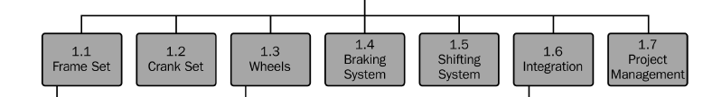
Work Breakdown Structure (WBS)
This example is quite simple and the whole purpose is to bring the students’ attention to focus on the WBS itself.
As you can see, the first level describes the product we want to achieve once the project is complete.
By meeting with the stakeholders, the team can start decomposing the product into smaller, more manageable components.
This is what the level 2 is showing below:

Slide 9
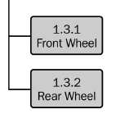
Work Breakdown Structure (WBS)
If we take the component called “Wheels” for example, we may want to break it down into several pieces. However, the team has to decide how much detail the work really requires.
For this example, we can just break this level into two pieces:
The bicycle as a product has only two wheels and from a project management standpoint, this is enough for the team.
Level 3

Slide 10
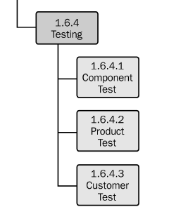
Work Breakdown Structure (WBS)
Finally, there could be a component that needs more details for other reasons. In our example, the team decides to bring even more detail to the component called “Testing”. Based on the project’s needs, there could be a reason to add three more work packages as you can see in the following figure:
Level 4

Slide 11

Work Breakdown Structure (WBS)
Very important key points to keep in mind while developing a WBS:
The WBS is created with the help of the team.
The first level is completed before the project is broken down further.
Each level of the WBS is a smaller piece of the level above.
The WBS includes only deliverables that are really needed.
Deliverables not included in the WBS are not part of the project.

Slide 12

Work Breakdown Structure (WBS)
Very important…
work packages are reached when they include deliverables that:
Can be realistically and confidently estimated.
Can be completed quickly.
Can be completed without interruption (in other words, without the need of more information).
May be outsourced or contracted out.

Slide 13

Work Breakdown Structure (WBS)
BENEFITS:
It helps prevent work from slipping through the cracks.
It provides the project team members with an understanding of where their pieces fit into the overall project management plan.
It facilitates communication and cooperation among team members.
It helps prevent changes.
It provides a basis for estimating staff, cost, and time.
It gets team buy-in and builds the team.
It helps people get their minds around the project.

Slide 14

Make sure you read this information twice:
Under a professional project management methodology, every single project you manage must have a WBS.
You cannot afford to misunderstand this important project management tool.
Why?
Without it, the project will take longer, elements will slip through the cracks, and the project will be negatively impacted.

Slide 15
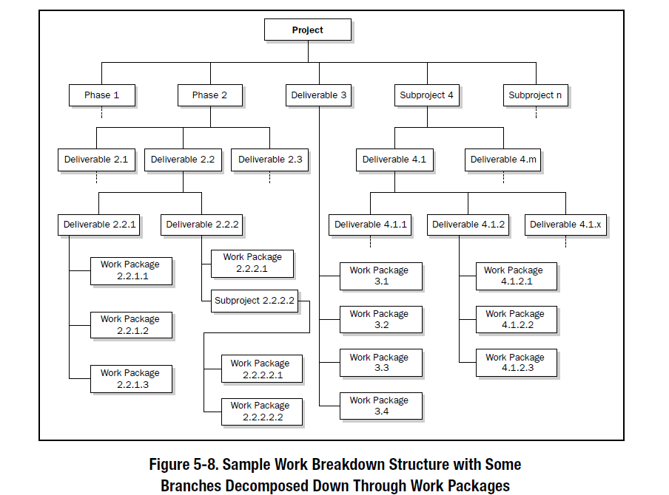
Work Breakdown Structure (WBS)
Example:

Slide 16
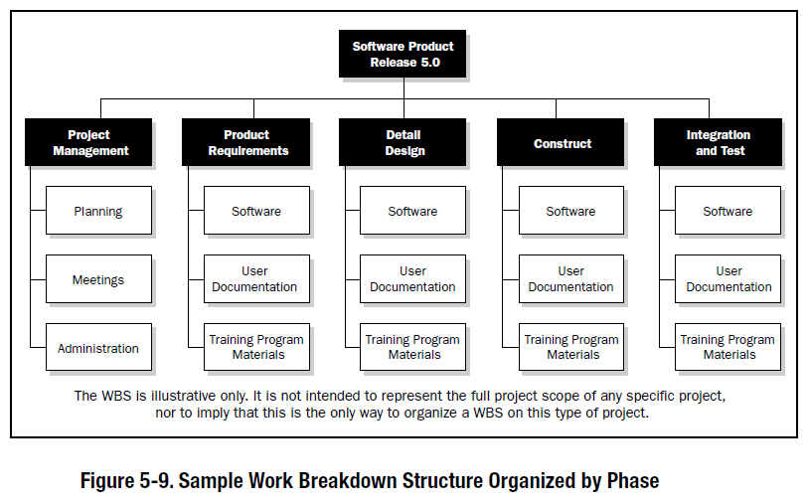
Work Breakdown Structure (WBS)
Example:

Slide 17
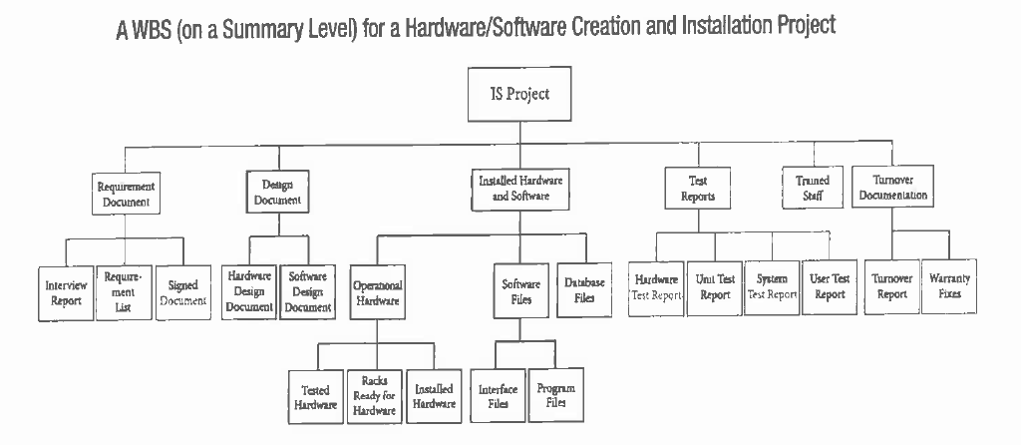
Work Breakdown Structure (WBS)
Example:

Slide 18

In summary:
Most commonly, the project title goes at the top of the WBS.
The first level is normally the same as the project life cycle.
The following levels break the project into smaller pieces.
This is a top – down effort to decompose the deliverables and
the work required to produce them.
The complete scope of the project (product, project, and management
efforts) are included.
Note that each work package consists of nouns (things) rather than actions.

Slide 19
THANK YOU
Ing. Osvaldo Martínez MSc. MAP
2016

