Slide 1
Handbook to access WizIQ videoconferences

Slide 2
We thank you for choosing our school as part of promoting virtual education, using free software and community projection.
UCI delivers events frequently and some times we use WizIQ Virtual Classroom as a way to do so.
You need to follow two steps in order to access those events, conferences or projections:
Register
Access the event

Slide 3
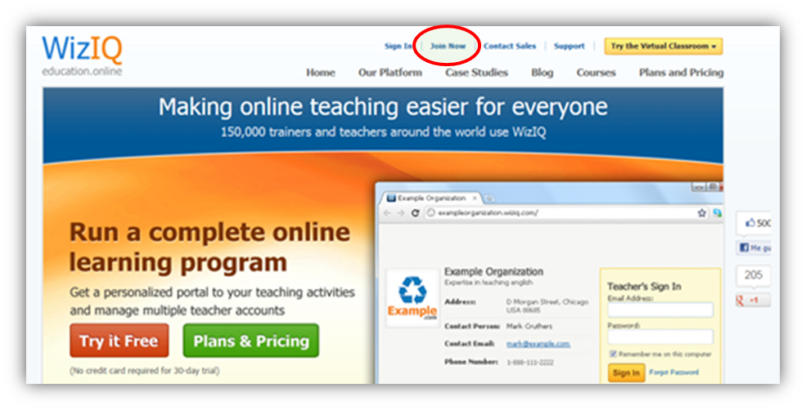
Step 1: Register
Go to www.wiziq.com
Click on “join now” if you do not have a WizIQ user yet.

Slide 4
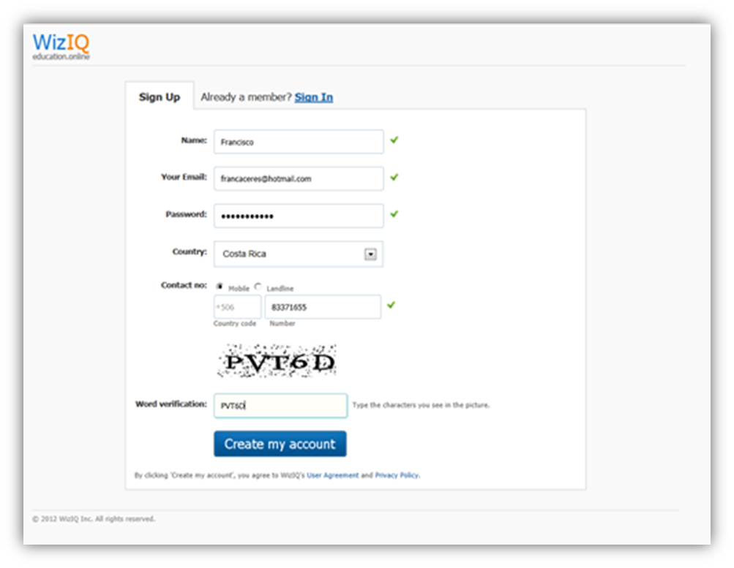
Fill the form and the verifying key.
The name you indicate will be your user name
Click on “Create my account”

Slide 5
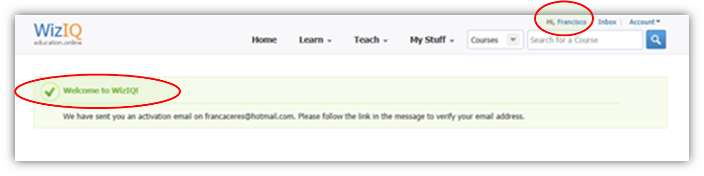
Your username is now registered and WizIQ will send you a confirmation email.

Slide 6
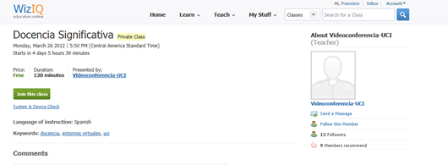
Step 2: Access the event
* Before accessing the event, you must have Flash updated, your computer will request it if you don´t have it updated.
After logging in, click on “Join class” ten or five minutes before the class starts.

Slide 7
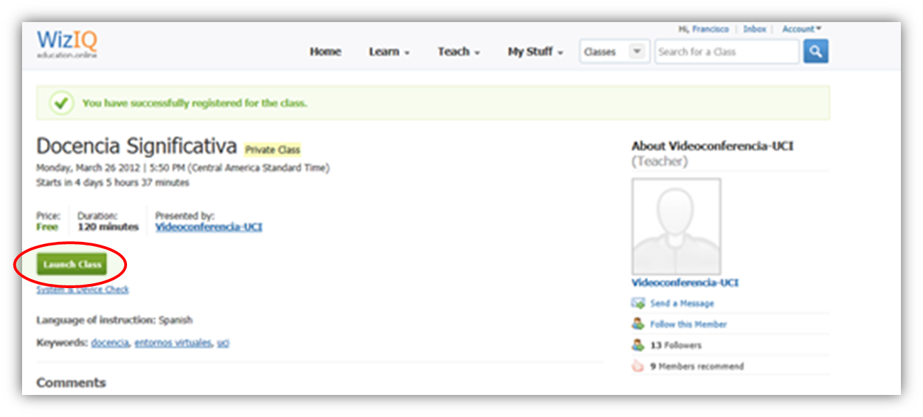
In the next page, click on “Launch class”

Slide 8
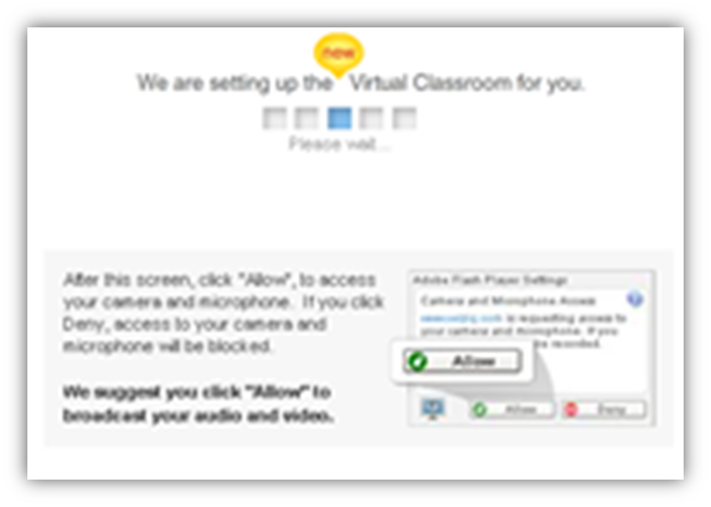
Wait until WizIQ lauches the class and Clic on “Allow” so the system has access to your camera and microphone.
You should now be able to watch the class, it´s presentation, and have access to the chat and video image.

