Slide 1
Project Controls
Module | Module Covers | Learning outcomes
11 Project Controls | What is Project Control? Managing Project Control Controls Process PBS/WBS/OBS Estimating Accuracy Procurement Estimating/ Budgeting/ Costing Earned Value Management Analysis and Reporting Change Control | This module covers areas of project control. While there are many factors to controlling a project, some of which are covered in detail in other modules, this module focuses on Analysis, Costing, Estimating and Reporting
Language
English
Version
5.0

Slide 2

What is Project Control?
Project controls ensure that actual project performance aligns with the business case through analyzing variances in scope, costing, and activities, and taking appropriate corrective and preventive action with regard to risk as needed in order to realize benefits.
Can sometimes feel like herding cats
Img src: https://www.youtube.com/watch?v=FEU1lPzD5RQ

Slide 3
Project Controls Breakdown
Project
  Planning
  Costing/Procurement
  Scheduling
  Reporting
  Analyzing
Also includes management of:
  Change
  Risk
  Issues
  Benefits
  Sustainability
Covered in this module
Also part of project controls but are
Covered in other areas
Notes:
We just covered a lot. Time for a quick break.

Slide 4
Establishing Project Control
The first step in setting up analytics for project control is to identify the key factors to be monitored
The project manager must define precisely which specific characteristics of performance, cost, and time, risk, quality, and sustainability are in accordance with the business case and should be controlled
Exact boundaries must then be established, within which control should be maintained

Slide 5
Establishing Project Control
The best source of items to be monitored is the project plan documents.
  The control system is a direct connection between planning and control
  It is common to focus control activities on data that are easily gathered - rather than important
  Control analytics should concentrate primarily on measuring various facets of performance as it relates to the business case.

Slide 6
Project Controls Principles
A
Original plan
B
Trend
Actual Route
Monitoring
“Are we there yet?”
Notes:
Variances are useful in showing where the project is at any point in time and how far away the project is from the baseline plan. Variances alone will not show how well the project will meet its objectives.
By comparing the current variance with the plan the pro rata effect on the overall parameters can be assessed allowing the completion dates, costs and quality to be forecasted. However, this assumes that the past performance will continue. Also the simple analysis may be misleading if the intervals between measurements are too large.
By tracking performance more frequently, trends can be developed and these may give a more realistic view of performance, allowing the development of corrective action plans.
Earned Value Analysis to be discussed later, is a particularly useful method since it provides variances, trends and allows the development of what if scenarios.

Slide 7
Project Controls Process
Approval
Plan
Baseline
Do work
Update plans
Monitor
Corrective Action
Acceptance
Notes:
A simple control process is shown above.
Effective control involves the comparison between actual performance and the baseline plan. Changes to baseline plans must therefore be controlled.
The purpose of monitoring is to establish deviations and evaluate their impact. Tolerances may be set to enable work to continue with minor deviations.
Control and co-ordination involves the planning and implementation of corrective actions to address adverse situations. Alternatively, it may involve re-planning if the original plans appear to be unworkable or unrealistic.
On completion of all project work, the project is formally accepted.
The key control and co-ordination cycle and associated processes are shown in more detail above.
Reporting – the status of the project is reported in accordance with requirements defined in the project management plan and agreed between the project sponsor and project manager.
Monitoring and Evaluation – measuring achievement, identifying variances between the CSCs, problems and establishing the current position. This will enable further analysis to determine trends and predict the final result based on current performance. It is therefore important to establish the root causes of problems and variances to enable appropriate corrective action to be taken. Such analysis can be done by specific techniques such as Critical Path Analysis (time) and Earned Value Analysis.
Corrective action - there are typically four options depending on the situation:
if performance is outside the specification but within agreed tolerances, corrective action is taken to improve performance
if the original plan is no longer representative, the baseline plan may be changed
if performance is outside the specification (off spec), the variance is escalated to a higher authority
if the variance is due to unauthorised scope changes, the change process is invoked retrospectively.

Slide 8

Product Breakdown Structure
In the PRiSM planning phase
and occurs after refining the SMP
Chocolate Chip Cookie
Chocolate Chips
Dough
Flour
Eggs
Sugar
Butter
Notes:
The Product Breakdown Structure (PBS) is a hierarchical breakdown of the products that are to be produced by the project. Typically the final solution for the project is shown at the highest level, with major products that make up that solution shown at the next highest level. The components of each product (or sub products) will typically be shown at lower levels. The higher levels are used to support development of the Work Breakdown Structure, asking what needs to be done to complete each product. Products are easily identified on a breakdown structure, as they are nouns or naming words. The PBS also used in the identification of the items to be used in configuration management and on change impact assessments.
The PBS provides a high level view of the key products and is useful for the project stakeholders who are more likely to be focused on products than the work to be accomplished.

Slide 9
Work Breakdown
In the PRiSM Initiation Phase
Derived from the PBS
Chocolate Chip Cookie
Chocolate Chips
Dough
Flour
Eggs
Sugar
Butter
Work Packages at lowest level of any branch
Beat Eggs until fluffy
Notes:
The Product Breakdown Structure (PBS) is a hierarchical breakdown of the products that are to be produced by the project. Typically the final solution for the project is shown at the highest level, with major products that make up that solution shown at the next highest level. The components of each product (or sub products) will typically be shown at lower levels. The higher levels are used to support development of the Work Breakdown Structure, asking what needs to be done to complete each product. Products are easily identified on a breakdown structure, as they are nouns or naming words. The PBS also used in the identification of the items to be used in configuration management and on change impact assessments.
The PBS provides a high level view of the key products and is useful for the project stakeholders who are more likely to be focused on products than the work to be accomplished.

Slide 10
Numbering System
1.0
Level One
1.1
1.2
1.3
Level Two
1.3.1
1.3.2
Level Three
1.3.1.1
1.3.1.2
Level Four
Notes:
It is important to provide a unique numbering system to ensure that each element of the product or work breakdown structure can be referenced. The system should maintain the hierarchical relationship, as shown above.
Considerations that may need to be taken into account when deciding the level of breakdown are:
Single point accountability – when one person can be assigned to manage an appropriate manageable level of work, and that no one person controls too many work packages.
Clear definition of work – when work has been defined in clear terms of deliverables, objectives and critical success criteria.
Performance Measurement – when the same methods of performance measurement can be used for activities within a work package (particularly important for earned value management).
Cost – that cost can be allocated to the work package. This may depend on the level and type of cost involved, for example sub contract work, high cost materials.
Criticality or risk – where critical and risky activities may need greater visibility, further decomposition may be appropriate and advantageous.
External contracting - the possibility of controlling external work through contracts can reduce the need for detailed breakdown. In this way areas of the PBS/WBS can be ‘blocked off’ and allocated to the contractor for their own structure to be developed.

Slide 11
Responsibility Matrix
Organization Structure
Project Manager
Product or Work Breakdown Structure
Team Manager
Team Manager
1
Jane
Sam
Joe
Mary
Dave
Contractor
1.1
1.1.1
R
A
C
I
1.1.2
R
A
C
I
1.1.3
I
R
C
A
Products or Work Packages
R – Responsible A -Accountable
C - Consult I - Inform
Notes:
The Responsibility Assignment Matrix is used to define the accountability, role and responsibility of each team member. It is developed by combining the WBS (or PBS) and the OBS.
The completed matrix shows who is accountable, who is responsible for performing the work, who is responsible for product delivery, who else may be involved and their particular role and contribution.
When completing a RAM, one very important rule is that if the highest level you have set in the matrix is ‘Responsible’, only one person can be allocated this for each line.

Slide 12
Cost Breakdown
Company Cost Accounting System
Accounts
Project Work Breakdown Structure
Labor
Purchases
1
Mgmt.
Design
Manf.
Material
Contract
Expense
1.1
1.1.1
1.25k
0.25k
3.25k
1.1.2
1.15k
5.00k
2.75k
1.1.3
0.25k
0.25k
Other Areas
Work Packages
Notes:
Another useful breakdown that can be derived from the WBS is the Cost Breakdown Structure (CBS). It important that costs for each work package are broken into elements since different types require different monitoring and control processes. For example, in-house labour may be controlled through time sheets, materials through purchase orders and contracts used to control sub-contracted work. Some cost categories will need to be isolated if earned value is to be used for cost control.
The Cost Breakdown Structure is derived from the company system of allocating costs and the WBS. Typically, budgets (estimates) for each work package are broken down into cost elements corresponding to the company system of accounts. Actual costs charged to each work package are detailed at cost element level. This enables work package managers to compare actual costs with baseline work package budgets to pinpoint variances and problem areas, allowing them to take any corrective action.

Slide 13
Procurement Terms
Sustainable Procurement
A process whereby organizations meet their needs for goods, services, works and utilities in a way that achieves value for money on a whole life basis in terms of generating benefits not only to the organization, but also to society and the economy, whilst minimizing damage to the environment.
Sustainable Procurement seeks to achieve the appropriate balance between the three pillars of sustainable development i.e. economic, social and environmental.
Economic factors include the costs of products and services over their entire life cycle, such as: acquisition, maintenance, operations and end-of-life management costs (including waste disposal) in line with good financial management;
Social factors include social justice and equity; safety and security; human rights and employment conditions;
Environmental factors include emissions to air, land and water, climate change, biodiversity, natural resource use and water scarcity over the whole product life cycle.
http://www.unep.org/resourceefficiency/Consumption/SustainableProcurement/WhatisSustainablePublicProcurement/tabid/101245/Default.aspx

Slide 14
A risk based approach
Foundation
Embed
Practice
Enhance
Lead
Best practice on the development and implementation of sustainable procurement is based on risk.
Utilize a flexible framework
Src: UK Government Flexible Framework Guidance Pg. 3

Slide 15
Foundation :Level 1, People
Flexible Framework
Sustainable procurement Champion identified
Key procurement staff have received basic training in sustainable procurement principles
Sustainable procurement is included as part of a key employee induction program
Embed :Level 2, Policy Strategy & Comm’s
  Review and enhance sustainable procurement policy, in particular consider supplier engagement
  Ensure it is part of a wider sustainable development strategy
  Communicate to staff, suppliers and key stakeholders

Slide 16
Practice: level 3, Procurement Process
Flexible Framework
All contracts are assessed for general sustainability risks and management actions identified
Risks managed throughout all stages of the procurement process
Targets to improve sustainability are agreed with key suppliers.
Enhance: level 4, Engaging Suppliers
  Key suppliers targeted for intensive development
  Sustainability audits and supply chain improvement programs in place
  Achievements are formally recorded
  Executive involved in the supplier engagement program.

Slide 17
Lead: Level 5 Measurements and Results
Flexible Framework
Measures used to drive organizational sustainable development strategy direction
Progress formally benchmarked with peer organisations
Benefits from sustainable procurement are clearly evidenced
Independent audit reports available in the public domain.

Slide 18
Common Project Procurement Terminology
Acquisition
Contracts
  Firm Fixed Price, Fixed Price
  Cost plus Incentive
  Cost plus Fixed Fee
  Cost - reimbursable
Changes & Variation Orders
Notes:
Procurement is the process of acquiring new services or products. It covers the financial appraisal of the options available, development of the procurement or acquisition strategy, preparation of contract documentation, selection and acquisition of suppliers, pricing, purchasing, and administration of contracts. It may also extend to storage, logistics, inspection, expediting, transportation, and handling of materials and supplies. It may cover all members of the supply chain. Operations and maintenance, for example, often need to be supported by a ‘supply chain’ management process.
The are a number of general types of contract and payment structures:
Firm fixed price
Fixed price
Cost plus incentive fee
Cost plus fixed fee
Cost-reimbursement
Although these are general definitions, most contracts include specific clauses defining cost and profit/fee payment terms.

Slide 19

Evaluation and Selection Criteria
Price
Quality
Timescales – Delivery Dates
Contract Terms – Guarantees, etc.
Support Costs/Arrangements
Risk Management
Quality Management
Responsiveness to Changes
Sustainability Factor*
Notes:
The main criteria for evaluating bids would be drawn from the project Critical Success Criteria, Specific Procurement Requirements and Performance required from the supplier. Examples are given below:
Price – linked to the overall project cost budgets
Quality – requirements of project deliverables
Timescales – linked to overall project timescales
Supplier delivery dates
Contractual Terms -including payment arrangements
Incentives and Guarantees
Cost of in service support - such as spares and maintenance
Risk Management capability
Resource and mobilisation capability
Quality Management capability
Responsiveness to changes
Sustainability Factor

Slide 20
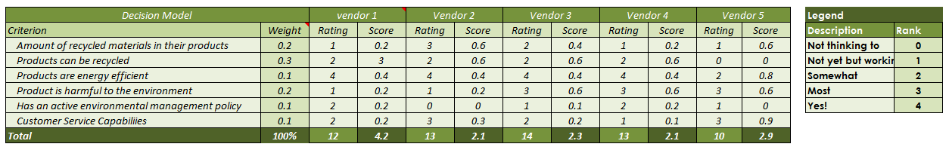
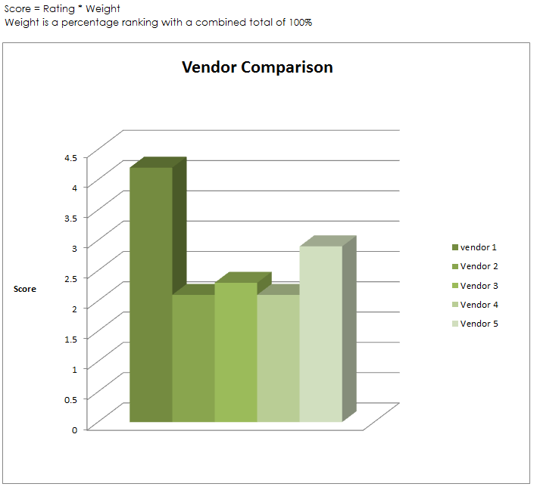

Green Vendor Scorecard
Notes:
Green supplier selection criteria may be developed with intent of focusing on meeting government regulations, focusing on process improvement, and focusing on buying company’s environmental policy. P.K Humphreys, et al (2003) categorize the green criteria into two groups of Qualitative and Quantitative Criteria. Depending on whether an organization is using a reactive or proactive environmental management strategy, one or both groups of criteria may be used at the same time.
Quantitative environmental criteria:
These criteria are based on the cost in monetary terms. A potential supplier may incur costs investing in environmental management of its processes or it may be a source of environmental costs because of its destructive processes.
Pollutant costs/effects: Representing environmental costs caused by a potential supplier.
Improvement cost: Represent the degree of commitment the supplier has in environmental management.
Qualitative environmental criteria:
These are more subjective criteria and their application depends on the weight given to each one depending on its importance to the organization or industry and total points score obtained on the bases of the measured parameters.
Management competences
Green image
Design for Environment (DFE)
Environment Management Systems
Environment competencies

Slide 21
Benefits of Cost Management
More likely to achieve Budget
Control expenditure within Ability to Pay
Control cash flow
Learn Lessons
Improve Estimating Accuracy
Notes:
Some benefits from cost management are shown above.
The Project Manager is more likely to achieve their planned budget
Having a controlled expenditure within an ability to pay as and when invoices are charged within each phase or stage
Knowing what funds are available throughout the life cycle with a control on cash flow
learn lessons from previous work to ensure that the costs of materials and tasks is better understood for the future
improve estimating accuracy on the work packages by feeding back the information to assist future projects

Slide 22
Project Costs
Committed – Placement of an order for work to be done. The money has already been allocated to the resource.
Accrual – Work that has been done but for which payment has not yet been made
Actual – Real expenditure that has left the budget and has already been spent.
Forecast Out-turn – The total of Committed Costs, Accruals and Actual costs plus the estimate of the costs remaining in the work packages left to complete the project
Notes:
There are typically four types of costs that will be incurred by a Project Manager as they work through the logical network of work packages.
These are:
Committed Costs – Where a placement for an order for work to be done has been made, but the work is yet to be started. This money has already therefore been allocated to the resource and cannot be used by the project for anything other than that payment.
Accrual – Work that has been done by the contractor, but for which the project has not yet paid but will be doing in the near future.
Actual – Real expenditure that has left the budget and has already been spent.
Forecast Out-turn – The total of Committed Costs, Accruals and Actual costs plus the estimate of the costs remaining in the work packages left to complete the project.

Slide 23
Pre-Requisites to EVM
Define the Work Breakdown Structure (WBS)
Identify the Organization / Who is on the team
Integrate the WBS and OBS (Who will do what)
Schedule the work / When to do the what
Identify milestones / When will we know we are there
Set time phased Budget / How much can we spend
Record direct costs / Maintain the budget
Determine variances / What are the differences
Sum Data and Variance / What is the impact of the variance
Manage Action Plans / Determine action items
Incorporate Changes / …
Notes:
For Earned Value Management to be carried out most effectively, many pre-requisites must be in place before attempting to carry out the calculations, measurements or reports.
These include:
A detailed and robust WBS where the budgets have been distributed correctly
Defined responsibilities for all the team members involved within the EVM activity
A baseline plan with a fully authorised work schedule
A recognised method for measuring achievement of the task being carried out for EVM
A budget phased over time within the work packages
Baseline Plans fully authorised
A cost recording mechanism in place
Performance data collection and analysis methods
Forecasts for remaining work must be in place and methods to do so

Slide 24
Earned Value Parameters
Earned Value
Value of useful work achieved at specific time based on performance measurements
Planned Value
Actual Cost
Value of work planned at specific time taken from baseline estimates and schedules
Costs for work accomplished – i.e. bills, invoices, etc.
Notes:
Earned Value Analysis uses the measurement of useful work (earned value) that has been accomplished to enable comparison with the planned value and actual costs at any time in the project. This provides an instant health view of the project and enables variances to be established showing areas that are under achieving in terms of cost and schedule. It also enables schedule and cost efficiency to be calculated in terms of useful work as a ratio of planned work and actual costs incurred. Performance Indices can be used for trend analysis and prediction of forecast completion dates and costs.
There are three key parameters in Earned Value Analysis:
Planned Value – this is developed by scheduling activities and their budgets against project timescales. The Planned Spend is typically represented by a spend profile or ‘S’ curve that shows the planned spend against time.
Actual Cost – the actual costs charged for the work accomplished. Actual costs are taken from bills, labour booking and invoices for materials, sub contract work etc., as recorded in operating accounts.
Earned Value – a measured value of the work completed (or performed) based on the percentage progress and the budget for the completed activity.
All three parameters must be synchronised to the ‘Time Now’ date to prevent inaccuracies.

Slide 25
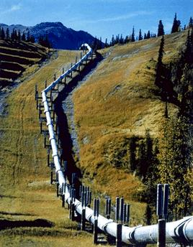
Earned Value Principles
New Pipeline
Ground Works
Pipe
Works

buy pipe
lay pipe




Work completed
Alaska Pipeline
Notes:
The principles of Earned Value Analysis can be illustrated through a simple example as shown.
The project objectives are to lay a new pipeline. The work has been broken down into two areas: Ground Works and Pipe Works. Ground works has been completed. There are two work packages in the Pipe Works. The first, ‘Buy Pipe’ has been completed and the pipe has been delivered to site. The other work package ‘Lay Pipe’ has been in progress for two weeks.
Here are the key objectives and parameters for the ‘lay pipe’ work package:
Estimated cost for laying pipe = $100 per meter
Length to be laid = 1000 meter
Thus total budget allocated = $100K
Duration for WP = 8 weeks
Quality = no leaks

Slide 26
Advantages of Earned Value
Measures the efficiency of work in progress
Provides auditable and repeatable answers to:
  Current performance
  Future out-turn predictions
  Future performance improvement needs
Provides reliable information to aid decision making
Facilitates trend analysis
Provides data for future estimates of similar work
Notes:
There are a number of advantages that can be gained by the correct use of EVM.
It provides an application to measure the efficiency of work in progress
It provides an auditable and repeatable answers to:
The project’s current performance
How the project is predicting to be completed (Future out-turn)
A guide to the Project Manager as to the future performance improvement needs
Quality EVM provides reliable information to aid with decision making
It facilitates trend analysis to see how things are starting to change and how this may change the end result
Provides data for future estimates of similar work so therefore helping with lessons learned and continuous improvement

Slide 27
Disadvantages of EVM
Because the technique takes a whole view, over-performance in one area may hide under-performance in another
EVM requires considerable data administration and effort
Notes:
Although Earned Value can be used as a very powerful tool in Project Management, it must be reminded that no method is completely full proof and that EVM or EVA should be carried out in a disciplined manner to ensure that the right message is passed over and that one area of over performance is not allowed to mask the inadequacies of another area as this will now allow the true development of the project team or the organization.
All this work and analysis takes a great deal of time and commitment and so this can also been seen as a distinct drain on your project resources through all the administrative effort that is required to manage this discipline correctly.

Slide 28
Need for Change Control
To control adverse impact of uncontrolled changes
To enable beneficial changes
To communicate changes to stakeholders
To maintain baselines for effective control
Notes:
Uncontrolled change is seen as one of the major causes of project failure. It is inevitable that changes to the project will be required because the environment has changed or that a better solution to the original problem has been identified. Change should not be stifled but it should be controlled. Uncontrolled changes will undermine the validity of baseline plans and forecasting. Any proposed and authorised changes should be clearly and swiftly communicated to the stakeholders to ensure that there is no misunderstanding on what versions or what specifications the project is working to. This is why Change Control is so closely linked with Configuration Management.

Slide 29
Roles
External Stakeholders
  Customers
  Users
  Experts
  Regulators
Corporate Management
Project Sponsor
Sustainability Manager
Functions
Quality Assurance
Change Control Board
Project Manager
Project Support Office
Team Leader
Team Leader
Team Leader
Notes:
Sponsor – has overall responsibility for authorising changes internal changes and for co-ordinating external changes. External changes may be raised by clients, or arise through a change in the organizations overall business strategy through other external stakeholders such as regulators.
The sponsor may delegate some authority to a Change Control Board or the project manager.
Change Control Board – in complex projects involving many key stakeholders it may be appropriate to establish a team with responsibility for approving or evaluating changes and making recommendations for approval.
Project Manager – is responsible for defining the change and configuration management process for the project and for agreeing authorization limits, tolerances and priority categories with the sponsor. The project manager will co-ordinate and control changes throughout the implementation phase.
Project Team – may raise changes where appropriate to address problems, be involved in change management activities such as assessment and will implement the changes as approved.
Project Support Office – are likely to carry out the day to day change management processes, provide support during impact assessment, planning and implementation.

Slide 30

Best Practice
Review what the original requirement was
Assess the Impact on the Sustainability Measures
Look for additional benefits within the change request
Recommend action or actions to be taken with summarised impact
Await Authorization

Slide 31
We have covered
What is Project Control?
Managing Project Control
PBS/WBS/OBS
Estimating Accuracy
Procurement
Estimating/ Budgeting/ Costing
Earned Value Management
Analysis and Reporting
Change Control

Slide 32
Issue and Risk Management
Module | Module Covers | Learning outcomes
12 Issue and Risk Management | What is the definition of a risk? Both positive and negative effects on project objectives Threats and Opportunities What are Issues? How to manage Risk and Issues | Gain an understanding of risks, issues and how to manage them.
Language
English
Version
5.0

Slide 33
Context
External context can include:
  Social and cultural, political, legal, regulatory, financial, technological, economic, natural and competitive environment whether international, national, regional or local
  Key drivers and trends
  Relationships with, perceptions and values of external stakeholders
Internal context can include:
  Governance, organizational structures, roles and accountabilities
  Policies, objectives and strategies
  Capabilities
  Relationships with, perceptions and values of internal stakeholders
  The organization’s culture
  Information systems, information flows and decision making processes
  Standards, guidelines and models
  Contractual relationships

Slide 34
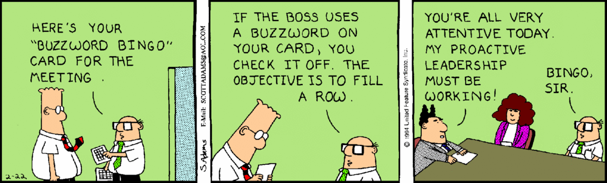
Terminology
Risk Event
  What might happen – Opportunity or
  Threat
Risk Probability
  What is the chance of it happening
Risk Impact
  If it happens, what are the consequences
Risk Planning
  What can we do about it
Risk Management
  How do we stay on top of it
Inherent risk
  The exposure arising from a specific risk before any action has been taken to manage it
Residual risk
  The risk remaining after the risk response has been applied
Secondary risk
  A risk event that may occur as a result of invoking a risk response or fallback plan
https://stancarey.files.wordpress.com/2013/01/dilbert-buzzword-bingo.gif
Notes:
We just covered a lot. Time for a quick break.

Slide 35
Levels of Risk
Strategic
Portfolio
Project
Operational
Social | Environmental | Economic
Notes:
Risk occurs at every level and in all aspects of any organization.
Risks from one level can affect other levels and it can be difficult to identify precisely at what level a risk should be managed. The reason for allocating different levels of risk is to clearly assign who is best placed to take responsibility for its management.
Strategic
All companies face risks to their business strategy. This can range from currency fluctuations to threat or opportunity of takeovers. Risks of this level are typically handled by the Board of Directors.
Program
Major changes that are required to realise the business strategy are often achieved through the management of many diverse projects. Risks that occur at this level can be due to factors such as the interdependencies of component projects, resource conflicts or project priorities. These risks are managed by the Program Management Team.
Project
Risks at this level are threats to the achievement of the objectives agreed for time, cost and quality. These may well arise from threats or opportunities at another level, but must be placed at this level so that they can be managed by the Project Management Team.
Operational
Day to day activities have their own risks such a Health and Safety or Industrial relations. The whole emphasis of projects and programs is to bring about change and so this may introduce new or eliminate existing risks from the work place. The operational readiness to change will affect the project or program risks. Pure operational risk must be managed by the operational managers but they should always be working closely with the relevant project and program management teams.

Slide 36

Sustainability in Risk Management
“Project Managers need to evaluate all risk exposures relative to potential sustainability issues, as well as how those sustainability issues may impact other risks present within the organization. Organizations can then prioritize the issues within traditional considerations of impact and probability.”
Notes:
Risk Management
Sustainability should be top-of-mind when considering risk identification as a whole, but particularly when comparing sustainability risks and opportunities against a change initiative such as a project. At this level, sustainability can pose a higher-level impact, which subsequently defines how the organization evaluates the risks and opportunities.
The objective of the Risk Identification process is to identify, classify and rank the risks that could both negatively and positively affect the project. That said, perhaps Green Project Management is way of identifying the positive elements of risk within a project. These positive elements of risk are also known as Opportunities. The information that is captured in the Risk Identification process is used to develop an effective risk response plan and to define action items, thresholds and metrics for the Risk Monitoring and Control process. The risk data captured within the Risk Identification process can also be used to estimate the project’s impact and likelihood of risk occurrence. ISO 14000 and EMS will guide the Project Manager through identifying environmental issues that can be affected by the risks in the complete life cycle.
Practical Application
Include in your requests for quotations or proposals that vendors and suppliers include with their response how they might meet your green criteria.
Examples
Quantitative criteria:
A vendor may incur costs by executing an environmental management plan or be a source of environmental costs because of wasteful processes. Early identification of these costs can point the Project Manager in the right direction to a suitable vendor or not as applicable.
Pollution Case/Effect: Representing environmental costs caused by a potential supplier
Environmental Commitment: Represents the degree of commitment the supplier has in environmental management.
Qualitative criteria
Scoring on qualitative criteria will depend on the weight that is applied to each item on a pre-assigned scorecard based on the importance that your organization or you as the Project Manager place on each category.
Environmental Commitment: Their overall corporate goals to decrease their carbon footprint
Logistics: How streamlined are their logistics
Strength of their SMP: How their action and results measure up to their goals

Slide 37

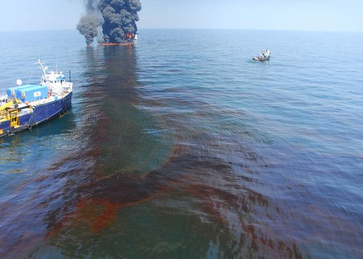
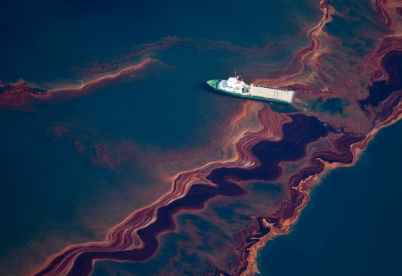
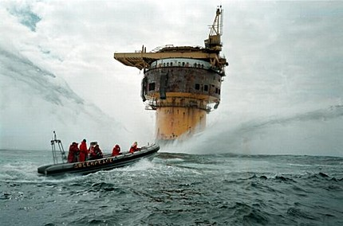
Oil and Water
The project to deploy the the Deepwater Horizon did not include an SMP or Risk Register.
Notes:
Talk about the cost of not doing one.

Slide 38
Risk Balance vs. Sustainability
Drawbacks
Benefits
Overhead
Visibility
Hard
Soft
Notes:
The benefits of Risk Management are significant, but it is often the case that it is the drawbacks that people focus on.
Benefits can be broken down into two styles.
Hard
These comprise direct benefits to the project plan such as having the ability to make better more informed decision making, being less likely of accepting unsound projects, increased likelihood of project adherence to its plan and provision of data that assists with future lessons learned.
Soft
The softer benefits are less tangible but include a better understanding of the project by the stakeholders, being able to have the management team focus on the most significant risks and to assist in the distinction between being a good manager and a lucky one.The drawbacks of Risk Management are also broken down into two specific aspects.

Slide 39
Risk Management Process
INITIATE
Project definition
Risk management focus
IDENTIFY
What are the risks
Sources of risk
ASSESS
Likelihood / Impact
Ranking / Prioritisation
MANAGE PROCESS
PLAN RESPONSES
Identify & evaluate options
Plan mitigation strategies
IMPLEMENT RESPONSES
Assigned responsibilities
Monitor & review
Notes:
Project risk management recognises a formal approach to the process as opposed to an intuitive approach. Risks, once identified and assessed, should be managed in order to minimise or completely mitigate their effect on a project.
Key steps in the risk management process shown above are as follows:
Plan – a Risk Management Plan is developed to provide guidance on how risk management will be carried on the project.
Identification – aims to identify all significant risks that may impact on project objectives, and gather all relevant information for analysis. The possibility of new risks are investigated throughout the life of the project.
Analysis – qualitative methods are typically used to determine the probability and impact of each risk. The information is used to prioritise risks and decide appropriate responses. Quantitative methods are used to determine the effects of uncertainties and risks on project objectives.
Responses – appropriate responses are considered, selected on the basis of overall benefit, authorised and implemented.
Monitor & Control – current risks are monitored and corrective action taken for adverse trends. Action Plans are monitored to ensure progress and effectiveness. The overall process is audited and reviewed typically at end of phases to ensure effectiveness.

Slide 40
Risk Identification Methods
P5 Impact Analysis
Brainstorming
Interviews
Risk Identification workshops
Checklists
Questionnaires
Expert facilitation
Lessons Learned (Previous Projects)
Assumption analysis
SWOT analysis
Notes:
Brainstorming - interactive, open format group method to identify and rank risks. Strengths: quick and inexpensive; easy to use. Useful as start up activity and for team building. Weaknesses: requires expert involvement for reliable inputs; unreliable for identifying high level risks in complex scenarios.
SWOT Analysis - A specific brainstorming technique using Strengths, Weaknesses, Opportunities and Threats as main focal points. Threats and Weaknesses indicate risks, Opportunities and Strengths support definition of responses. Strengths: encourages 'big picture' view; can stimulate thinking; others as for brainstorming. Weaknesses: may miss important areas of uncertainty; others as for brainstorming.
Assumption Analysis - check assumptions in project documents for validity. If invalid, check significance in terms of impact on project success criteria. If significant determine nature of risk and decide appropriate response. Strengths: helps to reduce uncertainty; can be easily integrated into routine everyday procedures. Weaknesses: time consuming; requires disciplined and consistent action.
Delphi Technique - For use where you have a number of experts with differing opinions. This technique uses a facilitator to gather opinions, summarise them and then redistribute for further consideration. The range of opinions gradually narrows until an agreed consensus is arrived at.
Interviews - Interviews with stakeholders and experts to identify risks and possible responses. Strengths: relatively quick and inexpensive; often provides information on preventive actions. Weaknesses: may not be relevant to current situation; requires good interviewing technique.
Prompt and Check Lists - Open and specific structured questions to identify risks. Strengths: useful for gathering information; reduces need for expert involvement; easy to use. Weaknesses: may not include new risks; may not be relevant (therefore unproductive).
Post Project Reviews – Use of historical records that describe how a risk has been handled previously. This can be beneficial if the risk is similar again although the context of the project must be taken into consideration before the response is selected.

Slide 41
Risk Register
Risk Register
Version………….
Project:
Project number
Page ……. of ……..
Ref.
Description
Probability
Impact
Action
Owner
1273
Residents object to planning submission
H
VH
Agree to develop garden amenity area
DPJ
1274
Furniture damaged en route
M
M
Pay premium for high quality removal
AJD
firm and agree packing specification
1275
Production line equipment damaged en
H
M
Pay premium for high quality removal
AJD
route
firm and agree packing specification
1276
Furniture supplier fails to meet delivery
H
H
Retain old furniture temporarily
JK
deadline
1277
Building company goes bust
VL
VH
Perform detailed financial check
FDM
Poor weather during external
Plan external work when weather is
LD
1278
refurbishment
L
M
favourable. May require short term
changes to schedule
1279
Scope of refurbishment work extended
H
H
Maintain strict Change Control
FDM
procedures
1280
Injury during decommissioning
M
L
Ensure safety regulations are strictly
PH
enforced
1281
Petty vandalism
L
H
Cover with insurance
FDM
1282
New furniture faulty
M
M
Retain old furniture temporarily
JK
Identification
Assessment
Response
Other fields that may be included: Proximity/Status/Title/Associated Risks/Project Area
Notes:
The Risk Register - is a key document that is used to record, communicate and track risks.
The simple register above contains the minimum set of information that is required. Most registers contain more detail on the nature of the risk such as who may be affected, changes in risk status and the status of the risk.
It is important to record ownership of risks, where a risk owner is generally considered to be the person best placed to manage a particular risk through the process. Other people may also be responsible for undertaking specific actions and responses.
It is a live document used to communicate risks and their status to stakeholders. A data entry form is typically used to gather detailed information on each risk.
A risk register should be opened as soon the first risks are identified and updated as new information emerges or on a regular basis if the current risks are the only records. This is essential even though it may be earlier than implementation (e.g. during Feasibility) and before a full risk management plan has been developed. New risks will arise throughout the life of the project and the risk register is used to capture these, show ownership and ensure they are communicated and tracked through the whole process. It is therefore applied as soon as possible and for the duration of the project.

Slide 42
Analysis (Assessment)
Two Techniques
  Qualitative
    Subjective judgement of probability and impact.
    These techniques will be used for the majority of risks identified. They involve subjective assessments of the probability and impacts of risks. The key element to this style of risk assessment is that it involves the need for judgement.
  Quantitative
    Statistical assessment of variations. These focus on the numerical analysis of risk and range from statistical assessment of variations in activity duration or cost, to decision making tools.
Notes:
Qualitative – These techniques will be used for the majority of risks identified. They involve subjective assessments of the probability and impacts of risks. The key element to this style of risk assessment is that it involves the need for judgement.
Quantitative – These focus on the numerical analysis of risk and range from statistical assessment of variations in activity duration or cost, to decision making tools. Examples include Monte Carlo techniques.
Note, an example could include a Monte Carlo technique is a problem solving technique used to approximate the probability of certain outcomes by running multiple trial runs, called simulations, using random variables.

Slide 43
Probability & Impact Grid
High
Probability
Medium
Low
Low
Medium
High
Impact
Notes:
Risks may be plotted on probability-impact charts for analysis, as shown above. Categories such as High, Medium and Low Values are typically used for probability and impact scales.
These categories represent ranges. For example, a high cost impact may be greater than $100K, a medium between $50 - 100K, and a low impact less than $50K. The purpose of these definitions is to ensure consistency throughout project teams in risk estimates.
The benefits of probability impact charts are:
useful for plotting & comparing risks in order to decide priorities
can show cost, time and quality factors
provides bands for escalation
provides bands for RAG reporting
scales are directly related to project critical success criteria
highlights the difference between Low Impact- High Probability and High Impact - Low Probability risks
visual easy to understand
ensures consistency
Whilst probability-impact charts are an ideal way to show risk priorities, there may be other considerations that affect priority decision such as when the risk is likely to occur, or the cost of risk reduction.

Slide 44
Risk Response
Risk responses should be tied to the drivers of risk and anchored in what is an acceptable range of solutions. Sustainability factors that form the core of an organization’s values can help frame what will or won’t serve as an acceptable risk response, and why.
Sample Sustainable Risk Balanced Sustainability Scorecard
Sustainability Performance | Sustainability Risk
Develop a new green product or service | Stakeholder backlash or accusations of “green washing” if product or service not truly green or sustainable enough
Move operations to a low-cost geography | Increased exposure to political instability, employee dissatisfaction, negative brand impact from exporting jobs.
Use of harmful chemicals/materials | Compliance risk for non-disclosure, negative consumer and investor reactions
Sub-par or non existent Sustainability Reporting | Decreased consumer confidence, decreased competitive advantage and market share.

Slide 45
Risk Threat Responses
Response plans can be developed and implemented once the risks have been assessed and prioritized. There are a number of generic response strategies.
Avoidance - an alternative approach is taken to avoid the risk.
Transfer - assign contractual responsibility to for example, a sub contractor better placed to manage the risk. Another example of this is insurance where another party provides compensation in event of risk impact
Reduction - proactive measures to reduce likelihood, impact or both Ideally reduction measures should be taken for high level risks.
Acceptance - where the risk impact is low or cost of mitigation too high. This is sometimes known as absorption.
Notes:
Response plans can be developed and implemented once the risks have been assessed and prioritized. There are a number of generic response strategies.
Avoidance - an alternative approach is taken to avoid the risk.
Transfer - assign contractual responsibility to for example, a sub contractor better placed to manage the risk. Another example of this is insurance where another party provides compensation in event of risk impact
Reduction - proactive measures to reduce likelihood, impact or both Ideally reduction measures should be taken for high level risks.
Acceptance - where the risk impact is low or cost of mitigation too high. This is sometimes known as absorption.

Slide 46
Risk Opportunity Responses
Exploit – This method is carried out when an opportunity materializes that allows you to truly gain from it.
Enhance – This is where the project team puts in place pro-active measures to maximize the likelihood of a situation occurring. Opposite to the reduce response.
Share – This is a chance where not only your project but any other relevant projects that can use the situation make sure that the opportunity is fully communicated to gain the most company wide.
Reject – This is a response that can be chosen should the situation not be right for the project at the time for financial or other reasons.
Contingency - A fall-back plan that will be implemented if the risk occurs. Additionally we can add an allowance included in estimates for events that cannot be predicted with any degree of reliability.
Notes:
Exploit – This method is carried out when an opportunity materialises that allows you to truly gain from it in the fullest way.
Enhance – This is where the project team put in place pro-active measures to maximise the likelihood of a situation occurring. Opposite to the reduce response.
Share – This is a chance where not only your project but any other relevant projects that can use the situation make sure that the opportunity is fully communicated to gain the most company wide.
Reject – This is a response that can be chosen should the situation not be right for the project at the time for financial or perhaps storage reasons and so no matter the fact that a saving could be made it is passed over on this occasion.
Contingency - A fallback plan that will be implemented if the risk occurs. Additionally we can add an allowance included in estimates for events that cannot be predicted with any degree of reliability.

Slide 47
Monitor and Control
Monitor and Control
Risk Happens
Unidentified or
accepted risk
Identified Risk
Implement planned
Response
Quantify effect
on project
Links to
performance, cost and change control
Develop responses
and implement
Revise plans
Notes:
Monitor and Control
We should periodically review the Risk Response Plan to identify changes in status of any of the existing risks or to review and identify new risks. This will link closely to other forms of control such as Change Control where the assessment of change requests will naturally include a review of risk from identification through to planning responses.
Risk Happens
Hopefully, our threat avoidance or reduction measures will prevent the threats from occurring but inevitably some will still happen. Conversely, we hope that enhancement actions will cause opportunities to occur.
Implement Planned Response
If the risk had been identified, we should implement our planned response. This may be as simple as claiming on the insurance we took out to transfer the risk or as complex as implementing an extensive contingency plan. However, if we had accepted the risk, or a risk arises that we had not identified we need to take immediate action. Because the risk has now happened there is no element of uncertainty so strictly speaking it is not a risk. The next two steps are therefore often referred to as Issue Management. An issue is something that has no uncertainty and must be dealt with by a higher authority than the Project Manager.

Slide 48

GPM Best Practice
Understand the three elements
  Cause, Event and Impact
Look for the opportunities
Can the risk provide a sustainable benefit ?
Plan the response to risk in detail
Watch and react

Slide 49
PESTLE
Factors in a PESTLE Analysis
Political The current and potential influences from political pressures
Economic The local, national and world economic impact
Sociological The ways in which changes in society affect the project
Technological How new and emerging technology affects our project / organization
Legal How local, national and global legislation affects the project
Environmental Local, national and global environmental issues
PESTLE is an analytical tool which considers external factors and to assist in determining impacts.
Notes:
Is a useful for understanding the “big picture” of the environment in which you are operating. By understanding your environment, you can take advantage of the opportunities and minimize the threats.
Provides the context within which more detailed planning can take place to take full advantage of the opportunities that present themselves.

Slide 50
SWOT
SWOT
Strengths
Weaknesses
Threats
Opportunities
SWOT is an analytical tool to identify opportunities. Similar to PESTLE, it is used to help in decision making.
Notes:
Possible Questions.
Strengths
-What advantages does your organization have?
-What do you do better than anyone else?
-What unique or lowest-cost resources can you draw upon that others can't?
-What do people in your market see as your strengths?
Weaknesses
-What could you improve?
-What should you avoid?
-What are people in your market likely to see as weaknesses?
-What factors lose you sales?
Opportunities
-What good opportunities can you spot?
-What interesting trends are you aware of?
-Useful opportunities can come from such things as:
-Changes in technology and markets on both a broad and narrow scale.
-Changes in government policy related to your field.
-Changes in social patterns, population profiles, lifestyle changes, and so on.
-Local events.
Threats
-What obstacles do you face?
-What are your competitors doing?
-Are quality standards or specifications for your job, products or services changing?
-Is changing technology threatening your position?
-Do you have bad debt or cash-flow problems?
-Could any of your weaknesses seriously threaten your business?

Slide 51
Issue Definition
Threat to project objectives that cannot be resolved by Project Manager
Problems are day to day concerns
Risks may not happen
Issues have already occurred and must be escalated
Outside the direct control of the Project Manager
Project Sponsor has the option to further escalate
Poor Issue Management is a major source of project failure
Notes:
An issue is defined as a threat to the project objectives that cannot be resolved by the Project Manager.
Issues should be differentiated from problems, which are the day to day concerns that a Project Manager has to deal with case by case.
In addition, risks should not be confused with issues. Risks are uncertain in that an event may not occur, whereas issues have already occurred and are therefore not uncertain.
The importance of Issue Management in projects is that issues are outside the direct control of the Project Manager.
It is the Project Manager’s responsibility to ensure that all issues are escalated to the Project Sponsor, who can then assess and decide on the next course of action. If the Project Sponsor deems that it requires further escalation then they can further escalate the issue to the Project Steering Group.
Issues that remain unaddressed or unresolved are the cause of many project failures. Therefore, it is the Project Manager’s responsibility to ensure all issues are correctly identified, registered, appropriately escalated and then resolved.

Slide 52
Issue Escalation Route
Stakeholders
Steering Group
Project Sponsor
Issues
Project Manager
Day to Day Activity
Problems
Team Members
Notes:
Problems and risks are managed on a day to day basis by the project team.
A concern that threatens the project objectives becomes an issue when it cannot be controlled by the project manager. In such situations, the project manager must escalate the issue to the project sponsor. The sponsor will then seek a resolution by engaging the stakeholders as appropriate and/or involvement of the project steering group.
Issue management is a fundamental purpose of the steering group and the appropriate membership of the group will impact on their ability to resolve issues.
Reporting on the development or progress of an issue is performed by the project manager until it has been successful concluded.
Common problems in issue management are:
The Project Manager incorrectly identifying problems as issues and therefore diverting senior management’s attention away from other important tasks.
Failing to escalate issues in a timely manner when the resolution owner has been unable to resolve the issue.

Slide 53
Issue Log - Contents
# | Description: | Reported by: | Date of Issue | Impacts | Possible resolution | Owner | Final Outcome | Closure Date
1 | Delivered Concrete is not not the grade we ordered | Chris | January 1st | Structure could be unstable | 1. Perform Stress test and use concrete 2. Put activity on hold and require higher grade concrete | Chris | Performed Stress test. Ordered new concrete | January 7th.
Notes:
The issue log is used to communicate and track progress through life, support project reviews and lessons learned exercises.
It should be maintained throughout the whole of the Project Life Cycle and then should be closed off formally by the Project Manager as part of the closure of the project and any outstanding actions or issues transferred to the product owner within the Operations phase.

Slide 54
We have covered
What risk is
Both positive and negative effects on project objectives
Threats and Opportunities
What are Issues?
How to manage Risk and Issues

Slide 55
Organizational Structures and Roles
Module | Module Covers | Learning outcomes
13 Organizational Structures and Roles | Different types of organizational structures: Functional Project based (Projectized) Matrix | Gain an understanding of the various types of organizations and roles in each.
Language
English
Version
5.0

Slide 56
Functional
Organization
Works well for projects contained within a single function/department
Larger projects tend to get passed from function to function
Line manager responsible for projects as well as business-as-usual
Function #1 (Sales)
Function #2 (Production)
Function #3 (Accounts)

Slide 57
Advantage / Disadvantage
+
-
Full control over resources for functional projects
Easy access to expertise
Easy to solve functional problems
Simple communication structure
Good for personal development within function
Projects are learning opportunities
Resources are more loyal to their function/department that to project
Tends to be inward looking
Can be isolated
Larger projects get passed from function to function
Larger projects have many PMs
No single authority/ responsibility for larger projects
Decreased Flexibility and Capacity for change

Slide 58
Projectized
Organization
Works well for large, long-term project
Project manager has overall control of both work and line management
Uses a dedicated team
Project #1
Project #2
Function #1
Function #2
Function #3
Function #1
Function #2
Function #3

Slide 59
Advantage / Disadvantage
+
-
Project manager has full authority
Strong sense of identity with the project and team
Focussed on the project’s goals
Dedicated resources
Good environment for developing project skills
A dedicated team can be expensive, and an inefficient use of budget resources
Team members can fall behind in their functional skills
Team can become isolated
Limits the number of projects that can be taken on at one time
End of project can mean end of employment

Slide 60
Matrix
Organisation
Responsibility split between project manager and line manager
Team members have responsibilities to both project(s) and to business-as-usual
Project office can help with communication, prioritisation and integration
Project #1
Function #1
Function #2
Function #3
Function #4
Project #2
Project #3

Slide 61
Advantage / Disadvantage
+
-
Efficient use of resources
Entire organisation is a single resource pool
Consistent methods across projects
Easy to respond to changes
Flexible approach
Can handle different types of project
Resource conflict is common
  between projects
  between projects and business-as-usual
Easy to overload resources
Conflict of loyalties
Conflict of instructions
Conflict over development path: functional or project

Slide 62
Organizational Influences
Functional Orientation
Project Orientation
Strong Project
Relative Level of Influence
Strong Functional
Strong technological & process centres of excellence
Stable, consistent, efficient
Good vertical integration through function – clear lines of communication
Poor horizontal integration across functions
Strong business and product focus
Flexible, inconsistent, effective
Good vertical integration through project – clear lines of communication
Poor horizontal integration across projects
Notes:
Between these extremes the relative level of influence changes from strong functional on the left to strong project on the right. Traditionally, organizations were either functional or project orientated.
Each of them have their own strengths and weaknesses. Certain types of structure suit certain types of industry. The Project Manager must gain a clear understanding of what environment they are in before any real control of the project can be attained.

Slide 63
Organizational Roles
Organisational roles are the roles performed by individuals or groups in a project
Both roles and responsibilities within projects must be defined to address the transient and unique nature of projects and to ensure that clear accountabilities can be assigned
APM BoK, 5th edition

Slide 64
Example project team structure
Organizational Strategy
PMO Function
Project
Project Board
Project Executive/Sponsor
Project Manager
Project Support
Team Leader
(internal/external)
Team Leader
(internal/external)

Slide 65
Project Sponsor/Executive
Responsibilities
Activities
Primary owner of the project on behalf of the business (should have the relevant level of business authority).
  Accountable for the investment in the project and the resultant benefit delivery.
  Produces and ‘owns’ the Business Case.
  Obtains approval for expenditure.
  Authorizes phase transitions and the key management outputs.
  Terminates the project if necessary.
Defines the business investment aims and priorities
  Initiates the project and ensures a competent project manager is selected.
  Agrees the project’s success criteria.
  Supports the project manager during the project lifecycle
  Monitors project progress & makes control decisions when necessary.
  Monitors the project’s external environment and business risks.
  Keeps executive stakeholders informed and engaged

Slide 66

Project Manager
A project manager is an individual responsible for accomplishing the stated project objectives.
Key project management responsibilities include developing clear and attainable project objectives, documenting the project requirements, and managing the constraints of the project’s finite resources to successful completion.

Slide 67
Project Board
Provides strategic direction and guidance (including inputs to context beyond the project)
Ensures cross-functional representation from the business
Chaired by the sponsor
Includes representatives from
  Users
  Suppliers
  Key stakeholder groups
Project Manager may attend board meetings
Resolves escalated risks and issues that Project Manager and Sponsor cannot resolve
May fulfil role of deciding ‘Go / No Go’ decisions at end of each phase of the project lifecycle on behalf of the business

Slide 68
We have covered
Functional organizations
Project based (Projectized)
Matrix organizations

Slide 69
Project Sponsorship
Module | Module Covers | Learning outcomes
14 Project Sponsorship | The role and responsibilities of the project sponsor How sponsors impact the project life cycle. | Learn where the project sponsor comes in to play, the relationship with the project manager and the functions they are responsible for.
Language
English
Version
5.0

Slide 70
Project Sponsorship
Project sponsorship is an active senior management role, responsible for identifying the business need, problem or opportunity.
The sponsor ensures the project remains a viable proposition and that benefits are realised, resolving any issues outside the control of the project manager.
APM BoK, 5th edition

Slide 71
Roles
External Stakeholders
  Customers
  Users
  Experts
  Regulators
Corporate Management
Project Sponsor
Sustainability Manager
Functions
Quality Assurance
Change Control Board
Project Manager
Project Support Office
Team Leader
Team Leader
Team Leader
Notes:
Sponsor – has overall responsibility for authorising changes internal changes and for co-ordinating external changes. External changes may be raised by clients, or arise through a change in the organizations overall business strategy through other external stakeholders such as regulators.
The sponsor may delegate some authority to a Change Control Board or the project manager.
Change Control Board – in complex projects involving many key stakeholders it may be appropriate to establish a team with responsibility for approving or evaluating changes and making recommendations for approval.
Project Manager – is responsible for defining the change and configuration management process for the project and for agreeing authorization limits, tolerances and priority categories with the sponsor. The project manager will co-ordinate and control changes throughout the implementation phase.
Project Team – may raise changes where appropriate to address problems, be involved in change management activities such as assessment and will implement the changes as approved.
Project Support Office – are likely to carry out the day to day change management processes, provide support during impact assessment, planning and implementation.

Slide 72
Role of the sponsor
Represents the business
Provides leadership from a business perspective
Sets goals and direction
Makes timely decisions
Primary risk taker
Owns the business case
Provides a link to senior management
Supports the project manager

Slide 73
Responsibilities of the sponsor
Responsible for benefit realisation
Obtains approval for the overall expenditure / investment
Deals with obstacles
Chairs the steering group
Authorises phase transitions and the key management outputs (e.g. PMP)
Terminates the project if necessary

Slide 74
Characteristics of the sponsor
A business leader and decision maker
Can work across functional boundaries
Can commit time and support
Sufficiently experienced in projects to judge effectiveness
Needs to understand the stakeholders
Needs good influencing skills

Slide 75
The relationship between Sponsor and PM
Sponsor
Project Manager
Benefits in mind
Concerned with effectiveness
Provides direction
Deals with investment
Delivery and benefits in mind
Concerned with efficiency and effectiveness
Provides management
Deals with budget

Slide 76
We have covered
The role and responsibilities of the project sponsor and how it impacts the project life cycle.

Slide 77
Stakeholder Engagement
Module | Module Covers | Learning outcomes
15 Stakeholder Engagement | What/Who are Stakeholders Management or Engagement Analysis, Methods, Techniques and Competence | This module covers stakeholder engagement and the necessary skills that a project manager needs to have in order to manage change with the support of stakeholders.
Language
English
Version
5.0

Slide 78
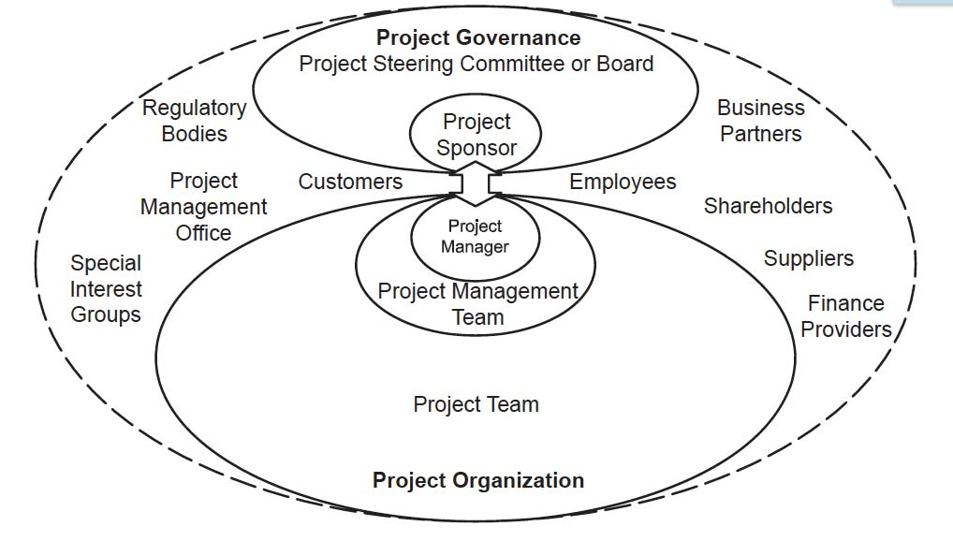
What are Stakeholders?
Definition:
A Stakeholder is a person, group or organization that has interests in, or can affect, be affected by, or perceive itself to be affected by, any aspect of the project.
Stakeholders
ISO 21500 Pg. 2 and 7
Notes:
Stakeholder person, group or organization that has interests in, or can affect, be affected by, or perceive itself to be affected
by, any aspect of the project

Slide 79
Management of Stakeholders
Engagement
Most PM Associations and organization refer to what is called “Stakeholder Management”.
ISO 21500, Guidance on Project Management states on Page 18 that the purpose of “Manage Stakeholders” is:
  To give appropriate understanding and attention to stakeholders’ needs and expectations. This process includes activities such as identifying stakeholder concerns and resolving issues.
  Diplomacy and tact are essential when negotiating with stakeholders. When it is not possible for the project manager to resolve stakeholder issues, it may be necessary to escalate the issues to a higher authority, in accordance with the project organization, or to elicit the assistance of external individuals.
  A detailed analysis should be made of stakeholders and of the impacts they might have on the project, so that the project manager can take maximum advantage of their contribution to the project. From this process, prioritized stakeholder management plans may be developed.
IMPORTANT: DO NOT Manage Stakeholders, Engage them!

Slide 80
Why?
Project Managers must be comfortable engaging with individuals in the “c” suite. (CEO, CFO, CTO, CST, etc.)
PMs are looked upon as strategists and must make decisions that affect the business
The individuals who entrust PMs with the mandates to do these activities are higher on the corporate ladder. You can’t manage your boss.

Slide 81
Keys to Stakeholder Engagement
Get to know them.
  Who are they? What do they care about? How do they relate to the initiative you are trying to launch?
Engage as early as possible.
  No one likes to be surprised by change.
Listen with Both Ears
  Take the time to ask stakeholders for their opinions or to open the doors for participation and make sure it counts for something. You must be open to receiving incorporating stakeholder input, even if it doesn’t align with the project’s vision or goals.

Slide 82
Keys to Stakeholder Engagement
Communicate, Communicate, Communicate.
  Stakeholders must be aware of the project’s status but also have a clear understanding of goals and benefits and a strong sense of how it will impact them.
Use Policy as a Carrot, not as a Baseball bat.
  Policy is what a PM falls back on when they fail to secure buy-in from stakeholders. In essence, the tendency to mandate change through rules and regulations without more comprehensive change management efforts to encourage and support new behaviors

Slide 83
Stakeholder Engagement process
Identify stakeholders
Analyze
Stakeholder mapping
Develop strategy
Communications plan
Gather information
Review influence
Notes:
Start the process with Identify stakeholders. Mention brainstorming. Mention asking the initial set of stakeholders who else they think should be involved.
Gather information is about finding out how interested they are in the project as it is currently defined. What financial or political interest do they have in the outcome of your work? Is it positive or negative? It is worth also finding out what motivates each stakeholder, so you know what to include to bring them on board. What is their current opinion of your work? Is it based on good information?
Review influence is primarily about how much power and influence each stakeholder wields. However, it is also worth considering who influences their opinions generally, and who influences their opinion of you? Should some of these influencers therefore become important stakeholders in their own right? Who else might be influenced by their opinions? Should these people become stakeholders in their own right?
Analyze is covered on subsequent slides.
Stakeholder mapping allows stakeholders to be grouped together so they can be managed as just a few groups rather than having to manage each individually.
Develop strategy has to answer questions such as: If they are not likely to be positive, what will win them around to support your project? If you don't think you will be able to win them around, how will you manage their opposition?
Communication plan is about developing a communication plan to help you manage the stakeholders. What information do they want from you? How do they want to receive information from you? What is the best way of communicating your message to them? The plan then needs to be continuously monitored and reviewed in light of changing situations.

Slide 84
Identify stakeholders
Who is involved in, affected by or can affect the project?
Identifying stakeholders may help identify:
  Resources needed
  Organizations/people affected
  Organizations/people with influence
  Statutory and regulatory bodies

Slide 85
Stakeholder analysis
Are they interested in the project succeeding?
Will they openly support it?
Are they ambivalent?
Are they negative?
What are their expectations and how can these be managed?

Slide 86
Analysis tools – 2x2 grid
Blockers
Champions
High
Level of power and influence
Detractors
Supporters
Low
Negative
Positive
Level of interest
Notes:
Champions (high power, highly interested people): these are the people you must fully engage and make the greatest efforts to satisfy.
Blockers (high power, less interested or negative people): put enough work in with these people to keep them satisfied, but not so much that they become bored with your message.
Supporters (low power, highly interested people): keep these people adequately informed, and talk to them to ensure that no major issues are arising. These people can often be very helpful with the detail of your project.
Detractors (low power, less interested or negative people): again, monitor these people, but do not bore them with excessive communication.
.

Slide 87
Stakeholder Register
Depending on each stakeholder’s influence and impact rating, the Project Manager can develop a strategy to assess each stakeholder’s level and timing of involvement.
Notes:
The aim of this document is to list the stakeholders, identify what role they play in the organization and assess how they are involved in the project. This document may need to be revised as new stakeholders may be identified or existing stakeholders may change in terms of their involvement, influence, etc.

Slide 88

Skills Essential for Effective Stakeholder Engagement
Behavioral Competence
Strong Leadership
Ability to Engage Executives
Self – Control
Assertiveness
Dependent Upon:
Ability to Relax under Stress
Openness to new ideas
Creativity to try something new
Focused on Results
Efficiency
Able to Consult and Negotiate
Effective during a crisis or conflict
Reliability and Patient
Strong appreciation for values, Principles and Ethics

Slide 89
We have covered
What/Who are Stakeholders
Management or Engagement
Analysis, Methods, Techniques and Competence

Slide 90
Performance and Quality
Module | Module Covers | Learning outcomes
16 Performance and Quality | Quality planning, quality assurance, quality control and continuous improvement. The need to manage the quality of the deliverables (products) or service that a project delivers. The need to manage the quality of the project management process. Techniques used in quality planning and assurance such as quality plans, audit, procedures/checklists. Techniques used in quality control and improvement such as inspection, Ishikawa diagrams, Pareto analysis, control charts. The importance of acceptance criteria for each work package. Benefits and costs of project quality management. | Describe project quality management. Explain the differences between quality planning, quality assurance the quality control and continuous improvement. Explain benefits of project quality management.
Language
English
Version
5.0

Slide 91
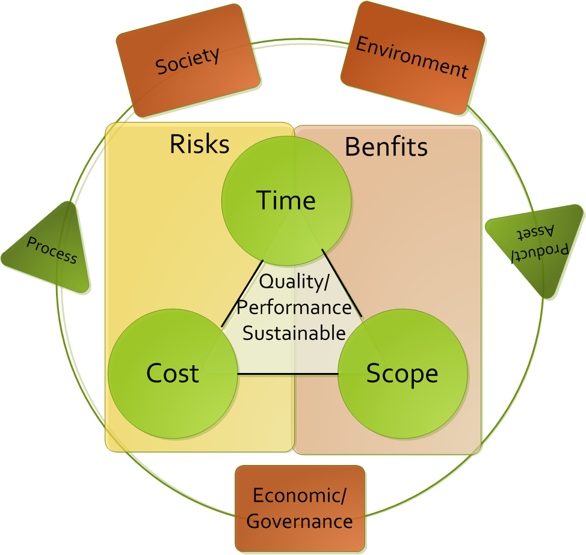
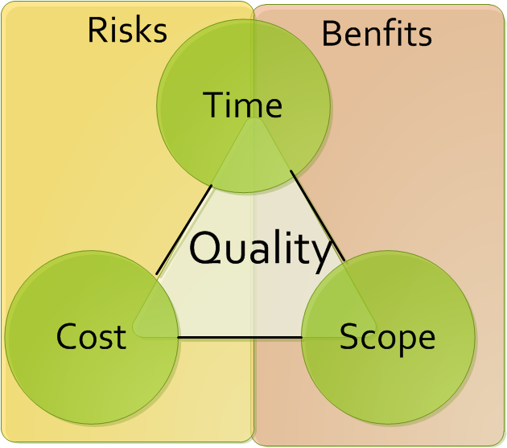
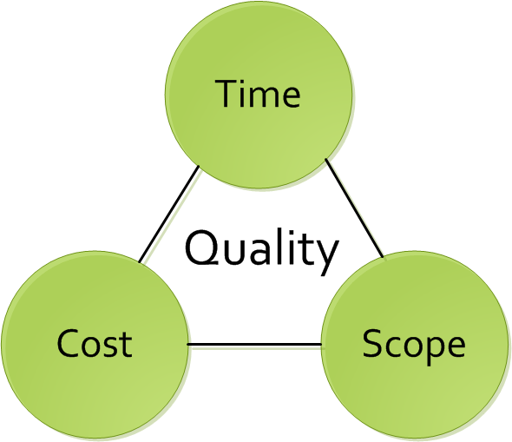
The evolution of Quality
Quality means that the end result produces the intended benefits.
Designed by Martin Barnes in 1978
“The Iron Triangle”
Evolution to a benefits focus to include
Risk and Benefits to emphasize performance
The GPM Standard includes Social, Environmental and Economic/Governance as they relate to the delivery process and asset lifecycle.

Slide 92
Preamble
The customer will have quality requirements
These need to be expressed in measurable terms
Which of these examples are measureable?
The cake must be tasty
The house must have a front door
The car must be able to accelerate to 80 MpH
The patient must survive the surgery

Slide 93
Four quality processes
Quality planning
Prepares to meet stakeholders’ quality requirements
Allows trade-offs between scope, time, cost and quality
Quality assurance
Provides confidence that quality will be achieved
Validates the consistent use of procedures and standards
Uses independent reviews and quality audits
A source of lessons and ideas
Quality control
Inspection, testing and quality measurement
Verifies deliverables conform to specification, are fit for purpose and meet stakeholders expectations
Continuous improvement
Meeting requirements without wasting time or resources

Slide 94
Quality of deliverables
Stakeholders’ requirements and expectations need to be captured
They need to be expressed in ‘provable’ terms so that the project team knows when it has achieved the right quality
Each deliverable needs a set of acceptance criteria to specify its quality requirements/expectations

Slide 95
Acceptance criteria
Answer the question “How good does it have to be?”
Must be measurable
Must relate to the product / deliverables (WBS / Work Packages)
Could have a tolerance

Slide 96
Why manage quality
Quality doesn’t just happen it needs to be planned and managed
More likely to meet stakeholders’ expectations
Failure to manage quality can mean:
Producing what the customer doesn’t want
Not producing what the customer really wants
Wasting time and resource

Slide 97
Techniques in quality planning and assurance
Planning
Defining a project quality plan
Setting up a quality log/register
Training staff
Assurance
Defining a quality management system (QMS)
Setting standards
Conducting reviews and audits
Ensuring staff are qualified

Slide 98
Techniques in quality control
Inspection
Testing
Walkthroughs
Measurement
Ishikawa (Cause and Effect / Fishbone) Diagrams
Pareto Analysis

Slide 99
Quality in work packages
The PM delegates work/products to specialist teams
The Work Package is the formal method of communicating the scope and quality of this delegated work
As well as non-quality information, the work package includes relevant aspects of quality such as:
  Standards
  Specific Processes to be used (specialist and management)
  Change control procedures
  Configuration Management procedures (e.g. version control)
  Acceptance Criteria and sign-off requirements

Slide 100
Benefits of quality management
Right first time
Lowers costs
Improves team morale
Build reputation
Encourages structured and objective thinking
Reduces risk & uncertainty

Slide 101

Quality Principles from ISO 9001
These principles embodied in ISO 9001 have been developed with the intention that management can lead the organization towards improved performance.
Customer Focus
leadership
Involvement of people
Process Approach
System approach to management
Continuous Improvement
Factual approach to decision making
Mutually beneficial supplier

Slide 102
Quality Control Tools
Cause & effect
Pareto chart
Flowchart
Seven quality control tools
Run chart
Histogram
Scatter
Control chart
A P5 Matrix is a Control Chart
Notes:
Cause & Effect (Ishikawa) – is simply a graphical technique to help develop an understanding of how certain causes may lead to a particular effect.
Pareto – a type of histogram that orders the information in a particular way. This gives rise to the Pareto principle that 80% of the problems are the result of 20% of the causes. This enables us to direct problem solving where it will be most effective.
Run Chart – plots the history of a single variable. For example if a key performance criteria for a project was the variance between actual cost and budget cost, this variable could be plotted over time to track its variation and identify trends.
Control Chart – plots value for each of a number of outputs of the same process. It also sets tolerances for the values measured. This allows us to identify if the process is in or out of control. For example plotting the results of a test on each weld on the ship to ensure our welding process was within acceptable control limits.
Scatter – used where there are two variable and we want to see if there is a relationship between them. e.g. the strength of a number of cubes against recorded outside temperatures may show relationship between strength and temperature.
Histogram – plots frequency of variables. The height of the bar shows how often a particular result occurs and the number of bars indicates the range of results.
Flowchart – a graphical representation of a process showing activities and decision points. A flow chart is used to show how different parts of a system interrelate. It can help the project team identify where quality problems may occur or redesign a process to correct problems.

Slide 103
We have covered
Quality planning, quality assurance, quality control and continuous improvement.
The need to manage the quality of the deliverables (products) or service that a project delivers.
The need to manage the quality of the project management process.
Techniques used in quality planning and assurance such as quality plans, audit, procedures/checklists.
Techniques used in quality control and improvement such as inspection, Ishikawa diagrams, Pareto analysis, control charts.
The importance of acceptance criteria for each work package.
Benefits and costs of project quality management.

