Slide 1




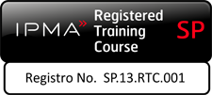
Parte 3
Release 6

Slide 2
Gestión de la Información y los Informes del Proyecto
Versión 6

Slide 3
Gestión de la Información y los Informes del Proyecto
Módulo 18 | El Módulo Cubre | Resultados del Aprendizaje
Gestión de la Información y los Informes del Proyecto | ¿Qué es la Gestión de la información? ¿Qué es el Sistema de Información de la Dirección de Proyectos (PMIS)? Informes del proyecto | Aprender cómo se gestiona la información de los proyecto sy cuál es la función de un PMIS y qué tipos de informes se recomiendan para los grupos de interés y el éxito de los proyectos.
Version
6.0

Slide 4
Propósito
Asegura que la información está disponible para apoyar la toma de decisiones en el momento oportuno
Controla la calidad, la utilización y el mantenimiento de la información en toda la vida del proyecto y después
Soporta los procesos de comunicación
Notes:
Reliable information is required by project stakeholders to enable them to make effective decisions, anticipate and respond to future events such as risks and opportunities and take into account uncertainties and current problems.
Information management is required to ensure that appropriate information relevant to and generated in the course of a project, is made available to project stakeholders in a timely manner to help with more improved decision making.
A project information management plan defines how information will be managed during the life and after the project, the purpose and scope of information products, their ownership, formats, distribution, control, processing, storage and disposal.
The Plan will address the following:
Information Management Objectives
Roles and responsibilities
The process
Documentation and Information Product specifications
Links to the communication plan and process
The way in which information is managed should be established as early as possible in the project. Typically this would be part of the communications strategy in the project management plan.

Slide 5
Procesamiento de Información
Documentos
Comunicar
Almacenamiento
Fuentes
Adquisición
Acceso
Datos
Proceso
Archivo
Recuperar
Notes:
The process will define how information will be acquired, accessed, stored, communicated, disposed of and archived. The Communication Plan will define stakeholder information requirements in terms of scope and timing, the source of the information, the media and format, distribution and ownership.
Sources - data received during the life of project is varied and may be collected in many ways, for example through meetings, from reports on progress and so on.
Distribution - information needs to recorded if relevant and communicated. Key questions such as the level of information needed and who needs to be informed, must be answered.
Recording and storage - records may be handwritten or created electronically. Whichever method is used, records must be maintained to support the project and for auditable purposes.
Access – dependant upon the project and the sensitivity of the data, many organizations will have restrictions on certain data access. Team members will need to be able to have information that allows them to complete their tasks, but some information will be protected from some stakeholders.

Slide 6
Productos de Información Claves
Caso de Negocio
Especificaciones del Producto
Requirements
Plans
Reports
Plan de Gestión del Proyecto
Planes de la Línea Base
Plan de Entrega
Informes (Resaltar los logros, final de etapa, de estado, de materialidad, de cierre, etc.)
Registros (Cambios, Calidad y Riesgos)
Notes:
Documents used to define requirements include the Business Case and Product Specification. These are typically defined during Concept and Definition and updated in the course of the project. Stakeholders involved in these documents are likely to include the project sponsor, project manager, users and operators, external client and corporate management.
Planning documents include the project management plan, supporting plans such as quality, change and risk management plans, and implementation plans such as project networks. These are mainly used by the project team and other stakeholders such as resources managers, to define and control day to day activities.
Control documents include routine progress reports, exception reports, various logs such as quality, change, risk and configuration logs. These are used for both day to day activities and at major milestones to record and communicate status on progress to project stakeholders.

Slide 7
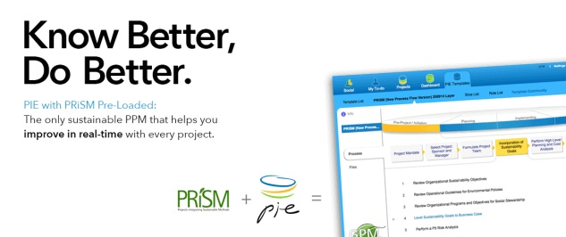
Ejemplo– Pie del PieMatrix
Sostenible
Con base en la Nube
PRISM es parte de la plataforma
Alojado en un centro de datos que funciona con energía renovable
Notes:
We just covered a lot. Time for a quick break.

Slide 8

Características de un PMIS
Colaboración Social
| Panel de estado
| Lista deTareas

Slide 9
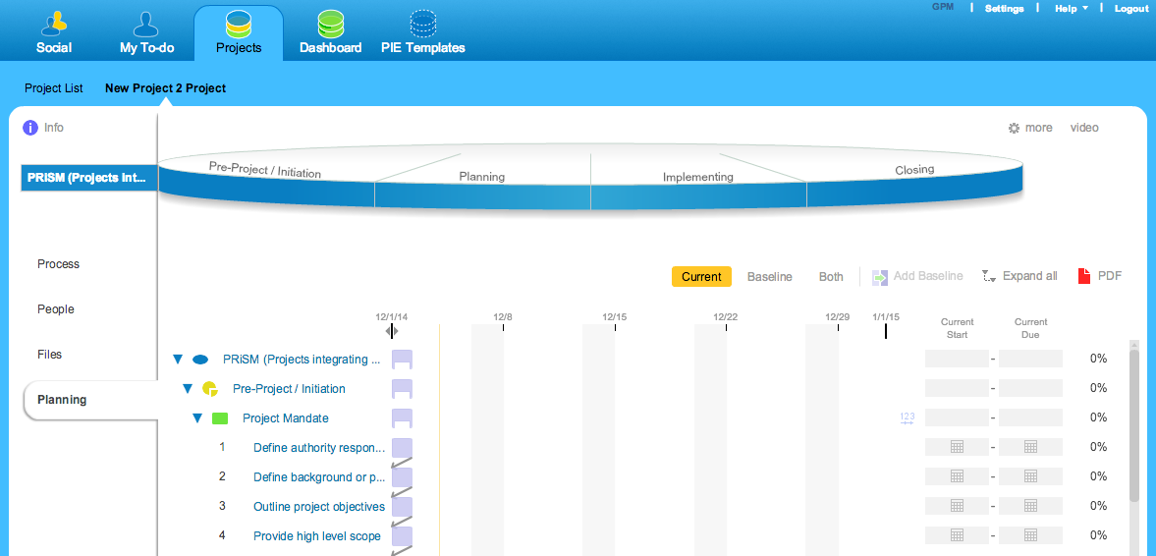
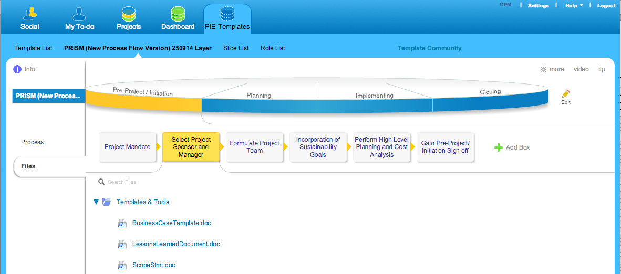
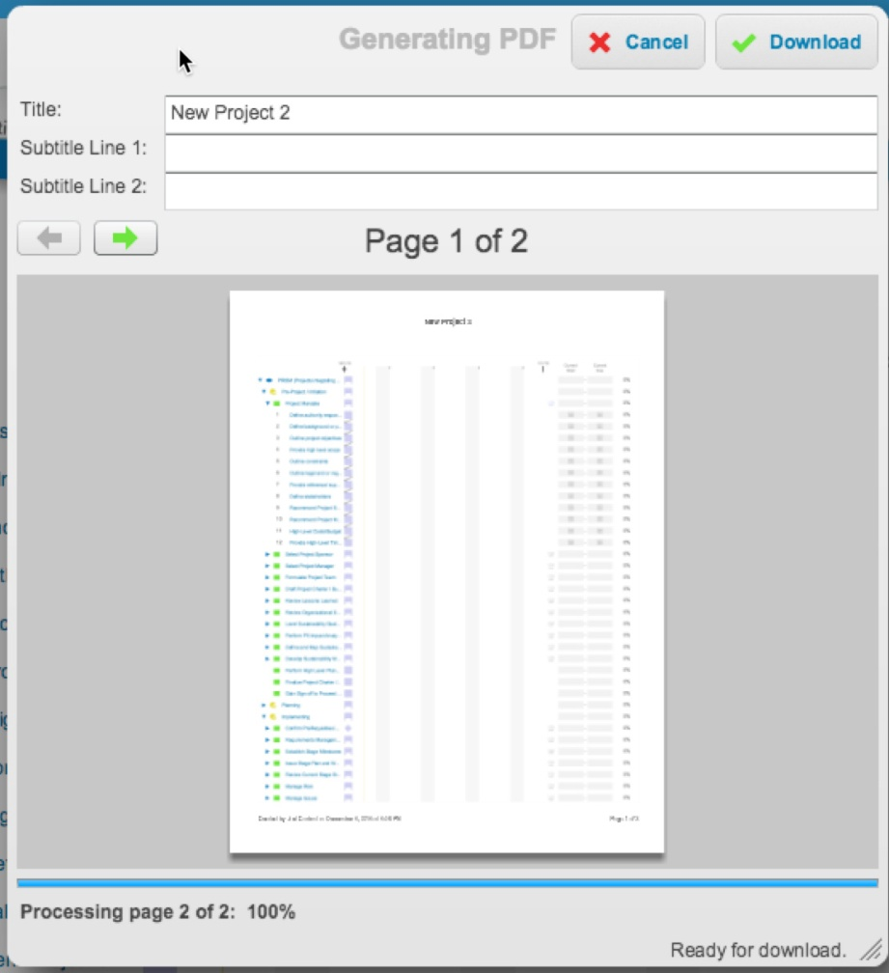
Características de un PMIS
Gestión de Doc.
| Gestión del Cronograma
| Informes

Slide 10
Hemos cubierto
¿Qué es gestión de la información?
¿Qué es un PMIS?
Informes del Proyecto

Slide 11
Liderazgo y Comunicación
Versión 6

Slide 12
Liderazgo y Comunicación
Módulo 19 | El Módulo Cubre | Resultados del Aprendizaje
Liderazgo y Comunicación | Liderazgo Rasgos de Liderazgo Actos Mortales de Liderazgo Comunicación Motivación Responsabilidades | Lograr comprender acerca del liderazgo, lo que significa ser un líder y cómo los líderes se comunican
Versión
6.0

Slide 13

Desarrollar Raíces Fuertes
“"Las personas que dejan de crecer no pueden inspirar a otros. El liderazgo comienza con desafiarse a uno mismo”
– Daisaku Ikeda
Notes:
When you stand at the base of a 100 year old oak tree and look up, one can’t help but be awestruck by its size and strength. What makes this tree so strong though is its foundation. People, are the same. Without a solid foundation, as a tree can sway with the wind, people can lose their way and become misguided.
Project Management is a challenging but rewarding profession. The difference between a good project manager and a great project manager is the foundation and principles by which one adheres to and their ability to impart that to others.

Slide 14

Liderazgo
Gerente Analítico, estructurado, controlado, deliberado, ordenado | ¿Qué hace el mejor Director de Proyecto? | Líder Experimental, visionario, flexible, perseverante, creativo
Utiliza el poder y la lógica de la mente racional Considera los peligros Se concentra en los resultados a corto plazo Sigue visiones Persigue lo tangible Realiza labores Controla Depende de la autoridad |  | Utiliza el poder de la intuición y la lógica del corazón Percibe la oportunidad Se centra en los resultados a largo plazo Crea visiones Busca el potencial Procura lo intangible Persigue sueños Inspira Depende de la influencia
Notes:
Management is doing things right; leadership is doing the right things.
(Ask audience their thoughts on which is best.)

Slide 15
Perspectivas
Mirando hacia Arriba
Mirando hacia Afuera
Gestionando al patrocinador interno para
Gestionando los interesados externos
lograr el compromiso
(incluidos clientes, proveedores y
organizacional
subcontratistas) para asegurar que el
proyecto satisafce sus necesidades
Director de Proyecto Sostenible
Mirando hacia Atrás
Mirando hacia adelante
Monitoreando el progreso
Planificando para asegurar que el
equipo establezca metas realistas
Aprender de los errores
y obtenga los recursos para lograrlos
Mirando hacia Adentro
Mirando a través
Gestionándose a sí mismo revisando su
Asegurando la contribución y
Desempeño para asegurar que su liderazgo sea una
Cooperación de los departamentos
Contribución positiva
al proyecto
Mirando hacia Abajo
Gestionando al equipo a fin de maximizar
su desempeño
Notes:
If the Project Manager is to be a good leader, then they must know where and when to look and lead in the right direction.
They must know when they look upwards towards the Sponsor and Corporate Management, how the performance of their project can affect the strategy of the organization and where it fits into the vision set by those above.
The Project Manager must also know when to look outward, realising that their team alone, may not have the answers to all the projects questions. Here the project manager must learn to influence and direct stakeholders from outside their natural line of management.
A good leader knows when to look forward, to plan and strategise the route ahead for the project, whilst also reflecting backwards on those tasks they have been completed and the lessons that they have learned and brought with them to develop themselves and the team for the future.
Understanding the needs of their team is paramount, whilst also addressing their performance and supporting those in need. Knowing that your project does not lay in isolation, makes the project manager understand the effects that others have on their projects as much as they are dependent on theirs.
A true leader know how to look inward, at themselves and their own performance, knowing they are the standard bearer, the setter of the standards, where self discipline is the highest form of discipline.
To quote an Indian proverb, “Leadership is lifting a person's vision to higher sights, the raising of a person's performance to higher standards, the building of a personality beyond its normal limitations.”

Slide 16

La Mejor Práctica de GPM
Objtivo
Objetivo
Líder
Staff
Gerente
Modelo derivado del término shite-fune (Sheetay - Foonie), que significa dos, pero no dos
Staff
Notes:
The fundamentals of management are required to have success at any levels of project management whereas leadership is a skill that requires the ability to understand the overall goal and inspire others to work alongside you to achieve it.
Can you be a successful Project Manager without having strong leadership skills? Absolutely. Different parts of project management appeal to different people. While one person may excel at building the perfect Gantt chart but due to their personality, isn’t the type that you would send in to a question and answer session when you are bidding on a project. Is this person valuable? Yes.
The same question can be asked in terms of leadership. The long and short of it is that a leader should have the abilities to do the standard project management tasks as well as inspire the team to work towards a shared goal. This is the mark of a true Green Project Manager.

Slide 17
Rasgos Prácticos
¿Esto lo describe?
  Genuinamente interesado en ideas de otras personas;
  ¿Sonríes? Un viejo proverbio chino dice: "Un hombre sin una cara sonriente no debe abrir una tienda.”
  ¿Eres bueno escuchando?
  ¿Ud hace sentir a otras personas importantes u lo hace sinceramente?

Slide 18
Habilidades de Liderazgo
Centrado
Gestiona conflictos
Buen Motivador del Equipo
Flexible y ajustable mediante estilos correctos apropiados
Buen tomador de Riesgos
Influyente y Solucionador de Problemas
Delega y Comunica
Da y Recibe Comentarios Constructivos
Notes:
Key attributes of successful leaders:
Focus -gives clear direction and provides the vision, is fully committed to the project critical success criteria and able to maintain focus throughout the project life.
Manages conflict – a good leader is able to identify conflict, establish its impact on the project and resolve quickly.
Good team motivator – recognises need to manage motivational factors such as recognition, job satisfaction, reward. Recognises success and gives credit.
Flexible and adaptable - able to use an appropriate leadership style to suit the circumstances.
Good risk taker- having situational awareness, so they are able to weigh up the pro’s and con’s and make effective decisions.
Good influencer – able to obtain commitment to project goals from the project stakeholders, including the external and internal team, end-user and subcontractors.
Good problem solver - able to deal with uncertainty through innovation.
Able to delegate – defines clear objectives, empowers, gives authority and responsibility – ensures individual is competent, defines effective rules for escalation, and provides adequate supervision and support.
Good communicator - good networker able to maintain constructive relationships with all project stakeholders and ensure effective communications throughout.
Gives Feedback - able to provide constructive criticism and feedback

Slide 19
Liderazgo Situacional
ALTO
Apoyar
Entrenar/Coaching
Comportamiento de apoyo (Relación)
Delegar
Dirigir
BAJO
ALTO
Comportamiento Directivo ( Tarea)
Notes:
Leading the Individual
One of the best known frameworks for the development of an individual within a team is the Situational Leadership model developed by Hersey and Blanchard. The model was not specifically developed for projects and is a little simplistic for the project environment but it is still a useful framework.
The model describes the developing relationship between leader and team member. The matrix has two dimensions: Task Behaviour and Relationship Behaviour.
Directing
When the team member first arrives there is anxiety, tension and confusion. The leader adopts a task oriented approach, provides specific instructions and closely supervises performance.
Coaching
As individuals begin to understand what is required the leader will spend more time establishing a relationship of trust and mutual understanding. Since the individual may not yet have developed sufficient competency to assume full responsibility for the task it is still necessary to explain decisions and provide the opportunity for clarification.

Slide 20
Enfoques del Liderazgo
Tarea
Procesos de Planificación y Control
Equipo
Individual
Modelo de Tuckman
Liderzago Situacional
Notes:
John Adair identified three overlapping areas of core responsibility: Task, Team and Individual.
Effective leaders are able to balance their focus in these areas according to the situation. If there is too much focus in one area it will have a detrimental effect on the others. Conversely, each area has a positive influence on the others if properly balanced. For example a well thought out Project Management Plan provides effective guidance to the individual and the team. However, a well though out plan can only be achieved through awareness of the team and individual’s needs.
Task - the leader has to ensure that the required task is achieved. This requires the setting of task objectives, control and co-ordination. The leader must maintain focus on the objectives until completion.
Individual - good leaders recognise that each individual has needs that are fulfilled through the task. They understand the needs, strengths and weakness of individuals, and are able to apply the leadership style appropriate to the situation. They are able to produce the motivation and commitment needed for the individual to perform their task.
Team - an effective leader recognises that the team is an entity that also requires direction, information, performance feedback and support, as well as the individuals within the team.

Slide 21
Preparación de los Seguidores
Alto
Capaz y con Confianza
Capaz pero Inseguro
Preparación de los Seguidores
o
Moderado
Incapaz pero con Confianza
Bajo
Incapaz e Inseguro
Notes:
Supporting
As the individual develops high levels of competency and motivation, greater delegation and group decision making is possible. The leader concentrates on developing relationships with individuals.
Delegating
Finally a point is reached where team members are confident in their ability, trusted to get on with the task and have a good relationship with the leader. Both task and relationship behaviour drop to low levels. Complacency on the part of the leader is now, perhaps, the greatest danger.
The parallel development of the individual through these stages can be viewed in a different way. Hersey and Blanchard also identify something called Follower Readiness which is a combination of Ability (knowledge, experience and skill) and Confidence (willingness, commitment and motivation).
A new team member may not have all the necessary ability or confidence. It is the leader’s job to develop both in the individual as they move through the four stages.

Slide 22

Los 5 Actos Mortales del Liderazgo
1. Lujuria
Ejecutivo de Google Forrest Hayes (51 años) fue encontrado muerto en la cabina de su yate de lujo abandonado por una chica llamada de gama alta, muerto de una sobredosis de drogas.
Una cámara de seguridad muestra su cuerpo pasando por encima de Hayes para terminar una copa de vino mientras estaba inconsciente, sin hacer ningún intento de ayudarlo.
Hayes era un hombre casado y padre de cinco y anteriormente ocupó puestos de alto rango en Sun Microsystems y Apple.
Los compañeros de trabajo elogiaron su profesionalismo y ética de trabajo. "Usted nos enseñó a ser mejores ingenieros y un equipo mejor." "Su impacto y enfoque fue tremendo, pero su tacto para inspirar a los que lo rodean es lo que lo hace un líder increíble."
Notes:
Discipline and self-control are crucial. Today you can’t pick up the newspaper without reading of some politician, public or prominent figure of society succumbing to this vice. Cherishing lust will erode your reasoning and cloud your judgement. I can’t say this enough ”think before you act”. Is it really worth it? Can you play with fire and not get burned? If it’s too good to be true, then it probably is. Some pay steeply more than others.

Slide 23

5 Deadly Acts of Leadership
2. El orgullo
Microsoft - Steve Ballmer construyó su propia burbuja.
Apasionado en su creencia de que siempre y cuando él lo
dijera, se podría y se llevaría a cabo; además, estaba convencido de que, siempre que denunciara a gritos cualquier producto o servicio de la competencia sería el final del mismo.
Las estrategias de Windows 8 de Steve Ballmer crearon el desprecio de los medios de comunicación, la burla de los inversores, y relativamente pocos clientes satisfechos. Microsoft comenzó a perder su posición dominante en la industria del software.
Bajo Ballmer, las acciones de Microsoft se desplomaron, perdiendo un 44% durante su mandato.
Notes:
The ego must go. It’s not about you. Build a strong team and surround yourself with smart, passionate and highly competent people.vDeveloping leadership skills is a lifetime project.It’s too easy, as a leader, to feel like you have to be the one who knows everything. Great leaders recognize that they need to keep learning. Additionally, treat everyone with respect at all times whether they are employees, customers, suppliers, or partners. Be humble. The more humble you remain, the more subordinates would be motivated to share their suggestions and recommendations with you. The greater your success, the more you need to stay in touch with fresh opinions and perspectives and welcome honest feedback.

Slide 24

5 Deadly Acts of Leadership
3. Complacencia
Blackberry –Research with no Motion. Cómo los CEOs de BlackBerry perdieron un imperio.
Research In Motion, cuyos teléfonos BlackBerry pioneros de los correo electrónico inalámbricos, ya no comanda el mercado de teléfonos inteligentes.
La firma era la canadiense Research In Motion (RIM), cuyo BlackBerry prácticamente creó el mercado de teléfonos inteligentes. El éxito había llegado casi de manera natural a la empresa, hasta que Apple lanzó su estrategia de larga data del primer iPhone; Apple expandió el mercado con un teléfono inteligente no sólo para gente de negocios, sino para la gran masa de consumidores de tecnología. El éxito de Apple abrió la puerta para otro gran competidor, con mucho dinero: Google, con la adquisición y el desarrollo de Android. El panorama móvil cambió drásticamente - nuevos competidores, nuevos clientes y nuevas alianzas - y RIM cometió errores costosos luchando por adaptarse.
Notes:
Get rid of Complacency. Embrace Change. Be adaptable. Consumer needs and the market place are ever evolving. The global playing field has leveled. As a result of continuous technology acceleration, the change is rapid, inevitable and unstoppable. Listen to what your customers and employees are saying and go back to the drawing board. I remember once making a recommendation to a boss and being told thanks but no thanks. “This is how we have always done things and we will continue to do it this way.”

Slide 25

5 Deadly Acts of Leadership
4. La Codicia
La muerte a los 57 años de edad, del banquero Richard Talley, Director General de American Title Services (ATS) con sede en Denver fue acompañado por el hecho de que su firma estaba siendo investigado por los reguladores de seguros.
Los fiscales habían puesto en marcha una investigación criminal por sobre $ 2 millones faltantes en sus cuentas de depósito en garantía. Talley se suicidó.
La policía lo encontró vestido para el trabajo, sentado en su coche. Los registros muestran que Talley debía ser confrontado, sobre los fondos de garantía que faltaban, la mañana murió. ATS se declaró en liquidación por quiebra poco después del suicidio de Talley.
Notes:
GREED and Dishonesty go hand in hand. Reputation, Integrity and Credibility is everything. Your reputation, whether good or bad will spread faster than a viral video on YouTube. Once lost it is extremely difficult to regain.

Slide 26

5 Deadly Acts of Leadership
4. La Envidia
Hewlett Packard - La disfunción pública comenzó con la lucha interna feroz sobre la fusión de HP con Compaq en el 2002, que alcanzó su punto más bajo cuando el CEO de alto perfil de la empresa, Carly Fiorina, ridiculizó a Walter Hewlett, miembro del Directorio e hijo del fundador de la empresa, por atreverse a expresar su oposición. Hubo un Directorio dividido por las disputas y tan fuera de control que algunos directores filtraron secretos a la prensa, mientras que el presidente del Directorio contrató investigadores privados para obtener registros telefónicos y poder descubrir a los autores. Esto provocó la repentina dimisión del ex presidente ejecutivo, Mark Hurd.
Notes:
Executive infighting and power struggle. If you don’t control your emotions, they will control you. Envy is like a consuming vine and can lead to anger, resentment and bitterness.

Slide 27
Motivación - Autonomía
La necesidad que la gente tiene de darse cuenta de que tienen opciones, que lo que están haciendo es por su propia voluntad, y que son la fuente de sus propias acciones.
La forma en que los líderes enmarcan la información y las situaciones promueve la probabilidad de que una persona vaya a percibir la autonomía o atente contra ella.
Enmarque objetivos y líneas de tiempo como información esencial para asegurar el éxito de una persona, en lugar de dictarlos como forma de hacer que las personas sean responsables.
Absténgase de incentivar a la gente a través de concursos y juegos. Pocas personas han aprendido la habilidad de cambiar el motivo por el que están compitiendo desde un motivo externo (ganador de un premio o la obtención de estatus) a uno de mayor calidad (una oportunidad para cumplir una meta significativa).
No aplique presión para llevar a cabo. El rendimiento máximo sostenido es el resultado de personas que actúan porque eligen - no porque se sienten que tienen que.
Harvard Business Review November, 2014

Slide 28
Motivación – Relación/Afinidad
Relación es la necesidad de las personas de cuidar/preocuparse y ser cuidados por otros, sentirse conectados a otros sin preocupaciones por motivos ocultos, y sentir que están contribuyendo a algo más grande que ellos mismos.
Los líderes tienen una gran oportunidad de ayudar a la gente a entender el significado de su trabajo.
Valide la exploración de los sentimientos en el lugar de trabajo. Esté dispuesto a preguntar a la gente cómo se sienten acerca de un proyecto o meta asignada y escuchar su respuesta. Todo comportamiento puede no ser aceptable, pero vale la pena explorar todos los sentimientos.
Tómese el tiempo para facilitar el desarrollo de los valores de las personas en el trabajo – luego ayuden a alinear esos valores con sus objetivos. Es imposible vincular el trabajo con los valores si los individuos no saben cuáles son sus valores.
Conecte el trabajo de las personas a un propósito noble.
Harvard Business Review November, 2014

Slide 29
Motivación - Competencia
La competencia es la necesidad de la gente a sentirse eficaz en el cumplimiento de los desafíos y oportunidades de todos los días, demostrando habilidad con el tiempo, y sintiendo un sentido de crecimiento y florecimiento.
Los líderes pueden reavivar el deseo de las personas a crecer y aprender.
.
Ponga a disposición los recursos para el aprendizaje. ¿Qué mensaje envía sobre los valores sobre el aprendizaje y el desarrollo de competencias cuando los presupuestos de formación son la primera víctima de los recortes económicos?
Establecezca metas de aprendizaje - no sólo las orientados a los resultados tradicionales y a los objetivos de resultados.
Al final de cada día, en lugar de preguntarse: "¿Qué lograste hoy?" Preguntarse "¿Qué aprendiste hoy? ¿Cómo creciste hoy de modo de ayudarte a tí y a otros mañana?”
Harvard Business Review Noviembre, 2014

Slide 30
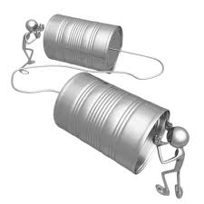
Planificación de la Comunicación
Requisitos de Información
Mecanismos de Comunicación
Frecuencia de Distribución
Fuentes de Información
Tratamiento de la información y colación
Roles y Responsabilidades
Notes:
Primary forms of communication
Verbal
Body language
Written
Environment
A Project Manager depends on a communication network. This may be formal or informal.
Channels of communication
Active
Passive
When developing a Communication plan, the first step is Stakeholder analysis. It is important to know what your audience wants to know, when they want to know it, how they want it presenting and how often they want it. The Project Manager must understand where their information is coming from and if they are receiving any assistance in collating or collecting the information. One last consideration is to understand how as a Project Manager you will approach the dissemination of unexpected information. The majority of this time the news is bad, knowing your team and trying to anticipate their reaction needs many hours of team development and understanding by the Project Manager.

Slide 31
Barreras a la Comunicación
Alcance de las Experiencia de la Fuente
Alcance de la Experiencia del Receptor
Mensaje
Ambiental
Antecedentes
Entendimiento Mutuo
Fuente
Receptor
Personal
Organizacional
Retroalimentación
Send Reinforcements, we are going to advance .....
Send Three and Four pence, we are going to the dance
Notes:
Barriers to communication
In the simple model above there are in effect four potential barriers that the communication navigate.
Environmental - Noise, temperature and air fall into this category
Background – individuals are influenced by their technical, social and educational backgrounds. It is also important to consider social and cultural differences.
Personal - Tiredness, hunger, thirst, etc. any affect ability to communicate well. Permanent or temporary loss of vision, sight, hearing, etc. can have an impact on sending and receiving communications. Personal prejudices also have an impact.
Organizational - The relative position or status of the individual will clearly have an impact. For example, individual to peers, individual to boss, individual to subordinates. These relationships may affect the quality of the communication process.

Slide 32
Responsabilidades en las Comunicaciones
Beneficios
Riesgos
Factores Ambientales
Usuarios
Gestión Corporativa
Caso de Negocio
Cambios
Lograr los Criterios de Éxito
Indicadores Claves de Desempeño
Riegos del Proyecto
Mejoras
Foco y Motivación
Integración y Coordinación
Consciencia Socially y Ambiental
Patrocinador
Director de Sostenibilidad
Longer Term
Day to Day
Notes:
The main communication responsibilities for the Project Sponsor and Project Manager differ. In essence the Project Sponsor is mainly concerned with the longer term, i.e. achieving the benefits whereas the project manager is actively managing the project on a day to day basis.
The project sponsor is more likely to be communicating with project external stakeholders such as users, corporate management and regulators. The project manager on the other hand is more likely to be concerned with project internal communications and keeping the project moving to achieve its critical success criteria.
Effective communications between the project sponsor and project manager is therefore crucial to the successful management of the project.

Slide 33
Hemos cubierto
Liderazgo
Rasgos de Liderazgos
Actos Mortales de Liderazgo
Communicación
Motivación
Responsabilidades

Slide 34
Conflicto y Negociación
Versión 6

Slide 35
Conflicto y Negociación
Módulo 20 | El Módulo Cubre | Resultados del Aprendizaje
Conflicto y Negociación | Preparación de la Negociación Habilidades de Negociación Las Tácticas de Negociación La Resolución de Conflictos Enfoques de los Conflicto | Este módulo abarca la forma de abordar las negociaciones y cómo gestionar el conflicto..
Versión
6.0

Slide 36
Preparando el Escenario para las Negociaciones
Requisitos previos a la Reunión
Comprender las diferencias entre los Intereses de las Partes Interesadas
  ¿Hay diferentes puntos de vista o enfoques?
  ¿Qué autoridad existe?
  ¿Hay algún poder o influencia?
  ¿Cuáles son sus límites de tolerancia?
  ¿Cuál es el impacto del fracaso? ¿y del éxito?
Notes:
All projects involve negotiations. The art of negotiation in projects is to balance the needs of the project with the needs of the stakeholders involved in the negotiations.
In projects therefore, the aim of negotiations should be to develop a ‘win-win’ solution that is in line with the overall project objectives and needs of the stakeholders.
A pre-requisite stage for any negotiation is to conduct a stakeholder analysis in order to anticipate the needs of the stakeholders involved, their authority (e.g. are they able to make formal agreements), their relative power and influence.
It is also important to understand the negotiation limits and impact on the project in terms of success or failure.

Slide 37
Proceso de Negociación Process
¿Cuáles son sus Objetivos?
¿Cuáles son los objetivos de la otra Parte?
¿Cuáles son las Variables?
¿Cuál será su Oferta de Apertura?
¿Dónde está usted dispuesto a hacer concesiones?
Preparación
Presente a las Partes y Explique sus Roles
Presente sus Objectivos
Invite a la otra Parte a Presentar sus objetivos
Acuerde una Agenda Holgada
Apertura
Presente su Oferta
Evalúe la Respuesta de la otra Parte
Negocie los temas Específicos
Busque un Acuerdo
Negociación
Concesiones Mutuas Finales
Resuma los Acuerdos y Acciones
Programar Futuras Negociaciones
Cierre
Notes:
The major part of the negotiation process is broken down in four distinct areas.
Preparation – the selection and briefing of the negotiation team on the definition of objectives, consideration of the other party’s objectives, defining the variables, and a strategy including opening offer, bargaining limits and concessions that can be made.
Opening – introductions, objectives should be stated by both parties, an agenda and the rules of the negotiation should be agreed.
Bargaining – collaborating to achieve a win - win solution. Present offers, evaluate responses, bargain and seek agreement.
Closing – conduct final trade offs before starting to closeout, summarise the findings of the negotiations and record and approved all agreements made, follow up actions needed to be taken before future meeting and conclusions reached. Agree the timetable for any further negotiations if necessary.

Slide 38
El Poder de la Negociación
Recompensa
Referente
Coercitivo
Experto
Legítima
Informacional
Notes:
Having done the pre requisite research that helped you prepare for the negotiations, you may have identified a potential edge that you could have during the meeting. These types of advantage or edge can come in various forms of power.
Reward Power - ability to dispense rewards to entice the other party, such as bonuses.
Coercive Power - threat of taking something away if one party does not accede to the desires of the other.
Legitimate Power – one party has genuine authority over the other.
Informational Power – an advantage gained because one party has access to relevant key information that the other party does not have.
Expert Power – experience that provides an advantage.
Referent Power – derived from reputation for fair dealing, development of long term relationships and trust.

Slide 39

Tácticas
Libere Presión
Se acabó el tiempo
Silencio
Coerción
Preguntas dirigidas/maliciosas
Las concesiones no balanceadas
Segmentación
Desafiante
Notes:
Parties may use various tactics during bargaining to achieve their objectives. Tactics can be used positively or negatively.
Pressure Release – a concession may be offered as a way of apparently breaking a stalemate. Stand firm and hold the planned limits. Do not concede unless the concession is beneficial. Make a counter offer or take time out if further consideration is required.
Coercion, intimidation – ignore any emotive aspects and maintain focus on the key objectives. Maintain an assertive approach and continually remind the other party of the overall objectives. Agree rules at the beginning to reduce the possibility of coercion and intimidation. Use an expert negotiator/facilitator.
Unbalanced Concessions – making concessions that have much greater value to one party than the other. Maintain awareness, or make rough assessments of the value of the offer. Explain your perception of the concession to the other party.
Challenging – the right amount of challenging can be constructive, too much can be destructive. Keep positive and acknowledge the other party’s position. Keep focused on the objectives and take time out to consider appropriate responses with your team.
Time out – the parties break into their teams to discuss the situation and tactics privately. Time outs are useful when the negotiation team experiences fatigue, loss of concentration, or gets ‘bogged down’. Over use of time outs can be disruptive. Only agree to Time out requests if beneficial. Agree time scales and rules for taking time out, prior or during the introduction stage.

Slide 40
Key Skills
Use Questions to Persuade
Label your Behaviour
Be Innovative
Don’t Dilute a good Argument
Use Questions to Control
Set Deadlines
Test & Summarize
Notes:
As well as tactics, it is important that the other party knows and understands who they are dealing with. There are certain skills that you can use to control a meeting. Keep in mind however, you are there to achieve a win-win scenario and not to over power or bully your counterpart.
Label your behaviour – give warning signals and signposts to avoid surprises and shocks. Indicate when you intend to ask a question.
Test and Summarize - test common understanding, summarise agreements and clarify key points at appropriate times.
Don’t dilute a good argument – use few strong points rather than many weak ones.
Use questions to persuade – structured questions can enhance a case and weaken resistance.
Use questions to control – asking questions can give control and more time to think.
Set deadlines – setting time limits can motivate towards achieving an agreement.
Be innovative - look for possible points of conflict and search for innovative solutions.

Slide 41
Gestión de Conflictos
…Debido a que cada proyecto funciona sin problemas
(photo from imdb.com)

Slide 42
Causas de Conflictos
El conflicto es la expresión emocional, verbal, escrita o física de las diferencias en cuanto a deseos, necesidades o expectativas entre dos o más individuos.
El conflicto impacta directamente en el comportamiento, la toma de decisiones y la capacidad para completar las tareas asignadas.
El conflicto es inevitable en el lugar de trabajo; no puede ser eliminado.
La clave para un lugar de trabajo funcional es la capacidad de minimizar la escalada del conflicto y, en definitiva resolver las diferencias.

Slide 43
Modelo de Progresión del Conflicto:
Evento disparador / Punto Caliente
Comportamiento Resultante
Consecuencias del comportamiento resultante
Notes:
Conflict exists where there are differences between individuals or groups and must be managed throughout the project life cycle.
Conflict may occur between stakeholders throughout the life cycle.
Project managers should anticipate potential conflicts and their significance and deal with them before they cause negative impacts on the project.
Often conflict is caused through lack of understanding, lack of facts or because individuals have different interests, beliefs and values.
Conflict may either be destructive (having an adverse effect on a project) or constructive (positive benefit). For example, if the cause of a conflict is due to a technical misunderstanding it is beneficial to bring this into the open and involve all interested parties. Conversely, destructive conflict typically occurs due to differences values, beliefs, feelings and background. Because these are usually emotively based they are more difficult to resolve and require sensitivity and empathy.
If conflicts cannot be resolved, they may need to be escalated to higher authorities, or specialist facilitators.

Slide 44
Costos Cualitativos del Conflicto
Estrés, frustación, ansiedad
Pérdida de Sueño
Relaciones torcidos o rotas
Agravios y Litigios
Ausentismo de los empleados
Rotación de empleados
Pérdida de productividad
Disminución de la calidad de servicio al cliente
Lesiones y accidentes
Demanadas por Incapacidad
Sabotage

Slide 45
Costos Cuatitativos del Conflicto
El valor total de tiempo de trabajo perdido debido a estrés se estima que sea $1.7 billion. (WarrenShepel online], Health &Wellness Research Database, 2005)
La tasa de presentismo se estima que sea hasta tres veces mayor que la ausentismo.
El conflicto representa el 90% de las salidas involuntarias (Dana, Dan, [online] The Dana Measure of Financial Cost of Organizational Conflict, 2001)
42% del Tiempo de un Manager se gasta en abordar conflictos en el lugar de trabajo. (Watson, C & Hoffman, R, Managers as Negotiators, Leadership Quarterly 7(1), 1996)

Slide 46
Modelo de Gestión de los Conflictos
Causas Raíces
Causas
Análisis Causa y Efecto
Conflicto
Resolución
Análisis de Interesados
Fuentes
Necesidades y Poder de los interesados
Notes:
The model is based on the work of Blake and Mouton and provides a framework for understanding and resolving conflict.
Causes - the subjects such as timescales, or priorities, changes.
Sources - the people involved in the conflict.
Conflict – the nature of the problem or issue, and its intensity.
Intensity may be defined as the combination of magnitude (say impacts on project objectives) and frequency (how often the conflict occurs).
Two techniques that support conflict management are:
Cause and Effect Analysis – establishing the root cause will help to determine how often it is likely to occur and will enable conflict intensity to be determined. Root causes often lead to the definition of preventive measures.
Stakeholder Analysis – understanding the needs and influences of the stakeholders will help to prevent conflict situations arising, or in the event of conflict, it will enable effective management strategies to be used.
Preventing conflict may also be covered by appropriate risk management.
A number of methods may be used to manage conflict such as formal negotiations, mediation and workshops, depending on the nature of the conflict and stakeholders involved.

Slide 47
El Conflicto a través del Ciclo de Vida
Concepto
Definición
Implementación
Entrega y Cierre
Ideas
Beneficios
Opciones
Financiación
Beneficios
Requerimientos
Opciones
Financiación
Criterios de Éxito
Riesgos
Cronogramas
Prioridades
Recursos
Cambios
Incidencias de Desempeño y Tecnológicas
Riesgos
Acepción
Firms/ganchos
Desmovilización
Actividades de Entrega
Riesgos
Causa
Patrocinador
Gestión Corporativa
El patrocinio de organismos
Patrocinador
Usuarios
Gestión Corporativa
Clientes Externos
Patrocinador
Director de Proyecto
Equipo de Proyecto
Sub Contratistas
Administradores de Recursos
Patrocinador
Operadores
Usuarios Finales
Equipo de Proyectos
Autoridad de Aceptación
Grupos BAU (Business as Usual
Fuente
Project Life Cycle
Notes:
Conflict occurs throughout the project. The nature and scale of conflict is directly related to the activities undertaken and the stakeholders involved.
Understanding where and who might be involved in the conflict will help the Project Manager in its early identification and resolution.

Slide 48
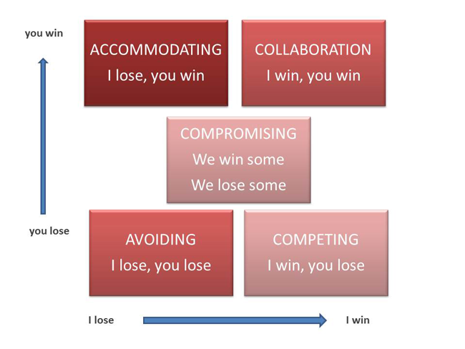
Resolución de los Conflictos
Notes:
The diagram above based on Thomas Kilman Model, shows strategies for managing conflict.
Competition (Win/Lose) – where one party drives to meet their own interests and disregards the other’s interests.
Avoidance (Lose/Lose) – withdrawing from conflict; where one party is unable to influence the more dominant party and wishes to avoid conflict.
Accommodation (Lose/Win) - the party is prepared to submit or comply to the other’s interests.
Compromise (Win/Win – Lose/Lose) – parties trade gains against losses.
Collaboration (Win/Win) - typically found in high performing teams, a problem solving style where parties confront issues and seek solutions that meet the interests of both parties.

Slide 49
Enfoques de los Conflictos
  Competencia/Forzado
  Adaptación
  Evasión
  Colaboración
  Compromiso
Notes:
Common strategies or approaches used to manage interpersonal conflict are shown above and described in more detail below:
Avoidance (Withdrawing) – contentious issues are avoided. This strategy is more likely to cause or exacerbate conflict in the long term, especially if issues are of significant importance. Useful where conflict issues are trivial, where the damage from conflict outweighs the benefits, or to reduce tension.
Accommodation (Smoothing) - playing down differences and emphasising common interests; issues that might cause divisions or hurt feelings are not discussed. It may be useful to preserve harmony and maintain focus on important factors.
Compromising - splitting the difference, bargaining, search for an intermediate position. No one loses but no one wins. Useful when there is a need to avoid disruption, achieve temporary settlements, where time is critical.
Competition (Forcing) – where one person can use their authority through knowledge or position to force a solution. A win-lose situation; use when quick decisive action is required such as emergencies, where time is critical and will not allow other solutions to be achieved.
Collaboration (Confrontation) – open exchanges of information about the conflict or problem as each sees it, and a working through of their differences to reach a solution that is optimal to both. Both can win. Useful when it is too important to compromise, there is a need to gain commitment or better understanding.

Slide 50
Hemos Cubierto
Preparación de la Negociación
Habilidades de Negociación
Tácticas de Negociación
Resolución de Conflictos
Enfoques de los Conflictos

