Slide 1


Parte I
V 5.0

Slide 2
About the presenter
Industrial Engineer MBA, GPM-M, PMP with more than 25 years of experience in Electrical Companies: Telecomanded electric grid, Marketing and Communications, Corporate Social Responsibility.
Implementation and improvement of Organizational Management Systems according to ISO 9001, ISO 14001, ISO 26000, OHSAS 18001 y Argentinean Resolucion ENRE 057/2003 Public Safety for Electric Power Transmission in High and Medium Voltage (Since 2000).
She was part of the Communication Committee and Environmental and Sustainable Development Committee of Electricité de France (EDF) Branch America along with colleagues from France, Brazil and Mexico (2002-2004).
As independent contractor, she is Organizational System Manager at Baresi SRL a Polyolefin Recycling Company (since 2005); and Professor of CSR and Sustainable Development at GSPM, University for International Cooperation –UCI- Costa Rica (since 2013).
Founder member and volunteer of PMI Nuevo Cuyo Argentina Chapter ( 2008-2013). Liaison of PMI Educational Foundation in PMINC (2010-2012).
Council member in PMI Global Sustainability Community of Practice (2010-2012)
Countributor member of the PC/ISO 236 Project Committee: Project Management, and then ISO/TC 258 – Technical Committee: Project, Program, Portfolio Management. (Since 2011)
Member of the GPM Global Leadership Executive Team for Latin America. Main Assesor for the GPM® y GPM-m® Certifications in Latin America and Spain (Since oct2012).
Co-autor: The GPM® Reference Guide to Sustainability in Project Management and The GPM Global P5 Standard for Sustainability in Project Management.
Monica can be contacted at: monica.gonzalez@greenprojectmanagement.org
Mónica González

Slide 3
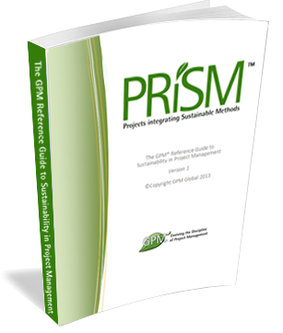
Course Kit
  You will be provided with:
  A One year Membership to the GPM to have access to:
    The GPM Reference Guide to Sustainability in Project Management eBook
    Responsible Management Education eBooks
    The Sustainability Calculator and other PM Templates
    USE CODE Agentofchange2015
    Visit members.greenprojectmanagement.org and select “partner discounted membership” enter the code in the discount code section
  And at the End of this course:
  A certificate of completion
  *PDUs or Professional Development Units are granted to the attendees completing the course.
  The GPM-b Certification for those who pass the exam.
*If Partner is a PMI REP, a code shall be provided, if not, Class B PDUs can be elected.
Notes:
Have the participants go to http://members.greenprojectmanagement.org and sign in using the PARTNER DISCOUNT MEMBERSHIP and add the code to receive a year for free.

Slide 4
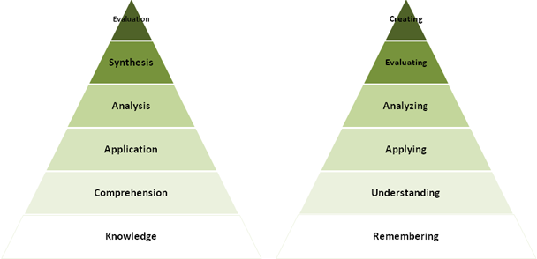
We will cover
This course will impart the knowledge and skills for
Project management using sustainable methods.
Where many training courses focus on knowledge, or memorization, we use an andragogical approach to ensure retention with a strong emphasis on “hands on”.
Course Modules
Sustainability Drivers
Systems Thinking - ISO
Ethics Principles and Values
Governance, Portfolio and Program Management
Organizational Capacity for Change
Business Case, Benefits and Value Management
Requirements Management
Project Management
Life Cycles and PRiSM
P5
Project Controls
Issue and Risk Management
Organizational Structures and Roles
Sponsorship
Stakeholder Engagement
Performance and Quality
Information Management and Reporting
Situational Leadership and Communication
Conflict and Negotiation
Notes:
We just covered a lot. Time for a quick break.

Slide 5
Learning Objectives
PRiSM™ Practitioner is a project management course that incorporates best practices, sustainability principles and governance in order to maximize value. The course places an emphasis on aligning benefits with strategic objectives to ensure that each project positions the organization for long-term growth and success through positive impacts to the economic, environmental, and social bottom lines.
The aim of PRiSM™ Practitioner is to train, educate, and develop individuals in project management and sustainability to improve the management and delivery of all types of projects within the set performance, time, cost and integration criteria throughout their own organization and to show how these changes can best be integrated into business as usual and become the normal embedded practices for the organization.

Slide 6
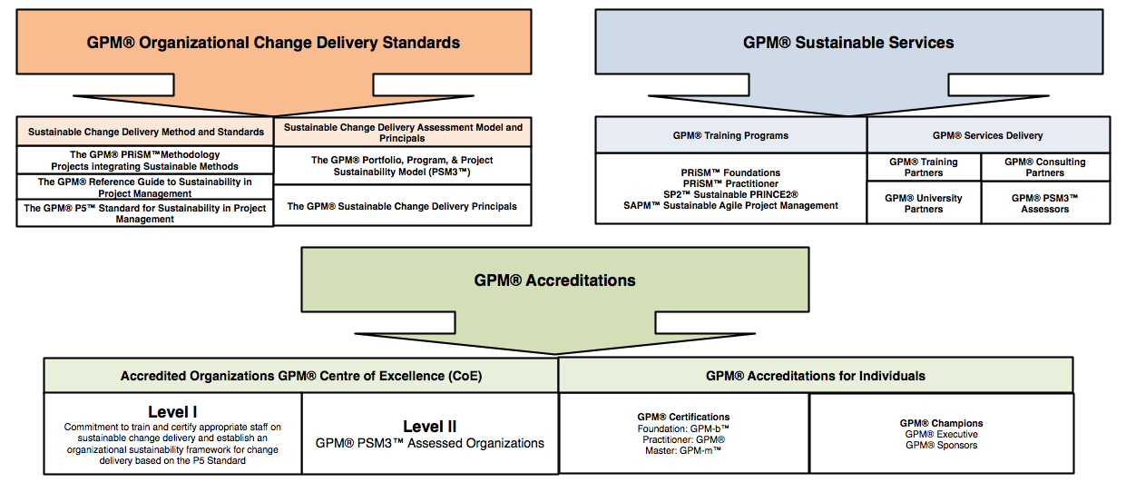
Introducing GPM
Notes:
GPM is a Social Enterprise established to address issues and profits realized are reinvested in the business with the aim of increasing social impact. Unlike a Non-Profit, the business is not dependent on donations or on private or public grants to survive and to operate, because, as any other business, it is self-sustainable and unlike a Non-Profit, where funds are spent only once on the field, our funds are invested to increase and improve the business' operations and the tools we offer to our partners. Our construct is unique among project management organizations in that we are able to function as a company and put into practice what we encourage others to do. (The GPMG Accreditation Board, is a separate not-for-profit organization that governs all GPM certifications.)

Slide 7
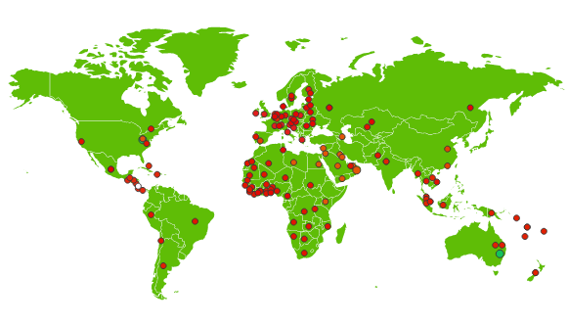

Active in over 140 countries and growing
GPM is the largest sustainability training organization in the world.
(The Sustainable Project Management Organization.)

Slide 8




Our Sustainability Affiliations
United Nations Global Compact
  First Project Management Professional Development Organization to become a signatory
United Nations PRME (Principles for Responsible Management Education) Supporting Organization
  One of only 14 worldwide
The Earth Charter Endorsers
  GPM founders have taken part since the initial 2001 Summit
UN Business for Peace Initiative
  GPM is a founding signatory

Slide 9

Our Focus – Change Delivery
Certification
  GPM-b™
  GPM®
  GPM-m™
Methodology
  PRiSM™
Assessments
  PSM3™
Training
  PRiSM™ Courses
  SP2™
  SAPM™
Notes:
What is SAPM?

Slide 10
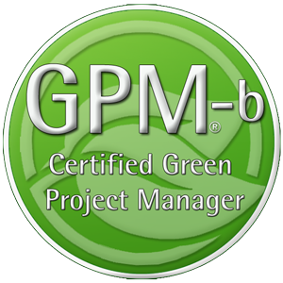
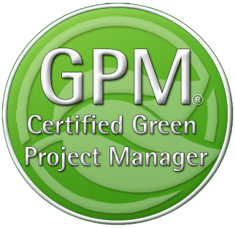

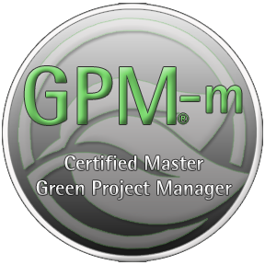
GPM Certifications
The GPM-b - Knowledge based foundational
Certification
The GPM® - Proficiency based Practitioner
Level Certification
The GPM-m - Proficiency Based Master
Level Certification
Notes:
GPM Adheres to ISO 17024, Certification of Professionals. All GPM Certifications are issued by the GPMG Accreditation Board, A semi-autonomous organization that provides governance and oversight

Slide 11
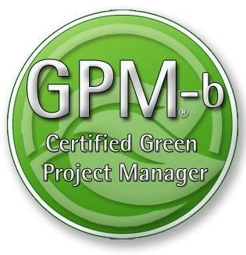
Certification
This course will prepare you for the GPM-b Certification.
The Certification Exam Format
To earn the Green Project Manager level B (GPM-b) credential, candidates must have 2,000 hours of project experience, and pass the 150 multiple choice question examination with a minimum passing score of 75%. The Exam is broken down into two primary sections as listed below.
1. Project Management
1.1. Project Management Standards based on ISO 21500
1.2. Project Management Competencies
1.3. Project management Knowledge Areas
1.4. Key Terms and Concepts
2. Sustainability Integration
2.1. Why Sustainability
2.2. PRiSM™
2.2.1. P5™
2.2.2. Sustainability Management Planning
2.2.3. Phases, inputs and outputs
2.3. Sustainability ISOs
2.3.1. The Energy Management Standard ISO 50001
2.3.2. The Environmental Management Standard ISO 14001
2.3.3. The Guidance on Social Responsibility ISO 26000
2.3.4. The Quality Management Standard ISO 9001
This course will prepare you for the IPMA Level D
Certification

Slide 12
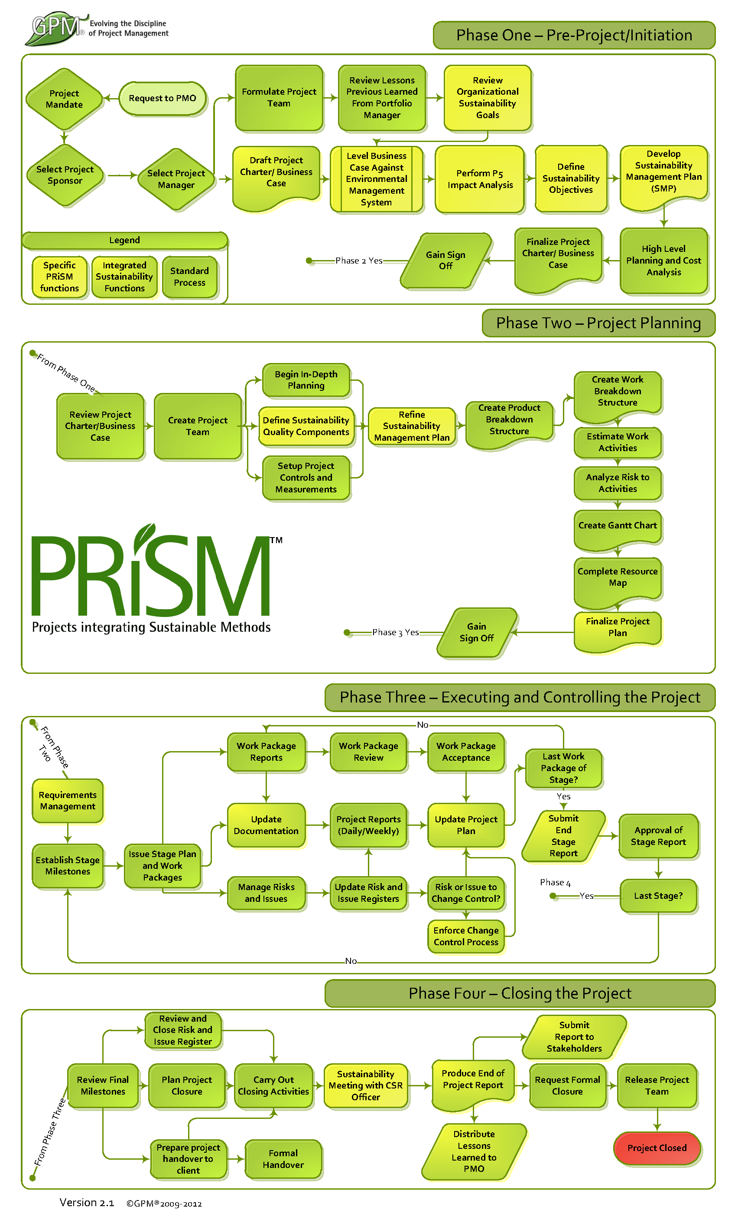
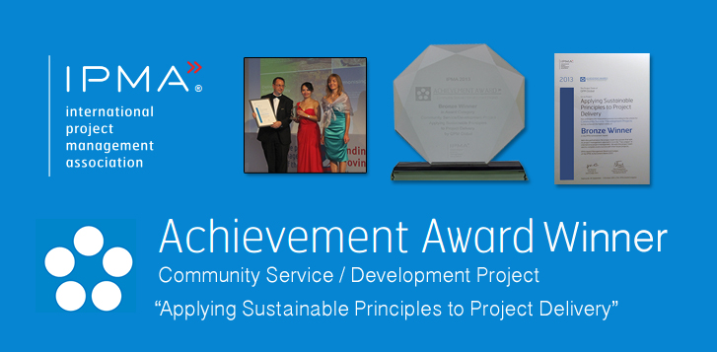
Industry Recognition
PRiSM is our structured project methodology that incorporates
ISO standards for:
Quality
Energy Management
Environmental Management
Corporate Social Responsibility
Project Management
The United Nations Global Compact Ten Principles for Sustainability
GRI G4 Framework
IPMA ICB 3.0 Competence Baseline
Notes:
GPM earned an achievement award from the International Project Management Association for the development of PRiSM.

Slide 13
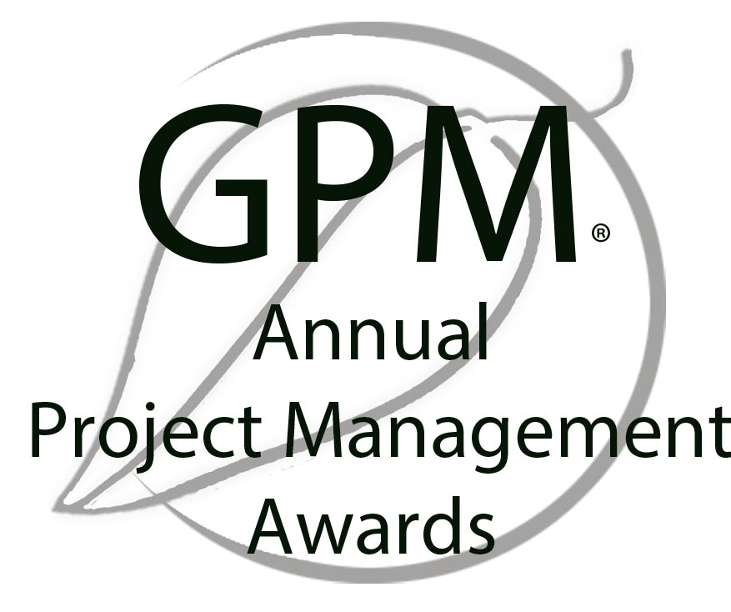
Award Yourself and/or a Colleague!
Project of the Year
  Gold and Silver
Sustainability Award
Fundamentals Award
The GPM® Fundamentals Award is bestowed upon the person who submits the most thorough EnVex in a PRiSM Practitioner course in a given year.
EnVexes are in-course-virtual-projects that are taken from real life case studies. These exercises challenge course participants to apply what they learn in the course to achieve project objectives while realizing benefits from a social, environmental, and economic standpoint.
2013 Award Winner – Anna Wang – Volkswagen Financial Services

Slide 14
Sustainability Drivers
Module | Module Covers | Learning outcomes
# 2 Sustainability Drivers | Sustainability Challenges The UN Global Compact UN PRME Initiative The Global Reporting Initiative The Post 2015 Business Engagement Architecture | Understand current challenges with sustainability from a business perspective, the driving force for business to engage in sustainability and the organizations driving the way forward.
Language
English
Version
5.0

Slide 15

A Growing Problem
According to Global Footprint Network’s calculations, our (global) demand for renewable ecological resources and the services they provide is now equivalent to that of more than 1.6 Earths.
The data shows us on track to require the resources of two planets well before mid-century.
(We don’t have 1.6 Planets)
http://www.footprintnetwork.org/en/index.php/GFN/page/earth_overshoot_day/
Notes:
We just covered a lot. Time for a quick break.

Slide 16
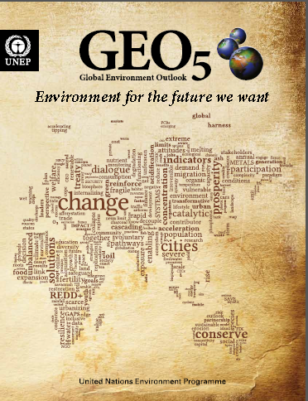
THE EARTH SYSTEM CONTEXT
The Earth System provides the basis for all human societies and their economic activities. People need clean air to breathe, safe water to drink, healthy food to eat, energy to produce and transport goods, and natural resources that provide the raw materials for all these services
The 7 billion humans alive today are collectively exploiting the Earth’s resources at accelerating rates and intensities that surpass the capacity of its systems to absorb wastes and neutralize the adverse effects on
the environment.
http://www.unep.org/geo/
Notes:
GEO-5 is designed to be the most comprehensive, impartial and in-depth assessment of its kind. It reflects the collective body of recent scientific knowledge, drawing on the work of leading experts, partner institutions and the vast body of research undertaken within and beyond the United Nations system.
The launch of GEO-5 coincides with the final stages of preparation for the UN Conference on Sustainable Development (Rio+20), taking place two decades after the Rio Earth Summit that set the agenda for contemporary thinking about sustainable development. The report underlines the reasons why world leaders need to show decisive leadership in Rio and beyond. It highlights the state, trends and trajectories of the planet and its people, and showcases more than 100 initiatives, projects and policies from across the globe that are pioneering positive environmental change. (BAN Ki-moon, may 2012)
There is an urgent need to address the underlying drivers of the human pressures on the Earth System. At the same time, it is necessary to adopt approaches that can deal better with the complexities and inherent uncertainties of the Earth System. This must include three elements: basic research to understand interactions and feedbacks; sustained long-term monitoring and observation to underpin basic research; and regular evaluation of progress to allow the adjustment of responses when observations indicate that this is necessary.

Slide 17
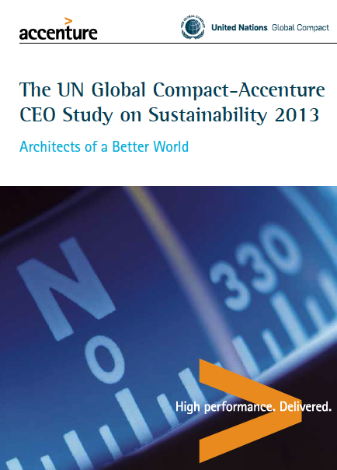
The Accenture – UNGC 2013 Report
Survey result of 1,000 global CEOs, from 27 industries across 103 countries
93%
62%
of CEOs regard Sustainability as the new key for business success
of CEOs believe they can not quantify the value or their sustainability intiatives
SRC: http://www.accenture.com/SiteCollectionDocuments/PDF/Accenture-UN-Global-Compact-Acn-CEO-Study-Sustainability-2013.PDF
Notes:
Which is is great news as the world seems to be poised to support such an architecture as the majority of CEOs from around the world view sustainability as the key to business. Tge unfortunate truth is that these same CEOs can’t quantify the value of what they are doing to address it. What happens to projects that have no value to the organization?

Slide 18
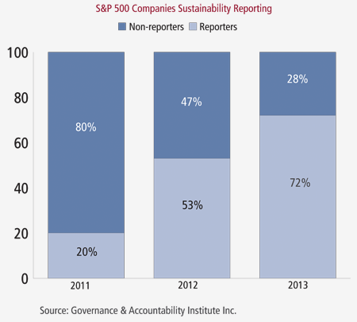
Fortune 500 Companies now Publishing
Sustainability/Responsibility Reports
“We are seeing clear indications over the past three years that senior corporate management understands the importance of adopting and implementing strategies that reflect the rising interest of investors and stakeholders in corporate sustainability,”
- Louis Coppola, executive vice president of G&A Institute.
72%
53%
20%
http://www.complianceweek.com/blogs/the-filing-cabinet/sustainability-reporting-on-the-rise
Notes:
It is no surprise to to see the trend shown here. If the number of CEOs that value sustainability as the way forward is on the rise and therefore reporting is also on the rise it is sure to create positive impacts. The problem is that focused attention in largely in part on supply chains.

Slide 19

The Cobb Salad Report
“These are all worthwhile topics however they are operationally focused and the emphasis needs to focus on what the organization produces from a product and service perspective.”
Timothy Hui. Head of Focal Point GRI for China
Health and Safety
Philanthropy
Carbon Emission Goals
Notes:
This rings loud and clear as when organizations report on sustainability, they look like chopped salads. Timothy Hui, Head of Focal Point GRI for China stated that the volume of reporting is increasing which is positive, however so is the volume of information in each report. Information is submitted on topics such as employee health and safety programs to carbon emission reduction goals to philanthropy initiatives (T. Hui, Presentation, May 27th, 2014). These are all worthwhile topics however they are operationally focused and the emphasis needs to focus on what the organization produces from a product and service perspective.
As of June 25th, 2014, 6,321 organizations having submitted over 15,234 reports to the Global Reporting Initiative alone.

Slide 20
What Happens?
50%
According to Executive Director Geog Kell, 50% of organizations that pledge to the the UN Global Compact are de-listed due to the fact that they are unable to fulfill their committment

Slide 21
Is this a problem?
97%
New report finds only 129 of 4,069 largest companies listed on the world’s stock exchanges are disclosing the most basic sustainability information
Src: http://www.theguardian.com/sustainable-business/2014/oct/13/97-companies-fail-to-provide-data-key-sustainability-indicators-stocck-exchange-report

Slide 22
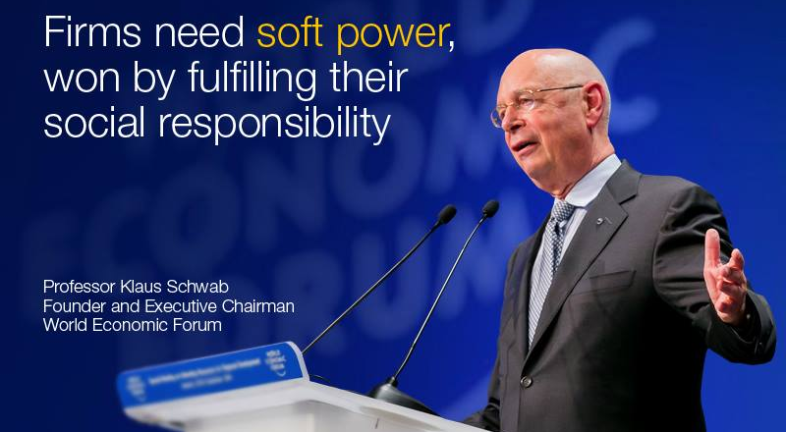
World Economic Forum
The real conflict is not between profit maximization and social responsibility, but rather between short- and long-term thinking," writes Professor Klaus Schwab.
https://agenda.weforum.org/2014/12/the-profitability-of-trust/

Slide 23
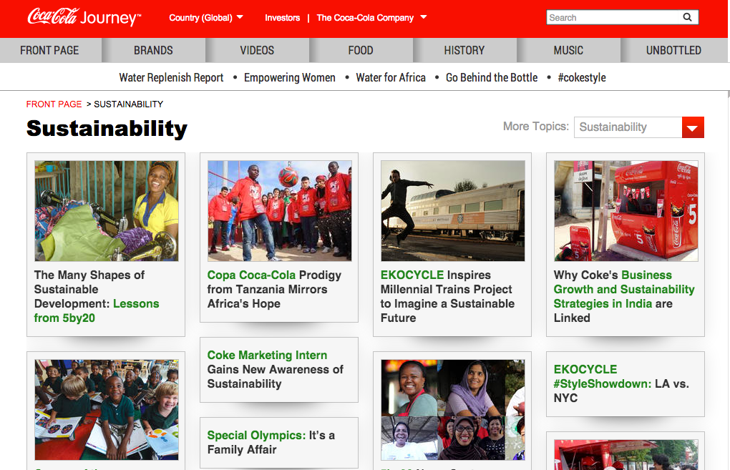


Example
Notes:
This is a snapshot coca cola’s sustainability website Each one of these efforts are outlined in a nice thick report of how responsible coca cola is and how much they care about sustainability. What is not shown is that coke spent One million seven hundred and fifty thousand USD to oppose labeling of food products that are made from GMO. Maybe they could focus on the sustainability of what they produce?

Slide 24
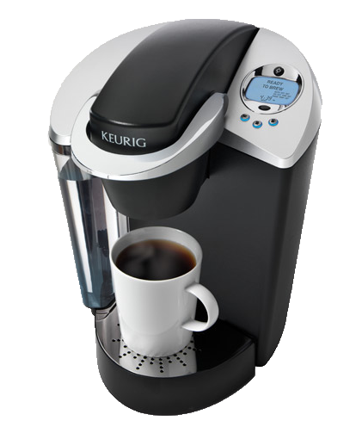

Success and Failures
In 2013, Green Mountain produced 8.3 billion K-Cups, enough to wrap around the equator 10.5 times.
Only five percent of its current cups are made out of recyclable plastic. (Don‘t buy any more K-cups until 2020)
Success or Failure?

Slide 25



Success and Failures
Nespresso Capsules are Aluminum
In many countries Nestle has setup pod
recycling centres to collect them so they can create new pods.
Success or Failure?

Slide 26
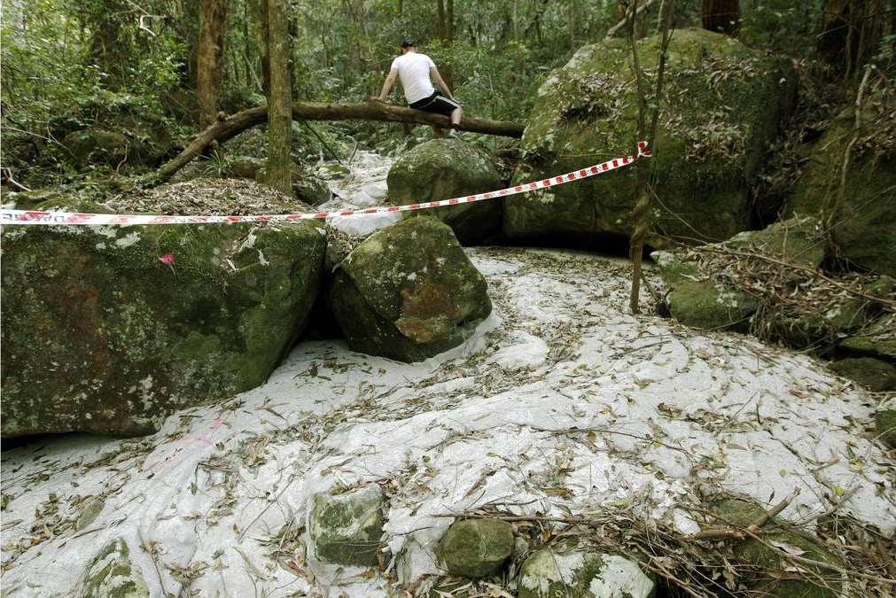
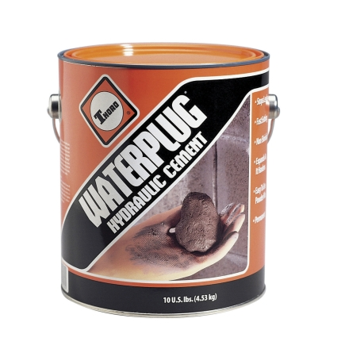
Success and Failures
Success or Failure?
Sugarloaf Colorado, USA
Workers Grouted the Coal Mine to fix cracks as a project to not impact the nature preserve that was adjacent to the mine.
Natural waterways absorbed the grout and created a concrete river in a nature reserve.
A massive fracture running up the hillside. Photo: Darren Pateman
Notes:
A large section of Sugarloaf State Conservation Area in the lower Hunter has been destroyed by massive subsidence from Glencore's West Wallsend Colliery.
A Fairfax Media investigation has uncovered cliff faces crumbled or collapsed, a waterway destroyed, large cracks opened in the earth and a huge collapse of a hillside.
Damage was tracked over more than two kilometres within the ecologically sensitive conservation area adjacent to the mine's Longwall 41.
In one area a cliff face fall of more than 20 metres was discovered.
Damage was cause by unplanned subsidence from longwall mining by West Wallsend Colliery that is mining beneath 23 per cent of the conservation area.
Fairfax Media can also reveal that in June this year a waterway was accidentally grouted by workers carrying out remediation works in the reserve.
Grouting in one of the cracks. Photo: Darren Pateman
A spokesman for the Office of Environment and Heritage confirmed grouting material, used to fill mine subsidence cracks and holes, leaked into a ''drainage line'' and the colliery had been ordered to ''clean up the site''.
Read more: http://www.smh.com.au/nsw/mine-subsidence-devastates-sugarloaf-conservation-area-20130828-2spuc.html#ixzz3D7KkWUy2

Slide 27
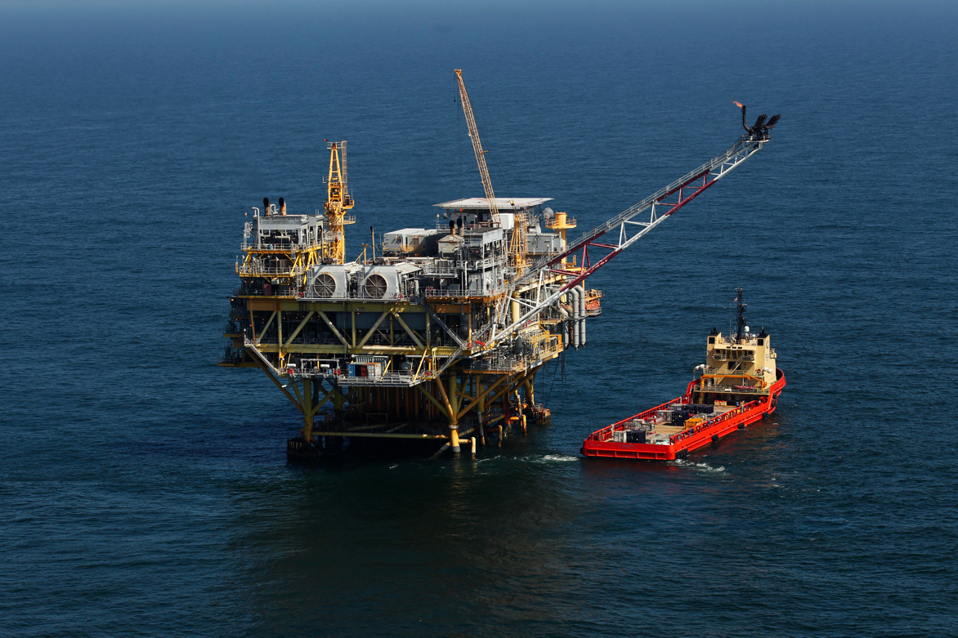
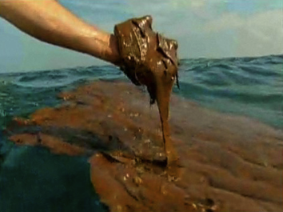
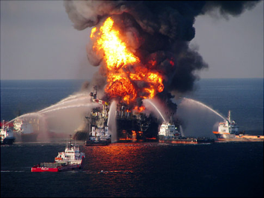
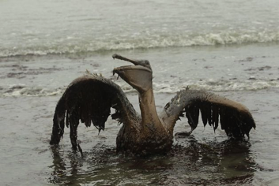
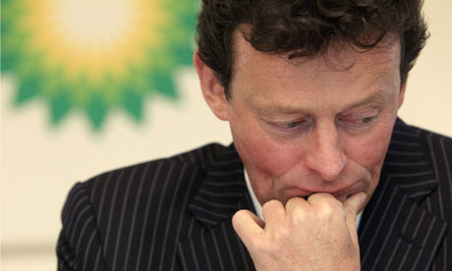
Success and Failures
Success or Failure?
Deep Water Horizon, USA
an ultra-deepwater, dynamically positioned, semi-submersible offshore oil drilling rig - Gulf of Mexico
Deep Water Horizon, USA
$20,000,000,000 USD in Fines
Or
734,60,000,000 AED

Slide 28
Organizations Driving Sustainability
Hundreds of NGO’s, Non-Profits and advocates promote sustainability
Internationally (and practically) the standards drivers are largely focused on
  ISO
  United Nations
    UN Global Compact
    UN PRME
  Global Reporting Initiative

Slide 29

The United Nations Global Compact
The Ten Principles
The UN Global Compact's ten principles in the areas of human rights, labour, the environment and anti-corruption enjoy universal consensus and are derived from:
The Universal Declaration of Human Rights
The International Labour Organization's Declaration on Fundamental Principles and Rights at Work
The Rio Declaration on Environment and Development
The United Nations Convention Against Corruption

Slide 30

The Ten Principles
Human Rights
Businesses should support and respect the protection of internationally proclaimed human rights; and
make sure that they are not complicit in human rights abuses.
Labour
3. Businesses should uphold the freedom of association and
the effective recognition of the right to collective bargaining;
4. the elimination of all forms of forced and compulsory labour;
5. the effective abolition of child labour; and
6. the elimination of discrimination in respect of employment and occupation.

Slide 31
The Ten Principles
Environment
7. Businesses should support a precautionary approach to environmental challenges;
8. undertake initiatives to promote greater environmental
responsibility; and
9. encourage the development and diffusion of environmentally friendly technologies.
Anti-Corruption
10. Businesses should work against corruption in all its forms, including extortion and bribery.

Slide 32

Principle 1 | Purpose: We will develop the capabilities of students to be future generators of sustainable value for business and society at large and to work for an inclusive and sustainable global economy.
Principle 2 | Values: We will incorporate into our academic activities and curricula the values of global social responsibility as portrayed in international initiatives such as the United Nations Global Compact.
Principle 3 | Method: We will create educational frameworks, materials, processes and environments that enable effective learning experiences for responsible leadership.
Principle 4 | Research: We will engage in conceptual and empirical research that advances our understanding about the role, dynamics, and impact of corporations in the creation of sustainable social, environmental and economic value.
Principle 5 | Partnership: We will interact with managers of business corporations to extend our knowledge of their challenges in meeting social and environmental responsibilities and to explore jointly effective approaches to meeting these challenges.
Principle 6 | Dialogue: We will facilitate and support dialog and debate among educators, students, business, government, consumers, media, civil society organisations and other interested groups and stakeholders on critical issues related to global social responsibility and sustainability.
Notes:
Launched at the 2007 UN Global Compact Leaders Summit in Geneva, the Principles for Responsible Management Education (PRME) initiative is the first organised relationship between the United Nations and business schools, with The mission of PRME is to inspire and champion responsible management education, research and thought leadership globally.
There are (only) 13 PRME supporting organizations. GPM Global represents the project management world.

Slide 33

Global Reporting Initiative (GRI)
A pioneering nonprofit propose a framework for sustainability reporting.
Companies use this report to inform its shareholders and consumers through their performance of economic, social and environmental
Learn more at www.globalreporting.org
Notes:
Global Reporting Initiative (GRI) is an organization whose purpose is to promote the development of sustainability reporting in all types of organizations. GRI produces a comprehensive framework for the preparation of Sustainability Reports, which are widely used worldwide. The Framework, including the Guide for the preparation of reports, sets out the principles and indicators that organizations can use to measure and disclose their economic, environmental and social. GRI is committed to continuously improving and increasing the use of these Guidelines, which are available to the public for free. ? GRI is a nonprofit organization with multiple stakeholders. It was founded by CERES and the United Nations Program for Environment (UNEP) in 1997 in the United States. In 2002, GRI moved its offices to Amsterdam, where he is currently its Secretariat. GRI has regional offices ("Focal Points") in Australia, Brazil, China, India and the United States, and also has a network of more than 30,000 people worldwide

Slide 34

Global Reporting Intiative’s Categories and Aspects
Economic
    Economic Performance
    Market Presence
    Direct Economic impact
Environment
  Materials, energy, water
  biodiversity
  Emissions, waste, transport
  Products and services
  Integral sustainability
Social
    Labor practices and decent work
    Society
    Human Rights
    Product liability
    Ethics
Notes:
Sustainability reporting’ is a broad term considered synonymous with others used to describe reporting on economic, environmental, and social impacts (e.g., triple bottom line, corporate responsibility reporting, etc.). A sustainability report should provide a balanced and reasonable representation of the sustainability performance
Reports can be used for the following purposes, among others:
• Benchmarking and assessing sustainability performance with respect to laws, norms, codes,
performance standards, and voluntary initiatives;
• Demonstrating how the organization influences and is influenced by expectations about sustainable development; and
• Comparing performance within an organization and between different organizations over time. – including both positive and negative contributions.

Slide 35
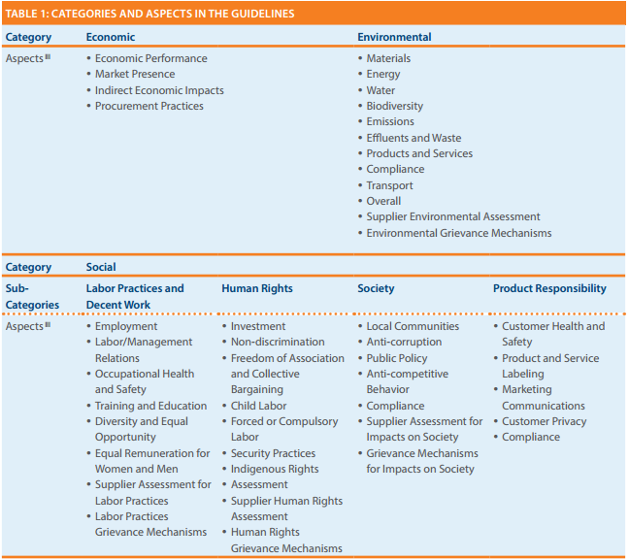
Going Deeper into 2013 G4 GRI
Product Responsability!!
(A little weak)
Notes:
The table in figure is from the 2013 G4 release for GRI reporting.
GRI G4 states “Sustainability reporting is fundamental to an organization’s integrated thinking and reporting process in providing input into the organization’s identification of its material issues, its strategic objectives, and the assessment of its ability to achieve those objectives and create value over time”.
The reporting indicators are primarily structured in pairs, with a Core Indicator seeking disclosure on the processes in place to address the aspect, and an additional Indicator to report on degree of compliance.
The final category “Product Responsibility” includes Customer Health and Safety, Product Labeling, Marketing Communications, Customer Privacy, and Compliance. A more complete approach to sustainability reporting would take into account lifespan and servicing as well as the efficiency and maturity of the product’s design and build process.

Slide 36
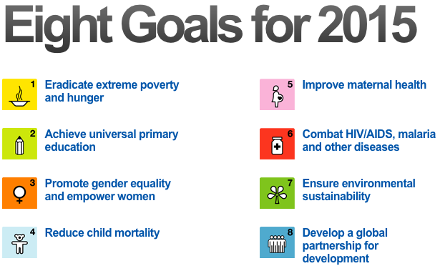
The UN Millenium Development Goals (MDGs)
Notes:
Globally, the The eight Millennium Development Goals or MDGs– which range from reducing extreme poverty to providing universal primary education, all by the target date of 2015 – form a blueprint agreed to by all the world’s countries and all the world’s leading development institutions. They have galvanized unprecedented efforts to meet the needs of the world.

Slide 37
Progress!
1. The world has reduced extreme poverty by half
In 1990, almost half of the population in developing regions lived on less than $1.25 a day. This rate dropped to 22 per cent by 2010, reducing the number of people living in extreme poverty by 700 million
2. 90% of children in developing regions are attending primary school
The school enrolment rate in primary education in developing regions increased from 83 per cent to 90 percent between 2000 and 2012. Most of the gains were achieved by 2007, after which progress stagnated. In 2012, 58 million children were out of school. High dropout rates remain a major impediment to universal primary education. An estimated 50 per cent of out-of-school children of primary school age live in conflict-affected areas.
3. Disparities in primary school enrolment between boys and girls are being eliminated in all developing regions
Substantial gains have been made towards reaching gender parity in school enrolment at all levels of education in all developing regions. By 2012, all developing regions have achieved, or were close to achieving, gender parity in primary education.
4. Child mortality has been almost halved
Worldwide, the mortality rate for children under age five dropped almost 50 per cent, from 90 deaths per 1,000 live births in 1990 to 48 in 2012. Preventable diseases are the main causes of under-five deaths and appropriate actions need to be taken to address them.

Slide 38
Progress!
5. Much more needs to be done to reduce maternal mortality
Globally, the maternal mortality ratio dropped by 45 percent between 1990 and 2013, from 380 to 210 deaths per 100,000 live births. Worldwide, almost 300,000 women died in 2013 from causes related to pregnancy and childbirth. Maternal death is mostly preventable and much more needs to be done to provide care to pregnant women.
6. Efforts in the fight against malaria and tuberculosis have shown results
Between 2000 and 2012, an estimated 3.3 million deaths from malaria were averted due to the substantial expansion of malaria interventions. About 90 percent of those averted deaths—3 million—were children under the age of five living in sub-Saharan Africa. The intensive efforts to fight tuberculosis have saved an estimated 22 million lives worldwide since 1995. If the trends continue, the world will reach the MDG targets on malaria and tuberculosis.
7. Major trends that threaten environmental sustainability continue, but examples of successful global action exist
Global emissions of carbon dioxide (CO2) continued their upward trend and those in 2011 were almost 50 percent above their 1990 level. Millions of hectares of forest are lost every year, many species are being driven closer to extinction and renewable water resources are becoming scarcer. At the same time, international action is on the verge of eliminating ozone-depleting substances and the proportion of terrestrial and coastal marine areas under protection has been increasing.
8. Last but not least… - The Global Partnership for Development (Next Slide…)

Slide 39
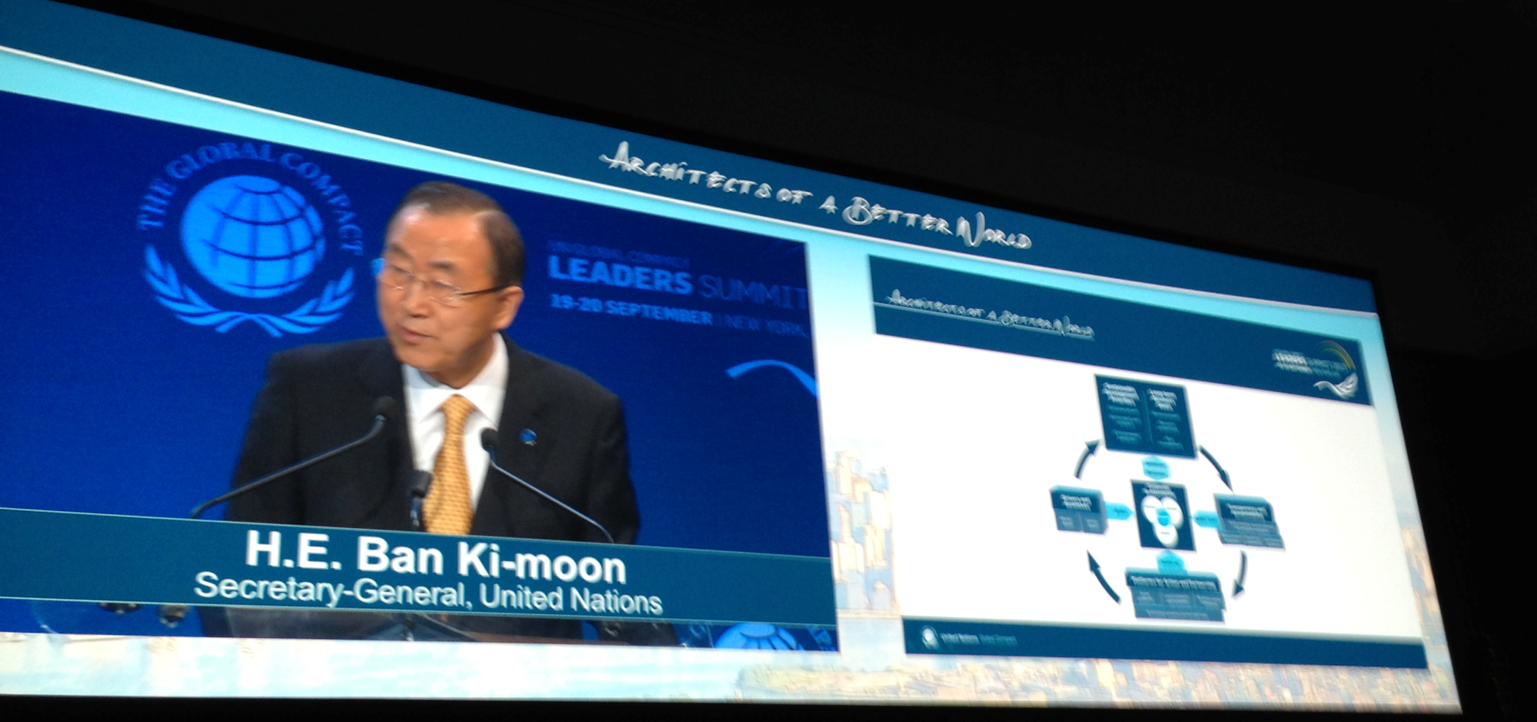
Explaining a Need for a Paradigm Shift
The MDGs brought together governments, the international community, civil society and the private sector to achieve concrete goals for development and poverty eradication. Much has been accomplished through the concerted and focused efforts of all, saving and improving the lives of many people, but the agenda remains unfinished. The analysis presented in this report points to the importance of intensifying efforts to meet all MDG targets.
Each of these building blocks (MDG’s) must be further strengthened and
connected through a comprehensive and collective effort.
UN Secretary Ban Ki-Moon outlining the Architecture on September 19th 2003
Notes:
The post-2015 development agenda is slated to carry on the work of the MDGs and integrate the social, economic and environmental dimensions of sustainable development. Continued progress towards the MDGs in the remaining year is essential to provide a solid foundation for the post-2015 development agenda

Slide 40
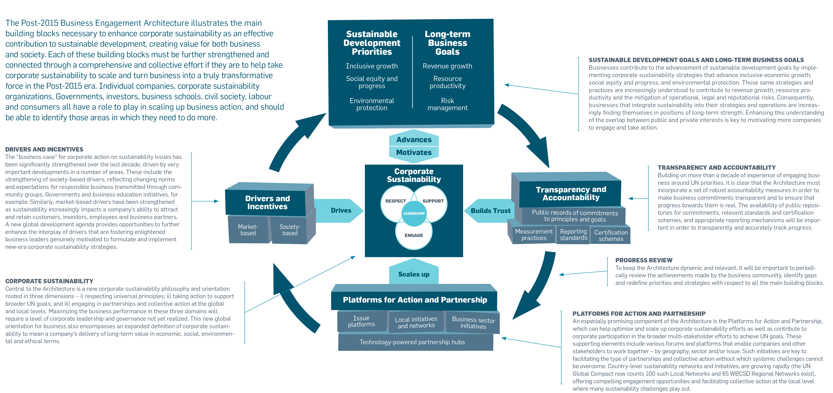

POST-2015 BUSINESS ENGAGEMENT ARCHITECTURE
Notes:
Facilitator – This slide is important but only from a high level. Highlight the fact that each building block is supposed to support forward progress towards business inclusion.
This model is a good from a high level, but what is missing are specific actionable items. GPM’s approach meets all of the requirements for this framework, including certification schemes under Transparency and Accountability. In this course, participants will learn how to naturally (holistically) put it into practice.

Slide 41

Essentially
• Leverage channels to communicate corporate sustainability performance to investors and, where relevant, adopt a responsible investment policy for corporate pension funds;
• Undertake sustainability due-diligence and set clear expectations before signing partnership contracts in order to encourage partners throughout the value chain to uphold minimum standards and advance sustainable practices;
• Intensify engagement in issue platforms and sector initiatives in order to scale-up and advance business engagement on sustainability issues and, as relevant, help overcome systemic challenges;
• Engage in local networks and initiatives, actively sharing best practice and learnings with local business community and providing operational support and resources, as appropriate;
• Engage in partnerships with other businesses and stakeholders that can have transformative impacts – moving beyond an ad-hoc project focus.
-RUN YOUR BUSINESS
-DO NO HARM
-MAKE THE WORLD A BETTER PLACE

Slide 42
What are we up against to embed sustainability into our culture?
Understanding the language
Topic legitimacy “is it our problem”
Prevailing mindsets and attitudes.
Eliminating the Silo mentality
Practical Tools
Organizational Capacity for Change
Aligning the challenges to Strategic Business goals

Slide 43
We have covered
Sustainability Challenges
UN Global Compact
Global Reporting Initiative
PRME
Millennium Development Goals
Post-2015 Business Engagement Architecture

Slide 44
Systems Thinking
Module | Module Covers | Learning outcomes
2 Systems Thinking | What is Systems Thinking ISO standards and how to use them. ISO 14000 Series on Environmental Management ISO 26000 Corporate Social Responsibility ISO 14000 Series on Environmental Management ISO 9000 Quality Management ISO 50001 Energy Management ISO 55000 Asset Management | This module covers a critical aspect of sustainable change delivery by explaining a thinking versus the traditional “input/output” approach
Language
English
Version
5.0

Slide 45
The GPM Sustainability Services Focus
Organizations are locked on process and output…
GPM encourages PMs to focus on the overall corporate system and benefits / strategic objectives… delivering real value for the business and customers!

Slide 46
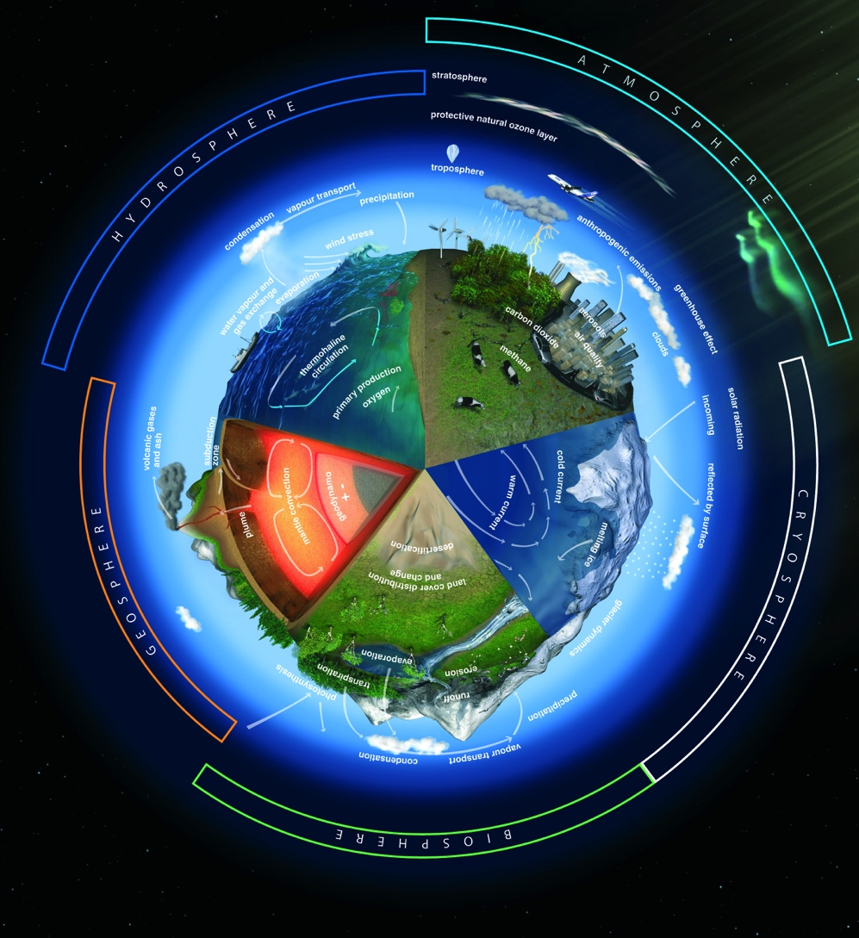
What is a System?
A system is a set of parts that interact and affect each other, thereby creating a larger whole of complex thing.
Notes:
Let's start with a simple example from nature: the Earth. Our planet is a very complex system consisting of atmosphere, water, mountains, plains, jungles, plants, insects, animals, humans and our technological wonders, just to name a few. A scientist may look at many interactions of these parts in researching climate change. General patterns may be found in these interactions that may help explain the system and find solutions to the problems by changing the patterns of interaction between the parts.
Now, let's apply the idea of a system to business. We'll start small and work our way up. A business is a system consisting of many parts: employees, management, capital, equipment, and products, among others. Your business and your competitors comprise a system, which we may call an industry. Different industries, along with consumers, governments, and non-governmental organizations make up our economic system.
http://education-portal.com/academy/lesson/systems-thinking-in-management-definition-theory-model.html

Slide 47
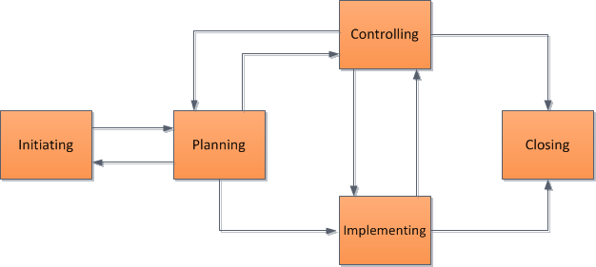
What is Systems Thinking?
According to system thinking, if we examine the interactions of the parts in a system, we will see larger patterns emerge.
By seeing the patterns, we can begin to understand the how the system works.
If the pattern is good for the organization, we can make decisions that reinforce it, but if the pattern is bad for the organization, we can make decisions that change the pattern.
Input/output thinking
Systems thinking
Notes:
System thinking is a major departure from the old way of business decision-making in which you would break the system into parts and analyze the parts separately. Supporters of system thinking believe that the old way is inadequate for our dynamic world, where there are numerous interactions between the parts of a system, creating the reality of a situation.

Slide 48


Why we encourage this?
Many Project Managers focus on project inputs and outputs rather than value and benefit to the overall system. This is the same as focusing on a single drop of water. If we pollute it, no big deal. It is only one drop…
That’s a lot of water… Over 20,000,000
Project Managers globally
Notes:
We just covered a lot. Time for a quick break.

Slide 49

Getting to Know ISO Standards (What drives systems…)
Notes:
CRITICAL!! Explain that we are going to review a few ISO standards that PMs should be familiar with not only from a conceptual point of view but in terms of how they are utilized in their organization, client organization and projects.

Slide 50

ISO standards
Guidelines and Standards
Guidelines
ISO 26000 - CSR
ISO 21500 – Project Management
Normative Standards
ISO 9000 – Quality Management
ISO 14000 - Environmental
ISO 50001- Energy Management
Notes:
What are the benefits of ISO International Standards?
We cover ISO Standards that pertain to sustainability as they are important in understanding the principles and approach that project managers should take to ensure quality, benefits and value.
ISO International Standards ensure that products and services are safe, reliable and of good quality. For business, they are strategic tools that reduce costs by minimizing waste and errors and increasing productivity. They help companies to access new markets, level the playing field for developing countries and facilitate free and fair global trade. (ISO.org)
There are two kinds. Guidelines and normative….

Slide 51

What ISO 26000 is NOT…
A management system standard.
Intended or appropriate for certification purposes or regulatory or contractual use.
Intended to provide a basis for legal actions, complaints, defenses or other claims in any international, domestic or other proceeding.
Intended to be cited as evidence of the evolution of customary international law.
Intended to prevent the development of national standards that are more specific, more demanding, or of a different type.

Slide 52
What ISO 26000 is…
Intended to assist organizations in contributing to Sustainable Development.
Intended to promote common understanding in the field of Social Responsibility.
Intended to complement other instruments & initiatives for Social Responsibility and not to replace them.
Intended to provide organizations with guidance concerning Social Responsibility and can be used as part of public policy activities.
Notes:
ISO 26000 contains no requirements and therefore the word “shall”, which indicates a requirement in ISO language, is not used
But does contain 386 “should”s

Slide 53
ISO 26000
Principles of Social Responsibility
Accountability
  Businesses are expected to be accountable for its impacts on society & the environment
Transparency
  Businesses are expected to be transparent in its decisions & activities that impact on society & the environment.
Ethical Behavior
  Businesses are expected to behave ethically at all times.
Stakeholder Interests
  Businesses are expected respect, consider & respond to the interests of its stakeholders.
Rule of Law
  Businesses are expected to abide by the rule of law for that region and or country.
International Norms of Behavior
  Businesses are expected to respect international norms of behavior, while adhering to the principle of respect for the rule of law.

Slide 54

ISO 14000 Family
A series of guidance documents and standards to help organizations address environmental issues.
These ISO’s below deal with Environmental Management Systems (EMS)
  14001: Environmental Management Systems
  14004: EMS general guidelines
  14010: Guidelines for Environmental Auditing
  14011: Guidelines for Auditing of an EMS
  14012: Auditing - Qualification criteria
  14064: Greenhouse gases
Notes:
ISO 14004 is guidance on how to implement ISO 14001
10, 11, and 12 relate to auditing of the 14001 standard. I would note here that a new joint auditing standard is currently being developed that will eventually replace 14010, 14011, and 14012. This new standard ISO 19011 is an auditing standard that may be used for both ISO 9000 and ISO 14001.
ISO 14064-1:2006
Greenhouse gases -- Part 1: Specification with guidance at the organization level for quantification and reporting of greenhouse gas emissions and removals

Slide 55
What is the Environment?
Environment: Surroundings in which an organization operates, including air, water, soil, natural resources, flora, fauna, humans and their interrelation. (ISO 14001:2004)

Slide 56
ISO 14001 Key Elements
  Policy Statement
  Identification of Significant Environmental Impacts and Environmental Legal Requirements
  Establishing Environmental Programs, Objectives and Targets
  Emergency Plan
  Operating Control to meet the Environmental Objectives and Targets
  Human Resources roles and Responsibilities.
  Training.
  Communication
  Internal Assessments. Corrective actions.
  Management Review (by Directors)

Slide 57
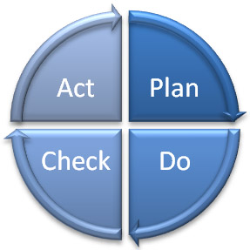
What is an EMS?
Deming Model - PDCA
Systematic way of managing an organization’s environmental affairs
Based on Plan-Do-Check-Act Model (PDCA)
Focused on Continual Improvement of system
Addresses immediate and long-term impact of an organization’s products, services and processes on the environment.
A tool to improve environmental performance
Management
Review
Planning
Checking
Corrective Action
Implementation
Notes:
I introduce the term “PDCA” here
I often use the term “activities, products, and services” here and reference the standard’s use of these terms
The steps in each successive PDCA cycle are:
PLAN Establish the objectives and processes necessary to deliver results in accordance with the expected output (the target or goals). By establishing output expectations, the completeness and accuracy of the specification is also a part of the targeted improvement. When possible start on a small scale to test possible effects.

Slide 58
Why Do Organizations Implement an EMS ?
Helps to identify the causes of environmental problems.
  better to make a product right the first time
  cheaper to prevent a spill or other accident
  cost effective to prevent pollution
Trade and competitive issues
  Inconsistency in environmental regulation and enforcement
Many individual parts may already be in place – just need to unify under the EMS umbrella!
??Why should a project manager be familiar with the EMS?

Slide 59

ISO 50001: 2011 Energy Management Systems
ISO 50001 gives organizations the requirements for energy management systems (EnMS)
Benefits:
1. Improved energy performance can provide rapid benefits for an organization by maximizing the use of its energy sources and energy-related assets, thus reducing both energy cost and consumption.
2. The organization will also make positive contributions toward reducing depletion of energy resources and mitigating worldwide effects of energy use, such as global warming.
Notes:
ISO 50001 — Why is it important?
Energy is critical to organizational operations and can be a major cost to organizations, whatever their activities. An idea can be gained by considering the use of energy through the supply chain of a business, from raw materials through to recycling.
In addition to the economic costs of energy to an organization, energy can impose environmental and societal costs by depleting resources and contributing to problems such as climate change.
The development and deployment of technologies for new energy sources and renewable sources can take time.
Individual organizations cannot control energy prices, government policies or the global economy, but they can improve the way they manage energy in the here and now. Improved energy performance can provide rapid benefits for an organization by maximizing the use of its energy sources and energy-related assets, thus reducing both energy cost and consumption. The organization will also make positive contributions toward reducing depletion of energy resources and mitigating worldwide effects of energy use, such as global warming.
ISO 50001 is based on the management system model that is already understood and implemented by organizations worldwide. It can make a positive difference
for organizations of all types in the very near future, while supporting longer term efforts for improved energy technologies.

Slide 60
ISO 50001: 2011 Energy Management Systems
Primary Energy Sources
  Renewable: Solar, Water, Wind, Biomass
  Non-Renewable: Oil, Gas, Carbon and Nuclear fusion
Secondary Energy
  Electric, mechanic, Thermic, Hot water, Compressed Air, Biodiesel and Fuel in general
Final Use
  Lighting, Refrigeration, Heating, Process,

Slide 61

Principles of Quality Management
These principles embodied in ISO 9001 have been developed with the intention that management can lead the organization towards improved performance.
Customer Focus
leadership
Involvement of people
Process Approach
System approach to management
continuous Improvement
Factual approach to decision making
Mutually beneficial supplier

Slide 62
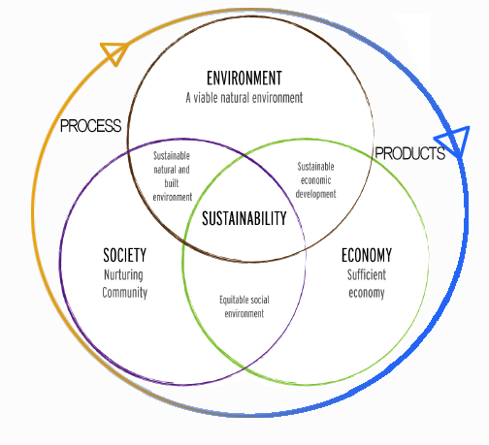
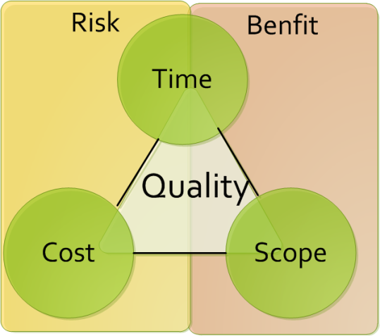
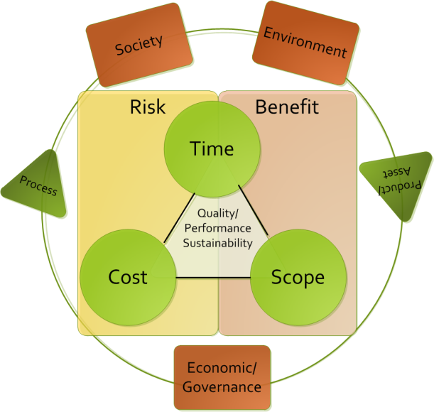
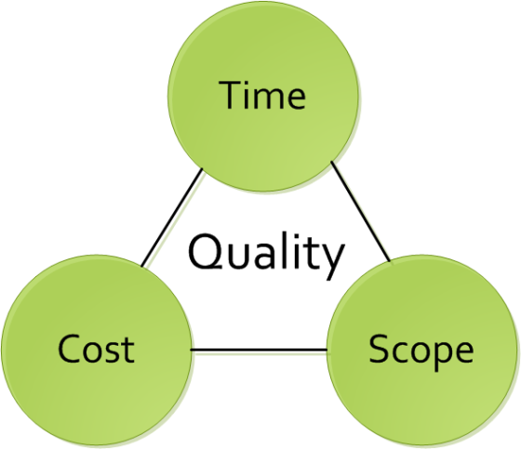
The Current PM Challenge - Quality
Many project managers are locked onto focusing on the traditional Time / Cost / Scope paradigm (if lucky they take into account quality)
Successful project managers focus on time, cost, quality, scope, benefits and risk
Exceptional project managers also take into account the other triple constraint… Though the key questions for organizations is how to facilitate this?
Notes:
SPEND TIME ON THIS SLIDE. This is THE key differentiator for GPM,

Slide 63

Audits
Audit Principles
  Ethical conduct: trust, integrity, confidentiality, and discretion.
  Fair Presentation: report truthfully and accurately
  Professional Care: Application of the audit. Necessary competence.
  Independence: the basis for the impartiality and objectivity of the conclusions.
Notes:
What is the Purpose of an Audit?
What are the stages of an Audit?
- Preparation, Execution, and Monitoring Report

Slide 64
What is ISO 55000?
The International Standard that is used for managing physical assets in particular, but can also be applied to other asset types.
Project managers must be responsible for the entire asset lifecycle and therefor understand how the asset (product) will be managed after it leaves the project lifecycle
55000
What other types of assets are there?

Slide 65
What is Asset Management
The factors which influence the type of assets that an organization requires to achieve its objectives, and how the assets are managed, include the following:
  the nature and purpose of the organization;
  its operating context;
  its financial constraints and regulatory requirements;
  the needs and expectations of the organization and its stakeholders.
These influencing factors need to be considered when establishing, implementing, maintaining and continually improving asset management.

Slide 66
What are the benefits of asset management?
The benefits of asset management can include, but are not limited to the following:
Improved financial performance: improving the return on investments and reducing costs can be achieved, while preserving asset value and without sacrificing the short or long-term realization of organizational objectives;
Informed asset investment decisions: enabling the organization to improve its decision making and effectively balance costs, risks, opportunities and performance;
Managed risk: reducing financial losses, improving health and safety, good will and reputation, minimizing environmental and social impact, can result in reduced liabilities such as insurance premiums, fines and penalties;
improved services and outputs: assuring the performance of assets can lead to improved services or products that consistently meet or exceed the expectations of customers and stakeholders;
Demonstrated social responsibility: improving the organization’s ability to, for example, reduce emissions, conserve resources and adapt to climate change, enables it to demonstrate socially responsible and ethical business practices and stewardship;
Demonstrated compliance: transparently conforming with legal, statutory and regulatory requirements, as well as adhering to asset management standards, policies and processes, can enable demonstration of compliance;
Enhanced reputation: through improved customer satisfaction, stakeholder awareness and confidence;
Improved organizational sustainability: effectively managing short and long-term effects, expenditures and performance, can improve the sustainability of operations and the organization;
Improved efficiency and effectiveness: reviewing and improving processes, procedures and asset performance can improve efficiency and effectiveness, and the achievement of organizational objectives.

Slide 67
Fundamentals : Leadership
Leadership and workplace culture are determinants of realization of value.
Leadership and commitment from all managerial levels is essential for successfully establishing, operating and improving asset management within the organization.
This includes:
clearly defined roles, responsibilities and authorities;
ensuring that employees are aware, competent, and empowered;
consultation with employees and stakeholders regarding asset management.

Slide 68
Fundamentals : Assurance
Asset management gives assurance that assets will fulfill their required purpose.
The need for assurance arises from the need to effectively govern an organization. Assurance applies to assets, asset management and the asset management system.
This includes:
developing and implementing processes that connect the required purposes and performance of the assets to the organizational objectives;
implementing processes for assurance of capability across all life cycle stages;
implementing processes for monitoring and continual improvement;
providing the necessary resources and competent personnel for demonstration of assurance, by undertaking asset management activities and operating the asset management system.

Slide 69
Correlation
According to ISO relevant asset management subject areas include:
data management;
condition monitoring;
risk management;
quality management;
environmental management;
systems and software engineering;
life cycle costing;
dependability (availability, reliability, maintainability, maintenance support);
configuration management;
tero-technology;
sustainable development;
inspection;
non-destructive testing;
pressure equipment;
financial management;
value management;
shock and vibration;
acoustics;
qualification and assessment of personnel;
project management;
property and property management;
facilities management;
equipment management;
commissioning process;
energy management.
Notes:
Ask the class which of these are not relevant to project management. The answer is none. They are all relevant. If a PM doesn’t understand asset management, they will not be successful.

Slide 70
Relationship to Projects
Stakeholders and organizational context
Portfolio, Program & Project Management
Organizational plans and objectives
Asset management policy
Strategic asset management plan (SAMP) Asset management objectives
Plans for developing asset management system & relevant support
Asset management plans
Implementation of asset management plans
Asset Management system + relevant support
Asset Portfolio
Performance evaluation and improvements
Based on ISO 55000, Relationship between key elements of an asset management system
Notes:
In blue, you will find the relationship between key elements of an asset management system. In green you will see the cross pollination to the project management realm.

Slide 71
We have covered
Systems Thinking
ISO 26000
ISO 14000 Series
ISO 9000
ISO 50001
ISO 55000

Slide 72
Ethics Values and Principles
Module | Module Covers | Learning outcomes
4 Ethics Values and Principles | Ethics Values Principles | Understand the Principles, Ethics and Values behind Sustainable Change Delivery.
Language
English
Version
5.0

Slide 73
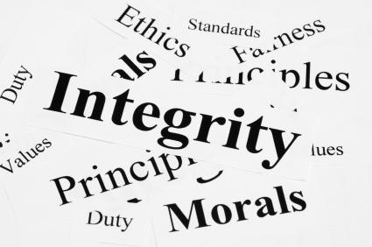
Business Ethics
Business ethics are:
  Rules of conduct
  Patterns of behaviour in business
  ‘Doing the right thing’
Involves responsibility to:
  Suppliers
  Employees
  Wider community
  Even competitors…

Slide 74
Business Principles
Shared values horizontally and vertically
  Shape relationships with all stakeholders
  Affects dealings through supply chain
Key principles
  Respect for human rights
  Setting appropriate conditions of employment in suppliers’ factories

Slide 75

Costs of ethical behaviour
Increased costs due to
  Audits and training
  Remedial actions
  Employment of Ethical Trade teams
However….. These produce
  Improvements to a supplier mean standards improve
  Transparency in business gives all stakeholders, including customers, confidence in the brand

Slide 76
Corporate Social Responsibility
(Why Morally)
Corporations cause socio-environmental issues and should therefore play a role in solving them (E.g.: pollution)
As powerful players in society, they should use that power responsibly
Corporations rely on the contributions of shareholders, employees, suppliers, communities and consumers and have a duty to take into account their collective needs.

Slide 77
Corporate Social Responsibility
(Why Ethically)
Expectations by society go beyond meeting legal responsibilities
  For Example:
    Ensuring contractors and sub-contractors pay their employees
    Purchasing from suppliers that have good environmental practices
    Not working with organizations the violate human rights

Slide 78
What are Principles and Values
Principles: Fundamental norms, rules, or values that represent what is desirable and positive for a person, group, organization, or community, and help it in determining the rightfulness or wrongfulness of its actions. Principles are more basic than policy and objectives, and are meant to govern both.
Values: Important and lasting beliefs or ideals shared by the members of a culture about what is good or bad and desirable or undesirable. Values have major influence on a person's behavior and attitude and serve as broad guidelines in all situations. Some common business values are fairness, innovation and community involvement.
Notes:
Source: http://www.businessdictionary.com/definition/principles.html
http://www.businessdictionary.com/definition/values.html

Slide 79
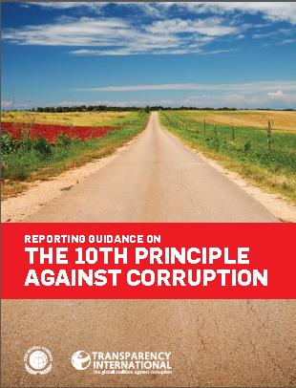
Communicating policies and values
According to Huguette Labelle - Chair, Transparency International Member, UN Global Compact Board
Reporting Guidance on the UNGC 10th Principle?
Through transparency, organizations can communicate to stakeholders and the public their values and polices and how they are being translated into action.
Transparency of commitment to values and openness about policies and processes will not only enhance a company’s reputation but act as a substantial deterrent to those wishing to act corruptly.
Transparency is a first line defence against corruption
Notes:
The Business Case for reporting on the 10th Principle:
There are three major benefits from reporting on anti-corruption. The first two categories apply to individual organizations (independent of their size), whereas the third category outlines benefits also for the overall community.
Increased internal integrity and transparency
Enhanced reputation
Common information basis
■■ sharing experience and procedures with other organizations;
■■ stimulating multi-stakeholder dialogues;
■■ increasing importance of disclosure on anti-corruption activities in overall sustainability agendas; and
■■ driving media coverage of good anti-corruption practices through provision of comparable progress reports.
Corruption is defined by Transparency International as “the abuse of entrusted power for private gain”. This convenient shorthand, encompassing myriad illegal and illicit acts, recognizes the breadth of the concept, but does not attempt to enumerate or precisely delimit. During the negotiations of the United Nations Convention against Corruption, UN Member States carefully considered the opportunity for the global anti-corruption treaty to provide a legal definition of corruption. Concluding that any attempt at a comprehensive definition inevitably would fail to address some relevant forms of corrupt behaviour, the international community reached global consensus on a large number of manifestations of corruption while leaving each State free to go beyond the minimum standards set forth in the Convention.
The Convention calls for ratifying States to outlaw, at a minimum, bribery of public officials; embezzlement, trading in influence, abuse of function, and illicit enrichment by public officials; and bribery and embezzlement in the private sector, as well as money laundering and obstruction of justice. These corrupt actions are spelled out under the chapter of the Convention devoted to criminalization
and law enforcement, denoting that corruption is a crime, which is a notion wider than bribery and extortion. In consonance with this approach, the 10th Principle of the United Nations Global Compact calls for companies to work against corruption in all its forms, including extortion and bribery.

Slide 80
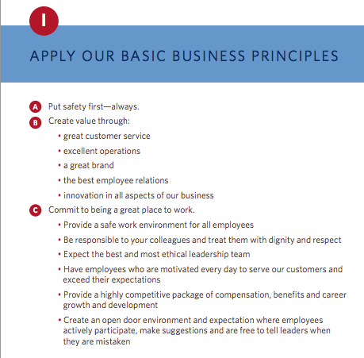
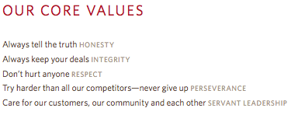
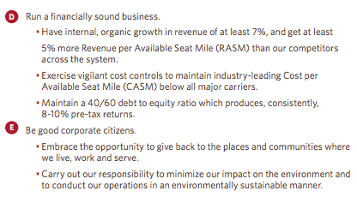
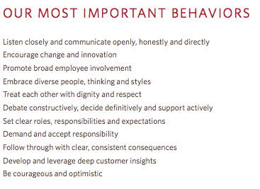

Example – Delta Airlines
http://www.delta.com/content/dam/delta-www/pdfs/policy/delta-rules-of-the-road.pdf

Slide 81
GPM® Sustainable Change Delivery Principles
Commitment & Accountability - Recognizing the essential rights of all to healthy, clean and safe environments, equal opportunity, fair remuneration, ethical procurement, and adherence to rule of law
Ethics & Decision Making - Supporting organizational ethics, decision making with respect for universal principles through identification, mitigation, and the prevention of adverse short and long-term impacts on society and the environment
Integrated & Transparent - Fostering the interdependence of economic development, social integrity, and environmental protection in all aspects of governance, practice and reporting
Principal & Values Based - Conserving and enhancing our natural resource base by improving the ways in which we develop and use technologies and resources
Social & Ecological Equity - Assessing human vulnerability in ecologically sensitive areas and centers of population through demographic dynamics
Economic Prosperity - Establishing fiscal strategies, objectives, and targets that balance the needs of stakeholders, including immediate needs and those of future generations
IF YOU DO NOT FACTOR THESE, YOUR PROJECT IS NOT SUSTAINABLE.

Slide 82
PSM3™ Levels for Sustainability
(Applying Principles to PM)
Level 5
PRINCIPLED
Has industry leading practices and procedures with continuous improvement, quantifiable value from sustainability initiatives
Level4
Essential
Organization demonstrates active interest, adopted policies and procedures for sustainability
Level 3
Foundational
Organization has formal policies, has identified formal processes and procedures

Slide 83
PSM3™ Levels for Sustainability
Level 2
Provisional
The organization is aware of some competency demonstrated in sustainable practice.
Level 1
Nonexistant
The organization is unaware of any focused attention to sustainability
Level 0
Uncertain
Organization does not know where it currently stands.

Slide 84
VALUES, MORALS & ETHICS
Values are the fundamental beliefs that we hold. They are the principles that we hold regarding what is right, good, and just.
Morals are the values which are inherent in a system of beliefs – a higher authority such as a business society in which business values such as performance excellence, quality, safety, service, and accomplishing desired results are important.

Slide 85
Eight ethical guidelines foundation for projects.
Recognize that managing ethics is a process. Ethics management is the process of reflection and dialog . that produces deliverables such as codes, policies and procedures.
The goal of an ethics management initiative is preferred behaviour in the project environment.
The best way to manage ethical dilemmas, like negative project risks, is to avoid their occurrence in the first place
Make ethics decisions in teams, and make decisions public, as appropriate
Integrate ethics management with other project practices. Define preferred ethical values directly in the project plan
Use cross-functional teams to develop your ethics management plan. Benefit from varied input
Value forgiveness Help project personnel recognize and address their mistakes and then support them to continue to try to operate ethically
Give yourself credit for trying Attempting to operate ethically and making a few mistakes is better than not trying at all. All projects are comprised of people and people are not perfect.
APMBoK V. 5

Slide 86
We have covered
Principles For Sustainable Change Delivery
Values
Ethics

Slide 87
Governance and P3O
Module | Module Covers | Learning outcomes
#5 Governance, Portfolio and Program Management | What is Project Governance Principles of Project Governance Project Governance Areas P3O (Portfolio, Program, Project Offices) Portfolio Management Program Management Benefits of Project Offices Types of Project Offices Responsibilities of Project Offices | Gain an understanding of governance, portfolio and program management.
Language
English
Version
5.0

Slide 88
Project Governance
Governance is the framework by which an organization is directed and controlled. Project governance includes, but is not limited to, those areas of organizational governance that are specifically related to project activities.
Project governance may include subjects such as the following:
  — defining the management structure;
  — the policies, processes and methodologies to be used;
  — limits of authority for decision-making;
  — stakeholder responsibilities and accountabilities;
  — interactions such as reporting and the escalation of issues or risks.
The responsibility for maintaining the appropriate governance of a project is usually assigned either to the project sponsor or to a project steering committee.
ISO 21500

Slide 89
Corporate Governance
The ongoing activity of maintaining a sound system of internal control by which the directors and officers of an organization ensure that effective management systems, including financial monitoring and control systems, have been put in place to protect assets, earning capacity and the reputation of the organization.
Src. GPM® PSM3™ 2014
Notes:
Sustainability is a critical function of project governance and change delivery in general.

Slide 90
Where Project Governance Exists
Project Governance
Notes:
Here is a diagram, from ISO 21500, Guidance on Project Management page 3 that depicts the project organization. The boxes represent project management concepts and the arrows represent a logical flow by which the concepts are connected. The dotted lines are organizational boundaries.
The blue box listed as opportunities represents what becomes the project initiation phase and comes from organizational need, market demand and so forth. I will stress that factors outside the organizational boundary include regulatory, socio-economic, and ecological. If they are penetrating the organization then where would they most likely live within the project environment? Project Governance. Makes sense.

Slide 91
Portfolio management characteristics
Screening, analysis and financial appraisal of project and program characteristics (resources, schedules, cash flows, risks, benefits, etc.) in relation to overall business strategy.
Prioritization and/or selection of projects and programs within the portfolio, given the resources available, likely returns and risks.
Continued monitoring of the portfolio characteristics as projects and programs develop.
Adjustment of the portfolio with regard to the constraints, risks and anticipated returns in the light of developing circumstances.
APMBoK V. 5
Notes:
This means:
Don’t take on more projects/programs than you can cope with. If you want to start up a new program/project you may need to slow or stop one or more others to free up the resources (including financial resources).
Don’t take on too many projects/programs that are high risk at any one time – unless you want to end up like Lehmann Brothers.
Keep an eye on the mix to make sure it doesn’t get out of hand.
When commercial/economic/political circumstances change, you might need to change what’s in the portfolio. Some projects/programs may no longer be appropriate or affordable. If costs rise on a key project/program you may need to close/suspend others to be able to continue to pay for the overrun.

Slide 92
More on portfolio management
Portfolio management is needed when an organisation operates a number of projects and programs
Normally it is part of the role of senior managers
A central project office, or network of project offices, can assist by providing information and updates about projects and programs

Slide 93
Project management vs. program management
Project
Defined start and end
Shorter timescale
May change
Delivers products
Benefits usually follow
Consists of activities
Manages resources
Program
Ends once goal achieved
Longer timescale
May evolve
Delivers strategic change
Benefits usually during
Consists of projects
Manages resource conflict

Slide 94
Program manager’s role
Identify and define projects within the program
Delegate to project managers
Monitor the projects in terms of time, cost, quality, risks and issues
Monitor interdependencies
Focus on strategic benefits
Intervene in projects when necessary
Manage resource conflicts

Slide 95
Benefits of program management
Closer alignment of projects with business strategy
Closer alignment with business priorities
Improved prioritisation of projects within the program
Improved focus on benefits
Improved resource management
Consistent management reporting within the program
program wide and cross-project view of risk
Consistent project management processes and standards within the program

Slide 96
Organizational Capacity for Change
Module | Module Covers | Learning outcomes
5 Organizational Capacity for Change | What is OCC Why Change initiatives fail The Eight Dimensions for OCC Six Points for Innovative Cultures ADKAR Model | Understand what Organizational Capacity for Change is, why it is necessary and what the critical components for change culture are.
Language
English
Version
5.0

Slide 97
Organizational Capacity for Change Defined
Organizational capacity for change (OCC) can be conceptualized as the overall capability of an organization to either effectively prepare for or respond to an increasingly unpredictable and volatile environmental context. This overall capability is multidimensional, and it comprises three ingredients:
  (a) human skill sets and resources
  (b) formal systems and procedures, and
  (c) organizational culture, values, and norms.

Slide 98
The New Mandate for Change Leadership
Executive leaders must react quickly to current problems and opportunities, they must also look to and prepare for the future.
Organizations must become more agile, flexible, and nimble.
The new leadership mandate for the 21st century is delivering results in the short term while building change capacity for the long term.

Slide 99
Primary Reasons for Failure to Bring About Change
Organizational members operating in “departmental silos” that focus on local optimization at the expense of the entire system.
Organizational Change takes time, a precious commodity.
The traditional view of organizations is that they are hierarchies with power concentrated at the top with rational and logical employees operating throughout this hierarchy. (While it is true that all organizations are hierarchical in some form and that organizational members are rational at times, this viewpoint is limited and not terribly realistic.)

Slide 100
The Eight Dimensions of organizational capacity for change
Corporate Social Infrastructure
Critical Human Capital
Accountable Cultures
Trustworthy Leadership
Systems
Thinking
Organizational
Capacity for
Change (OCC)
Involved
Mid-management
Innovative
Culture
Capable
Champions
Communication
Systems
Trustworthy
Followers
Adapted from Building Organizational Capacity for Change, Business Expert Press 2011, Pg. 8

Slide 101
Six points to establish Innovative Culture
Make Innovation Everyone’s Responsibility
Hire and Retain Creative Employees
Put as Many Promising Ideas to the Test as Possible
Use Your Human Resources System to Create Psychological Safety
Emphasize Interdisciplinary Teams Throughout the Entire Organization
Change Cultural Artifacts, Assumptions and Values to Signal Importance of Innovation
Notes:
Notes:
Easily Explained
Easily Explained
Easily Explained
Some mistakes are more lethal than others, so mistakes that do not jeopardize the survival of the organization need to be accepted, even welcomed by leaders. Relatedly, it is more important to focus on the ideas rather than the individuals behind the ideas so that failure is not personalized. And “failure-tolerant leaders emphasize that a good idea is a good idea, no matter where it comes from.
In the 1970s and 1980s, many organizations tried to create specialized subunits where their mandate was to make the organization more innovative. This structural approach to innovation largely failed, either immediately or in the long term. For example, General Motors created the Saturn division as a built-from-scratch innovative new way to produce and sell cars. At first, Saturn had spectacular success. However, the lessons learned from Saturn never translated to the rest of the organization and recently the Saturn division was eliminated. Similarly, too many large organizations try to rely solely on their research and development units for innovation, which greatly constrains the idea production and development process.
Hanna, D. (2010, March 8). How GM destroyed its Saturn success. Forbes, 28.

Slide 102
Business Case, Benefits and Value Management.
Module | Module Covers | Learning outcomes
6 Business Case, Benefits and Value Management. | What is the purpose of the business case. Contents of the business case Practical use of the business case Investment Appraisal techniques Calculating Valuation Understanding Benefits | This module covers the business case, how it relates to the project, how to evaluate value and manage benefits
Language
English
Version
5.0

Slide 103
What is the business case?
The business case provides justification for undertaking a project, in terms of evaluating the benefit, cost and risk of alternative options and rationale for the preferred solution
Its purpose is to obtain management commitment and approval for investment in the project
The business case is owned by the sponsor
APM BoK, 5th edition

Slide 104
Why do we need a business case
Every project should in some way contribute to the business strategy of the organisation and deliver benefits to the organisation or its customers
In most organisations there are usually several initiatives competing for limited funds.
The purpose of the Business Case is to demonstrate why a particular project should be favoured over others.
It should contain enough relevant information to enable a reasoned decision to be made

Slide 105
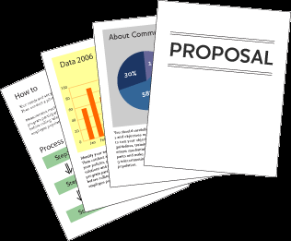
Purpose of Business Case
Justification of the project
To obtain authorization for the project and its funding
Used to give direction to a project team
Baseline document for phase and stage reviews
Used in evaluation of change requests
Baseline document for benefits reviews
Used by organization to facilitate lessons learned
Notes:
The Business Case is the key document to any project. Without a detailed and authorised Business Case a project should not be allowed to proceed.
It is also a document that lives on beyond the Project Lifecycle into the Operations Phase where the Benefits realization Review takes place, conducted by the Project Sponsor and any additional and useful stakeholders that can assist him/her in the identification and verification of the benefits.
Throughout the whole Project Lifecycle and beyond, the Business Case has many purposes.
It is there to justify the meaning of carrying out the work.
It is used as an authorization for a project to proceed or obtain its funding.
In the early stages of a project team’s development, it can be used by the Project Manager to give direction and purpose to the team.
It is the baseline document to all project activities to gauge performance and progress against the original plan of benefits.
It is used a an evaluating tool for any formal Change Control requests that may be submitted to a project to assess them against the potential alteration to the perceived benefits.
Within the Operations Phase it is used as the benchmark for Benefit realization.
After all project reviews it can be used to facilitate the future improvements to a project team and its organization by being using to learn from lessons within its project.

Slide 106

Contents of Business Case
Purpose
Project Summary
Business Objectives
Project Objectives
Benefits
Deliverables
Performance Indicators
Risks and Opportunities
Market and Competition Conditions
Organizational Constraints
Project Sponsor
Product Owner
Project Control
Resources
Other Constraints
Business Case
Business Case
(Not the one we are referring to.)
Notes:
The typical contents of a Business Case are shown on the slide above. (Couldn’t help the bad humor… in the picture.)
The first element to the document should be the reason or justification for the project.
A statement of Success and Acceptance Criteria should be shown within the Business Case to allow the Project Manager to identify from these the Quality Standards that he/she will be expected to achieve in their project goals.
The Project Sponsor should also identify what benefits the organization should be looking to gain by having this project go ahead so that anyone reading the document can see the reason and result of the project within one area.
The Project Manager will also need to know what they are being asked to produce as an end product. This product needs to be clear and precise so that the Project Manager can develop a prescriptive scope of work to match the deliverables.
A further area of the Business Case will be the Investment Appraisal which will give financial support to the project giving the true value of a project to the organization.
It is important within a Business Case to list the options or approaches available or being considered and this must also include the option of not doing the project and its relevant impact.
The Business Case as stated early is the driving force behind each project and so at every review it must be present for consideration as to whether or not the project should proceed or be halted as the justification or benefit can not now be realised. This is most commonly known as the Go/No go decision point.

Slide 107

Sustainability in the Business Case
Should include references to:
  Corporate Sustainability Governance
  Regulatory Compliance
  Goals and Objectives
  Principles and Values
  Performance Indicators Using P5 (We will get to that)
Project Managers should always review the Business Case or Charter from a CSR Perspective by leveling the deliverables against the EMS or with the CSR Officer.

Slide 108
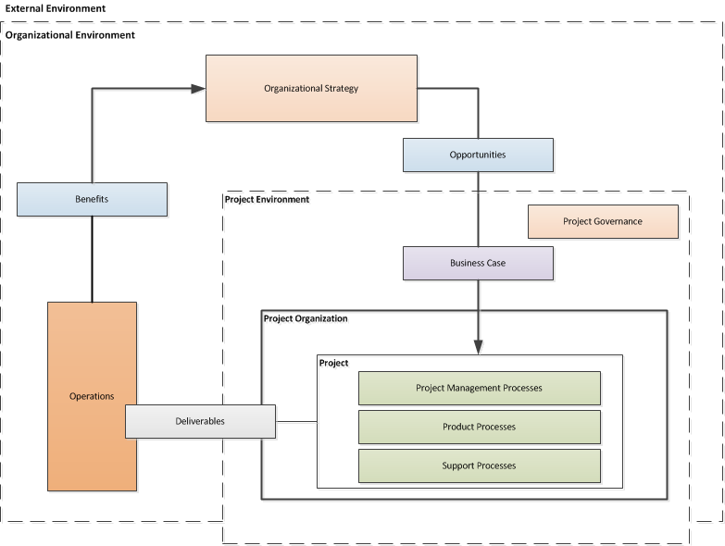
Business case in terms of concept to relationships
Business Case
Notes:
Overview of project management concepts and their relationships

Slide 109
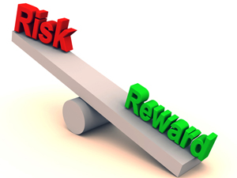
Investment appraisal
The investment appraisal enables the financial viability of projects to be measured both on a standalone basis and in comparison with other projects competing for funds
The process should confirm why the forecast cost and time will be worth the investment and justify the project based upon the estimated costs and the value of projected benefits.

Slide 110
Investment analysis techniques
Payback Period
The time taken to pay back the project investment.
Return on Investment (RoI)
The percentage ratio of average yearly profit over the productive life of the project, divided by the original investment.
Social Return on Investment (S-RoI)
A method for measuring extra-financial value (i.e., environmental and social value not currently reflected in conventional financial accounts) relative to resources invested.
Discounted Cash Flow (DCF)
DCF uses compound interest calculation to reflect the cost of money by “discounting” future cash flows to an equivalent “present value”
Net Present Value (NPV)
The aggregate of future net cash flows discounted back to a common base date, usually the present.
Internal Rate of Return (IRR)
The discount rate at which the Net Present Value of future cash flows is zero.

Slide 111
Payback period
If a project costs $1,000,000 and yields benefits as follows:
  Year 1 $200,000
  Year 2 $300,000
  Year 3 $500,000
  Year 4 $400,000
  Year 5 $400,000
The Payback Period is three years
$1M
Year 3
$500k
Year 2
$300k
Year 1
$200k

Slide 112
Return on investment (ROI)
ROI = (Average Annual Profit/Original Investment) x 100%
where Average Annual Profit = Total Profit/Years
Year | Investment | Benefits
0 | $1,000,000 | $0
1 |  | $200,000
2 |  | $300,000
3 |  | $500,000
4 |  | $400,000
5 |  | $400,000
 |  | $1,800,000
Average Annual Profit = ($1,800,000-$1,000,000)/5 = $160,000
ROI = ($160,000/$1,000,000) * 100% = 16%

Slide 113
Discounted cash flow
Leaving money invested in a deposit account at 10% interest would see growth based on compound interest:
Year 0 | $1.00
Year 1 | $1.10
Year 2 | $1.21
Year 3 | $1.33
If we kept the money instead of investing it, its comparative value would fall:
Year 0 | $1.00
Year 1 | $1.00/$1.10 = $0.91
Year 2 | $1.00/$1.21 = $0.83
Year 3 | $1.00/$1.33 = $0.75
Discounting is the opposite of compound interest. It recognises that the $1.33 in three years time is worth the same as $1.00 now.

Slide 114
Discounted cash flow example
Year | Investment | Benefits | DCF
0 | $1,000,000 | $0 | $0
1 |  | $200,000 x 0.91 | $182,000
2 |  | $300,000 x 0.83 | $249,000
3 |  | $500,000 x 0.75 | $375,000
4 |  | $400,000 x 0.68 | $272,000
5 |  | $400,000 x 0.62 | $248,000
 |  | $1,800,000 | $1,326,000

Slide 115
Net present value
The net present value (NPV) is the sum of all the discounted cash flows (both investments and benefits). It is the value of the project expressed in current monetary value.
Year | Investment | Benefits | Net cash flow | Discount factor (10%) | DCF
0 | $1,000,000 | $0 | -$1,000,000 | 1.00 | -$1,000,000
1 |  | $200,000 | $200,000 | 0.91 | $182,000
2 |  | $300,000 | $300,000 | 0.83 | $249,000
3 |  | $500,000 | $500,000 | 0.75 | $375,000
4 |  | $400,000 | $400,000 | 0.68 | $272,000
5 |  | $400,000 | $400,000 | 0.62 | $248,000
Total | $1,000,000 | $1,800,000 | $800,000 |  | NPV $326,000

Slide 116
Social Return on Investment (SROI)
Establishing scope and identifying key stakeholders. Clear boundaries about what the SROI will cover, and who the will be involved are determined in this first step.
Mapping outcomes. Through engaging with stakeholders, an impact map, or theory of change, which shows the relationship between inputs, outputs and outcomes is developed.
Evidencing outcomes and giving them a value. This step first involves finding data to show whether outcomes have happened. Then outcomes are monetized – this means putting a financial value on the outcomes, including those that don’t have a price attached to them.
Establishing impact. Having collected evidence on outcomes and monetized them, those aspects of change that would not have happened anyway (deadweight) or are not as a result of other factors (attribution) are isolated.
Calculating the SROI. This step involves adding up all the benefits, subtracting any negatives and comparing them to the investment.
Reporting, using and embedding. Easily forgotten, this vital last step involves sharing findings and recommendations with stakeholders, and embedding good outcomes processes within your organization.
Notes:
It can help organizations understand what social value an activity creates in a robust and rigorous way and so manage its activities and relationships to maximize that value.
The process opens up a dialogue with stakeholders, helping to assess the degree to which activities are meeting their needs and expectations.
SROI puts social impact into the language of 'return on investment’, which is widely understood by investors, commissioners and lenders. There is increasing interest in SROI as a way to demonstrate or measure the social value of investment, beyond the standard financial measurement.
Where it is not being used already, SROI may be helpful in showing potential customers (for example, public bodies or other large purchasers) that they can develop new ways to define what they want out of contracts, by taking account of social and environmental impacts.
SROI can also be used in strategic management. The monetized indicators can help management analyze what might happen if they change their strategy, as well as allow them to evaluate the suitability of that strategy to generating social returns, or whether there may be better means of using their resources.

Slide 117
What is project success and benefits management?
Project success is the satisfaction of stakeholder needs and is measured by the success criteria as identified and agreed at the start of the project.
Benefits management is the identification of the benefits at an organisational level and the monitoring and realisation of those benefits.
Src. APM BoK, 5th edition

Slide 118
What is success?
The definition of success will vary from project to project.
  The 2016 Olympics must open on time.
  A new medicine must be safe.
Each stakeholder will define success differently.
  The bride’s father wants the wedding to come in on budget.
  The bride’s mother wants every relative to be invited.

Slide 119
When to define success
Success should be defined and documented up front in the Concept phase of the project.
Success should be defined as a set of success criteria.
Once agreed and approved the success criteria should only be changed through formal change control.
Success is measured at the end.
Notes:
Ask the delegates what happens if success criteria aren't agreed up front.

Slide 120
Focusing on Benefits
Business Case
Project Outputs
Enable
Desired
Outcomes
Business
Changes
Create
Measured in
Also Cause
Benefits
Side-effects and consequences
Further Realize
Helps Achieve one or more
Result in
Strategic Initiatives
Dis-benefits
Notes:
Senior managers tend to focus on output delivery, which has no quantifiable value or benefit until successfully accepted, adopted and integrated into the organization as business as usual.
The real focus should be on demonstrable value and benefits aligned to strategic objectives, which also aligns with sustainability principals.

Slide 121
Key Principles / KPIs
Follow Best Practices while developing using Common Sense and Principles:
  Aligned to Strategy, Principles, Priorities and Expectations
  Conduct a Health Check
  Establish Governance
  Define the Vision
  Establish a Transformational approach
  Identify your Numbers
  Establish a Support Structure
  Don’t ignore Social and Environmental impacts

Slide 122
Benefits Realization
Measures of success
Common project management practice dictates that
benefits are based on business specific economic returns.
Concept
Definition
Implementation
Handover and Closeout
Operations
Benefits Realisation

Slide 123
Benefits Realization
Projects Infusing Sustainability
GPM’s benefits extend beyond economic returns
P5 Sustainability Framework
Concept
Definition
Implementation
Handover and Closeout
Operations
Benefits Realisation
Benefits are based on:
Business Specific Economic Returns
Alignment with Organizational and Government Sustainability Initiatives/Goals
Risk Responsiveness and Aversion
Global Reporting Initiative Reporting Standards & UN Post 2015 Engagement Architecture Reporting Capabilities
Alignment with ISO 14001 Environmental Management
Alignment with ISO 50001 Energy Management
Alignment with ISO 26000 Corporate Social Responsibility
Increased efficiency of process and increased organizational maturity in projects

Slide 124
Benefits Realization Plan
Description of the benefit
What strategic objective does it support?
Against values will the benefits be assessed and recorded?( for example: money, number of visitors, number of jobs, CO2 reduction etc.)
What is the current value of the benefit and what future value is anticipated?
Outputs required for the benefit to be realized
Dependency to other benefits
Benefit owner (see Benefit responsibilities section)
Which stakeholders this benefit will effect
How the benefit will be measured
Notes:
One of the causes for ineffective benefits management in practice is the lack of clear responsibilities in this respect. Assigning benefits management responsibilities can be challenging because this activity continues after the project.

Slide 125

The Benefit Owner
Benefit owner
The benefit owner is an individual who is responsible for ensuring it is realized.
The benefit owner is assigned during project initiation. Benefit owners do not have to be part of the project team but do play a role which is increasingly important towards the end of the project.
Typical responsibilities of the benefit owner will be:
Own the benefit profile
Provide input for the benefits realization plan
Manage benefits measurements
Organize benefit reviews
Report on progress of benefits realization

Slide 126
We have covered
What is the purpose of the business case.
Contents of the business case
Practical use of the business case
Investment Appraisal techniques
Calculating Valuation
Understanding Benefits

Slide 127
Requirements Management
Module | Module Covers | Learning outcomes
7 Requirements Management | The importance of requirements management Requirements and Definition | Understand requirements management, the dos and don’ts.
Language
English
Version
5.0

Slide 128
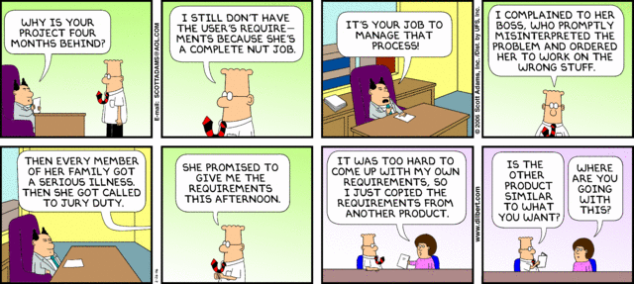
Poor Requirements = Poor Performance
Dilbert.com
Notes:
A simple opening on requirements.

Slide 129
What is Requirements Management?
Requirements management is the process of capturing, analysing and testing the documented statement of stakeholder and user wants and needs.
Requirements are a statement of the need that a project has to satisfy, and should be comprehensive, clear, well structured, traceable and testable.
47%
of unsuccessful projects
fail to meet goals due to poor requirements management
APM BoK 5th Edition
http://www.pmi.org/~/media/PDF/Knowledge%20Center/PMI-Pulse-Requirements-Management-In-Depth-Report.ashx
Notes:
We just covered a lot. Time for a quick break.

Slide 130
What Are Requirements?
The stakeholders’ and users’ wants and needs
They state ‘What’ is required NOT ‘How’ it is to be achieved
They contain acceptance criteria
They provide a measure against which project success can be judged
High-level requirements are documented during the Concept phase of the life cycle
They are further developed and agreed during the Definition phase

Slide 131
Requirements Life Cycle
Design Freeze
Baseline
Quick
Look
Detailed
Look
Finish
off
Benefits
Realization
Idea
Do It
Requirements Capture and Testing
Configuration Management & Change Control
Requirements Reviews
Notes:
The existence of a product specification is essential at the commencement of the implementation stage. This may initially only define requirements such as physical features, performance aspects and key acceptance criteria. To ensure the development of the design will achieve the objectives and benefits a series of reviews are conducted. This enables the design to be compared to the requirements in order to identify and address any deviations or shortcomings. A requirements review may be conducted during design to check that designers understand and can achieve the stated requirements.
As the product design develops, further reviews are carried out to check that the design will meet the product requirements. At the end of development the design is reviewed prior to build. As the design develops further, acceptance criteria, plans and methods are fully defined. These, the designs and production readiness are typically reviewed prior to the release of the design to production. This will check that the test methods are appropriate and will ensure that the product is adequately tested in line with the requirements.
Tests and inspections are typically carried out during the acceptance stage to verify that the deliverable products meet the requirements. If satisfactory, the product is formally accepted and signed off.
Throughout the development, the requirements, product specification and associated documentation is controlled using a formal change control and configuration management process.
The requirements management process facilitates the opportunity to provide confidence to the Project Team and the Stakeholders during the life cycle that the product is more likely to achieve the project objectives and its proposed benefits.

Slide 132
Requirements Structuring
Factors used to structure the construct of the requirements:
Value
  The size of the benefit from each requirement
Priority
  Stakeholders agree the priority order
Time
  Deadlines for each requirement
Process
  The way the solution is to be built, by which sub-contractors
Impact
  The P5* impact that the requirement has
*Sustainability Impact - People, Planet, Profit, Project Process and Resulting Product

Slide 133
Elements of a Requirements Management Plan
Introduction
  Purpose of The Requirements Management Plan
Requirements Management Overview
  Organization, Responsibilities, and Interfaces
  Tools, Environment, and Infrastructure
Requirements Management
  Assumptions/Constraints (Sustainability Impacts)
  Requirements Definition
  Requirements Traceability
  Workflows and Activities
Change Management
Key Terms
Requirements Management Plan Approval Page

Slide 134
Important Skills For Requirements Management
Active Listening and Communication Skills
Interpreting and articulating requirements, their alignment to organizational strategic goals and principles
Navigating ambiguity
Active Engagement of Stakeholders
Understanding the Need “You gave me what I asked for but not what I needed.”
Clearly defined and functioning change control
Ability to articulate the business value of the requirement

Slide 135
The study of why things go wrong
If you don’t know what you want,
or what you want keeps changing;
or you can’t commit the required money to the project;
or you don’t have anyone in charge of the project,
or you keep changing the person in charge,
or the person who
is supposed to be in charge doesn’t really call the shots;
or the person at the top of the business doesn’t care about the project;
and you don’t focus on what the actual benefit to the business is;
and you don’t regularly talk to the people who will have to use the system;
and you don’t constantly check progress;
or you have an unrealistic timetable and try to run before you can walk;
or you fail to test the system properly before you launch it;
or if you don’t provide enough training;
or you don’t have a Plan B in case things go wrong;
or you try to bite off more than you can chew in one go;
or if you don’t realise that the bigger project the greater the chance of its being overtaken by events or new technology or new legislation;
or you don’t realise that you may not have the skills you need to manage the project;
or you don’t realise that some suppliers are quite capable of telling you they can deliver when they can’t;
Then…..

Slide 136
The frequent result
Don’t be surprised if you end up with:
a mess that is way behind schedule,
damages your organiszation,
traumatises your staff,
costs much more than it is supposed to,
(and doesn’t work.)”

Slide 137
We have covered
Requirements Management
Requirements Lifecycle
Requirements Structuring
Requirements Management Plan
Important Skills For Requirements Management

Slide 138
Project Management
Module | Module Covers | Learning outcomes
8 Project Management | What is a Project What is Project Management What are Process Groups and how What are Subject Groups What is the project Environment | Understand what project management is, the ins and outs and the project environment
Language
English
Version
5.0

Slide 139
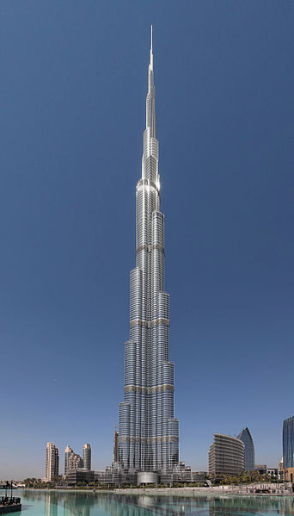

What is a Project?
A project consists of a unique set of processes consisting of coordinated and controlled activities with start and end dates, performed to achieve project objectives.
Achievement of the project objectives requires the provision of deliverables conforming to specific requirements. A project may be subject to multiple constraints.
Although many projects may be similar, each project is unique. Project differences may occur in the following:
  deliverables provided;
  stakeholders influencing;
  resources used;
  constraints;
  the way processes are tailored to provide the deliverables.
Every project has a definite start and end, and is usually divided into phases.
Both the Burj Khalifa and the wooden step stool are results of projects.
Notes:
http://en.wikipedia.org/wiki/File:Burj_Khalifa.jpg

Slide 140
Project Management
Constraints
time, cost, quality, technical, other performance parameters, legal, environmental, social
Input
Project Management
Output
business need
problem
opportunity
project deliverables:
Products
Services
change
Mechanisms
people, tools, techniques, equipment, organization
Notes:
Projects
A project consists of a unique set of processes consisting of coordinated and controlled activities with start and end dates, performed to achieve project objectives. Achievement of the project objectives requires the provision of deliverables conforming to specific requirements. A project may
be subject to multiple constraints.
Although many projects may be similar, each project is unique. Project differences may occur in: deliverables provided; stakeholders influencing; resources used; constraints; and the way processes are tailored to provide the deliverables.
Every project has a definite start and end, and is usually divided into phases
Project Management
Project management is the application of methods, tools, techniques and competencies to a project.
Project management includes the integration of the various phases of the project life cycle
Project management is performed through processes. The processes selected for performing a
project should be aligned in a systemic view. Each phase of the project life cycle should have
specific deliverables. These deliverables should be regularly reviewed during the project to meet
the requirements of the sponsor, customers and other stakeholders
ISO 21500 Section 3.2 and 3.3

Slide 141
Project Management Process Groups
Notes:
The management of a project starts with the initiating process group and finishes with the closing process group. The interdependency between process groups requires the controlling process group to interact with every other process group as shown in Figure 5. Process groups are seldom discrete or one-time in their application. The process groups are normally repeated within each project phase to drive the project to completion. All or some of the processes within the process groups may be required for a project phase.

Slide 142
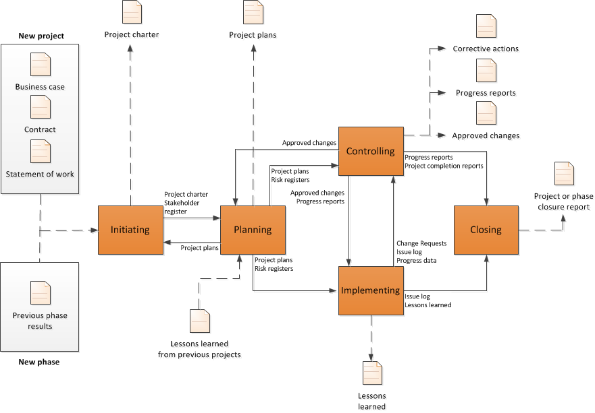
Interaction Among Process Groups
Source ISO 21500 Pg.12
Notes:
This page shows the interactions among the process groups inside the boundaries of the project, including the representative inputs and outputs of processes within the process groups. With the exception of the controlling process group, linkages between the various process groups are through individual processes within each process group. While linkage is shown in the diagram between the controlling process group and other process groups, the controlling process group may be considered self-standing because its processes are used to control not only the overall project, but also the individual process groups.

Slide 143
Subject Groups
Each subject group consists of processes applicable to any project phase or project. These processes are defined in terms of purpose, description and primary inputs and outputs in and are interdependent. Subject groups are independent of application area or industry focus.
Integration – Processes to identify, define, combine, unify, coordinate, control and close activities.
Stakeholder - the processes required to identify and engage the project sponsor, customers and other stakeholders
Scope – the processes required to identify and define the work and deliverables required
Resource – the processes required to identify and acquire adequate project resources
Time – the processes required to schedule the project activities and to monitor progress to control the schedule
Cost – the processes required to develop the budget and to monitor progress to control costs
Risk - the processes required to identify and manage threats and opportunities
Quality - the processes required to plan and establish quality assurance and control
Procurement - the processes required to plan and acquire products, services or results, and to manage supplier relationships
Communication - includes the processes required to plan, manage and distribute information relevant to the project
Derived from ISO 21500
Notes:
Some Organizations call these “knowledge areas”. This is incorrect. It is not enough to be knowledgeable. You must be proficient.
Each subject group consists of processes applicable to any project phase or project. These processes are defined in terms of purpose, description and primary inputs and outputs in and are interdependent. Subject
groups are independent of application area or industry focus.
ISO 21500 Definitions
Integration - The integration subject group includes the processes required to identify, define, combine, unify, coordinate, control and close the various activities and processes related to the project.
Stakeholder - The stakeholder subject group includes the processes required to identify and engage the project sponsor, customers and other stakeholders.
Scope - The scope subject group includes the processes required to identify and define the work and deliverables, and only the work and deliverables required.
Resource - The resource subject group includes the processes required to identify and acquire adequate project resources such as people, facilities, equipment, materials, infrastructure and tools.
Time - The time subject group includes the processes required to schedule the project activities and to monitor progress to control the schedule.
Cost -The cost subject group includes the processes required to develop the budget and to monitor progress to control costs.
Risk - The risk subject group includes the processes required to identify and manage threats and opportunities.
Quality - The quality subject group includes the processes required to plan and establish quality assurance and control.
Procurement - The procurement subject group includes the processes required to plan and acquire products, services or results, and to manage supplier relationships.
Communication - The communication subject group includes the processes required to plan, manage and distribute information relevant to the project.

Slide 144
Relationship between project management concepts and processes
Project management is accomplished through processes utilizing the concepts [knowledge] and application [competencies.]
A process is a set of interrelated activities. Processes used in projects are generally categorized into three major types.
  project management processes -- specific to project management and determine how the activities selected for the project are managed
  delivery processes -- not unique to project management, result in the specification and
  provision of a particular product, service, or result and vary depending on the particular project
Deliverable support processes -- not unique to project management, provide relevant and valuable support to product and project management processes in such disciplines as logistics, finance, accounting and safety
Notes:
This standard addresses only project management processes. However, it should be noted that product, support and project management processes might overlap and interact throughout a project.

Slide 145
True or False?
1. A project starts when the performing organization completes the processes required to mandate a new project.
FALSE
TRUE
2. A project ends when the project deliverables have been accepted or the project has been prematurely terminated, and when all project documentation is delivered and all closure activities have been completed.
TRUE
3. A project manager’s responsibility for a project ends when all closure activities have been completed.
Notes:
Understanding the management of the outcome after handover is important.

Slide 146
The Project Environment
ISO 21500
Notes:
This slide shows the project environment. Organizational Strategy creates opportunities that become business cases. The business case is carried out via projects that hand deliverables over to the operations side of the organization. Benefits are then derived and realized by the strategic level.
The Project Manager is responsible for benefit realization.

Slide 147

Project Complexity
GAPPS has developed an approach to categorizing projects based on their management complexity. The GAPPS framework uses a tool called the Crawford-Ishikura Factor Table for Evaluating Roles, or CIFTER. The tool, named after two major contributors to GAPPS, is used to differentiate project manager roles based on the complexity of the projects managed.
1. Stability of the overall project context
2. Number of distinct disciplines, methods, or approaches involved in performing the project
3. Magnitude of legal, social, or environmental implications from performing the project
4. Overall expected financial impact (positive or negative) on the project’s stakeholders
5. Strategic importance of the project to the organization or organizations involved
6. Stakeholder cohesion regarding the characteristics of the product of the project
7. Stakeholder cohesion regarding the characteristics of the product of the project
Notes:
Project Managers are expected to produce essentially the same results – outputs and outcomes that are acceptable to relevant stakeholders. However, the context in which these results are produced may differ: some projects are inherently harder to manage than others. A project manager who is competent to manage an easier, less complex project may not be competent to manage a harder, more complex project.

Slide 148
Great Project Managers
Focus on Customer Needs
Challenge “That’s the way we have always done it…”
Meet Face to Face (video conference also counts ;)
Understand the requirements and how they relate to organizational principles and benefit
Collaborate with the project team
Delegate Effectively
Are comfortable in the “C” Suite
Are proactive
Can lead under pressure

Slide 149
We have covered
What is a Project
What is Project Management
What are Process Groups and how What are Subject Groups
What is the project Environment

Slide 150
Project Lifecycles and PRiSM
Module | Module Covers | Learning outcomes
8 Project Life Cycles and PRiSM | Project and Product life cycles. Product Lifespans Cradle to Cradle and Cradle to Grave Project phases such as Initiate, Plan Implement and Close. The relationship between phases and stages. The PRiSM Flow | Describe a project life cycle. Describe a product life cycle Understand The PRiSM Life Cycle Understand the Product LifeCycle
Language
English
Version
5.0

Slide 151
Requirements Life Cycle
Design Freeze
Baseline
Idea
Quick
Look
Detailed
Look
Do It
Finish
off
Get the
benefits
Requirements Capture and Testing
Configuration Management & Change Control
Requirements Reviews
Notes:
The existence of a product specification is essential at the commencement of the implementation stage. This may initially only define requirements such as physical features, performance aspects and key acceptance criteria. To ensure the development of the design will achieve the objectives and benefits a series of reviews are conducted. This enables the design to be compared to the requirements in order to identify and address any deviations or shortcomings. A requirements review may be conducted during design to check that designers understand and can achieve the stated requirements.
As the product design develops, further reviews are carried out to check that the design will meet the product requirements. At the end of development the design is reviewed prior to build. As the design develops further, acceptance criteria, plans and methods are fully defined. These, the designs and production readiness are typically reviewed prior to the release of the design to production. This will check that the test methods are appropriate and will ensure that the product is adequately tested in line with the requirements.
Tests and inspections are typically carried out during the acceptance stage to verify that the deliverable products meet the requirements. If satisfactory, the product is formally accepted and signed off.
Throughout the development, the requirements, product specification and associated documentation is controlled using a formal change control and configuration management process.
The requirements management process facilitates the opportunity to provide confidence to the Project Team and the Stakeholders during the life cycle that the product is more likely to achieve the project objectives and its proposed benefits.

Slide 152
Initiation phase
Initiate
Plan
Handover & Closeout
Implement
The sponsor is selected
The Need/Problem/Opportunity is established
Feasibility is investigated
Fit with strategy is checked
High level risks are identified and assessed
Levelling against Management Systems are completed
P5 Impact analysis is completed and SMP is initiated
Initial stakeholders are identified and analysed
High level requirements are identified
Business options (inc Do Nothing) are identified, evaluated and documented in the Business Case
Plans for next phase (Definition) are produced.

Slide 153
Planning phase
Initiate
Plan
Handover & Closeout
Implement
Project Manager is appointed (if not already in place)
The preferred solution is checked against high level requirements
Alternative designs are considered
The approach is agreed with the Sponsor
Detailed requirements are gathered and refined
The Project Management Plan (PMP) is prepared
Estimates of time, resources and costs are produced
The Business Case is updated to reflect plans and estimates
Detailed plans for next phase (Implementation) are prepared

Slide 154
Implementation phase
Initiate
Plan
Handover & Closeout
Implement
Implementation phase may be divided into Stages:
  Design
    Design optimised and completed
    Design documentation produced
    Design approved
  Build
    Actual products are now produced
    Components tested against acceptance criteria
Project Manager:
  Controls and monitors the delivery
  Manages risks, issues and changes
  Communicates progress with stakeholders

Slide 155
Handover & closeout phase
Initiate
Plan
Handover & Closeout
Implement
Test the completed set of deliverables in operational mode
Sponsor and users accept products
Transfer ownership
Complete all project documentation
Review project performance (Post Project Review)
Capture and disseminate lessons (Lessons Learned)
Close the project

Slide 156

The Strength of PRiSM
The only project methodology that aligns with ISO 26000, 21500, 14001, 9000, 50001,55000 the UNGC Ten Principles, and The GRI G4 Framework for Sustainability Reporting and the Earth Charter.
Notes:
We are now going to do a walkthrough of the PRiSM Methodology from a Workflow Perspective before diving in a little deeper.
PRiSM Short for (Projects integrating Sustainable Methods)
PRiSM™ (Projects integrating Sustainable Methods) is the sustainability based project delivery method which incorporates tangible tools and methods to manage the balance between finite resources, social responsibility, and delivering “green” project outcomes. It was developed for organizations to integrate project processes with sustainability initiatives to achieve business objectives while decreasing negative environmental impact.
PRiSM is a structured project management methodology that highlights areas of sustainability and integrates them into the traditional core project phases which, when understood and effectively addressed, can reduce negative environmental impacts in all types of projects while maximizing opportunities to manage sustainability and finite resources. PRiSM is cut from the same cloth as the globally accepted standards for professional project management. These standards are the “books of knowledge” as they are known to project managers. PRiSM incorporates a framework of activities derived from ISO 21500, 14001, 26000, 50001 and 9001, focuses on specific areas and incorporates best practices to practically answer the question: "How do I apply sustainability in to my projects?”

Slide 157
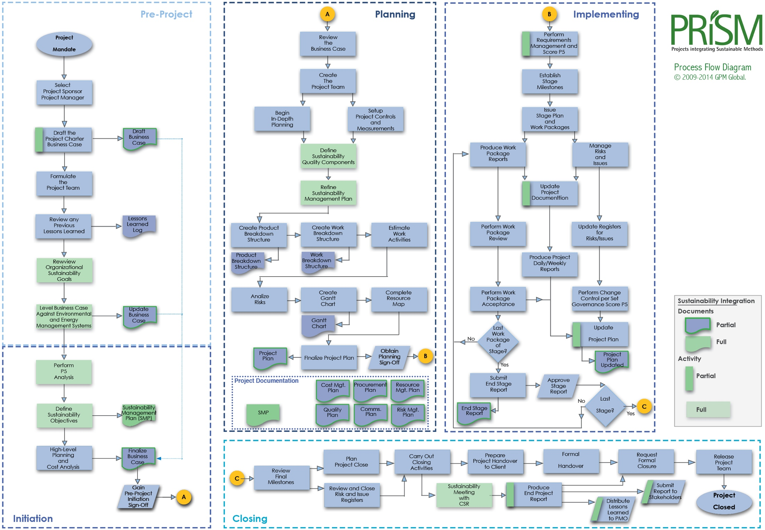
The Full PRiSM Process Flow

Slide 158
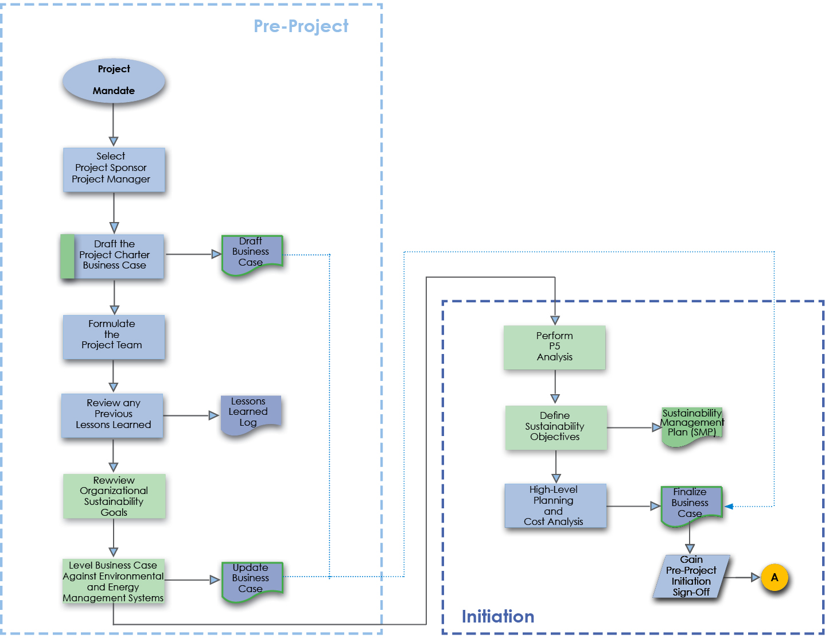
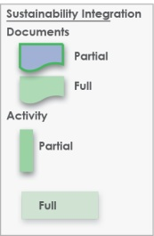
The PRiSM Pre Project/Initiation Phase
Review Organizational Sustainability
Goals
Notes:
The initiation phase is one where the ideas are formulated and the business reviews whether this is a feasible project or element of a project to be included within the portfolio of projects that it is currently running. What you see here is an example of steps-to-take in an initiation phase for sustainability integration. I will go over them in detail.
The key deliverable within this phase is the Project Charter. the value of the sustainability elements are housed here. We are going to mainly focus on this phase today but will touch on all four.

Slide 159

Leveling against the EMS
Notes:
As a project manager, we recommend that when you review the project charter, always level it against the corporate EMS. Meaning, does the request align with corporate targets and objectives already in place? Don’t leave it up to the project sponsor or anyone who handles the charter before it touches your hands to do so.

Slide 160

Project Sustainability Impact Analysis
Notes:
Performing an Impact analysis begins with mapping your project deliverables up by each category.

Slide 161

The PRiSM Pre Project/Initiation Phase
Notes:
The pre project phase is one where the ideas are formulated and the business reviews whether this is a feasible project or element of a project to be included within the portfolio of projects that it is currently running.
The key deliverable within this phase is the Project Charter or Business Case that will show the value of the sustainability element within the full project document. In addition, to support the charter, the delivery has to be leveled against the organization’s environmental management system allowing it therefore to develop further its Sustainability Management Plan (SMP) for the future.

Slide 162

Define Sustainability Objectives
Notes:
The next step is to define sustainability objectives.
Although, there may be some already in the charter, it is important to take what your findings from your impact analysis and what you have identified from the EMS and also what you may have learned from a CSR officer or from your company’s and outline some high level objectives. How are you going to address the impacts? Think of the deming model, Plan Do Check Act, this would be plan step to establish output expectations.
The outcomes from your P5 Impact analysis should result in sustainability objectives. If you have many +2s or +3s they should be documented and planned for in your SMP.

Slide 163

What is an SMP?
Notes:
Green Project Management® or Sustainability in Project Management in short addresses the impact of a project on the environment. There have been several theories identified over the past several years but none that can be adopted as repeatable processes that provide governance and deliver consistent results.
In order for green project management to take a permanent foothold a new set of activities that focus strictly on the sustainable aspects of an initiative through project governance is required.
The sustainability management plan (SMP) addresses these needs by determining how green the project delivery will be and how it aligns with organizational standards set forth in the environmental management system and or regulatory compliance standards document. The SMP is a true method to measure the impacts -long and short term- to organizational goals such as waste reduction, resource consumption, and energy efficiency.
The SMP is used to govern the benefits of the project and so therefore belongs either as part of or as an attachment to the business case. When it is accepted that the business case is the driving document of all projects, then it would be remised to believe that sustainability could exist without some sort of impact with the business case.
With the understanding that the business case must align itself with the strategy of the organization or company, then having a SMP and Environmental Management System in place ensures that the organization’s approach meets the strategy laid out within that. That is not to say that the business case has to ensure that it produces green projects each and every time, but that the elements or subjects within the business case also ask or investigate the five measureable aspects of sustainability to gain the full understanding, direction, costs and benefits available within this area for the organization.

Slide 164
Tools to Integrate Sustainability and Project Management
The SMP Ties corporate CSR goals and objectives to the project plan and identifies project impacts from an Environmental, Social, and Economic standpoint
Notes:
Sustainability in Project Management in short addresses the impact of a project on the environment. There have been several theories identified over the past several years but none that can be adopted as repeatable processes that provide governance and deliver consistent results.
The SMP uses a change management process to map sustainability objectives derived from the P5 impact analysis into a column table that outlines the P5 category (People, Planet, or Profit,) sub category, and element as well as the reason for the inclusion, the initial score, any legal or regulatory conflicts and a proposed action.

Slide 165

What is included in an SMP
Table of Contents
Document Control
  Version History and recipients list
Purpose
  A brief on what the document is
Executive Summary or Brief
  An outline of the sustainability factors in the project
List Project Sustainability Objectives
  Derived from the P5 Impact Analysis
Outline Key Measures and Performance Indicators (Qualitative and Quantitative)
The P5 Impact Assessment Score (and updates)
Scope Exclusions
Sustainability Reviews and Reporting
Checklist

Slide 166
What is included in an SMP
Table of Contents
Document Control
  Version History and recipients list
Purpose
  A brief on what the document is
Executive Summary or Brief
  An outline of the sustainability factors in the project
List Project Sustainability Objectives
  Derived from the P5 Impact Analysis
Outline Key Measures and Performance Indicators (Qualitative and Quantitative)
The P5 Impact Assessment Score (and updates)
Scope Exclusions
Sustainability Reviews and Reporting
Checklist

Slide 167
Version Control and Distribution

Slide 168
Key Performance Measures
(Qualitative and Quantitative)
Example:
Key Performance Indicators Environmental
Energy: Number of green Buildings in the city
Waste: Amount of dangerous waste treated
Transport: Number of electric public transport
Water Usage: Amount of building with water recycled system
Materials and Resources: amount of promotional benefits to acquire local materials and their impacts in the local industries. ie. Construction
Key Performance Indicators Financial
Return on Investment: ROI
Business Agility: number of days to resolve upcoming squatting, weeds, pests, unsafe buildings, graffiti
Key Performance Indicators Products
Servicing of Product: Satisfaction Survey Results (surveys carried out be independent agency)
Lifespan of Product: The Enforcement Agency should have 60% Community Satisfaction
Key Performance Indicators Processes
Maturity of process: Maturity of the EMS: Plan-Do-check-Act
Maturity Efficiency and fairness of process: number of corrective actions and its financial impact
Key Performance Indicators Personal
Labour Practices and Decent Work: Number of labor accidents and amount of money incurred
Society and Customers: Number of children received training course regarding Sustainability.
Ethical Behaviour: implement “Sustainability Awards” at school, restaurants, event organizer, etc.

Slide 169
P5 Impact Assessment
A summary of the planned environmental impact and steps that will be taken to decrease the effects or increase the opportunities identified

Slide 170
The final pieces
Scope Exclusions
None.
Sustainability Risk Management
For the Sustainability Risk Management the agency will apply the PMBOK® Guide. The Sustainability Risk Plan should include the above environmental aspects and impacts and the response for each of one.
Reviews and Reporting
The Enforcement Agency members monthly will review and make a Sustainability Report that will be published at website of Enforcement Agency; and maintain periodically meeting with representatives of local community groups, and State and local officials.
Current Sustainability (P5) Score
+2.03
Checklist
The Following Assessments are considered in this Sustainability Management Plan:
Financial Assessment
Process Assessment
Product Assessment
Environmental Assessment
Social and Corporate Assessment

Slide 171
Where does the SMP Interface with the Project?
Source ISO 21500 Pg.12

Slide 172


The Planning Phase
Notes:
The planning phase is the moment when the project starts to come to life. Here the project manager needs to gain a real understanding of what the client or organization is looking to achieve so that they can plot the best way to deliver the project, its main deliverables and the planned benefits in the most sensible and safest manner to benefit all parties involved.

Slide 173
Refining an SMP
Refine
Sustainability Management
Plan
Notes:
Green Project Management® or Sustainability in Project Management in short addresses the impact of a project on the environment. There have been several theories identified over the past several years but none that can be adopted as repeatable processes that provide governance and deliver consistent results.
In order for green project management to take a permanent foothold a new set of activities that focus strictly on the sustainable aspects of an initiative through project governance is required.
The sustainability management plan (SMP) addresses these needs by determining how green the project delivery will be and how it aligns with organizational standards set forth in the environmental management system and or regulatory compliance standards document. The SMP is a true method to measure the impacts -long and short term- to organizational goals such as waste reduction, resource consumption, and energy efficiency.
The SMP is used to govern the benefits of the project and so therefore belongs either as part of or as an attachment to the business case. When it is accepted that the business case is the driving document of all projects, then it would be remised to believe that sustainability could exist without some sort of impact with the business case.
With the understanding that the business case must align itself with the strategy of the organization or company, then having a SMP and Environmental Management System in place ensures that the organization’s approach meets the strategy laid out within that. That is not to say that the business case has to ensure that it produces green projects each and every time, but that the elements or subjects within the business case also ask or investigate the five measureable aspects of sustainability to gain the full understanding, direction, costs and benefits available within this area for the organization.

Slide 174

Refining the SMP
The Refinement of the SMP should include:
  Scope Changes
  Sustainability Quality Components
  Changes to the P5 Score +/-
  Sustainability Risks Identified

Slide 175
The Planning Phase
Define
Sustainability
Quality
Components

