Slide 1

Profesional PRiSM
PARTE II
Projectos que integran Métodos Sostenibles
V 3.0

Slide 2
Estructura de Desglose de Costos
Sistema de Contabilidad de Costos de la Compañia
Cuentas
Estructura de Desglose del Trabajo del Proyecto
Trabajo
Compras
Gestión
Diseño
Constr
Material
Contracto
Gastos
1
1.1
1.1.1
1.25k
0.25k
3.25k
1.1.2
1.15k
5.00k
2.75k
1.1.3
0.25k
0.25k
Otras Areas
Paquetes de Trabajo
Notes:
Another useful breakdown that can be derived from the WBS is the Cost Breakdown Structure (CBS). It important that costs for each work package are broken into elements since different types require different monitoring and control processes. For example, in-house labour may be controlled through time sheets, materials through purchase orders and contracts used to control sub-contracted work. Some cost categories will need to be isolated if earned value is to be used for cost control.
The Cost Breakdown Structure is derived from the company system of allocating costs and the WBS. Typically, budgets (estimates) for each work package are broken down into cost elements corresponding to the company system of accounts. Actual costs charged to each work package are detailed at cost element level. This enables work package managers to compare actual costs with baseline work package budgets to pinpoint variances and problem areas, allowing them to take any corrective action.

Slide 3

Mejores Prácticas de GPM
Separar los objetivos sostenibles que deben integrarse en el plan del proyecto
Desarrollar su propio PBS y WBS
Identificar el trabajo que es necesario hacer
Asignar responsabilidad a las tareas
Integre su PBS / WBS con el Director de Proyecto
Alinear las necesidades y los entregables

Slide 4
Precisión de las Estimaciones
Nivel de Incertidumbre
Precisión de las Estimaciones
Necesidad
Producción
Utilización
Visión Rápida
Visión Detallada
Idea
Hacerlo!
Fin
Notes:
Estimates in projects are quantified assessments of resources and time required to complete part or all of a project. They are used to support Investment Appraisal and support project Go/No Go decisions. They are also used throughout the project to support performance assessments and predictions.
Estimating accuracy will vary through the project lifecycle depending on the level of uncertainty and the quality and availability of information. Generally, information during the concept stage is likely to include only high level designs and strategies, consequently its accuracy is likely to be in a ‘rough order of magnitude’ due to the uncertainties and lack of defined information. As more data becomes available during definition, estimating accuracy should be sufficient for the approval of the business case. Accuracy will continue to improve at the beginning of implementation as detailed designs, scope of work and detailed plans are produced. This is necessary to control cost, time and performance during implementation since unreliable estimates could cause management problems and reduce team morale. Estimating accuracy should improve throughout implementation sub stages as more details and results of work are defined and recorded. At the end of each sub stage, information and lessons learned will help to improve estimating accuracy by the use of these actual costs and tasks being completed.
The reliability of estimates is likely to influence decisions to continue or terminate the project at the end of each project stage and sub stage.
Remember, cost and time always remains an estimate up until the final day of the project when it is closed. At no time should a Project Manager guarantee what their costs or timescales are going to be.

Slide 5

Gestion de los Recursos
La habilidad para gestionar recursos finitos es una habilidad crítica

Slide 6
Tipos de Recursos
Consumibles
  Materias Primas
  Dinero
  Recursos Naturales
No Consumibles (pero requieren cuidado)
  Máquinas
  Instalacioness
  Equipos de Ensayos
  Gente
Notes:
There are two main types of resource, those that can be consumed during work and those that can reused and are non-consumable. For example, the fuel that goes into a car is a consumable while the car is re-usable.
Remember, the most valuable resource that you will ever have is your people, so ensure you lead them and care for them well as they are the most re-useable assets that any Project Manager will ever have.

Slide 7

El Proceso de Asignación de Recursos
Los tres pasos básicos:
Asignación – Una vez que las actividades han sido programadas, los recursos son asignados a cada actividad. Esto permite determinar los requerimientos totales en relación a la escala de tiempo del proyecto.
Agregación – los requerimientos de recursos son totalizados para determinar el nivel de recursos requerido para cada periodo de tiempo.
Programación – Es poco probable que la disponibilidad de los requerimientos de los recursos coincida con los requerimientos (o demanda). Tales restricciones son aplicadas a los requerimientos de los recursos y se determina un cronograma optimizado.
Notes:
A resource is anything required to complete the work of an activity. It could be people, equipment or materials. Resource management ensures that the right resources have been identified and made available as an when necessary.
The sequence of steps during the resource process is as follows:
Allocation - once activities have been scheduled resources are allocated to each activity. This enables the total requirements to be determined against the project timescale.
Aggregation – resource requirements are totalled to determine the level of resources required for each timescale period. This is typically shown as a histogram.
Scheduling – it is unlikely that the availability of resource requirements will fit exactly into the requirements (or demand). Such constraints are applied to the resource requirements and an optimised schedule is determined. This may require activities to be delayed, extended and perhaps de-scoped.

Slide 8
Gestión de los Recursos
La Eficaz gestión de los recursos asegura:
  Eficiente utilización de los recursos
  Confianza que el cronograma es realista en términos de recursos requeridos y disponibles
  Temprana identificación de los cuellos de botella de la capacidad de los recursos y conflictos.
Notes:
The effective application of Resource Management by the Project Manager increases the opportunity for the project to:
Be more efficient in the utilisation of resources, this is vitally important when the resource is specialised or scarce.
Have greater confidence that the schedule is more realistic in what is really required and how it fits in terms of the resources available.
Have early indication of any resource bottlenecks or conflicts that will need managing.

Slide 9
Mejores Prácticas de GPM
Trabajar con el Director de Projecto para programar las actividades
Facilitar la Entrega del Proyecto con un Role de Soporte
Mantener un estricto control sobre los asuntos de asignación de recursos para evitar la deriva del alcance
Garantizar la capacidad de las auditorías en cuanto a Monitorear y Controlar cada recurso para posteriores lecciones aprendidas en el futuro.

Slide 10

Calidad
Asegurar los mejores resultados

Slide 11


Restricciones
Time
PERFORMANCE
Cost
Scope
Notes:
There is a common link to all constraints within project management.
The three major constraints that are placed upon a project are time, cost, and performance or quality. These constraints and how they are approached determine not only if the objectives are met but to what degree of success they will be. The understanding of these limitations early is crucial to assisting with project success.
Dr. Martin Barnes, Past President of the Association for Project Management (APM), stated in a keynote at the second-day plenary session of the 26th IPMA World Congress on October 30th titled “We can and should raise the standards”. [20]
Dr. Barnes’s keynote was very engaging and focused on how standards are more than processes. He shared that project management standards are frameworks for activities and provide benchmarks for performance. He shared the story behind the “iron triangle” which has been understood as time > cost > scope = quality
Dr. Barnes, the originator of the “iron triangle” (1972) asked everyone in the audience to replace quality with performance going forward as quality was not an appropriate component– performance would make a much better component as projects are so much more about the outcome.
He used a metaphor to make his point.
If a Surgeon contacts a patient after completing a procedure and explains that he accomplished a successful surgery even though it did not cure the patient’s illness. As it was on time, in scope, and in line with his fees, it was a quality procedure.
He further simplified his point saying that project success should be determined by the outcome matching the intent. “Does it work?
DISCUSSION POINTS:
How does sustainability affect the triple constraint?
(Additional discussion points…)

Slide 12
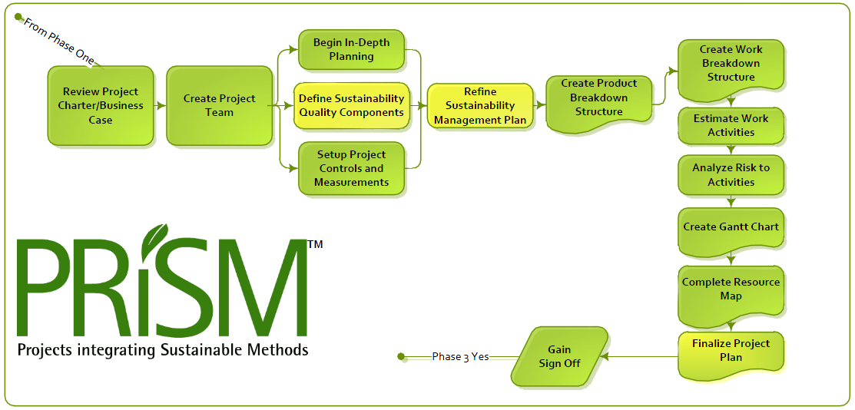
La Fase de Planificación
Define Sustainability Quality Components
Notes:
Recordemos la fase de Planificación cuando mencionábamos “Definir los Componentes de Calidad para la Sostenibilidad”

Slide 13
¿Qué Significa Calidad?
Los productos y procesos del proyecto cumplen con las necesidades de los interesados
  Adecuado para su propósito
  Grado de Conformidad
Notes:
Key points:
the requirements for quality are defined in measureable terms as acceptance criteria.
outputs and processes can only be fit for purpose if the purpose is understood.
definition of requirements enables the project manager to trade off between scope, time, cost and quality.
Also from ISO 9001 on Quality Management
Customer Focus
Leadership
Involvement of people
Process Approach
System approach to management
Continuous Improvement
Factual approach to decision making
Mutually beneficial supplier

Slide 14
Responsabilidades de la Calidad
Gestión responsable de crear un ambiente para el logro de la calidad del Proyecto (organización y Proyecto)
Organización responsable de la mejora de los procesos del proyecto – aprendizaje desde la experiencia (mejora continua)
La Calidad abarca a los productos y a los procesos de gestión
Notes:
Management is responsible for creating an environment for quality for the project. This is shared by the organization and project (ISO 10006, Section 5, Quality in project management processes).
The objectives, responsibilities, processes and methods for achieving quality at an organizational level are typically defined in the organization’s Quality Management System. The Project Manager is responsible for creating and implementing a quality management system for the project. This is defined in a Project Quality Management Plan.
The Plan sets out specific quality practices, resources and the sequence of quality management activities required to achieve the project objectives. It will also refer to processes and requirements defined in the organization’s quality management system.

Slide 15
Ambiente de la Calidad
Planificación de la Calidad
Mejora de la Calidad
Aseguramiento de la Calidad
Control de la Calidad
Notes:
The Quality Environment essentially covers four processes:
Quality Planning – defining standards, criteria to be achieved, appropriate actions to ensure the required quality is achieved. The Quality Plan provides guidance to project stakeholders on how quality management will be performed on the project. It includes a statement on stakeholder expectations, success criteria, standards applicable, how they will be applied and how quality will be assured through specific actions, e.g. auditing.
Quality Assurance – this involves pre-planned, regular reviews & independent audits to verify that work is being carried out consistently in accordance with defined procedures, and to provide confidence to stakeholders that the project will satisfy relevant quality requirements and standards.
Quality Control – the process of monitoring project results, evaluation to verify results are compliant with relevant standards and taking corrective action to eliminate causes or address unsatisfactory performance. Typically includes visual inspection, testing or trials to verify that the project deliverables conform to specification, that they are fit for purpose and meet stakeholder’s expectations.
Continuous improvement – continual systematic approaches to quality improvement such as TQM, ‘six sigma’, Kaizen. The focus is on specifying requirements tightly and meeting them as effectively and efficiently as possible. In order to measure success organizations use maturity models (e.g. the EFQM excellence model) which provide focus, motivation and mechanisms for objectively improving performance in every aspect of the business.

Slide 16
Herramientas de Control de la Calidad
Diagrama de Pareto
Causa y Efecto
Diagrama de Flujo
Seven quality control tools
Diagrama de Comportamiento
Histogramas
Gráficos de Control
Dispersión
El análisis de la Matriz P5 da como resultado un Gráfico de Control
Notes:
Cause & Effect (Ishikawa) – is simply a graphical technique to help develop an understanding of how certain causes may lead to a particular effect.
Pareto – a type of histogram that orders the information in a particular way. This gives rise to the Pareto principle that 80% of the problems are the result of 20% of the causes. This enables us to direct problem solving where it will be most effective.
Run Chart – plots the history of a single variable. For example if a key performance criteria for a project was the variance between actual cost and budget cost, this variable could be plotted over time to track its variation and identify trends.
Control Chart – plots value for each of a number of outputs of the same process. It also sets tolerances for the values measured. This allows us to identify if the process is in or out of control. For example plotting the results of a test on each weld on the ship to ensure our welding process was within acceptable control limits.
Scatter – used where there are two variable and we want to see if there is a relationship between them. e.g. the strength of a number of cubes against recorded outside temperatures may show relationship between strength and temperature.
Histogram – plots frequency of variables. The height of the bar shows how often a particular result occurs and the number of bars indicates the range of results.
Flowchart – a graphical representation of a process showing activities and decision points. A flow chart is used to show how different parts of a system interrelate. It can help the project team identify where quality problems may occur or redesign a process to correct problems.

Slide 17
Costos de la Calidad
Prevención
Cost
Falla
Inspección /Evaluación
Año 1
Año 2
Año 3
Año 4
Año
Notes:
Whether it be technical excellence or customer satisfaction there must be some cost in achieving high standards.
The often heard slogan “quality is free” goes back to the book written by Crosby in the late seventies. The principle is that money invested in quality up front will produce a reduction in costs longer term.
Quality costs are broken down into the three following categories, prevention, failure and appraisal.
Prevention
These are the costs associated with any action designed to reduce the incidence of defects and failures. The correct training of an individual and the use of suitable and well maintained equipment helps with this.
Failure
This can be further broken down into internal failure and external failure. Internal failure costs are those of investigating the cause, wasted materials, repairs and rework. External failure costs relate for example to the damage to reputation, your customer relationships and liability costs.
Appraisal
This is also called inspection costs, these relate to the costs of sampling and testing products, checking specifications and supervising staff.

Slide 18
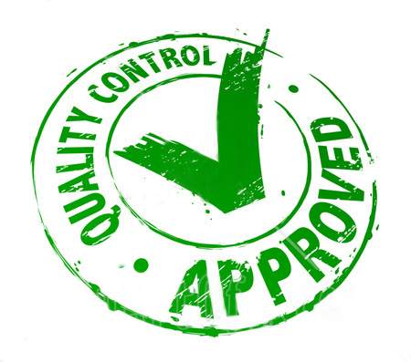
Sostenibilidad y los Componentes de la Calidad
Notes:
Quality Management
In Quality Management, Project Managers utilize constraints that will deliver the intended result. Quality Management “involves determining quality policies, objectives, and responsibilities so that the project will satisfy the need for which it was undertaken”. In a simpler description, Quality Management is accountable for making sure that any work performed is done so correctly to first time to avoid rework and wasted energy or resource. ISO 14000 and EMS convergence points are contained within each process of the quality management knowledge area.
The Quality Planning activity defines the inputs and controls for quality assurance activities. The inputs from ISO 14000 and the EMS set the level of influence that the standards will have on defining "quality".
Quality standards will be used in the development of a baseline and as the basis for monitoring within the Quality Assurance and Quality Control processes. The EMS and PMIS systems will monitor thresholds set by the quality management plan and help in developing changes for the change management process.
Quality Management has a direct relationship with Green Project Management. Ensuring that the right standard or specification to a product or a piece of work is carried, first time all of the time, means that your wastage costs are minimized.

Slide 19
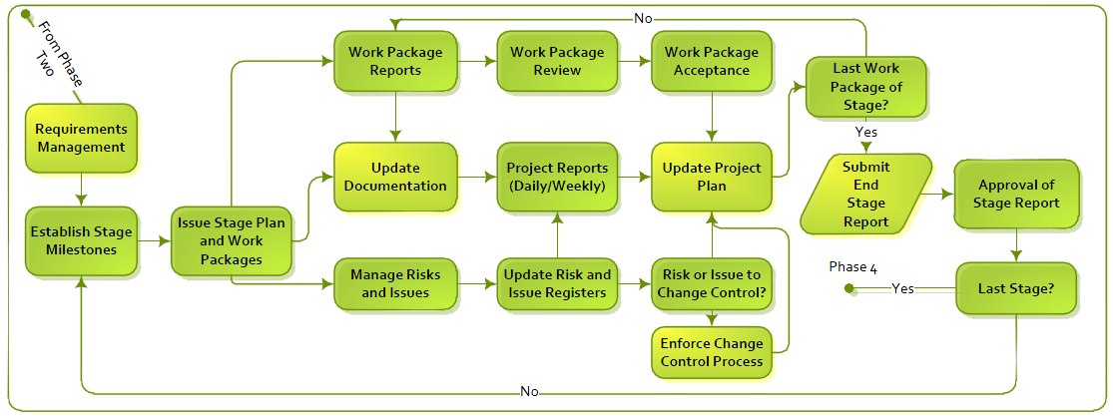
La Fase de Implementación y Control
Notes:
Note that ISO 21500 Calls Implementing what the PMI PMBOK® Guide Calls Executing

Slide 20
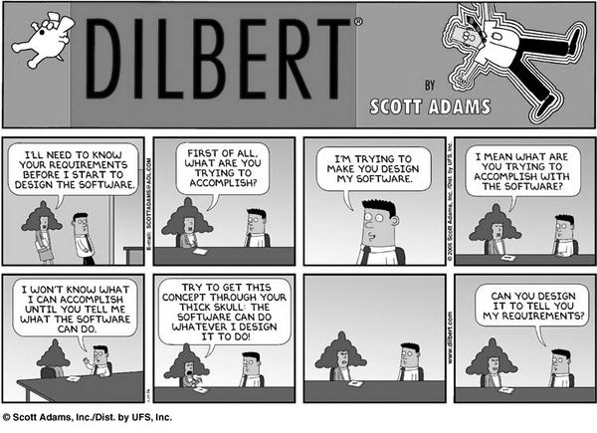
Gestión de los Requerimientos
Usted me dio lo que pedí, pero no lo que necesitaba …

Slide 21
Ciclo de Vida de los Requerimientos
Se congela el diseño
Línea Base
Idea
Visión Rápida
Visión
Detallada
Hacerlo!
Fin
Obtención de
los beneficios
Captura de los Requerimientos y testeos
Gestión de la Configuración y Control del Cambio
Revisión de los Requermientos
Notes:
The existence of a product specification is essential at the commencement of the implementation stage. This may initially only define requirements such as physical features, performance aspects and key acceptance criteria. To ensure the development of the design will achieve the objectives and benefits a series of reviews are conducted. This enables the design to be compared to the requirements in order to identify and address any deviations or shortcomings. A requirements review may be conducted during design to check that designers understand and can achieve the stated requirements.
As the product design develops, further reviews are carried out to check that the design will meet the product requirements. At the end of development the design is reviewed prior to build. As the design develops further, acceptance criteria, plans and methods are fully defined. These, the designs and production readiness are typically reviewed prior to the release of the design to production. This will check that the test methods are appropriate and will ensure that the product is adequately tested in line with the requirements.
Tests and inspections are typically carried out during the acceptance stage to verify that the deliverable products meet the requirements. If satisfactory, the product is formally accepted and signed off.
Throughout the development, the requirements, product specification and associated documentation is controlled using a formal change control and configuration management process.
The requirements management process facilitates the opportunity to provide confidence to the Project Team and the Stakeholders during the life cycle that the product is more likely to achieve the project objectives and its proposed benefits.

Slide 22
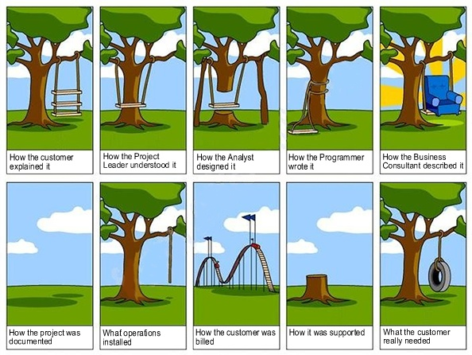
El Columpio
Notes:
In summary, effective Acceptance Criteria will be:
Defined as part of the Requirements Management Process
Reviewed constantly with the Customer but rigorously in the early phases to obtain the best description of the product with the greatest detail on its size, shape and performance capability
SMART (Specific, Measurable, Achievable, Realistic and Time bound)
Agreed between the Customer and the Project Manager then approved by the Project Sponsor
Inclusive of tolerances as to when and how the acceptance will take place
Process of acceptance when the product is ready for delivery, commonly found within the Handover Plan

Slide 23
La Fase de Implementación
Actualizar la Documentación
Notes:
Note that ISO 21500 Calls Implementing what the PMI PMBOK® Guide Calls Executing

Slide 24
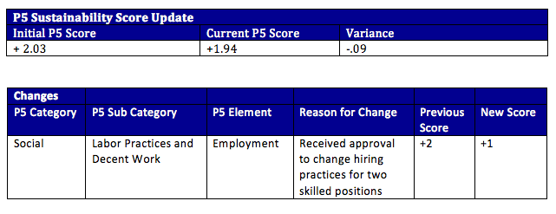
Informe de Estado
Los Informes de Estado del Proyecto son claves para monitorear y controlar los proyectos y deben incluir como mínimo:
El progreso hacia los hitos del proyecto
Los incidentes actuales y su estado
Los riesgos actuales y cómo están siendo abordados
La actualización del presupuesto
La actualización del Puntaje P5.
Notes:
Project status reports are key to monitoring and controlling projects and should include at minimum the progress towards project milestones, current issues and status, current risks and how they are being addressed, a budget update, and a P5 update. In support of a Log Frame Analysis the report provides key insight to the status on key elements of a project.
The P5 sustainability score that is derived during the initial analysis sets the baseline for the project. As the project life cycle continues, risk is introduced, scope changes, or issues arise, it is important to re-evaluate your analysis and the sustainability score.
Including the score in the project status report keeps stakeholders up to date and provides key insights for the organization to support overall sustainability reporting.
The status report should include a section that includes the following information

Slide 25

Gestión de Riesgos
Claves para la Sustentabilidad están en definir el riesgo posible para cada iniciativa.

Slide 26

¿Qué es el Riesgo?
¿Cuál es la definición del riesgo?
Efectos positivos y negativos sobre los objetivos del proyecto
Amenazas y Oportunidades
Notes:
Risks are present in all projects, whatever their size or complexity and whatever industry or business sector. Risks exist as a consequence of uncertainty. In project management terms, risks are those factors that may cause a failure to meet the project’s objectives.
“The exposure to a potential event that could impact adversely on business benefits or project critical success criteria.”
While risks are, according to the dictionary, associated with the possibility of failure, they may also be associated with opportunities. Risk management should balance the upside opportunities with downside risks, doing so in an open, clear and formal manner. A wider definition of risk is therefore:
“Combination of the probability or frequency of the occurrence of a defined threat or opportunity and the magnitude of the consequences of that occurrence”
The definition indicates a relationship between risks and opportunities. Both factors are possible future events and therefore have degrees of uncertainty.

Slide 27
Niveles de Riesgo
Estrategia
Programa
Projecto
Operacional
Notes:
Risk occurs at every level and in all aspects of any organization.
Risks from one level can affect other levels and it can be difficult to identify precisely at what level a risk should be managed. The reason for allocating different levels of risk is to clearly assign who is best placed to take responsibility for its management.
Strategic
All companies face risks to their business strategy. This can range from currency fluctuations to threat or opportunity of takeovers. Risks of this level are typically handled by the Board of Directors.
Program
Major changes that are required to realise the business strategy are often achieved through the management of many diverse projects as a program. Risks that occur at this level can be due to factors such as the interdependencies of component projects, resource conflicts or project priorities. These risks are managed by the Program Management Team.
Project
Risks at this level are threats to the achievement of the objectives agreed for time, cost and quality. These may well arise from threats or opportunities at another level, but must be placed at this level so that they can be managed by the Project Management Team.
Operational
Day to day activities have their own risks such a Health and Safety or Industrial relations. The whole emphasis of projects and programs is to bring about change and so this may introduce new or eliminate existing risks from the work place. The operational readiness to change will affect the project or program risks. Pure operational risk must be managed by the operational managers but they should always be working closely with the relevant project and program management teams.

Slide 28

La Sostenibilidad en la Gestión del Riesgo
Notes:
Risk Management
In the Risk Management knowledge area, a Project Manager will identify any and all possible risks to the project and establish an effective method to address them. Risk Management involves “planning, identification, analysis, responses, monitoring and control”. In other words, it is the Project Manager’s responsibility to address the possible detractors, identify the causes and situations of the risk, analyze the hurt or impact it will create should it occur and then develop work around to protect the project in the best manner. The convergence point for ISO 14000 and EMS within risk management fall under the Risk
Management Planning, Risk Identification, and Risk Monitoring and Control process areas.
The objective of the Risk Management Planning process area is to define and document how the project will deal with risk, set tolerance levels, thresholds, reporting requirements, roles and responsibilities. So what risks exist within Green Project Management; how can something that can help the planet be a risk to the project?
The objective of the Risk Identification process is to identify, classify and rank the risks that could both negatively and positively affect the project. That said, perhaps Green Project Management is way of identifying the positive elements of risk within a project. These positive elements of risk are also known as Opportunities. The information that is captured in the Risk Identification process is used to develop an effective risk response plan and to define action items, thresholds and metrics for the Risk Monitoring and Control process. The risk data captured within the Risk Identification process can also be used to estimate the project’s impact and likelihood of risk occurrence. ISO 14000 and EMS will guide the Project Manager through identifying environmental issues that can be affected by the risks in the complete life cycle.
Practical Application
Include in your requests for quotations or proposals that vendors and suppliers include with their response how they might meet your green criteria.
Examples
Quantitative criteria:
A vendor may incur costs by executing an environmental management plan or be a source of environmental costs because of wasteful processes. Early identification of these costs can point the Project Manager in the right direction to a suitable vendor or not as applicable.
Pollution Case/Effect: Representing environmental costs caused by a potential supplier
Environmental Commitment: Represents the degree of commitment the supplier has in environmental management.
Qualitative criteria
Scoring on qualitative criteria will depend on the weight that is applied to each item on a pre-assigned scorecard based on the importance that your organization or you as the Project Manager place on each category.
Environmental Commitment: Their overall corporate goals to decrease their carbon footprint
Logistics: How streamlined are their logistics
Strength of their SMP: How their action and results measure up to their goals

Slide 29
La Balanza de los Riesgos vs. Sostenibilidad
Inconvenientes
Beneficios
Alta
Visibilidad
Duros
Blandos
Notes:
The benefits of Risk Management are significant, but it is often the case that it is the drawbacks that people focus on.
Benefits can be broken down into two styles.
Hard
These comprise direct benefits to the project plan such as having the ability to make better more informed decision making, being less likely of accepting unsound projects, increased likelihood of project adherence to its plan and provision of data that assists with future lessons learned.
Soft
The softer benefits are less tangible but include a better understanding of the project by the stakeholders, being able to have the management team focus on the most significant risks and to assist in the distinction between being a good manager and a lucky one.
The drawbacks of Risk Management are also broken down into two specific aspects.

Slide 30
El Proceso de Gestión de Riesgos
Planificar
Identificar
Cualitativo
Cuantitativo
Analisis y Evaluación
Respuesta
Monitoreo y
Control
Notes:
Project risk management recognises a formal approach to the process as opposed to an intuitive approach. Risks, once identified and assessed, should be managed in order to minimise or completely mitigate their effect on a project.
Key steps in the risk management process shown above are as follows:
Plan – a Risk Management Plan is developed to provide guidance on how risk management will be carried on the project.
Identification – aims to identify all significant risks that may impact on project objectives, and gather all relevant information for analysis. The possibility of new risks are investigated throughout the life of the project.
Analysis – qualitative methods are typically used to determine the probability and impact of each risk. The information is used to prioritise risks and decide appropriate responses. Quantitative methods are used to determine the effects of uncertainties and risks on project objectives.
Responses – appropriate responses are considered, selected on the basis of overall benefit, authorised and implemented.
Monitor & Control – current risks are monitored and corrective action taken for adverse trends. Action Plans are monitored to ensure progress and effectiveness. The overall process is audited and reviewed typically at end of phases to ensure effectiveness.

Slide 31
Plan de Gestión de Riesgos
Estrategia
Organización
Presupuestos
Herramientas y Técnicas
Plantillas
Notes:
The typical contents of a Risk Management Plan can be categorized into five areas:
Strategy
In this area it is important to note the approach the project is taking to risk and how risk is planned to be accepted into the process. In addition, any points for escalation and the criteria that the risks will fall into for escalation will need to be explained.
Organization
Within this section, the roles and responsibilities of the Project Team with regards to what tasks and what skill sets are needed and who is being placed into these positions need completing.
Budgets
In this section, the budget allocation for the resources handling the risks will need to be mentioned and then also the allowance for contingency for each of the risk individually should this be applicable.
Tools and Techniques
Within this section it is important to describe the method by which the risks are being identified and then which tools or equipment is being used and which style of assessment is being planned to analyze the risks.
Templates
The final section of the plan is the templates department, this will give examples of any Risk Entry Forms and the Risk Register with explanations of how each can be completed to help anyone wishing to submit entries into the project.

Slide 32
Métodos de Identificación de Riesgos
Análisis de Impacto P5
Workshops/Talleres
Revisiones Post Proyectos
Listados de Verificación Rápida
Tormenta de ideas
Análisis de Supuestos
Análisis FODA/Análisis PESTLE
Entrevistas
Análisis Causa y Efecto
Notes:
Brainstorming - interactive, open format group method to identify and rank risks. Strengths: quick and inexpensive; easy to use. Useful as start up activity and for team building. Weaknesses: requires expert involvement for reliable inputs; unreliable for identifying high level risks in complex scenarios.
SWOT Analysis - A specific brainstorming technique using Strengths, Weaknesses, Opportunities and Threats as main focal points. Threats and Weaknesses indicate risks, Opportunities and Strengths support definition of responses. Strengths: encourages 'big picture' view; can stimulate thinking; others as for brainstorming. Weaknesses: may miss important areas of uncertainty; others as for brainstorming.
Assumption Analysis - check assumptions in project documents for validity. If invalid, check significance in terms of impact on project success criteria. If significant determine nature of risk and decide appropriate response. Strengths: helps to reduce uncertainty; can be easily integrated into routine everyday procedures. Weaknesses: time consuming; requires disciplined and consistent action.
Delphi Technique - For use where you have a number of experts with differing opinions. This technique uses a facilitator to gather opinions, summarise them and then redistribute for further consideration. The range of opinions gradually narrows until an agreed consensus is arrived at.
Interviews - Interviews with stakeholders and experts to identify risks and possible responses. Strengths: relatively quick and inexpensive; often provides information on preventive actions. Weaknesses: may not be relevant to current situation; requires good interviewing technique.
Prompt and Check Lists - Open and specific structured questions to identify risks. Strengths: useful for gathering information; reduces need for expert involvement; easy to use. Weaknesses: may not include new risks; may not be relevant (therefore unproductive).
Post Project Reviews – Use of historical records that describe how a risk has been handled previously. This can be beneficial if the risk is similar again although the context of the project must be taken into consideration before the response is selected.

Slide 33
Risk Register
Risk Register
Version………….
Project:
Project number
Page ……. of ……..
Ref.
Description
Probability
Impact
Action
Owner
1273
Residents object to planning submission
H
VH
Agree to develop garden amenity area
DPJ
1274
Furniture damaged en route
M
M
Pay premium for high quality removal
AJD
firm and agree packing specification
1275
Production line equipment damaged en
H
M
Pay premium for high quality removal
AJD
route
firm and agree packing specification
1276
Furniture supplier fails to meet delivery
H
H
Retain old furniture temporarily
JK
deadline
1277
Building company goes bust
VL
VH
Perform detailed financial check
FDM
Poor weather during external
Plan external work when weather is
LD
1278
refurbishment
L
M
favourable. May require short term
changes to schedule
1279
Scope of refurbishment work extended
H
H
Maintain strict Change Control
FDM
procedures
1280
Injury during decommissioning
M
L
Ensure safety regulations are strictly
PH
enforced
1281
Petty vandalism
L
H
Cover with insurance
FDM
1282
New furniture faulty
M
M
Retain old furniture temporarily
JK
Identificación
Evaluación
Respuesta
Otros campos que ser incluidos: Proximidad/Estado/Titulo/Riesgos Asociados/Area del Proyecto
Notes:
The Risk Register - is a key document that is used to record, communicate and track risks.
The simple register above contains the minimum set of information that is required. Most registers contain more detail on the nature of the risk such as who may be affected, changes in risk status and the status of the risk.
It is important to record ownership of risks, where a risk owner is generally considered to be the person best placed to manage a particular risk through the process. Other people may also be responsible for undertaking specific actions and responses.
It is a live document used to communicate risks and their status to stakeholders. A data entry form is typically used to gather detailed information on each risk.
A risk register should be opened as soon the first risks are identified and updated as new information emerges or on a regular basis if the current risks are the only records. This is essential even though it may be earlier than implementation (e.g. during Feasibility) and before a full risk management plan has been developed. New risks will arise throughout the life of the project and the risk register is used to capture these, show ownership and ensure they are communicated and tracked through the whole process. It is therefore applied as soon as possible and for the duration of the project.

Slide 34
Analisis (Evaluación)
Dos Técnicas
Cualitativa
  Juicio subjetivo de la probabilidad y el impacto
Cuantitativa
  Evaluación estadística de las variaciones
Notes:
Qualitative – These techniques will be used for the majority of risks identified. They involve subjective assessments of the probability and impacts of risks. The key element to this style of risk assessment is that it involves the need for judgement.
Quantitative – These focus on the numerical analysis of risk and range from statistical assessment of variations in activity duration or cost, to decision making tools. Examples include Monte Carlo techniques. (NB: these are not included in the APMP syllabus.)

Slide 35
Grilla Probabilidad e Impacto
Alto
Probabilidad
Medio
Bajo
Bajo
Medio
Alto
Impacto
Notes:
Risks may be plotted on probability-impact charts for analysis, as shown above. Categories such as High, Medium and Low Values are typically used for probability and impact scales.
These categories represent ranges. For example, a high cost impact may be greater than $100K, a medium between $50 - 100K, and a low impact less than $50K. The purpose of these definitions is to ensure consistency throughout project teams in risk estimates.
The benefits of probability impact charts are:
useful for plotting & comparing risks in order to decide priorities
can show cost, time and quality factors
provides bands for escalation
provides bands for RAG reporting
scales are directly related to project critical success criteria
highlights the difference between Low Impact- High Probability and High Impact - Low Probability risks
visual easy to understand
ensures consistency
Whilst probability-impact charts are an ideal way to show risk priorities, there may be other considerations that affect priority decision such as when the risk is likely to occur, or the cost of risk reduction.

Slide 36
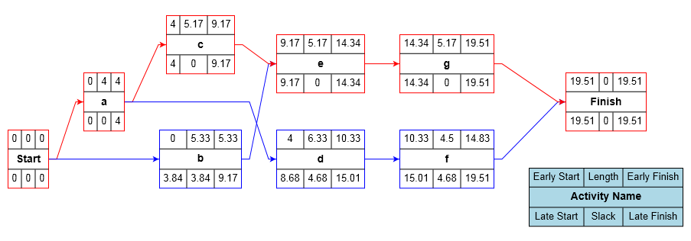
PERT
Program Evaluation Review Technique
  Las estimaciones son inciertas
  Se basa en tres estimaciones puntuales
  Asume la distribución Beta
  Genera un único resultado
  Utilizado para costos, cronogramas y parámetros técnicos
Notes:
The Program Evaluation Review Technique (PERT) takes into account uncertainty in task estimates to produce a more realistic forecast of the project out turn. (Three Point Estimating) It can be used for costs, schedules and technical parameters. It is commonly used to evaluate project timescales.
Whereas critical path analysis is usually carried out with a single value for each task duration, PERT uses three estimates: Optimistic, Most Likely and Pessimistic. Most analyses assume a Beta type of probability distribution as the profile for the range of probable durations, although other profiles can be used. The formula below provides the mean for a Beta distribution.
Mean = Optimistic + 4x Most Likely + Pessimistic / 6
The mean for each task is used in place of the single point estimate to produce the Critical Path Analysis. As a result, the overall project duration will be weighted according to the degree of pessimism and optimism in task estimates and is generally more realistic.
The quality of the data used is obviously important and will affect the overall reliability of the result. Obtaining reliable three point estimates may be difficult and depends on the experience of the estimator and availability of historical data. If PERT is going to be used in calculating the project duration, this should be explained and used from the start and not once subjective estimating has started as this tends to cause confusion from the team. This is because PERT Analysis has the capability of effecting the Critical Path Analysis work.

Slide 37
El Proceso PERT
Tres estimaciones puntuales:
    Optimista
    Pesimista
    Más Probably
Calcula el valor medio:
  = optimista + (4 x más probable) + pesimista
      6
Notes:
In PERT analysis we make three estimates for each task:
Optimistic – O - (very unlikely that the task will take shorter than this)
Pessimistic – P - (very unlikely that the task will take longer than this)
Most likely - L - (this is what we really think it will take)
These are then used to calculate a mean duration based on a Beta distribution.
Mean Duration = Optimistic + (4 x Most Likely) + Pessimistic
6
Or to show it more formally:
Mean Duration = O + 4L + P
6
For task B, it may be that although we think it is likely to take 5 days, there is a possibility that it could be done in 4 but there could be problems causing it to take as long as 12 days.
Its Mean Duration is therefore: 4 + (4 x 5) + 12 = 6
6

Slide 38
Demostración de PERT en el Análisis del Camino Crítico (CPA)
2
5
7
7
8
15
16
9
25
B
C
F
3
1
8
8
1
16
16
0
25
0
2
2
25
3
28
A
G
0
0
2
25
0
28
2
14
16
16
7
23
D
E
2
0
16
18
2
25
Notes:
The Program Evaluation and Review Technique (PERT) was developed for the Polaris project in 1956. It is based on the idea of estimating three durations for each task rather than the single estimate used in Critical Path Analysis (CPA).
The network above shows a normal CPA calculation with tasks A, D, F and G forming the critical path and an overall duration of 28 days.
However, it is based on a single point estimate and therefore does not take into account the possible range of each estimate.

Slide 39
Duraciones PERT
Tarea
Optimista
Más Probable
Pesimista
Medio
A
2
2
8
3
B
4
5
12
6
C
7
8
15
9
D
10
14
18
14
E
6
7
14
8
F
7
9
17
10
G
2
3
10
4
Notes:
You take the whole Network Diagram and place it into a spreadsheet, using the most likely figures as the starting point.
After elicitation, it should be possible to have identified the optimistic and pessimistic views of the group of individuals. The best practice to this method is to then remove the two most extreme durations or costs and remove them, before using the remainder to calculate the mean of each of the calculations.
Once these two measurements are taken into account they can be added to the spreadsheet and then used in the calculation to come up with the PERT mean figure.

Slide 40
CPA Recalculado
Task
Optimistic
Most likely
Pessimistic
Mean
A
2
2
8
3
B
4
5
12
6
C
7
8
15
9
D
10
14
18
14
E
6
7
14
8
F
7
9
17
10
G
2
3
10
4
3
6
9
9
9
18
18
10
28
B
C
F
3
0
9
9
0
18
18
0
28
0
3
3
28
4
32
A
G
0
0
3
28
0
32
3
14
17
17
8
25
D
E
4
1
18
20
3
28
Notes:
If mean durations are used in the network instead of the most likely estimates the duration is now 32 days and the critical path has changed. It now comprises tasks A, B, C, F and G.
Exactly the same principle may be used to deal with estimated ranges of cost. We simply use three estimates of the costs of each task rather than one and perform the same calculation to calculate a Mean Cost for each task. The total project cost is then the sum of all the Mean Costs.
These techniques were originally known as PERT/Time and PERT/Cost to distinguish which aspect of a project was being analysed.

Slide 41
Respuestas a los Riesgos de Amenazas
Los planes de respuesta pueden ser desarrollados e implementados una vez que los riesgos han sido evaluados y priorizados. Hay un número de estrategias de respuesta genéricos.
Evitar - se toma un enfoque alternativo para evitar el riesgo.
Transferir - asignar la responsabilidad contractual de por ejemplo, un subcontratista en mejores condiciones para gestionar el riesgo. Otro ejemplo de esto es el seguro de donde la otra parte ofrece una indemnización en caso de impacto de riesgo .
Reducción - medidas proactivas para reducir la probabilidad, impacto o ambas medidas de reducción Idealmente se deben tomar con respecto a riesgos de alto nivel.
Aceptación - donde el impacto del riesgo es bajo o el costo de la mitigación demasiado alto. Esto a veces se conoce como absorción.
Notes:
Response plans can be developed and implemented once the risks have been assessed and prioritized. There are a number of generic response strategies.
Avoidance - an alternative approach is taken to avoid the risk.
Transfer - assign contractual responsibility to for example, a sub contractor better placed to manage the risk. Another example of this is insurance where another party provides compensation in event of risk impact
Reduction - proactive measures to reduce likelihood, impact or both Ideally reduction measures should be taken for high level risks.
Acceptance - where the risk impact is low or cost of mitigation too high. This is sometimes known as absorption.

Slide 42
Respuesta a las Contingencias
Plan de Contingencia – Un plan de recuperación que será implementado en caso que la contingencia ocurra. Adicionalmente podemos agregar una asignación presupuestaria a las estimaciones para eventos que no pueden ser predecidos con ningún grado de confiabilidad.
Notes:
Exploit – This method is carried out when an opportunity materialises that allows you to truly gain from it in the fullest way.
Enhance – This is where the project team put in place pro-active measures to maximise the likelihood of a situation occurring. Opposite to the reduce response.
Share – This is a chance where not only your project but any other relevant projects that can use the situation make sure that the opportunity is fully communicated to gain the most company wide.
Reject – This is a response that can be chosen should the situation not be right for the project at the time for financial or perhaps storage reasons and so no matter the fact that a saving could be made it is passed over on this occasion.
Contingency - A fallback plan that will be implemented if the risk occurs. Additionally we can add an allowance included in estimates for events that cannot be predicted with any degree of reliability.

Slide 43
Respuesta a los Riesgos de Oportunidades
Explotar – Este método es llevado a cabo cuando una oportunidad si se materializa le permita verdaderamente ganar de ella.
Mejorar – Aquí es donde el equipo del proyecto pone en marcha medidas proactivas para maximizar la probabilidad de una situación que se produzca. Es opuesta a la respuesta de resducir.
Compartir – Esta es una oportunidad donde no sólo su proyecto, sino otros proyectos relevantes pueden utilizar la situación. Asegúrese de que la oportunidad sea totalmente comunicada para que gane toda la compañía.
Rechazar - Esta es una respuesta que se puede elegir en caso que la situación no sea adecuada para el proyecto por razones de cronograma o financieras u otras.
Notes:
Exploit – This method is carried out when an opportunity materialises that allows you to truly gain from it in the fullest way.
Enhance – This is where the project team put in place pro-active measures to maximise the likelihood of a situation occurring. Opposite to the reduce response.
Share – This is a chance where not only your project but any other relevant projects that can use the situation make sure that the opportunity is fully communicated to gain the most company wide.
Reject – This is a response that can be chosen should the situation not be right for the project at the time for financial or perhaps storage reasons and so no matter the fact that a saving could be made it is passed over on this occasion.
Contingency - A fallback plan that will be implemented if the risk occurs. Additionally we can add an allowance included in estimates for events that cannot be predicted with any degree of reliability.

Slide 44
Monitoreo y Control
Monitoreo y Control
El Riesgo Sucede
Riesgo No identificado
o aceptedo
Riesgo Identificado
Cuantificar el Efecto
sobre el Proyecto
Respuesta planificada
Implementada
Vincularlo al desempeño, al costo y al control de cambios
Develop responses
and implement
Revisar los planes
Notes:
Monitor and Control
We should periodically review the Risk Response Plan to identify changes in status of any of the existing risks or to review and identify new risks. This will link closely to other forms of control such as Change Control where the assessment of change requests will naturally include a review of risk from identification through to planning responses.
Risk Happens
Hopefully, our threat avoidance or reduction measures will prevent the threats from occurring but inevitably some will still happen. Conversely, we hope that enhancement actions will cause opportunities to occur.
Implement Planned Response
If the risk had been identified, we should implement our planned response. This may be as simple as claiming on the insurance we took out to transfer the risk or as complex as implementing an extensive contingency plan. However, if we had accepted the risk, or a risk arises that we had not identified we need to take immediate action. Because the risk has now happened there is no element of uncertainty so strictly speaking it is not a risk. The next two steps are therefore often referred to as Issue Management. An issue is something that has no uncertainty and must be dealt with by a higher authority than the Project Manager.

Slide 45
Mejores Prácticas de GPM
Entender los tres elementos
  Causa, Evento e Impacto
Busque las Opportunidades
¿Puede el riesgo de proporcionar un beneficio sostenible?
Planificar la Respuesta a los riesgos en detalle
Observar y Reaccionar

Slide 46

Gestión de Incidentes
Director de Proyecto al rescate!

Slide 47
Definición de Incidente
Amenaza a objetivos del proyecto que no pueden ser resueltos por el Director de Proyecto
Los Problemas son cuestiones del día a día
Los Riesgos pueden no suceder
Los incidentes ya se han producido y deben ser elevados
Fuera del Control directo del Director de Proyecto
El Patrocinador del Proyecto tiene la opción de elevarlos aún más
Una pobre Gestión de Incidentes es una fuente importante de fracaso del proyecto
Notes:
An issue is defined as a threat to the project objectives that cannot be resolved by the Project Manager.
Issues should be differentiated from problems, which are the day to day concerns that a Project Manager has to deal with case by case.
In addition, risks should not be confused with issues. Risks are uncertain in that an event may not occur, whereas issues have already occurred and are therefore not uncertain.
The importance of Issue Management in projects is that issues are outside the direct control of the Project Manager.
It is the Project Manager’s responsibility to ensure that all issues are escalated to the Project Sponsor, who can then assess and decide on the next course of action. If the Project Sponsor deems that it requires further escalation then they can further escalate the issue to the Project Steering Group.
Issues that remain unaddressed or unresolved are the cause of many project failures. Therefore, it is the Project Manager’s responsibility to ensure all issues are correctly identified, registered, appropriately escalated and then resolved.

Slide 48
Ruta de Elevación de Incidentes
Grupos de Interéss
Grupo de Dirección
Patrocinador del Proyecto
Incidente
Director de Proyecto
Actividades del día a día
Problemas
Miembros del Equipo
Notes:
Problems and risks are managed on a day to day basis by the project team.
A concern that threatens the project objectives becomes an issue when it cannot be controlled by the project manager. In such situations, the project manager must escalate the issue to the project sponsor. The sponsor will then seek a resolution by engaging the stakeholders as appropriate and/or involvement of the project steering group.
Issue management is a fundamental purpose of the steering group and the appropriate membership of the group will impact on their ability to resolve issues.
Reporting on the development or progress of an issue is performed by the project manager until it has been successful concluded.
Common problems in issue management are:
The Project Manager incorrectly identifying problems as issues and therefore diverting senior management’s attention away from other important tasks.
Failing to escalate issues in a timely manner when the resolution owner has been unable to resolve the issue.

Slide 49
Registro de Incidentes - Contenido
Nro
Descripción
Elevado por
Fecha Incidente
Impactos
Posible resolución
Propietario Resolución
Resultado final
Fecha de Cierre
Notes:
The issue log is used to communicate and track progress through life, support project reviews and lessons learned exercises.
It should be maintained throughout the whole of the Project Life Cycle and then should be closed off formally by the Project Manager as part of the closure of the project and any outstanding actions or issues transferred to the product owner within the Operations phase.

Slide 50
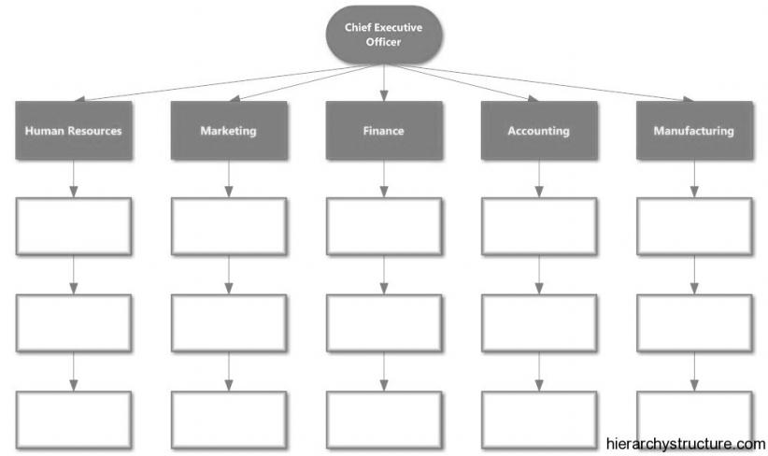
Estructura Organizacional
El Ambiente del Proyecto

Slide 51
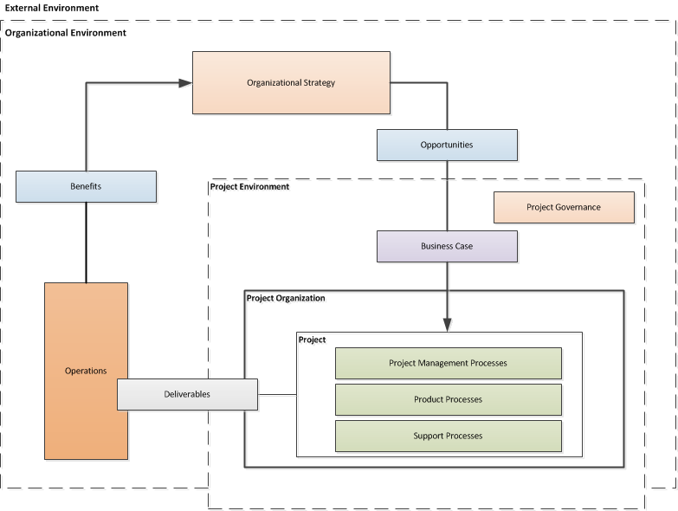
El Ambiente del Proyecto
ISO 21500
Notes:
Project environment
General
The project environment may impact project performance and success. The project team should
consider
• factors outside the organizational boundary such as socio-economic, geographical, political,
regulatory, technological and ecological; and
• factors inside the organizational boundary such as strategy, technology, project management
maturity, resource availability, organizational culture and structure.
Factors outside the organizational boundary
Factors outside the organizational boundary may have an impact on the project by imposing
constraints or introducing risks affecting the project. Although these factors are often beyond the
control of the project manager, they should still be considered.
Factors inside the organizational boundary
General
A project usually exists inside a larger organization encompassing other activities. In such cases
there are relationships between the project and its environment, business planning and operations.
Pre-project and post-project activities may include activities such as business case development

Slide 52
El Ambiente del Proyecto
Pregunta Sorpresa
P. Cómo se integra esta función del director de Sostenibilidad?
Notes:
Project environment
General
The project environment may impact project performance and success. The project team should
consider
• factors outside the organizational boundary such as socio-economic, geographical, political,
regulatory, technological and ecological; and
• factors inside the organizational boundary such as strategy, technology, project management
maturity, resource availability, organizational culture and structure.
Factors outside the organizational boundary
Factors outside the organizational boundary may have an impact on the project by imposing
constraints or introducing risks affecting the project. Although these factors are often beyond the
control of the project manager, they should still be considered.
Factors inside the organizational boundary
General
A project usually exists inside a larger organization encompassing other activities. In such cases
there are relationships between the project and its environment, business planning and operations.
Pre-project and post-project activities may include activities such as business case development

Slide 53
El Ambiente del Proyecto
Pregunta Sorpresa
R. Estrategia Operacional
  Gobernanza del Proyecto
  Operaciones
Notes:
Project environment
General
The project environment may impact project performance and success. The project team should
consider
• factors outside the organizational boundary such as socio-economic, geographical, political,
regulatory, technological and ecological; and
• factors inside the organizational boundary such as strategy, technology, project management
maturity, resource availability, organizational culture and structure.
Factors outside the organizational boundary
Factors outside the organizational boundary may have an impact on the project by imposing
constraints or introducing risks affecting the project. Although these factors are often beyond the
control of the project manager, they should still be considered.
Factors inside the organizational boundary
General
A project usually exists inside a larger organization encompassing other activities. In such cases
there are relationships between the project and its environment, business planning and operations.
Pre-project and post-project activities may include activities such as business case development

Slide 54
Influencias Organizacionales
Orientación Functional
Orientación por Projecto
Fuertemente proyectizada
Nivel Relativo de Influencia
Fuertemente Funcional
Fuertes centros tecnológicos y de procesos de excelencia
Estable, coherente, eficiente
Buena integración vertical a través de la funciones - claras líneas de comunicación
Pobre integración horizontal a través de las funciones
Fuerte enfoque de negocio y de producto
Flexible, inconsistente, effectiva
Buena integración vertical a través de proyectos – líneas claras de comunicación
Pobre integración horizontal a través de los proyectos
Notes:
Between these extremes the relative level of influence changes from strong functional on the left to strong project on the right. Traditionally, organizations were either functional or project orientated.
Each of them have their own strengths and weaknesses. Certain types of structure suit certain types of industry. The Project Manager must gain a clear understanding of what environment they are in before any real control of the project can be attained.

Slide 55
Matríz de fortalezas y Debilidades
Communicación e Integración
Foco y Motivación
Excelencia Tecnológica
Rendición de Cuentas
Capacidad de respuesta de los negocios
Notes:
To avoid the two extreme types of organization, there is a third option, Matrix Management. There are three forms of matrix: Weak, Balanced, Strong. The characteristics of each type depends on the level of authority assigned to functions or projects, as described below.
Weak Matrix
The weak matrix is perhaps the first step for an organization attempting projects with mixed skills. Project teams are assigned from different functions to work on a project. However, there is no overall leader and no single point accountability. Without leadership, a team will lack direction, focus on project goals and the ability to integrate the various functions involved.
In this organization, functions will always dominate over project goals. This is especially the case for internal change projects where vested interests in maintaining the status quo can become a significant barrier to the changes being introduced through the project.
Balanced Matrix
In a balanced matrix, project managers are appointed from functions to provide single point of accountability for the project. This provides leadership and enables effective integration. However, the project manager still reports through a functional discipline and this can compromise project objectives especially when they are in conflict with functional objectives.

Slide 56

El exito de los proyectos y la gestión de los beneficios
¿Qué define el Éxito?
Notes:
Success Criteria
Success criteria are the specific parameters that will be used to judge the project’s success. They must be measurable and unambiguous. Use of subjective phrases will inevitably lead to disputes over interpretation at some stage of the project. Criteria must be achievable within the scope of the project. They will be unique to the project and derived from the stakeholders needs.
In summary, effective success criteria will be:
Defined as part of the business case
Reviewed at the end of each phase or stage
SMART (Specific, Measurable, Achievable, Realistic and Time bound)
Agreed between the Sponsor and the Project Manager
Inclusive of tolerances
Related to the benefits within the Business Case

Slide 57
According to PMI’S Pulse of the Profession

Slide 58




Proceso de Entrega del Producto
EL TRIANGULO DE HIERRO
Tiempo
Desempeño
Calidad
Costo
Alcance
Notes:
There is a common link to all constraints within project management.
The three major constraints that are placed upon a project are time, cost, and performance or quality. These constraints and how they are approached determine not only if the objectives are met but to what degree of success they will be. The understanding of these limitations early is crucial to assisting with project success.
Dr. Martin Barnes, Past President of the Association for Project Management (APM), presented a keynote presentation in the second-day plenary session of the 26th IPMA World Congress on October 30th titled “We can and should raise the standards”.
Dr. Barnes’s keynote was very engaging and focused on how standards are more than processes. He shared that project management standards are frameworks for activities and provide benchmarks for performance. He shared the story behind the “iron triangle” which has been understood as time > cost > scope = quality
Dr. Barnes, the originator of the “iron triangle” asked everyone in the audience to replace quality with performance going forward as quality was not an appropriate component– performance would make a much better component as projects are so much more about the outcome.
He used a metaphor to make his point. If a Surgeon contacts a patient after completing a procedure and explains that he accomplished a successful surgery even though it did not cure the patient’s illness. As it was on time, in scope, and in line with his fees, it was a quality procedure.
He further simplified his point saying that project success should be determined by if the outcome does what was intended. “Does it work?

Slide 59

Criterios de Exito
Tiempo
Presupuesto
Alcance
Impacto al Medio Ambiente
Notes:
Success criteria are the measurable at the end of the project, the way that the project delivery is judged. These are typically broken down into three areas.
Time
This parameter is the simplest but you should just bear in mind that sometimes delivering the product early can be as undesirable as delivering it late. Some sources refer to this parameter as the schedule.
Cost
The cost of a project is the thing that customers most often want to fix. But it is also the parameter that is most often exceeded. This inevitably occurs because people do not understand the relationship between the project cost and the other two parameters. One of the major reasons for project cost overrun is a lack of understanding of the true scope of the work involved.
Scope
This parameter is given various names by various sources. Traditionally it has been called Quality and more recently Performance or Specification. Whatever you call it, it is fundamentally about the definition of the end product. The early stages of requirements management are crucial in understanding the needs of the customer.
The use of the term Scope fits better with the modern approach to the subjects of Scope Management and Quality which deals with a lot more than just the specification of the end product.
Throughout the lifetime of a project these three parameters are likely to conflict. The role of the project manager can be depicted as a juggler, trying to balance the conflicting demands for an extensive and ever changing scope in a short timescale at minimum cost.
For any project, priorities must be set and it is a useful exercise to place a project within this triangle to indicate the relative flexibility, or lack of it, in any of the three parameters. The closer the project appears to one of the corners, the more important and therefore less flexible that parameter is. Naturally, the tendency is to want to show that all three parameters are fixed, but as you move the project towards one corner it naturally gets further away from the others.

Slide 60


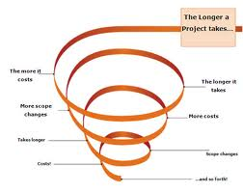
La Cruda Verdad Acerca de los Proyectos: hay más posibilidades de Fracasar que Triunfar
74% de los Proyectos Cumplen sus Objetivos
51% Proyectos finalizan en tiempo y dentro del presupuesto
50% Projects sufre deslizamientos
.
Notes:
To grab audience attention mention those figures and relate them to their business:
51% of project finish on time and within budget when OPM is implemented across the organization. This means that within the same time period, you could finish more projects & potentially double your business results.
74% of projects meet their targets. This means that you have less waste, less rework, and less down time.
50% of Projects suffer scope creeps for under the absence of structured processes. This means that your teams are wasting their time on work that is not being rewarded or accounted for!
This could mean millions of dollars!

Slide 61
¿Cuánto cuesta el fracaso de los proyectos?
Airbus A380: Retraso de 3 años, un 30% por sobre el presupuesto y los clientes han cancelado los pedidos y han pedido grandes descuentos. La tasa de recuperación de la inversión (TIR) se corta de 20% a 13%, con US$ 6.1 mil millones en ganancias operativas borradas
Aeropuerto International de Denver: Retraso de 2 years, el costo planificado original era de US$ 1 mil millones, el costo final fue de US$ 5 mil millones
American Airlines: El proyecto del sistema de reservas de hotel y alquiler de Autos desguasado despues de gastar US$165 million
El Sistema de Expedientes Virtuales del FBI USA: el programa de US$175 million fue desguasado
The Opera House, Sydney, Australia: Costo Original A$ 7 million, Cost Final A$ 100 million

Slide 62

Plan de Gestión de los Benefcios
Beneficios
Perfiles de los Beneficios (cuándo, dónde, cómo)
Roles y Responsabilidades
Seguimiento y control
Revisión de la obtención de
los beneficios
Métodos de apoyo
Notes:
The typical contents of a benefits management plan are as follows:
Benefits
The results expected from project deliverables during operation. These should be tangible, quantifiable and measureable
Benefits Profile
Showing when, where and how the benefits will be realised
Roles and Responsibilities
The sponsor is responsible overall for achievement of benefits, however other stakeholders will be involved including those working in the business as usual activities. The plan defines the specific roles and responsibilities of each participant.

Slide 63
Entender los Objetivos Organizacionales
El Director de Proyecto debe tener un entendimiento de los objetivos organizacionales más allá de los objetivos del proyecto.
Los proyectos o entregables que no se alinean con los objetivos de la organización deben ser ponderados por el riesgo.
P. ¿Cuáles son algunas de la maneras de mantenerse actualizado?

Slide 64
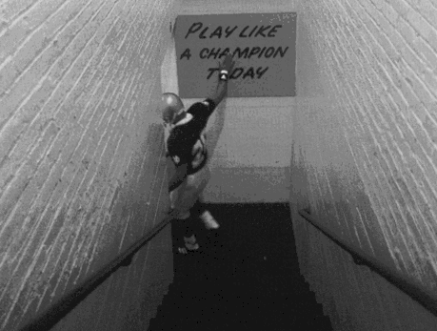
Habilidades del Equipo

Slide 65
Atributos del Equipo
Foco
Motivación
Roles Definidos
Cohesion y Confianza
Responsabilidades Compartidas
Valores Compartidos
Notes:
Team work is when people work together towards a common goal, but cannot achieve the goal alone and must therefore work in collaboration with others.
The project team can be supported by working groups which are delegated work through a single individual. The groups may not share the same objectives as the team. For example: a contractor organization could be managed as a working group or as part of the team.
The management requirements would be different depending on the approach decided in such a case.
The project manager should therefore decide on appropriate teaming arrangements during the planning stage of the project.
Teams tend to develop mutual accountability rather than individual accountability which might be the case in a working group. An effective team is cohesive, aware of the objectives and motivated towards achieving them. Typically, team members are likely to support each other, communicate well, share information, make decisions and work together. When a group develops into a cohesive team they are more likely to outperform other groups.
However, some teams can also become too cohesive, which runs the risk therefore of losing focus on their purpose and objectives.

Slide 66
Desarrollo de Equipos – Modelo deTuckman
Tel Equipo se Disuelve
Cambio
Disolución
Desempeño
Formación
Haciendo el trabajo, produciendo resultados
El DP debe lograr:
Desempeño
Control y Coordinación
Ansiedad por la Identidad Personal e Impresion
El DP debe lograr:
Cohesion
Involucramiento
Normalización
Turbulencia
Desarrollo de modos de trabajar juntos
El DP debe lograr:
Roles, Responsibilidades, Planes y Reglas
Metas personales en conflicto. Hostilidad
El DP debe lograr:
Dirección del Grupo
Resolución de Conflicto
Notes:
Tuckman suggested that groups go through stages during development as discussed below. The model shows how a group typically develops. In the beginning they are a group of individuals with different values, goals and expectations. Eventually a group can develop into a team with shared values and expectations. Key stages are as follows:
Forming – the group is established. Individuals are anxious about their personal identity, role, the impression they make, the attitudes and backgrounds of others.
Storming – conflicts emerge between individuals as they sort out their roles, revealing differences. It is characterised by hostility and disruption.
Norming – the group develops ways of working together, closer relationships are created and camaraderie. The organization, roles and working rules (norms) are established. The framework enables group members to relate to each other and deal with performance issues.
Performing – the group matures and becomes productive. Some groups may get bogged down in earlier stages and never achieve maximum effectiveness.
Adjourning - eventually the group disbands or reforms. In projects this may be triggered by a change. Some may be planned, for example the completion of a stage and will require the cycle to be repeated.

Slide 67
Enfoques para la Contrucción de Equipos
Dar Dirección
Reuniones de Lanzamiento
Caso de Negocio
Reforzar Metas
Medición de Desempeño
Control y Coordinación
Desempeño
Formación
Normalización
Turbulencia
Reforzar Metas
Desarrollar el PDP y WBS
Asignar Roles
Definir Planes
Definir Metas
Gestionar Conflictos
Talleres de Construcción de Equipo (Teambuilding Workshops)
Notes:
1. Review Project Performance
2. Individual Performance
3. Feedback Lessons Learned
4. Start up Next Phase

Slide 68
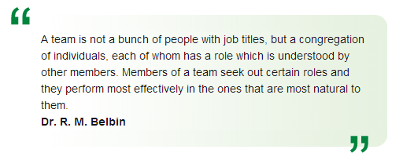

Los Roles de los Equipos de Belbin
Fortalezas y Debilidades PERMITIDAS
Además de la fuerza o la contribución que ofrecen, cada rol del equipo también tiene una debilidad admisiblea: una contracara de las características del comportamiento, lo que es permisible en el equipo debido a la fuerza que va con ella.
Por ejemplo:
Celebrales: podrían ser un poco ortodoxos u olvidadizos
Inverstigadores de Recursos: podrían olvidarse de seguir al líder
Monitor Evaluador podrían ser demasiado críticos y moverse lentamente
Coordinadores: podría sobre delegar dejándose poco trabajo para hacer
Implementadores: pueden ser lentos en renunciar a sus planes en favor de cambios positivos
Finalizadores: podrían ser acusados su perfeccionamiento al extremo
Cohesionadores: podrían ser indecisos en situaciones cruciales. Evita las confrontaciones
Impulsores: podrían correr el riesgo de convertirse en agresivos y de mal humor en su intento de que las cosas se hagan
Especialista: puede tener tendencia a focalizarse sobre su propio punto de vista
(belbin.com)
Notes:
R. Meredith Belbin studied teams working on management games and experimented with different mixes of people. He found that teams based on selected high performing individuals did not perform as well as control teams of mixed abilities. Further studies identified that a high performing team requires a complementary mix character roles, each providing specific non-technical skills. Each role type has strengths and allowable weaknesses.
Belbin team roles describe a pattern of behaviour that characterises one person’s behaviour in relationship to another in facilitating the progress of a team.
Belbin developed tools to measure individual profiles and from this showed that people are typically strong in two or three areas.
The value of Belbin team-role theory lies in enabling an individual or team to benefit from self-knowledge and adjust according to the demands being made by the external situation.
http://www.belbin.com/
http://www.belbin.com/content/page/8140/Descripci%C3%B3n%20Resumen%20de%20los%20Roles%20de%20Equipo.pdf

Slide 69

La Sostenibilidad y la Gestión de los Recursos Humanos
Notes:
Human Resource Management
Human Resources Management focuses on the allocation of resources and how to manage them effectively. This knowledge area distinguishes itself in its management of organizational resources, (e.g. training, compensation, stakeholder buy-in) to verify that the appropriate people are placed in the right positions due to their knowledge and experience so that they have the right tools they need to succeed. human resources management involves “organizing and managing the project team”
This element of project and man management involves developing the suitable roles and responsibilities for each project team member by identifying the needs and qualification requirements of a particular post to manage their work to be completed. These requirements are completed in the Human Resources Planning, the Project Team Acquisition and the Development and Management process areas. The primary role from an environmental or a green project management standpoint in the ‘Acquire Project Team’, ‘Develop Project Team’ and ‘Manage Project Team’ process areas is to provide input and guidance for the areas of training and the qualifications of the right person to manage environmental concerns based on your EMS and the guidelines set forth in ISO 14000.
Ensuring that the right message and the correct understanding of what difference having a greener approach will make will allow the whole team to gain a fuller appreciation of the justification of spending the extra time spent, finances issued and resources associated to the project, something that can sometimes be considered an expense or a waste in time that can be better utilized within the organization elsewhere.

Slide 70
Principios de Control de los Proyectos
A
Plan Original
B
Tendencia
Ruta Real
Monitoreo
“Estamos todavía aquí?”
Notes:
Variances are useful in showing where the project is at any point in time and how far away the project is from the baseline plan. Variances alone will not show how well the project will meet its objectives.
By comparing the current variance with the plan the pro rata effect on the overall parameters can be assessed allowing the completion dates, costs and quality to be forecasted. However, this assumes that the past performance will continue. Also the simple analysis may be misleading if the intervals between measurements are too large.
By tracking performance more frequently, trends can be developed and these may give a more realistic view of performance, allowing the development of corrective action plans.
Earned Value Analysis to be discussed later, is a particularly useful method since it provides variances, trends and allows the development of what if scenarios.

Slide 71
Proceso de Control de Proyectos
Aprobación
Planificación
Línea Base
Ejecución
del trabajo
Actualización del Plan
Monitoreo
Acciones Correctivas
Aceptación
Notes:
A simple control process is shown above.
Effective control involves the comparison between actual performance and the baseline plan. Changes to baseline plans must therefore be controlled.
The purpose of monitoring is to establish deviations and evaluate their impact. Tolerances may be set to enable work to continue with minor deviations.
Control and co-ordination involves the planning and implementation of corrective actions to address adverse situations. Alternatively, it may involve re-planning if the original plans appear to be unworkable or unrealistic.
On completion of all project work, the project is formally accepted.
The key control and co-ordination cycle and associated processes are shown in more detail above.
Reporting – the status of the project is reported in accordance with requirements defined in the project management plan and agreed between the project sponsor and project manager.
Monitoring and Evaluation – measuring achievement, identifying variances between the CSCs, problems and establishing the current position. This will enable further analysis to determine trends and predict the final result based on current performance. It is therefore important to establish the root causes of problems and variances to enable appropriate corrective action to be taken. Such analysis can be done by specific techniques such as Critical Path Analysis (time) and Earned Value Analysis.
Corrective action - there are typically four options depending on the situation:
if performance is outside the specification but within agreed tolerances, corrective action is taken to improve performance
if the original plan is no longer representative, the baseline plan may be changed
if performance is outside the specification (off spec), the variance is escalated to a higher authority
if the variance is due to unauthorised scope changes, the change process is invoked retrospectively.

Slide 72
Tolerancias y Disparadores
Patrocinador del Proyecto
Indicadores Claves de Desempeño
Disparador debido a la Escalación
Criterios y Tolerancias
del Proyecto
Delegación
Límite Superior
Plan
Director de Proyecto
Límite Inferior
Disparador debido a la Escalación
Work Package Criteria & Tolerances
Escalation
Puntos de Control
Work Package Manager
Elapsed Time
Baseline Planning
Notes:
From the previous page, it can be seen that control will be virtually impossible unless objectives are clearly defined and cover all Critical Success Criteria (CSC) including time, cost and quality. For each CSC, Key Performance Indicators (KPI) based on measurable parameters, are defined to support monitoring and reporting. For example, the ratio of the planned completion and forecast completion dates will indicate the health of the project in achieving the time CSC. Tolerances or control limits are defined for each CSC and KPI to provide triggers for escalating off specification situations to higher authorities.
These methods enable work to be delegated to the project team within certain limits. This allows a work package manager to make decisions locally and raise ‘off-specification’ reports by exception. For example, the project sponsor is chiefly concerned with the business case, benefits and overall CSCs. Outside of regular, scheduled meetings the project sponsor would not be involved in day to day control decisions unless the business case is threatened. By establishing tolerances at the beginning of the project, the project sponsor can leave day to day operations to the project manager, whilst being assured that important issues will be escalated to enable intervention as appropriate.
Likewise, the project manager can define CSCs and tolerances when delegating responsibilities to work package managers. This will enable a work package manager to take decisions locally and to escalate off-specifications to the project manager as soon as they arise.

Slide 73
Modelo de Puntaje del Proyecto
Total Project Score
Value To The Organization
Value To Others
Financial
Strategic
Socio-Economic
Environment
Pollution
CO2 Emission
ROI
Payback Period
NPV
Competitive Issues
New Business Issues
Capability Improvement
Jobs Creation
Reduce Poverty
Risk Exposure
Schedule
Budget
Technical

Slide 74
Fórmula de Desarrollo de Puntaje Ponderado del Proyecto
Puntaje del Proyecto =
Riesgo Financiero versus Retorno * 20% +
Ajuste Estratégico * 20% +
Producto * 10% +
Atractividad del Mercado * 20% +
Ciclo de Vida de la Adopción tecnológica * 10% +
Sinergias * 10% +
Factibilidad Tecnica * 10%
Notes:
A weight scoring model is a tool that provides a systematic process for selecting projects based on many criteria.
Identify criteria important to the project selection process
Assign weight (percentages) to each criterion so they add up to 100%
Assign scores to each criterion for each project
Multiply the scores by the weights and get the total weighted scores.
The height the weighted score the better.

Slide 75
Disparadores e Indicadores Claves de Despeño
Indicadores de Desempeño Claves
R
Acción Immediata
1.20
1.15
Investigar
A
1.10
1.05
No requiere acción
G
1.00
0.90
A
0.85
Investigar
Acción Inmediata
R
Notes:
The Key Performance Indicator and tolerances may also be used to indicate appropriate action as shown above.
In this case tolerance zones have been defined and identified through a colour coding system. This is sometimes referred to as RAG reporting after the colours of traffic lights. Within certain limits the status is green. Greater movement away from the original plan gives a status of amber and high deviation shows red.

Slide 76
Métodos y Ciclo de Vida
Descripción de los procesos de cada Fase
Enntradas y Salidas de los Procesos
Documentación y Plantillas
Descripción de la Organización
Roles y Responsabilidades claras
Procedimientos más claros para las Habilidades Específicas
Notes:
A method may be based around a Project Life Cycle and includes:
Process descriptions for each phase of a Project Life Cycle
Inputs and Outputs for each process
Documentation guidelines and templates
Guidelines for organization design, accountability, responsibility and communication
Role definitions for all those involved in the Project, including the Project Team
Procedures to be used throughout the Life Cycle, for example Value Management, Risk Management, Quality Management, Issue Management, Change Control and Configuration Management

Slide 77
Beneficios de los Métodos
Consistencia
Mejora Continua
Entendimiento Común entre el Equipo de Proyecto y las Partes Interesadas
Notes:
The use of a Standard Method or Procedure has a variety of Benefits:
Providing a consistent approach to all projects within the organization, leading to a better development of projects and governance of Project Management
Creates an environment for developing Continuous Improvement in Project Management processes
Gives common understanding of roles within the Project Team and Stakeholders

Slide 78

Gestión de las adquisiciones
Notes:
Procurement Management
According to the PMBOK® Guide, Procurement Management includes “the processes to purchase or acquire the products, services, or results to complete the work associated with the project” (PMI, 2004, p. 269). In essence, Procurement Management serves as the mechanism to manage external relationships and access specialized support for skill areas. The convergence of ISO 14000, which shapes your Environmental Management System (EMS) and Procurement Management are contained within the Purchase and Acquisition Plan and Contract Administration process areas.
The Purchases and Acquisitions Plan process looks at developing or acquiring products or services to accomplish the project objectives. The rules of procurement are established and documented in the procurement management plan. ISO 14000 inputs as well as your Environmental Management System can be used to influence the development and interpretation of requirements as well as influence the selection of vendors and products. The inputs that are molded by ISO 14000 policies should be utilized to create assumptions, constraints, measurement metrics and other criteria for making decisions and that will be incorporated into the plan.
The Contract Administration process monitors performance of any contracts that correlate to the project and its overall completion. The ISO 14000 EMS can be used to monitor vendor performance against the environmental standards that you decreed in the original procurement or contractual document.
The results of the measurements can also be used to in change management to keep the project within the guidelines set forth in the project charter. In addition, the project team would use these outputs to conduct audits and inspection to verify that project work is not only meeting requirements, but also meeting ISO 14000 requirements and are in line with your organization’s EMS.
So when it comes to Green Project Management, you can see, it is not to replace standard project management nor is it a new process that will solve all your problems and green issues alone. Green Project Management is not simply just a badge to be held or achieved, so what is it? What Green Project Management gives you, a new way of looking at delivering projects, in alignment with those tools and techniques that best practice project management gives you; by thinking through the project, by planning it, by delivering and controlling it, whilst thinking about how you can improve the environment, but without stopping a project or spending a fortune to alter your deliverables, you can be a part of the changing evolution in the project management industry, the change that is a Green Project Manager.

Slide 79
Términos de las Adquisiciones
Adquisición
Contratos
  De precio fijo, con precio cerrado
  De costo más Incentivos
  De costo más Honorarios
  De Costo Reembolsable
Cambios y Órdenes de Variaciones
Notes:
Procurement is the process of acquiring new services or products. It covers the financial appraisal of the options available, development of the procurement or acquisition strategy, preparation of contract documentation, selection and acquisition of suppliers, pricing, purchasing, and administration of contracts. It may also extend to storage, logistics, inspection, expediting, transportation, and handling of materials and supplies. It may cover all members of the supply chain. Operations and maintenance, for example, often need to be supported by a ‘supply chain’ management process.
The are a number of general types of contract and payment structures:
Firm fixed price
Fixed price
Cost plus incentive fee
Cost plus fixed fee
Cost-reimbursement
Although these are general definitions, most contracts include specific clauses defining cost and profit/fee payment terms.

Slide 80
Proceso
EMS
Planificación
de las
Adquisiciones
Selección
de Proveedores
Preparación
de Contratos
Gestión
de Contratos
Preparación
de Ofertas
Cierre
de Contratos
Notes:
The procurement process starts with the decision of whether to procure goods or services and finishes with the closure of the contact. In principle, it is a relatively simple and intuitive process but it requires sound commercial and legal skills. Getting it wrong even at this early phase could spell disaster for your project.
Procurement Planning
As with any other aspect of project management, the first thing you need to do is plan your approach. The host organization may already have existing policies for procurement and where at all possible the project or program should adhere to these. The best case scenario is to have organizational standards as well as an environmental management plan that compliment each other. You will receive an EMP template at the completion of this class.
Contract Preparation
There are many different approaches to the customer/supplier relationship and you will need to consider what is the best one for each contract on its own individual merits. This will include how you would like the contract to be priced and what form of legal contract you will choose to employ.
Supplier Selection
Selecting the right supplier is obviously of vital importance to the success of your project or program. Tenders can be assessed qualitatively or quantitatively. Whichever method you choose, the cost must be balanced against value and this should include whole life costing rather than just the initial price.
Appointing a supplier will inevitably include contract negotiations for which the project manager needs to have at least a basic understanding of Contract Law but in general should seek assistance by employing legal specialists within this area.
Tender Preparation
The first steps in preparing a tender include ensuring that we have the clearest possible statement of requirements for all the suppliers to bid against whilst having also decided the categories and how best to evaluate the tenders.
Contract Management
Once your supplier is in place, you will need to manage the contract. This can include all the negotiation, leadership and conflict management skills that you use to manage an in-house team but will also need the legal awareness to understand the relationship between the different parties.
Contract Close Out
Throughout the project, contracts will eventually come to an end. When they do, these need to be formally closed with the final accounts being paid and any follow on actions agreed and having any maintenance arrangements in place.

Slide 81
Contractos vs. Riesgo
Alto
Precio Fijo
Precio Cerrado
Desempeño de Cronograma y Técnico
Costo más Incentivos
Costo más Honorarios
Costos Reembolsables
Bajo
Bajo
Alto
Control Precio/Costo
Notes:
The trade-off between contract pricing terms and their associated risks are shown in the diagram.
Firm and fixed price terms will minimise the risk of price changes. However, technical and schedule performance are at greater risk since a contractor is likely to de-scope work or change delivery schedules to minimise the impact of overspends. Additional contract terms may be needed to prevent changes to scope and timescales.
Cost plus and Cost reimbursable contract terms allow price changes to accommodate variations due to technical and schedule factors. For example, additional work to ensure that a product achieves a certain specification, additional costs such as premiums to ensure materials are delivered by a certain date. Contracting organizations using these contract terms generally need visibility of the contractor’s detailed costs, changes and methods used to ensure an appropriate level of control.
The type of contract used should be selected on the basis of the risk to project critical success criteria and their relative importance. For example, Firm and Fixed Price contracts work best for off-the-shelf products where the technical risk is low. Cost Plus contracts are useful where the technical scope is uncertain and risks unknown. Cost are typically controlled within spend limits and by using stage gates to authorise release of funds progressively to the project.

Slide 82
Plan de las Adquisiciones
Acquisiciones, Materiales, Sub Contractos y Servicios
Estrategia
Productos Requeridos
Requerimientos de Calidad
Proveedores/Selección y Control del Contratista
Requerimientos de Planificación de la Calidad
Requerimientos Regulatorios
Notes:
Procurement Management Plan (or Acquisition Plan) shows how acquisitions, materials and services will be managed during the project life cycle.
The project manager owns the procurement management plan, which typically forms part of the project management plan.
It should indicate:
a) the overall procurement strategy: make/buy; competitive tendering; supply chains and relationships; etc.
b) key products to be purchased, their source; acceptance criteria and relevant quality assurance requirements
c) methods used to evaluate, select and control suppliers and sub contractors
d) contractual terms and conditions including typical clauses such as: product acceptance and delivery terms; payment terms; compensation terms e.g. liquidated damages; intellectual property rights (IPR); change control; indemnity; dispute and termination
e) requirements for and reference to supplier and sub contractor quality plans where appropriate
f) types of pricing and methods of reimbursement
g) methods to be used to satisfy legal and regulatory requirements which apply to purchased goods

Slide 83
Proceso de Selección de Proveedores
  Definir la Estrategia y Requerimiento de las Adquisiciones
  Investigar el mercado e Identificar los proveedores potenciales
  Verificar trazabilidad registro/capacidad y preselección
  Invitar a Ofertas
  Evaluar las Ofertas
  Seleccionar Proveedores y Negociar Términos Contractuales
Notes:
Procurement Strategy and Requirements – decide an appropriate strategy, such as competitive tendering, partnering, collaboration, etc. Define requirements including quality, time and price parameters.
Research market & Identify Potential Suppliers – identify potential suppliers. Research methods: mail-shots, business directories, industrial libraries, trade journals, networking.
Check track record/capability & shortlist – investigate suppliers ability to achieve the procurement requirements. Shortlist to reduce tender evaluation effort and costs, using criteria such as price, quality, delivery time scales, support capability, contractual terms and arrangements, and risks.
Invite Tenders – request suppliers submit proposals and tenders. Any subsequent technical or contractual questions from suppliers will be answered. The tender evaluation team is likely to decide the final criteria for selection.
Evaluate Tenders – against the pre-defined criteria. It may be necessary to ask suppliers follow up questions to validate or cover missing information, understand risks, etc.
Select and Negotiate Contract Terms – selected supplier(s) will be invited to negotiate a contract. A final decision on the supplier will be taken and the contract agreed and signed.

Slide 84

Criterios de Evaluación y Selección
Precio
Calidad
Fechas de Entrega - Cronogramas
Términos Contractuales – Garantías, etc.
Costos de Soporte/Mantenimiento
Gestión de Riesgos
Gestión de Calidad
Capacidad de Respuesta a los
Factor de Sostenibilidad*
Notes:
The main criteria for evaluating bids would be drawn from the project Critical Success Criteria, Specific Procurement Requirements and Performance required from the supplier. Examples are given below:
Price – linked to the overall project cost budgets
Quality – requirements of project deliverables
Timescales – linked to overall project timescales
Supplier delivery dates
Contractual Terms -including payment arrangements
Incentives and Guarantees
Cost of in service support - such as spares and maintenance
Risk Management capability
Resource and mobilisation capability
Quality Management capability
Responsiveness to changes
Sustainability Factor

Slide 85
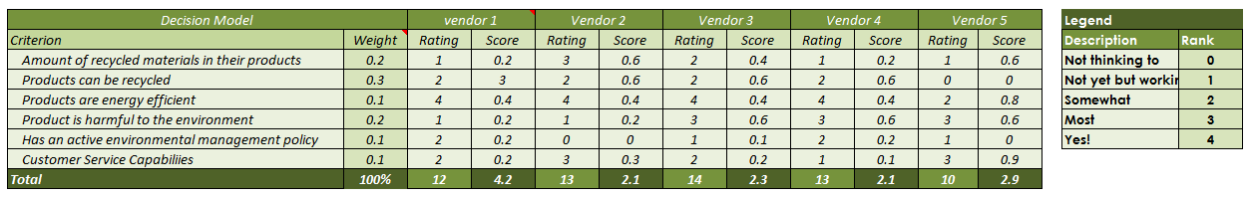
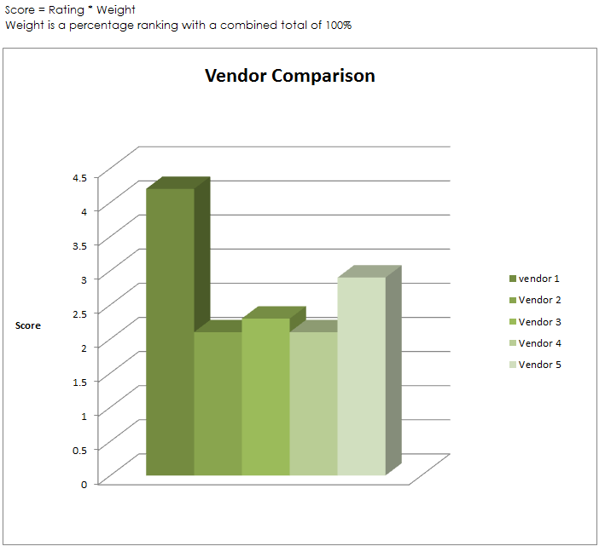
Tablero de Comando de Vendedores Verdes
Notes:
Green supplier selection criteria may be developed with intent of focusing on meeting government regulations, focusing on process improvement, and focusing on buying company’s environmental policy. P.K Humphreys, et al (2003) categorize the green criteria into two groups of Qualitative and Quantitative Criteria. Depending on whether an organization is using a reactive or proactive environmental management strategy, one or both groups of criteria may be used at the same time.
Quantitative environmental criteria:
These criteria are based on the cost in monetary terms. A potential supplier may incur costs investing in environmental management of its processes or it may be a source of environmental costs because of its destructive processes.
Pollutant costs/effects: Representing environmental costs caused by a potential supplier.
Improvement cost: Represent the degree of commitment the supplier has in environmental management.
Qualitative environmental criteria:
These are more subjective criteria and their application depends on the weight given to each one depending on its importance to the organization or industry and total points score obtained on the bases of the measured parameters.
Management competences
Green image
Design for Environment (DFE)
Environment Management Systems
Environment competencies

Slide 86
Relaciones Contractuales
Ética, Legislación, Reputación
Organización
Preferido o Contratista Líder
Proveedor
Socio
Alianza
E-commerce
Partes externas a la Organización quién contribuye al proyecto vía el proceso de compras
Restricciones Organizacionales
El Proyecto
Notes:
Organization may have long standing supplier relationships both informal and formal that may need to be taken into account by the project.
The project may introduce the organization to new procurement relationships and constraints.
Terms:
Alliancing
Partnering
Prime or lead contractor
Private Finance Initiative
Public Private Partnership
Sub contract
Supply chain management
Turnkey contract

Slide 87

Gestión de Costos

Slide 88
Estimaciones, Presupuestos y Costos
Evaluación de inversiones y Caso de Negocio
Estimación Agregada por el Patrocinador
Estimación Inicial
Presupuesto
Concepto
Definición
Implementación
Estimaciones Refinadas
Provisión para Riesgos y Contingencias Incluidas
$
$
$
Presupuestos Asignados a los Paquetes de Trabajo
Costos Monitoreados respecto de Presupuestos
Notes:
The diagram shows an overview of the process for developing budget from estimates and monitoring costs.
Initial estimates are used to support investment appraisal during the Concept phase. These are refined during definition as more detailed information becomes available. This is typically an iterative process which is done alongside the development of baseline plans.
When the estimates have been accepted by the sponsor, they become the budget. This budget is allocated to the work packages in a project inline with estimates. During implementation costs are monitored against the budgets and controlled.
The cost breakdown structure is a hierarchy typically derived by mapping the work breakdown structure against the organization’s system of cost accounting.
The integrated structure allows costs budgets to be allocated to each work package in line with the work to be undertaken and the time and quality objectives to be achieved.
Summary levels are produced to show the overall project spend profile corresponding to the cost breakdown structure.
The system enables costs for each work package to be broken down into each cost type to provide greater visibility and control, such as labour types, materials and expenses.
An effective cost breakdown structure is essential for earned value analysis and will be discussed later.

Slide 89
Plan de Costos del Proyecto
Project Months
Project Months
1
1
2
2
3
3
4
4
5
5
6
6
Total
Cost Categories
Total
Cost Categories
440
Resource A
440
Resource A
50
50
75
75
75
75
100
100
100
100
40
40
210
Resource B
210
Resource B
30
30
40
40
40
40
40
40
40
40
20
20
350
Resource C
350
Resource C
50
50
100
100
100
100
50
50
50
50
Total
Total
Labor
Labor
1000
130
1000
130
215
215
215
215
190
190
190
190
60
60
300
Materials
300
Materials
50
50
50
50
50
50
50
50
100
100
580
Sub Contracts
580
Sub Contracts
30
30
100
100
250
250
150
150
50
50
110
Expenses
110
Expenses
10
10
20
20
20
20
20
20
20
20
20
20
Period Costs
Period Costs
140
140
315
315
385
385
510
510
410
410
230
230
1990
1990
Cumulative Costs
Cumulative Costs
140
140
455
455
840
840
1350
1350
1760
1760
1990
1990
Budget at Completion
Budget at Completion
$
$
K
K
2000
2000
Costos Comprometidos Planificados
1500
1500
1000
1000
Spend Profile
500
Spend Profile
500
(Planned Value)
(Planned Value)
0
0
Notes:
A project cost plan (or phased cost plan) shows planned spend against time, usually based on a fully resourced bar chart which includes material purchases, sub contract and labour expenditure.
Spend Profile – the project timescale is divided into financial periods (typically months). Estimates for different cost categories are spread against each project activity. The values of each cost category are summed for each financial period (Period Costs). The period costs are accumulated for each financial period to produce a spend profile (‘S’ curve).
The plan is typically produced at work package level. Summary levels are produced to show the overall project spend profile corresponding to the cost breakdown structure.
Planned Committed Costs – are costs that have been formally committed and which will eventually be included in the final project cost. For example, orders placed for which goods have not yet been received or invoiced. A cost plan may also show the planned commitments based on the expected dates that orders will be placed. This can help to determine the level of financial exposure at any time and is useful in risk analysis and decisions.
The spend profile (S curve) is used to monitor cash flow and expenditure.
The S curve - shows the amount of spend up to the total budget against the project timescales. Thus the planned spend at any time in the project can be determined by reading the appropriate cost value at the corresponding time.
Actual Costs – are costs that have been charged to the project. For example, invoices paid to contractors, bills paid for materials purchased; charges for labour. Actual costs are monitored and compared to the S curve.
On the above example, actual costs exceed the spend profile at time now ( the reference date for the analysis, e.g. end of financial period). This may indicate that the project is overspending. However, it could also indicate that work is being done more quickly than planned. To understand the current status and predict the outcome requires an understanding of the useful work being accomplished for the costs incurred, which can be done effectively through Earned Value Analysis.

Slide 90
Beneficios de la Gestión de Costos
Más probabilidades de lograr Presupuesto
Control del gasto dentro de la Capacidad de Pago
Control del Flujo de Caja
Lecciones Aprendidas
Mejorade la Exactitud de las Estimaciones
Notes:
Some benefits from cost management are shown above.
The Project Manager is more likely to achieve their planned budget
Having a controlled expenditure within an ability to pay as and when invoices are charged within each phase or stage
Knowing what funds are available throughout the life cycle with a control on cash flow
learn lessons from previous work to ensure that the costs of materials and tasks is better understood for the future
improve estimating accuracy on the work packages by feeding back the information to assist future projects

Slide 91
Costos del Proyecto
Comprometido – La colocación de una orden de trabajo por hacer. El dinero ya se ha asignado al recurso.
Devengado – El Trabajo ya se ha realizado pero el pago aún no se ha hecho.
Real – El gasto real que se ha restado del presupuesto y ya a sido gastado.
Pronosticado de ejecución– El total de Costos Comprometidos, Devengados y Reales más la estimación de los costos restantes en los paquetes de trabajo que quedan para completar el proyecto
Notes:
There are typically four types of costs that will be incurred by a Project Manager as they work through the logical network of work packages.
These are:
Committed Costs – Where a placement for an order for work to be done has been made, but the work is yet to be started. This money has already therefore been allocated to the resource and cannot be used by the project for anything other than that payment.
Accrual – Work that has been done by the contractor, but for which the project has not yet paid but will be doing in the near future.
Actual – Real expenditure that has left the budget and has already been spent.
Forecast Out-turn – The total of Committed Costs, Accruals and Actual costs plus the estimate of the costs remaining in the work packages left to complete the project.

Slide 92

Gestion del valor ganado

Slide 93
Pre-Requisitos para la Gestión del
Value Ganado
Estructura de Desglose del Trabajo (EDT)
Responsabilidades definidas
Presupuestos distribuidos como en la EDT
Trabajo programado autorizado
Método para medir el logro
Presupuesto por etapas en el tiempo
Planes de línea Base
Registros de Costos
Recolección de los datos de desempeño y Métodos de Análisis
Pronósticos para el trabajo remanente
Notes:
For Earned Value Management to be carried out most effectively, many pre-requisites must be in place before attempting to carry out the calculations, measurements or reports.
These include:
A detailed and robust WBS where the budgets have been distributed correctly
Defined responsibilities for all the team members involved within the EVM activity
A baseline plan with a fully authorised work schedule
A recognised method for measuring achievement of the task being carried out for EVM
A budget phased over time within the work packages
Baseline Plans fully authorised
A cost recording mechanism in place
Performance data collection and analysis methods
Forecasts for remaining work must be in place and methods to do so

Slide 94
Parámetros del Valor Ganado
Valor Ganado
Valor del trabajo útil logrado en un tiempo específico basado en mediciones de desempeño
Valor Planeado
Costo Real
Valor de trabajo planificado en un tiempo específico tomado des las línea Bases de estimaciones y presupuestos
Costos del trabajo realizado- i.e. Facturas, etc.
Notes:
Earned Value Analysis uses the measurement of useful work (earned value) that has been accomplished to enable comparison with the planned value and actual costs at any time in the project. This provides an instant health view of the project and enables variances to be established showing areas that are under achieving in terms of cost and schedule. It also enables schedule and cost efficiency to be calculated in terms of useful work as a ratio of planned work and actual costs incurred. Performance Indices can be used for trend analysis and prediction of forecast completion dates and costs.
There are three key parameters in Earned Value Analysis:
Planned Value – this is developed by scheduling activities and their budgets against project timescales. The Planned Spend is typically represented by a spend profile or ‘S’ curve that shows the planned spend against time.
Actual Cost – the actual costs charged for the work accomplished. Actual costs are taken from bills, labour booking and invoices for materials, sub contract work etc., as recorded in operating accounts.
Earned Value – a measured value of the work completed (or performed) based on the percentage progress and the budget for the completed activity.
All three parameters must be synchronised to the ‘Time Now’ date to prevent inaccuracies.

Slide 95
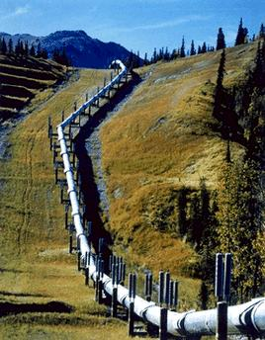
Principios del Valor Ganado
New Pipeline
Ground Works
Pipe
Works

buy pipe
lay pipe




Trabajo Completados
Alaska Pipeline
Notes:
The principles of Earned Value Analysis can be illustrated through a simple example as shown.
The project objectives are to lay a new pipeline. The work has been broken down into two areas: Ground Works and Pipe Works. Ground works has been completed. There are two work packages in the Pipe Works. The first, ‘Buy Pipe’ has been completed and the pipe has been delivered to site. The other work package ‘Lay Pipe’ has been in progress for two weeks.
Here are the key objectives and parameters for the ‘lay pipe’ work package:
Estimated cost for laying pipe = $100 per meter
Length to be laid = 1000 meter
Thus total budget allocated = $100K
Duration for WP = 8 weeks
Quality = no leaks

Slide 96
Mediciones del Valor Ganado
Valor Planificado a la Fecha Actual = $25K
Puntos de Control
2 wk
4 wk
6 wk
8 wk
Fecha Actual
20 % Progreso
Valor Ganado a la Fecha Actual
  = % Progreso x Presupuesto
  = 20% x $100K
  = $20K
Costos Reales registrados a la Fecha Actual = $30K
Notes:
After two weeks (Time Now) the work package manager reviews progress.
The manager is expecting 25% of the work to be completed at Time Now. This is based on the estimated spend over two weeks. Since the budget for all of the work is $100K, the value for 25% of the work is $25K assuming a linear rate of spend.
At Time Now the manager also checks the accounts and finds that $30K has been charged to the work package. However, also at Time Now, the manager checks the surveyor’s report which shows that 20% progress has been achieved.
From this initial inspection and measurement we can now identify several key pieces of information that are needed for our EVM calculations.
Total Budget: $100k
Total Duration: 8 weeks
EV: $20k
PV: $25k
AC: $30k
The manager can now complete the analysis.
The first task is to calculate schedule variance. This will indicate how much the project is off-spec in terms of time.
Schedule Variance = Earned Value – Planned Value (SV = EV – PV)
= $20K - $25K
= - $5K
The next task is to calculate the cost variance. This will show how much the project is off-spec in terms of cost.
Cost Variance = Earned Value – Actual Cost (CV = EV – AC)
= $20K - $30K
= - $10K
Note that the formula in both cases begins with Earned Value and that negative values reflect under achievement.
From the above we can see that the project is behind schedule and overspending. Further analysis will provide predictions of the time and cost at completion.
The variance calculation will have given the Project Manager a good idea of what state his work package is in, but it is restricted to that work package and cannot be used to compare across other work. An alternative and more acceptable method of measurement is based on performance indices. In this case the likely outturn in time and cost terms may be calculated by applying the ratios of useful work done to planned values and actual costs, to the original planned duration and overall budget. These ratios are called the schedule and cost performance indices (or indicators).
The performance indices are calculated as shown above. Note that in each case Earned Value is the quotient (on top).
The following formula will enable the forecast duration to be determined, based on current performance:
Forecast duration = Total Duration / SPI
= 8 weeks/0.8
= 10 weeks
Similarly, the estimated cost at completion may be derived from:
Forecast Cost = Total Budget / CPI
= $100K/0.67
= $150K

Slide 97
Desempeño Futuro
  Naturaleza del trabajo futuro sea diferente al trabajo realizado
  Las actividades futuras sean más fáciles o más difíciles que las actividades completadas
Future performance may be different to current performance
  EAC = Actual Cost + Estimated Cost to Go / CPI
  Medidas proactivas sean tomadas para recuperar las variaciones
Trabajo completado incluya elementos no recurrentes
  Trabajo completado incluye aprendizaje que no se aplicará a los trabajos futuros
Notes:
Past performance may in some cases be an appropriate indicator of future performance. However, this is not always the case as the nature of the work may have changed or you may have completed the more difficult tasks in the early stages. In these cases it will be necessary to use a different Performance Index for future work compared to that derived from completed work.
For example, the Estimated Cost at Completion can be calculated as follows:
EAC = Actual Cost + Estimated Cost to Go / CPI
In these examples you can either be given the CPI as a guide to see how this could effect the outcome of the project, or alternatively you could be asked to calculate the cost efficiency needed to come back on budget.

Slide 98
Ventajas de la Gestión del
Valor Ganado (EVM)
Mide la eficacia del trabajo en progreso
Proporciona respuestas auditables y repetibles a:
  Desempeño Actual
  Predictiones Futuras fuera de término
  Necesidades de mejora en el desempeño futuro
Proporciona información confiable para ayudar en la toma de decisiones
Facilita el análisis de tendencias
Proporciona datos para futuras estimaciones de trabajo similar
Notes:
There are a number of advantages that can be gained by the correct use of EVM.
It provides an application to measure the efficiency of work in progress
It provides an auditable and repeatable answers to:
The project’s current performance
How the project is predicting to be completed (Future out-turn)
A guide to the Project Manager as to the future performance improvement needs
Quality EVM provides reliable information to aid with decision making
It facilitates trend analysis to see how things are starting to change and how this may change the end result
Provides data for future estimates of similar work so therefore helping with lessons learned and continuous improvement

Slide 99
Desventajas del EVM
Bebido a que la técnica toma una visión completa, el mayor desempeño en una área puede esconder menor desempeño en otra
EVM requiere una administración de datos considerable y esfuerzo
Notes:
Although Earned Value can be used as a very powerful tool in Project Management, it must be reminded that no method is completely full proof and that EVM or EVA should be carried out in a disciplined manner to ensure that the right message is passed over and that one area of over performance is not allowed to mask the inadequacies of another area as this will now allow the true development of the project team or the organization.
All this work and analysis takes a great deal of time and commitment and so this can also been seen as a distinct drain on your project resources through all the administrative effort that is required to manage this discipline correctly.

Slide 100

Control del Cambio
La única constante con que siempre se puede contar es el cambio.

Slide 101
La Necesidad del Control del Cambio
Para controlar el impacto adverso de los cambios no controlados
Para posibilitar cambios beneficiosos
Para comunicar cambios a las partes interesadas
Para mantener las líneas de base para un control efectivo
Notes:
Uncontrolled change is seen as one of the major causes of project failure. It is inevitable that changes to the project will be required because the environment has changed or that a better solution to the original problem has been identified. Change should not be stifled but it should be controlled. Uncontrolled changes will undermine the validity of baseline plans and forecasting. Any proposed and authorised changes should be clearly and swiftly communicated to the stakeholders to ensure that there is no misunderstanding on what versions or what specifications the project is working to. This is why Change Control is so closely linked with Configuration Management.

Slide 102
Roles
Partes Interesadas bExternas
  Consumidores
  Usuarios
  Expertos
  Reguladores
Gestión Corporativa
Patrocinador del Proyecto
Director de Sostenibilidad
Funciones
Aseguramiento de la Calidad
Comité de Control de Cambios
Director de Proyecto
Oficina de Soporte de los Proyectos
Líder de Equipo
Líder de Equipo
Líder de Equipo
Notes:
Sponsor – has overall responsibility for authorising changes internal changes and for co-ordinating external changes. External changes may be raised by clients, or arise through a change in the organizations overall business strategy through other external stakeholders such as regulators.
The sponsor may delegate some authority to a Change Control Board or the project manager.
Change Control Board – in complex projects involving many key stakeholders it may be appropriate to establish a team with responsibility for approving or evaluating changes and making recommendations for approval.
Project Manager – is responsible for defining the change and configuration management process for the project and for agreeing authorization limits, tolerances and priority categories with the sponsor. The project manager will co-ordinate and control changes throughout the implementation phase.
Project Team – may raise changes where appropriate to address problems, be involved in change management activities such as assessment and will implement the changes as approved.
Project Support Office – are likely to carry out the day to day change management processes, provide support during impact assessment, planning and implementation.

Slide 103
Proceso de Control de Cambios
Solicitud
Registro de cambios
Registro
Proceso de Gestión de la Configuración
Evaluación
Acepta o Rechaza
No
Yes
Actualiza
el Plan
Informa al
Solicitante
Implementa
Notes:
A simple change control process is shown in the diagram above.
Request may come from any project stakeholder. Changes requested by external stakeholders may be subject to contract conditions or agreements.
Registration - requests are usually formally made on a change request form and recorded in a change register (log). This records key information such as requestor, date, description of change and priority.
Assessment – changes are assessed for impact on project objectives using the Project Management Plan and the Business Case as a baseline, and effects on configuration items (through the Configuration Management Process). The costs of processing the change itself should be taken into account. This stage will produce an estimate of cost, time and quality impacts.
Acceptance – the change is evaluated, accepted, rejected or deferred. The authority for this decision may rest with a special group called the Change Control Board – a group of stakeholders that may be given responsible for approving, rejecting or recommending changes. The terms of reference for this group should be defined in the Change Management Plan. Changes may be authorised by the Project Sponsor, the Project Manager or others as defined in the terms of reference and depending on the nature, priority and impact of a change.
Updating Plans & Implementation – baseline plans are updated to record changes to management and implementation documents, and the approved change is implemented.

Slide 104
Documentos Claves – Solicitud de Cambio
Change Request:
Activity Description:
Description of Change Request:
Reason for Change:
CHANGE IMPACT
Impact on Schedule:
Impact on Cost:
Impact on Scope:
Impact on Environment:
Impact on Process:
Impact on Product:
Impact on Personal:
APROVAL REQUERIMENTS
Project Manager |  | Date:
Activity Owner: |  | Date:
Project Sponsor: |  | Date:
Any other people who need to approve the change request. This is based on your change control procedures
People, Planet, Profit Measures
Notes:
The two main forms used are the Change Request Form that documents the history of a change from origination to conclusion, and the Change Register or Log that records summary details of all project changes in order to communicate their current status to stakeholders.
The Change Form is typically completed in four stages.
Change Description - is completed by the originator and contains title information, description of the change, originator details, the date raised, priority. The benefits and reason for the change are also included in this part.
Impact Assessment -is completed by change assessors to detail the impact of the change in terms of cost, time and quality, and propose recommended actions to implement the change. Further information may include any consequential risks arising, implications for project stakeholders, or any effects on delivered items.
Authorization -records the approval including authorization signatures and any conditions or additional comments on the change.
Summary information entered in the change form is read across to the risk register to inform project stakeholders of progress.

Slide 105

Mejor Práctica
Revise cuál era el requisito original
Evalúe el impacto en las medidas de sostenibilidad
Buque los beneficios adicionales dentro de la solicitud de cambio
Recomiende acción o acciones a ser tomadas con impacto acotado
Espere la Autorización

