Slide 1
Part III
V 5.0

Slide 2
Information Management and Reporting
Module | Module Covers | Learning outcomes
17 Information Management | What is Information management? What is a PMIS? Project Reporting | Learn how project information is managed and what the function of a PMIS is and what types of reports are recommended for stakeholder engagement and project success.
Language
English
Version
5.0

Slide 3
Purpose
Ensures information is available to support decision making in a timely manner
Controls the quality, use and maintenance of information throughout the project life and after
Supports communication processes
Notes:
Reliable information is required by project stakeholders to enable them to make effective decisions, anticipate and respond to future events such as risks and opportunities and take into account uncertainties and current problems.
Information management is required to ensure that appropriate information relevant to and generated in the course of a project, is made available to project stakeholders in a timely manner to help with more improved decision making.
A project information management plan defines how information will be managed during the life and after the project, the purpose and scope of information products, their ownership, formats, distribution, control, processing, storage and disposal.
The Plan will address the following:
Information Management Objectives
Roles and responsibilities
The process
Documentation and Information Product specifications
Links to the communication plan and process
The way in which information is managed should be established as early as possible in the project. Typically this would be part of the communications strategy in the project management plan.

Slide 4
Information Processing
Documents
Communicate
Store
Data
Acquire
Access
Sources
Process
Archive
Retrieve
Notes:
The process will define how information will be acquired, accessed, stored, communicated, disposed of and archived. The Communication Plan will define stakeholder information requirements in terms of scope and timing, the source of the information, the media and format, distribution and ownership.
Sources - data received during the life of project is varied and may be collected in many ways, for example through meetings, from reports on progress and so on.
Distribution - information needs to recorded if relevant and communicated. Key questions such as the level of information needed and who needs to be informed, must be answered.
Recording and storage - records may be handwritten or created electronically. Whichever method is used, records must be maintained to support the project and for auditable purposes.
Access – dependant upon the project and the sensitivity of the data, many organizations will have restrictions on certain data access. Team members will need to be able to have information that allows them to complete their tasks, but some information will be protected from some stakeholders.

Slide 5
Key Information Products
Business Case
Product Specifications
Requirements
Plans
Reports
Project Management Plan
Baseline Plans
Handover Plan
Reports (Highlight, End of Stage and Closure)
Logs (Changes, Quality and Risk)
Notes:
Documents used to define requirements include the Business Case and Product Specification. These are typically defined during Concept and Definition and updated in the course of the project. Stakeholders involved in these documents are likely to include the project sponsor, project manager, users and operators, external client and corporate management.
Planning documents include the project management plan, supporting plans such as quality, change and risk management plans, and implementation plans such as project networks. These are mainly used by the project team and other stakeholders such as resources managers, to define and control day to day activities.
Control documents include routine progress reports, exception reports, various logs such as quality, change, risk and configuration logs. These are used for both day to day activities and at major milestones to record and communicate status on progress to project stakeholders.

Slide 6
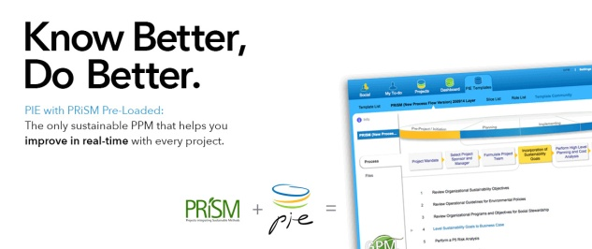
Example – Pie from PieMatrix
Sustainable
Cloud Based
PRiSM is part of the platform
Hosted in a data center that runs on renewable energy
Notes:
We just covered a lot. Time for a quick break.

Slide 7
Features of a PMIS
Social Collaboration
| Status Dashboard
| Task List

Slide 8
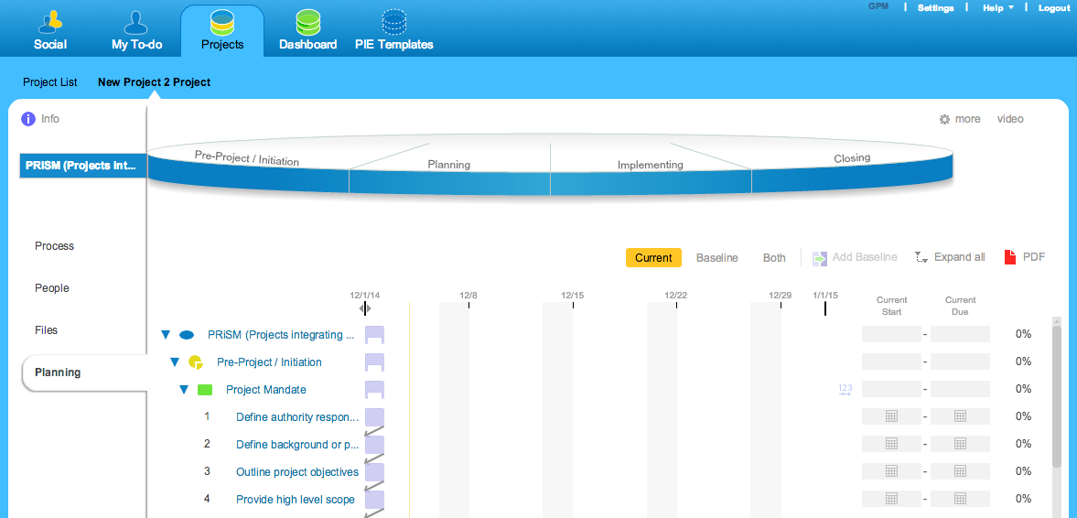
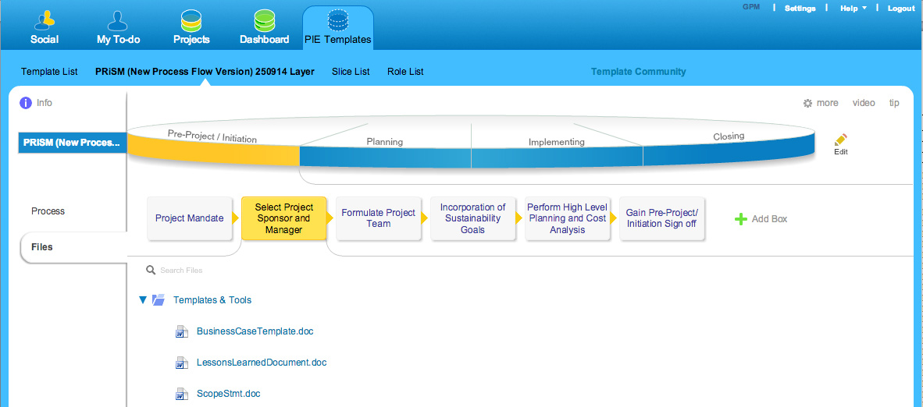
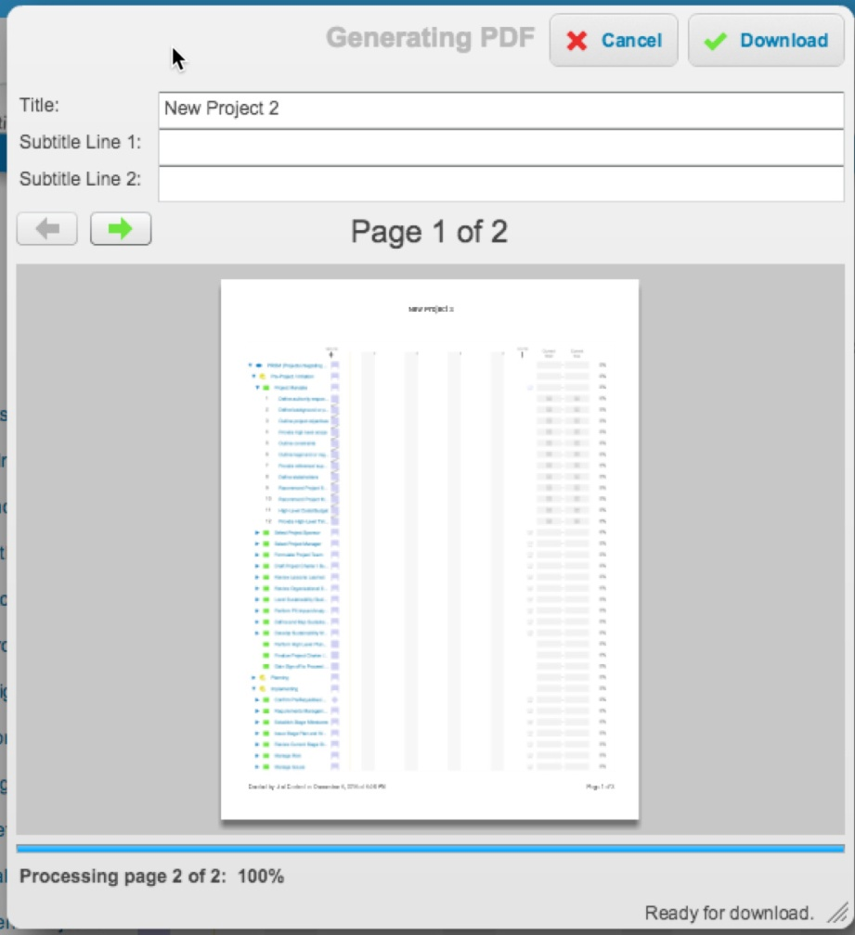
Features of A PMIS
Doc Management
| Schedule Management
| Reports

Slide 9
We have covered
What is Information management?
What is a PMIS?
Project Reporting

Slide 10
Situational Leadership and Communication
Module | Module Covers | Learning outcomes
18 Situational Leadership | Leadership Leadership Traits Deadly acts of Leadership Communication Motivation Responsibilities | Gain insight on leadership, what it means to be a leader and how leaders communicate
Language
English
Version
5.0

Slide 11
Leadership
Manager Analytical, structured, controlled, deliberate, orderly | Which makes the best PM? | Leader Experimental, visionary, flexible, undeterred, creative
Uses the power and logic of the rational mind Considers the dangers Concentrates on short-term results Follows visions Pursues the tangible Performs duties Controls Depends on authority |  | Uses the power of intuition and logic of the heart Senses opportunity Focuses on long-term results Creates visions Searches for potential Seeks the intangible Pursues dreams Inspires Depends on influence
Notes:
Management is doing things right; leadership is doing the right things.
(Ask audience their thoughts on which is best.)

Slide 12
Perspectives
Looking Upwards
Looking Outwards
Managing the internal sponsor to
Managing external stakeholders
achieve organizational
(including the client, suppliers and
commitment
subcontractors) to ensure the
project meets their needs
Sustainability Manager
Looking Backwards
Looking Forwards
Monitoring progress,
Planning to ensure the
learning from mistakes.
team sets realistic targets
and obtains the resources
to meet them
Looking Inwards
Looking Across
Managing yourself by reviewing your
Ensuring contribution and
performance to ensure your
co-operation from
leadership is a positive contribution
departments
to the project
Looking Downwards
Managing the team in order to
maximise their performance
Notes:
If the Project Manager is to be a good leader, then they must know where and when to look and lead in the right direction.
They must know when they look upwards towards the Sponsor and Corporate Management, how the performance of their project can affect the strategy of the organization and where it fits into the vision set by those above.
The Project Manager must also know when to look outward, realising that their team alone, may not have the answers to all the projects questions. Here the project manager must learn to influence and direct stakeholders from outside their natural line of management.
A good leader knows when to look forward, to plan and strategise the route ahead for the project, whilst also reflecting backwards on those tasks they have been completed and the lessons that they have learned and brought with them to develop themselves and the team for the future.
Understanding the needs of their team is paramount, whilst also addressing their performance and supporting those in need. Knowing that your project does not lay in isolation, makes the project manager understand the effects that others have on their projects as much as they are dependent on theirs.
A true leader know how to look inward, at themselves and their own performance, knowing they are the standard bearer, the setter of the standards, where self discipline is the highest form of discipline.
To quote an Indian proverb, “Leadership is lifting a person's vision to higher sights, the raising of a person's performance to higher standards, the building of a personality beyond its normal limitations.”

Slide 13
Practical Traits
Does this describe you?
Genuinely interested in other peoples ideas;
Do you smile? An old Chinese proverb states “A man without a smiling face must not open up a shop.”
Are you a good listener?
Do you make the other person feel important and do it sincerely?

Slide 14
Leadership Skills
Focused
Manages conflict
Good team Motivator
Flexible & adaptable using the right appropriate styles
Good Risk Taker
Influencer & Problem Solver
Delegates & Communicates
Gives and Receives Constructive Feedback
Notes:
Key attributes of successful leaders:
Focus -gives clear direction and provides the vision, is fully committed to the project critical success criteria and able to maintain focus throughout the project life.
Manages conflict – a good leader is able to identify conflict, establish its impact on the project and resolve quickly.
Good team motivator – recognises need to manage motivational factors such as recognition, job satisfaction, reward. Recognises success and gives credit.
Flexible and adaptable - able to use an appropriate leadership style to suit the circumstances.
Good risk taker- having situational awareness, so they are able to weigh up the pro’s and con’s and make effective decisions.
Good influencer – able to obtain commitment to project goals from the project stakeholders, including the external and internal team, end-user and subcontractors.
Good problem solver - able to deal with uncertainty through innovation.
Able to delegate – defines clear objectives, empowers, gives authority and responsibility – ensures individual is competent, defines effective rules for escalation, and provides adequate supervision and support.
Good communicator - good networker able to maintain constructive relationships with all project stakeholders and ensure effective communications throughout.
Gives Feedback - able to provide constructive criticism and feedback

Slide 15
Situational Leadership
HIGH
Supporting
Coaching
Supportive (Relationship) Behaviour
Delegating
Directing
LOW
HIGH
Directive (Task) Behavior
Notes:
Leading the Individual
One of the best known frameworks for the development of an individual within a team is the Situational Leadership model developed by Hersey and Blanchard. The model was not specifically developed for projects and is a little simplistic for the project environment but it is still a useful framework.
The model describes the developing relationship between leader and team member. The matrix has two dimensions: Task Behaviour and Relationship Behaviour.
Directing
When the team member first arrives there is anxiety, tension and confusion. The leader adopts a task oriented approach, provides specific instructions and closely supervises performance.
Coaching
As individuals begin to understand what is required the leader will spend more time establishing a relationship of trust and mutual understanding. Since the individual may not yet have developed sufficient competency to assume full responsibility for the task it is still necessary to explain decisions and provide the opportunity for clarification.

Slide 16
Leadership Focus
Task
Planning and
Controlling Processes
Team
Individual
Tuckman Model
Situational Leadership
Notes:
John Adair identified three overlapping areas of core responsibility: Task, Team and Individual.
Effective leaders are able to balance their focus in these areas according to the situation. If there is too much focus in one area it will have a detrimental effect on the others. Conversely, each area has a positive influence on the others if properly balanced. For example a well thought out Project Management Plan provides effective guidance to the individual and the team. However, a well though out plan can only be achieved through awareness of the team and individual’s needs.
Task - the leader has to ensure that the required task is achieved. This requires the setting of task objectives, control and co-ordination. The leader must maintain focus on the objectives until completion.
Individual - good leaders recognise that each individual has needs that are fulfilled through the task. They understand the needs, strengths and weakness of individuals, and are able to apply the leadership style appropriate to the situation. They are able to produce the motivation and commitment needed for the individual to perform their task.
Team - an effective leader recognises that the team is an entity that also requires direction, information, performance feedback and support, as well as the individuals within the team.

Slide 17
Follower Readiness
High
Able and Confident
Able but Insecure
Follower Readiness
Moderate
or
Unable but Confident
Low
Unable and Insecure
Notes:
Supporting
As the individual develops high levels of competency and motivation, greater delegation and group decision making is possible. The leader concentrates on developing relationships with individuals.
Delegating
Finally a point is reached where team members are confident in their ability, trusted to get on with the task and have a good relationship with the leader. Both task and relationship behaviour drop to low levels. Complacency on the part of the leader is now, perhaps, the greatest danger.
The parallel development of the individual through these stages can be viewed in a different way. Hersey and Blanchard also identify something called Follower Readiness which is a combination of Ability (knowledge, experience and skill) and Confidence (willingness, commitment and motivation).
A new team member may not have all the necessary ability or confidence. It is the leader’s job to develop both in the individual as they move through the four stages.

Slide 18
5 Deadly Acts of Leadership
1. Lust
Google Executive Forrest Hayes (51 years) was found dead in the cabin of his luxury yacht abandoned by a high end call girl, dying of a drug overdose.
Security camera footage shows her stepping over Hayes' body to finish a glass of wine while he lay unconscious, making no attempt to help him.
Hayes was a married father of five and previously held senior roles at Sun Microsystems and Apple.
Co-workers praised his professionalism and work ethic. "You showed us how to be better engineers and a better team.” "Your impact and focus was tremendous, but your touch for inspiring those around you is what made you an incredible leader."
Notes:
We just covered a lot. Time for a quick break.

Slide 19
5 Deadly Acts of Leadership
3. Pride
Microsoft - Steve Ballmer constructed his own private bubble.
Passionate in his belief that so long as he said it, could and would be done; furthermore he was convinced that so long as he vociferously denounced any competing product or service that would be the end of it.
Steve Ballmer's Windows 8 strategies created media scorn, investor derision, and relatively few happy customers. Microsoft began losing it's dominance in the software industry.
Under Ballmer, Microsoft's stock slumped, losing 44 per cent during his tenure.
Notes:
The ego must go. It’s not about you. Build a strong team and surround yourself with smart, passionate and highly competent people.vDeveloping leadership skills is a lifetime project.It’s too easy, as a leader, to feel like you have to be the one who knows everything. Great leaders recognize that they need to keep learning. Additionally, treat everyone with respect at all times whether they are employees, customers, suppliers, or partners. Be humble. The more humble you remain, the more subordinates would be motivated to share their suggestions and recommendations with you. The greater your success, the more you need to stay in touch with fresh opinions and perspectives and welcome honest feedback.

Slide 20
5 Deadly Acts of Leadership
4. Complacency
Blackberry – Research with no motion; In a board meeting, Mike Lazaridis, the BlackBerry co-founder and former chief executive pointed to a BlackBerry “I get this,” he said. “It’s clearly differentiated.”
Then he pointed to a touchscreen phone. “I don’t get this.” To turn away from a product that had always done well with corporate customers, and focus on selling yet another all-touch smartphone in a market crowded with them, was a huge mistake, Lazaridis warned his fellow directors.
Some of them agreed. Success had come almost naturally to the Blackberry, until Apple released the first iPhone and upended their long-held strategy of appealing primarily to email-addicted professionals.
Notes:
Get rid of Complacency. Embrace Change. Be adaptable. Consumer needs and the market place are ever evolving. The global playing field has leveled. As a result of continuous technology acceleration, the change is rapid, inevitable and unstoppable. Listen to what your customers and employees are saying and go back to the drawing board. I remember once making a recommendation to a boss and being told thanks but no thanks. “This is how we have always done things and we will continue to do it this way.”

Slide 21
5 Deadly Acts of Leadership
5. Greed
The death of the 57-year-old banker Richard Talley, CEO of Denver-based American Title Services (ATS) was accompanied by the fact that his firm was under investigation by the insurance regulators.
Prosecutors had launched a criminal investigation for over $2 million missing from escrow accounts. Talley committed suicide.
Police found him dressed for work, sitting in his car. Records show Talley was to be confronted about the missing escrow funds the morning he died. ATS filed for bankruptcy liquidation shortly after Talley's suicide.
Notes:
GREED and Dishonesty go hand in hand. Reputation, Integrity and Credibility is everything. Your reputation, whether good or bad will spread faster than a viral video on YouTube. Once lost it is extremely difficult to regain.

Slide 22
Motivation - Autonomy
People’s need to perceive that they have choices, that what they are doing is of their own volition, and that they are the source of their own actions.
The way leaders frame information and situations either promotes the likelihood that a person will perceive autonomy or undermines it.
Frame goals and timelines as essential information to assure a person’s success, rather than as dictates or ways to hold people accountable.
Refrain from incentivizing people through competitions and games. Few people have learned the skill of shifting the reason why they’re competing from an external one (winning a prize or gaining status) to a higher-quality one (an opportunity to fulfill a meaningful goal).
Don’t apply pressure to perform. Sustained peak performance is a result of people acting because they choose to — not because they feel they have to.
Harvard Business Review November, 2014

Slide 23
Motivation - Relatedness
Relatedness is people’s need to care about and be cared about by others, to feel connected to others without concerns about ulterior motives, and to feel that they are contributing to something greater than themselves. Leaders have a great opportunity to help people derive meaning from their work.
Validate the exploration of feelings in the workplace. Be willing to ask people how they feel about an assigned project or goal and listen to their response. All behavior may not be acceptable, but all feelings are worth exploring.
Take time to facilitate the development of people’s values at work — then help them align those values with their goals. It is impossible to link work to values if individuals don’t know what their values are.
Connect people’s work to a noble purpose.
Harvard Business Review November, 2014

Slide 24
Motivation - Competence
Competence is people’s need to feel effective at meeting every-day challenges and opportunities, demonstrating skill over time, and feeling a sense of growth and flourishing. Leaders can rekindle people’s desire to grow and learn.
Make resources available for learning. What message does it send about values for learning and developing competence when training budgets are the first casualty of economic cutbacks?
Set learning goals — not just the traditional results-oriented and outcome goals.
At the end of each day, instead of asking, “What did you achieve today?” ask “What did you learn today? How did you grow today in ways that will help you and others tomorrow?”
Harvard Business Review November, 2014

Slide 25
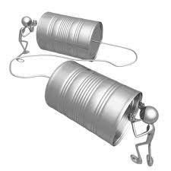
Forms of Communication
Primary forms of communication
Verbal
Body language
Written
Environment
A Project Manager depends on a communication network. This may be formal or informal.
Channels of communication
Active
Passive
Notes:
When developing a Communication plan, the first step is Stakeholder analysis. It is important to know what your audience wants to know, when they want to know it, how they want it presenting and how often they want it. The Project Manager must understand where their information is coming from and if they are receiving any assistance in collating or collecting the information. One last consideration is to understand how as a Project Manager you will approach the dissemination of unexpected information. The majority of this time the news is bad, knowing your team and trying to anticipate their reaction needs many hours of team development and understanding by the Project Manager.

Slide 26
Barriers to Communication
Scope of Source’s Experience
Scope of Recipient’s Experience
Message
Environmental
Background
Mutual Understanding
Source
Recipient
Personal
Organizational
Feedback
Send Reinforcements, we are going to advance .....
Send Three and Four pence, we are going to the dance
Notes:
Barriers to communication
In the simple model above there are in effect four potential barriers that the communication navigate.
Environmental - Noise, temperature and air fall into this category
Background – individuals are influenced by their technical, social and educational backgrounds. It is also important to consider social and cultural differences.
Personal - Tiredness, hunger, thirst, etc. any affect ability to communicate well. Permanent or temporary loss of vision, sight, hearing, etc. can have an impact on sending and receiving communications. Personal prejudices also have an impact.
Organizational - The relative position or status of the individual will clearly have an impact. For example, individual to peers, individual to boss, individual to subordinates. These relationships may affect the quality of the communication process.

Slide 27
Communication Responsibilities
Benefits
Risks
Environmental Factors
Users
Corporate Management
Business Case
Changes
Achieving Success Criteria
Key Performance Indicators
Project Risks
Improvements
Focus & Motivation
Integration & Co-ordination
Sponsor
Sustainability Manager
Longer Term
Day to Day
Notes:
The main communication responsibilities for the Project Sponsor and Project Manager differ. In essence the Project Sponsor is mainly concerned with the longer term, i.e. achieving the benefits whereas the project manager is actively managing the project on a day to day basis.
The project sponsor is more likely to be communicating with project external stakeholders such as users, corporate management and regulators. The project manager on the other hand is more likely to be concerned with project internal communications and keeping the project moving to achieve its critical success criteria.
Effective communications between the project sponsor and project manager is therefore crucial to the successful management of the project.

Slide 28
We have covered
Leadership
Leadership Traits
Deadly acts of Leadership
Communication
Motivation
Responsibilities

Slide 29
Conflict and Negotiation
Module | Module Covers | Learning outcomes
20 Negotiation and Conflict | Negotiation Preparing Negotiation Skills Negotiation Tactics Conflict Resolution Conflict Approaches | This module covers how to address negotiations and how to manage conflict.
Language
English
Version
5.0

Slide 30
Setting the Stage for Negotiations
Meeting Pre-Requisites
Understand differences between Stakeholder Interests
Are there different views or approaches
What authority exists
Is there any power or influence
What are your tolerance limits
What is the impact of failure? Success?
Notes:
All projects involve negotiations. The art of negotiation in projects is to balance the needs of the project with the needs of the stakeholders involved in the negotiations.
In projects therefore, the aim of negotiations should be to develop a ‘win-win’ solution that is in line with the overall project objectives and needs of the stakeholders.
A pre-requisite stage for any negotiation is to conduct a stakeholder analysis in order to anticipate the needs of the stakeholders involved, their authority (e.g. are they able to make formal agreements), their relative power and influence.
It is also important to understand the negotiation limits and impact on the project in terms of success or failure.

Slide 31
Negotiation Process
Preparation
What are your Objectives?
What are the Other Party’s Objectives?
What are the Variables?
What will your Opening Offer be?
Where are you willing to make Concessions?
Introduce Parties and Explain their Roles
State your Objectives
Invite the other Party to State their Objectives
Agree a Loose Agenda
Opening
Present Your Offer
Evaluate other Party’s Response
Bargain for Specifics
Seek Agreement
Bargaining
Final Trade Offs
Summarize Agreements and Actions
Schedule Further Negotiations
Closing
Notes:
The major part of the negotiation process is broken down in four distinct areas.
Preparation – the selection and briefing of the negotiation team on the definition of objectives, consideration of the other party’s objectives, defining the variables, and a strategy including opening offer, bargaining limits and concessions that can be made.
Opening – introductions, objectives should be stated by both parties, an agenda and the rules of the negotiation should be agreed.
Bargaining – collaborating to achieve a win - win solution. Present offers, evaluate responses, bargain and seek agreement.
Closing – conduct final trade offs before starting to closeout, summarise the findings of the negotiations and record and approved all agreements made, follow up actions needed to be taken before future meeting and conclusions reached. Agree the timetable for any further negotiations if necessary.

Slide 32
Tactics
Pressure Release
Time Out
Silence
Coercion
Leading Questions
Unbalanced Concessions
Segmentation
Challenging
Notes:
Parties may use various tactics during bargaining to achieve their objectives. Tactics can be used positively or negatively.
Pressure Release – a concession may be offered as a way of apparently breaking a stalemate. Stand firm and hold the planned limits. Do not concede unless the concession is beneficial. Make a counter offer or take time out if further consideration is required.
Coercion, intimidation – ignore any emotive aspects and maintain focus on the key objectives. Maintain an assertive approach and continually remind the other party of the overall objectives. Agree rules at the beginning to reduce the possibility of coercion and intimidation. Use an expert negotiator/facilitator.
Unbalanced Concessions – making concessions that have much greater value to one party than the other. Maintain awareness, or make rough assessments of the value of the offer. Explain your perception of the concession to the other party.
Challenging – the right amount of challenging can be constructive, too much can be destructive. Keep positive and acknowledge the other party’s position. Keep focused on the objectives and take time out to consider appropriate responses with your team.
Time out – the parties break into their teams to discuss the situation and tactics privately. Time outs are useful when the negotiation team experiences fatigue, loss of concentration, or gets ‘bogged down’. Over use of time outs can be disruptive. Only agree to Time out requests if beneficial. Agree time scales and rules for taking time out, prior or during the introduction stage.

Slide 33
Key Skills
Use Questions to Persuade
Label your Behaviour
Be Innovative
Don’t Dilute a good Argument
Use Questions to Control
Set Deadlines
Test & Summarize
Notes:
As well as tactics, it is important that the other party knows and understands who they are dealing with. There are certain skills that you can use to control a meeting. Keep in mind however, you are there to achieve a win-win scenario and not to over power or bully your counterpart.
Label your behaviour – give warning signals and signposts to avoid surprises and shocks. Indicate when you intend to ask a question.
Test and Summarize - test common understanding, summarise agreements and clarify key points at appropriate times.
Don’t dilute a good argument – use few strong points rather than many weak ones.
Use questions to persuade – structured questions can enhance a case and weaken resistance.
Use questions to control – asking questions can give control and more time to think.
Set deadlines – setting time limits can motivate towards achieving an agreement.
Be innovative - look for possible points of conflict and search for innovative solutions.

Slide 34
Quantitative Costs of Conflict
The total value of lost work time due to stress is estimated to be $1.7 billion. (WarrenShepel online], Health &Wellness Research Database, 2005)
Conflict accounts for up to 90% of involuntary departures (Dana, Dan, [online] The Dana Measure of Financial Cost of Organizational Conflict, 2001)
42% of a Manager's Time is spent addressing conflict in the workplace. (Watson, C & Hoffman, R, Managers as Negotiators, Leadership Quarterly 7(1), 1996)

Slide 35
Conflict Causes
Conflict is the emotional, verbal, written or physical expression of differences regarding wants, needs or expectations between two or more individuals.
Conflict directly impacts behavior, decision-making and the ability to complete assigned tasks.
Conflict is inevitable in the workplace; it cannot be eliminated.
The key to a functional workplace is the ability to minimize the escalation of conflict and ultimately resolve the differences.

Slide 36
Model of Conflict Progression:
Trigger Event/Hot Button
Resulting Behavior
Consequences of resulting behavior
Notes:
Conflict exists where there are differences between individuals or groups and must be managed throughout the project life cycle.
Conflict may occur between stakeholders throughout the life cycle.
Project managers should anticipate potential conflicts and their significance and deal with them before they cause negative impacts on the project.
Often conflict is caused through lack of understanding, lack of facts or because individuals have different interests, beliefs and values.
Conflict may either be destructive (having an adverse effect on a project) or constructive (positive benefit). For example, if the cause of a conflict is due to a technical misunderstanding it is beneficial to bring this into the open and involve all interested parties. Conversely, destructive conflict typically occurs due to differences values, beliefs, feelings and background. Because these are usually emotively based they are more difficult to resolve and require sensitivity and empathy.
If conflicts cannot be resolved, they may need to be escalated to higher authorities, or specialist facilitators.

Slide 37
Qualitative Costs of Conflict
Stress, frustration and anxiety
Loss of sleep
Strained or broken relationships
Grievances and Litigation
Employee Absenteeism
Employee turnover
Loss of productivity
Decrease in customer service quality
Injury and accidents
Disability claims
Presenteeism
Sabotage

Slide 38
Conflict Management Model
Root Causes
Causes
Cause and Effect Analysis
Conflict
Resolution
Stakeholder Analysis
Sources
Stakeholder Needs & Power
Notes:
The model is based on the work of Blake and Mouton and provides a framework for understanding and resolving conflict.
Causes - the subjects such as timescales, or priorities, changes.
Sources - the people involved in the conflict.
Conflict – the nature of the problem or issue, and its intensity.
Intensity may be defined as the combination of magnitude (say impacts on project objectives) and frequency (how often the conflict occurs).
Two techniques that support conflict management are:
Cause and Effect Analysis – establishing the root cause will help to determine how often it is likely to occur and will enable conflict intensity to be determined. Root causes often lead to the definition of preventive measures.
Stakeholder Analysis – understanding the needs and influences of the stakeholders will help to prevent conflict situations arising, or in the event of conflict, it will enable effective management strategies to be used.
Preventing conflict may also be covered by appropriate risk management.
A number of methods may be used to manage conflict such as formal negotiations, mediation and workshops, depending on the nature of the conflict and stakeholders involved.

Slide 39
Conflict through the Life Cycle
Concept
Definition
Implementation
Handover & Closure
Ideas
Benefits
Options
Funding
Benefits
Requirements
Options
Funding
Success Criteria
Risks
Schedules
CSC priorities
Resources
Changes
Tech & Performance Issues
Risks
Acceptance
Snags
Demobilisation
Handover Activities
Risks
Cause
Sponsor
Corporate Management
Sponsoring bodies
Sponsor
Users
Corporate Management
External Customers
Sponsor
Project Manager
Project Team
Sub Contractors
Resource Managers
Sponsor
Operators
End Users
Project Team
Acceptance Authority
BAU groups
Source
Project Life Cycle
Notes:
Conflict occurs throughout the project. The nature and scale of conflict is directly related to the activities undertaken and the stakeholders involved.
Understanding where and who might be involved in the conflict will help the Project Manager in its early identification and resolution.
BAU – Business as Usual

Slide 40
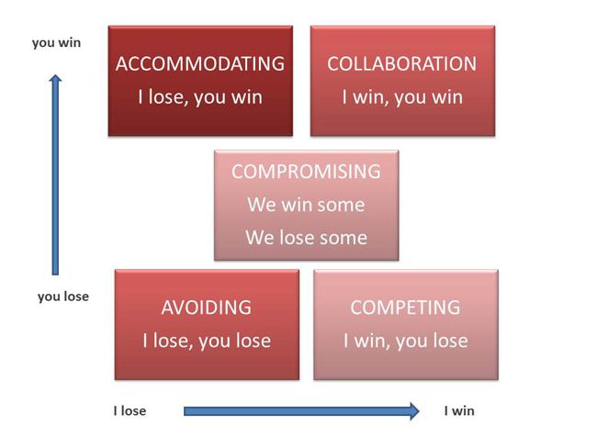
Conflict Resolution
Notes:
The diagram above based on Thomas Kilman Model, shows strategies for managing conflict.
Competition (Win/Lose) – where one party drives to meet their own interests and disregards the other’s interests.
Avoidance (Lose/Lose) – withdrawing from conflict; where one party is unable to influence the more dominant party and wishes to avoid conflict.
Accommodation (Lose/Win) - the party is prepared to submit or comply to the other’s interests.
Compromise (Win/Win – Lose/Lose) – parties trade gains against losses.
Collaboration (Win/Win) - typically found in high performing teams, a problem solving style where parties confront issues and seek solutions that meet the interests of both parties.

Slide 41
Conflict Approaches
Common strategies or approaches used to manage interpersonal conflict are shown above and described in more detail below:
Avoidance (Withdrawing) – contentious issues are avoided. This strategy is more likely to cause or exacerbate conflict in the long term, especially if issues are of significant importance. Useful where conflict issues are trivial, where the damage from conflict outweighs the benefits, or to reduce tension.
Accommodation (Smoothing) - playing down differences and emphasising common interests; issues that might cause divisions or hurt feelings are not discussed. It may be useful to preserve harmony and maintain focus on important factors.
Compromising - splitting the difference, bargaining, search for an intermediate position. No one loses but no one wins. Useful when there is a need to avoid disruption, achieve temporary settlements, where time is critical.
Competition (Forcing) – where one person can use their authority through knowledge or position to force a solution. A win-lose situation; use when quick decisive action is required such as emergencies, where time is critical and will not allow other solutions to be achieved.
Collaboration (Confrontation) – open exchanges of information about the conflict or problem as each sees it, and a working through of their differences to reach a solution that is optimal to both. Both can win. Useful when it is too important to compromise, there is a need to gain commitment or better understanding.
Notes:
Common strategies or approaches used to manage interpersonal conflict are shown above and described in more detail below:
Avoidance (Withdrawing) – contentious issues are avoided. This strategy is more likely to cause or exacerbate conflict in the long term, especially if issues are of significant importance. Useful where conflict issues are trivial, where the damage from conflict outweighs the benefits, or to reduce tension.
Accommodation (Smoothing) - playing down differences and emphasising common interests; issues that might cause divisions or hurt feelings are not discussed. It may be useful to preserve harmony and maintain focus on important factors.
Compromising - splitting the difference, bargaining, search for an intermediate position. No one loses but no one wins. Useful when there is a need to avoid disruption, achieve temporary settlements, where time is critical.
Competition (Forcing) – where one person can use their authority through knowledge or position to force a solution. A win-lose situation; use when quick decisive action is required such as emergencies, where time is critical and will not allow other solutions to be achieved.
Collaboration (Confrontation) – open exchanges of information about the conflict or problem as each sees it, and a working through of their differences to reach a solution that is optimal to both. Both can win. Useful when it is too important to compromise, there is a need to gain commitment or better understanding.

Slide 42
We have covered
Negotiation Preparing
Negotiation Skills
Negotiation Tactics
Conflict Resolution
Conflict Approaches

Slide 43
Acknowledgements and References
The Energy Management Standard ISO 50001
The Environmental Management Standard ISO 14001
The Guidance on Social Responsibility ISO 26000
The Quality Management Standard ISO 9001
Guidance on Project Management ISO 21500
Global Reporting Initiative. G3, GRI
ICB 3.0® International Project Management Association
PMBOK® Guide, 5th. Ed, 2013. Project Management Institute
Sustainability in Project Management. (2011) Gilbert Silvius and Ron Schipper
http://worldinbalance.net/intagreements/1987-brundtland.php
Maria Eugenia Gonzalez, Jorge Martinez del Campo, Lorena Perdomo, Monica Gonzalez, Gilbert Silvius, Ron Schipper, Michael Ruiz
Dr. R. M. Belbin http://Belbin.com
United States Census Bureau
http://www.un.org/en/sustainablefuture/
Coca Cola http://en.wikipedia.org/wiki/New_coke
UNWCED: United Nations World Commission on Environment and
Development (1987). Our Common Future (Brundtland Report). Oxford: Oxford University Press.
Fourth Assessment Report of the Intergovernmental Panel on Climate Change, (2007) IPCC. University of Cambridge.
The United Nations Framework Convention on Climate Change
, (1992) UNFCCC. New York, New York
International competence baseline. (3.0 ed.) (2006). Nijkerk, The Netherlands: International Project Management Association.
ISO 26000. In (2012). Guidance on Corporate Social Responsibility (ISO 26000:2012 E). Geneva, Switzerland: International Standards Organization.
G4 sustainability reporting guidelines. (2013). Amsterdam, The Netherlands: Global Reporting Initiative.
Post-2015 business engagement architecture. (2013). New York, New York: UN Global Compact Office.\
ECONOMIC life (The equivalent annual cost of owning and operating an asset (EUAC or AW) http://www.investopedia.com/terms/e/economic-life.asp
The logical framework document - details. (n.d.). Retrieved from http://lgausa.com/logframdoc.htm on 1/3/201
Decision making in manufacturing environment using graph theory and fuzzy multiple attribute decision making. (2013) (Vol. 2). Springer.
ISO 21500. In (2012). Guidance on Project Management (ISO 21500:2012 E ). Geneva, Switzerland: International Standards Organization.
Elkington, J. (1997). Cannibals with forks. Oxford: Capstone Publishing.
Engendering the Logical Framework – Helen Hambly Odame, Research Officer, ISNAR, August 2001
Why Change Management -(2014, 1 03). Retrieved from https://www.prosci.com/change-management/why-change-management/
Carboni, Gonzalez, Hodgkinson (2013) The GPM Reference Guide to Sustainability in Project Management
Epa faqs on ewaste. (2012, 11 14). Retrieved from http://www.epa.gov/osw/conserve/materials/ecycling/faq.htm
http://www.cs.utexas.edu/~fussell/courses/cs352h/papers/moore.pdf
The Sustainability Reporting definitions for P5 were developed internally to match what is required from the GRI G4 Framework sourced from https://www.globalreporting.org/resourcelibrary/Sust-Dev-Review.pdf Read more at www.globalreporting.org

