Slide 1
Profesional PRiSM
PARTE III
Projectos que integran Métodos Sostenibles
V 3.0

Slide 2
Gestión de la Configuracion
Haciendo que todo encaje

Slide 3
Propósito
Para definir las características físicas y funcionales de los entregables y la gestión de los productos, incluidos sus componentes y la documentación relacionada.
Para controlar los cambios en los productos y sus componentes y para asegurar la compatibilidad física y funcional y la integridad.
Notes:
The configuration of an item defines what it is (physical characteristics) and what it does (Functional Characteristics). Configuration Management is the planning and control of product configurations including functional and physical characteristics.
Configuration Management begins as the first products are identified and produced and continues throughout the life of the product. Configuration Management continues through the Implementation, Operational and Termination stages of project.
The purpose of Configuration Management is to ensure integrity of the products in terms of their description (specifications), their physical form and their functionality. It covers components of a product and their configuration control to ensure that each component performs its function within the product.
Configuration Management Plan – owned by the project manager, and developed as part of the Project Management Plan to provide guidance on the configuration policy, objectives and processes.
Configuration management is undertaken alongside the change control process and involves four main activities: Identification, Control, Status Accounting and Auditing.

Slide 4
Proceso de Configuración
Planificación del Producto
Identificación
Control
Control de Cambios
Auditoría
Control de Calidad
Estado Contable
Entrega
Notes:
Configuration Identification – products that are to be controlled are called configuration items. The Product Breakdown Structure is used to identify configuration items. Each item is given a unique reference number.
Control - once the configuration item comes under control, it is ‘Frozen’. This commonly used term means that the change process must be applied before the configuration of the item can be changed. Changes will only be made if authorised. This prevents ad hoc changes and ensures that changes can be traced during the life of the configuration item.
Status Accounting – once a change is approved the status of the product is recorded as it changes through any modification or changes. A log is used for the purpose of recording and tracking the history of all changes to the item. The task is normally performed by a configuration librarian.
Auditing – This involves quality checks to ensure that all items conform to each other. For example, that each product conforms to a technical specification; each component in a system is compatible with others. It also ensures consistency and that relevant quality assurance procedures have been implemented.
There are two main groups of products: deliverables that are used during operation and management products that are produced during the project for development and management purposes, but not delivered to users.
The items to be controlled are identified by the project team and approved by the project manager. Other stakeholders may also be involved in identification including operators and users.
A Configuration item is a product or component controlled by the configuration management system. A configuration item can only be changed through the formal change process.
The example shows how the deliverable system is broken down into its components. At each level the component characteristics are defined in a component specification. Configuration management must ensure that all components will work effectively as part of the system, that the system achieves its performance and that each specification accurately describes the characteristics of each product.

Slide 5
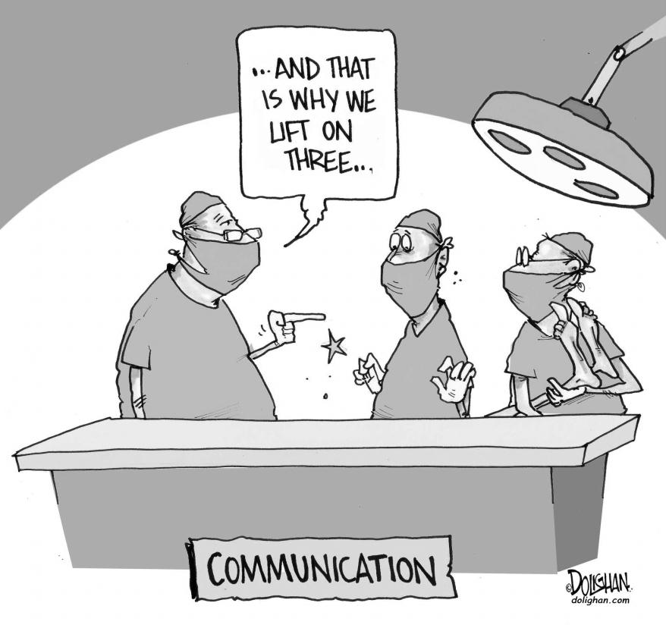
Habilidades de comunicación
¿Cómo será difundida la información y será recuperada desde todas las partes interesadas?

Slide 6
Planificación de la Communicación
Requerimientos de Información
Mecanismos de Comunicación
Frecuencia de Distribución
Fuentes de Información
Procesamiento de la Información y cotejo
Roles & Responsibilities
Notes:
Primary forms of communication
Verbal
Body language
Written
Environment
A Project Manager depends on a communication network. This may be formal or informal.
Channels of communication
Active
Passive
When developing a Communication plan, the first step is Stakeholder analysis. It is important to know what your audience wants to know, when they want to know it, how they want it presenting and how often they want it. The Project Manager must understand where their information is coming from and if they are receiving any assistance in collating or collecting the information. One last consideration is to understand how as a Project Manager you will approach the dissemination of unexpected information. The majority of this time the news is bad, knowing your team and trying to anticipate their reaction needs many hours of team development and understanding by the Project Manager.

Slide 7
Barreras para la Comunicación
Alcance de la Experiencia de la Fuente
Alcance de la Experiencia del Receptor
Mensaje
Ambiente
Background/Conocimientos
Entendimiento
Mutuo
Fuente
Destinatario
Personal
Organizacional
Retroalimentación
Envíen refuerzos, vamos a avanzar .....
Envíen tres y cuatro peniques, vamos al baile….
Notes:
Barriers to communication
In the simple model above there are in effect four potential barriers that the communication navigate.
Environmental - Noise, temperature and air fall into this category
Background – individuals are influenced by their technical, social and educational backgrounds. It is also important to consider social and cultural differences.
Personal - Tiredness, hunger, thirst, etc. any affect ability to communicate well. Permanent or temporary loss of vision, sight, hearing, etc. can have an impact on sending and receiving communications. Personal prejudices also have an impact.
Organizational - The relative position or status of the individual will clearly have an impact. For example, individual to peers, individual to boss, individual to subordinates. These relationships may affect the quality of the communication process.

Slide 8
Responsabilidades de la Communicación
Beneficios
Riesgos
Factores Ambientales
Usuarios
Gestión Corporativa
Caso de Negocio
Cambios
El logro de los Criterios de Exitos
Indicadores de Desempeño Claves
Riesgos del Proyecto
Mejoras
Foco y Motivación
Integratción y Coordinación
Patrocinador
Director Sostenibilidad
Longer Term
Day to Day
Notes:
The main communication responsibilities for the Project Sponsor and Project Manager differ. In essence the Project Sponsor is mainly concerned with the longer term, i.e. achieving the benefits whereas the project manager is actively managing the project on a day to day basis.
The project sponsor is more likely to be communicating with project external stakeholders such as users, corporate management and regulators. The project manager on the other hand is more likely to be concerned with project internal communications and keeping the project moving to achieve its critical success criteria.
Effective communications between the project sponsor and project manager is therefore crucial to the successful management of the project.

Slide 9
Gestión de la Información

Slide 10
Propósito
Asegurar que la información esté disponible para apoyar la toma de decisiones en el momento oportuno
Controlar la calidad, uso y mantenimiento de la información durante toda la vida del proyecto y después
Soportar los procesos de comunicación
Notes:
Reliable information is required by project stakeholders to enable them to make effective decisions, anticipate and respond to future events such as risks and opportunities and take into account uncertainties and current problems.
Information management is required to ensure that appropriate information relevant to and generated in the course of a project, is made available to project stakeholders in a timely manner to help with more improved decision making.
A project information management plan defines how information will be managed during the life and after the project, the purpose and scope of information products, their ownership, formats, distribution, control, processing, storage and disposal.
The Plan will address the following:
Information Management Objectives
Roles and responsibilities
The process
Documentation and Information Product specifications
Links to the communication plan and process
The way in which information is managed should be established as early as possible in the project. Typically this would be part of the communications strategy in the project management plan.

Slide 11
Proceso de la información
Communicar
Almacenamiento
Fuentes de
Adquirir
Acceso
Datos
Proceso
Archivar
Recuperar
Notes:
The process will define how information will be acquired, accessed, stored, communicated, disposed of and archived. The Communication Plan will define stakeholder information requirements in terms of scope and timing, the source of the information, the media and format, distribution and ownership.
Sources - data received during the life of project is varied and may be collected in many ways, for example through meetings, from reports on progress and so on.
Distribution - information needs to recorded if relevant and communicated. Key questions such as the level of information needed and who needs to be informed, must be answered.
Recording and storage - records may be handwritten or created electronically. Whichever method is used, records must be maintained to support the project and for auditable purposes.
Access – dependant upon the project and the sensitivity of the data, many organizations will have restrictions on certain data access. Team members will need to be able to have information that allows them to complete their tasks, but some information will be protected from some stakeholders.

Slide 12
Productos Claves de Información
Caso de Negocio
Especificaciones del Producto
Requirements
Plans
Reports
Plan de Gestión del Proyecto
Planes de la Línea Base
Plan de Entrega
Informes (Lo destacado, fín de Etapa, Cierre)
Registros (Cambios, Calidad y Riesgos)
Notes:
Documents used to define requirements include the Business Case and Product Specification. These are typically defined during Concept and Definition and updated in the course of the project. Stakeholders involved in these documents are likely to include the project sponsor, project manager, users and operators, external client and corporate management.
Planning documents include the project management plan, supporting plans such as quality, change and risk management plans, and implementation plans such as project networks. These are mainly used by the project team and other stakeholders such as resources managers, to define and control day to day activities.
Control documents include routine progress reports, exception reports, various logs such as quality, change, risk and configuration logs. These are used for both day to day activities and at major milestones to record and communicate status on progress to project stakeholders.

Slide 13
Habilidades de Negociación

Slide 14
Meeting Pre-Requisites
Comprender las diferencias entre los intereses de los diferentes grupos de interés
Si hay diferentes Puntos de Vista o Enfoques
¿Qué Autoridad existe?
¿Hay algún Poder o Influencia?
¿Cuáles son los Límites de Tolerancias?
¿Cuál es el impacto de la Fracaso o Éxito de Proyecto?
Notes:
All projects involve negotiations. The art of negotiation in projects is to balance the needs of the project with the needs of the stakeholders involved in the negotiations.
In projects therefore, the aim of negotiations should be to develop a ‘win-win’ solution that is in line with the overall project objectives and needs of the stakeholders.
A pre-requisite stage for any negotiation is to conduct a stakeholder analysis in order to anticipate the needs of the stakeholders involved, their authority (e.g. are they able to make formal agreements), their relative power and influence.
It is also important to understand the negotiation limits and impact on the project in terms of success or failure.

Slide 15
Proceso de Negociación
Preparación
Apertura
Negociación
Cierre
Notes:
The major part of the negotiation process is broken down in four distinct areas.
Preparation – the selection and briefing of the negotiation team on the definition of objectives, consideration of the other party’s objectives, defining the variables, and a strategy including opening offer, bargaining limits and concessions that can be made.
Opening – introductions, objectives should be stated by both parties, an agenda and the rules of the negotiation should be agreed.
Bargaining – collaborating to achieve a win - win solution. Present offers, evaluate responses, bargain and seek agreement.
Closing – conduct final trade offs before starting to closeout, summarise the findings of the negotiations and record and approved all agreements made, follow up actions needed to be taken before future meeting and conclusions reached. Agree the timetable for any further negotiations if necessary.

Slide 16
Preparación
Preparación
¿Cuáles son sus Objetivos?
¿Cuáles son los Objetivos de las Otras Partes?
¿Cuáles son las Variables?
¿Cuál será su Oferta de Apertura?
¿Dónde está usted dispuesto a hacer Concesiones?
Apertura
Negociación
Cierre
Notes:
Preparation – each party should define objectives and consider the likely objectives of the other party. These need to be in line with the Project Critical Success Criteria.
Variables - elements that may be adjusted in order to make concessions need to be identified. Limits are set for these variables to provide the bargaining framework.

Slide 17
Apertura
Preparación
Presente las Partes y Explique sus Roles
Establezca sus Objetivos
Invite a la otra parte a que establezca sus Objetivos
Acuerde los Objetivos
Apertura
Negociación
Cierre
Notes:
Although preliminary negotiations may take place by correspondence, most involve face to face bargaining at some stage. Negotiation meetings should start with an introduction of the attendees and their role in the meeting.
The parties should each state their objectives and agree an agenda for the negotiations.

Slide 18
Negociación
Preparación
Apertura
Presente Su Oferta
Evalúe la Respuesta de la otra Parte
Negocie for Specifics
Busque el Acuerdo
Negociación
Cierre
Notes:
The parties present offers and evaluate responses. This will most likely result in some “horse trading” involving tactics as discussed later in this section.

Slide 19
Cierre
Preparación
Apertura
Negociación
Ajustes Finales
Resuma Acuerdos y Acciones
Programe Futuras Negociaciones
Cierre
Notes:
Final trade offs – once bargaining is complete small adjustments may be made to produce a workable solution.
The conclusions and agreements reached during the negotiations should be summarised, agreed and formally recorded. Any further actions or negotiations that may be required, should also be scheduled during the closing stage.

Slide 20
El Poder de la Negociación
Recompensa
Referente
Coercitivo
Experto
Legitimo
Informacional
Notes:
Having done the pre requisite research that helped you prepare for the negotiations, you may have identified a potential edge that you could have during the meeting. These types of advantage or edge can come in various forms of power.
Reward Power - ability to dispense rewards to entice the other party, such as bonuses.
Coercive Power - threat of taking something away if one party does not accede to the desires of the other.
Legitimate Power – one party has genuine authority over the other.
Informational Power – an advantage gained because one party has access to relevant key information that the other party does not have.
Expert Power – experience that provides an advantage.
Referent Power – derived from reputation for fair dealing, development of long term relationships and trust.

Slide 21
Tácticas
Pressure Release
Time Out
Silence
Coercion
Leading Questions
Unbalanced Concessions
Segmentation
Challenging
Notes:
Parties may use various tactics during bargaining to achieve their objectives. Tactics can be used positively or negatively.
Pressure Release – a concession may be offered as a way of apparently breaking a stalemate. Stand firm and hold the planned limits. Do not concede unless the concession is beneficial. Make a counter offer or take time out if further consideration is required.
Coercion, intimidation – ignore any emotive aspects and maintain focus on the key objectives. Maintain an assertive approach and continually remind the other party of the overall objectives. Agree rules at the beginning to reduce the possibility of coercion and intimidation. Use an expert negotiator/facilitator.
Unbalanced Concessions – making concessions that have much greater value to one party than the other. Maintain awareness, or make rough assessments of the value of the offer. Explain your perception of the concession to the other party.
Challenging – the right amount of challenging can be constructive, too much can be destructive. Keep positive and acknowledge the other party’s position. Keep focused on the objectives and take time out to consider appropriate responses with your team.
Time out – the parties break into their teams to discuss the situation and tactics privately. Time outs are useful when the negotiation team experiences fatigue, loss of concentration, or gets ‘bogged down’. Over use of time outs can be disruptive. Only agree to Time out requests if beneficial. Agree time scales and rules for taking time out, prior or during the introduction stage.

Slide 22
Habilidades Clavess
Use preguntas para persuadir
Etiquete su Comportamiento
Sea Innovador
No diluya un buen Argumento
Use Preguntas para Controlar
Establezca Plazos
Test y Resuma
Notes:
As well as tactics, it is important that the other party knows and understands who they are dealing with. There are certain skills that you can use to control a meeting. Keep in mind however, you are there to achieve a win-win scenario and not to over power or bully your counterpart.
Label your behaviour – give warning signals and signposts to avoid surprises and shocks. Indicate when you intend to ask a question.
Test and Summarize - test common understanding, summarise agreements and clarify key points at appropriate times.
Don’t dilute a good argument – use few strong points rather than many weak ones.
Use questions to persuade – structured questions can enhance a case and weaken resistance.
Use questions to control – asking questions can give control and more time to think.
Set deadlines – setting time limits can motivate towards achieving an agreement.
Be innovative - look for possible points of conflict and search for innovative solutions.

Slide 23
Gestion de conflictos management
Debido a que cada proyecto se ejecuta sin problemas …
(photo from imdb.com)

Slide 24
Causa de Conflictos
El conflicto es la expresión emocional, verbal, escrita o física de las diferencias con respecto a sus deseos, necesidades o expectativas entre dos o más individuos.
El conflicto afecta directamente el comportamiento, la toma de decisiones y la capacidad para realizar las tareas asignadas.
El conflicto es inevitable en el lugar de trabajo, no puede ser eliminado.
La clave para un lugar de trabajo funcional es la capacidad de minimizar la escalada de los conflictos y en última instancia, resolver las diferencias.

Slide 25
Modelo de Progresión de Conflictos:
Evento Disparador/Punto Sensible
Comportamiento resultante
Consecuencias del comportamiento resultante
Notes:
Conflict exists where there are differences between individuals or groups and must be managed throughout the project life cycle.
Conflict may occur between stakeholders throughout the life cycle.
Project managers should anticipate potential conflicts and their significance and deal with them before they cause negative impacts on the project.
Often conflict is caused through lack of understanding, lack of facts or because individuals have different interests, beliefs and values.
Conflict may either be destructive (having an adverse effect on a project) or constructive (positive benefit). For example, if the cause of a conflict is due to a technical misunderstanding it is beneficial to bring this into the open and involve all interested parties. Conversely, destructive conflict typically occurs due to differences values, beliefs, feelings and background. Because these are usually emotively based they are more difficult to resolve and require sensitivity and empathy.
If conflicts cannot be resolved, they may need to be escalated to higher authorities, or specialist facilitators.

Slide 26
Costos Cualitativos de Conflictos
Estrés, frustración and ansiedad
Pérdida de sueño
Strained or broken relationships
Quejas y Litijios
Ausentismo de Emplesados
Rotación de Empleados
Pérdida de Productividad
Decrease in customer service quality
Injury and accidents
Disability claims
Presentismo
Sabotage

Slide 27
Costos Cuantitativos de Conflictos
El valor total de tiempo de trabajo perdido debido al estrés se estima en $ 1.7 mil millones. (WarrenShepel online], Health &Wellness Research Database, 2005)
Se estima que la tasa de presentismo ser hasta tres veces mayor que el ausentismo.
Presenteeism is the act of attending work while sick.
Conflict representa hasta el 90% de las salidas involuntarias (Dana, Dan, [online] The Dana Measure of Financial Cost of Organizational Conflict, 2001)
El 42% del tiempo de un gerente se gasta abordando el conflicto en el lugar de trabajo. (Watson, C & Hoffman, R, Managers as Negotiators, Leadership Quarterly 7(1), 1996)

Slide 28
Modelo de Gestión de Conflictos
Causa Raíz
Causas
Análisis de Causa y Efecto
Conflicto
Resolución
Análisis de las Partes Interesadas
Fuentes
Necesidades y Poder de las Partes Interesadas
Notes:
The model is based on the work of Blake and Mouton and provides a framework for understanding and resolving conflict.
Causes - the subjects such as timescales, or priorities, changes.
Sources - the people involved in the conflict.
Conflict – the nature of the problem or issue, and its intensity.
Intensity may be defined as the combination of magnitude (say impacts on project objectives) and frequency (how often the conflict occurs).
Two techniques that support conflict management are:
Cause and Effect Analysis – establishing the root cause will help to determine how often it is likely to occur and will enable conflict intensity to be determined. Root causes often lead to the definition of preventive measures.
Stakeholder Analysis – understanding the needs and influences of the stakeholders will help to prevent conflict situations arising, or in the event of conflict, it will enable effective management strategies to be used.
Preventing conflict may also be covered by appropriate risk management.
A number of methods may be used to manage conflict such as formal negotiations, mediation and workshops, depending on the nature of the conflict and stakeholders involved.

Slide 29
El Conflicto a través del Ciclo de Vida de los Proyectos
Concepto
Definición
Implementación
Entrega y Cierre
Ideas
Benefitcios
Opciones
Financiamiento
Beneficios
Requerimientos
Opciones
Financiamiento
Criterios de Exito
Riesgos
Cronogramas
CSC priorities
Recursos
Cambios
Teconología e Incidentes de desempeño
Riesgos
Aceptación
Snags (Inconvenientes)
Desmovilización
Actividades de Entrega
Riegos
Causa
Patrocinador
Gestión Corporativa
Organismos Patrocinadores
Patrocinador
Usuarios
Gestión Corporativa
Clientes Externos
Patrocinador
Director de Proyecto
Equipo de Proyecto
Sub Contratitas
Administradores de Recursos
Patrocinador
Operadores
Usuarios Finales
Equipo de Proyecto
Autoridad de Aceptación
Benefits As Usual groups
Fuente
Ciclo de Vida de los Proyectos
Notes:
Conflict occurs throughout the project. The nature and scale of conflict is directly related to the activities undertaken and the stakeholders involved.
Understanding where and who might be involved in the conflict will help the Project Manager in its early identification and resolution.

Slide 30
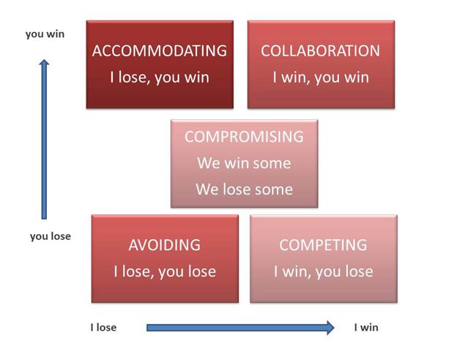
Resolución de Conflictos
Notes:
The diagram above based on Thomas Kilman Model, shows strategies for managing conflict.
Competition (Win/Lose) – where one party drives to meet their own interests and disregards the other’s interests.
Avoidance (Lose/Lose) – withdrawing from conflict; where one party is unable to influence the more dominant party and wishes to avoid conflict.
Accommodation (Lose/Win) - the party is prepared to submit or comply to the other’s interests.
Compromise (Win/Win – Lose/Lose) – parties trade gains against losses.
Collaboration (Win/Win) - typically found in high performing teams, a problem solving style where parties confront issues and seek solutions that meet the interests of both parties.

Slide 31
Estrategias de Resolución de Conflictos
Compitiendo/forzando
Siendo complaciente
Evitando
Colaborando
Compromiso
Notes:
Common strategies or approaches used to manage interpersonal conflict are shown above and described in more detail below:
Avoidance (Withdrawing) – contentious issues are avoided. This strategy is more likely to cause or exacerbate conflict in the long term, especially if issues are of significant importance. Useful where conflict issues are trivial, where the damage from conflict outweighs the benefits, or to reduce tension.
Accommodation (Smoothing) - playing down differences and emphasising common interests; issues that might cause divisions or hurt feelings are not discussed. It may be useful to preserve harmony and maintain focus on important factors.
Compromising - splitting the difference, bargaining, search for an intermediate position. No one loses but no one wins. Useful when there is a need to avoid disruption, achieve temporary settlements, where time is critical.
Competition (Forcing) – where one person can use their authority through knowledge or position to force a solution. A win-lose situation; use when quick decisive action is required such as emergencies, where time is critical and will not allow other solutions to be achieved.
Collaboration (Confrontation) – open exchanges of information about the conflict or problem as each sees it, and a working through of their differences to reach a solution that is optimal to both. Both can win. Useful when it is too important to compromise, there is a need to gain commitment or better understanding.

Slide 32
Liderazgo
Notes:
Leadership is the ability to establish vision and direction, to influence and align others towards a common purpose, and to empower and inspire people to achieve project success. It enables the project to proceed in an environment of change and uncertainty.

Slide 33
Desarrollo de Raices Fuertes
“Las personas que dejan de crecer no pueden inspirar a otros. El liderazgo comienza desafiándose a sí mismo.”
– Daisaku Ikeda
Notes:
When you stand at the base of a 100 year old oak tree and look up, one can’t help but be awestruck by its size and strength. What makes this tree so strong though is its foundation. People, are the same. Without a solid foundation, as a tree can sway with the wind, people can lose their way and become misguided.
Project Management is a challenging but rewarding profession. The difference between a good project manager and a great project manager is the foundation and principles by which one adheres to and their ability to impart that to others.

Slide 34
Liderazgo
Gerente Analítico, estructurado, controlado, deliberado, ordenado | ¿Qué hace el mejor DP? | Líder Experimental, visionario, flexible, no se inmuta, creativo
Usa el poder de la lógica de la mente racional Considera los peligros Se concentra en los resultado de corto plazo Sigue a los visionarios Persigue lo tangible Realiza actividades Controla Depende de la Autoridad |  | Usa el poder de la intuición y la lógica del corazón Tiene sentido de oportunidad Se focaliza en los resultados de largo plazo Crea visiones Busca potencial Busca lo intangible Persigue sueños Inspira Depende de la Influencia
Notes:
Management is doing things right; leadership is doing the right things.
(Ask audience their thoughts on which is best.)

Slide 35
Perspectives
Mirando hacia Arriba
Mirando hacia Afuera
Gestionando al patrocinador interno
Gestionando Partes Interesadas Externas
Para lograr el comprmiso
(incluídos los clientes, proveedores y subcontratistas)
organizacional
Para asegurar cumplir con sus necesidades
Sustainability Manager
Mirando haci Atrás
Mirando hacia Adelante
Monitoreando el progreso
Planeando para asegurar que el
Aprendiendo de los errores
Equipo establezca metas realísticas
Y obtenga los recursos para cumplirlas
cumplirlas
Mirando hacia Adentro
Mirando a Través
Gestionandose a sí mismo revisando
Asegurando la contribución y la
su desempeño para asegurar que su liderazgo
Cooperación de los departamentos
sea una contribución positiva
para el proyecto
Mirando hacia Abajo
Gestionando el equipo a fin de
maximizar su desempeño
Notes:
If the Project Manager is to be a good leader, then they must know where and when to look and lead in the right direction.
They must know when they look upwards towards the Sponsor and Corporate Management, how the performance of their project can affect the strategy of the organization and where it fits into the vision set by those above.
The Project Manager must also know when to look outward, realising that their team alone, may not have the answers to all the projects questions. Here the project manager must learn to influence and direct stakeholders from outside their natural line of management.
A good leader knows when to look forward, to plan and strategise the route ahead for the project, whilst also reflecting backwards on those tasks they have been completed and the lessons that they have learned and brought with them to develop themselves and the team for the future.
Understanding the needs of their team is paramount, whilst also addressing their performance and supporting those in need. Knowing that your project does not lay in isolation, makes the project manager understand the effects that others have on their projects as much as they are dependent on theirs.
A true leader know how to look inward, at themselves and their own performance, knowing they are the standard bearer, the setter of the standards, where self discipline is the highest form of discipline.
To quote an Indian proverb, “Leadership is lifting a person's vision to higher sights, the raising of a person's performance to higher standards, the building of a personality beyond its normal limitations.”

Slide 36
Mejor Práctica de GPM
Objetivo
Objetivo
Líder
Staff
Gerente
Staff
Notes:
The fundamentals of management are required to have success at any levels of project management whereas leadership is a skill that requires the ability to understand the overall goal and inspire others to work alongside you to achieve it.
Can you be a successful Project Manager without having strong leadership skills? Absolutely. Different parts of project management appeal to different people. While one person may excel at building the perfect Gantt chart but due to their personality, isn’t the type that you would send in to a question and answer session when you are bidding on a project. Is this person valuable? Yes.
The same question can be asked in terms of leadership. The long and short of it is that a leader should have the abilities to do the standard project management tasks as well as inspire the team to work towards a shared goal. This is the mark of a true Green Project Manager.

Slide 37
Rasgos Persoanles en la Práctica
¿Esto le describe?
Genuinamente interesado en otras ideas de la gente;
¿Sonríe? Un viejo proverbio chino dice: "Un hombre sin una cara sonriente no debe abrir una tienda".
¿Es usted un buen oyente?
¿Usted hace que la otra persona se sienta importante y hágalo sinceramente?

Slide 38
Habilidades de Liderazgo
Enfocado
Gestiona conflictos
Buen Motivador del Equipo
Flexible y adaptable usando estilos apropiados
Buen Tpmador de Riesgos
Influenciador y Solucionador de Problemas
Delegates & Communicates
Gives and Receives Constructive Feedback
Notes:
Key attributes of successful leaders:
Focus -gives clear direction and provides the vision, is fully committed to the project critical success criteria and able to maintain focus throughout the project life.
Manages conflict – a good leader is able to identify conflict, establish its impact on the project and resolve quickly.
Good team motivator – recognises need to manage motivational factors such as recognition, job satisfaction, reward. Recognises success and gives credit.
Flexible and adaptable - able to use an appropriate leadership style to suit the circumstances.
Good risk taker- having situational awareness, so they are able to weigh up the pro’s and con’s and make effective decisions.
Good influencer – able to obtain commitment to project goals from the project stakeholders, including the external and internal team, end-user and subcontractors.
Good problem solver - able to deal with uncertainty through innovation.
Able to delegate – defines clear objectives, empowers, gives authority and responsibility – ensures individual is competent, defines effective rules for escalation, and provides adequate supervision and support.
Good communicator - good networker able to maintain constructive relationships with all project stakeholders and ensure effective communications throughout.
Gives Feedback - able to provide constructive criticism and feedback

Slide 39
Situational Leadership
ALTO
Perticipativo
Persuadir
Comportamiento de Apoyo (Orientado a las Relaciones)
Delegar
Dirigir
BAJO
HIGH
Comportamiento Directivo (Orientado a la Tarea)
Notes:
Leading the Individual
One of the best known frameworks for the development of an individual within a team is the Situational Leadership model developed by Hersey and Blanchard. The model was not specifically developed for projects and is a little simplistic for the project environment but it is still a useful framework.
The model describes the developing relationship between leader and team member. The matrix has two dimensions: Task Behaviour and Relationship Behaviour.
Directing
When the team member first arrives there is anxiety, tension and confusion. The leader adopts a task oriented approach, provides specific instructions and closely supervises performance.
Coaching
As individuals begin to understand what is required the leader will spend more time establishing a relationship of trust and mutual understanding. Since the individual may not yet have developed sufficient competency to assume full responsibility for the task it is still necessary to explain decisions and provide the opportunity for clarification.

Slide 40
Focos del Liderazgo
Tarea
Procesos de Planeamiento y Control
Individuo
Equipo
Liderazgo Situacional
Modelo de Tuckman
Notes:
John Adair identified three overlapping areas of core responsibility: Task, Team and Individual.
Effective leaders are able to balance their focus in these areas according to the situation. If there is too much focus in one area it will have a detrimental effect on the others. Conversely, each area has a positive influence on the others if properly balanced. For example a well thought out Project Management Plan provides effective guidance to the individual and the team. However, a well though out plan can only be achieved through awareness of the team and individual’s needs.
Task - the leader has to ensure that the required task is achieved. This requires the setting of task objectives, control and co-ordination. The leader must maintain focus on the objectives until completion.
Individual - good leaders recognise that each individual has needs that are fulfilled through the task. They understand the needs, strengths and weakness of individuals, and are able to apply the leadership style appropriate to the situation. They are able to produce the motivation and commitment needed for the individual to perform their task.
Team - an effective leader recognises that the team is an entity that also requires direction, information, performance feedback and support, as well as the individuals within the team.

Slide 41
Aptitud del Seguidor
Alta
Capaz y Seguro
Capaz pero Inseguro
Aptitud de los Seguidores
o
Moderada
Incapaz pero Seguro
Baja
Incapaz e Inseguro
Notes:
Supporting
As the individual develops high levels of competency and motivation, greater delegation and group decision making is possible. The leader concentrates on developing relationships with individuals.
Delegating
Finally a point is reached where team members are confident in their ability, trusted to get on with the task and have a good relationship with the leader. Both task and relationship behaviour drop to low levels. Complacency on the part of the leader is now, perhaps, the greatest danger.
The parallel development of the individual through these stages can be viewed in a different way. Hersey and Blanchard also identify something called Follower Readiness which is a combination of Ability (knowledge, experience and skill) and Confidence (willingness, commitment and motivation).
A new team member may not have all the necessary ability or confidence. It is the leader’s job to develop both in the individual as they move through the four stages.

Slide 42
Fase de Cierre y Revisión
Reunión con el Funcionario de Responsabilidad Social Empresaria
Notes:
The final phase of the project is the closure phase. The project manager has many activities to deliver in this phase and must ensure that they have planned the closure in a structured and organized manner to make sure that everything is truly accounted for within the project.
Carrying out a review of the project once it has been delivered is essential for learning for future development. The green matters of the project should be included as part of the project review, however early maturity or highly mature organizations may choose to hold the sustainability element of the review separately from the remainder of the post project review. This is a personal choice, however the most important thing is that a review is carried out, the lessons are captured and that the organization then use these lessons to develop in the future.
However, the story does not stop there. Ensuring that the product or service is used in a sustainable manner throughout its full life allows the continuance of sustainability into operations and then through to its demise and disposal in a clean and sustainable way.

Slide 43
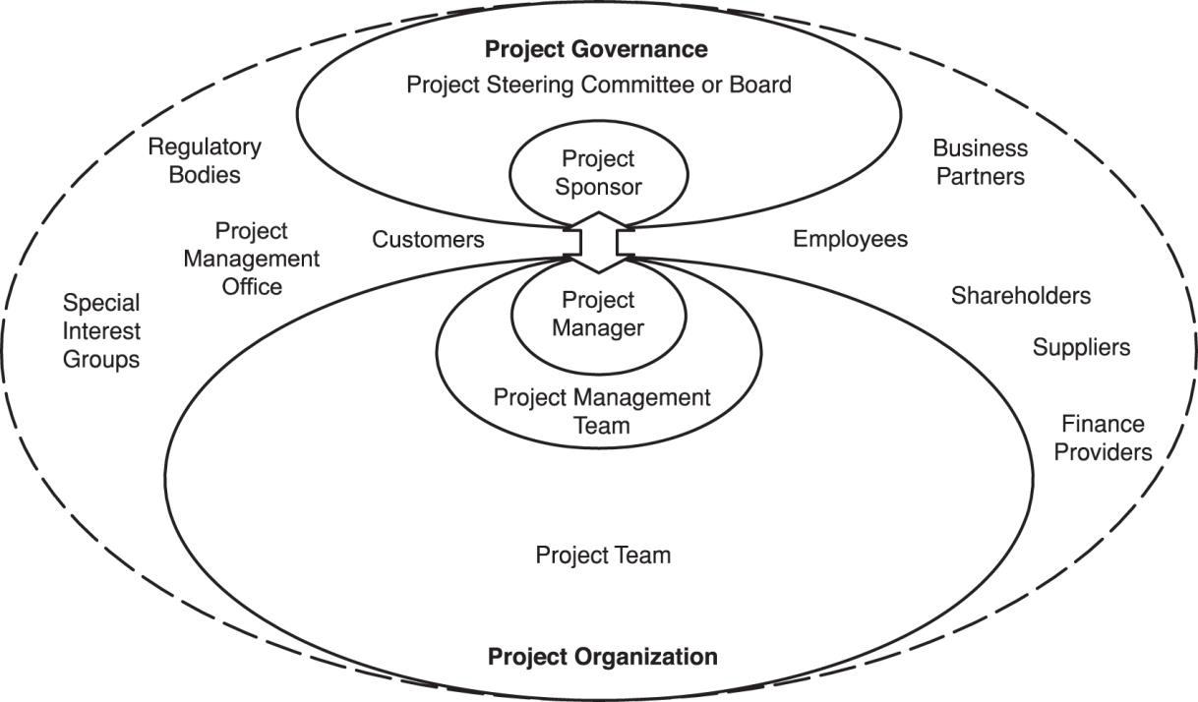
Gestión de las Partes Interesadas y Roles de la Organización
Meet with CSR Officer
Notes:
Stakeholders and project organization
The project stakeholders, including the project organization, should be described in sufficient detail
to enable project success. The roles and responsibilities of stakeholders should be defined and
communicated based on the organization and project goals. Typical project stakeholders are
shown in the slide. Stakeholder interfaces should be managed within the project through the project management
Processes. The project organization is the temporary structure that includes project roles, responsibilities, and
levels of authority and boundaries that need to be defined and communicated to all stakeholders of
the project. The project organization may be dependent on legal, commercial, interdepartmental or
other arrangements that exist among project stakeholders.
The project organization may include the following roles and responsibilities:
• project manager – leads and manages project activities and is accountable for project
completion
• project management team – supports the project manager in leading and managing the project
activities
• project team – performs project activities
Project governance may involve the following:
• project sponsor – authorizes the project, makes executive decisions, and solves problems and
conflicts beyond the project manager’s authority
• project steering committee or board – contributes to the project by providing senior level
guidance to the project
The Slide — Project stakeholders
Figure 4 includes some additional stakeholders:
• customers or customer representatives – contribute to the project by specifying project
requirements and accepting the project deliverables
• suppliers – contribute to the project by supplying resources to the project
• project management office – may perform a wide variety of activities including governance,
standardization, project management training, project planning and project monitoring

Slide 44
Entrega
Entrega del Producto
Criterios de Aceptación
Listado de dificultades pendientes
Transferencia de Propietario
Proceso de Aceptación y Entrega
Principales Partes Interesadas presentes
Requerimientos de Puesta en Marcha y entrenamiento de operadores
Revisión de los riesgos e incidentes a ser transferidos a la fase de operación con el entregable
Notes:
The Handover milestone is a significant point in the project life cycle since it allows the project to enter into an operational environment. At this point the ownership of all project deliverables is transferred from the project manager to the sponsor and user.
The decision will depend on the product achieving the acceptance criteria.
A snagging list is generated during handover to list any minor shortcomings identified during acceptance. Typically rectification actions will be agreed between the sponsor, project manager and operators as appropriate.
It defines handover objectives, identifies the stakeholders involved, and explains how acceptance and handover will be achieved for each deliverable.
Key stakeholders likely to be involved include:
project manager – achievement of acceptance and delivering products
project sponsor – formal acceptance of product and handover to operators/users
project team – conducting acceptance testing and handover activities
quality assurance – monitoring and auditing acceptance and certifying results
users – (including those people involved in the business as usual activities) witness acceptance testing, taking delivery and starting up product operation
The handover plan will include tasks to be undertaken by the project implementation team to complete acceptance and delivery of the products, and tasks that need to be carried out by the sponsor and stakeholders (most likely operators and users), to receive, start up and operate the deliverables safely in their final operation mode. Handover may be an instantaneous, gradual or phased process.
The handover stage also includes the transfer of any live risks, actions or issues associated with the product. This allows the customer or the Project Sponsor to have a defined and precise view of potential problems that may exist with the product throughout its whole life cycle.

Slide 45
Cierre
Informe de Cierre
Se compara con los Criterios de Éxito
Transferencia/cierre de Riesgos e Incidentes pendientes
Llevar a cabo auditorías, documentación de cierre
Revisión de contrato y cierre
Disposición de activos y reasignación del equipo.
Realizar Enviar la revisión del Proyecto
Firma formal del Patrocinador del Proyecto
Notes:
Project closeout will normally occur when all of the products have been delivered and the implementation stage is complete. In certain circumstances such as changes in viability or requirements, projects may be closed before planned completion.
Project closeout involves completion of all product and project handover activities in a controlled manner. Product handover activities are included in the previous discussion covering product handover.
A closure report is produced by the project manager to record the final outcome of the project against the Success Criteria, any issues outstanding and actions arising from closure.
Actions specific to project closure include:
identification and disposal of non deliverable materials and documents. For example, product design data may need to be archived to enable retrieval at a later date.
demobilisation, including arrangements for disbanding the project team and supporting infrastructure; conducting performance appraisals; completion of technical and quality audits.
contract and purchase order closure and arrangements for any continuing contractual obligations such as technical support during operation.
all project accounts are finalised
Before project closure, the project manager should conduct the Post-Project Review, record lessons and recommend improvements.
Finally, when all closure tasks have been completed, the sponsor will formally sign off the project to release the project manager.

Slide 46
Revisiones del Proyecto

Slide 47
Tipos de Revisiones
Revisiones
Durante el proyecto
Después del Proyecto
Revisión de las Fases
Revisión de las Etapas
Revisión Pos-Proyecto
Revisión de los Beneficios
Notes:
Project Reviews take place throughout the Project Life Cycle to check the likely or actual achievement of the objectives specified within the Project Management Plan (PMP) and the benefits detailed in the Business Case.
Additional reviews will take place following handover to ensure that the benefits are being realised by the Organization.
Reviews should be planned throughout the whole Project Life Cycle to allow the Project Manager and the Project Team to reflect objectively on the current performance and any forthcoming work.
The aims of a Project Review are:
Evaluate the Project Management processes used
Establish Lessons Learned and actions arising from them
Raise any concerns and agree corrective actions
Review the likely technical success of the Project
Validate overall progress against the plan, schedule, budget, resources and quality
Consider Stakeholders relationships and perceptions

Slide 48
Revisión de Calidad
Partes Interesadas
Secretario
Presidente
Notes:
The fifth and most regularly forgotten review is the Quality Review.
After a point of testing for a product or as a request from the Project Sponsor or Project Manager, a review of the quality of the product that has been tested or of the project’s ability to follow the processes is held.
Here, the findings of the audit or test are explained and the Project Manager can gain a clearer understanding of how their project and their team is progressing.
There are typically three outcomes from a Quality Review:
First that the item being tested or team being assessed has passed and that everything should continue as planned.
Second, the item or team could still pass the review, however a few minor defects or areas for improvement have been identified and must be carried out to ensure that all quality requirements are adhered to.
The third and final option is that the item or team has failed the test or assessment and will not be allowed to proceed until the areas of failure have been rectified and have been re-tested and have passed another formal review.

Slide 49
Revisión Pos Proyecto
Historia del Proyecto
Lessons Learned
Desempeño
Respecto de los Criterios de Exito
¿Qué estuvo mal?
¿Qué estuvo bien?
Exactitud de las Estimaciones
Eficacia de la Estrategia y de los Planes
Informe
Pos Proyecto
Retroalimentación al Sistema
De Gestión de la Calidad
Documentos del Proyecto
Informe de Cierre
PMP
SMP
Logs
Reports
Recomendaciones para la Mejora
Notes:
The Post Project Review (or Appraisal, or Evaluation) is a structured audit and review of how the project went. Its output is a report that provides learning points for the future including recommendations for process improvement and training.
Review Objectives - the main objectives are to:
identify strengths and weaknesses in the performance of the project
establish the key lessons learnt
to make recommendations for improvements (methods and competences)
Scope - the Post Project Review addresses:
History of the project – what major problems occurred during the project and how well they were dealt with?
Performance - how well the organization and team performed? Areas such as decision making, team leadership and development, team working, single point accountability.
Effectiveness of the project strategy - how well it was implemented? – What went wrong and what went well?
Estimating accuracy – how accurate was the original estimate? Were sufficient provisions made to cover uncertainties, changes and risks?
Effectiveness of specific processes - such as change control, risk management, control and co-ordination. How well did these processes control specific aspects of the project?

Slide 50
Realización de la Revisión Pos Proyectoa Project Review
Preparaciónn
Implementación
Push to Start
Hallazgos
Notes:
Review Preparation - The project manager is typically responsible for organising the meeting and ensuring that any preliminary audits and reviews are carried out. Stakeholder attendance is typically decided by the Project Sponsor and Project Manager. The review meeting should aim to get views from as many stakeholders as possible, both within the project team and from outside. It is not always practical for all stakeholders to attend the review. In such cases, their contributions may be obtained prior to the meeting through for example, interviews, workshops or correspondence. These inputs may then be included in the meeting.
Implementation - Ideally an independent facilitator should chair the meeting to prevent the review from being dominated by subjective and ‘blaming’ issues. Facilitators are often provided by functions within the organization with responsibility for improvement and maintenance of standards, for instance Quality Assurance or Project Support Office.
During the meeting it is necessary to document the review and record the results and actions that arise. This is typically undertaken by an individual from the Project Support Office.
Findings - The project manager or facilitator is typically responsible for co-ordinating and issuing the report covering the lessons learned and recommendations for improvement to relevant stakeholders. Distribution may include the project team, other project managers within the organization, the internal organization, external sponsors, and external suppliers.

Slide 51
Los Roles de Revisión de las Partes Interesadas
Stakeholders
Secretario
DP
Presidente
Implementador
Usuario
Patrocinador
OSP
Proveedores
Gerente
de Calidad
Notes:
Typical representation of a Post Project Review and their key inputs are listed below as follows :
Chair – maintains focus on review objectives; ensures objectivity/no blame process; ensures effective participation of stakeholders
User – inputs on aspects such as: how well users were involved; quality of product specifications; change implementation; product acceptance and handover
Quality Assurance - quality planning and execution processes; audits and reviews; conformance to standards & procedures; quality variances
Implementer – successes and problems arising in the planning and execution of work; the technical strategy; changes; risks and issues; team working; motivation
Project Sponsor – quality of requirements definition; accuracy of estimates; quality of reporting; involvement; quality of decision making; management of stakeholders and environmental factors; achievement of CSC’s; issues, changes, variances and risks
Project Manager – achievement of CSC’s; decision making processes; project planning and control including issues, changes and risks; effectiveness of the project strategy; management processes; leadership and team working
Supplier – procurement processes; supplier performance in meeting specifications, cost and time requirements; supplier risk management
Project Support Office – effectiveness of project planning and control methods; issue management; change implementation; reporting processes and risk management.

Slide 52
Mejor Práctica de GPM
El Director de Sostenibilidad realice una revisión independiente/separada
Asegurar que la Sostenibilidad sea parte de la Revisión Pos Proyecto
Completar un Reporte Exhaustivo de Hallazgos
Asegurar que los hallazgos sean difundidos
en toda la organización para mejorar
las lecciones aprendidas.

Slide 53
Acknowledgements and References
The Energy Management Standard ISO 50001
The Environmental Management Standard ISO 14001
The Guidance on Social Responsibility ISO 26000
The Quality Management Standard ISO 9001
Guidance on Project Management ISO 21500
Global Reporting Initiative. G3, GRI
ICB 3.0® International Project Management Association
PMBOK® Guide, 5th. Ed, 2013. Project Management Institute
Sustainability in Project Management. (2011) Gilbert Silvius and Ron Schipper
http://worldinbalance.net/intagreements/1987-brundtland.php
Maria Eugenia Gonzalez, Jorge Martinez del Campo, Lorena Perdomo, Monica Gonzalez, Gilbert Silvius, Ron Schipper, Michael Ruiz
Dr. R. M. Belbin http://Belbin.com
United States Census Bureau
http://www.un.org/en/sustainablefuture/
Coca Cola http://en.wikipedia.org/wiki/New_coke
UNWCED: United Nations World Commission on Environment and
Development (1987). Our Common Future (Brundtland Report). Oxford: Oxford University Press.
Fourth Assessment Report of the Intergovernmental Panel on Climate Change, (2007) IPCC. University of Cambridge.
The United Nations Framework Convention on Climate Change
, (1992) UNFCCC. New York, New York
International competence baseline. (3.0 ed.) (2006). Nijkerk, The Netherlands: International Project Management Association.
ISO 26000. In (2012). Guidance on Corporate Social Responsibility (ISO 26000:2012 E). Geneva, Switzerland: International Standards Organization.
G4 sustainability reporting guidelines. (2013). Amsterdam, The Netherlands: Global Reporting Initiative.
Post-2015 business engagement architecture. (2013). New York, New York: UN Global Compact Office.\
ECONOMIC life (The equivalent annual cost of owning and operating an asset (EUAC or AW) http://www.investopedia.com/terms/e/economic-life.asp
The logical framework document - details. (n.d.). Retrieved from http://lgausa.com/logframdoc.htm on 1/3/201
Decision making in manufacturing environment using graph theory and fuzzy multiple attribute decision making. (2013) (Vol. 2). Springer.
ISO 21500. In (2012). Guidance on Project Management (ISO 21500:2012 E ). Geneva, Switzerland: International Standards Organization.
Elkington, J. (1997). Cannibals with forks. Oxford: Capstone Publishing.
Engendering the Logical Framework – Helen Hambly Odame, Research Officer, ISNAR, August 2001
Why Change Management -(2014, 1 03). Retrieved from https://www.prosci.com/change-management/why-change-management/
Carboni, Gonzalez, Hodgkinson (2013) The GPM Reference Guide to Sustainability in Project Management
Epa faqs on ewaste. (2012, 11 14). Retrieved from http://www.epa.gov/osw/conserve/materials/ecycling/faq.htm
http://www.cs.utexas.edu/~fussell/courses/cs352h/papers/moore.pdf
The Sustainability Reporting definitions for P5 were developed internally to match what is required from the GRI G4 Framework sourced from https://www.globalreporting.org/resourcelibrary/Sust-Dev-Review.pdf Read more at www.globalreporting.org

Slide 54
Gracias

