Slide 1




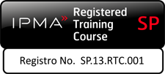
Introduction
Release 6

Slide 2
About the presenter
Industrial Engineer MBA, GPM-M, PMP with more than 25 years of experience in Electrical Companies: Telecomanded electric grid, Marketing and Communications, Corporate Social Responsibility.
Implementation and improvement of Organizational Management Systems according to ISO 9001, ISO 14001, ISO 26000, OHSAS 18001 y Argentinean Resolucion ENRE 057/2003 Public Safety for Electric Power Transmission in High and Medium Voltage (Since 2000).
She was part of the Communication Committee and Environmental and Sustainable Development Committee of Electricité de France (EDF) Branch America along with colleagues from France, Brazil and Mexico (2002-2004).
As independent contractor, she is Organizational System Manager at Baresi SRL a Polyolefin Recycling Company (2005-2015); and Professor of CSR and Sustainable Development at GSPM, University for International Cooperation –UCI- Costa Rica (since 2013).
Founder member and volunteer of PMI Nuevo Cuyo Argentina Chapter ( 2008-2013). Liaison of PMI Educational Foundation in PMINC (2010-2012).
Council member in PMI Global Sustainability Community of Practice (2010-2012)
Countributor member of the PC/ISO 236 Project Committee: Project Management, and then ISO/TC 258 – Technical Committee: Project, Program, Portfolio Management. (Since 2011)
Member of the GPM Global Leadership Executive Team for Latin America. Main Assesor for the GPM® y GPM-m® Certifications in Latin America and Spain (Since oct2012).
Co-autor: The GPM® Reference Guide to Sustainability in Project Management and The GPM Global P5 Standard for Sustainability in Project Management.
Monica can be contacted at: monica.gonzalez@greenprojectmanagement.org
Mónica González

Slide 3
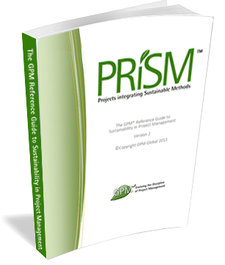
Course Kit
You will be provided with:
A complimentary one year Membership to with access to:
The GPM Reference Guide to Sustainability in Project Management eBook
Responsible Management Education eBooks
The GPM Sustainability Calculator and other PM Templates
Visit members.greenprojectmanagement.org and select “partner discounted membership”
USE CODE 2016agentofchange
At the end of this course:
A certificate of completion will be given
The GPM-b Certification exam will be given for those who quality
*If Partner is a PMI REP, a code shall be provided, if not, Class B PDUs can be elected.
Notes:
Have the participants go to http://members.greenprojectmanagement.org and sign in using the PARTNER DISCOUNT MEMBERSHIP and add the code to receive a year for free.

Slide 4
Course Introduction
Module 1 | Module Covers | Learning outcomes
Introduction | Course Introduction | This module introduces GPM and sets course expectations
Version
6.0

Slide 5
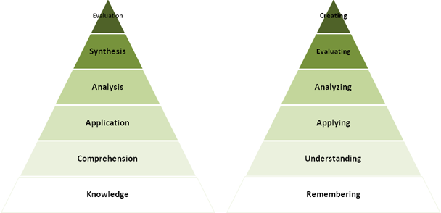
We will cover
This course will impart the knowledge and skills for
Project management using sustainable methods.
Where many training courses focus on knowledge, or memorization, we use an andragogical approach to ensure retention with a strong emphasis on “hands on”.
Course Modules
Sustainability Drivers
Systems Thinking - ISO
Ethics Principles and Values
Governance, Portfolio and Program Management
Organizational Capacity for Change
Business Case, Benefits and Value Management
Requirements Management
Project Management
Life Cycles and PRiSM
The P5 Standard
Project Controls
Issue and Risk Management
Organizational Structures and Roles
Sponsorship
Stakeholder Engagement
Performance and Quality
Information Management and Reporting
Situational Leadership and Communication
Conflict and Negotiation
Notes:
We just covered a lot. Time for a quick break.

Slide 6
Learning Objectives
PRiSM™ Practitioner is a project management course that incorporates best practices, sustainability principles and governance in order to maximize value. The course places an emphasis on aligning benefits with strategic objectives to ensure that each project positions the organization for long-term growth and success through positive impacts to the economic, environmental, and social bottom lines.
The aim of PRiSM™ Practitioner is to train, educate, and develop individuals in project management and sustainability to improve the management and delivery of all types of projects within the set performance, time, cost and integration criteria throughout their own organization and to show how these changes can best be integrated into business as usual and become the normal embedded practices for the organization.

Slide 7

About GPM?
Sustainable Project Management or “Change Delivery” Professional Development Organization
Services in over 145 Countries
Training through partners (Corp., University, Associations)
Certification of individuals (GPM-b™, GPM®, and GPM-m™)
Sustainable PM Methodology (PRiSM™)
Organizational Sustainability Materiality Assessments (PSM3™)
Sustainability Centre of Excellence
Standards (P5 Standards for Sustainability in Project Management)
Notes:
As you saw from my title slide, I am with GPM. Who or what is that? We are a certified social enterprise (we believe in paying taxes and putting into practice what we preach… We funciton like a non-profit in all other aspects.

Slide 8
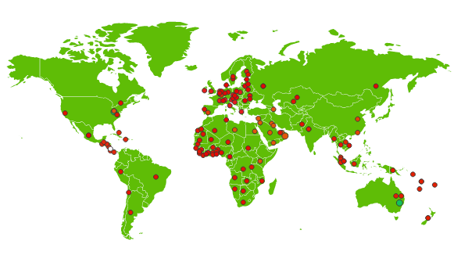
Active in over 145 countries and growing
GPM is the largest sustainability training organization in the world.
(The Sustainable Project Management Organization.)

Slide 9





Our Sustainability Affiliations
United Nations Global Compact
First Project Management Professional Development Organization or Member Association to become a signatory (2013) and still are.
United Nations PRME (Principles for Responsible Management Education) Supporting Organization
One of only 14 worldwide
The Earth Charter Endorsers
GPM founders have taken part since the initial 2001 Summit
UN Business for Peace Initiative
GPM is a founding signatory

Slide 10
We are making a difference
Mbabane. Swaziland Shanty Town
“LEDtek’s attention to managing the aspects of the design phase, with particular emphasis on the incorporation of sustainability methodologies as per PRiSM, combined to produce the effective outcome of the project, meeting all the criteria.”
Notes:
Absolutely. This project was taken on to reduce crime in one of the most violent places in the world. They used our method PRISM to solve night time crime in shanty towns and rather than using the low cost approach, invested in solar powered high LED lights and are seeing results!

Slide 11

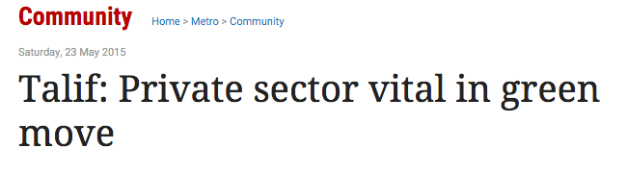
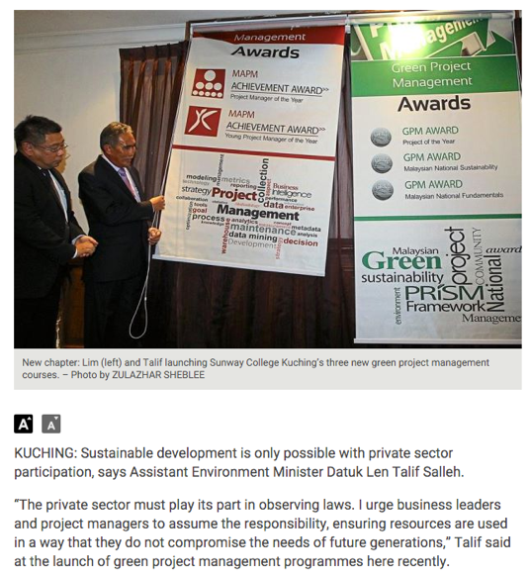
Borneo - Sarawak
Tackling Deforestation and Air Pollution in Malaysia and Borneo
“The private sector must play its part in observing laws. I urge business leaders and project managers to assume the responsibility, ensuring resources are used in a way that they do not compromise the needs of future generations,” Talif said at the launch of green project management programs here recently.
He said the business community tended to focus on “one P” when considering the health of a company. “They only look at the P representing profit at the expense of the planet and the people living on it.”
A recent survey showed that up to 64% of business leaders did not understand how to improve project sustainability, he said.
Notes:
State and Federal Governments in Malaysia and Borneo have combined our awards and IPMA Awards together to encourage rain forest protection and climate change mitigation among organizations. As a result, maybank, petronas, ssi-schaefer and some of the other large Malay corporations have adopted GPM and our certification system.

Slide 12
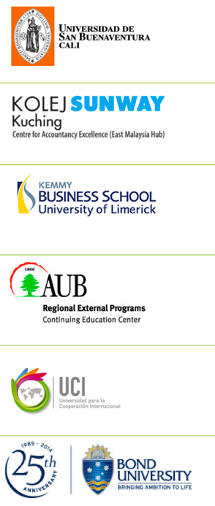

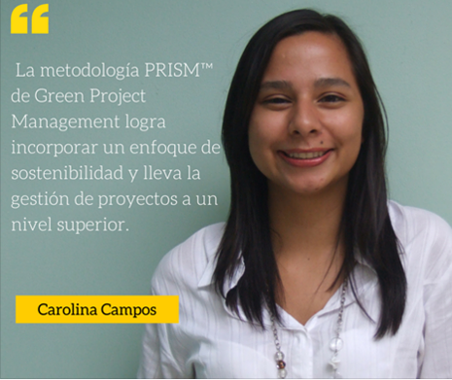
Impacting the future through our University Partner Program and the UN PRME initiative
UN
Notes:
As one of 14 UN PRME organizations, GPM partner Universities are using our program to provide students with the tools they need in the field that are in line with what is important to them, sustainability. The program is customized to the University’s needs and allows them to join and submit progress reports to UN PRME.

Slide 13

Our Focus – Change Delivery
Certification
GPM-b™
GPM®
GPM-m™
Methodology
PRiSM™
Assessments
PSM3™
Training
PRiSM™ Courses
SP2™
SAPM™
Notes:
What is SAPM?

Slide 14
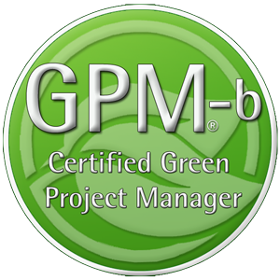
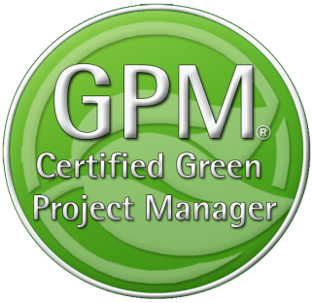

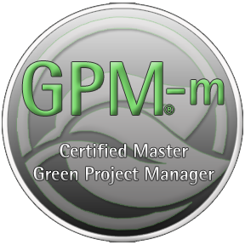
GPM Certifications
The GPM-b - Knowledge based foundational Certification
The GPM® - Proficiency based Practitioner Level Certification
The GPM-m - Proficiency Based Master
Level Certification
Notes:
GPM Adheres to ISO 17024, Certification of Professionals. All GPM Certifications are issued by the GPMG Accreditation Board, A semi-autonomous organization that provides governance and oversight

Slide 15
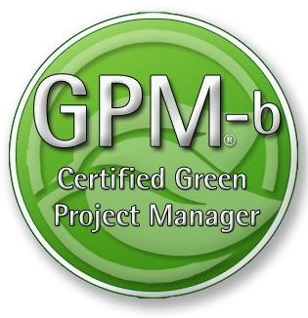
Certification
This course will prepare you for the GPM-b Certification.
The Certification Exam Format
To earn the Green Project Manager level B (GPM-b) credential, candidates must have 2,000 hours of project experience, and pass the 150 multiple choice question examination with a minimum passing score of 75%. The Exam is broken down into two primary sections as listed below. 1. Project Management
1.1. Project Management Standards based on ISO 21500
1.2. Project Management Competencies
1.3. Project management Knowledge Areas
1.4. Key Terms and Concepts

Slide 16
Certification
This course will prepare you for the GPM-b Certification.
The Certification Exam Format
To earn the Green Project Manager level B (GPM-b) credential, candidates must have 2,000 hours of project experience, and pass the 150 multiple choice question examination with a minimum passing score of 75%. The Exam is broken down into two primary sections as listed below.
2. Sustainability Integration
2.1. Why Sustainability
2.2. PRiSM™
2.2.1. P5™
2.2.2. Sustainability Management Planning
2.2.3. Phases, inputs and outputs
2.3. Sustainability ISOs
2.3.1. The Energy Management Standard ISO 50001
2.3.2. The Environmental Management Standard ISO 14001
2.3.3. The Guidance on Social Responsibility ISO 26000
2.3.4. The Quality Management Standard ISO 9001
This course will also prepare you for the IPMA Level D Certification

Slide 17
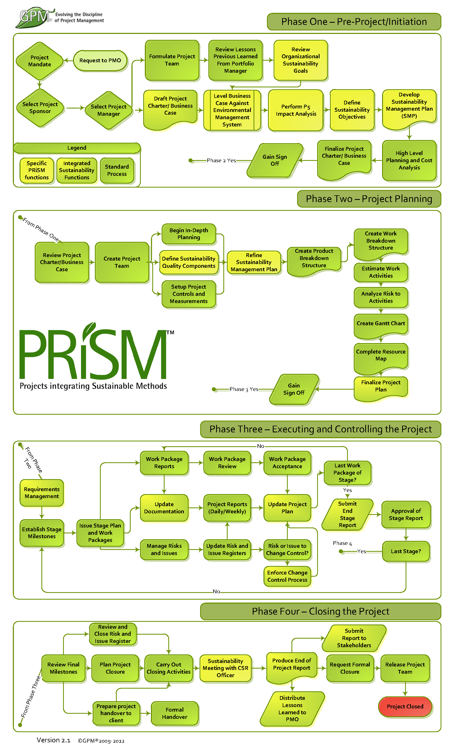
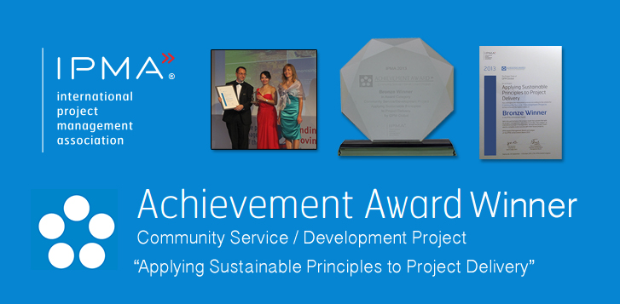
Industry Recognition
PRiSM is our structured project methodology that incorporates
ISO standards for:
Quality
Energy Management
Environmental Management
Corporate Social Responsibility
Project Management
The United Nations Global Compact Ten Principles for Sustainability
GRI G4 Framework
IPMA ICB Competence Baseline
Notes:
GPM earned an achievement award from the International Project Management Association for the development of PRiSM.

Slide 18
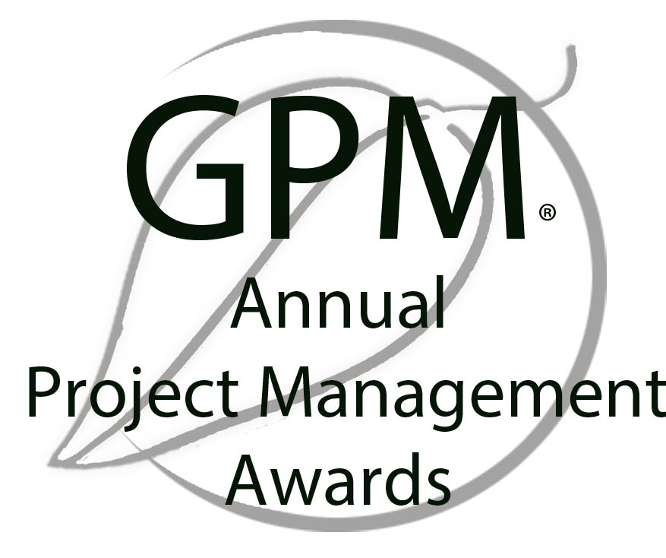
Award Yourself and/or a Colleague!
Project of the Year
Gold and Silver
Sustainability Award
Fundamentals Award
The GPM® Fundamentals Award is bestowed upon the person who submits the most thorough EnVex in a PRiSM Practitioner course in a given year.
EnVexes are in-course-virtual-projects that are taken from real life case studies. These exercises challenge course participants to apply what they learn in the course to achieve project objectives while realizing benefits from a social, environmental, and economic standpoint.

Slide 19



Sustainability Drivers
Release 6

Slide 20
Sustainability Drivers
Module 2 | Module Covers | Learning outcomes
Sustainability Drivers | Sustainability Challenges The UN Global Compact 2030 Sustainable Development Goals UN PRME Initiative The Global Reporting Initiative Climate Change The Post 2015 Business Engagement Architecture | Understand current challenges with sustainability from a business perspective, the driving force for business to engage in sustainability and the organizations driving the way forward.
Version
6.0

Slide 21

A Growing Problem
According to Global Footprint Network’s calculations, our (global) demand for renewable ecological resources and the services they provide is now equivalent to that of more than 1.6 Earths.
The data shows us on track to require the resources of two planets well before mid-century.
(We don’t have 1.6 Planets)
http://www.footprintnetwork.org/en/index.php/GFN/page/earth_overshoot_day/
Notes:
We just covered a lot. Time for a quick break.

Slide 22
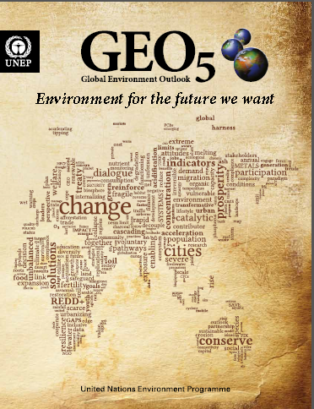
The earth system context
The Earth System provides the basis for all human societies and their economic activities. People need clean air to breathe, safe water to drink, healthy food to eat, energy to produce and transport goods, and natural resources that provide the raw materials for all these services
The 7 billion humans alive today are collectively exploiting the Earth’s resources at accelerating rates and intensities that surpass the capacity of its systems to absorb wastes and neutralize the adverse effects on
the environment.
http://www.unep.org/geo/
Notes:
GEO-5 is designed to be the most comprehensive, impartial and in-depth assessment of its kind. It reflects the collective body of recent scientific knowledge, drawing on the work of leading experts, partner institutions and the vast body of research undertaken within and beyond the United Nations system.
The launch of GEO-5 coincides with the final stages of preparation for the UN Conference on Sustainable Development (Rio+20), taking place two decades after the Rio Earth Summit that set the agenda for contemporary thinking about sustainable development. The report underlines the reasons why world leaders need to show decisive leadership in Rio and beyond. It highlights the state, trends and trajectories of the planet and its people, and showcases more than 100 initiatives, projects and policies from across the globe that are pioneering positive environmental change. (BAN Ki-moon, may 2012)
There is an urgent need to address the underlying drivers of the human pressures on the Earth System. At the same time, it is necessary to adopt approaches that can deal better with the complexities and inherent uncertainties of the Earth System. This must include three elements: basic research to understand interactions and feedbacks; sustained long-term monitoring and observation to underpin basic research; and regular evaluation of progress to allow the adjustment of responses when observations indicate that this is necessary.

Slide 23
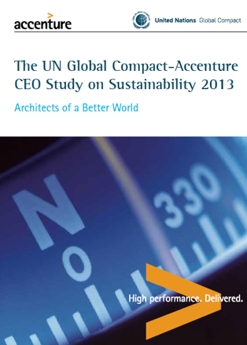
The Accenture – UNGC 2013 Report
Survey result of 1,000 global CEOs, from 27 industries across 103 countries
93%
62%
of CEOs regard Sustainability as the new key for business success
of CEOs believe they can not quantify the value or their sustainability intiatives
SRC: http://www.accenture.com/SiteCollectionDocuments/PDF/Accenture-UN-Global-Compact-Acn-CEO-Study-Sustainability-2013.PDF
Notes:
Which is is great news as the world seems to be poised to support such an architecture as the majority of CEOs from around the world view sustainability as the key to business. Tge unfortunate truth is that these same CEOs can’t quantify the value of what they are doing to address it. What happens to projects that have no value to the organization?

Slide 24
What Happens?
50%
According to Executive Director Geog Kell, 50% of organizations that pledge to the the UN Global Compact are de-listed due to the fact that they are unable to fulfill their committment

Slide 25
Is this a problem?
97%
New report finds only 129 of 4,069 largest companies listed on the world’s stock exchanges are disclosing the most basic sustainability information
Src: http://www.theguardian.com/sustainable-business/2014/oct/13/97-companies-fail-to-provide-data-key-sustainability-indicators-stocck-exchange-report

Slide 26
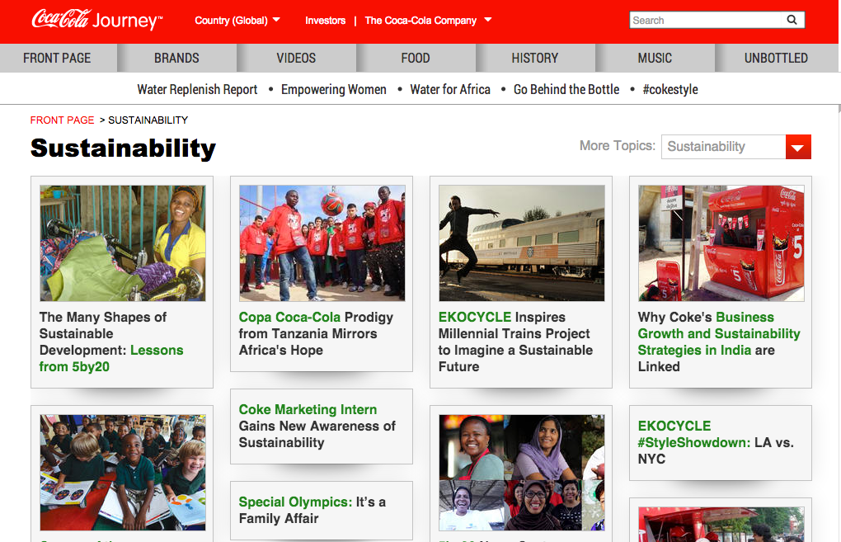


Example
Notes:
This is a snapshot coca cola’s sustainability website Each one of these efforts are outlined in a nice thick report of how responsible coca cola is and how much they care about sustainability. What is not shown is that coke spent One million seven hundred and fifty thousand USD to oppose labeling of food products that are made from GMO. Maybe they could focus on the sustainability of what they produce?

Slide 27
Organizations Driving Sustainability
Hundreds of NGO’s, Non-Profits and advocates promote sustainability
Internationally (and practically) the standards drivers are largely focused on
ISO
United Nations
UN Global Compact
UN PRME
Global Reporting Initiative

Slide 28

The United Nations Global Compact
The Ten Principles
The UN Global Compact's ten principles in the areas of human rights, labour, the environment and anti-corruption enjoy universal consensus and are derived from:
The Universal Declaration of Human Rights
The International Labour Organization's Declaration on Fundamental Principles and Rights at Work
The Rio Declaration on Environment and Development
The United Nations Convention Against Corruption

Slide 29

The Ten Principles
Human Rights
Businesses should support and respect the protection of internationally proclaimed human rights; and
make sure that they are not complicit in human rights abuses.
Labor
3. Businesses should uphold the freedom of association and
the effective recognition of the right to collective bargaining;
4. the elimination of all forms of forced and compulsory labor;
5. the effective abolition of child labor; and
6. the elimination of discrimination in respect of employment and occupation.

Slide 30

The Ten Principles
Environment
7. Businesses should support a precautionary approach to environmental challenges;
8. undertake initiatives to promote greater environmental
responsibility; and
9. encourage the development and diffusion of environmentally friendly technologies.
Anti-Corruption
10. Businesses should work against corruption in all its forms, including extortion and bribery.

Slide 31

Principle 1 | Purpose: We will develop the capabilities of students to be future generators of sustainable value for business and society at large and to work for an inclusive and sustainable global economy.
Principle 2 | Values: We will incorporate into our academic activities and curricula the values of global social responsibility as portrayed in international initiatives such as the United Nations Global Compact.
Principle 3 | Method: We will create educational frameworks, materials, processes and environments that enable effective learning experiences for responsible leadership.
Principle 4 | Research: We will engage in conceptual and empirical research that advances our understanding about the role, dynamics, and impact of corporations in the creation of sustainable social, environmental and economic value.
Principle 5 | Partnership: We will interact with managers of business corporations to extend our knowledge of their challenges in meeting social and environmental responsibilities and to explore jointly effective approaches to meeting these challenges.
Principle 6 | Dialogue: We will facilitate and support dialog and debate among educators, students, business, government, consumers, media, civil society organisations and other interested groups and stakeholders on critical issues related to global social responsibility and sustainability.
Notes:
Launched at the 2007 UN Global Compact Leaders Summit in Geneva, the Principles for Responsible Management Education (PRME) initiative is the first organised relationship between the United Nations and business schools, with The mission of PRME is to inspire and champion responsible management education, research and thought leadership globally.
There are (only) 13 PRME supporting organizations. GPM Global represents the project management world.

Slide 32
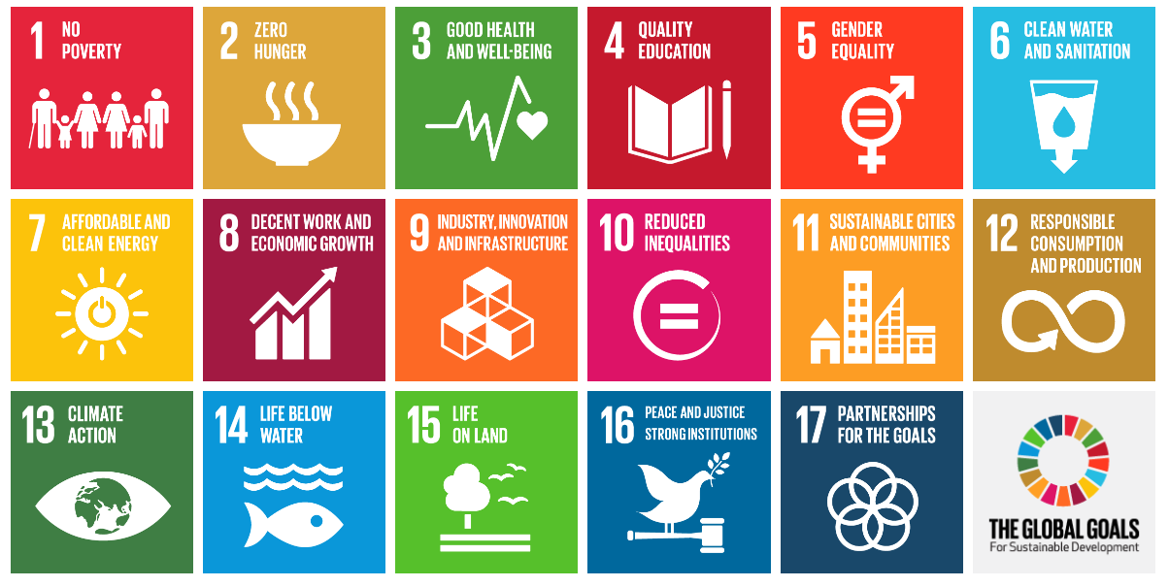
The Sustainable Development Goals
“Business is a vital partner in achieving the Sustainable Development Goals. Companies can contribute through their core activities, and we ask companies everywhere to assess their impact, set ambitious goals and communicate transparently about the results.”
- Ban Ki-moon, United Nations Secretary-General
Notes:
IN 2000, 189 COUNTRIES OF THE WORLD CAME TOGETHER TO FACE THE FUTURE. And what they saw was daunting. Famines. Drought. Wars. Plagues. Poverty.
The perennial problems of the world. Not just in some faraway place, but in their own cities and towns and villages. They knew things didn’t have to be this way. They knew we had enough food to feed the world, but that it wasn’t getting shared. They knew there were medicines for HIV and other diseases, but that they cost a lot. They knew that earthquakes and floods were inevitable, but that the high death tolls were not. They also knew that billions of people worldwide shared their hope for a better future.
Leaders from these countries created a plan called the Millennium Development Goals (MDGs). This set of 8 goals imagined a future just 15 years off that would be rid of poverty and hunger. It was an ambitious plan.
The United Nations Development Programme (UNDP) has been one of the leading organizations working to achieve the MDGs. Present in more than
170 countries and territories, we funded projects that helped fulfil the Goals. We championed the Goals so that people everywhere would know how to do their part. And we acted as “scorekeeper,” helping countries track their progress. And the progress in those 15 years has been tremendous. Hunger has been cut in half. Extreme poverty is down nearly by half. More kids are going to school and fewer are dying.
Now these countries want to build on the many successes of the past 15 years, and go further. The new set of goals, the Sustainable Development Goals (SDGs), aims to end poverty and hunger by 2030. World leaders, recognizing the connection between people and planet, have set goals for the land, the oceans and the waterways

Slide 33
Responsibilities for Business
Understand the SDGs
Understand and implement the business case
Define Priorities
Map the value chain to identify impact areas
Select indicators and collect data
Define Priorities
Setting Goals
Define Scope of goals and select Key Performance Indicators (KPIs)
Define baseline and select goal type
Set level of ambition
Announce commitment
Integration
Anchor goals with the business
Embed sustainability across all functions
Engage in partnerships
Reporting and communicating
Stakeholder Reporting
UNGC Reporting
GRI Reporting
Src. SDG Compass

Slide 34

Understanding the business case for sustainability in project management.
Identify future business opportunities
Innovative technologies to increase efficiency
Reduce waste and emissions through sustainable project management practices
Enhancing the value of
corporate sustainability
Younger generations value responsible and inclusive business practices, and sustainability performance is emerging as an important factor in the ‘war for talent’.
Around the world, consumers are increasingly basing their purchasing decisions on their perception of a company’s sustainability
performance, and the SDGs may further
strengthen this trend.
Strengthening stakeholder relations and
keeping pace with policy developments
Improve trust among stakeholders;
Strengthen their license to operate;
Reduce legal, reputational and other
business risks;
Build resilience to costs or requirements imposed by future legislation.
Notes:
As a first step, it’s important to familiarize yourself with the SDGs and understand the opportunities and responsibilities they represent to the business. According to the UN Guiding Principles, it should always be a priority for a company to address all adverse human rights impacts associated with its operations and value chain. Where companies need to prioritize the order in which they address these issues, the UN Guiding Principles make clear that they should do so based first and foremost on the severity of the potential adverse impacts – in other words, how grave these impacts would be, how widespread, and how hard to remedy. Priority should be given to adverse human rights impacts or risk, regardless of the potential cost or benefit to the business.
Nevertheless, there is increasing evidence that risks to human rights frequently converge with risks to business and that this convergence is particularly strong where the most severe human rights impacts are concerned.

Slide 35




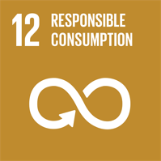
Define Priorities: Map the Value Chain
Increasing Positive Impact
Raw materials
Suppliers
Inbound Logistics
Company Operations
Distribution
Product Use
Product End of Life
Minimizing Negative Impact
Notes:
To benefit from the opportunities and challenges presented by the SDGs, defining where your business priorities are will help you to focus efforts. The extent to which an organization's initiatives contribute to each SDG, and the risks and opportunities they individually represent, will ultimately define how successful they will be as more an more, investors are looking at how organization’s put stock in How they do what they do…
NOTE: Not all 17 SDGs will be equally
relevant for your business. The extent to which your company can contribute to each, and the risks and opportunities they individually represent, will depend on many factors.
6. Company identifies as a priority to reduce its negative impact on SDG 6 in its supply chain by working with suppliers to reduce its water consumption in water stressed regions
8. Company identifies as a priority to increase its positive impact on SDG 8 in its operations by providing a living wage to all employees at all sites globally.
11. Company identifies as a priority to decrease its negative impact on SDG 11 in its inbound and outbound logistics by improving road safety for its drivers.
12. Company identifies as a priority to reduce its negative impact on SDG 12 at its products end of life by improving the reusability and recyclability of its products.
13. Company identifies as a priority to increase its positive impact on SDG 13 for use of its products by developing and delivering products that allow customers to reduce their energy use and related GHG emissions.
Later in the course, we will cover P5 which can be used to tie priorities to project activities.

Slide 36
Select Indicators and collect data
Example: A Project to develop water purification tablets has the potential to reduce incidence of water-borne diseases
Inputs
What Resources will be used that could affect an SDG?
Activities
What project activities will be undertaken?
Outputs
What is created?
Outcomes
Impacts
What does the change initiative do?
What are the changes that occur as a result?
Example
Example
Example
Example
Example
R&D, manufacturing,
marketing spend
($ spent).
Water purification
tablet sales (qualitative description
of marketing and distribution efforts).
Tablets sold (# sold and demographic information regarding consumers
buying the tablets).
Purified water
consumed (% of total water
consumed).
Reduced incidence
of water-borne diseases (% reduction
Vs.pre-sales).
Notes:
Mapping high impact areas will help your company understand where to concentrate its efforts. For each of the areas of potential high impact, identify one or more indicators that most adequately express the relationship between your company’s activities and their impact on sustainable development, so that performance can be tracked over time.
An example will help demonstrate how a Logic
model works. A company that is investing in
the development of water purification tablets has
the potential to reduce incidence of water-borne
diseases, which contributes to SDG Goal 3

Slide 37
Define Priorities
Consider the magnitude, severity, and likelihood of current and potential negative impacts the the project and ourtcome “asset” will have. The importance of such impacts to key stakeholders and the opportunity to strengthen competitiveness through sustainable practices.
Assess the opportunity for your projects to gain advantage from its current or potential positive impacts across the SDGs. (This may include opportunities to innovate, develop new products and solutions or target new market segments.)
Notes:
The company should now have an understanding of its current and potential, negative and positive impacts on sustainable development. The next action is to define your priorities across the SDGs. The two suggestions listed on this page can assist.
Additional considerations include the likelihood that new regulation, standardization, market shortages (of materials or labor), supply chain disruptions, stakeholder pressure or changing market dynamics over time may translate these negative impacts into costs or risks for the company.

Slide 38
Minding the Gap
The Outside In Approach
The Inside Out Approach
By looking at what is needed externally from a global perspective and setting goals accordingly, projects can bridge the gap between current performance (Business as Usual) and Increased performance (Supporting SDGs)
Today’s internally focused approach to goal setting is not enough to address global needs.
SDGs
SDGs
Combined Impact of Project
Objectives
(Most Companies)
GAP
Global Societal Needs
(Where Companies should be)
SDGs
SDGs
Notes:
So… What we need to do is to get organizations to use projects as a mechanism to drive sustainable development (and do so sustainably). In this picture (in red), it shows how most companies look at sustainability as external to how they approach goals and objectives.
Project objectives should be based on business goals that are set based on external societal or global need, based on science and external data, AND benchmarked against the needs of society and how the business can address them.

Slide 39
Understand and share the commitment internally
1. Understanding a company’s goals can be an effective communication tool because they express in simple and practical terms the company’s aspirations on sustainable development.
2. Doing so may inspire and engage the project team and stakeholder. It provides a good basis for constructive dialogue with external stakeholders.

Slide 40
Integrating the SDGS
Corporate Management Strategy 2016
KPI: Contribute to SDG 12
Phasing out harmful* Chemicals in products by 2020
Ensuring that all harmful chemicals are identified and phased out where possible, and alternatives identified by year ending 2016
Project Governance
Actions
Operations Management
Phase in governance for projects and programs in 2016 to ensure that when harmful chemicals are required, alternative materials are sourced.
Identify and phase out where possible all harmful chemicals in purchased products and components by year ending 2016.
Actions
Actions
Project Level Action
Op. Mgmt. Action
Identify alternative materials for all identified harmful chemicals in products and components under responsibility by year 2016
Ensure all supply
accounts comply with
purchasing policy on
harmful chemicals by
year ending 2016.
* Harmful chemicals as identified with input from internal and external experts, which go beyond those that are prohibited by law
Notes:
As an outcome of goal setting, you will have identified specific KPIs and set goals for each of your company’s strategic priorities. Integrating sustainability into the core business and embedding targets\ across functions is fundamental towards addressing these goals.
Although dedicated sustainability teams and professionals can play an important role in achieving the company’s sustainability goals, the support and ownership of corporate functions such as R&D, Project Management, Business Development, Supply Management, Operations and Human Resources are the key to embedding sustainability in business strategy, culture and operations, and products.

Slide 41


Reporting
The GRI is a pioneering nonprofit propose a framework for sustainability reporting.
Companies use this report to inform its shareholders and consumers through their performance of economic, social and environmental
Learn more at www.globalreporting.org
GPM Global
Notes:
Global Reporting Initiative (GRI) is an organization whose purpose is to promote the development of sustainability reporting in all types of organizations. GRI produces a comprehensive framework for the preparation of Sustainability Reports, which are widely used worldwide. The Framework, including the Guide for the preparation of reports, sets out the principles and indicators that organizations can use to measure and disclose their economic, environmental and social. GRI is committed to continuously improving and increasing the use of these Guidelines, which are available to the public for free. ? GRI is a nonprofit organization with multiple stakeholders. It was founded by CERES and the United Nations Program for Environment (UNEP) in 1997 in the United States. In 2002, GRI moved its offices to Amsterdam, where he is currently its Secretariat. GRI has regional offices ("Focal Points") in Australia, Brazil, China, India and the United States, and also has a network of more than 30,000 people worldwide

Slide 42
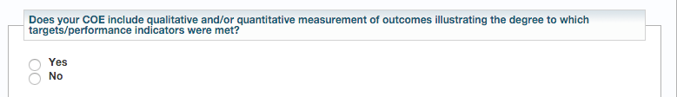
UN Global Compact Reporting
The UN Global Compact Reporting process requires communication on engagements or COEs
Project outcome reports are material to the reporting process and should be provided to whomever submits on behalf of the organization.
Src. The UN Global Compact Submission Dashboard

Slide 43

About GRI Reporting
video

Slide 44

Global Reporting Intiative’s Categories and Aspects
Economic
Economic Performance
Market Presence
Direct Economic impact
Environment
Materials, energy, water
biodiversity
Emissions, waste, transport
Products and services
Integral sustainability
Social
Labor practices and decent work
Society
Human Rights
Product liability
Ethics
Notes:
Sustainability reporting’ is a broad term considered synonymous with others used to describe reporting on economic, environmental, and social impacts (e.g., triple bottom line, corporate responsibility reporting, etc.). A sustainability report should provide a balanced and reasonable representation of the sustainability performance
Reports can be used for the following purposes, among others:
• Benchmarking and assessing sustainability performance with respect to laws, norms, codes,
performance standards, and voluntary initiatives;
• Demonstrating how the organization influences and is influenced by expectations about sustainable development; and
• Comparing performance within an organization and between different organizations over time. – including both positive and negative contributions.

Slide 45
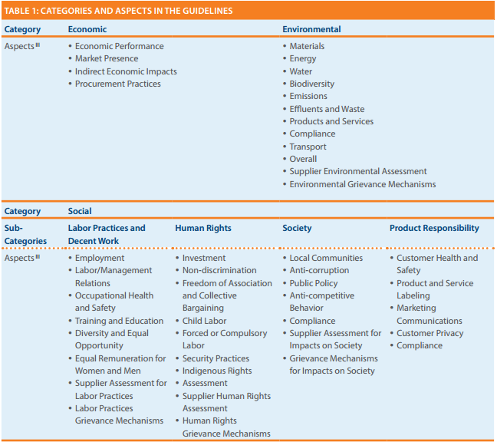
Going Deeper into the G4 GRI
Product Responsability!!
(A little weak)
Notes:
The table in figure is from the 2013 G4 release for GRI reporting.
GRI G4 states “Sustainability reporting is fundamental to an organization’s integrated thinking and reporting process in providing input into the organization’s identification of its material issues, its strategic objectives, and the assessment of its ability to achieve those objectives and create value over time”.
The reporting indicators are primarily structured in pairs, with a Core Indicator seeking disclosure on the processes in place to address the aspect, and an additional Indicator to report on degree of compliance.
The final category “Product Responsibility” includes Customer Health and Safety, Product Labeling, Marketing Communications, Customer Privacy, and Compliance. A more complete approach to sustainability reporting would take into account lifespan and servicing as well as the efficiency and maturity of the product’s design and build process.

Slide 46
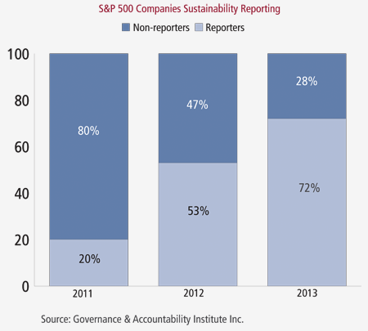
Fortune 500 Companies now Publishing Sustainability/Responsibility Reports
“We are seeing clear indications over the past three years that senior corporate management understands the importance of adopting and implementing strategies that reflect the rising interest of investors and stakeholders in corporate sustainability,”
- Louis Coppola, executive vice president of G&A Institute.
72%
53%
20%
http://www.complianceweek.com/blogs/the-filing-cabinet/sustainability-reporting-on-the-rise
Notes:
It is no surprise to to see the trend shown here. If the number of CEOs that value sustainability as the way forward is on the rise and therefore reporting is also on the rise it is sure to create positive impacts. The problem is that focused attention in largely in part on supply chains.

Slide 47

The Cobb Salad Report
“These are all worthwhile topics however they are operationally focused and the emphasis needs to focus on what the organization produces from a product and service perspective.”
Timothy Hui. Head of Focal Point GRI for China
Health and Safety
Philanthropy
Carbon Emission Goals
Notes:
This rings loud and clear as when organizations report on sustainability, they look like chopped salads. Timothy Hui, Head of Focal Point GRI for China stated that the volume of reporting is increasing which is positive, however so is the volume of information in each report. Information is submitted on topics such as employee health and safety programs to carbon emission reduction goals to philanthropy initiatives (T. Hui, Presentation, May 27th, 2014). These are all worthwhile topics however they are operationally focused and the emphasis needs to focus on what the organization produces from a product and service perspective.
As of June 25th, 2014, 6,321 organizations having submitted over 15,234 reports to the Global Reporting Initiative alone.

Slide 48
Responsibilities for Business
Understand the SDGs
Understand and implement the business case
Define Priorities
Map the value chain to identify impact areas
Select indicators and collect data
Define Priorities
Setting Goals
Define Scope of goals and select Key Performance Indicators (KPIs)
Define baseline and select goal type
Set level of ambition
Announce commitment
Integration
Anchor goals with the business
Embed sustainability across all functions
Engage in partnerships
Reporting and communicating
Stakeholder Reporting
UNGC Reporting
GRI Reporting
Src. SDG Compass

Slide 49
Understanding the business case for sustainability in project management.
Identify future business opportunities
Innovative technologies to increase efficiency
Reduce waste and emissions through sustainable project management practices
Enhancing the value of
corporate sustainability
Younger generations value responsible and inclusive business practices, and sustainability performance is emerging as an important factor in the ‘war for talent’.
Around the world, consumers are increasingly basing their purchasing decisions on their perception of a company’s sustainability
performance, and the SDGs may further
strengthen this trend.
Strengthening stakeholder relations and
keeping pace with policy developments
Improve trust among stakeholders;
Strengthen their license to operate;
Reduce legal, reputational and other
business risks;
Build resilience to costs or requirements imposed by future legislation.
Notes:
As a first step, it’s important to familiarize yourself with the SDGs and understand the opportunities and responsibilities they represent to the business. According to the UN Guiding Principles, it should always be a priority for a company to address all adverse human rights impacts associated with its operations and value chain. Where companies need to prioritize the order in which they address these issues, the UN Guiding Principles make clear that they should do so based first and foremost on the severity of the potential adverse impacts – in other words, how grave these impacts would be, how widespread, and how hard to remedy. Priority should be given to adverse human rights impacts or risk, regardless of the potential cost or benefit to the business.
Nevertheless, there is increasing evidence that risks to human rights frequently converge with risks to business and that this convergence is particularly strong where the most severe human rights impacts are concerned.

Slide 50
Define Priorities: Map the Value Chain
Increasing Positive Impact
Raw materials
Suppliers
Inbound Logistics
Company Operations
Distribution
Product Use
Product End of Life
Minimizing Negative Impact
Notes:
To benefit from the opportunities and challenges presented by the SDGs, defining where your business priorities are will help you to focus efforts. The extent to which an organization's initiatives contribute to each SDG, and the risks and opportunities they individually represent, will ultimately define how successful they will be as more an more, investors are looking at how organization’s put stock in How they do what they do…
NOTE: Not all 17 SDGs will be equally
relevant for your business. The extent to which your company can contribute to each, and the risks and opportunities they individually represent, will depend on many factors.
6. Company identifies as a priority to reduce its negative impact on SDG 6 in its supply chain by working with suppliers to reduce its water consumption in water stressed regions
8. Company identifies as a priority to increase its positive impact on SDG 8 in its operations by providing a living wage to all employees at all sites globally.
11. Company identifies as a priority to decrease its negative impact on SDG 11 in its inbound and outbound logistics by improving road safety for its drivers.
12. Company identifies as a priority to reduce its negative impact on SDG 12 at its products end of life by improving the reusability and recyclability of its products.
13. Company identifies as a priority to increase its positive impact on SDG 13 for use of its products by developing and delivering products that allow customers to reduce their energy use and related GHG emissions.
Later in the course, we will cover P5 which can be used to tie priorities to project activities.

Slide 51
Select Indicators and collect data
Example: A Project to develop water purification tablets has the potential to reduce incidence of water-borne diseases
Inputs
What Resources will be used that could affect an SDG?
Activities
What project activities will be undertaken?
Outputs
What is created?
Outcomes
Impacts
What does the change initiative do?
What are the changes that occur as a result?
Example
Example
Example
Example
Example
R&D, manufacturing,
marketing spend
($ spent).
Water purification
tablet sales (qualitative description
of marketing and distribution efforts).
Tablets sold (# sold and demographic information regarding consumers
buying the tablets).
Purified water
consumed (% of total water
consumed).
Reduced incidence
of water-borne diseases (% reduction
Vs.pre-sales).
Notes:
Mapping high impact areas will help your company understand where to concentrate its efforts. For each of the areas of potential high impact, identify one or more indicators that most adequately express the relationship between your company’s activities and their impact on sustainable development, so that performance can be tracked over time.
An example will help demonstrate how a Logic
model works. A company that is investing in
the development of water purification tablets has
the potential to reduce incidence of water-borne
diseases, which contributes to SDG Goal 3

Slide 52
Define Priorities
Consider the magnitude, severity, and likelihood of current and potential negative impacts the the project and ourtcome “asset” will have. The importance of such impacts to key stakeholders and the opportunity to strengthen competitiveness through sustainable practices.
Assess the opportunity for your projects to gain advantage from its current or potential positive impacts across the SDGs. (This may include opportunities to innovate, develop new products and solutions or target new market segments.)
Notes:
The company should now have an understanding of its current and potential, negative and positive impacts on sustainable development. The next action is to define your priorities across the SDGs. The two suggestions listed on this page can assist.
Additional considerations include the likelihood that new regulation, standardization, market shortages (of materials or labor), supply chain disruptions, stakeholder pressure or changing market dynamics over time may translate these negative impacts into costs or risks for the company.

Slide 53
Minding the Gap
The Outside In Approach
The Inside Out Approach
By looking at what is needed externally from a global perspective and setting goals accordingly, projects can bridge the gap between current performance (Business as Usual) and Increased performance (Supporting SDGs)
Today’s internally focused approach to goal setting is not enough to address global needs.
SDGs
SDGs
Combined Impact of Project
Objectives
(Most Companies)
GAP
Global Societal Needs
(Where Companies should be)
SDGs
SDGs
Notes:
So… What we need to do is to get organizations to use projects as a mechanism to drive sustainable development (and do so sustainably). In this picture (in red), it shows how most companies look at sustainability as external to how they approach goals and objectives.
Project objectives should be based on business goals that are set based on external societal or global need, based on science and external data, AND benchmarked against the needs of society and how the business can address them.

Slide 54
Understand and share the commitment internally
1. Understanding a company’s goals can be an effective communication tool because they express in simple and practical terms the company’s aspirations on sustainable development.
2. Doing so may inspire and engage the project team and stakeholder. It provides a good basis for constructive dialogue with external stakeholders.

Slide 55
Integrating the SDGS
Corporate Management Strategy 2016
KPI: Contribute to SDG 12
Phasing out harmful* Chemicals in products by 2020
Ensuring that all harmful chemicals are identified and phased out where possible, and alternatives identified by year ending 2016
Project Governance
Actions
Operations Management
Phase in governance for projects and programs in 2016 to ensure that when harmful chemicals are required, alternative materials are sourced.
Identify and phase out where possible all harmful chemicals in purchased products and components by year ending 2016.
Actions
Actions
Project Level Action
Op. Mgmt. Action
Identify alternative materials for all identified harmful chemicals in products and components under responsibility by year 2016
Ensure all supply
accounts comply with
purchasing policy on
harmful chemicals by
year ending 2016.
* Harmful chemicals as identified with input from internal and external experts, which go beyond those that are prohibited by law
Notes:
As an outcome of goal setting, you will have identified specific KPIs and set goals for each of your company’s strategic priorities. Integrating sustainability into the core business and embedding targets\ across functions is fundamental towards addressing these goals.
Although dedicated sustainability teams and professionals can play an important role in achieving the company’s sustainability goals, the support and ownership of corporate functions such as R&D, Project Management, Business Development, Supply Management, Operations and Human Resources are the key to embedding sustainability in business strategy, culture and operations, and products.

Slide 56
Reporting
The GRI is a pioneering nonprofit propose a framework for sustainability reporting.
Companies use this report to inform its shareholders and consumers through their performance of economic, social and environmental
Learn more at www.globalreporting.org
GPM Global
Notes:
Global Reporting Initiative (GRI) is an organization whose purpose is to promote the development of sustainability reporting in all types of organizations. GRI produces a comprehensive framework for the preparation of Sustainability Reports, which are widely used worldwide. The Framework, including the Guide for the preparation of reports, sets out the principles and indicators that organizations can use to measure and disclose their economic, environmental and social. GRI is committed to continuously improving and increasing the use of these Guidelines, which are available to the public for free. ? GRI is a nonprofit organization with multiple stakeholders. It was founded by CERES and the United Nations Program for Environment (UNEP) in 1997 in the United States. In 2002, GRI moved its offices to Amsterdam, where he is currently its Secretariat. GRI has regional offices ("Focal Points") in Australia, Brazil, China, India and the United States, and also has a network of more than 30,000 people worldwide

Slide 57
UN Global Compact Reporting
The UN Global Compact Reporting process requires communication on engagements or COEs
Project outcome reports are material to the reporting process and should be provided to whomever submits on behalf of the organization.
Src. The UN Global Compact Submission Dashboard

Slide 58
About GRI Reporting
video

Slide 59
Global Reporting Intiative’s Categories and Aspects
Economic
Economic Performance
Market Presence
Direct Economic impact
Environment
Materials, energy, water
biodiversity
Emissions, waste, transport
Products and services
Integral sustainability
Social
Labor practices and decent work
Society
Human Rights
Product liability
Ethics
Notes:
Sustainability reporting’ is a broad term considered synonymous with others used to describe reporting on economic, environmental, and social impacts (e.g., triple bottom line, corporate responsibility reporting, etc.). A sustainability report should provide a balanced and reasonable representation of the sustainability performance
Reports can be used for the following purposes, among others:
• Benchmarking and assessing sustainability performance with respect to laws, norms, codes,
performance standards, and voluntary initiatives;
• Demonstrating how the organization influences and is influenced by expectations about sustainable development; and
• Comparing performance within an organization and between different organizations over time. – including both positive and negative contributions.

Slide 60
Going Deeper into the G4 GRI
Product Responsability!!
(A little weak)
Notes:
The table in figure is from the 2013 G4 release for GRI reporting.
GRI G4 states “Sustainability reporting is fundamental to an organization’s integrated thinking and reporting process in providing input into the organization’s identification of its material issues, its strategic objectives, and the assessment of its ability to achieve those objectives and create value over time”.
The reporting indicators are primarily structured in pairs, with a Core Indicator seeking disclosure on the processes in place to address the aspect, and an additional Indicator to report on degree of compliance.
The final category “Product Responsibility” includes Customer Health and Safety, Product Labeling, Marketing Communications, Customer Privacy, and Compliance. A more complete approach to sustainability reporting would take into account lifespan and servicing as well as the efficiency and maturity of the product’s design and build process.

Slide 61
Fortune 500 Companies now Publishing Sustainability/Responsibility Reports
“We are seeing clear indications over the past three years that senior corporate management understands the importance of adopting and implementing strategies that reflect the rising interest of investors and stakeholders in corporate sustainability,”
- Louis Coppola, executive vice president of G&A Institute.
72%
53%
20%
http://www.complianceweek.com/blogs/the-filing-cabinet/sustainability-reporting-on-the-rise
Notes:
It is no surprise to to see the trend shown here. If the number of CEOs that value sustainability as the way forward is on the rise and therefore reporting is also on the rise it is sure to create positive impacts. The problem is that focused attention in largely in part on supply chains.

Slide 62
The Cobb Salad Report
“These are all worthwhile topics however they are operationally focused and the emphasis needs to focus on what the organization produces from a product and service perspective.”
Timothy Hui. Head of Focal Point GRI for China
Health and Safety
Philanthropy
Carbon Emission Goals
Notes:
This rings loud and clear as when organizations report on sustainability, they look like chopped salads. Timothy Hui, Head of Focal Point GRI for China stated that the volume of reporting is increasing which is positive, however so is the volume of information in each report. Information is submitted on topics such as employee health and safety programs to carbon emission reduction goals to philanthropy initiatives (T. Hui, Presentation, May 27th, 2014). These are all worthwhile topics however they are operationally focused and the emphasis needs to focus on what the organization produces from a product and service perspective.
As of June 25th, 2014, 6,321 organizations having submitted over 15,234 reports to the Global Reporting Initiative alone.

Slide 63

Example LEDtek
Principle | Commitment | Project | Considerations
9. and encourage the development and diffusion of environmentally friendly technologies. | Our organization has committed to reducing dependency on fossil fuels | Design and installation of cost effective aerial security lighting for Mbabane Shanty Towns | The balancing of these imperatives highlighted the overall integrated linkage between social, environmental. Alternative lighting sources were trailed by were not able to meet the criteria of lighting levels delivered on the ground. LEDtek attention to managing the aspects of the design phase, with particular emphasis on the incorporation of sustainability methodologies as per PRiSM, combined to produce the effective outcome of the project, meeting all the criteria.
Notes:
Projects are material to non-financial reporting. Aligning the project to the organization’s commitment in correlation with the ten principles provides a greater and more complete picture of “what” the company does which is what the true spirit of reporting.

Slide 64
GPM’s Non Financial Report (UNGC)
Principle | Committment | Systems and Principles | Services
Human Rights
1. Businesses should support and respect the protection of internationally proclaimed human rights; 2. and make sure that they are not complicit in human rights abuses. | GPM Global, our partners and suppliers recognize that human rights are an integral part of corporate citizenship. We respect, support and advocate the Universal Declaration of Human Rights and the Guiding Principles on Business and Human Rights: Implementing the United Nations' Protect, Respect and Remedy Framework’. GPM Global has a Human Rights Statement, in line with international best practice. | GPM Global Human Rights Statement GPM Global Core Principles GPM Global Supplier and Partner Code of Conduct The GPM Global P5 Standard for Sustainability in Project Management The GPM Reference Guide to Sustainability in Project Management | Portfolio, Program, & Project Management Sustainability and Materiality Assessments (PSM3) Projects integrating Sustainable Methods (PRiSM) Project Methodology PRiSM Training
Labor Standards
3. Businesses should uphold the freedom of association and the effective recognition of the right to collective bargaining; 4. the elimination of all forms of forced and compulsory labor; 5. the effective abolition of child labor; | GPM Global, our partners and suppliers do not use forced, compulsory or child labor. GPM Global, our partners and suppliers support freedom of association and recognize the right to collective bargaining. | GPM Global Human Rights Statement GPM Global Core Principles The GPM Global P5 Standard for Sustainability in Project Management The GPM Reference Guide to Sustainability in Project Management | Portfolio, Program, & Project Management Sustainability and Materiality Assessments (PSM3) Projects integrating Sustainable Methods (PRiSM) Project Methodology PRiSM Training
https://www.unglobalcompact.org/participation/report/cop/create-and-submit/detail/202031
Notes:
Materiality should tie to what the business does and include governance policies that are available for public viewing. Find our full report on the UN Global Compact Website under “GPM Global” and COE

Slide 65
Corporations get it (sort of).
The UN Global Compact comprises of 8,000 companies +4,000 non-businesses
All must communicate on progress of HOW they put the ten principles into practice.
(almost) none of them see the materiality of projects to their strategy.
50% are delisted for not reporting.
The Global Reporting Initiative
2015 saw a 28% increase in reports compared to 2014 with a total of 19,192 as of July
Notes:
What is encouraging is that the number of organizations who put stock in sustainability is increasing. This will require all aspects of business to evolve. I point out that 50% are delisted for not reporting on progress which is alarming.
As I mentioned earlier, we are a social enterprise so reporting is required and we just published our report two days ago.

Slide 66

Climate Change
video

Slide 67
Climate Change
From 1880 to 2012, average global temperature increased by 0.85°C. To put this into perspective, for each 1 degree of temperature increase, grain yields decline by about 5 per cent. Maize, wheat and other major crops have experienced significant yield reductions at the global level of 40 megatons per year between 1981 and 2002 due to a warmer climate.
Oceans have warmed, the amounts of snow and ice have diminished and sea level has risen. From 1901 to 2010, the global average sea level rose by 19 cm as oceans expanded due to warming and ice melted. The Arctic’s sea ice extent has shrunk in every successive decade since 1979, with 1.07 million km² of ice loss every decade
Given current concentrations and on-going emissions of greenhouse gases, it is likely that by the end of this century, the increase in global temperature will exceed 1.5°C compared to 1850 to 1900 for all but one scenario. The world’s oceans will warm and ice melt will continue. Average sea level rise is predicted as 24 – 30cm by 2065 and 40-63cm by 2100. Most aspects of climate change will persist for many centuries even if emissions are stopped
Global emissions of carbon dioxide (CO2) have increased by almost 50 per cent since 1990
Emissions grew more quickly between 2000 and 2010 than in each of the three previous decades
It is still possible, using a wide array of technological measures and changes in behavior, to limit the increase in global mean temperature to two degrees Celsius above pre-industrial levels
Major institutional and technological change will give a better than even chance that global warming will not exceed this threshold
Notes:
Every country in the world is seeing the drastic effects of climate change, some more than others. On average, the annual losses just from earthquakes, tsunamis, tropical cyclones and flooding count in the hundreds of billions of dollars. We can reduce the loss of life and property by helping more vulnerable regions—such as land-locked countries and island states—become more resilient. The impact of global warming is getting worse. We’re seeing more storms, more droughts and more extremes than ever before. It is still possible, with political will and technological measures, to limit the increase in global mean temperature to two degrees Celsius above pre-industrial levels—and thus avoid the worst effects of climate change. The Sustainable Development Goals lay out a way for countries to work together to meet this urgent challenge.

Slide 68
Executives on Climate Change
Just as we drive product innovations, we also further develop our own production processes. Since 1990, we have reduced the greenhouse gas
intensity of our production by 74%.
In order to continue on this path, we just set ourselves the new corporate target to implement energy efficiency management systems at all our production sites by 2020. However, we have to realize that the technological improvement of existing processes has physical limits. That is why we are also looking for disruptive innovations for our production processes.
Kurt Bock CEO, BASF

Slide 69
Executives On Climate Change
80%
77%
74%
Climate change will create opportunities for growth and innovation for my company in the next 3 - 5 years
My company is already seeing rewards from our investments in low-carbon solutions
Action on climate change is an urgent priority for my business
Data based on survey of 75 CEOs of Caring for Climate participant companies; data represents proportion of respondents selecting “agree” and “strongly agree”.
Notes:
Amid the commitment of CEOs to tackling the global climate challenge is a clear message to governments and policymakers. With one-third reporting that current policy and regulation is hindering their company from investing in low-carbon solutions, fully 87% of CEOs believe that the long-term agreement made in Paris is critical in unlocking private sector investment in addressing the climate challenge.

Slide 70
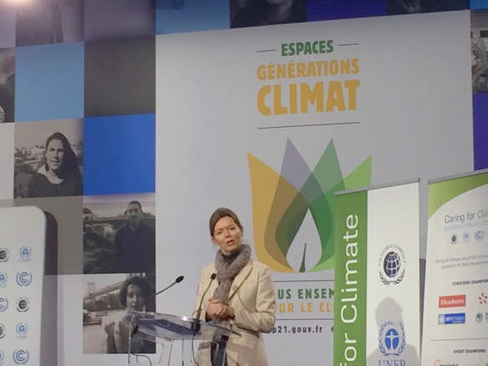

Paris Agreement
Strengthen resilience and adaptive capacity to climate-related hazards and natural disasters in all countries
Integrate climate change measures into national policies, strategies and planning
Improve education, awareness-raising and human and institutional capacity on climate change mitigation, adaptation, impact reduction and early warning
Implement the commitment undertaken by developed-country parties to the United Nations Framework Convention on Climate Change to a goal of mobilizing jointly $100 billion annually by 2020 from all sources to address the needs of developing countries in the context of meaningful mitigation actions and transparency on implementation and fully operationalize the Green Climate Fund through its capitalization as soon as possible
Promote mechanisms for raising capacity for effective climate change-related planning and management in least developed countries and small island developing States, including focusing on women, youth and local and marginalized communities
Lise Kingo, UN Global Compact Executive Director Speaking at COP21

Slide 71
Status Update from Paris
Setting emissions reduction targets is now common practice for business:
80% of the world’s 500 LARGEST COMPANIES reported targets to CDP in 2014.
However, most of them are not sufficient to meet the threat posed by climate change and keep warming below 2°C.
Notes:
The science tells us that we must cut global greenhouse gas emissions by up to 70% by 2050 to limit global warming to 2°C and avert catastrophic and irreversible climate change.
This will require global transformational change. Never before have there been methodologies to support companies to keep their emissions aligned with planetary boundaries.
Using science-based targets is an ambitious approach and leading companies have now started to take an “outside-in” approach to goal setting.

Slide 72
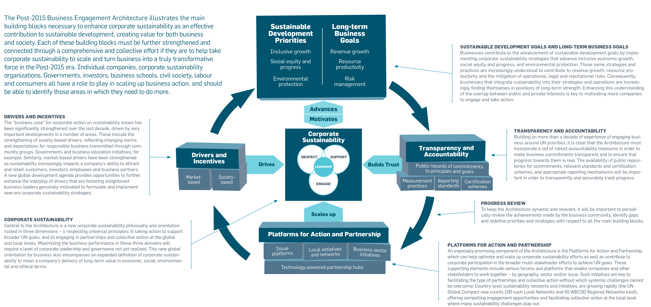
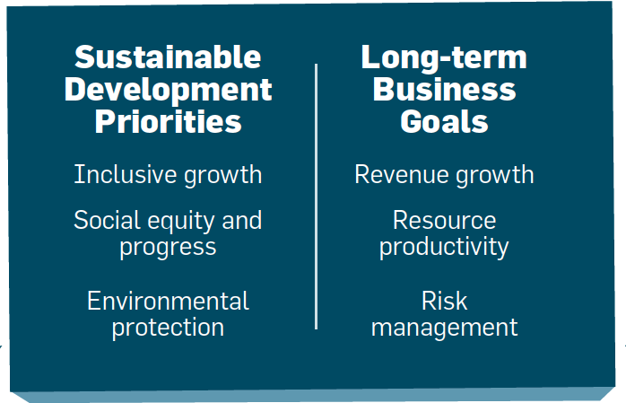

POST-2015 BUSINESS ENGAGEMENT ARCHITECTURE
Notes:
Facilitator – This slide is important but only from a high level. Highlight the fact that each building block is supposed to support forward progress towards business inclusion.
This model is a good from a high level, but what is missing are specific actionable items. GPM’s approach meets all of the requirements for this framework, including certification schemes under Transparency and Accountability. In this course, participants will learn how to naturally (holistically) put it into practice.

Slide 73

Essentially
• Leverage channels to communicate corporate sustainability performance to investors and, where relevant, adopt a responsible investment policy for corporate pension funds;
• Undertake sustainability due-diligence and set clear expectations before signing partnership contracts in order to encourage partners throughout the value chain to uphold minimum standards and advance sustainable practices;
• Intensify engagement in issue platforms and sector initiatives in order to scale-up and advance business engagement on sustainability issues and, as relevant, help overcome systemic challenges;
• Engage in local networks and initiatives, actively sharing best practice and learnings with local business community and providing operational support and resources, as appropriate;
• Engage in partnerships with other businesses and stakeholders that can have transformative impacts – moving beyond an ad-hoc project focus.
-RUN YOUR BUSINESS
-DO NO HARM
-MAKE THE WORLD A BETTER PLACE

Slide 74
Where do we fit in?
“
I guarantee that within four years, the marketplace will have changed from within because sustainability and its reality is becoming a transformative force.
...finally, asset managers are waking up to the basic reality that sustainability pays off. Long term financial success can only be assured if companies also good on governance, on social behavior, and environmental stewardship.
Failure on any of these three pillars will make it impossible for companies to sustain success over time or to become successful.
Georg Kell,
Former UN Global Compact Executive Director
June 25th 2015
Notes:
We deliver the assets… If asset owners are waking up, we will have to drive.

Slide 75
We must move beyond this.
TIME
QUALITY
COST
SCOPE

Slide 76
To this.
SOCIAL
RISK
VALUE
TIME
PERFORMANCE
&
QUALITY
ECONOMIC
ENVIRONMENTAL
COST
SCOPE
BENEFITS
PROCESS & PRODUCTS

Slide 77
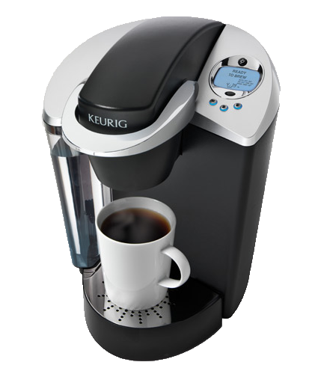

Success and Failures
In 2013, Green Mountain produced 8.3 billion K-Cups, enough to wrap around the equator 10.5 times.
Only five percent of its current cups are made out of recyclable plastic. (Don‘t buy any more K-cups until 2020)
Success or Failure?

Slide 78



Success and Failures
Nespresso Capsules are Aluminum
In many countries Nestle has setup pod recycling centres to collect them so they can create new pods.
Success or Failure?

Slide 79
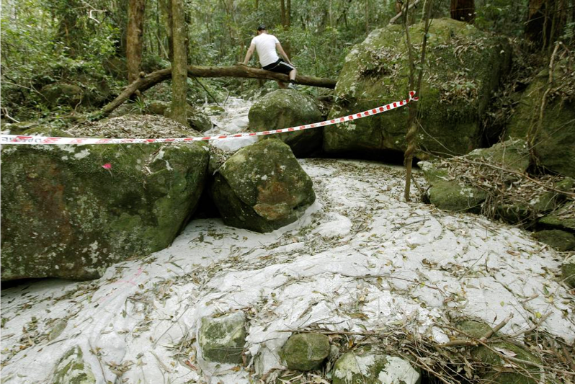

Success and Failures
Success or Failure?
Sugarloaf Colorado, USA
Workers Grouted the Coal Mine to fix cracks as a project to not impact the nature preserve that was adjacent to the mine.
Natural waterways absorbed the grout and created a concrete river in a nature reserve.
A massive fracture running up the hillside. Photo: Darren Pateman
Notes:
A large section of Sugarloaf State Conservation Area in the lower Hunter has been destroyed by massive subsidence from Glencore's West Wallsend Colliery.
A Fairfax Media investigation has uncovered cliff faces crumbled or collapsed, a waterway destroyed, large cracks opened in the earth and a huge collapse of a hillside.
Damage was tracked over more than two kilometres within the ecologically sensitive conservation area adjacent to the mine's Longwall 41.
In one area a cliff face fall of more than 20 metres was discovered.
Damage was cause by unplanned subsidence from longwall mining by West Wallsend Colliery that is mining beneath 23 per cent of the conservation area.
Fairfax Media can also reveal that in June this year a waterway was accidentally grouted by workers carrying out remediation works in the reserve.
Grouting in one of the cracks. Photo: Darren Pateman
A spokesman for the Office of Environment and Heritage confirmed grouting material, used to fill mine subsidence cracks and holes, leaked into a ''drainage line'' and the colliery had been ordered to ''clean up the site''.
Read more: http://www.smh.com.au/nsw/mine-subsidence-devastates-sugarloaf-conservation-area-20130828-2spuc.html#ixzz3D7KkWUy2

Slide 80
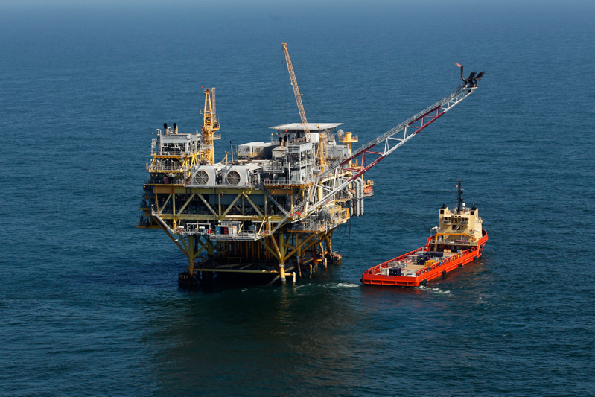

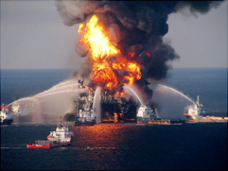
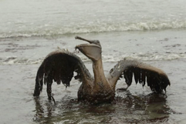
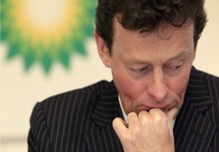
Success and Failures
Success or Failure?
Deep Water Horizon, USA
an ultra-deepwater, dynamically positioned, semi-submersible offshore oil drilling rig - Gulf of Mexico
Deep Water Horizon, USA
$20,000,000,000 USD in Fines
Or
734,60,000,000 AED

Slide 81
What are we up against?
Understanding the language
Topic legitimacy “is it our problem”
Prevailing mindsets and attitudes.
Eliminating the Silo mentality
Practical Tools
Organizational Capacity for Change
Aligning the challenges to Strategic Business goals

Slide 82
We have covered
Sustainability Challenges
UN Global Compact
Sustainable Development Goals
Global Reporting Initiative
PRME
Post-2015 Business Engagement Architecture

Slide 83
Systems Thinking
Release 6

Slide 84
Systems Thinking
Module 3 | Module Covers | Learning outcomes
Systems Thinking | What is Systems Thinking ISO standards and how to use them. ISO 14000 Series on Environmental Management ISO 26000 Corporate Social Responsibility ISO 14000 Series on Environmental Management ISO 9000 Quality Management ISO 50001 Energy Management ISO 55000 Asset Management | This module covers a critical aspect of sustainable change delivery by explaining a thinking versus the traditional “input/output” approach
Version
6.0

Slide 85
The GPM Sustainability Services Focus
Organizations are locked on process and output…
GPM encourages focus on the overall corporate system and benefits / strategic objectives… delivering real value for the business and customers!

Slide 86

What is a System?
A system is a set of parts that interact and affect each other, thereby creating a larger whole of complex thing.
Notes:
Let's start with a simple example from nature: the Earth. Our planet is a very complex system consisting of atmosphere, water, mountains, plains, jungles, plants, insects, animals, humans and our technological wonders, just to name a few. A scientist may look at many interactions of these parts in researching climate change. General patterns may be found in these interactions that may help explain the system and find solutions to the problems by changing the patterns of interaction between the parts.
Now, let's apply the idea of a system to business. We'll start small and work our way up. A business is a system consisting of many parts: employees, management, capital, equipment, and products, among others. Your business and your competitors comprise a system, which we may call an industry. Different industries, along with consumers, governments, and non-governmental organizations make up our economic system.
http://education-portal.com/academy/lesson/systems-thinking-in-management-definition-theory-model.html

Slide 87
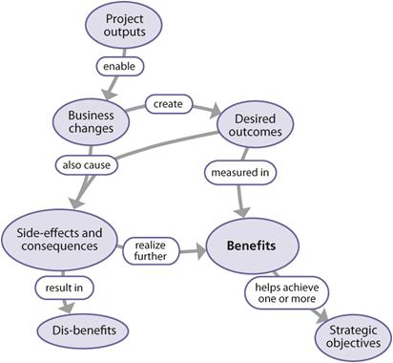
Output vs. Benefit
Output
The deliverable, or output developed by a project from a planned activity.
Capability
The completed set of project outputs required to deliver an outcome; exists prior to transition.
Outcome
A new operational state achieved after transition of the capability into live operations.
Benefit
The measurable improvement resulting from an outcome perceived as an advantage by one or more stakeholders, which contributes towards one or more organizational objectives.
Relationship between outputs, outcomes and benefits, The Office of Government Commerce (2009-07-15). Managing Successful Projects with PRINCE2™ 2009 Edition, Kindle Edition.

Slide 88


Why we encourage this?
Many Project Managers focus on project inputs and outputs rather than value and benefit to the overall system. This is the same as focusing on a single drop of water. If we pollute it, no big deal. It is only one drop…
That’s a lot of water… Over 20,000,000
Project Managers globally
Notes:
We just covered a lot. Time for a quick break.

Slide 89

Getting to Know ISO Standards

Slide 90

ISO standards
Guidelines and Standards
Guidelines
ISO 26000 - CSR
ISO 21500 – Project Management
Normative Standards ISO 9000 – Quality Management
ISO 14000 - Environmental
ISO 50001- Energy Management
ISO 55000 – Asset Management
Notes:
What are the benefits of ISO International Standards?
We cover ISO Standards that pertain to sustainability as they are important in understanding the principles and approach that project managers should take to ensure quality, benefits and value.
ISO International Standards ensure that products and services are safe, reliable and of good quality. For business, they are strategic tools that reduce costs by minimizing waste and errors and increasing productivity. They help companies to access new markets, level the playing field for developing countries and facilitate free and fair global trade. (ISO.org)
There are two kinds. Guidelines and normatives….

Slide 91

What ISO 26000 is NOT…
A management system standard.
Intended or appropriate for certification purposes or regulatory or contractual use.
Intended to provide a basis for legal actions, complaints, defenses or other claims in any international, domestic or other proceeding.
Intended to be cited as evidence of the evolution of customary international law.
Intended to prevent the development of national standards that are more specific, more demanding, or of a different type.

Slide 92
What ISO 26000 is…
Intended to assist organizations in contributing to Sustainable Development.
Intended to promote common understanding in the field of Social Responsibility.
Intended to complement other instruments & initiatives for Social Responsibility and not to replace them.
Intended to provide organizations with guidance concerning Social Responsibility and can be used as part of public policy activities.
Notes:
ISO 26000 contains no requirements and therefore the word “shall”, which indicates a requirement in ISO language, is not used
But does contain 386 “should”s

Slide 93
ISO 26000 Principles of Social Responsibility
Accountability
Businesses are expected to be accountable for its impacts on society & the environment
Transparency
Businesses are expected to be transparent in its decisions & activities that impact on society & the environment.
Ethical Behavior
Businesses are expected to behave ethically at all times.
Stakeholder Interests
Businesses are expected respect, consider & respond to the interests of its stakeholders.
Rule of Law
Businesses are expected to abide by the rule of law for that region and or country.
International Norms of Behavior
Businesses are expected to respect international norms of behavior, while adhering to the principle of respect for the rule of law.

Slide 94
ISO 26000 Principles of Social Responsibility
Respect for Human Rights
An organization should: respect and, where possible, promote the rights set out in the International Bill of Human Rights;
respect the universality of these rights, that is, that they are indivisibly applicable in all countries, cultures and situations;
in situations where human rights are not protected, take steps to respect human rights and avoid taking advantage of these situations; and
in situations where the law or its implementation does not provide for adequate protection of human rights, adhere to the principle of respect for international norms of behavior.

Slide 95
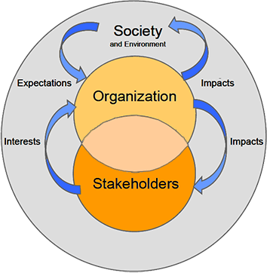
ISO 26000 Principles of Social Responsibility
Recognizing Social Responsibility - Impacts, Interests, and Expectations In addressing its social responsibility an organization should understand three relationships
Between the organization and society - An organization should understand and recognize how its decisions and activities impact on society and the environment. An organization should also understand society's expectations of responsible behavior concerning these impacts. This should be done by considering the core subjects and issues of social responsibility
Between the organization and its stakeholders - An organization should be aware of its various stakeholders. These are the individuals or groups whose interests could be affected by the decisions and activities of the organization
Between the stakeholders and society An organization should understand the relationship between the stakeholders' interests that are affected by the organization, on the one hand, and the expectations of society on the other.
Figure - Relationship between an organization, its stakeholders and society
Notes:
The recognition of social responsibility involves identifying the issues raised by the impacts of an
organization's decisions and activities, as well as the way these issues should be addressed so as to
contribute to sustainable development.
The recognition of social responsibility also involves the recognition of an organization's stakeholders. As
described in earlier is a basic principle of social responsibility is that an organization should respect and consider
the interests of its stakeholders that will be affected by its decisions and activities.

Slide 96

ISO 14000 Family
A series of guidance documents and standards to help organizations address environmental issues.
These ISO’s below deal with Environmental Management Systems (EMS)
14001: Environmental Management Systems
14004: EMS general guidelines
14010: Guidelines for Environmental Auditing
14011: Guidelines for Auditing of an EMS
14012: Auditing - Qualification criteria
14064: Greenhouse gases
Notes:
ISO 14004 is guidance on how to implement ISO 14001
10, 11, and 12 relate to auditing of the 14001 standard. I would note here that a new joint auditing standard is currently being developed that will eventually replace 14010, 14011, and 14012. This new standard ISO 19011 is an auditing standard that may be used for both ISO 9000 and ISO 14001.
ISO 14064-1:2006 Greenhouse gases -- Part 1: Specification with guidance at the organization level for quantification and reporting of greenhouse gas emissions and removals

Slide 97
What is the Environment?
Environment: Surroundings in which an organization operates, including air, water, soil, natural resources, flora, fauna, humans and their interrelation. (ISO 14001:2015)

Slide 98
ISO 14001:2015 Key Elements
Context of the Organization
Understanding the organization and its context
Understanding the needs and expectation of interested parties
Understanding the scope of the environmental management system
Environmental management system
Leadership
Leadership and commitment
Environmental policy
Organizational roles, responsibilities and authorities
Planning
Actions to address risks and opportunities
Environmental objectives and planning to achieve them
Support
Resources
Competence
Awareness
Communication
Documented information
Operation
Operational planning and control
Emergency preparedness and response
Performing Evaluation
Monitoring, measurement, analysis and evaluation
Internal Audit
Management review
Improvement
General
Nonconformity and corrective action
Continual Improvement
Notes:
According to ISO 14001:2015
Introduction
Achieving a balance between the environment, society and the economy is considered essential to meet the needs of the present without compromising the ability of future generations to meet their needs. Sustainable development as a goal is achieved by balancing the three pillars of sustainability.
Societal expectations for sustainable development, transparency and accountability have evolved with increasingly stringent legislation, growing pressures on the environment from pollution, inefficient use of resources, improper waste management, climate change, degradation of ecosystems and loss of biodiversity.
This has led organizations to adopt a systematic approach to environmental management by implementing environmental management systems with the aim of contributing to the environmental pillar of sustainability.
Aim of an environmental management system
The purpose of this International Standard is to provide organizations with a framework to protect the environment and respond to changing environmental conditions in balance with socio-economic needs. It specifies requirements that enable an organization to achieve the intended outcomes it sets for its environmental management system.
A systematic approach to environmental management can provide top management with information to build success over the long term and create options for contributing to sustainable development by:
— protecting the environment by preventing or mitigating adverse environmental impacts;
— mitigating the potential adverse effect of environmental conditions on the organization;
— assisting the organization in the fulfilment of compliance obligations;
— enhancing environmental performance;
— controlling or influencing the way the organization's products and services are designed, manufactured, distributed, consumed and disposed by using a life cycle perspective that can prevent environmental impacts from being unintentionally shifted elsewhere within the life cycle;
— achieving financial and operational benefits that can result from implementing environmentally sound alternatives that strengthen the organization’s market position;
— communicating environmental information to relevant interested parties

Slide 99
What is an EMS?
Systematic way of managing an organization’s environmental affairs
Based on Plan-Do-Check-Act Model (PDCA)
Focused on Continual Improvement of system
Addresses immediate and long-term impact of an organization’s products, services and processes on the environment.
A tool to improve environmental performance
Notes:
I introduce the term “PDCA” here
I often use the term “activities, products, and services” here and reference the standard’s use of these terms

Slide 100
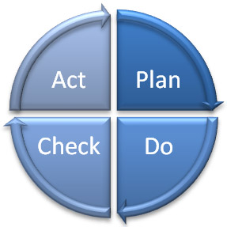
What is an EMS?
Deming Model - PDCA
Management
Review
Planning
Checking
Corrective Action
Implementation
Notes:
The steps in each successive PDCA cycle are:
PLAN Establish the objectives and processes necessary to deliver results in accordance with the expected output (the target or goals). By establishing output expectations, the completeness and accuracy of the specification is also a part of the targeted improvement. When possible start on a small scale to test possible effects.
DO Implement the plan, execute the process, make the product. Collect data for charting and analysis in the following "CHECK" and "ACT" steps.
CHECK Study the actual results (measured and collected in "DO" above) and compare against the expected results (targets or goals from the "PLAN") to ascertain any differences. Look for deviation in implementation from the plan and also look for the appropriateness and completeness of the plan to enable the execution, i.e., "Do". Charting data can make this much easier to see trends over several PDCA cycles and in order to convert the collected data into information. Information is what you need for the next step "ACT".
ACT Request corrective actions on significant differences between actual and planned results. Analyze the differences to determine their root causes. Determine where to apply changes that will include improvement of the process or product. When a pass through these four steps does not result in the need to improve, the scope to which PDCA is applied may be refined to plan and improve with more detail in the next iteration of the cycle, or attention needs to be placed in a different stage of the process.

Slide 101
Why Do Organizations Implement an EMS ?
Helps to identify the causes of environmental problems.
better to make a product right the first time
cheaper to prevent a spill or other accident
cost effective to prevent pollution
Trade and competitive issues
Inconsistency in environmental regulation and enforcement
Many individual parts may already be in place – just need to unify under the EMS umbrella!
??Why should a project manager be familiar with the EMS?

Slide 102

ISO 50001: 2011 Energy Management Systems
ISO 50001 gives organizations the requirements for energy management systems (EnMS)
Provides a framework for
Industrial plants
Commercial
Institutional and governmental facilities
Entire organizations to manage energy
Notes:
ISO 50001 establishes a framework for industrial plants ; commercial, institutional, and governmental facilities ; and entire organizations to manage energy.
Targeting broad applicability across national economic sectors, it is estimated that the standard could influence up to 60 % of the world’s energy use.*
* This estimate is based on information provided in the section, “ World Energy Demand and Economic Outlook ”, in the International Energy Outlook 2010, published by the US Energy Information Administration. This cites 2007 figures on global energy consumption by sector, including 7 % by the commercial sector (defined as businesses, institutions, and organizations that provide services), and 51 % by the industrial sector, (including manufacturing, agriculture, mining, and construction). As ISO 50001 is primarily targeted at the commercial and industrial sectors, adding the above figures provides an approximate total of 60 % of global energy demand on which the standard could have a positive impact.

Slide 103
ISO 50001: 2011 Energy Management Systems
ISO 50001 — Why is it important ?
1. Improved energy performance can provide rapid benefits for an organization by maximizing the use of its energy sources and energy-related assets, thus reducing both energy cost and consumption.
2. The organization will also make positive contributions toward reducing depletion of energy resources and mitigating worldwide effects of energy use, such as global warming.
Notes:
ISO 50001 — Why is it important?
Energy is critical to organizational operations and can be a major cost to organizations, whatever their activities. An idea can be gained by considering the use of energy through the supply chain of a business, from raw materials through to recycling.
In addition to the economic costs of energy to an organization, energy can impose environmental and societal costs by depleting resources and contributing to problems such as climate change.
The development and deployment of technologies for new energy sources and renewable sources can take time.
Individual organizations cannot control energy prices, government policies or the global economy, but they can improve the way they manage energy in the here and now. Improved energy performance can provide rapid benefits for an organization by maximizing the use of its energy sources and energy-related assets, thus reducing both energy cost and consumption. The organization will also make positive contributions toward reducing depletion of energy resources and mitigating worldwide effects of energy use, such as global warming.
ISO 50001 is based on the management system model that is already understood and implemented by organizations worldwide. It can make a positive difference
for organizations of all types in the very near future, while supporting longer term efforts for improved energy technologies.

Slide 104
ISO 50001: 2011 Energy Management Systems
Primary Energy Sources
Renewable: Solar, Water, Wind, Biomass
Non-Renewable: Oil, Gas, Carbon and Nuclear fusion
Secondary Energy
Electric, mechanic, Thermic, Hot water, Compressed Air, Biodiesel and Fuel in general
Final Use
Lighting, Refrigeration, Heating, Process, etc.

Slide 105

Principles of Quality Management (ISO 9001:2015)
These principles embodied in ISO 9001 have been developed with the intention that management can lead the organization towards improved performance.
Customer Focus
Leadership
Engagement of people
Process approach
Improvement
Evidence-based decision making
Relationship management
Look for this again during Project Quality Management!
Notes:
Source: http://www.iso.org/iso/iso_9001-2015_-_how_to_use_it.pdf

Slide 106
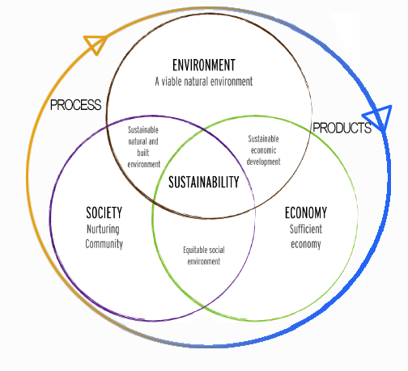
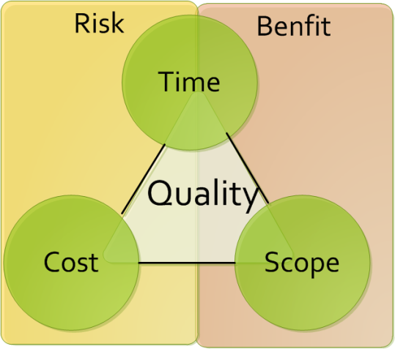
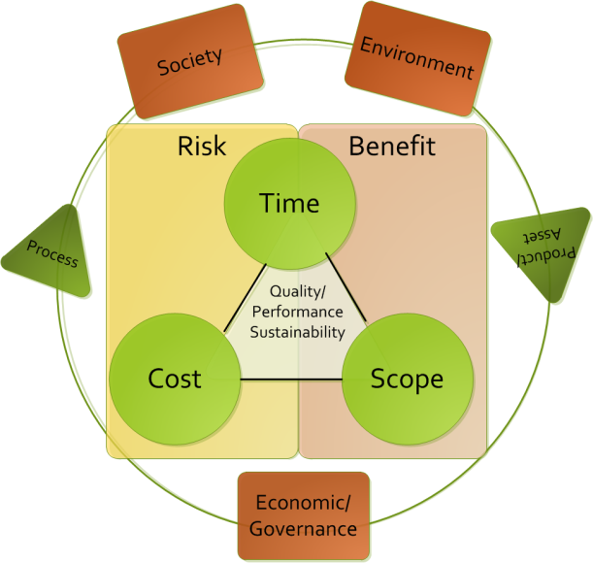
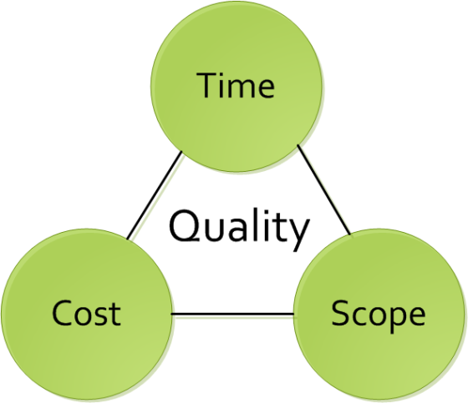
The Current PM Challenge
Many project managers are locked onto focusing on the traditional Time / Cost / Scope paradigm (if lucky they take into account quality)
Successful project managers focus on time, cost, quality, scope, benefits and risk
Exceptional project managers also take into account the other triple constraint… Though the key questions for organizations is how to facilitate this?

Slide 107

Internal Audits
Definitions (ISO 9000:2005)
"A systematic, independent and documented process for obtaining audit evidence of
Audit Evidence: Records, statements of fact or other information relevant to the audit criteria and verifiable
... And evaluating it objectively to determine the extent to which they meet the criteria for audit “
Audit Criteria: A set of policies, procedures or requirements.
(They are used as a benchmark against which we compare the evidence of the audit)

Slide 108
Internal Audits
Audit Principles
Ethical conduct: trust, integrity, confidentiality, and discretion.
Fair Presentation: report truthfully and accurately
Professional Care: Application of the audit. Necessary competence.
Independence: the basis for the impartiality and objectivity of the conclusions.
Notes:
What is the Purpose of an Audit?
What are the stages of an Audit?
- Preparation, Execution, and Monitoring Report

Slide 109
What is ISO 55000?
The International Standard that is used for managing physical assets in particular, but can also be applied to other asset types.
Project managers must be responsible for the entire asset lifecycle and therefor understand how the asset (product) will be managed after it leaves the project lifecycle
55000

Slide 110
What is Asset Management
The factors which influence the type of assets that an organization requires to achieve its objectives, and how the assets are managed, include the following:
the nature and purpose of the organization;
its operating context;
its financial constraints and regulatory requirements;
the needs and expectations of the organization and its stakeholders.
These influencing factors need to be considered when establishing, implementing, maintaining and continually improving asset management.

Slide 111
What are the benefits of asset management?
Improved financial performance: improving the return on investments and reducing costs can be achieved, while preserving asset value and without sacrificing the short or long-term realization of organizational objectives;
Informed asset investment decisions: enabling the organization to improve its decision making and effectively balance costs, risks, opportunities and performance;
Managed risk: reducing financial losses, improving health and safety, good will and reputation, minimizing environmental and social impact, can result in reduced liabilities such as insurance premiums, fines and penalties;
Improved organizational sustainability: effectively managing short and long-term effects, expenditures and performance, can improve the sustainability of operations and the organization;
Improved efficiency and effectiveness: reviewing and improving processes, procedures and asset performance can improve efficiency and effectiveness, and the achievement of organizational objectives.

Slide 112
What are the benefits of asset management?
improved services and outputs: assuring the performance of assets can lead to improved services or products that consistently meet or exceed the expectations of customers and stakeholders;
Demonstrated social responsibility: improving the organization’s ability to, for example, reduce emissions, conserve resources and adapt to climate change, enables it to demonstrate socially responsible and ethical business practices and stewardship;
Demonstrated compliance: transparently conforming with legal, statutory and regulatory requirements, as well as adhering to asset management standards, policies and processes, can enable demonstration of compliance;
Enhanced reputation: through improved customer satisfaction, stakeholder awareness and confidence;

Slide 113
Fundamentals : Value
Assets exist to provide value to the organization and its stakeholders.
Asset management does not focus on the asset itself, but on the value that the asset can provide to the organization. The value (which can be tangible or intangible, financial or non-financial) will be determined by the organization and its stakeholders, in accordance with the organizational objectives.
This includes:
a clear statement of how the asset management objectives align with the organizational objectives;
the use of a life cycle management approach to realize value from assets;
the establishment of decision-making processes that reflect stakeholder need and define value.

Slide 114
Fundamentals : Alignment
Asset management translates the organizational objectives into technical and financial decisions, plans and activities.
Asset management decisions (technical, financial and operational) collectively enable the achievement of the organizational objectives.
This includes:
the implementation of risk-based, information-driven, planning and decision-making processes and activities that transform organizational objectives into asset management plans
the integration of the asset management processes with the functional management processes of the organization, such as finance, human resources, information systems, logistics and operations;
the specification, design and implementation of a supporting asset management system.

Slide 115
Fundamentals : Leadership
Leadership and workplace culture are determinants of realization of value.
Leadership and commitment from all managerial levels is essential for successfully establishing, operating and improving asset management within the organization.
This includes:
clearly defined roles, responsibilities and authorities;
ensuring that employees are aware, competent, and empowered;
consultation with employees and stakeholders regarding asset management.

Slide 116
Fundamentals : Assurance
Asset management gives assurance that assets will fulfill their required purpose.
The need for assurance arises from the need to effectively govern an organization. Assurance applies to assets, asset management and the asset management system.
This includes:
developing and implementing processes that connect the required purposes and performance of the assets to the organizational objectives;
implementing processes for assurance of capability across all life cycle stages;
implementing processes for monitoring and continual improvement;
providing the necessary resources and competent personnel for demonstration of assurance, by undertaking asset management activities and operating the asset management system.

Slide 117
Correlation
According to ISO relevant asset management subject areas include:
data management;
condition monitoring;
risk management;
quality management;
environmental management;
systems and software engineering;
life cycle costing;
dependability (availability, reliability, maintainability, maintenance support);
configuration management;
tero-technology;
sustainable development;
inspection;
non-destructive testing;
pressure equipment;
financial management;
value management;
shock and vibration;
acoustics;
qualification and assessment of personnel;
project management;
property and property management;
facilities management;
equipment management;
commissioning process;
energy management.
Notes:
Ask the class which of these are not relevant to project management. The answer is none. They are all relevant. If a PM doesn’t understand asset management, they will not be successful.

Slide 118
Relationship to Projects
Stakeholders and organizational context
Portfolio, Program & Project Management
Organizational plans and objectives
Asset management policy
Strategic asset management plan (SAMP) Asset management objectives
Plans for developing asset management system & relevant support
Asset management plans
Implementation of asset management plans
Asset Management system + relevant support
Asset Portfolio
Performance evaluation and improvements
Based on ISO 55000, Relationship between key elements of an asset management system
Notes:
In blue, you will find the relationship between key elements of an asset management system. In green you will see the cross pollination to the project management realm.

Slide 119
We have covered
Systems Thinking
ISO 26000
ISO 14000 Series
ISO 9000
ISO 50001
ISO 55000

Slide 120
Ethics, Principles, and Values
Module 4 | Module Covers | Learning outcomes
Ethics, Principles and Values | Ethics Principles Values | Understand the Principles, Ethics and Values behind Sustainable Change Delivery. .
Version
6.0

Slide 121

Business Ethics
Business ethics are:
Rules of conduct
Patterns of behaviour in business
‘Doing the right thing’
Involves responsibility to:
Suppliers
Employees
Wider community
Even competitors…

Slide 122
Business Principles
Shared values horizontally and vertically
Shape relationships with all stakeholders
Affects dealings through supply chain
Key principles
Respect for human rights
Setting appropriate conditions of employment in suppliers’ factories

Slide 123

Costs of ethical behaviour
Increased costs due to
Audits and training
Remedial actions
Employment of Ethical Trade teams
However….. These produce
Improvements to a supplier mean standards improve
Transparency in business gives all stakeholders, including customers, confidence in the brand

Slide 124
Corporate Social Responsibility (Why Morally)
Corporations cause socio-environmental issues and should therefore play a role in solving them (E.g.: pollution)
As powerful players in society, they should use that power responsibly
Corporations rely on the contributions of shareholders, employees, suppliers, communities and consumers and have a duty to take into account their collective needs.

Slide 125
Corporate Social Responsibility (Why Ethically)
Expectations by society go beyond meeting legal responsibilities
For Example:
Ensuring contractors and sub-contractors pay their employees
Purchasing from suppliers that have good environmental practices
Not working with organizations the violate human rights

Slide 126
The 9 components of Business Ethics Management
Business Ethics Management
Mission or Values Statement
Code of Ethics
Reporting/ Advice Channels
Risk Analysis and Management
Ethics Officers and Committees
Ethics Consultants
Ethics Education and Training
Stakeholder consultation dialogue and partnership programs
Auditing, Accounting and Reporting
Notes:
The direct attempt to formally manage ethical issues through specific policies practices and programs.

Slide 127
Enhanced Focus
Early in the course we covered the UN Global Compact Ten Principles and the PRME Six Principles.
GPM Has taken these principles as well as principles from the Earth Charter and developed Six Principles for Sustainable Change Delivery that should be employed on all Projects.

Slide 128
What are Principles and Values
Principles: Fundamental norms, rules, or values that represent what is desirable and positive for a person, group, organization, or community, and help it in determining the rightfulness or wrongfulness of its actions. Principles are more basic than policy and objectives, and are meant to govern both.
Values: Important and lasting beliefs or ideals shared by the members of a culture about what is good or bad and desirable or undesirable. Values have major influence on a person's behavior and attitude and serve as broad guidelines in all situations. Some common business values are fairness, innovation and community involvement.
Notes:
Source: http://www.businessdictionary.com/definition/principles.html
http://www.businessdictionary.com/definition/values.html

Slide 129
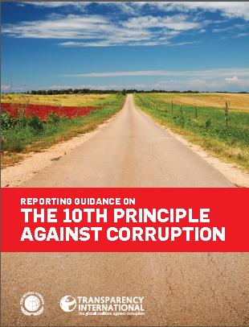
Communicating policies and values
According to Huguette Labelle - Chair, Transparency International Member, UN Global Compact Board
Reporting Guidance on the UNGC 10th Principle?
Through transparency, organizations can communicate to stakeholders and the public their values and polices and how they are being translated into action.
Transparency of commitment to values and openness about policies and processes will not only enhance a company’s reputation but act as a substantial deterrent to those wishing to act corruptly.
Transparency is a first line defence against corruption
Notes:
The Business Case for reporting on the 10th Principle:
There are three major benefits from reporting on anti-corruption. The first two categories apply to individual organizations (independent of their size), whereas the third category outlines benefits also for the overall community.
Increased internal integrity and transparency
Enhanced reputation
Common information basis
■■ sharing experience and procedures with other organizations;
■■ stimulating multi-stakeholder dialogues;
■■ increasing importance of disclosure on anti-corruption activities in overall sustainability agendas; and
■■ driving media coverage of good anti-corruption practices through provision of comparable progress reports.
Corruption is defined by Transparency International as “the abuse of entrusted power for private gain”. This convenient shorthand, encompassing myriad illegal and illicit acts, recognizes the breadth of the concept, but does not attempt to enumerate or precisely delimit. During the negotiations of the United Nations Convention against Corruption, UN Member States carefully considered the opportunity for the global anti-corruption treaty to provide a legal definition of corruption. Concluding that any attempt at a comprehensive definition inevitably would fail to address some relevant forms of corrupt behaviour, the international community reached global consensus on a large number of manifestations of corruption while leaving each State free to go beyond the minimum standards set forth in the Convention.
The Convention calls for ratifying States to outlaw, at a minimum, bribery of public officials; embezzlement, trading in influence, abuse of function, and illicit enrichment by public officials; and bribery and embezzlement in the private sector, as well as money laundering and obstruction of justice. These corrupt actions are spelled out under the chapter of the Convention devoted to criminalization
and law enforcement, denoting that corruption is a crime, which is a notion wider than bribery and extortion. In consonance with this approach, the 10th Principle of the United Nations Global Compact calls for companies to work against corruption in all its forms, including extortion and bribery.

Slide 130
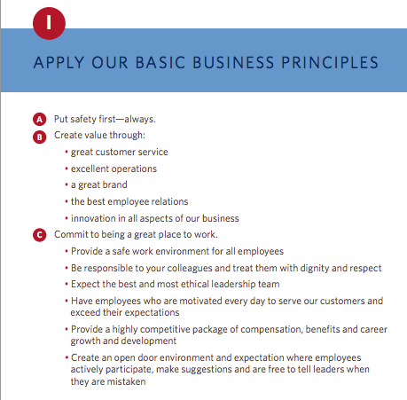
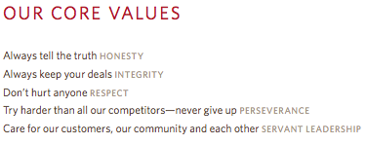
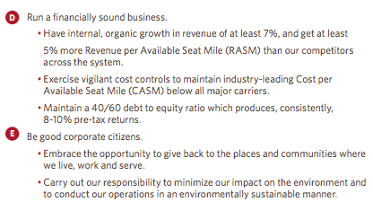
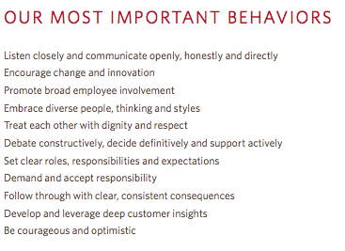

Example – Delta Airlines
http://www.delta.com/content/dam/delta-www/pdfs/policy/delta-rules-of-the-road.pdf

Slide 131
GPM® Sustainable Change Delivery Principles
Commitment & Accountability - Recognizing the essential rights of all to healthy, clean and safe environments, equal opportunity, fair remuneration, ethical procurement, and adherence to rule of law
Ethics & Decision Making - Supporting organizational ethics, decision making with respect for universal principles through identification, mitigation, and the prevention of adverse short and long-term impacts on society and the environment
Integrated & Transparent - Fostering the interdependence of economic development, social integrity, and environmental protection in all aspects of governance, practice and reporting
Principal & Values Based - Conserving and enhancing our natural resource base by improving the ways in which we develop and use technologies and resources
Social & Ecological Equity - Assessing human vulnerability in ecologically sensitive areas and centers of population through demographic dynamics
Economic Prosperity - Establishing fiscal strategies, objectives, and targets that balance the needs of stakeholders, including immediate needs and those of future generations

Slide 132
PSM3™ Levels for Sustainability
Level 5
PRINCIPLED
Has industry leading practices and procedures with continuous improvement, quantifiable value from sustainability initiatives
Level4
Essential
Organization demonstrates active interest, adopted policies and procedures for sustainability
Level 3
Foundational
Organization has formal policies, has identified formal processes and procedures

Slide 133
PSM3™ Levels for Sustainability
Level 2
Provisional
The organization is aware of some competency demonstrated in sustainable practice.
Level 1
Nonexistant
The organization is unaware of any focused attention to sustainability
Level 0
Uncertain
Organization does not know where it currently stands.

Slide 134
Conflict of Interest.
A situation that arises when a practitioner of project management is faced with making a decision or doing some act that will benefit the practitioner or another person or organization to which the practitioner owes a duty of loyalty and at the same time will harm another person or organization to which the practitioner owes a similar duty of loyalty.
The only way practitioners can resolve conflicting duties is to disclose the conflict to those affected and allow them to make the decision about how the practitioner should proceed.

Slide 135
VALUES, MORALS & ETHICS
Values are the fundamental beliefs that we hold. They are the principles that we hold regarding what is right, good, and just.
Morals are the values which are inherent in a system of beliefs – a higher authority such as a business society in which business values such as performance excellence, quality, safety, service, and accomplishing desired results are important.

Slide 136
Ethics in Project Management
Project team members are required to work in different environments that have unique cultural value systems, morals, and ethics.
It is expected that people in the project management field have both personal and professional ethics.

Slide 137
Eight ethical guidelines foundation for projects.
Recognize that managing ethics is a process. Ethics management is the process of reflection and dialog . that produces deliverables such as codes, policies and procedures.
The goal of an ethics management initiative is preferred behaviour in the project environment.
The best way to manage ethical dilemmas, like negative project risks, is to avoid their occurrence in the first place
Make ethics decisions in teams, and make decisions public, as appropriate
Integrate ethics management with other project practices. Define preferred ethical values directly in the project plan
Use cross-functional teams to develop your ethics management plan. Benefit from varied input
Value forgiveness Help project personnel recognize and address their mistakes and then support them to continue to try to operate ethically
Give yourself credit for trying Attempting to operate ethically and making a few mistakes is better than not trying at all. All projects are comprised of people and people are not perfect.
APMBoK V. 5

Slide 138
The Opposite of Ethics
INSERT VIDEO FROM MODULE FOLDER (ZAMBIA)
Notes:
Show video on zambia

Slide 139
We have covered
Principles For Sustainable Change Delivery
Values
Ethics

Slide 140
Governance, Portfolio and Program Management
Release 6

Slide 141
Governance, Portfolio and Program Management
Module 5 | Module Covers | Learning outcomes
Governance, Portfolio and Program Management | What is Project Governance Principles of Project Governance Project Governance Areas P3O (Portfolio, Program, Project Offices) Portfolio Management Program Management Benefits of Project Offices Types of Project Offices Responsibilities of Project Offices | Gain an understanding of governance, portfolio and program management.
Version
6.0

Slide 142
Project Governance
Governance is the framework by which an organization is directed and controlled. Project governance includes, but is not limited to, those areas of organizational governance that are specifically related to project activities.
ISO 21500

Slide 143
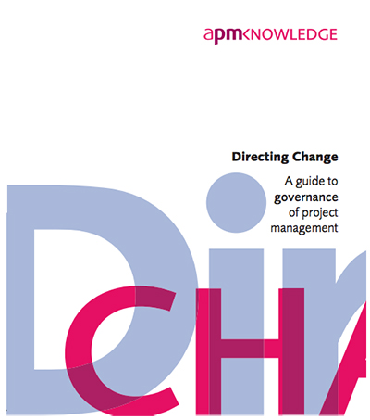
Four Key Principles of Governance
Portfolio Direction
Project Sponsorship
Project Management Capability
Disclosure and Reporting

Slide 144
Eight Key Principles of Project Governance
The (project) board has overall responsibility for the governance of project management.
The organization differentiates between projects and non project-based activities.
Roles and responsibilities for the governance of project management are defined clearly.
Disciplined governance arrangements, supported by appropriate methods, resources and controls are applied throughout the project life cycle. Every project has a sponsor.
There is a demonstrably coherent and supporting relationship between the overall business strategy and the project portfolio.
All projects have an approved plan containing authorization points at which the business case, inclusive of cost, benefits and risk is reviewed. Decisions made at authorization points are documented and communicated.

Slide 145
Eight Key Principles of Project Governance
Members of delegated authorization bodies have sufficient representation, competence, authority and resources to enable them to make appropriate decisions.
Project business cases are supported by relevant and realistic information that provides a reliable basis for making authorization decisions.

Slide 146
Project Governance
Project governance may include subjects such as the following:
— defining the management structure;
— the policies, processes and methodologies to be used;
— limits of authority for decision-making;
— stakeholder responsibilities and accountabilities;
— interactions such as reporting and the escalation of issues or risks.
The responsibility for maintaining the appropriate governance of a project is usually assigned either to the project sponsor or to a project steering committee.
Src. ISO 21500 Pg.6
Notes:
We just covered a lot. Time for a quick break.

Slide 147
Where Project Governance Exists
Project Governance
Notes:
Here is a diagram, from ISO 21500, Guidance on Project Management page 3 that depicts the project organization. The boxes represent project management concepts and the arrows represent a logical flow by which the concepts are connected. The dotted lines are organizational boundaries.
The blue box listed as opportunities represents what becomes the project initiation phase and comes from organizational need, market demand and so forth. I will stress that factors outside the organizational boundary include regulatory, socio-economic, and ecological. If they are penetrating the organization then where would they most likely live within the project environment? Project Governance. Makes sense.

Slide 148
Project portfolios
a collection of projects or programs and other work that are grouped together to facilitate effective management of that work to meet strategic business needs’ (Project Management Institute, 2008)
the totality of an organisation’s investment in the changes [projects and programs] required to achieve its strategic objectives (Office of Government Commerce, 2009)

Slide 149
Why portfolio management?
Portfolio management is needed when an organisation operates a number of projects and programs
The decision on which projects to undertake is usually made by senior managers
A central project office, or network of project offices, can assist by providing information and updates about projects and programs

Slide 150
Aims of Portfolio Management
Effective portfolio management is based on:
Sources: Kendall & Rollins, 2003; Cooper, Edgett, Klienschmidt, 2001
ALIGN | Aligning projects with strategy
SELECT | Selecting the right number of projects
BALANCE | Maintaining a balance of project types
VALUE | Maximising value to the organisation
RESOURCE | Ensuring that the project portfolio fits with resource capability so that the organization can sustain the maximum value from project investments
RISK | Reduce overall risk

Slide 151
Sustainable Portfolios
Collection of projects and programs that delivers value for the organisation and society
without creating undue impact on the organization and its workers, society or the
environment.
ALIGN | Aligning projects with strategy AND obligations to environment and society
SELECT | Incorporating sustainability principles into project selection criteria Using non-financial measures (eg SROI) to determine desirable projects
BALANCE | Balancing projects positive and negative impacts across environmental, social and economic dimensions Use integrated reporting on portfolio performance
VALUE | Embedding sustainability into capital investment appraisal and risk management Managing benefits delivery to maximize positive outcomes
RESOURCE | Determine the carrying capacity of the portfolio
RISK | Determine the organization's sustainability risk and opportunities (using PSM3) Undertaking an sustainability impact assessment for all projects in the portfolio

Slide 152
Portfolio management characteristics
Screening, analysis and financial appraisal of project and program characteristics (resources, schedules, cash flows, risks, benefits, etc.) in relation to overall business strategy.
Prioritization and/or selection of projects and programs within the portfolio, given the resources available, likely returns and risks.
Continued monitoring of the portfolio characteristics as projects and programs develop.
Adjustment of the portfolio with regard to the constraints, risks and anticipated returns in the light of developing circumstances.
Practically, this means…
APMBoK V. 5
Notes:
This means:
Don’t take on more projects/programs than you can cope with. If you want to start up a new program/project you may need to slow or stop one or more others to free up the resources (including financial resources).
Don’t take on too many projects/programs that are high risk at any one time – unless you want to end up like Lehmann Brothers.
Keep an eye on the mix to make sure it doesn’t get out of hand.
When commercial/economic/political circumstances change, you might need to change what’s in the portfolio. Some projects/programs may no longer be appropriate or affordable. If costs rise on a key project/program you may need to close/suspend others to be able to continue to pay for the overrun.

Slide 153
Project Portfolio Management
1
6
7
2
8
3
4
5
Notes:
A portfolio is a collection of projects, programs and other work. Think of it like a suitcase containing objects, or even a share portfolio that contains a range of different stocks.

Slide 154
Project Portfolio Management
Environment
Strategy
9
11
10
1
6
7
2
3
8
4
5
Notes:
A portfolio is a permanent structure in an organisation, unlike projects and programs which are temporary in nature. This means that over time, new projects are kicked off {blue bubbles} (and become part of the portfolio) and projects are completed {green bubbles} (and exit the portfolio). Some projects are also cancelled {red bubble}. New projects come from a variety of sources. Quite often the projects are established due to a range of ideas that emanate from within the organisation. This could be to make an improvement to a business process or practice, or to replace an old platform or system, for example. Projects may also be established as a result of key priorities in the organisations strategy or due to factors outside the organsation, such as new products being demanded by customers or in response to the actions of a competitor.

Slide 155
Project Portfolio Management
17
12
9
6
7
13
16
10
11
3
4
5
15
14
Notes:
One of the biggest issues in portfolio management is the organisations desire to deliver more projects than is possible, resulting in projects being under resourced or only partially funded. When new projects are identified, the prioritization and selection process must occur and both new and existing projects must be prioritised. This may result in some existing projects being put on hold or cancelled as they are no longer the highest priority (and other projects are now a higher priority).

Slide 156
Project Portfolio Management
9
6
7
10
11
3
4
5
Notes:
When projects are successfully completed they exit the portfolio. This allows for new projects to be identified and prioritized

Slide 157
The P3O
There is a growing argument against the creation of PMOs (Project Management Office) and instead the development of Organizational Project Management that supports the enterprise. We will refer to the function as P3O
P3Os can range from simple setups that offer support functions for the project manager to larger scale operations such as departments that are responsible for linking corporate strategy to project execution.

Slide 158
Program management characteristics
Initiate, accelerate, decelerate, redefine and terminate projects
Manage interdependencies between projects and between projects and business as usual
Manage resources and resource conflicts
Manage program level risks, issues and changes
Define and realize strategic benefits
Notes:
Initiate, accelerate, decelerate, redefine and terminate projects is about prioritising where to apply resources (including financial resources). Which project(s) need to be speeded up, which ones slowed down to free up resource, etc.

Slide 159
Project management vs. program management
Project
Defined start and end
Shorter timescale
May change
Delivers products
Benefits usually follow
Consists of activities
Manages resources
Program
Ends once goal achieved
Longer timescale
May evolve
Delivers strategic change
Benefits usually during
Consists of projects
Manages resource conflict

Slide 160
Program manager’s role
Partner the business
Identify and define projects within the program
Delegate to project managers
Monitor the projects in terms of time, cost, quality, risks and issues
Monitor interdependencies
Focus on strategic benefits
Intervene in projects when necessary
Manage resource conflicts

Slide 161
Benefits of program management
Closer alignment of projects with business strategy
Closer alignment with business priorities
Improved prioritization of projects within the program
Improved focus on benefits
Improved resource management
Consistent management reporting within the program
Program wide and cross-project view of risk
Consistent project management processes and standards within the program

Slide 162
Types of PMOs
Whether it a department or office inside a department, the P3O’s mandate will come from executive leadership.
Project Management Office (PMO)
Project support office (PSO)
Program and Project support office (PPSO)
Program management office (PgMO)
Enterprise project management office (EPMO)
Project Management Department (PMD)
Notes:
Add p30

Slide 163
Benefits of PMXs
Provides a centre of excellence
Expertise and support in planning tools, risk software, etc
Provide economies of scale
Supports multiple projects
Maintains corporate standards
Ensures the consistent application of standards
Supports effective governance
Acts as a single source of information
Supports quality assurance
Supports Continuous improvement

Slide 164
“Experts” advise…
Companies that implemented successful PMOs achieved:
80% ROI
20% reduction in project time
30-35% successful project delivery
Companies without a PMO experience 74% project failure rate
Source: Forrester Research

Slide 165
Strategic Roles
These Ten Functions are key for an optimized P3O. Most start with a few and mature over time to take on more responsibility.
Build, manage and sustain the project methodology
Setting up and providing professional development for competence development that links to a competence framework
Ensuring that Resources are balanced appropriately among projects
Leading and Managing Project Governance
Offering support to project owner/project board
Overall administration in support of projects (tools, software, templates etc.)
Maintaining Project Documents and archives
Providing insight/consult to organizational leadership
Providing information to increase overall organizational knowledge and stewarding organizational capacity for change
Ensuring that projects align with current organizational strategy

Slide 166
The EPMO Enables The Adaptive Organization
By 2015, 60% of the Fortune 1000 will establish an EPMO to improve the value created by investments in projects and programs.
Supporting the Strategic Planning Assumption:
With continued pressure on financial accountability, organizations will require enterprise-level visibility of where their money is going
Continued problems with project coordination across silos will further fuel the need for enterprise visibility and coordination of programs and investments
Alternate position to the Strategic Planning Assumption:
Organizations have the structure that suits their real objectives. A strong PMO is often perceived as a threat to other senior managers.
Most PMOs are in IT — a weak PMO operating in a weak matrixed management environment allows the squeaky wheel to get greased.
Notes:
Strategic Planning Assumption: By 2015, 60% of the Fortune 1000 will establish an EPMO to improve the value created by investments in projects and programs.
Organizations are increasingly concerned with understanding the value that their investment in projects and programs is actually creating.
The strategy execution gap has gone from something pundits write about to something companies are actively beginning to close as quickly and effectively as possible.
The need to proactively rationalize cross-silo dependencies is driving a need to establish an organization at the enterprise level that is chartered with keeping everyone focused on building toward the same strategic outcome.
The economic environment in which organizations find themselves is driving their decision to adopt one of the four common styles of an enterprise PMO (EPMO).

Slide 167


Case study - Fifth Third bank
Super Regional Bank
Founded in 1862
Headquartered in Cincinnati, Ohio.
Fortune 500 - #326
Lines of Business
Commercial Banking
Branch Banking
Consumer Lending
Investment Advisors
49% interest in Fifth Third Processing Solutions/
Affiliate Model (15 Affiliates)
>1,300 full-service banking centers (>100 Bank Marts)
>2,450 ATMs
12 States: Ohio, Kentucky, Indiana, Michigan, Illinois, Florida, Tennessee, North Carolina, West Virginia, Pennsylvania, Missouri, and Georgia.
Fifth Third Bank
(NASDAQ – FITB)
Over $5 B in Revenue
Over $12.3 B Market Capitalization
Over $274 B in Assets under care
Notes:
Placeholder for text (substitute your own text; delete when not used)

Slide 168
Problem
“Silo-ed” Operational Model (by LOB/by Affiliate)
Project redundancies
PMO = IT Governance
Viewed strictly as an enforcement agency
Redundant/inefficient approval & prioritization of initiatives
Enterprise Risk’s NPI (New Product & Initiative) = Business Case justification + Risk Identification Questionnaires
Finance’s AR (Appropriation Request) = Business Case Justification + Capitalization Worksheets
IT Architecture’s ITAC Review = Business Case Justification + Architecture Questionnaires
Adoption challenges

Slide 169
Results
Over 900 Active Projects
Health
On-time Delivery
Executive Dashboards
Over 900 Projects Proposals
IT Compliance self-regulation
5/3 emerged from TARP in Q1 2011
2011 Bloomberg’s World 7th Strongest Bank
Reviewed & prioritized by Tier 1 / Tier 2
Delegation of Toll Gate Audits except for the Top Level of Rigor
Paid U.S. Treasury back $ 3.4 B
Only 3 U.S. Banks made it in the Top 20

Slide 170
We have covered
What is Project Governance
Principles of Project Governance
Project Governance Areas
Portfolio Management
PMO (Project Offices)
Benefits of Project Offices
Types of Project Offices
Responsibilities of Project Offices

Slide 171
Organizational Capacity for Change
Module 6 | Module Covers | Learning outcomes
Organizational Capacity for Change | What is OCC Why Change initiatives fail The Eight Dimensions for OCC Six Points for Innovative Cultures ADKAR Model | Understand what Organizational Capacity for Change is, why it is necessary and what the critical components for change culture are.
Version
6.0

Slide 172
Organizational Capacity for Change Defined
Organizational capacity for change (OCC) can be conceptualized as the overall capability of an organization to either effectively prepare for or respond to an increasingly unpredictable and volatile environmental context. This overall capability is multidimensional, and it comprises three ingredients:
(a) human skill sets and resources
(b) formal systems and procedures, and
(c) organizational culture, values, and norms.

Slide 173
On Change
“It is not the strongest of the species that will survive, nor the most intelligent, but the one most responsive to change.”
—Charles Darwin
“The only person who likes change is a wet baby.”
—Price Pritchett

Slide 174
The New Mandate for Change Leadership
Executive leaders must react quickly to current problems and opportunities, they must also look to and prepare for the future.
Organizations must become more agile, flexible, and nimble.
The new leadership mandate for the 21st century is delivering results in the short term while building change capacity for the long term.

Slide 175
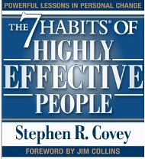
Capacity Opportunity
All individuals must invest time and energy in balancing “production” with “production capacity.”
Covey states that “every production problem is a production capacity opportunity.”
While this insight was directed to individuals and personal effectiveness, it also applies to strategic leaders and collective effectiveness.
Covey, S. (1989). The seven habits of highly effective people. New York, NY: Free Press.

Slide 176
Primary Reasons for Failure to Bring About Change
Organizational members operating in “departmental silos” that focus on local optimization at the expense of the entire system.
Organizational Change takes time, a precious commodity.
The traditional view of organizations is that they are hierarchies with power concentrated at the top with rational and logical employees operating throughout this hierarchy. (While it is true that all organizations are hierarchical in some form and that organizational members are rational at times, this viewpoint is limited and not terribly realistic.)

Slide 177

Leading with both hands
“Strategic leaders today need to be ambidextrous in their approach to leadership. This balancing act is much more challenging than pushing hard for short-term results or nurturing the organization so that new ideas and capabilities emerge in the long term.”
Notes:
Because current pressures usually shove long-term objectives to the side, leaders are proving to be much more practiced in reacting to putting out brush fires in today’s organizations than in preparing the organization to be more change capable. Nonetheless, leaders must learn to fly the plane while rewiring it in flight—this is the mandate of the 21st century.
Change-capable organizations optimize on both of these seemingly contradictory cultural virtues. Hence, the organization needs to become ambidextrous culturally, using the right-handed accountability norms in balance with the left-handed innovation norms.

Slide 178
The Eight Dimensions of organizational capacity for change
Corporate Social Infrastructure
Critical Human Capital
Accountable Cultures
Trustworthy Leadership
Systems
Thinking
Organizational
Capacity for
Change (OCC)
Involved
Mid-management
Innovative
Culture
Capable
Champions
Communication
Systems
Trustworthy
Followers
Adapted from Building Organizational Capacity for Change, Business Expert Press 2011, Pg. 8

Slide 179
Breaking them down
1. Trustworthy Leadership - authority is not enough to make an organization change capable; the strategic leaders must be perceived to be competent and looking out for the well-being of the rest of the employees in the organization.
2. Trusting Followers - within the organization must be favorably disposed to trusting their organization to be change capable.
Notes:
Trustworthy leaders. No lasting, productive change within an organization ever happens without a modicum of trust between its members. As a consequence, the first essential dimension for OCC is the extent to which an organization is perceived to be led by trustworthy leaders. A trustworthy leader is someone who is not only perceived to be competent in leading the organization but also perceived as someone who has the best interests of the organization as their priority. They are only half of the equation when it comes to organizational change; the other half is the followers.
Psychologists tell us that all individuals have a “disposition to trust” others. This disposition is influenced by such things as a person’s genetic background, family norms, and work-related experiences. When an organization
is filled with a critical mass of individuals who are hopeful, optimistic, and trusting, it will be well positioned to experiment with new ways of operating. When an organization is dominated with a critical mass of individuals who are cynical, pessimistic, and not trusting, it will not be well positioned to engage with organizational change initiatives. In sum, a second key dimension of organizational capacity for change is the overall level of trust held by the employees of the organization.

Slide 180
Breaking them down
3. Capable Champions - those individuals within the senior executive group, the middle management ranks, or both who drive the change initiatives within an organization. These individuals are often mavericks and they don’t normally fit in well in bureaucratic structures.
4. Involved Middle Managers- The middle management group that is often uninvolved with the strategy formation design initiatives. This is a mistake. Middle managers have a unique and important role to play in enhancing the change capability of the organization.
Notes:
Individuals, and hence organizations, tend to be inertial. In other words, change takes extra energy and it is much easier to keep doing things the way in which we are accustomed to. Consequently, organizations must identify, develop, and retain a cadre of capable change champions in order to lead the change initiative(s). Within small organizations, these champions are often the same as the head of the organization. Within medium and larger organizations, these champions are often drawn from the ranks of middle management.
Middle managers are those who link top executives to frontline workers. Department heads are classic examples of middle managers, but there are many other types of linkages. While it is undeniable that today’s organizations are flatter hierarchies with fewer middle managers than in the past, their role in helping to bring about change is still important. While change champions often come from the middle management ranks, middle managers can passively or actively block change initiatives due to their unique position within an organization.

Slide 181
Breaking them down
5. Systems Thinking-System thinking is a major departure from the old way of business decision-making in which you would break the system into parts and analyze the parts separately.
6. Effective Communication Systems- When an organization combines systems thinking with high-functioning communication systems, systemic knowledge is created and dispersed throughout the organization.
Notes:
Organizational change capacity involves more than just the “getting the right people on the bus and the wrong people off the bus,” however. It also depends on a proper organization infrastructure.
One of the key infrastructure issues that influence or retard an organizational change initiative is what is called “systems thinking.” These are the rules, structural arrangements, and budgetary procedures that facilitate or hinder an organization-wid —as opposed to a “segmentalist”—approach to organizational change. While segmentalism works quite well for routine procedures, it is anathema to the study of nonroutine events such as strategic decision making, organizational change, or both

Slide 182
Breaking them down
7 and 8 Accountable Cultures – where there are consequences for employees that fail or succeed. Must be counterbalanced with an Innovative Culture. Together, these two dimensions of organizational change capacity—accountability and innovativeness—help to ensure that the organization efficiently marshals scarce resources while creatively looking to the future.
Notes:
the degree to which an organization holds its members accountable for results.

Slide 183
Six points to establish Innovative Culture
Make Innovation Everyone’s Responsibility
Hire and Retain Creative Employees
Put as Many Promising Ideas to the Test as Possible
Use Your Human Resources System to Create Psychological Safety
Emphasize Interdisciplinary Teams Throughout the Entire Organization
Change Cultural Artifacts, Assumptions and Values to Signal Importance of Innovation
Notes:
Notes:
Easily Explained
Easily Explained
Easily Explained
Some mistakes are more lethal than others, so mistakes that do not jeopardize the survival of the organization need to be accepted, even welcomed by leaders. Relatedly, it is more important to focus on the ideas rather than the individuals behind the ideas so that failure is not personalized. And “failure-tolerant leaders emphasize that a good idea is a good idea, no matter where it comes from.
In the 1970s and 1980s, many organizations tried to create specialized subunits where their mandate was to make the organization more innovative. This structural approach to innovation largely failed, either immediately or in the long term. For example, General Motors created the Saturn division as a built-from-scratch innovative new way to produce and sell cars. At first, Saturn had spectacular success. However, the lessons learned from Saturn never translated to the rest of the organization and recently the Saturn division was eliminated. Similarly, too many large organizations try to rely solely on their research and development units for innovation, which greatly constrains the idea production and development process.
Hanna, D. (2010, March 8). How GM destroyed its Saturn success. Forbes, 28.

Slide 184
The Prosci® ADKAR® Model
Briefly describe the change that is being implemented at your workplace and summarize the key elements of. the change
Awareness - Describe your awareness of the need to change. What are the business, customer or competitor issues that have created a need to change?
Desire - List the motivating factors or consequences (good and bad) related to this change that impact your desire to change, including compelling reasons to support the change and specific objections to the change.
Knowledge - List the skills and knowledge you need to support this change, both during and after the transition.
Ability- Considering the skills and knowledge from above, assess your overall ability to implement this change. What challenges do you foresee?
Reinforcement - List the reinforcements in your organization that will help you sustain the change. What incentives are in place to make the change stick? What incentives do not support the change?
ADKAR® is a registered trademark of PROSCI Inc.
Notes:
Using the Prosci ADKAR® Model to analyze a change at your workplace will give you insight as to where you are in the change process and what steps you can take to survive change and advance professionally in a changing business environment. Complete the worksheet to the best of your ability, rating each element on a scale of one (e.g. no awareness) to five (e.g. complete awareness).

Slide 185
Conclusions
“Since organizations are so central to our lives and since they are so important to the fate of humanity, it is imperative that they function well. However, the organizations of the 21st century are not agile enough to deal with the unpredictable and increasingly volatile nature of the environments that they occupy. We need organizations that are more capable of change.” - William Q. Judge, Jr

Slide 186
We have covered
What is OCC
Why Change initiatives fail
The Eight Dimensions for OCC
Six Points for Innovative Cultures
ADKAR Model

Slide 187
The Business Case, Benefits and Value Management
Release 6

Slide 188
The Business Case, Benefits and Value Management
Module 7 | Module Covers | Learning outcomes
The Business Case, Benefits and Value Management | What is the purpose of the business case. Contents of the business case Practical use of the business case Investment Appraisal techniques Calculating Valuation Understanding Benefits | This module covers the business case, how it relates to the project, how to evaluate value and manage benefits
Version
6.0

Slide 189
What is a business case?
The business case provides justification for undertaking a project, in terms of evaluating the benefit, cost and risk of alternative options and rationale for the preferred solution
Its purpose is to obtain management commitment and approval for investment in the project
The business case is owned by the sponsor
APM BoK, 5th edition

Slide 190
Why do we need a business case?
Every project should in some way contribute to the business strategy of the organisation and deliver benefits to the organisation or its customers
In most organisations there are usually several initiatives competing for limited funds.
The purpose of the Business Case is to demonstrate why a particular project should be favoured over others.
It should contain enough relevant information to enable a reasoned decision to be made

Slide 191

Purpose of Business Case
Justification of the project
To obtain authorization for the project and its funding
Used to give direction to a project team
Baseline document for phase and stage reviews
Used in evaluation of change requests
Baseline document for benefits reviews
Used by organization to facilitate lessons learned

Slide 192

Contents of Business Case
Purpose
Project Summary
Business Objectives
Project Objectives
Benefits
Deliverables
Performance Indicators
Risks and Opportunities
Market and Competition Conditions
Organizational Constraints
Project Sponsor
Product Owner
Project Control
Resources
Other Constraints
Business Case
Business Case (Not the one we are referring to.)
Notes:
The typical contents of a Business Case are shown on the slide above. (Couldn’t help the bad humor… in the picture.)
The first element to the document should be the reason or justification for the project.
A statement of Success and Acceptance Criteria should be shown within the Business Case to allow the Project Manager to identify from these the Quality Standards that he/she will be expected to achieve in their project goals.
The Project Sponsor should also identify what benefits the organization should be looking to gain by having this project go ahead so that anyone reading the document can see the reason and result of the project within one area.
The Project Manager will also need to know what they are being asked to produce as an end product. This product needs to be clear and precise so that the Project Manager can develop a prescriptive scope of work to match the deliverables.
A further area of the Business Case will be the Investment Appraisal which will give financial support to the project giving the true value of a project to the organization.
It is important within a Business Case to list the options or approaches available or being considered and this must also include the option of not doing the project and its relevant impact.
The Business Case as stated early is the driving force behind each project and so at every review it must be present for consideration as to whether or not the project should proceed or be halted as the justification or benefit can not now be realised. This is most commonly known as the Go/No go decision point.

Slide 193

Sustainability in the Business Case
Should include references to:
Corporate Sustainability Governance
Regulatory Compliance
Goals and Objectives
Principles and Values
Performance Indicators Using P5 (We will get to that)
Project Managers should always review the Business Case or Charter from a CSR Perspective by leveling the deliverables against the EMS or with the CSR Officer.

Slide 194
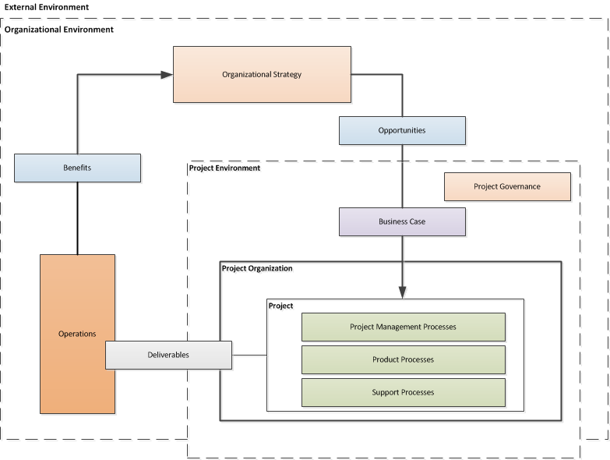
Business case in terms of concept to relationships
Business Case
Notes:
Overview of project management concepts and their relationships

Slide 195
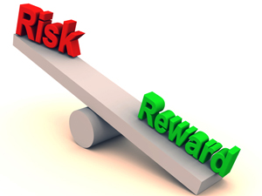
Investment appraisal
The investment appraisal enables the financial viability of projects to be measured both on a standalone basis and in comparison with other projects competing for funds
The process should confirm why the forecast cost and time will be worth the investment and justify the project based upon the estimated costs and the value of projected benefits.

Slide 196
Investment analysis techniques
Payback Period
The time taken to pay back the project investment.
Return on Investment (RoI)
The percentage ratio of average yearly profit over the productive life of the project, divided by the original investment.
Social Return on Investment (S-RoI)
A method for measuring extra-financial value (i.e., environmental and social value not currently reflected in conventional financial accounts) relative to resources invested.
Discounted Cash Flow (DCF)
DCF uses compound interest calculation to reflect the cost of money by “discounting” future cash flows to an equivalent “present value”
Net Present Value (NPV)
The aggregate of future net cash flows discounted back to a common base date, usually the present.
Internal Rate of Return (IRR)
The discount rate at which the Net Present Value of future cash flows is zero.

Slide 197
Payback period
If a project costs $1,000,000 and yields benefits as follows:
Year 1 $200,000
Year 2 $300,000
Year 3 $500,000
Year 4 $400,000
Year 5 $400,000
The Payback Period is three years
$1M
Year 3
$500k
Year 2
$300k
Year 1
$200k

Slide 198
Return on investment (ROI)
ROI = (Average Annual Profit/Original Investment) x 100%
where Average Annual Profit = Total Profit/Years
Year | Investment | Benefits
0 | $1,000,000 | $0
1 |  | $200,000
2 |  | $300,000
3 |  | $500,000
4 |  | $400,000
5 |  | $400,000
 |  | $1,800,000
Average Annual Profit = ($1,800,000-$1,000,000)/5 = $160,000
ROI = ($160,000/$1,000,000) * 100% = 16%

Slide 199
Discounted cash flow
Leaving money invested in a deposit account at 10% interest would see growth based on compound interest:
Year 0 | $1.00
Year 1 | $1.10
Year 2 | $1.21
Year 3 | $1.33
If we kept the money instead of investing it, its comparative value would fall:
Year 0 | $1.00
Year 1 | $1.00/$1.10 = $0.91
Year 2 | $1.00/$1.21 = $0.83
Year 3 | $1.00/$1.33 = $0.75
Discounting is the opposite of compound interest. It recognises that the $1.33 in three years time is worth the same as $1.00 now.

Slide 200
Discounted cash flow example
Year | Investment | Benefits | DCF
0 | $1,000,000 | $0 | $0
1 |  | $200,000 x 0.91 | $182,000
2 |  | $300,000 x 0.83 | $249,000
3 |  | $500,000 x 0.75 | $375,000
4 |  | $400,000 x 0.68 | $272,000
5 |  | $400,000 x 0.62 | $248,000
 |  | $1,800,000 | $1,326,000

Slide 201
Net present value
The net present value (NPV) is the sum of all the discounted cash flows (both investments and benefits). It is the value of the project expressed in current monetary value.
Year | Investment | Benefits | Net cash flow | Discount factor (10%) | DCF
0 | $1,000,000 | $0 | -$1,000,000 | 1.00 | -$1,000,000
1 |  | $200,000 | $200,000 | 0.91 | $182,000
2 |  | $300,000 | $300,000 | 0.83 | $249,000
3 |  | $500,000 | $500,000 | 0.75 | $375,000
4 |  | $400,000 | $400,000 | 0.68 | $272,000
5 |  | $400,000 | $400,000 | 0.62 | $248,000
Total | $1,000,000 | $1,800,000 | $800,000 |  | NPV $326,000

Slide 202
Social Return on Investment
Establishing scope and identifying key stakeholders. Clear boundaries about what the SROI will cover, and who the will be involved are determined in this first step.
Mapping outcomes. Through engaging with stakeholders, an impact map, or theory of change, which shows the relationship between inputs, outputs and outcomes is developed.
Evidencing outcomes and giving them a value. This step first involves finding data to show whether outcomes have happened. Then outcomes are monetized – this means putting a financial value on the outcomes, including those that don’t have a price attached to them.
Establishing impact. Having collected evidence on outcomes and monetized them, those aspects of change that would not have happened anyway (deadweight) or are not as a result of other factors (attribution) are isolated.
Calculating the SROI. This step involves adding up all the benefits, subtracting any negatives and comparing them to the investment.
Reporting, using and embedding. Easily forgotten, this vital last step involves sharing findings and recommendations with stakeholders, and embedding good outcomes processes within your organization.
Notes:
It can help organizations understand what social value an activity creates in a robust and rigorous way and so manage its activities and relationships to maximize that value.
The process opens up a dialogue with stakeholders, helping to assess the degree to which activities are meeting their needs and expectations.
SROI puts social impact into the language of 'return on investment’, which is widely understood by investors, commissioners and lenders. There is increasing interest in SROI as a way to demonstrate or measure the social value of investment, beyond the standard financial measurement.
Where it is not being used already, SROI may be helpful in showing potential customers (for example, public bodies or other large purchasers) that they can develop new ways to define what they want out of contracts, by taking account of social and environmental impacts.
SROI can also be used in strategic management. The monetized indicators can help management analyze what might happen if they change their strategy, as well as allow them to evaluate the suitability of that strategy to generating social returns, or whether there may be better means of using their resources.

Slide 203
What is project success and benefits management?
Project success is the satisfaction of stakeholder needs and is measured by the success criteria as identified and agreed at the start of the project.
Benefits management is the identification of the benefits at an organisational level and the monitoring and realisation of those benefits.
APM BoK, 5th edition
This text has been reproduced from APM BoK with prior permission from the Association for Project Management

Slide 204
What is success?
The definition of success will vary from project to project.
The 2016 Olympics must open on time.
A new medicine must be safe.
Each stakeholder will define success differently.
The bride’s father wants the wedding to come in on budget.
The bride’s mother wants every relative to be invited.

Slide 205
When to define success
Success should be defined and documented up front in the Concept phase of the project.
Success should be defined as a set of success criteria.
Once agreed and approved the success criteria should only be changed through formal change control.
Success is measured at the end.
Notes:
Ask the delegates what happens if success criteria aren't agreed up front.

Slide 206
Focusing on Benefits
Business Case
Project Outputs
Enable
Desired
Outcomes
Business
Changes
Create
Measured in
Also Cause
Benefits
Side-effects and consequences
Further Realize
Helps Achieve one or more
Result in
Strategic Initiatives
Dis-benefits
Notes:
Senior managers tend to focus on output delivery, which has no quantifiable value or benefit until successfully accepted, adopted and integrated into the organization as business as usual.
The real focus should be on demonstrable value and benefits aligned to strategic objectives, which also aligns with sustainability principals.

Slide 207
Key Principles / KPIs
Follow Best Practices while developing using Common Sense and Principles:
Aligned to Strategy, Principles, Priorities and Expectations
Conduct a Health Check
Establish Governance
Define the Vision
Establish a Transformational approach
Identify your Numbers
Establish a Support Structure
Don’t ignore Social and Environmental impacts

Slide 208
Benefits Realization
Measures of success
Common project management practice dictates that
benefits are based on business specific economic returns.
Concept
Definition
Implementation
Handover and Closeout
Operations
Benefits Realisation

Slide 209
Benefits Realization with Sustainability
GPM’s benefits extend beyond economic returns
P5 Sustainability Framework
Concept
Definition
Implementation
Handover and Closeout
Operations
Benefits Realisation
Benefits are based on:
Business Specific Economic Returns
Alignment with Organizational and Government Sustainability Initiatives/Goals
Risk Responsiveness and Aversion
Global Reporting Initiative Reporting Standards & UN Post 2015 Engagement Architecture Reporting Capabilities
Alignment with ISO 14001 Environmental Management
Alignment with ISO 50001 Energy Management
Alignment with ISO 26000 Corporate Social Responsibility
Increased efficiency of process and increased organizational maturity in projects

Slide 210
Benefits Realization Plan
Description of the benefit
What strategic objective does it support?
Against values will the benefits be assessed and recorded?( for example: money, number of visitors, number of jobs, CO2 reduction etc.)
What is the current value of the benefit and what future value is anticipated?
Outputs required for the benefit to be realized
Dependency to other benefits
Benefit owner (see Benefit responsibilities section)
Which stakeholders this benefit will effect
How the benefit will be measured
Notes:
One of the causes for ineffective benefits management in practice is the lack of clear responsibilities in this respect. Assigning benefits management responsibilities can be challenging because this activity continues after the project.

Slide 211

The Benefit Owner
Benefit owner
The benefit owner is an individual who is responsible for ensuring it is realized.
The benefit owner is assigned during project initiation. Benefit owners do not have to be part of the project team but do play a role which is increasingly important towards the end of the project.
Typical responsibilities of the benefit owner will be:
Own the benefit profile
Provide input for the benefits realization plan
Manage benefits measurements
Organize benefit reviews
Report on progress of benefits realization

Slide 212
We have covered
What is the purpose of the business case.
Contents of the business case
Practical use of the business case
Investment Appraisal techniques
Calculating Valuation
Understanding Benefits

Slide 213
Requirements Management
Release 6

Slide 214
Requirements Management
Module 8 | Module Covers | Learning outcomes
Requirements Management | The importance of requirements management Requirements and Definition | Understand requirements management, and preferred practices.
Version
6.0

Slide 215
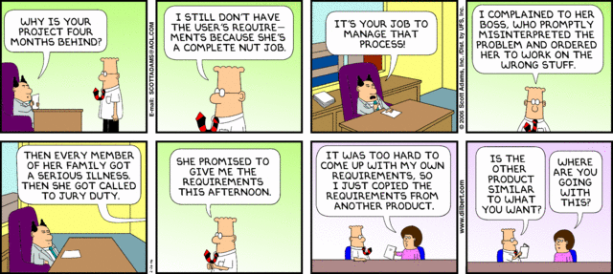
Poor Requirements = Poor Performance
Dilbert.com
Notes:
A simple opening on requirements.

Slide 216
What is Requirements Management?
Requirements management is the process of capturing, analysing and testing the documented statement of stakeholder and user wants and needs.
Requirements are a statement of the need that a project has to satisfy, and should be comprehensive, clear, well structured, traceable and testable.
47%
of unsuccessful projects
fail to meet goals due to poor requirements management
APM BoK 5th Edition
http://www.pmi.org/~/media/PDF/Knowledge%20Center/PMI-Pulse-Requirements-Management-In-Depth-Report.ashx
Notes:
We just covered a lot. Time for a quick break.

Slide 217
What Are Requirements?
The stakeholders’ and users’ wants and needs
They state ‘What’ is required NOT ‘How’ it is to be achieved
They contain acceptance criteria
They provide a measure against which project success can be judged
High-level requirements are documented during the Concept phase of the life cycle
They are further developed and agreed during the Definition phase

Slide 218
Requirements Life Cycle
Design Freeze
Baseline
Quick
Look
Detailed
Look
Finish
off
Benefits
Realization
Idea
Do It
Requirements Capture and Testing
Configuration Management & Change Control
Requirements Reviews
Notes:
The existence of a product specification is essential at the commencement of the implementation stage. This may initially only define requirements such as physical features, performance aspects and key acceptance criteria. To ensure the development of the design will achieve the objectives and benefits a series of reviews are conducted. This enables the design to be compared to the requirements in order to identify and address any deviations or shortcomings. A requirements review may be conducted during design to check that designers understand and can achieve the stated requirements.
As the product design develops, further reviews are carried out to check that the design will meet the product requirements. At the end of development the design is reviewed prior to build. As the design develops further, acceptance criteria, plans and methods are fully defined. These, the designs and production readiness are typically reviewed prior to the release of the design to production. This will check that the test methods are appropriate and will ensure that the product is adequately tested in line with the requirements.
Tests and inspections are typically carried out during the acceptance stage to verify that the deliverable products meet the requirements. If satisfactory, the product is formally accepted and signed off.
Throughout the development, the requirements, product specification and associated documentation is controlled using a formal change control and configuration management process.
The requirements management process facilitates the opportunity to provide confidence to the Project Team and the Stakeholders during the life cycle that the product is more likely to achieve the project objectives and its proposed benefits.

Slide 219
Requirements Structuring
Factors used to structure the construct of the requirements:
Value
The size of the benefit from each requirement
Priority
Stakeholders agree the priority order
Time
Deadlines for each requirement
Process
The way the solution is to be built, by which sub-contractors
Impact
The P5* impact that the requirement has
*Sustainability Impact - People, Planet, Profit, Project Process and Resulting Product

Slide 220
Elements of a Requirements Management Plan
Introduction
Purpose of The Requirements Management Plan
Requirements Management Overview
Organization, Responsibilities, and Interfaces
Tools, Environment, and Infrastructure
Requirements Management
Assumptions/Constraints (Sustainability Impacts)
Requirements Definition
Requirements Traceability
Workflows and Activities
Change Management
Key Terms
Requirements Management Plan Approval Page

Slide 221
Important Skills For Requirements Management
Active Listening and Communication Skills
Interpreting and articulating requirements, their alignment to organizational strategic goals and principles
Navigating ambiguity
Active Engagement of Stakeholders
Understanding the Need “You gave me what I asked for but not what I needed.”
Clearly defined and functioning change control
Ability to articulate the business value of the requirement

Slide 222
The study of why things go wrong
If you don’t know what you want,
or what you want keeps changing;
or you can’t commit the required money to the project;
or you don’t have anyone in charge of the project,
or you keep changing the person in charge,
or the person who
is supposed to be in charge doesn’t really call the shots;
or the person at the top of the business doesn’t care about the project;
and you don’t focus on what the actual benefit to the business is;
and you don’t regularly talk to the people who will have to use the system;
and you don’t constantly check progress;
or you have an unrealistic timetable and try to run before you can walk;
or you fail to test the system properly before you launch it;
or if you don’t provide enough training;
or you don’t have a Plan B in case things go wrong;
or you try to bite off more than you can chew in one go;
or if you don’t realise that the bigger project the greater the chance of its being overtaken by events or new technology or new legislation;
or you don’t realise that you may not have the skills you need to manage the project;
or you don’t realise that some suppliers are quite capable of telling you they can deliver when they can’t;

Slide 223
The frequent result
Don’t be surprised if you end up with:
a mess that is way behind schedule,
damages your organization,
traumatises your staff,
costs much more than it is supposed to,
(and doesn’t work.)”

Slide 224
We have covered
Requirements Management
Requirements Lifecycle
Requirements Structuring
Requirements Management Plan
Important Skills For Requirements Management

Slide 225
Project Management
Release 6

Slide 226
Project Management
Module 9 | Module Covers | Learning outcomes
Project Management | What is a Project What is Project Management What are Process Groups and how What are Subject Groups What is the Project Environment | Understand what project management is, the ins and outs, and the project environment
Version
6.0

Slide 227
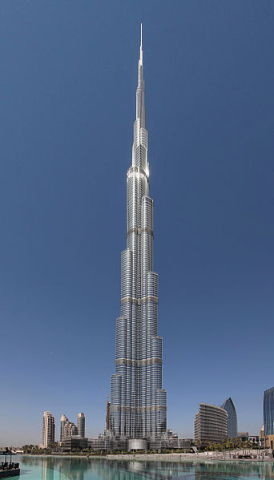
What is a Project?
A project consists of a unique set of processes consisting of coordinated and controlled activities with start and end dates, performed to achieve project objectives.
Achievement of the project objectives requires the provision of deliverables conforming to specific requirements. A project may be subject to multiple constraints.
Although many projects may be similar, each project is unique. Project differences may occur in the following:
deliverables provided;
stakeholders influencing;
resources used;
constraints;
the way processes are tailored to provide the deliverables.
Every project has a definite start and end, and is usually divided into phases.
Both the Burj Khalifa and a wedding are examples of projects.
Notes:
Projects are a way to deliver value to an organization. Although there may be other ways to deliver this value, projects often have certain advantages that make them apt for the specific task. These advantages include focus, control and specialization.
Focus, as projects are a temporary organization established for just one set of objectives: to deliver this value; control, as projects are subject to predefined constraints, including deadlines, budgets, quality standards, and specialization, as project management has become a profession, including best practices, tools, methods and certification schemes.
A project is defined as a unique, temporary, multi-disciplinary and organized endeavor to realize agreed deliverables within predefined requirements and constraints. Achievement of the project objective requires these deliverables to conform to specific requirements, including multiple constraints such as time, cost, resources and quality standards or requirements.
Project management is concerned with the application of methods, tools, techniques and competences to a project to achieve goals. It is performed through processes and includes the integration of the various phases of the project life cycle.
Effective project management has a number of benefits for the organization and stakeholders. It provides a greater likelihood of achieving the goals and ensures efficient
http://en.wikipedia.org/wiki/File:Burj_Khalifa.jpg

Slide 228
Project Management
Constraints
time, cost, quality, technical, other performance parameters, legal, environmental, social
Input
Project Management
Output
business need
problem
opportunity
project deliverables:
Products
Services
change
Mechanisms
people, tools, techniques, equipment, organization
Notes:
Projects
A project consists of a unique set of processes consisting of coordinated and controlled activities with start and end dates, performed to achieve project objectives. Achievement of the project objectives requires the provision of deliverables conforming to specific requirements. A project may
be subject to multiple constraints.
Although many projects may be similar, each project is unique. Project differences may occur in: deliverables provided; stakeholders influencing; resources used; constraints; and the way processes are tailored to provide the deliverables.
Every project has a definite start and end, and is usually divided into phases
Project Management
Project management is the application of methods, tools, techniques and competencies to a project.
Project management includes the integration of the various phases of the project life cycle
Project management is performed through processes. The processes selected for performing a
project should be aligned in a systemic view. Each phase of the project life cycle should have
specific deliverables. These deliverables should be regularly reviewed during the project to meet
the requirements of the sponsor, customers and other stakeholders
ISO 21500 Section 3.2 and 3.3

Slide 229

Competences
The individual has to have perspective competences that address the contexts of projects, people competences that address personal and social topics and project competences that address the specific practice competences for managing projects.
SRC. IPMA ICB PG. 21
Notes:
The IPMA Eye of Competence is applicable for the three management domains project management, program management and portfolio management.
Based on the generic model every individual has to have a specific set of competences to manage projects successfully.

Slide 230

Project Management Process Groups
Notes:
The management of a project starts with the initiating process group and finishes with the closing process group. The interdependency between process groups requires the controlling process group to interact with every other process group as shown in Figure 5. Process groups are seldom discrete or one-time in their application. The process groups are normally repeated within each project phase to drive the project to completion. All or some of the processes within the process groups may be required for a project phase.

Slide 231

Interaction Among Process Groups
Source ISO 21500 Pg.12
Notes:
This page shows the interactions among the process groups inside the boundaries of the project, including the representative inputs and outputs of processes within the process groups. With the exception of the controlling process group, linkages between the various process groups are through individual processes within each process group. While linkage is shown in the diagram between the controlling process group and other process groups, the controlling process group may be considered self-standing because its processes are used to control not only the overall project, but also the individual process groups.

Slide 232
Projects and the business
All projects need to be aligned with the values of the organization and have to follow the formal cultural rules and demands of related functional departments or support units, and the culture of superordinate projects and strategic decision making bodies.
Notes:
Sometimes the espoused values are written down in one or more documents (for instance mission statement, quality policy, or corporate values). The individual should be able to discern the relevant implications of these cultural aspects for the project and take these into account in the approach. Moreover, the individual needs to be sure that the project supports the sustainable development of the organisation, which also includes corporate social responsibility (CSR).

Slide 233
Subject Groups
Each subject group consists of processes applicable to any project phase or project. These processes are defined in terms of purpose, description and primary inputs and outputs in and are interdependent. Subject groups are independent of application area or industry focus.
Integration – Processes to identify, define, combine, unify, coordinate, control and close activities.
Stakeholder - the processes required to identify and engage the project sponsor, customers and other stakeholders
Scope – the processes required to identify and define the work and deliverables required
Resource – the processes required to identify and acquire adequate project resources
Time – the processes required to schedule the project activities and to monitor progress to control the schedule
Cost – the processes required to develop the budget and to monitor progress to control costs
Risk - the processes required to identify and manage threats and opportunities
Quality - the processes required to plan and establish quality assurance and control
Procurement - the processes required to plan and acquire products, services or results, and to manage supplier relationships
Communication - includes the processes required to plan, manage and distribute information relevant to the project
Derived from ISO 21500
Notes:
Some Organizations call these “knowledge areas”. This is incorrect. It is not enough to be knowledgeable. You must be proficient.
Each subject group consists of processes applicable to any project phase or project. These processes are defined in terms of purpose, description and primary inputs and outputs in and are interdependent. Subject
groups are independent of application area or industry focus.
ISO 21500 Definitions
Integration - The integration subject group includes the processes required to identify, define, combine, unify, coordinate, control and close the various activities and processes related to the project.
Stakeholder - The stakeholder subject group includes the processes required to identify and engage the project sponsor, customers and other stakeholders.
Scope - The scope subject group includes the processes required to identify and define the work and deliverables, and only the work and deliverables required.
Resource - The resource subject group includes the processes required to identify and acquire adequate project resources such as people, facilities, equipment, materials, infrastructure and tools.
Time - The time subject group includes the processes required to schedule the project activities and to monitor progress to control the schedule.
Cost -The cost subject group includes the processes required to develop the budget and to monitor progress to control costs.
Risk - The risk subject group includes the processes required to identify and manage threats and opportunities.
Quality - The quality subject group includes the processes required to plan and establish quality assurance and control.
Procurement - The procurement subject group includes the processes required to plan and acquire products, services or results, and to manage supplier relationships.
Communication - The communication subject group includes the processes required to plan, manage and distribute information relevant to the project.

Slide 234
Relationship between project management concepts and processes
Project management is accomplished through processes utilizing the concepts [knowledge] and application [competencies.]
A process is a set of interrelated activities. Processes used in projects are generally categorized into three major types.
project management processes -- specific to project management and determine how the activities selected for the project are managed
delivery processes -- not unique to project management, result in the specification and
provision of a particular product, service, or result and vary depending on the particular project
Deliverable support processes -- not unique to project management, provide relevant and valuable support to product and project management processes in such disciplines as logistics, finance, accounting and safety
Notes:
This standard addresses only project management processes. However, it should be noted that product, support and project management processes might overlap and interact throughout a project.

Slide 235
True or False?
1. A project starts when the performing organization completes the processes required to mandate a new project.
FALSE
TRUE
2. A project ends when the project deliverables have been accepted or the project has been prematurely terminated, and when all project documentation is delivered and all closure activities have been completed.
TRUE
3. A project manager’s responsibility for a project ends when all closure activities have been completed.
Notes:
Understanding the management of the outcome after handover is important.

Slide 236
The Project Environment
ISO 21500
Notes:
This slide shows the project environment. Organizational Strategy creates opportunities that become business cases. The business case is carried out via projects that hand deliverables over to the operations side of the organization. Benefits are then derived and realized by the strategic level.
The Project Manager is responsible for benefit realization.

Slide 237

Project Complexity
GAPPS has developed an approach to categorizing projects based on their management complexity. The GAPPS framework uses a tool called the Crawford-Ishikura Factor Table for Evaluating Roles, or CIFTER. The tool, named after two major contributors to GAPPS, is used to differentiate project manager roles based on the complexity of the projects managed.
1. Stability of the overall project context
2. Number of distinct disciplines, methods, or approaches involved in performing the project
3. Magnitude of legal, social, or environmental implications from performing the project
4. Overall expected financial impact (positive or negative) on the project’s stakeholders
5. Strategic importance of the project to the organization or organizations involved
6. Stakeholder cohesion regarding the characteristics of the product of the project
7. Stakeholder cohesion regarding the characteristics of the product of the project
Notes:
Project Managers are expected to produce essentially the same results – outputs and outcomes that are acceptable to relevant stakeholders. However, the context in which these results are produced may differ: some projects are inherently harder to manage than others. A project manager who is competent to manage an easier, less complex project may not be competent to manage a harder, more complex project.

Slide 238



The Current PM Challenge
Many project managers are locked onto focusing on the traditional Time / Cost / Scope paradigm (if lucky they take into account quality)
Successful project managers focus on time, cost, quality, scope, benefits and risk
Exceptional project managers also take into account the other triple constraint… Though the key questions for organizations is how to facilitate this?

Slide 239
Great Project Managers
Focus on Customer Needs
Challenge “TTWWHADI” –Anyone know what this is?
Meet Face to Face (video conference also counts ;)
Understand the requirements and how they relate to organizational principles and benefit
Collaborate with the project team
Delegate Effectively
Are comfortable in the “C” Suite
Are proactive
Can lead under pressure
Notes:
TTWWHADI “That’s the way we have always done it.

Slide 240
We have covered
What is a Project
What is Project Management
What are Process Groups and how What are Subject Groups
What is the project Environment

Slide 241
Project Lifecycles and PRiSM
Release 6

Slide 242
Project Lifecycles and PRiSM
Module 10 | Module Covers | Learning outcomes
Project Lifecycles And PRiSM | Project and Product life cycles. Product Lifespans Cradle to Cradle and Cradle to Grave Project phases such as Initiate, Plan Implement and Close. The relationship between phases and stages. The PRiSM Flow The Product Life Cycle | Describe a project life cycle. Describe a product life cycle Understand The PRiSM Lifecycle Understand the Product Lifecycle
Version
6.0

Slide 243
Requirements Life Cycle
Design Freeze
Baseline
Quick
Look
Detailed
Look
Do It
Finish
off
Get the
benefits
Idea
Requirements Capture and Testing
Configuration Management & Change Control
Requirements Reviews
Notes:
The existence of a product specification is essential at the commencement of the implementation stage. This may initially only define requirements such as physical features, performance aspects and key acceptance criteria. To ensure the development of the design will achieve the objectives and benefits a series of reviews are conducted. This enables the design to be compared to the requirements in order to identify and address any deviations or shortcomings. A requirements review may be conducted during design to check that designers understand and can achieve the stated requirements.
As the product design develops, further reviews are carried out to check that the design will meet the product requirements. At the end of development the design is reviewed prior to build. As the design develops further, acceptance criteria, plans and methods are fully defined. These, the designs and production readiness are typically reviewed prior to the release of the design to production. This will check that the test methods are appropriate and will ensure that the product is adequately tested in line with the requirements.
Tests and inspections are typically carried out during the acceptance stage to verify that the deliverable products meet the requirements. If satisfactory, the product is formally accepted and signed off.
Throughout the development, the requirements, product specification and associated documentation is controlled using a formal change control and configuration management process.
The requirements management process facilitates the opportunity to provide confidence to the Project Team and the Stakeholders during the life cycle that the product is more likely to achieve the project objectives and its proposed benefits.

Slide 244
Project Lifecycle – High Level
A project lifecycle typically consists of of four phases:
Initiate
Plan
Implement
Handover & Closeout
Initiate – identify options and consider viability
Plan – produce plans
Implement – implement the plans
Handover and Closeout – handover the outputs
Notes:
GPM divides projects into phases and follow the ISO 21500 guideline.
Projects are usually organized into phases that are determined by governance and control needs. These phases should follow a logical sequence, with a start and an end, and should use resources to provide deliverables. In order to manage the project efficiently during the entire project life cycle, a set of activities should be performed in each phase. Project phases are collectively known as the project life cycle.
The project life cycle spans the period from the start of the project to its end. The phases are divided by decision points, which can vary depending on the organizational environment. The decision points facilitate project governance. By the end of the last phase, the project should have provided all deliverables. To manage a project throughout its life cycle, project management processes should be used for the project as a whole or for individual phases for each team or sub project.

Slide 245
Initiation phase
Initiate
Plan
Handover & Closeout
Implement
The sponsor is selected
The Need/Problem/Opportunity is established
Feasibility is investigated
Fit with strategy is checked
High level risks are identified and assessed
Levelling against Management Systems are completed
P5 Impact analysis is completed and SMP is initiated
Initial stakeholders are identified and analysed
High level requirements are identified
Business options (inc Do Nothing) are identified, evaluated and documented in the Business Case
Plans for next phase (Definition) are produced.

Slide 246
Planning phase
Initiate
Plan
Handover & Closeout
Implement
Project Manager is appointed (if not already in place)
The preferred solution is checked against high level requirements
Alternative designs are considered
The approach is agreed with the Sponsor
Detailed requirements are gathered and refined
The Project Management Plan (PMP) is prepared
Estimates of time, resources and costs are produced
The Business Case is updated to reflect plans and estimates
Detailed plans for next phase (Implementation) are prepared

Slide 247
Implementation phase
Initiate
Plan
Handover & Closeout
Implement
Implementation phase may be divided into Stages:
Design
Design optimised and completed
Design documentation produced
Design approved
Build
Actual products are now produced
Components tested against acceptance criteria
Project Manager:
Controls and monitors the delivery
Manages risks, issues and changes
Communicates progress with stakeholders

Slide 248
Handover & closeout phase
Initiate
Plan
Handover & Closeout
Implement
Test the completed set of deliverables in operational mode
Sponsor and users accept products
Transfer ownership
Complete all project documentation
Review project performance (Post Project Review)
Capture and disseminate lessons (Lessons Learned)
Close the project

Slide 249

Process Groups (Review)
IMPORTANT! Process Groups are not to be confused with phases of a Life-Cycle!
The management of a project starts with the initiating process group and finishes with the closing process group. The interdependency between process groups requires the controlling process group to interact with every other process group.
Notes:
Initiating process group
The initiating processes are used to start a project phase or project, to define the project phase or project objectives and to authorize the project manager to proceed with the project work.
Planning process group
The planning processes are used to develop planning detail. This detail should be sufficient to establish baselines against which project implementation can be managed and project performance can be measured and controlled.
Implementing process group
The implementing processes are used to perform the project management activities and to support the provision of the project’s deliverables in accordance with the project plans.
Controlling process group
The controlling processes are used to monitor, measure and control project performance against the project plan. Consequently, preventive and corrective actions may be taken and change requests made, when necessary, in order to achieve project objectives.
Closing process group
The closing processes are used to formally establish that the project phase or project is finished, and to provide lessons learned to be considered and implemented as necessary.
Project management process group interrelationships and interactions

Slide 250

The Strength of PRiSM
The project methodology/approach that was designed to align with ISO 26000, 21500, 14001, 9000, 50001 the UNGC Ten Principles, and The GRI G4 Framework for Sustainability Reporting.
Notes:
We are now going to do a walkthrough of the PRiSM Methodology from a Workflow Perspective before diving in a little deeper.
PRiSM Short for (Projects integrating Sustainable Methods)
PRiSM™ (Projects integrating Sustainable Methods) is the sustainability based project delivery method which incorporates tangible tools and methods to manage the balance between finite resources, social responsibility, and delivering “green” project outcomes. It was developed for organizations to integrate project processes with sustainability initiatives to achieve business objectives while decreasing negative environmental impact.
PRiSM is a structured project management methodology that highlights areas of sustainability and integrates them into the traditional core project phases which, when understood and effectively addressed, can reduce negative environmental impacts in all types of projects while maximizing opportunities to manage sustainability and finite resources. PRiSM is cut from the same cloth as the globally accepted standards for professional project management. These standards are the “books of knowledge” as they are known to project managers. PRiSM incorporates a framework of activities derived from ISO 21500, 14001, 26000, 50001 and 9001, focuses on specific areas and incorporates best practices to practically answer the question: "How do I apply sustainability in to my projects?”

Slide 251

PRiSM Flow
Workflow
Step/Process
Phase Connector
Document
Begin / End
Decision
Sub Process

Slide 252

The PRiSM Pre-Project Phase
Projects arise from an idea or a need. This may result from new business objectives, responding to competitive pressures, changes in legislation, or a recommendation in a report or an audit.
The project mandate is provided by the commissioning organization (corporate or program management) and can vary in form from a verbal instruction to a well-defined and justified project definition.
Notes:
The initiation phase is one where the ideas are formulated and the business reviews whether this is a feasible project or element of a project to be included within the portfolio of projects that it is currently running. What you see here is an example of steps-to-take in an initiation phase for sustainability integration. I will go over them in detail.
The key deliverable within this phase is the Project Charter. the value of the sustainability elements are housed here. We are going to mainly focus on this phase today but will touch on all four.

Slide 253
The PRiSM Pre-Project Phase
Nothing should be done until foundational information needed to make decisions about the commissioning of the project is defined.
The Project Sponsor and Project Manager is selected/appointed
The project PLANNING team is selected
Notes:
The initiation phase is one where the ideas are formulated and the business reviews whether this is a feasible project or element of a project to be included within the portfolio of projects that it is currently running. What you see here is an example of steps-to-take in an initiation phase for sustainability integration. I will go over them in detail.
The key deliverable within this phase is the Project Charter. the value of the sustainability elements are housed here. We are going to mainly focus on this phase today but will touch on all four.

Slide 254
The PRiSM Pre-Project Phase
During the Pre-Project Phase, if the Business Case for the project should be in (at least) draft form.
Business Case
Provides justification for undertaking a project or program. It evaluates the benefit, cost and risk of alternative options and provides a rationale for the preferred solution.
Notes:
The initiation phase is one where the ideas are formulated and the business reviews whether this is a feasible project or element of a project to be included within the portfolio of projects that it is currently running. What you see here is an example of steps-to-take in an initiation phase for sustainability integration. I will go over them in detail.

Slide 255

The PRiSM Pre-Project Phase
Determination to proceed with or abandon a plan or project. In quality control, 'go' denotes that a product conforms to the specifications; when it does not, it is 'no go.’
Notes:
The initiation phase is one where the ideas are formulated and the business reviews whether this is a feasible project or element of a project to be included within the portfolio of projects that it is currently running. What you see here is an example of steps-to-take in an initiation phase for sustainability integration. I will go over them in detail.
The key deliverable within this phase is the Project Charter. the value of the sustainability elements are housed here. We are going to mainly focus on this phase today but will touch on all four.

Slide 256

PRiSM Project Initiation
Notes:
Once there is a decision to go ahead with the project, it needs to be planned in detail. Funding needs to be obtained and controls should be defined to ensure that the project proceeds in accordance with the wishes of those people paying for the project and those who will make use of what the project delivers. The detailed planning, establishment of the project management strategies and controls, development of a robust Business Case, and a means of reviewing benefits are covered by the Initiating a Project process.
The initiation stage culminates in the production of a finalized business case, which is reviewed by the Project Board to decide whether to authorize the project. As the contents of the project plan are likely to change throughout the project (under change control), the business case is preserved as input for later performance reviews.

Slide 257

PRiSM Project Initiation
Always Review Lessons Learned!

Slide 258
PRiSM Project Initiation
Reconcile with Organizational Management Systems
The organization should update the business case to reflect findings.
Notes:
With an understanding of the interaction with, dependency on, and impact to organizational management systems, of the organization, the project manager must review the project’s objectives and reconcile with existing management systems. The internal and external forces that impinge on the organization of the project must be reconciled to mutual benefit. The project manager must be cognizent existing management systems or have resources on the project planning team that can provide a statement of reconciliation to outline potential risks.
It is tat this point the organization can update the business case.

Slide 259

PRiSM Project Initiation
Perform P5 Impact Analysis
Based on the Analysis, score the project (at this point) define risks.
Draft the SMP including the P5 Score, and the recommendations for risk mitigation and opportunities for increased benefit.

Slide 260

Tools to Integrate Sustainability and Project Management
The Sustainability Management Plan (SMP) Ties corporate CSR goals and objectives to the project plan and identifies project impacts from an Environmental, Social, and Economic standpoint.
Notes:
Sustainability in Project Management in short addresses the impact of a project on the environment. There have been several theories identified over the past several years but none that can be adopted as repeatable processes that provide governance and deliver consistent results.
The SMP uses a change management process to map sustainability objectives derived from the P5 impact analysis into a column table that outlines the P5 category (People, Planet, or Profit,) sub category, and element as well as the reason for the inclusion, the initial score, any legal or regulatory conflicts and a proposed action.

Slide 261

What is included in an SMP
Table of Contents
Document Control
Version History and recipients list
Purpose
A brief on what the document is
Executive Summary or Brief
An outline of the sustainability factors in the project
List Project Sustainability Objectives
Derived from the P5 Impact Analysis
Outline Key Measures and Performance Indicators (Qualitative and Quantitative)
The P5 Impact Assessment Score (and updates)
Scope Exclusions
Sustainability Reviews and Reporting
Checklist

Slide 262
Version Control and Distribution

Slide 263
Project Sustainability Objectives
Sustainability objectives are taken from the P5 analysis. Anything that needs to be improved upon is included.

Slide 264
Key Performance Measures (Qualitative and Quantitative)
Example:
Key Performance Indicators Environmental
Energy: Number of green Buildings in the city
Waste: Amount of dangerous waste treated
Transport: Number of electric public transport
Water Usage: Amount of building with water recycled system
Materials and Resources: amount of promotional benefits to acquire local materials and their impacts in the local industries. ie. Construction
Key Performance Indicators Financial
Return on Investment: ROI
Business Agility: number of days to resolve upcoming squatting, weeds, pests, unsafe buildings, graffiti
Key Performance Indicators Products
Servicing of Product: Satisfaction Survey Results (surveys carried out be independent agency)
Lifespan of Product: The Enforcement Agency should have 60% Community Satisfaction
Key Performance Indicators Processes
Maturity of process: Maturity of the EMS: Plan-Do-check-Act
Maturity Efficiency and fairness of process: number of corrective actions and its financial impact
Key Performance Indicators Personal
Labour Practices and Decent Work: Number of labor accidents and amount of money incurred
Society and Customers: Number of children received training course regarding Sustainability.
Ethical Behaviour: implement “Sustainability Awards” at school, restaurants, event organizer, etc.

Slide 265
P5 Impact Assessment
A summary of the planned environmental impact and steps that will be taken to decrease the effects or increase the opportunities identified

Slide 266
The final pieces
Scope Exclusions
None.
Sustainability Risk Management
For the Sustainability Risk Management the agency will apply the PMBOK® Guide. The Sustainability Risk Plan should include the above environmental aspects and impacts and the response for each of one.
Reviews and Reporting
The Enforcement Agency members monthly will review and make a Sustainability Report that will be published at website of Enforcement Agency; and maintain periodically meeting with representatives of local community groups, and State and local officials.
Current Sustainability (P5) Score
+2.03
Checklist
The Following Assessments are considered in this Sustainability Management Plan:
Financial Assessment
Process Assessment
Product Assessment
Environmental Assessment
Social and Corporate Assessment

Slide 267
Where does the SMP Impact the project?
Source ISO 21500 Pg.12
Notes:
Once an SMP is used in a project, it will impact future business cases, contracts, SOWs, charters (if you use them), etc. Essentially, Sustainability will become business as usual…

Slide 268

PRiSM Project Initiation
The estimation of costs, the setting of an agreed budget, and management of actual and forecast costs against that budget.
The organization can now complete the business
Case.

Slide 269

PRiSM Project Initiation
This review focuses on the business justification of the project prior to the key decision to approve project initiation and authorizes the project to proceed to planning.
If it is determined that the project will not proceed or will be put on hold, document lessons learned and close the project.
If the determination is made to continue, gain sign off and proceed to the planning phase.
Notes:
Once there is a decision to go ahead with the project, it needs to be planned in detail. Funding needs to be obtained and controls should be defined to ensure that the project proceeds in accordance with the wishes of those people paying for the project and those who will make use of what the project delivers. The detailed planning, establishment of the project management strategies and controls, development of a robust Business Case, and a means of reviewing benefits are covered by the Initiating a Project process.
The initiation stage culminates in the production of a finalized business case, which is reviewed by the Project Board to decide whether to authorize the project. As the contents of the project plan are likely to change throughout the project (under change control), the business case is preserved as input for later performance reviews.
This review focuses on the business justification of the project prior to the key decision to approve project initiation. It aligns with the Directing a Project activity of authorizing initiation

Slide 270

PRiSM Project Planning
Notes:
The planning processes are used to develop planning detail. This detail should be sufficient to establish baselines against which project implementation can be managed and project performance can be measured and controlled.

Slide 271

PRiSM Project Planning
The project needs the right people in place, with the authority, responsibility and competence to make decisions.
The project management team needs to reflect the interests of all the stakeholders who will be involved.
Notes:
The planning processes are used to develop planning detail. This detail should be sufficient to establish baselines against which project implementation can be managed and project performance can be measured and controlled.

Slide 272

PRiSM Project Planning
Together with the project team, review the business case and define the scope of work.
The scope of the project outlines the objectives set forth in the business case and the goals that need to be met to achieve the intended result and benefits.
Notes:
The planning processes are used to develop planning detail. This detail should be sufficient to establish baselines against which project implementation can be managed and project performance can be measured and controlled.

Slide 273
PRiSM Project Planning
Draft a Benefits Management Plan.
Managing Benefits can be broken down into the following:
Identifying & Structuring Benefits
Planning Benefits Realisation
Realising & Tracking Benefits
Evaluation
Notes:
The planning processes are used to develop planning detail. This detail should be sufficient to establish baselines against which project implementation can be managed and project performance can be measured and controlled.

Slide 274

PRiSM Project Planning
Perform Stakeholder Analysis
Who are the project stakeholders?
Who must you keep satisfied?
Who must be engaged closely/carefully?
Who must be kept highly informed?
Who needs a basic status appraisal?
Notes:
The planning processes are used to develop planning detail. This detail should be sufficient to establish baselines against which project implementation can be managed and project performance can be measured and controlled.

Slide 275

PRiSM Project Planning
Develop an Organizational Breakdown Structure
Owner
Head Chef
Manager
Sous Chef
Assistant Manager
Beverage Manager
Line Cooks
Wait Staff
Bar Staff
Notes:
The planning processes are used to develop planning detail. This detail should be sufficient to establish baselines against which project implementation can be managed and project performance can be measured and controlled.

Slide 276


PRiSM Project Planning
Define sustainability quality component
aspects of the project.
Establishes thresholds for sustainability impacts relevant to the project to for both project deliverables and project processes against P5.
An Example could be: If procuring resources, the P5 score must not exceed +1

Slide 277
PRiSM Project Planning
Project controls can include:
The frequency and format of communication between the project manager and stakeholders
Mechanisms to capture and analyze issues and changes
Mechanisms to escalate exceptions
Etc.
Notes:
Covered in Project Controls

Slide 278

PRiSM Project Planning

Slide 279
PRiSM Project Planning
Chocolate Chip Cookie
Chocolate Chips
Dough
Eggs
Flour
Sugar
Butter

Slide 280
PRiSM Project Planning
1.0
Level One
1.1
1.2
1.3
Level Two
1.3.1
1.3.2
Level Three
1.3.1.1
1.3.1.2
Level Four
Notes:
Covered in Project Controls

Slide 281
PRiSM Project Planning
2 Wks.
4 Wks.
2 Wks.
A
C
D
Start
Finish
B
E
F
3 Wks.
1 Wk.
3 Wks.
Notes:
Covered in Project Controls

Slide 282
PRiSM Project Planning
Establish Responsibility Assignment Matrix (RAM)
Project Manager
Team Manager
Team Manager
1
Jane
Sam
Joe
Mary
Dave
Contractor
1.1
1.1.1
R
A
C
I
1.1.2
R
A
C
I
1.1.3
I
R
C
A
Products or Work Packages
R – Responsible A -Accountable C - Consult I - Inform
282
Notes:
Covered in Project Controls

Slide 283

PRiSM Project Planning
Once you have your RAM
In place, calibrate your estimators and the duration of activities.
Techniques:
Expert Judgment
Analogous Estimate (based on similar activity)
Parametric Estimate (based on relationship)
Notes:
Essentially, a parametric estimate is determined by identifying the unit cost or duration and the number of units required for the project or activity.
Analogous estimating uses a similar past project to estimate the duration or cost of your current project, thus the root of the word: analogy.

Slide 284
PRiSM Project Planning
The Refinement of the SMP should include:
Scope Changes
Sustainability Quality Components
Changes to the P5 Score +/-
Sustainability Risks Identified
Notes:
Essentially, a parametric estimate is determined by identifying the unit cost or duration and the number of units required for the project or activity.
Analogous estimating uses a similar past project to estimate the duration or cost of your current project, thus the root of the word: analogy.

Slide 285


PRiSM Project Planning
Once your SMP is refined,
compile your management
Plans, hold a review and establish
a go forward strategy.
If the project will continue, proceed to
Implementation. If not, document
Lessons learned and close the project.

