Slide 1

Creating a Sustainability
Management Plan
Tips for Success
Dr. Joel B. Carboni
Founder and President, GPM Global

Slide 2
Learning objectives for this presentation
From this presentation you will learn about the purpose of, and how to develop, the project sustainability management plan.

Slide 3
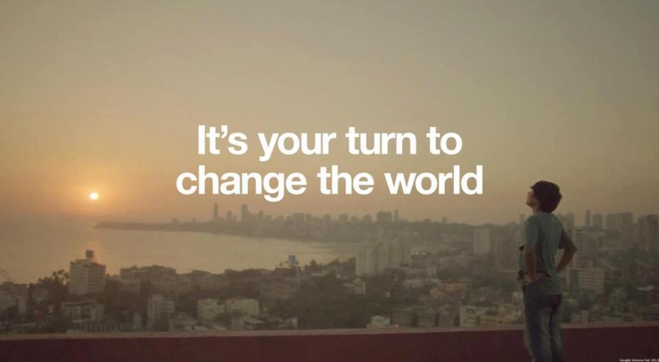
Where we are going
Notes:
In business, success depends on a variety of factors: an innovative idea, a brave entrepreneur willing to take risks, a good business model, capital to realise the idea, the right pool of people to build a strong organisation and a willingness to work with partners. With the right operating environment, a level playing field for competition, good incentives and a bit of luck, success should follow.
In the past decades, we have come to realise that prosperity– for a country as well as for a company – depends on more than accumulating wealth. We also need to nurture and protect the natural environment, to develop the right intellectual
resources, to create a strong and motivated workforce and support stable societies.
Yet, the world remains on an unsustainable path. Despite tremendous progress in the past century, challenges are mounting. Rapidly deteriorating environmental conditions, widening income gaps, severe resource constraints, economic uncertainty, widespread social upheaval and conflict; a set of difficult, interconnected problems that threaten to seriously undermine our social stability and prosperity. Humanity is on a deeply troubling path.
But there is hope: in the midst of all this, we are seeing encouraging signs of change. Human ingenuity and capacity for creativity and innovation is astonishing. Unexpected new technologies pop up every day. Radical new approaches to doing business, such as the circular and sharing models, are flourishing. We also see new forms of collaboration – at the international, national and local levels, and across sectors – that continually bring new ideas to the table. These are truly exciting times.
If we can make the right decisions and work together, we can change the path we are on and make a leap towards a new sustainable, inclusive, prosperous future for all. We have the capital, the knowledge and the technology to create change – if we make the right choices, and if we make them now. For project managers, it is just a matter of having a clear mindset and the right tools.

Slide 4
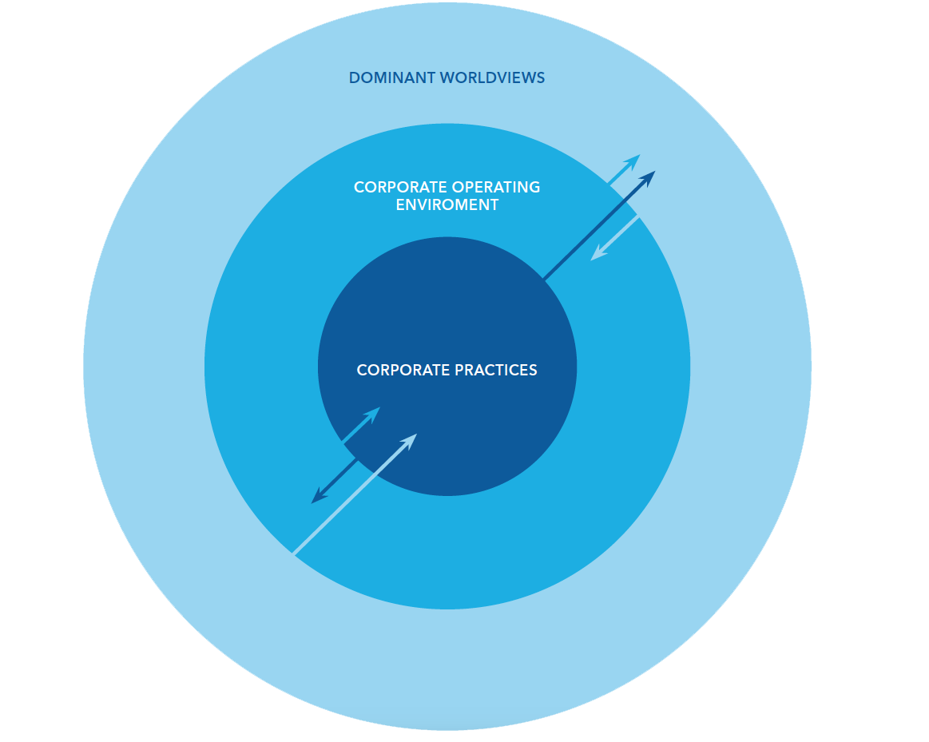
Our Current Challenge
CATALYSING SYSTEM CHANGE
Three levels of transformation framework
1. In corporate practices: How have global business practices changed towards deeper integration of sustainability and the Global Compact objectives?
2. In the corporate operating environment: How have conditions and drivers in the corporate operating environment changed so they are more supportive or enabling of sustainable business practices?
3. In the dominant worldviews: How has the dominant worldview, our thinking, attitudes, values and beliefs, over the role and responsibility of business changed?
Does your project management approach
benefit these realms?
The framework is developed by DNV GL, inspired by, among others,
Karen O’Brien’s “Three Spheres of Transformation” framework (2013)
and Donella Meadows work on leverage points to catalyse systems
change (1999).
Notes:
“Change does not happen by itself. It must be pursued with vigour, and by all of society. The sustainable journey that we need to take is in everybody’s best interest. Nobody benefits from catastrophic climate change or rampant unemployment and the social unrest that comes with it. Prosperous, stable societies and a healthy planet are the bedrock of political stability, economic growth and flourishing new markets. Everyone has a role to play.
For Project Managers, our work spans three realms as outlined by the diagram on this page. If we constrain ourselves to an input/output mentality, we will never be able to create positive change. Projects deliver benefits, not outputs.

Slide 5
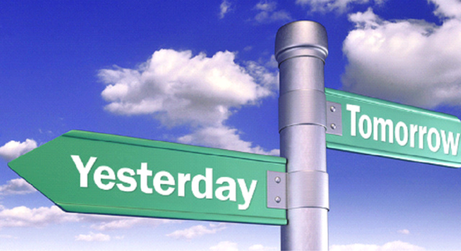
Constant Response to Moving Targets
Evolving Project Management
Focus on Stakeholders and relationships
Focus on Opportunity and Value Creation
Integrated into business strategies and across all business functions
Taking responsibility for driving systems change
Multi-stakeholder collaboration
Value Chain Focus, investing in leading others
Broad Understanding of material and strategic issues for the company.
Projects are more than resource management, timelines, budgets and outcomes
Notes:
15 years ago, the world looked very different. Globalisation had just kicked off and global investment was skyrocketing. NGOs were calling out corporate misconduct and governments were riding a wave of liberalisation. Google was just a baby and the number of Internet users in the entire world was 413 million, not even close to the size of Facebook in 2015 with 1.44 billion active users.
Constantly changing expectations combined with unprecedented challenges puts the onus on companies to demonstrate a willingness to work with partners and stakeholders in ways never imagined. Today, the notion of project leadership has evolved dramatically from where it was and those who realise that they need to step into the role of architects of a better will shape the future.

Slide 6
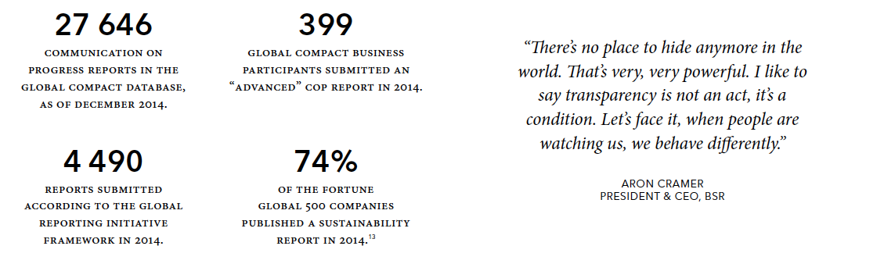
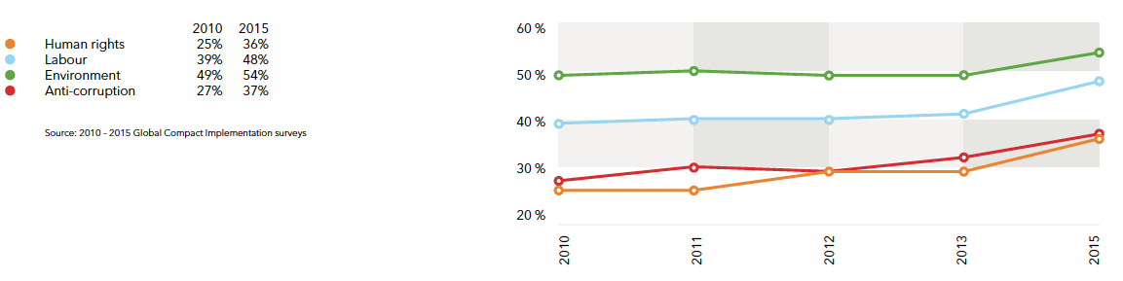
TRANSPARENCY
IS BECOMING THE NEW NORM
Notes:
Since 2000, there has been a monumental shift in disclosure by companies on their sustainability performance. The number of Global Reporting Initiative reports submitted, from 44 in 2000 to close to 4,500 in 2014
This shift reflects the growing recognition of the materiality of sustainability issues to business, as well as the enhanced stakeholder expectations of how companies are addressing sustainability. The resulting transparency and engagement has also helped to improve companies’ understanding of good practice and shape their sustainability progress. Evidence of the shift over the last 15 years is provided by the dramatic increase in sustainability reporting, to the point that it is now considered the norm for most large or multi-national companies. Reporting is also gaining traction within SMEs, often in response to top-down requirements from large companies for their suppliers to know and disclose their sustainability performance.

Slide 7
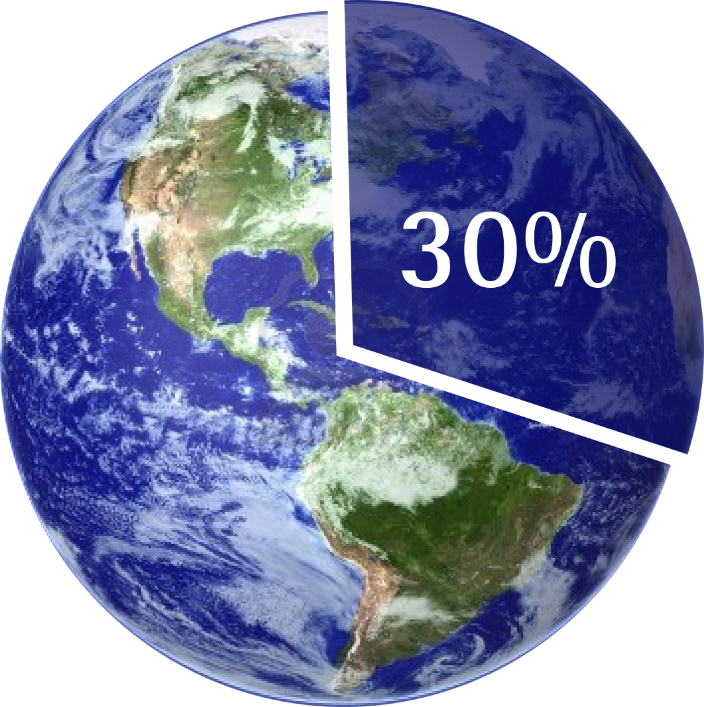
Projects and GDP

Slide 8
The % of CEOs Who…
93%
Src. UNGC/Accenture Survey of CEOs 2013

Slide 9
The % of CEOs Who…
64%
Src. UNGC/Accenture Survey of CEOs 2013

Slide 10

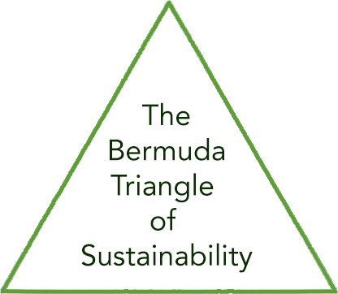
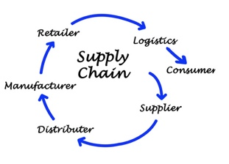
Excluding Projects
Sustainability
Notes:
This is a simple slide that is taken from ISO 21500. The red arrow shows where sustainability policies are usually emphasized, operations. How is it possible to derive benefit and be able to quantify the value if you are skipping change delivery? Put another way, how can you change anything by ignoring the part of the organization who’s by nature delivers……..Change?

Slide 11
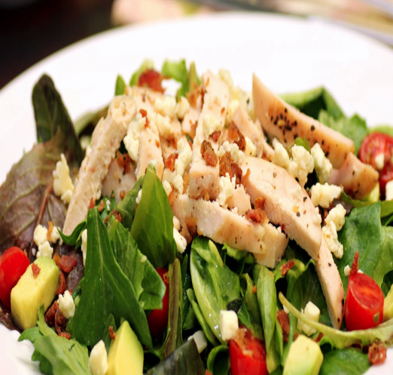
The Cobb Salad Report
“These are all worthwhile topics. However, they are operationally focused and the emphasis needs to focus on what the organization produces from a product and service perspective.”
-Timothy Hui. Head of Focal Point GRI for China
Health and Safety
Philanthropy
Carbon Emission Goals
Notes:
This rings loud and clear as when organization’s sustainability reports look like chopped salads. The volume of reporting is increasing worldwide which is positive, however so is the volume of information in each report on topics such as employee health and safety programs to carbon emission reduction goals to philanthropy initiatives These are all worthwhile topics however they are operationally focused and the emphasis needs to focus on what the organization produces from a product and service perspective.
As of June 25th, 2014, 6,321 organizations having submitted over 15,234 reports to the Global Reporting Initiative alone.
(T. Hui, Presentation, May 27th, 2014).

Slide 12



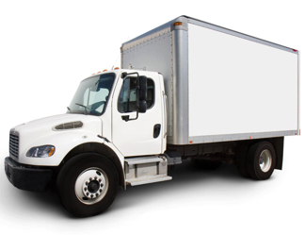

How Sustainability Fits in
Sustainability
Notes:
This slide is a simple explanation of why sustainability must be focused on the project organization in order to provide true cradle to cradle / cradle to grave approach.

Slide 13
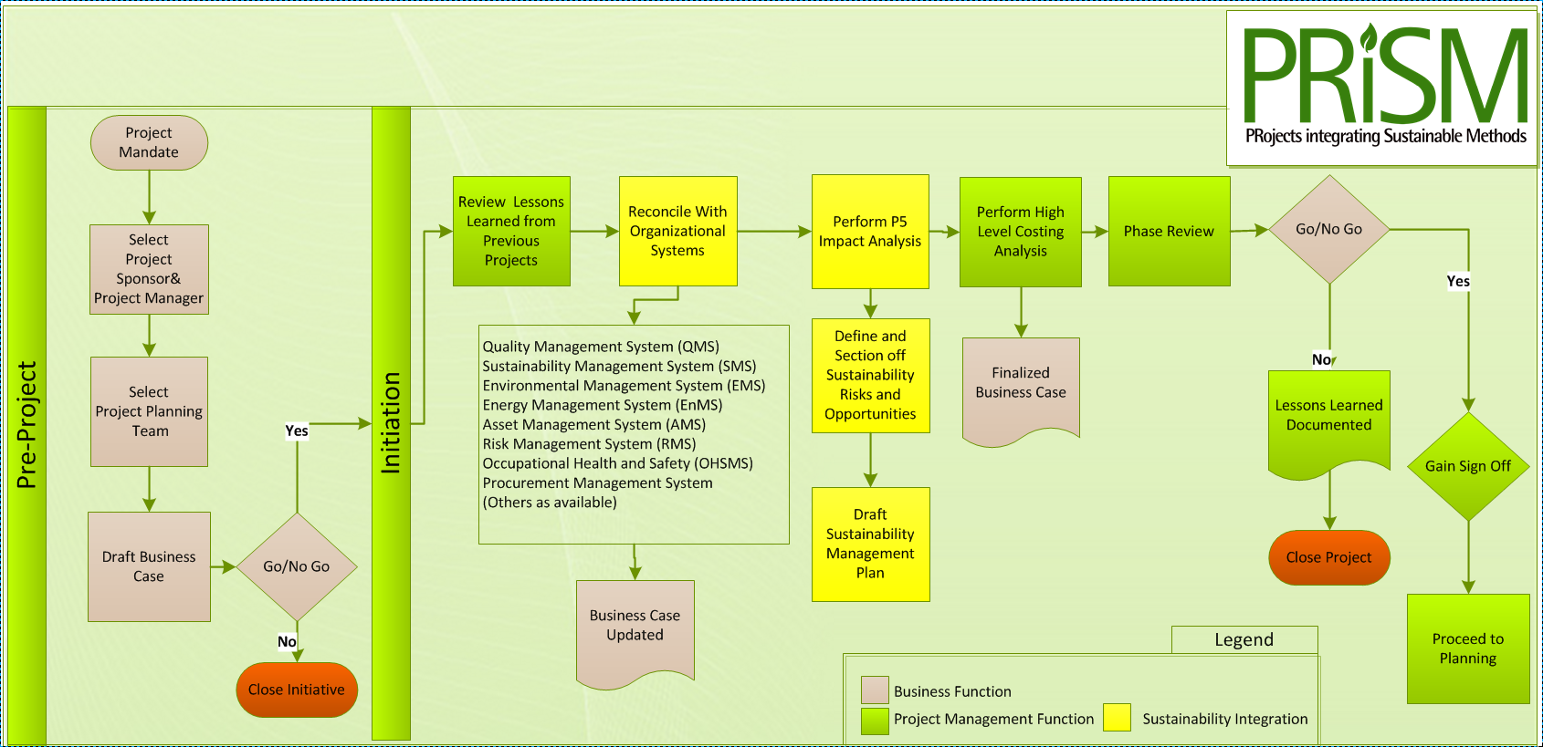
Leading with P5
Perform P5
Impact Analysis
P5 provides the basis by which sustainability can be evaluated for projects and programs.

Slide 14
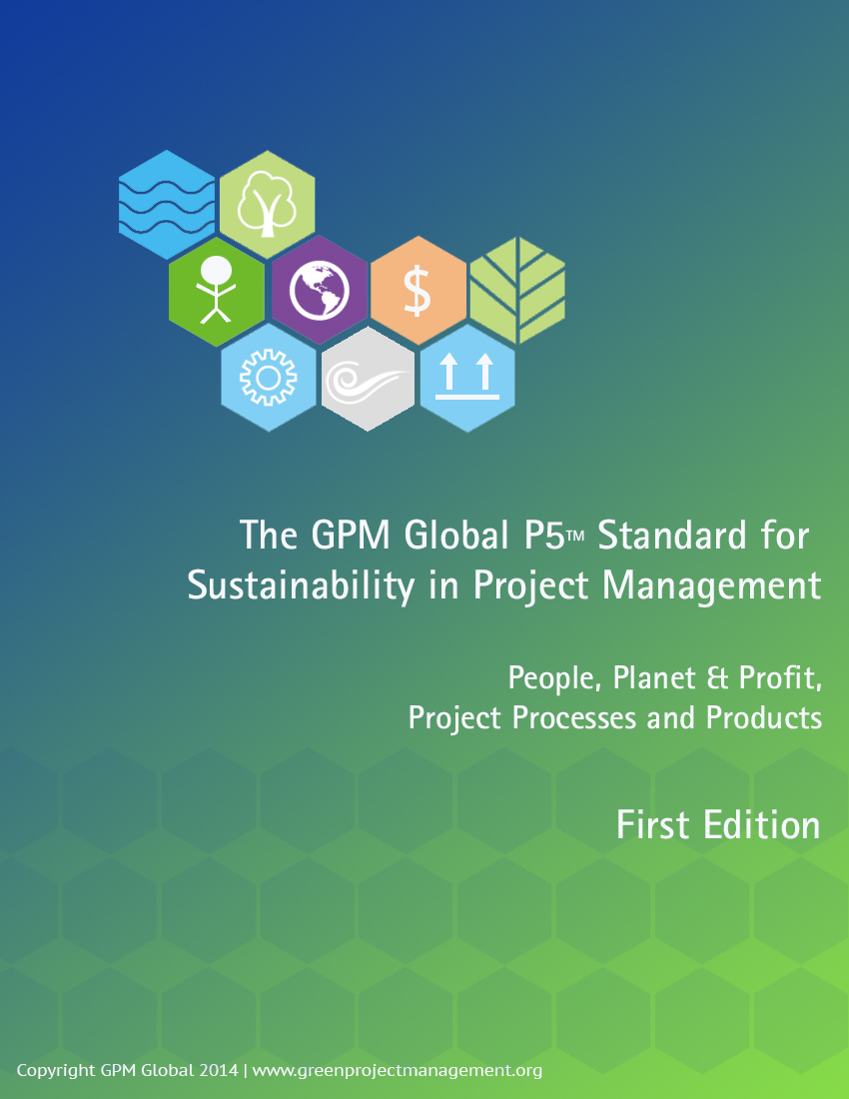


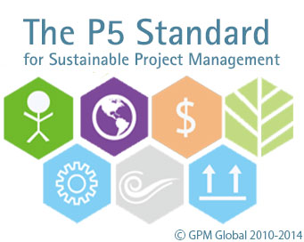


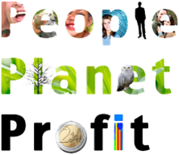
Introducing the GPM® P5™ Standard for Sustainability and Project Management
Notes:
P5 is the link between the UNGC, GRI, TBL, and PMLC

Slide 15
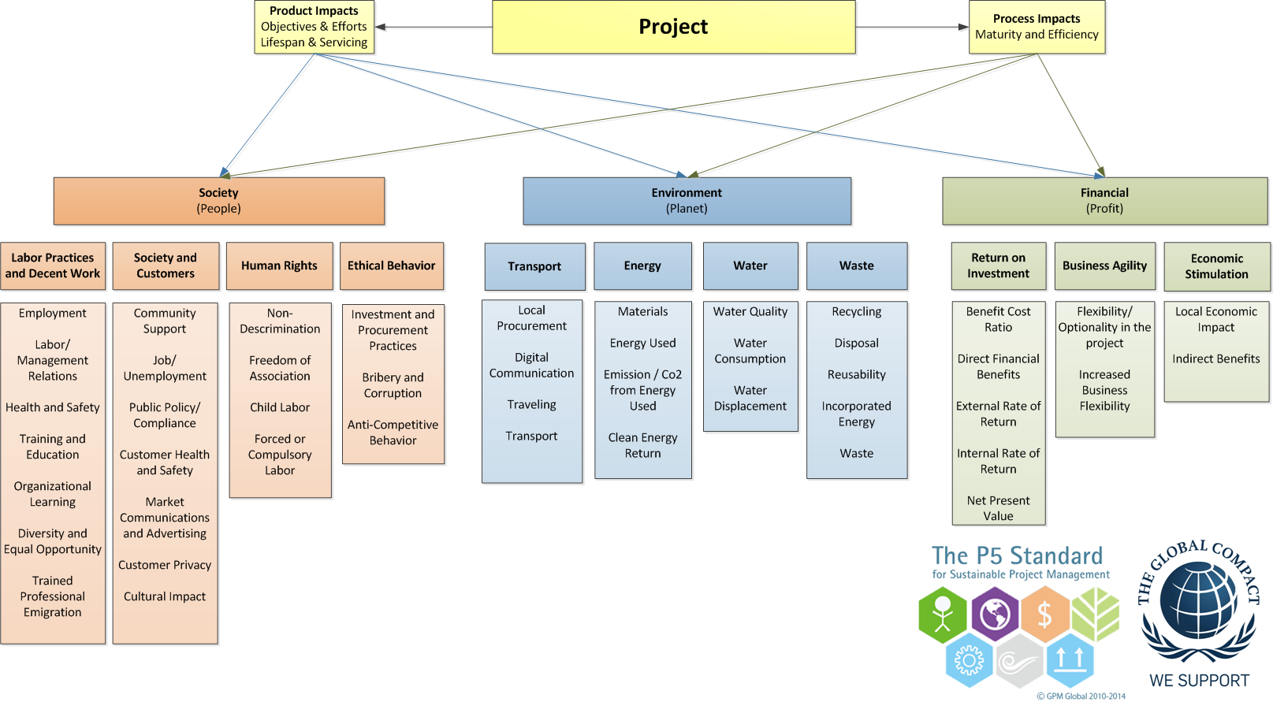
The P5 Chart
Notes:
This diagram shows how Process and product Impact the Categories, Sub-Categories, and Elements.

Slide 16
P5 Overview
Five measurable elements to sustainability
Each measured individually and through Mutual Possession
  Planet (Environmental aspect)
  People (Social aspect)
  Profit (Financial aspect)
  Process (Governance aspect)
  Product (Technical aspect)
Notes:
(Cue and read from slide… DETAILS to follow in upcoming slides)

Slide 17
How to Perform the Analysis
There are several ways to perform a P5 impact analysis. Developing a risk register, using each element as a category, is the simplest.
The most effective way is to use a scoring system.

Slide 18
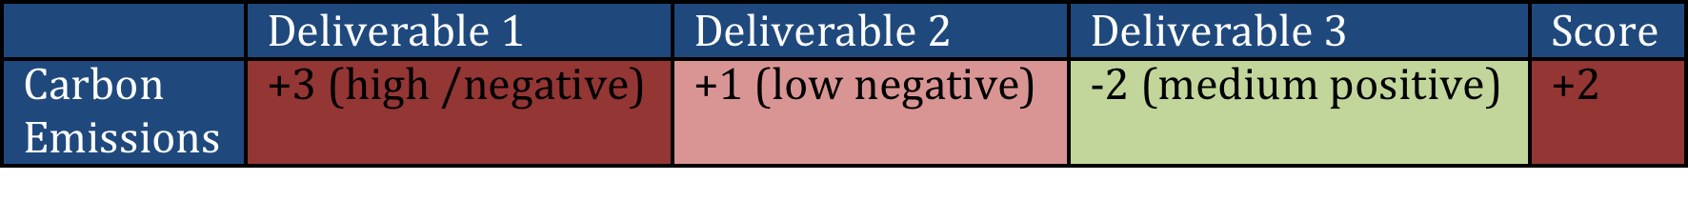
Example
When using a scoring system, each product deliverable and project process will be scored against each element of P5, based on a positive/neutral/negative scale, ranging from a neutral (o) high (+ or -3) , medium (+ or -2) , and low (+ or -3).
This method is a simplified Analytic Hierarchy Process, one of the most popular analytical techniques for complex decision-making problems.
  Note: An AHP hierarchy can have as many levels as needed to fully characterize a particular decision situation.

Slide 19
Why do this?
The P5 impact analysis will provide key insight on where the problem areas are from a sustainability perspective.
Once the analysis is completed, the items that pose a risk (anything with a + score) should be sectioned off and reviewed, and mapped to into the Sustainability Management Plan (SMP)

Slide 20
Developing the SMP
Perform P5
Impact Analysis
Draft Sustainability management Plan
The SMP ties corporate sustainability goals and objectives to the project plan and identifies impacts from an Environmental, Social, and Economic standpoints.

Slide 21

What is included in an SMP
Table of Contents
Document Control
  Version History and recipients list
Purpose
  A brief on what the document is
Executive Summary or Brief
  An outline of the sustainability factors in the project
List Project Sustainability Objectives
  Derived from the P5 Impact Analysis
Outline Key Measures and Performance Indicators (Qualitative and Quantitative)
The P5 Impact Assessment Score (and updates)
Scope Exclusions
Sustainability Reviews and Reporting
Checklist

Slide 22
Version Control and Distribution

Slide 23
Project Sustainability Objectives
Sustainability objectives are taken from the P5 analysis. Anything that needs to be improved upon is included.

Slide 24
Key Performance Measures
(Qualitative and Quantitative)
Performance Measuring
Key Performance Indicators Environmental
Energy: Number of green Buildings in the city
Waste: Amount of dangerous waste treated
Transport: Number of electric public transport
Water Usage: Amount of building with water recycled system
Materials and Resources: amount of promotional benefits to acquire local materials and their impacts in the local industries. ie. Construction
Key Performance Indicators Financial
Return on Investment: ROI
Business Agility: number of days to resolve upcoming squatting, weeds, pests, unsafe buildings, graffiti
Key Performance Indicators Products
Servicing of Product: Satisfaction Survey Results (surveys carried out by independent agency)
Lifespan of Product: The Enforcement Agency should have 60% Community Satisfaction
Key Performance Indicators Processes
Maturity of process: Maturity of the EMS: Plan-Do-Check-Act
Maturity Efficiency and fairness of process: number of corrective actions and their financial impact
Key Performance Indicators Personal
Labour Practices and Decent Work: Number of labor accidents and amount of money incurred
Society and Customers: Number of children received training course regarding Sustainability.
Ethical Behaviour: implement “Sustainability Awards” at school, restaurants, event organizer, etc.

Slide 25
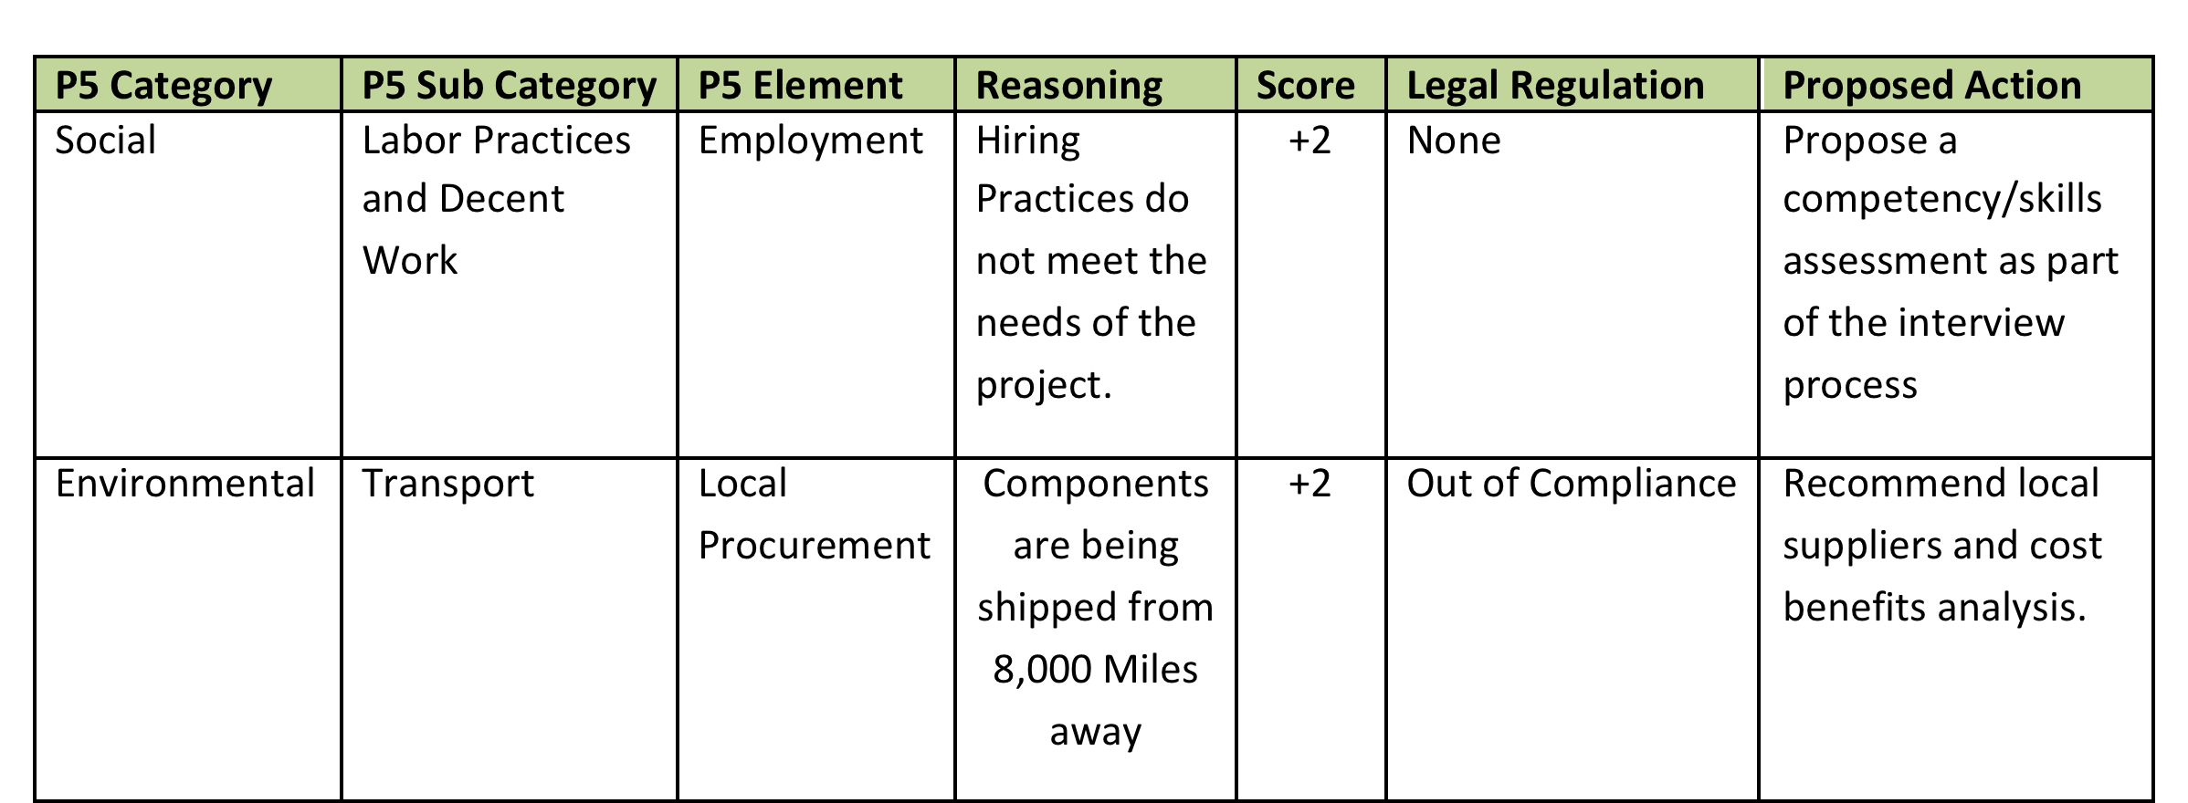
P5 Impact Assessment
A summary of the planned environmental impact and steps that will be taken to decrease the effects or increase the opportunities identified

Slide 26
The Final pieces
Scope Exclusions
Sustainability Risk Management
Reviews and Reporting
Current Sustainability (P5) Score
+2.03
Checklist
The Following Assessments are considered in this Sustainability Management Plan:
  Financial Assessment
  Process Assessment
  Product Assessment
  Environmental Assessment
  Social and Corporate Assessment

Slide 27
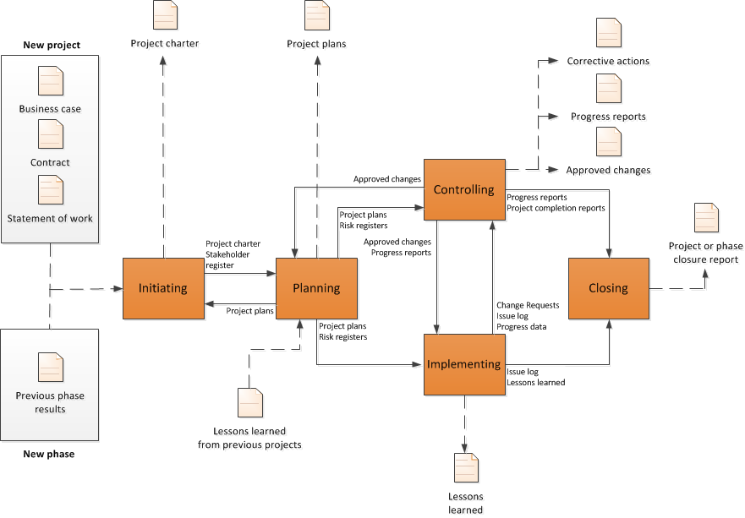
Where does the SMP Interface with the Project?
Source ISO 21500 Pg.12

Slide 28
Thank you!
Joel.carboni@greenprojectmanagement.org
Linkedin.com/in/joelcarboni

Slide 29



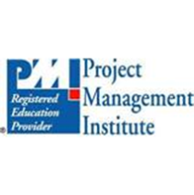

The PMI Registered Education Provider logo is a registered mark of the Project Management Institute, Inc.
The GPM and RME Partner logos are registered marks of GPM Global.
El logotipo de PMI Registered Education Provider es una marca registrada del Project Management Institute, Inc.
Los logotipos de GPM y RME son marcas registradas de GPM Global.

