Slide 1
Uso forestal

Slide 3
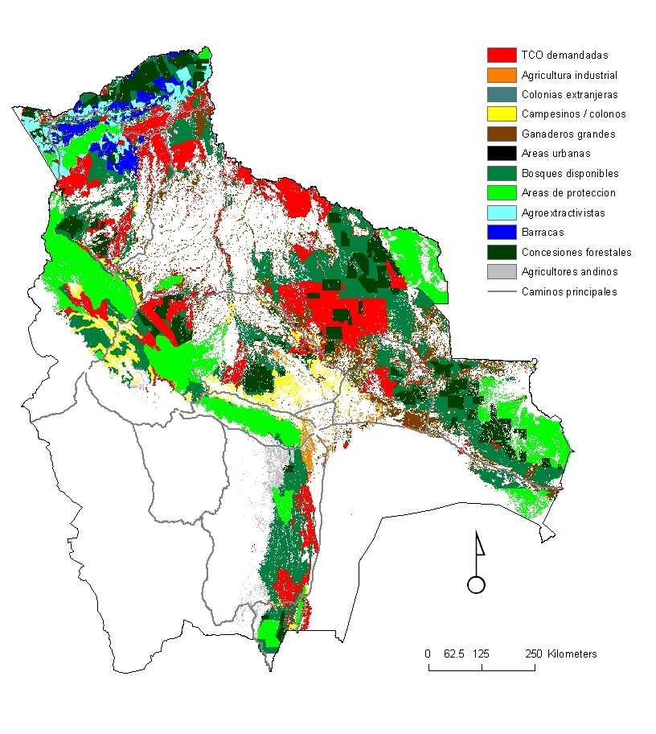
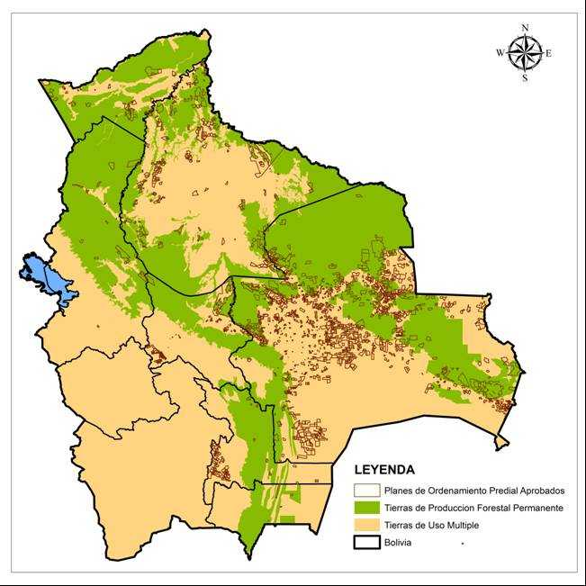

Slide 4
DETALLE | TPFP | USO MULTIPLE | TOTAL
Comunal | 3.771.057 | 2.704.446 | 6.475.503
Empresa | 470.225 | 1.633.861 | 2.104.086
Mediana | 323.393 | 945.639 | 1.269.032
Pequeña | 1.080.789 | 1.874.251 | 2.955.040
Territorio Indígena | 9.098.184 | 11.928.343 | 21.026.527
TOTAL | 14.743.648 | 19.086.540 | 33.830.188
Fuente ABT, 2012

Slide 5
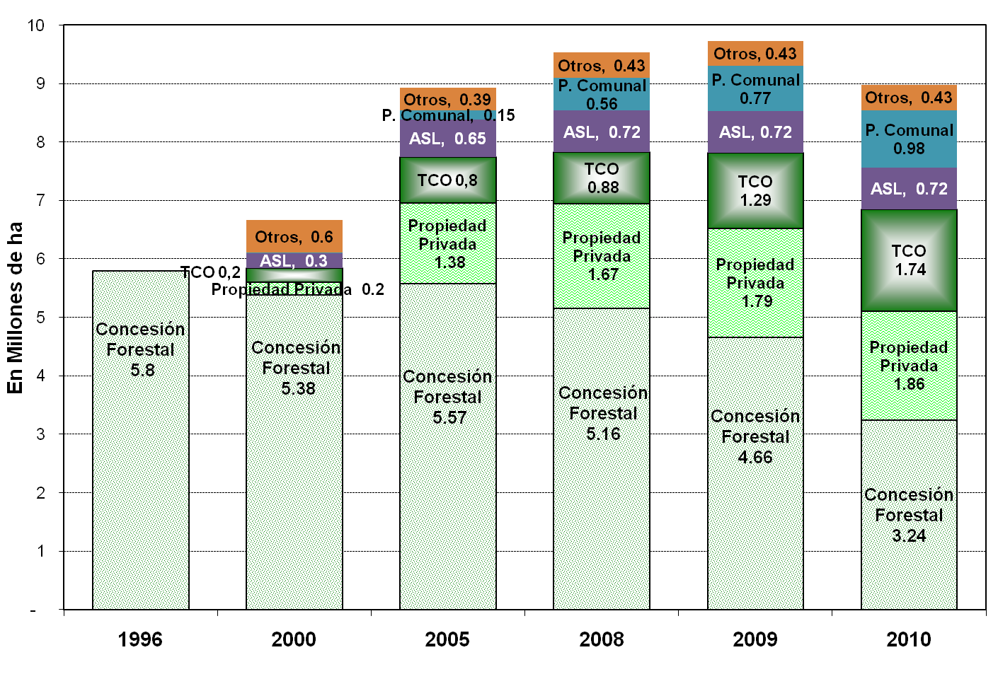
5%
11%
8%
19%
21%
36%
Fuente: CFB

